Slide 1
Intelligent Systems (AI-2)
Computer Science cpsc422, Lecture 20
Mar, 3, 2021
Slide credit: some slides adapted from Stuart Russell (Berkeley), some from Padhraic Smyth (UCIrvine)
Notes:
Lecture 20

Slide 2
StarAI (statistical relational AI)
Hybrid: Det +Sto
422 big picture
Prob CFG
Prob Relational Models
Markov Logics
Deterministic
Stochastic
Belief Nets
Logics
Approx. : Gibbs
First Order Logics
Markov Chains and HMMs
Ontologies
Forward, Viterbi….
Approx. : Particle Filtering
Query
Full Resolution
SAT
Undirected Graphical Models
Markov Networks
Conditional Random Fields
Markov Decision Processes and
Partially Observable MDP
Planning
Value Iteration
Approx. Inference
Reinforcement Learning
Representation
Applications of AI
Reasoning
Technique
Notes:
Breadth and Depth

Slide 3
Logics in AI (322):
Similar slide to the one for planning
Propositional Definite Clause Logics
Semantics and Proof Theory
Propositional Logics
First-Order Logics
Satisfiability Testing (SAT)
Description Logics
Hardware Verification
Production Systems
Product Configuration
Ontologies
Cognitive Architectures
Semantic Web
Video Games
Summarization
Tutoring Systems
Information Extraction

Slide 4
Relationships between different Logics (better with colors)

Slide 5
Lecture Overview
Basics Recap: Interpretation / Model /..
Propositional Logics
Satisfiability, Validity
Resolution in Propositional logics

Slide 6
Basic definitions from 322 (Semantics)
Definition (interpretation)
An interpretation I assigns a truth value to each atom.
Definition (truth values of statements cont’): A knowledge base KB is true in I if and only if every clause in KB is true in I.
Notes:
We can use the interpretation to determine the truth value of clauses and knowledge bases:

Slide 7

PDC Semantics: Knowledge Base (KB)
  A knowledge base KB is true in I if and only if every clause in KB is true in I.
 | p | q | r | s
I₁ | true | true | false | false
Which of the three KB below is true in I₁ ?
A
B
C
p
r
s ← q ∧ p
p
q
s ← q
p
q ← r ∧ s

Slide 8
PDC Semantics: Knowledge Base (KB)
  A knowledge base KB is true in I if and only if every clause in KB is true in I.
 | p | q | r | s
I₁ | true | true | false | false
KB₁
KB₂
KB₃
p
r
s ← q ∧ p
p
q
s ← q
p
q ← r ∧ s
Which of the three KB above is True in I₁ ?
KB₃

Slide 9
PDC Semantics: Knowledge Base
Definition (truth values of statements cont’): A knowledge base KB is true in I if and only if every clause in KB is true in I.

Slide 10
Basic definitions from 322 (Semantics)
Definition (interpretation)
An interpretation I assigns a truth value to each atom.
Definition (truth values of statements cont’): A knowledge base KB is true in I if and only if every clause in KB is true in I.
Definition (model)
A model of a set of clauses (a KB) is an interpretation in which all the clauses are true.
Notes:
We can use the interpretation to determine the truth value of clauses and knowledge bases:

Slide 11
Example: Models
 | p | q | r | s
I₁ | true | true | true | true
I₂ | false | false | false | false
I₃ | true | true | false | false
I₄ | true | true | true | false
I₅ | true | true | false | true
Which interpretations are models?
Notes:
is a model of KB
not a model of KB
is a model of KB
is a model of KB
not a model of KB

Slide 12
Basic definitions from 322 (Semantics)
Definition (interpretation)
An interpretation I assigns a truth value to each atom.
Definition (truth values of statements cont’): A knowledge base KB is true in I if and only if every clause in KB is true in I.
Definition (model)
A model of a set of clauses (a KB) is an interpretation in which all the clauses are true.
Definition (logical consequence)
If KB is a set of clauses and G is a conjunction of atoms, G is a logical consequence of KB, written KB ⊧ G, if G is true in every model of KB.
Notes:
We can use the interpretation to determine the truth value of clauses and knowledge bases:

Slide 13
Example: Logical Consequences
 | p | q | r | s
I₁ | true | true | true | true
I₂ | true | true | true | false
I₃ | true | true | false | false
I₄ | true | true | false | true
I₅ | false | true | true | true
I₆ | false | true | true | false
I₇ | false | true | false | false
I₈ | false | true | false | true
… | …. | … | … | …
Which of the following is true?
KB ⊧ q, KB ⊧ p, KB ⊧ s, KB ⊧ r
Notes:
KB ⊧ q, KB ⊧ p, KB ⊭ s, KB ⊭ r

Slide 14

Is it true that if

Slide 15
Basic definitions from 322 (Proof Theory)
Definition (soundness)
A proof procedure is sound if KB ⊦ G implies KB ⊧ G.
Definition (completeness)
A proof procedure is complete if KB ⊧ G implies KB ⊦ G.

Slide 16



(Propositional) Logic: Key ideas
Given a domain that can be represented with n propositions you have ............interpretations (possible worlds)
If you do not know anything you can be in any of those
If you know that some logical formulas are true (your …….). You know that you can be only in .........................
It would be nice to know what else is true in all those.......

Slide 17
Lecture Overview
Basics Recap: Interpretation / Model /
Propositional Logics
Satisfiability, Validity
Resolution in Propositional logics

Slide 18
Relationships between different Logics (better with colors)

Slide 19
Propositional logic: Syntax
Atomic sentences = single proposition symbols
  E.g., P, Q, R
  Special cases: True = always true, False = always false
Complex sentences:
  If S is a sentence, ¬S is a sentence (negation)
  If S₁ and S₂ are sentences, S₁ ∧ S₂ is a sentence (conjunction)
  If S₁ and S₂ are sentences, S₁ ∨ S₂ is a sentence (disjunction)
  If S₁ and S₂ are sentences, S₁ ⇒ S₂ is a sentence (implication)
  If S₁ and S₂ are sentences, S₁ ⇔ S₂ is a sentence (biconditional)

Slide 20
Propositional logic: Semantics
Each interpretation specifies true or false for each proposition symbol
  E.g. p q r
  false true false
Rules for evaluating truth with respect to an interpretation I :
¬S is true iff S is false
S₁ ∧ S₂ is true iff S₁ is true and S₂ is true
S₁ ∨ S₂ is true iff S₁is true or S₂ is true
S₁ ⇒ S₂ is true iff S₁ is false or S₂ is true
i.e., is false iff S₁ is true and S₂ is false
S₁ ⇔ S₂ is true iff S₁⇒S₂ is true and S₂⇒S₁ is true
Simple recursive process evaluates an arbitrary sentence, e.g.,
(¬p ∧ (q ∨ r )) ⇔ ¬p =
Notes:
With these symbols, 8 possible models, can be enumerated automatically.
is true iff S₁ is false or S₂ is true
¬p ∧ (q ∨ r ) = true ∧ (true ∨ false) = true ∧ true = true

Slide 21
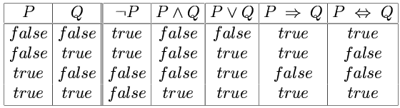
Truth tables for connectives

Slide 22
Truth tables for connectives
Notes:
Implication is always true
when the premise is false
Why? P=>Q means “if P is true then I am claiming that Q is true,
otherwise no claim”
Only way for this to be false is if P is true and Q is false

Slide 23
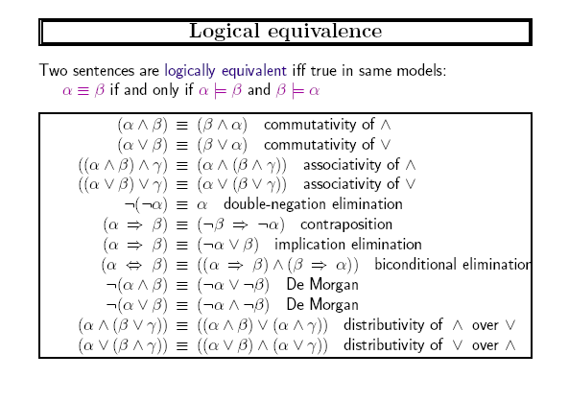
interpretations
Notes:
To manipulate logical sentences we need some rewrite rules.

Slide 24
Can be used to rewrite formulas….

Slide 25
Can be used to rewrite formulas….

Slide 26
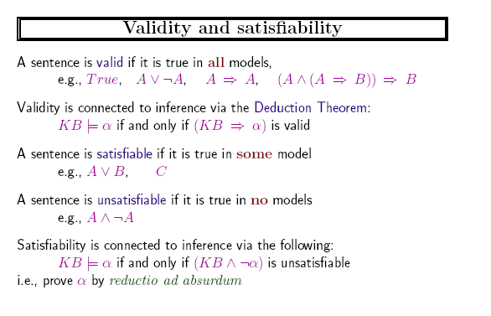



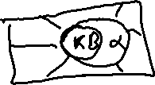


interpretations
interpretation
interpretations

Slide 27
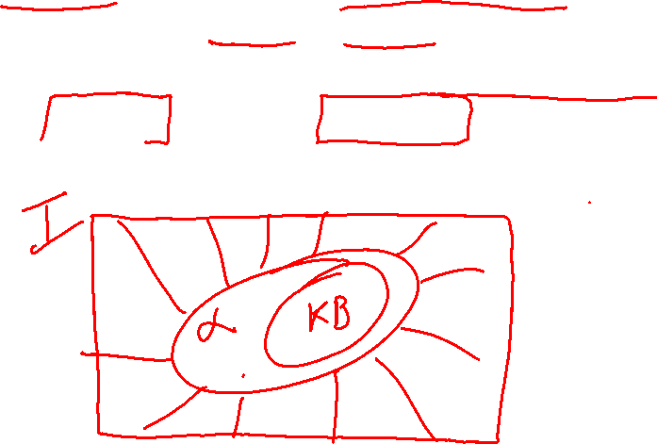
interpretations
i.e There is no interpretations where KB is true and α is false

Slide 28
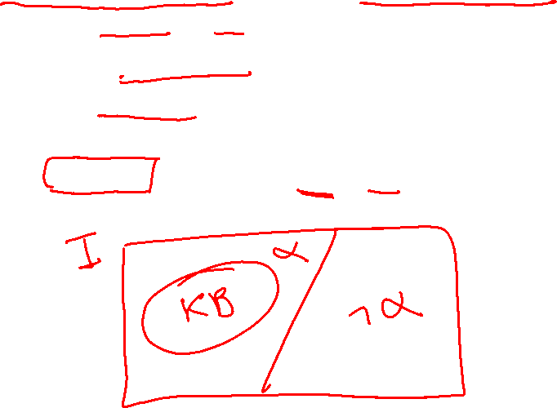
interpretations
interpretations
interpretations

Slide 29
Validity and Satisfiability

Slide 30
Validity and Satisfiability

Slide 31
Lecture Overview
Basics Recap: Interpretation / Model /
Propositional Logics
Satisfiability, Validity
Resolution in Propositional logics

Slide 32
Proof by resolution
Key ideas
Simple Representation for
Simple Rule of Derivation

Slide 33
Conjunctive Normal Form (CNF)
Rewrite into conjunction of disjunctions
literals
(A ∨ ¬B) ∧ (B ∨ ¬C ∨ ¬D)
Clause
Clause
Any KB can be converted into CNF !
Notes:
In fact, any KB can be converted into CNF-3 using clauses
with at most 3 literals.

Slide 34
Example: Conversion to CNF
A ⇔ (B ∨ C)
Eliminate ⇔, replacing α ⇔ β with (α ⇒ β)∧(β ⇒ α).
  (A ⇒ (B ∨ C)) ∧ ((B ∨ C) ⇒ A)
2. Eliminate ⇒, replacing α ⇒ β with ¬α∨ β.
  (¬A ∨ B ∨ C) ∧ (¬(B ∨ C) ∨ A)
3. Using de Morgan's rule replace ¬(α∨ β) with (¬α ∧ ¬ β) :
  (¬A ∨ B ∨ C) ∧ ( (¬ B ∧ ¬ C) ∨ A)
4. Apply distributive law (∨ over ∧) and flatten:
  (¬A ∨ B ∨ C) ∧ (¬B ∨ A) ∧ (¬C ∨ A)

Slide 35
Example: Conversion to CNF
A ⇔ (B ∨ C)
5. KB is the conjunction of all of its sentences (all are true),
so write each clause (disjunct) as a sentence in KB:
…
  (¬A ∨ B ∨ C)
  (¬B ∨ A)
  (¬C ∨ A)
  …

Slide 36
Resolution Deduction step
Resolution: inference rule for CNF: sound and complete! *
“If A or B or C is true, but not A, then B or C must be true.”
“If A is false then B or C must be true,
or if A is true then D or E must be true,
hence since A is either true or false,
B or C or D or E must be true.”
Simplification
Notes:
* Resolution is “refutation complete”
in that it can prove the truth of any entailed sentence by refutation.

Slide 37
Learning Goals for today’s class
You can:
Describe relationships between different logics
Apply the definitions of Interpretation, model, logical entailment, soundness and completeness
Define and apply satisfiability and validity
Convert any formula to CNF
Justify and apply the resolution step

Slide 38
Next Class Fri
Finish Resolution
Another proof method for Prop. Logic
  Model checking - Searching through truth assignments. Walksat.
Start First Order Logics

Slide 39
Midterm, Mon, March 8
Will be a Canvas Quiz
We will start at 4pm sharp
55 minutes
How to prepare…
Go to Office Hours
Learning Goals (look at the end of the slides for each lecture – complete list has been posted)
Revise all the clicker questions and practice exercises
Practice material has been posted
Check questions and answers on Piazza
CPSC 422, Lecture 19
39

