Slide 1
Intelligent Systems (AI-2)
Computer Science cpsc422, Lecture 2
Jan, 13, 2021
Notes:
Lecture 1

Slide 2
Lecture Overview
Value of Information and Value of Control
Recap Markov Chain
Markov Decision Processes (MDPs)
Formal Specification and example

Slide 3
StarAI (statistical relational AI)
Hybrid: Det +Sto
422 big picture
Parsing
Prob CFG
Prob Relational Models
Markov Logics
Deterministic
Stochastic
Belief Nets
Logics
Approx. : Gibbs
First Order Logics
Markov Chains and HMMs
Ontologies
Forward, Viterbi….
Approx. : Particle Filtering
Query
Full Resolution
SAT
Undirected Graphical Models
Markov Networks
Conditional Random Fields
Markov Decision Processes and
Partially Observable MDP
Planning
Value Iteration
Approx. Inference
Reinforcement Learning
Representation
Applications of AI
Reasoning
Technique
Notes:
Breadth and Depth

Slide 4
Cpsc 322 Big Picture
Environment
Deterministic
Stochastic
Problem
Arc Consistency
Search
Constraint Satisfaction
Vars +
Constraints
SLS
Static
Belief Nets
Query
Logics
Var. Elimination
Search
Markov Chains
Sequential
STRIPS
Decision Nets
Planning
Var. Elimination
Search
Representation
Reasoning
Technique
Notes:
If you have not taken 322 last semester – go back to notes!
We will build directly on all this!

Slide 5







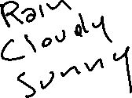
Simple Decision Net
Early in the morning. Shall I take my umbrella today? (I’ll have to go for a long walk at noon)
Relevant Random Variables… with reasonable values…
Notes:
Example syntactic
Simplest <-> degenerate case (random var is parent to a decision)
Weather Forecast Umbrella
In Aispace example Forecast has 3 values Rainy Cloudy Sunny
And the weather @12 has two values Rain and Sunshine (it would have been more appropriate to have two more realistic names: Rain and NoRain)

Slide 6

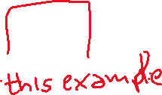
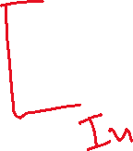



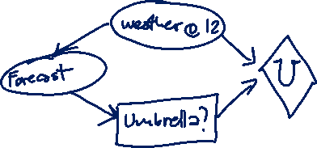
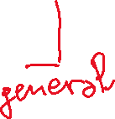
Polices for Umbrella Problem
A policy specifies what an agent should do under each circumstance (for each decision, consider the parents of the decision node)
In the Umbrella case:
D₁
One possible Policy
pD₁
How many policies?

Slide 7
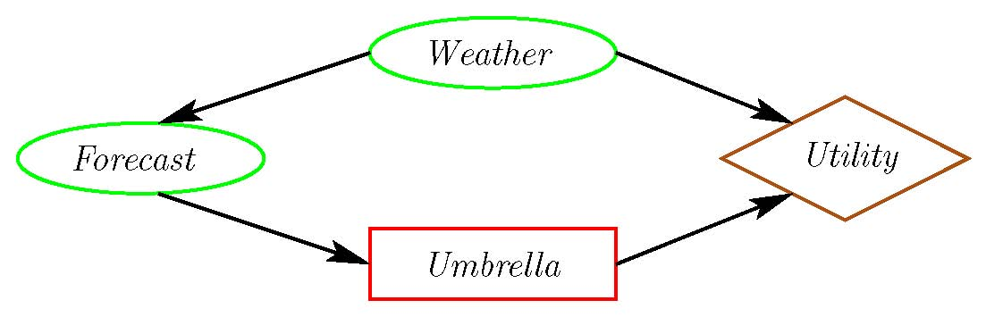
Value of
Information
Early in the morning. I listen to the weather forecast, shall I take my umbrella today? (I’ll have to go for a long walk at noon)
What would help the agent make a better Umbrella decision?
Notes:
What info would allow the agent to make the best possible Umbrella decision?

Slide 8
Value of
Information
The value of information of a random variable X for decision D is:
the utility of the network with an arc from X to D minus the utility of the network without the arc.
Intuitively:
  The value of information is always
  It is positive only if the agent changes
Notes:
Clickers
- First question?
– structure of the network?

Slide 9
Value of Information (cont.)
The value of information provides a bound on how much you should be prepared to pay for a sensor. How much is a perfect weather forecast worth?
77
Original maximum expected utility:
Maximum expected utility when we know Weather:
Better forecast is worth at most:
91

Slide 10
Value of Information
The value of information provides a bound on how much you should be prepared to pay for a sensor. How much is a perfect fire sensor worth?
-22.6
Original maximum expected utility:
Maximum expected utility when we know Fire:
Perfect fire sensor is worth:
-2
Notes:
Clickers
- Non forgetting link to call

Slide 11
Value of Control
What would help the agent to make an even better Umbrella decision? To maximize its utility.
Weather Umbrella | Value
Rain true Rain false noRain true noRain false | 70 0 20 100
The value of control of a variable X is :
the utility of the network when you make X a decision variable minus the utility of the network when X is a random variable.
Notes:
You need to be explicit about what information is available when you control X.
If you control X without observing, controlling X can be worse than observing X.
If you keep the parents the same, the value of control is always non-negative.

Slide 12
Value of Control
What if we could control the weather?
77
Original maximum expected utility:
Maximum expected utility when we control the weather:
Value of control of the weather:
100

Slide 13
Value of Control
What if we control Tampering?
-22.6
Original maximum expected utility:
Maximum expected utility when we control the Tampering:
Value of control of Tampering:
Let’s take a look at the optimal policy
Conclusion: do not tamper with fire alarms!
-20.7
Notes:
The policy when you control tampering requires Tampering=F

Slide 14
Lecture Overview
Value of Information and Value of Control
Recap Markov Chain
Markov Decision Processes (MDPs)
Formal Specification and example

Slide 15

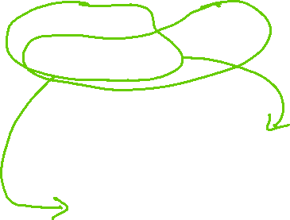
Planning in Stochastic Environments
Environment
Deterministic
Stochastic
Problem
Arc Consistency
Search
Constraint Satisfaction
Vars +
Constraints
SLS
Static
Belief Nets
Query
Logics
Var. Elimination
Search
Markov Chains and HMMs
Sequential
Decision Nets
STRIPS
Var. Elimination
Planning
Search
Markov Decision Processes
Representation
Value Iteration
Reasoning
Technique
Notes:
R&R Sys Representation and reasoning Systems
Each cell is a R&R system
STRIPS actions preconditions and effects

Slide 16
Lecture Overview (from my 322)
Recap
Temporal Probabilistic Models
Start Markov Models
  Markov Chain
  Markov Chains in Natural Language Processing

Slide 17
Simplest Possible DBN
One random variable for each time slice: let’s assume S_{t} represents the state at time t. with domain {v₁ …v_{n} }
Each random variable depends only on the previous one
Thus
Intuitively S_{t} conveys all of the information about the history that can affect the future states.
“The future is independent of the past given the present.”
Notes:
P (S_{t+1}| S₀,…,S_{t}) = P (S_{t+1}|S₀)

Slide 18


Simplest Possible DBN (cont’)
  How many CPTs do we need to specify?
A. 1
C . 2
D. 3
B. 4
  Stationary process assumption: the mechanism that regulates how state variables change overtime is stationary, that is it can be described by a single transition model
  P(S_{t}|S_{t-1})
Notes:
18

Slide 19
Stationary Markov Chain (SMC)
A stationary Markov Chain : for all t >0
P (S_{t+1}| S₀,…,S_{t}) = P (S_{t+1}|S_{t}) and
P (S_{t +1}|S_{t}) is the same
So we only need to specify?
A. P (S_{t +1} |S_{t}) and P (S₀)
B. P (S₀)
C . P (S_{t +1}|S_{t})
D. P (S_{t} |S_{t+1} )
Notes:
19

Slide 20





Stationary Markov Chain (SMC)
A stationary Markov Chain : for all t >0
P (S_{t+1}| S₀,…,S_{t}) = P (S_{t+1}|S_{t}) and
P (S_{t +1}|S_{t}) is the same
We only need to specify and
Simple Model, easy to specify
Often the natural model
The network can extend indefinitely
Notes:
20

Slide 21
Stationary Markov-Chain: Example
Domain of variable S_{i} is {t , q, p, a, h, e}
t
.6
q
.4
Probability of initial state
P (S₀)
p
a
Stochastic Transition Matrix
P (S_{t+1}|S_{t})
h
Which of these two is a possible STM?
e
t
q
p
a
h
e
t
q
p
a
h
e
t
0
.3
0
.3
.4
0
t
1
0
0
0
0
0
q
.4
0
.6
0
0
0
q
0
1
0
0
0
0
p
0
0
1
0
0
0
p
.3
0
1
0
0
0
a
0
0
.4
.6
0
0
a
0
0
0
1
0
0
h
0
0
0
0
0
1
h
0
0
0
0
0
1
e
1
0
0
0
0
0
e
0
0
0
.2
0
1
A.Left one only
B. Right one only
C . Both
D. None
E. I want to sleep

Slide 22
Stationary Markov-Chain: Example
Domain of variable S_{i} is {t , q, p, a, h, e}
We only need to specify…
t
.6
P (S₀)
q
.4
p
Probability of initial state
a
h
e
Stochastic Transition Matrix
P (S_{t+1}|S_{t})
t
q
p
a
h
e
t
0
.3
0
.3
.4
0
q
.4
0
.6
0
0
0
p
0
0
1
0
0
0
a
0
0
.4
.6
0
0
h
0
0
0
0
0
1
e
1
0
0
0
0
0

Slide 23

Markov-Chain: Inference
Probability of a sequence of states S₀ … S_{T}
P (S_{t+1}|S_{t})
P (S₀)
t
q
p
a
h
e
t
0
.3
0
.3
.4
0
t
.6
q
.4
0
.6
0
0
0
Example:
q
.4
p
0
0
1
0
0
0
p
0
a
0
a
0
0
.4
.6
0
0
h
0
h
0
0
0
0
0
1
e
0
e
1
0
0
0
0
0

Slide 24
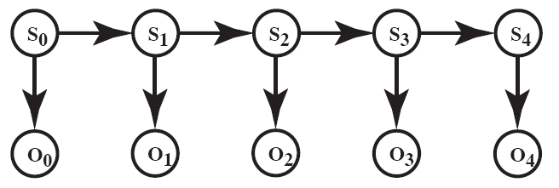
Recap: Markov Models

Slide 25
Lecture Overview
Value of Information and Value of Control
Recap Markov Chain
Markov Decision Processes (MDPs)
Formal Specification and example

Slide 26
Markov Models
Markov Chains
Hidden Markov Model
Partially Observable Markov Decision Processes (POMDPs)
Markov Decision Processes (MDPs)

Slide 27
Combining ideas for Stochastic planning
What is a key limitation of decision networks?
What is an advantage of Markov models?
Represent (and optimize) only a fixed number of decisions
The network can extend indefinitely
Goal: represent (and optimize) an indefinite sequence of decisions

Slide 28
Decision Processes
Often an agent needs to go beyond a fixed set of decisions – Examples?
  Would like to have an ongoing decision process
Infinite horizon problems: process does not stop
Indefinite horizon problem: the agent does not know when the process may stop
Finite horizon: the process must end at a give time N
Notes:
Helper of a senior
Monitoring system (of a plant)
Treatment of a chronic disease

Slide 29
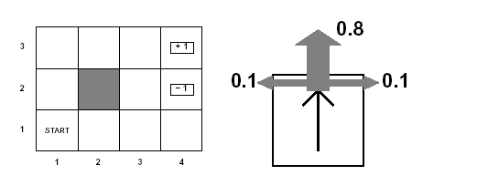
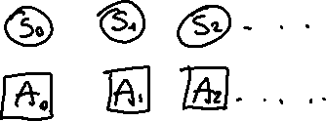
How can we deal with indefinite/infinite Decision processes?
Like in a Markov Chain one random variable S_{t} for each time slice represents the state at time t.
And A_{t} be the action/decision at time t
Example
Agent moves in the above grid :
States are the cells of the grid
Actions Up, Down, Left, Right

Slide 30
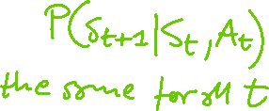
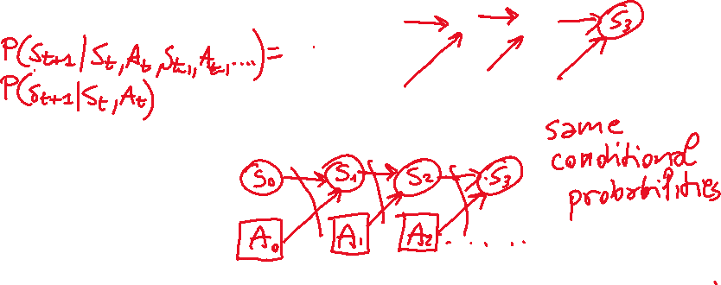
How can we deal with indefinite/infinite Decision processes?
Like in a Markov Chain one random variable S_{t} for each time slice represents the state at time t.
And A_{t} be the action/decision at time t
Make the same two assumptions we made for Markov Chains
(a) The action outcome (the state S_{t+1} at time t+1) only depends on S_{t} and A_{t}
(b) The process is stationary…
Notes:
depends on the sequence of states involved in a decision process (environment history), rather than a single final state
P(S_{t+1}|S₀, A₀,...,S_{t}, A_{t}) = P(S_{t+1}|S_{t}, A_{t})
if P(s’|s , a) is the same at each point in time, where P(s’|s , a) the probability that the agent will be in state s’ after doing action a in state s

Slide 31

Agent knows in which state it is at time t when it selects the action at time t
The robot always knows in
Which cell it is…
Notes:
depends on the sequence of states involved in a decision process (environment history), rather than a single final state
P(S_{t+1}|S₀, A₀,...,S_{t}, A_{t}) = P(S_{t+1}|S_{t}, A_{t})
if P(s’|s , a) is the same at each point in time, where P(s’|s , a) the probability that the agent will be in state s’ after doing action a in state s

Slide 32
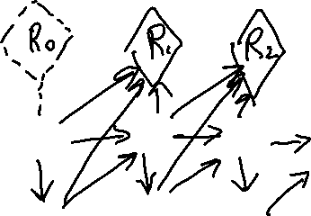
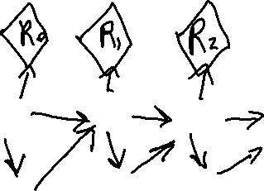
How can we deal with indefinite/infinite Decision processes?
We also need a more flexible specification for the utility. How?
  Defined based on a reward/punishment that the agent receives in each time slice
  Typically summing them up
Notes:
depends on the sequence of states involved in a decision process (environment history), rather than a single final state
P(S_{t+1}|S₀, A₀,...,S_{t}, A_{t}) = P(S_{t+1}|S_{t}, A_{t})
if P(s’|s , a) is the same at each point in time, where P(s’|s , a) the probability that the agent will be in state s’ after doing action a in state s

Slide 33
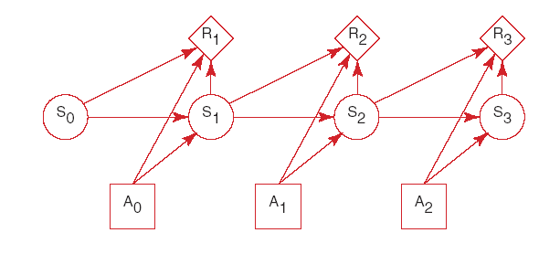


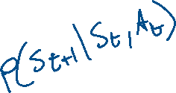




MDP graphical specification
Basically a MDP is a Markov Chain augmented with actions and rewards/values

Slide 34
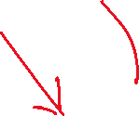
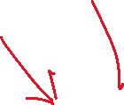
When Rewards only depend on the state

Slide 35
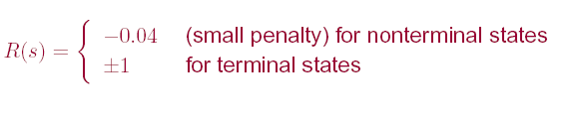
Example MDP: Rewards

Slide 36
MDP: formal specification
For an MDP you specify:
  set S of states and set A of actions
  the process’ dynamics (or transition model)
    P(S_{t+1}|S_{t}, A_{t})
  The reward function
      R(s) is used when the reward depends only on the state s and not on how the agent got there
      More complex R(s, a,, s’) describing the reward that the agent receives when it performs action a in state s and ends up in state s’
  Absorbing/stopping/terminal state

Slide 37
Summary Decision Processes: MDPs
To manage an ongoing (indefinite… infinite) decision process, we combine….
Markovian
Stationary
Utility not just at the end
Sequence of rewards
Fully Observable
Notes:
forget the proper sequence of tasks that need to be completed
they lose track of the steps that they have already completed.
At any stage of the process
The agent decides which action to perform
The new state of the world depends on the previous state(s) as well as the action(s) performed
The agent receives rewards or punishments at various points in the process
Aim: maximize the reward received

Slide 38
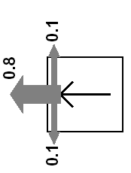
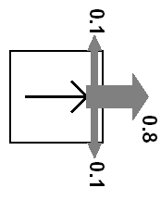
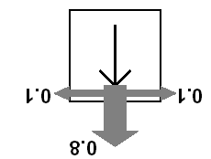
Example MDP: Scenario and Actions
Agent moves in the above grid via actions Up, Down, Left, Right
Each action has:
  0.8 probability to reach its intended effect
  0.1 probability to move at right angles of the intended direction
  If the agents bumps into a wall, it stays there
How many states?
There are two terminal states (3,4) and (2,4)
Notes:
Terminal = absorbing

Slide 39
Learning Goals for today’s class
You can:
Define and compute Value of Information and Value of Control in a decision network
Effectively represent indefinite/infinite decision processes with a Markov Decision Process (MDP)
Compute the probability distribution on states given a sequence of actions in an MDP
Define a policy for an MDP

Slide 40
For Fro:
TODO for Fri
Read textbook 9.4
Read textbook 9.5
  9.5.1 Value of a Policy
  9.5.2 Value of an Optimal Policy
  9.5.3 Value Iteration

Slide 41
CPSC 322 Review “Exam”
https://forms.gle/SpQwrXfonTZrVf4P7
Based on CPSC 322 material
  Logic
  Uncertainty
  Decision Theory
Review material (e.g., 322 slides from 2017):
https://www.cs.ubc.ca/~carenini/TEACHING/CPSC322-17S/index.html

Slide 42
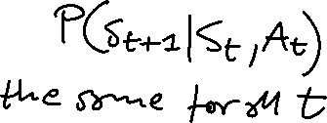
How can we deal with indefinite/infinite Decision processes?
We make the same two assumptions we made for….
The action outcome depends only on the current state
Let S_{t} be the state at time t …
The process is stationary…
We also need a more flexible specification for the utility. How?
  Defined based on a reward/punishment R(s) that the agent receives in each state s
Notes:
depends on the sequence of states involved in a decision process (environment history), rather than a single final state
P(S_{t+1}|S₀, A₀,...,S_{t}, A_{t}) = P(S_{t+1}|S_{t}, A_{t})
if P(s’|s , a) is the same at each point in time, where P(s’|s , a) the probability that the agent will be in state s’ after doing action a in state s

