Slide 1
Intelligent Systems (AI-2)
Computer Science cpsc422, Lecture 8
Jan, 27, 2021

Slide 2
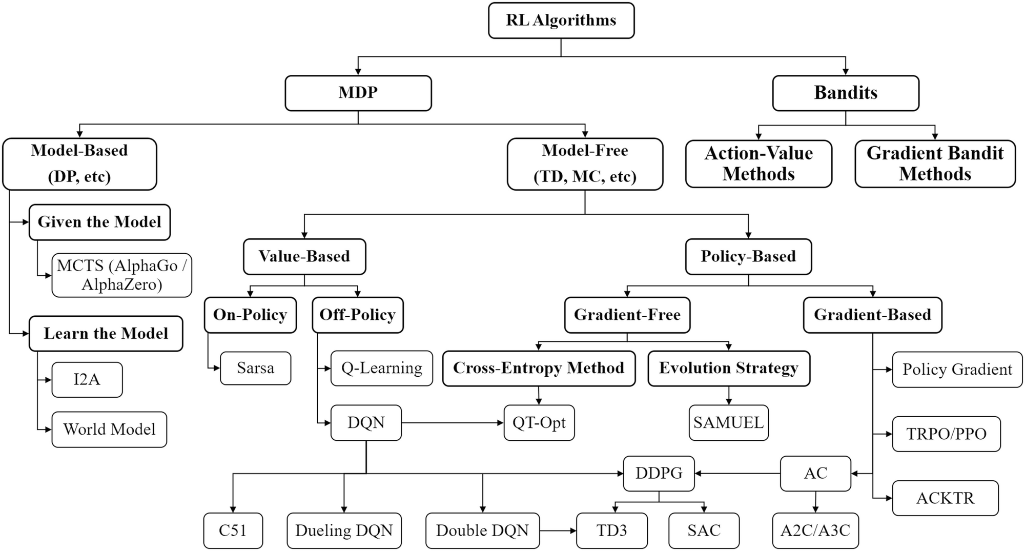


NOT REQUIRED for 422! Map of reinforcement learning algorithms. Boxes with thick lines denote different categories, others denote specific algorithms
Notes:
Map of reinforcement learning algorithms. Boxes with thick lines denote different categories, others denote specific algorithms
Deep Reinforcement Learning pp 125-133| Cite as
Taxonomy of Reinforcement Learning Algorithms
Authors
Authors and affiliations
Hongming Zhang
Tianyang Yu
ChapterFirst Online: 30 June 2020

Slide 3
Lecture Overview
Finish Q-learning
  Algorithm Summary
  Example
Exploration vs. Exploitation
Notes:
POMDPs were initially formalized by the control theory and operations research communities
to optimally control stochastic dynamical systems.
More recently, the articial intelligence community also considered POMDPs for planning
under uncertainty. To date, a wide range of sequential decision problems
such as robot navigation, preference elicitation, stochastic resource
allocation, maintenance scheduling, spoken-dialog systems
and many others have been modeled using POMDPs.

Slide 4
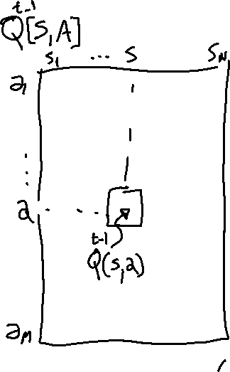

Slide 7

Clarification on the α_{κ}

Slide 8
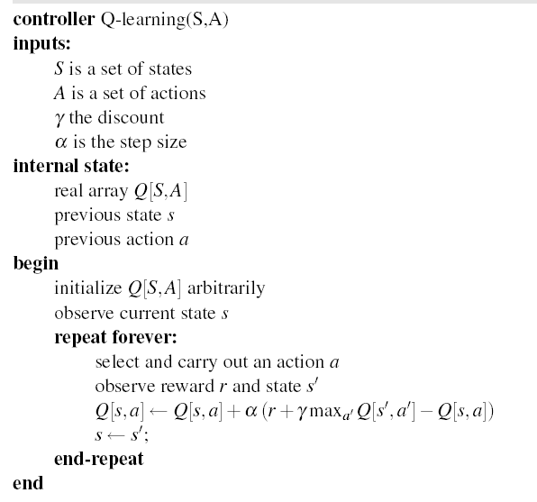
Notes:
In reinforcement learning, the values are estimates of the effects of actions; more recent values could more accurate than earlier values because the agent is learning, and so they should be weighted more. One way to weight later examples more is to use Equation 12.1, but with α as a constant (0<α≤10<α≤1) that does not depend on kk. Unfortunately, this does not converge to the average value when there is variability in the values in the sequence, but it can track changes when the underlying process generating the values changes.

Slide 9
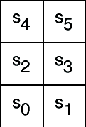
Example
Six possible states <s₀,..,s₅>
4 actions:
  UpCareful: moves one tile up unless there is wall, in which case stays in same tile. Always generates a penalty of -1
  Left: moves one tile left unless there is wall, in which case
    stays in same tile if in s₀ or s₂
    Is sent to s₀ if in s₄
  Right: moves one tile right unless there is wall, in which case stays in same tile
  Up: 0.8 goes up unless there is a wall, 0.1 like Left, 0.1 like Right
-1
-1
+ 10
-1
-100
-1
-1
-1
Reward Model:
  -1 for doing UpCareful
  Negative reward when hitting a wall, as marked on the picture

Slide 10
Example
-1
-1
+ 10
-1
The agent knows about the 6 states and 4 actions
Can perform an action, fully observe its state and the reward it gets
Does not know how the states are configured, nor what the actions do
  no transition model, nor reward model
-100
-1
-1
-1

Slide 11
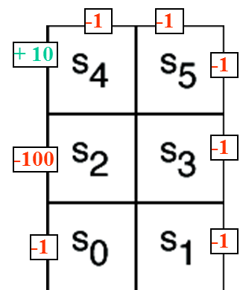
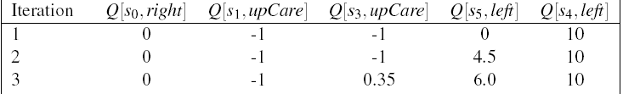
Example (variable α_{k})
Suppose that in the simple world described earlier, the agent has the following sequence of experiences
<s₀, right, 0, s₁, upCareful, -1, s₃, upCareful, -1, s₅, left, 0, s₄, left, 10, s₀>
And repeats it k times (not a good behavior for a Q-learning agent, but good for didactic purposes)
Table shows the first 3 iterations of Q-learning when
  Q[s,a] is initialized to 0 for every a and s
  α_{k}= 1/k, γ= 0.9
Notes:
Not working ☹ For full demo, see http://artint.info/demos/rl/tGame.html

Slide 12
-1
-1
+ 10
-1
Q[s,a] | s₀ | s₁ | s₂ | s₃ | s₄ | s₅
upCareful | 0 | 0 | 0 | 0 | 0 | 0
Left | 0 | 0 | 0 | 0 | 0 | 0
Right | 0 | 0 | 0 | 0 | 0 | 0
Up | 0 | 0 | 0 | 0 | 0 | 0
-100
-1
k=1
k=1
-1
-1
Only immediate rewards
are included in the update
in this first pass

Slide 13
-1
-1
+ 10
-1
Q[s,a] | s₀ | s₁ | s₂ | s₃ | s₄ | s₅
upCareful | 0 | -1 | 0 | -1 | 0 | 0
Left | 0 | 0 | 0 | 0 | 10 | 0
Right | 0 | 0 | 0 | 0 | 0 | 0
Up | 0 | 0 | 0 | 0 | 0 | 0
-100
-1
k=1
k=2
-1
-1
1 step backup from previous positive reward in s4

Slide 14
-1
-1
+ 10
-1
Q[s,a] | s₀ | s₁ | s₂ | s₃ | s₄ | s₅
upCareful | 0 | -1 | 0 | -1 | 0 | 0
Left | 0 | 0 | 0 | 0 | 10 | 4.5
Right | 0 | 0 | 0 | 0 | 0 | 0
Up | 0 | 0 | 0 | 0 | 0 | 0
-100
-1
k=1
0.35
k=3
6
-1
-1
The effect of the positive reward in s4 is felt two steps earlier at the 3rd iteration

Slide 15
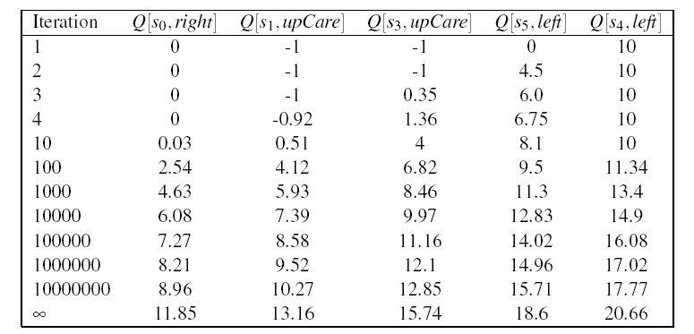
Example (variable α_{k})
-1
-1
+ 10
-1
-100
-1
-1
-1
As the number of iterations increases, the effect of the positive reward achieved by moving left in s₄ trickles further back in the sequence of steps
Q[s₄,left] starts changing only after the effect of the reward has reached s₀ (i.e. after iteration 10 in the table)
Notes:
Why 10 and not 6?
Because before s0 feels a positive effect, the Q value in s1 need to become positive, otherwise the actions that bring to states with Q = 0 get picked first

Slide 16
Example (Fixed α=1)
First iteration same as before, let’s look at the second
-1
-1
+ 10
-1
Q[s,a] | s₀ | s₁ | s₂ | s₃ | s₄ | s₅
upCareful | 0 | -1 | 0 | -1 | 0 | 0
Left | 0 | 0 | 0 | 0 | 10 | 0
Right | 0 | 0 | 0 | 0 | 0 | 0
Up | 0 | 0 | 0 | 0 | 0 | 0
-100
-1
k=2
-1
-1
New evidence is given much more weight than original estimate
Notes:
Note that each Q(s,a) corresponds to a different TD equation. Thus the value of k in each update depends upon how many times that specific (s,a) pair has been visited. Need a separate K counter for each (s,a) pair

Slide 17
-1
-1
+ 10
-1
Q[s,a] | s₀ | s₁ | s₂ | s₃ | s₄ | s₅
upCareful | 0 | -1 | 0 | -1 | 0 | 0
Left | 0 | 0 | 0 | 0 | 10 | 9
Right | 0 | 0 | 0 | 0 | 0 | 0
Up | 0 | 0 | 0 | 0 | 0 | 0
-100
-1
k=1
k=3
-1
-1
Same here
No change from previous iteration, as all the reward from the step ahead was included there

Slide 18
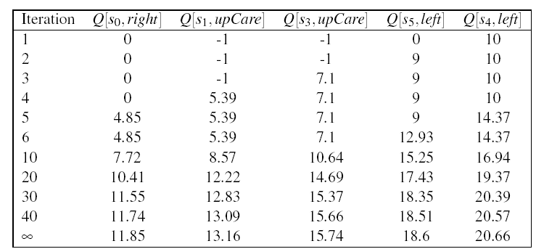
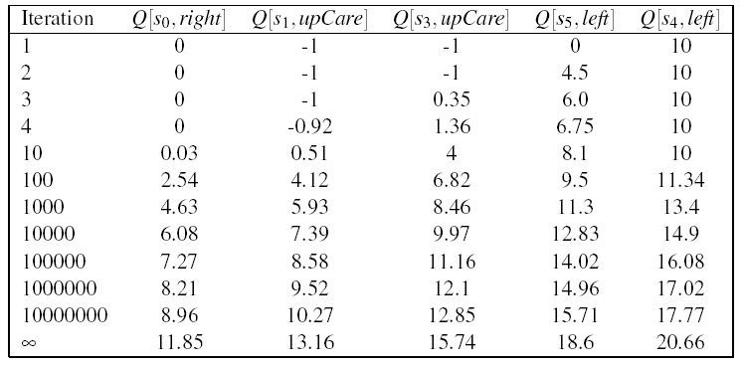
Comparing fixed α and …
Fixed α generates faster update:
all states see some effect of the
positive reward from <s4, left> by
the 5th iteration
Each update is much larger
Gets very close to final numbers by
iteration 40, while with variable α
still not there by iteration 10⁷
However:
Q-learning with fixed α is not guaranteed to converge
variable α

Slide 19

On the approximation…
True relation between Q(s.a) and Q(s’a’)
Q-learning approximation based on each individual experience <s, a, r, s’>
For the approximation to work…..
  A. There is positive reward in most states
B. Q-learning tries each action an unbounded number of times
  C. The transition model is not sparse
Notes:
Unlikely transitions will be observed much less frequently than likely ones, so their related updates will have limited impact in the long term

Slide 20


Matrix sparseness
Number of zero elements of a matrix divided by the number of elements. For conditional probabilities the max sparseness is
Density is = (1 – sparseness)
The min density for conditional probabilities is
Note: the action is deterministic!

Slide 21
Why approximations work…
True relation between Q(s.a) and Q(s’a’)
Q-learning approximation based on each individual experience <s, a, s’>
Way to get around the missing transition model and reward model
Aren’t we in danger of using data coming from unlikely transition to make incorrect adjustments?
No, as long as Q-learning tries each action an unbounded number of times
  Frequency of updates reflects transition model, P(s’|a,s)
Notes:
Unlikely transitions will be observed much less frequently than likely ones, so their related updates will have limited impact in the long term

Slide 22
Lecture Overview
Finish Q-learning
  Algorithm
  Example
Exploration vs. Exploitation
Notes:
POMDPs were initially formalized by the control theory and operations research communities
to optimally control stochastic dynamical systems.
More recently, the articial intelligence community also considered POMDPs for planning
under uncertainty. To date, a wide range of sequential decision problems
such as robot navigation, preference elicitation, stochastic resource
allocation, maintenance scheduling, spoken-dialog systems
and many others have been modeled using POMDPs.

Slide 23
What Does Q-Learning learn
Does Q-learning gives the agent an optimal policy?

Slide 24
Q values
 | s₀ | s₁ | … | s_{k}
a₀ | Q[s₀,a₀] | Q[s₁,a₀] | …. | Q[s_{k},a₀]
a₁ | Q[s₀,a₁] | Q[s₁,a₁] | … | Q[s_{k},a₁]
… | … | … | …. | …
a_{n} | Q[s₀,a_{n}] | Q[s₁,a_{n}] | …. | Q[s_{k},a_{n}]

Slide 25
Exploration vs. Exploitation
Q-learning does not explicitly tell the agent what to do
    just computes a Q-function Q[s,a] that allows the agent to see, for every state, which is the action with the highest expected reward
Given a Q-function the agent can :
      Exploit the knowledge accumulated so far, and chose the action that maximizes Q[s,a] in a given state (greedy behavior)
      Explore new actions, hoping to improve its estimate of the optimal Q-function, i.e. *do not chose* the action suggested by the current Q[s,a]
Notes:
Q-learning does not explicitly tell the agent what to do
just computes a Q-function Q[s,a] that allows the agent to see, for every state, which is the action with the highest expected reward
Given a Q-function, there are two things that the agent can do:
Exploit the knowledge accumulated so far, and chose the action that maximizes Q[s,a] in a given state (greedy behavior)
Explore new actions, hoping to improve its estimate of the optimal Q-function, i.e. *do not chose* the action suggested by the current Q[s,a]

Slide 26
Exploration vs. Exploitation
When to explore and when the exploit?
  Never exploring may lead to being stuck in a suboptimal course of actions
  Exploring too much is a waste of the knowledge accumulated via experience
  A. Only (1) is true
  B. Only (2) is true
  C. Both are true
  D. Both are false
Notes:
When to explore and when the exploit?
Never exploring may lead to being stuck in a suboptimal course of actions
Exploring too much is a waste of the knowledge accumulated via experience

Slide 27
Exploration vs. Exploitation
When to explore and when the exploit?
  Never exploring may lead to being stuck in a suboptimal course of actions
  Exploring too much is a waste of the knowledge accumulated via experience
Must find the right compromise
Notes:
When to explore and when the exploit?
Never exploring may lead to being stuck in a suboptimal course of actions
Exploring too much is a waste of the knowledge accumulated via experience

Slide 28
Exploration Strategies
Hard to come up with an optimal exploration policy (problem is widely studied in statistical decision theory)
But intuitively, any such strategy should be greedy in the limit of infinite exploration (GLIE), i.e.
  Try each action an unbounded number of times, to avoid the possibility of missing an optimal action because of an unusually bad series of outcomes
  Choose the predicted best action when, in the limit, it has found the optimal value function/policy
We will look at two exploration strategies
  ε-greedy
  soft-max

Slide 29
Exploration Strategies
Hard to come up with an optimal exploration policy (problem is widely studied in statistical decision theory)
But intuitively, any such strategy should be greedy in the limit of infinite exploration (GLIE), i.e.
  Choose the predicted best action in the limit
  Try each action an unbounded number of times
We will look at two exploration strategies
  ε-greedy
  soft-max
Notes:
…, to avoid the possibility of missing an optimal action because of an unusually bad series of outcomes
…. Choose the predicted best action when, in the limit, it has found the optimal value function/policy

Slide 30
ε-greedy
Choose a random action with probability ε and choose best action with probability 1- ε
First GLIE condition (try every action an unbounded number of times) is satisfied via the ε random selection
What about second condition?
  Select predicted best action in the limit.
reduce ε overtime!
Notes:
It always chooses the non-optimal action with probability ε, while ideally you would want to explore more at the beginning and become greedier as estimates become more accurate
But it is rather slow
It always chooses the non-optimal action with probability ε, while ideally you would want to do it less and less frequently overtime

Slide 31


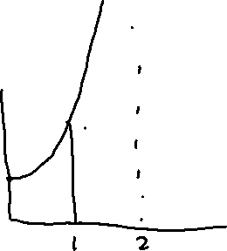
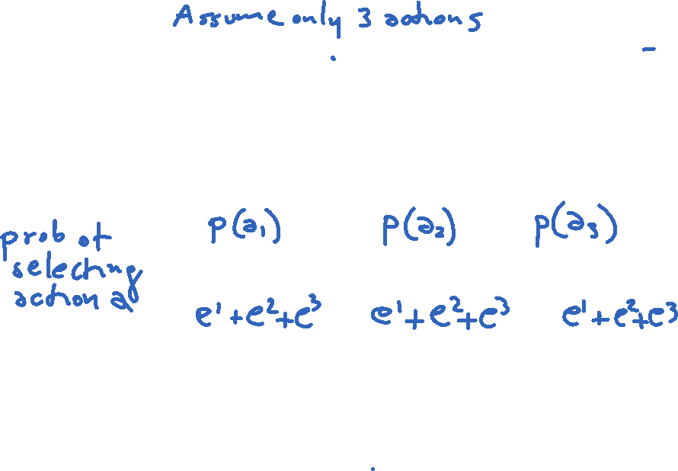


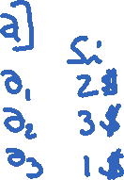
Soft-Max
Takes into account improvement in estimates of expected reward function Q[s,a]
  Choose action a in state s with a probability proportional to current estimate of Q[s,a]
Notes:
Tau is called a temperature parameter (in allusion to chemical kinetics). For high temperatures (tau -> infinite), all actions have nearly the same probability and the lower the temperature, the more expected rewards affect the probability. For a low temperature (tau -> 0), the probability of the action with the highest expected reward tends to 1.

Slide 32


(τ controlled) Soft-Max
Takes into account improvement in estimates of expected reward function Q[s,a]
  Choose action a in state s with a probability proportional to current estimate of Q[s,a]
τ (tau) in the formula above influences how randomly actions should be chosen
  if τ is high, the exponentials approach 1, the fraction approaches 1/(number of actions), and each action has approximately the same probability of being chosen ( exploration or exploitation?)
  as τ → 0, the exponential with the highest Q[s,a] dominates, and the current best action is always chosen (exploration or exploitation?)
Notes:
Tau is called a temperature parameter (in allusion to chemical kinetics). For high temperatures (tau -> infinite), all actions have nearly the same probability and the lower the temperature, the more expected rewards affect the probability. For a low temperature (tau -> 0), the probability of the action with the highest expected reward tends to 1.

Slide 33
Soft-Max
Takes into account improvement in estimates of expected reward function Q[s,a]
  Choose action a in state s with a probability proportional to current estimate of Q[s,a]
τ (tau) in the formula above influences how randomly actions should be chosen
  if τ is high, the exponentials approach 1, the fraction approaches 1/(number of actions), and each action has approximately the same probability of being chosen ( exploration or exploitation?)
  as τ → 0, the exponential with the highest Q[s,a] dominates, and the current best action is always chosen (exploration or exploitation?)
Notes:
Tau is called a temperature parameter (in allusion to chemical kinetics). For high temperatures (tau -> infinite), all actions have nearly the same probability and the lower the temperature, the more expected rewards affect the probability. For a low temperature (tau -> 0), the probability of the action with the highest expected reward tends to 1.

Slide 34
(τ controlled) Soft-Max example

Slide 35
Learning Goals for today’s class
You can:
Explain, trace and implement Q-learning
Describe and compare techniques to combine exploration with exploitation

Slide 36
TODO for Fri
Carefully read : A Markov decision process approach to multi-category patient scheduling in a diagnostic facility, Artificial Intelligence in Medicine Journal, 2011
Follow instructions on course WebPage
<Readings>
Keep working on assignment-1 (due next Wed)

