Slide 1
Intelligent Systems (AI-2)
Computer Science cpsc422, Lecture 19
March, 1, 2021
Slide Sources
Raymond J. Mooney University of Texas at Austin
D. Koller, Stanford CS - Probabilistic Graphical Models
D. Page, Whitehead Institute, MIT
Several Figures from
“Probabilistic Graphical Models: Principles and Techniques” D. Koller, N. Friedman 2009

Slide 2
Lecture Overview
Recap: Naïve Markov – Logistic regression (simple CRF)
CRFs: high-level definition
CRFs Applied to sequence labeling
NLP Examples: Name Entity Recognition, joint POS tagging and NP segmentation
CFR + deep learning Example

Slide 3
  Conditional Random Fields (CRFs)
Model P(Y₁ .. Y_{k} | X₁.. X_{n})
Special case of Markov Networks where all the X_{i} are always observed
  Simple case P(Y₁| X₁…X_{n})
Notes:
To have the network structure and parametrization correspond naturally to a conditional distribution, we want to avoid representing a probabilistic model over X. We therefore disallow potentials that involve only variables in X
IT WOULD PROBABLY HAVE BEEN BETTER TO USE T and F as the two values

Slide 4























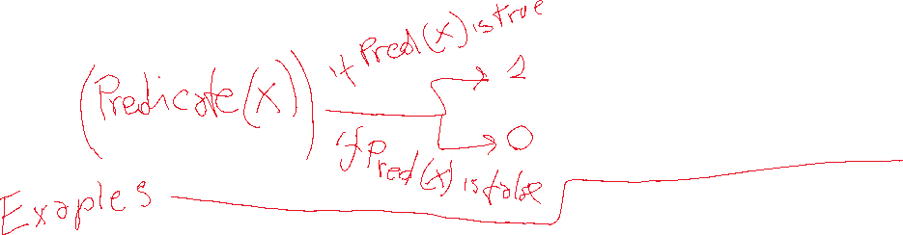
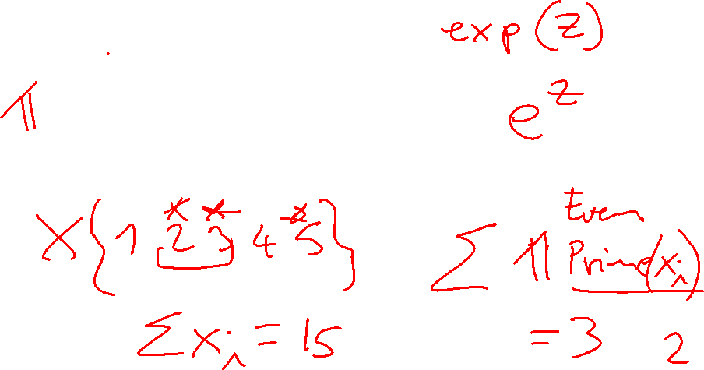
Some notation
exp and indicator function
Notes:
Prime 2 3 5 set of 3 elements
Even 2 4 set of 2 elemts

Slide 5
What are the Parameters?

Slide 6

Let’s derive the probabilities we need
  To compute
  P(Y₁| X₁…X_{n}) = P(Y₁ ,X₁…X_{n}) / P(X₁…X_{n})
  We compute
  P(Y₁ =1| X₁…X_{n}) = P (Y₁ =1, X₁…X_{n}) / P(X₁…X_{n})

Slide 7


Let’s derive the probabilities we need
Y₁
…
X₁
X₂
X_{n}

Slide 8
Let’s derive the probabilities we need
Y₁
…
X₁
X₂
X_{n}

Slide 9
Let’s derive the probabilities we need
Y₁
…
X₁
X₂
X_{n}
0

Slide 10
Let’s derive the probabilities we need
Y₁
…
X₁
X₂
X_{n}

Slide 11
Let’s derive the probabilities we need
Y₁
…
X₁
X₂
X_{n}

Slide 12
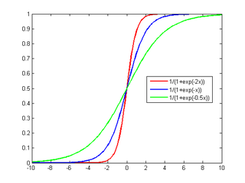
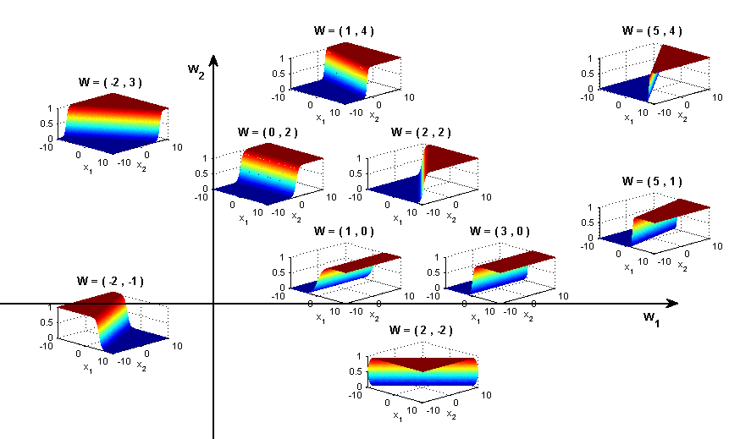
Sigmoid Function used in Logistic Regression
Y₁
Y₁
Great practical interest
Number of param w_{i} is linear instead of exponential in the number of parents
Natural model for many real-world applications
Naturally aggregates the influence of different parents
…
…
X₁
X₂
X_{n}
X₁
X₂
X_{n}

Slide 13
Logistic Regression as a Markov Net (CRF)
Logistic regression is a simple Markov Net (a CRF) aka naïve markov model
Y
…
X₁
X₂
X_{n}
But only models the conditional distribution, P(Y | X ) and not the full joint P(X,Y )

Slide 14
Let’s generalize ….
Assume that you always observe a set of variables X = {X₁…X_{n}} and you want to predict one or more variables Y = {Y₁…Y_{k}}
A CRF is an undirected graphical model whose nodes corresponds to X ∪ Y.
ϕ₁(D₁)… ϕ_{m}(D_{m}) represent the factors which annotate the network (but we disallow factors involving only vars in X – why?)
Notes:
Normalization constant is only difference between this and standard Markov Network definition
The product of all the factors is P(X,Y)
The product of all the factors marginalized over Y is P(X)
The formula above is just saying P(Y|X)= P(Y,X) / P(X)

Slide 15
Lecture Overview
Recap: Naïve Markov – Logistic regression (simple CRF)
CRFs: high-level definition
CRFs Applied to sequence labeling
NLP Examples: Name Entity Recognition, joint POS tagging and NP segmentation
CFR + deep learning Example

Slide 16
Sequence Labeling
..
Y₁
Y₂
Y_{T}
Linear-chain CRF
…
X₁
X₂
X_{T}

Slide 17
Increase representational Complexity: Adding Features to a CRF
Instead of a single observed variable X_{i} we can model multiple features X_{ij} of that observation.
Y₁
Y₂
…
Y_{T}
…
…
…
…
X_{1,1}
X_{1,m}
X_{2,1}
X_{2,m}
X_{T,1}
X_{T,m}

Slide 18
CRFs in Natural Language Processing
One target variable Y for each word X, encoding the possible labels for X
Each target variable is connected to a set of feature variables that capture properties relevant to the target distinction
…
Y₁
Y₂
Y_{T}
…
…
…
…
X_{1,1}
X_{1,2}
X_{1,m}
X_{2,1}
X_{2,1}
X_{2,m}
X_{T,1}
X_{T,m}
Is the word capitalized?
Does the word end in “ing”?
Notes:
The label for word X can be its part of speech or Beginning of an EDU or…..

Slide 19
Named Entity Recognition Task
Entity often span multiple words “British Columbia”
Type of an entity may not be apparent for individual words “University of British Columbia”
Let’s assume three categories: Person, Location, Organization
BIO notation (for sequence labeling)
Notes:
BIO to allow the model to segment adjacent entities of the same type
The challenge of this problem is that many named entity strings are too rare to appear even in a large
training set, and therefore the system must identify them based only on context.

Slide 20
Linear chain CRF parameters
With two factors “types” for each word
Dependency between neighboring target vars
Dependency between target variable and its context in the word sequence, which can include also features of the words (capitalized, appear in an atlas of location names, etc.)
Factors are similar to the ones for the Naïve Markov (logistic regression)
Notes:
Draw model on the board
Discriminative models, such as CRFs, make conditional independence assumptions
among y, and assumptions about how the y can depend on x, but do
not make conditonal independence assumptions among x. This point
also be understood graphically. Suppose that we have a factor graph
representation for the joint distribution p(y,x). If we then construct a
graph for the conditional distribution p(y|x), any factors that depend
only on x vanish from the graphical structure for the conditional distribution.
They are irrelevant to the conditional because they are constant
with respect to y.

Slide 21
Features can also be
The word
Following word
Previous word
Notes:
There are no factors that depend only on X. They vanish because they are constant with respect to Y

Slide 22
More on features
Including features that are conjunctions of simple features increases accuracy
Total number of features can be 10⁵-10⁶
However features are sparse i.e. most features are 0 for most words
Notes:
So inference is fast….

Slide 23
Linear-Chain Performance
Per-token/word accuracy in the high 90% range for many natural datasets
Per-field precision and recall are more often around 80-95% , depending on the dataset. Entire Named Entity Phrase must be correct

Slide 24
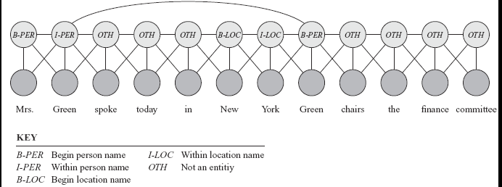
Skip-Chain CRFs
Include additional factors that connect non-adjacent target variables
E.g., When a word occur multiple times in the same documents
Graphical structure over Y can depend on the values of the Xs !
Notes:
The first occurrence has neighboring nodes that provide strong evidence that it is a PERSON’s name; however the second occurrence is much more ambiguous.
New factor “prefers” its connected variables to have the same value
Graphical structure over Y can easily depend on the values of the Xs (the factor / edge is added because the two words are the same)
Additional links make exact inference intractable, so must resort to approximate inference to try to find the most probable labeling.

Slide 25
Lecture Overview
Recap: Naïve Markov – Logistic regression (simple CRF)
CRFs: high-level definition
CRFs Applied to sequence labeling
NLP Examples: Name Entity Recognition, joint POS tagging and NP segmentation
CFR + deep learning Example

Slide 26
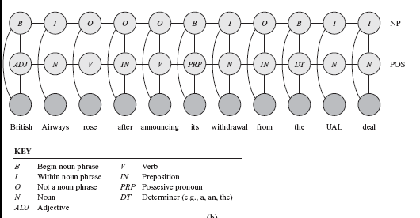
Coupled linear-chain CRFs
Linear-chain CRFs can be combined to perform multiple tasks simultaneously
Performs part-of-speech labeling and noun-phrase segmentation

Slide 27
Coupled linear-chain CRFs
Linear-chain CRFs can be combined to perform multiple tasks simultaneously
Performs part-of-speech labeling and noun-phrase segmentation

Slide 28

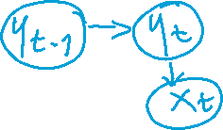
Inference in CRFs (just intuition)
Forward / Backward / Smoothing and Viterbi can be rewritten (not trivial!) using these factors
Then you plug in the factors of the CRFs and all the algorithms work fine with CRFs! ☺

Slide 29
CRFs Summary
Ability to incorporate arbitrary overlapping local and global features
Graphical structure over Y can depend on the values of the Xs (see slide 24)
Can perform multiple tasks simultaneously (see slide 26)
Standard Inference algorithm for HMM can be applied
Practical Learning algorithms exist
Strong baseline on many labeling tasks (deep learning recently shown to be often better when large training data are available... current research on ensembling them!)
See MALLET package for CRF implementation
Notes:
Ability to relax strong independence assumptions
This is referring to the fact that in HMMs the future is independent from the past given the present ?

Slide 30
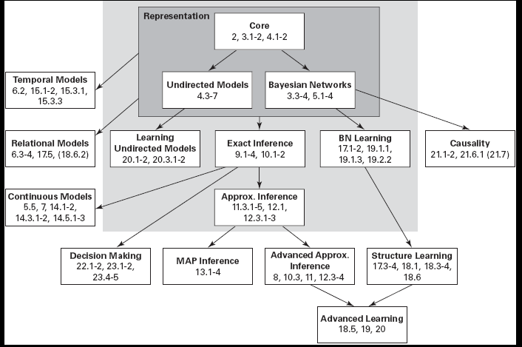
Probabilistic Graphical Models
From “Probabilistic Graphical Models: Principles and Techniques” D. Koller, N. Friedman 2009
Notes:
MAP
Most likely assignment to all of the (non-evidence) variables
Simplest is Viterbi !

Slide 31
Combining CRFs and Neural Models
SEMANTIC IMAGE SEGMENTATION WITH DEEP CONVOLUTIONAL NETS AND FULLY CONNECTED CRFS
International Conference on Learning Representations (ICLR), San Diego, California, USA, May 2015.
Liang-Chieh Chen Univ. of California, Los Angeles; George Papandreou Google Inc. ; Iasonas Kokkinos INRIA ; Kevin Murphy Google Inc. ; Alan L. Yuille Univ. of California, Los Angeles
1.Use CNN to generate a rough prediction of segmentation (smooth, blurry heat map)
2.Refine this prediction with a conditional random field (CRF)

Slide 33
StarAI (statistical relational AI)
Hybrid: Det +Sto
422 big picture
Prob CFG
Prob Relational Models
Markov Logics
Deterministic
Stochastic
Belief Nets
Logics
Approx. : Gibbs
First Order Logics
Markov Chains and HMMs
Ontologies
Forward, Viterbi….
Approx. : Particle Filtering
Query
Full Resolution
SAT
Undirected Graphical Models
Markov Networks
Conditional Random Fields
Markov Decision Processes and
Partially Observable MDP
Planning
Value Iteration
Approx. Inference
Reinforcement Learning
Representation
Applications of AI
Reasoning
Technique
Notes:
Breadth and Depth

Slide 34
Learning Goals for today’s class
You can:
Provide general definition for CRF
Apply CRFs to sequence labeling
Describe and justify features for CRFs applied to Natural Language processing tasks
Explain benefits of CRFs

Slide 35
Next class Wed
Midterm, Mon, March 8, 4-4:55pm
Check on Piazza for details on format
How to prepare…
Go to Office Hours x
Learning Goals (look at the end of the slides for each lecture – complete list has been posted)
Revise all the clicker questions and practice exercises
More practice material has been posted
Check questions and answers on Piazza
Start Logics
Revise Logics from 322!
CPSC 422, Lecture 19
35

Slide 36
From in class 2017

Slide 37
  Conditional Random Fields (CRFs)
Model P(Y₁ .. Y_{k} | X₁.. X_{n})
Special case of Markov Networks where all the X_{i} are always observed
  Simple case P(Y₁| X₁…X_{n})
Notes:
To have the network structure and parametrization correspond naturally to a conditional distribution, we want to avoid representing a probabilistic model over X. We therefore disallow potentials that involve only variables in X
IT WOULD PROBABLY HAVE BEEN BETTER TO USE T and F as the two values

Slide 38
What are the Parameters?

Slide 39
Let’s derive the probabilities we need
Y₁
…
X₁
X₂
X_{n}

Slide 40
Let’s derive the probabilities we need
Y₁
…
X₁
X₂
X_{n}

Slide 41
Let’s derive the probabilities we need
Y₁
…
X₁
X₂
X_{n}
0

Slide 42
Let’s derive the probabilities we need
Y₁
…
X₁
X₂
X_{n}

Slide 43
Continue…..

Slide 44
END in class 2017

Slide 45
Let’s derive the probabilities we need
Y₁
…
X₁
X₂
X_{n}

Slide 46
Continue…..

Slide 47
Sigmoid Function used in Logistic Regression
Y₁
Y₁
Great practical interest
Number of param w_{i} is linear instead of exponential in the number of parents
Natural model for many real-world applications
Naturally aggregates the influence of different “parents”
…
…
X₁
X₂
X_{n}
X₁
X₂
X_{n}

Slide 48
Logistic Regression as a Markov Net (CRF)
Logistic regression is a simple Markov Net (a CRF) aka naïve markov model
Y
…
X₁
X₂
X_{n}
But only models the conditional distribution, P(Y | X ) and not the full joint P(X,Y )

