Slide 1
Intelligent Systems (AI-2)
Computer Science cpsc422, Lecture 18
Feb, 26, 2021
Slide Sources
Raymond J. Mooney University of Texas at Austin
D. Koller, Stanford CS - Probabilistic Graphical Models

Slide 2
Lecture Overview
Probabilistic Graphical models
Recap Markov Networks
Inference in Markov Networks (Exact and Approx.)
Conditional Random Fields

Slide 3
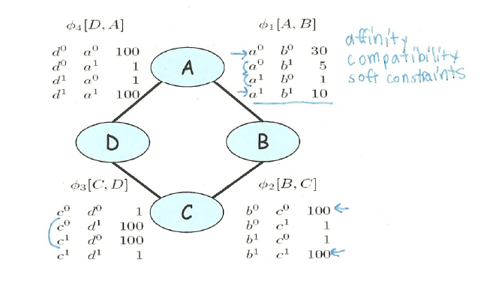
Parameterization of Markov Networks
X
X
Factors define the local interactions (like CPTs in Bnets)
What about the global model? What do you do with Bnets?
Notes:
Not conditional probabilities – capture the affinities between related variables
Also called clique potentials or just potentials
D and A and BC tend to agree. DC tend to disagree
Table values are typically nonnegative
Table values have no other restrictions
Not necessarily probabilities
Not necessarily < 1

Slide 4
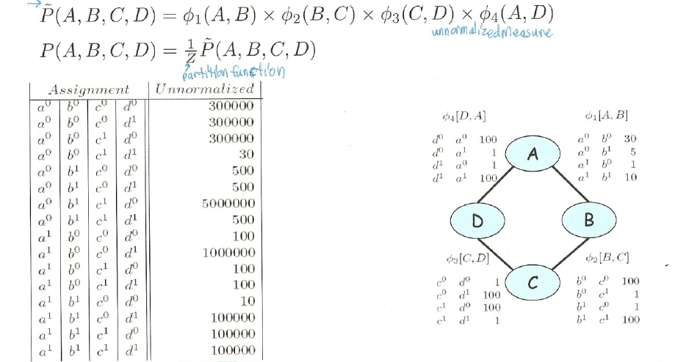
How do we combine local models?
As in BNets by multiplying them!
Notes:
This is the joint distribution from which I can compute any

Slide 5
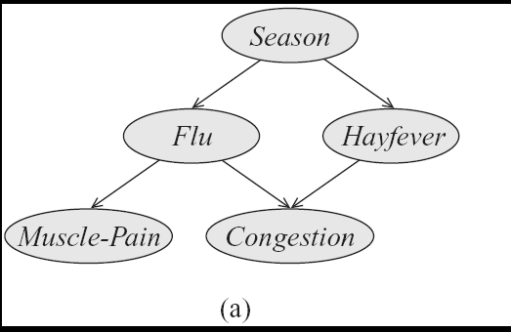
Step Back…. From structure to factors/potentials
In a Bnet the joint is factorized….
In a Markov Network you have one factor for each maximal clique
Notes:
a clique in an undirected graph is a subset of its vertices such that every two vertices in the subset are connected by an edge.

Slide 6
General definitions
Two nodes in a Markov network are independent if and only if every path between them is cut off by evidence
eg for A C
So the markov blanket of a node is…?
eg for C

Slide 7
Lecture Overview
Probabilistic Graphical models
Recap Markov Networks
Inference in Markov Networks (Exact and Approx.)
Conditional Random Fields

Slide 8
Variable elimination algorithm for Bnets
Given a network for P(Z, Y₁,… ,Y_{j} Z₁,… ,Z_{i}), :
To compute P(Z| Y₁=v₁ ,… ,Y_{j}=v_{j} ) :
Construct a factor for each conditional probability.
Set the observed variables to their observed values.
Given an elimination ordering, simplify/decompose sum of products
Perform products and sum out Z_{i}
Multiply the remaining factors Z
Normalize: divide the resulting factor f(Z) by ∑_{Z} f(Z) .
Variable elimination algorithm for Markov Networks…..
Notes:
They are all going to be only in Q

Slide 9
Variable Elimination on MN: Example
Notes:
Not conditional probabilities – capture the affinities between related variables
Also called clique potentials or just potentials
D and A and BC tend to agree. DC tend to disagree
Table values are typically nonnegative
Table values have no other restrictions
Not necessarily probabilities
Not necessarily < 1

Slide 10
Gibbs sampling for Markov Networks
Example: P(D | C=0)
Resample non-evidence variables in a pre-defined order or a random order
Suppose we begin with A
Note: never change evidence!
What do we need to sample?
a. P(A | B=0)
b. P(A | B=0, C=0)
c. P( B=0, C=0| A)
A | B | C | D | E | F
1 | 0 | 0 | 1 | 1 | 0
Initial assigmnet
Notes:
B and C are Markov blanket of A
Calculate P(A | B,C)
Use current Gibbs sampling value for B & C

Slide 11
Gibbs sampling MN: what to sample
For Bnets
For Markov Networks just the product of the factors involving X (normalized)
Resample probability distribution of P(A|BC)
 | A=1 | A=0
C=1 | 1 | 2
C=0 | 3 | 4
 | A=1 | A=0
B=1 | 1 | 5
B=0 | 4.3 | 0.2
B=0 ; C=0
A | B | C | D | E | F
1 | 0 | 0 | 1 | 1 | 0
? | 0 | 0 | 1 | 1 | 0
A=1 | A=0
12.9 | 0.8
Normalized result =
A=1 | A=0
0.95 | 0.05

Slide 12
Example: Gibbs sampling
Resample probability distribution of B given A D
 | A=1 | A=0
B=1 | 1 | 5
B=0 | 4.3 | 0.2
A | B | C | D | E | F
1 | 0 | 0 | 1 | 1 | 0
1 | 0 | 0 | 1 | 1 | 0
1 | ? | 0 | 1 | 1 | 0
 | D=1 | D=0
B=1 | 1 | 2
B=0 | 2 | 1
B=1 | B=0
1 | ??
Normalized result =
B=1 | B=0
0.11 | 0.89
A. 10
B. 0.4
C. 8.6

Slide 13
Lecture Overview
Probabilistic Graphical models
Recap Markov Networks
Inference in Markov Networks (Exact and Approx.)
Conditional Random Fields

Slide 14
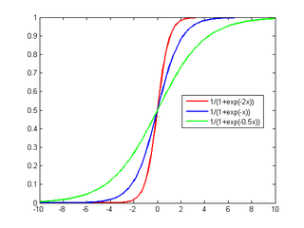
We want to model P(Y₁| X₁.. X_{n})
… where all the X_{i} are always observed
MN
BN
Y₁
Y₁
…
…
X₁
X₂
X_{n}
X₁
X₂
X_{n}
Which model is simpler, MN or BN?
Naturally aggregates the influence of different parents
Notes:
Number of param w_{i} is linear instead of exponential in the number of parents
Natural model for many real-world applications
Naturally aggregates the influence of different parents

Slide 15
Conditional Random Fields (CRFs)
Model P(Y₁ .. Y_{k} | X₁.. X_{n})
Special case of Markov Networks where all the X_{i} are always observed
Simple case P(Y₁| X₁…X_{n})
Notes:
To have the network structure and parametrization correspond naturally to a conditional distribution, we want to avoid representing a probabilistic model over X. We therefore disallow potentials that involve only variables in X
IT WOULD PROBABLY HAVE BEEN BETTER TO USE T and F as the two values

Slide 16
Some notation: exp and indicator function
exp and indicator function
Notes:
Prime 2 3 5 set of 3 elements
Even 2 4 set of 2 elemts

Slide 17
What are the Parameters?

Slide 18
Let’s derive the probabilities we need
To compute
P(Y₁| X₁…X_{n}) = P(Y₁ ,X₁…X_{n}) / P(X₁…X_{n})
We compute
P(Y₁ =1| X₁…X_{n}) = P (Y₁ =1, X₁…X_{n}) / P(X₁…X_{n})

Slide 19
Let’s derive the probabilities we need
Y₁
…
X₁
X₂
X_{n}

Slide 20
Let’s derive the probabilities we need
Y₁
…
X₁
X₂
X_{n}
0

Slide 21
Let’s derive the probabilities we need
Y₁
$$\overset{≈}{P}\left(Y_{1}=0,x_{1},....,x_{n}\right)…$$
…
X₁
X₂
X_{n}

Slide 22
Sigmoid Function used in Logistic Regression
Y₁
Y₁
Great practical interest
Number of param w_{i} is linear instead of exponential in the number of parents
Natural model for many real-world applications
Naturally aggregates the influence of different parents
…
…
X₁
X₂
X_{n}
X₁
X₂
X_{n}

Slide 23
Logistic Regression as a Markov Net (CRF)
Logistic regression is a simple Markov Net (a CRF) aka naïve markov model
Y
…
X₁
X₂
X_{n}
But only models the conditional distribution, P(Y | X ) and not the full joint P(X,Y )

Slide 24
Learning Goals for today’s class
You can:
Perform Exact and Approx. Inference in Markov Networks
Describe a natural parameterization for a Naïve Markov model (which is a simple CRF)
Derive how P(Y|X) can be computed for a Naïve Markov model
Explain the discriminative vs. generative distinction and its implications

Slide 25
Next class Mon
Assignment 2 – due on Mon
Linear-chain CRFs
To Do
Revise generative temporal models (HMM)
Midterm, Mon, March 8,
How to prepare….
Go to Office Hours
Learning Goals (look at the end of the slides for each lecture – complete list will be posted)
Revise all the clicker questions, practice exercises, assignments
More practice material will be posted
Check questions and answers on Piazza

