Slide 1
Intelligent Systems (AI-2)
Computer Science cpsc422, Lecture 17
Feb, 24, 2021
Slide Sources
D. Koller, Stanford CS - Probabilistic Graphical Models
D. Page, Whitehead Institute, MIT
Several Figures from
“Probabilistic Graphical Models: Principles and Techniques” D. Koller, N. Friedman 2009

Slide 2
StarAI (statistical relational AI)
Hybrid: Det +Sto
422 big picture: Where are we?
Prob CFG
Prob Relational Models
Markov Logics
Deterministic
Stochastic
Belief Nets
Logics
Approx. : Gibbs
First Order Logics
Markov Chains and HMMs
Ontologies
Temporal rep.
Forward, Viterbi….
Approx. : Particle Filtering
Query
Full Resolution
SAT
Undirected Graphical Models
Markov Networks
Conditional Random Fields
Markov Decision Processes and
Partially Observable MDP
Planning
Value Iteration
Approx. Inference
Reinforcement Learning
Representation
Applications of AI
Reasoning
Technique
Notes:
First Order Logics (will build a little on Prolog and 312)
Temporal reasoning from NLP 503 lectures
Reinforcement Learning (not done in 340, at least in the latest offering)
Markov decision process
Set of states S, set of actions A
Transition probabilities to next states P(s’| s, a′)
Reward functions R(s, s’, a)
RL is based on MDPs, but
Transition model is not known
Reward model is not known
While for MDPs we can compute an optimal policy
RL learns an optimal policy

Slide 3
Lecture Overview
Probabilistic Graphical models
Intro
Example
Markov Networks Representation (vs. Belief Networks)
Inference in Markov Networks (Exact and Approx.)
Applications of Markov Networks

Slide 4
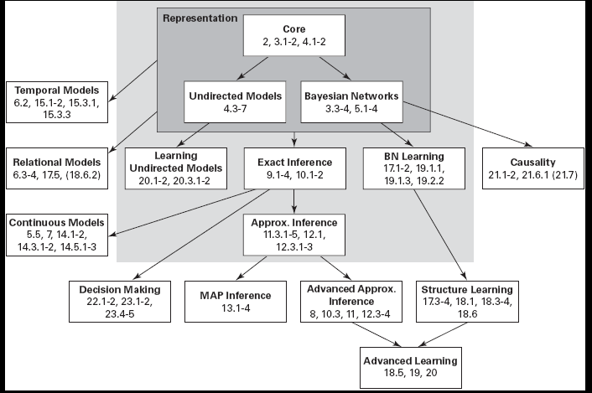
Probabilistic Graphical Models
From “Probabilistic Graphical Models: Principles and Techniques” D. Koller, N. Friedman 2009
Notes:
Viterbi is MAP, right?
maximum a posteriori probability (MAP)

Slide 5
Misconception Example
Four students (Alice, Bill, Debbie, Charles) get together in pairs, to work on a homework
But only in the following pairs: AB AD DC BC
Professor misspoke and might have generated misconception
A student might have figured it out later and told study partner
Notes:
Undirected graphs (cf. Bayesian networks, which are directed)
A Markov network represents the joint probability distribution over events which are represented by variables
Nodes in the network represent variables

Slide 6

Example: In/Depencencies
Are A and C independent because they never spoke?
No, because A might have figured it out and told B who then told C
But if we know the values of B and D….
And if we know the values of A and C
  a. Yes
  b. No
  c. Cannot Tell

Slide 7
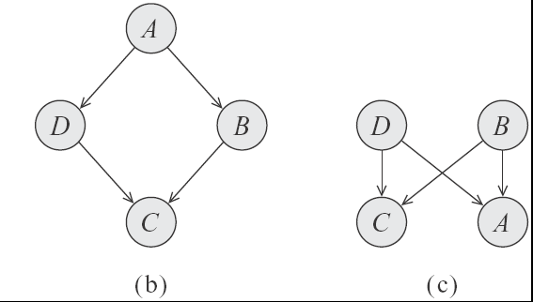
Which of these two Bnets captures the two independencies of our example?
  a.
  b.
  c. Both
  d. None
Notes:
A Bnet require that we ascribe directionality to the influence while in this case the interaction between the variables is symmetrical
A BD independent only given A
B BD marginally independent

Slide 8
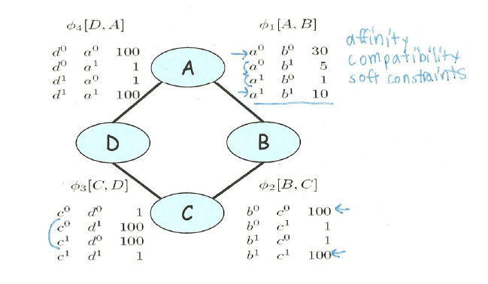
Parameterization of Markov Networks
X
X
Factors define the local interactions (like CPTs in Bnets)
What about the global model? What do you do with Bnets?
Notes:
Not conditional probabilities – capture the affinities between related variables
Also called clique potentials or just potentials
D and A and BC tend to agree. DC tend to disagree
Table values are typically nonnegative
Table values have no other restrictions
Not necessarily probabilities
Not necessarily < 1

Slide 9
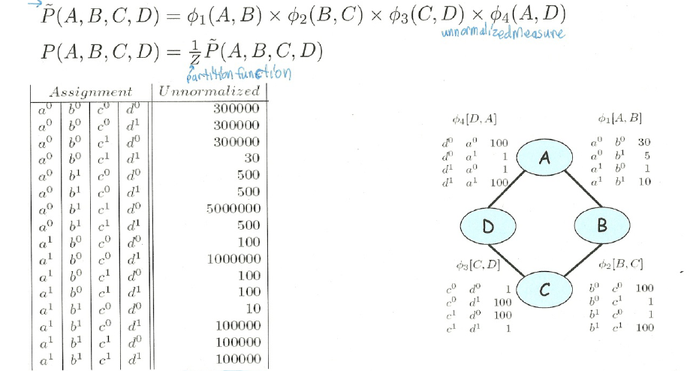
How do we combine local models?
As in BNets by multiplying them!
Notes:
This is the joint distribution from which I can compute any

Slide 10
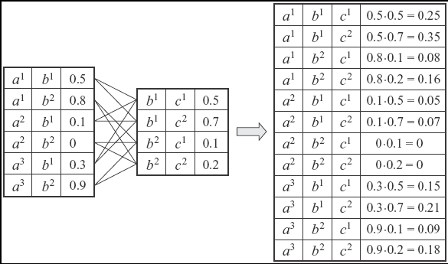
Multiplying Factors (same seen in 322 for VarElim)
Notes:
Deliberately chosen factors that do not correspond to prob or to conditional prob. To emphasize the generality of this operation
You have seen this in VarElimination

Slide 11
Factors do not represent marginal probs. !
a⁰ b⁰ | 0.13
a⁰ b¹ | 0.69
a¹ b⁰ | 0.14
a¹ b¹ | 0.04
Marginal P(A,B)
Computed from the joint
Notes:
The reason for the discrepancy is the influence of the other factors on the distribution
D and C tend to disagree but A and D AND C and B tend to agree so A and B should disagree
This is dominating the weaker agreement according to the AB factor

Slide 12
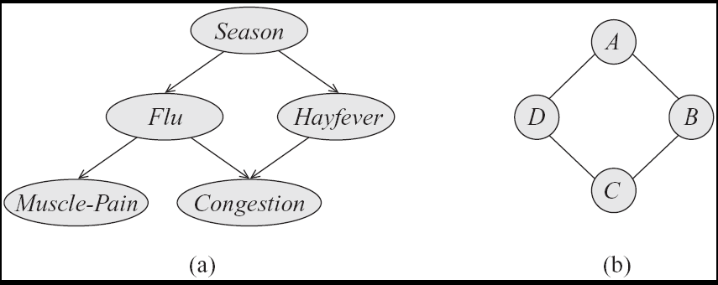
Step Back…. From structure to factors/potentials
In a Bnet the joint is factorized….
In a Markov Network you have one factor for each maximal clique
Notes:
a clique in an undirected graph is a subset of its vertices such that every two vertices in the subset are connected by an edge.

Slide 13
Directed vs. Undirected
Independencies
Factorization

Slide 14
General definitions
Two nodes in a Markov network are independent if and only if ...
eg for A C
So the markov blanket of a node is... ?
eg for C
  a. All the parents of its children
  c. All its neighbors
  b. The whole network

Slide 15
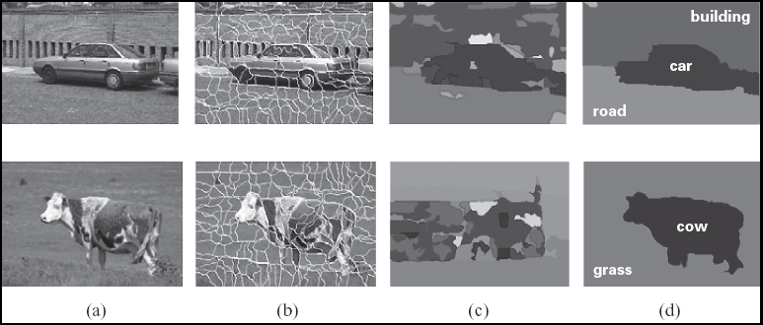
Markov Networks Applications (1): Computer Vision
Called Markov Random Fields
Stereo Reconstruction
Image Segmentation
Object recognition
Typically pairwise MRF
Each vars correspond to a pixel (or superpixel )
Edges (factors) correspond to interactions between adjacent pixels in the image
  E.g., in segmentation: from generically penalize discontinuities, to road under car

Slide 16
Image segmentation

Slide 17


Markov Networks Applications (1): Computer Vision
Each vars correspond to a pixel (or superpixel )
Edges (factors) correspond to interactions between adjacent pixels in the image
  E.g., in segmentation: from generically penalize discontinuities, to road under car

Slide 18


















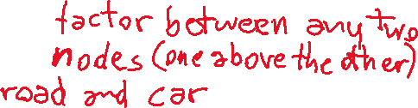

Markov Networks Applications (1): Computer Vision
Each vars correspond to a pixel (or superpixel )
Edges (factors) correspond to interactions between adjacent pixels in the image
  E.g., in segmentation: from generically penalize discontinuities, to road under car

Slide 19
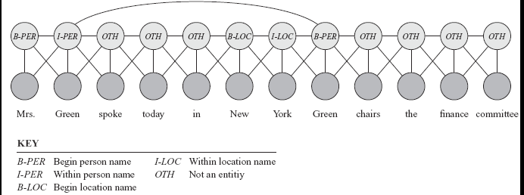
Markov Networks Applications (2): Sequence Labeling in NLP and BioInformatics
Conditional random fields (next class Fri)
Notes:
A skip chain CRF for named entity recognition, with connection between adjacent words and long rang connection between multiple occurrences of the same word

Slide 20
Combining CRFs and Neural Models
SEMANTIC IMAGE SEGMENTATION WITH DEEP CONVOLUTIONAL NETS AND FULLY CONNECTED CRFS
International Conference on Learning Representations (ICLR), San Diego, California, USA, May 2015.
Liang-Chieh Chen Univ. of California, Los Angeles; George Papandreou Google Inc. ; Iasonas Kokkinos INRIA ; Kevin Murphy Google Inc. ; Alan L. Yuille Univ. of California, Los Angeles
1.Use CNN to generate a rough prediction of segmentation (smooth, blurry heat map)
2.Refine this prediction with a conditional random field (CRF)

Slide 21
Learning Goals for today’s class
You can:
Justify the need for undirected graphical model (Markov Networks)
Interpret local models (factors/potentials) and combine them to express the joint
Define independencies and Markov blanket for Markov Networks
Perform Exact and Approx. Inference in Markov Networks
Describe a few applications of Markov Networks

Slide 22
Less than Two weeks to Midterm, Mon, March 8
How to prepare….
Keep Working on assignment-2 !
Go to Office Hours x
Learning Goals (look at the end of the slides for each lecture – complete list will be posted)
Revise all the clicker questions and practice exercises
More practice material will be posted next week
Check questions and answers on Piazza

Slide 23
How to acquire factors?

Slide 24
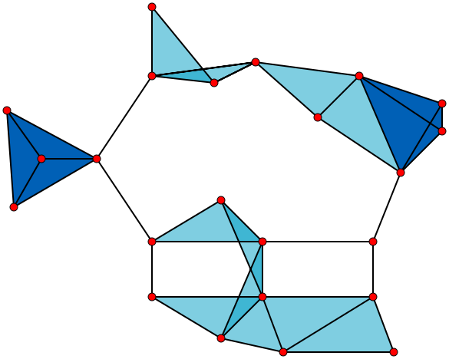
Notes:
[Source: WIKIPEDIA] A graph with 23 1-vertex cliques (its vertices), 42 2-vertex cliques (its edges), 19 3-vertex cliques (the light and dark blue triangles), and 2 4-vertex cliques (dark blue areas). The six edges not associated with any triangle and the 11 light blue triangles form maximal cliques. The two dark blue 4-cliques are both maximum and maximal, and the clique number of the graph is 4.

