Slide 1
Intelligent Systems (AI-2)
Computer Science cpsc422, Lecture 16
Feb, 22, 2021

Slide 2
Lecture
Overview
Probabilistic temporal Inferences
Filtering
Prediction
Smoothing (forward-backward)
Most Likely Sequence of States (Viterbi)
Approx. Inference (Particle Filtering)

Slide 3
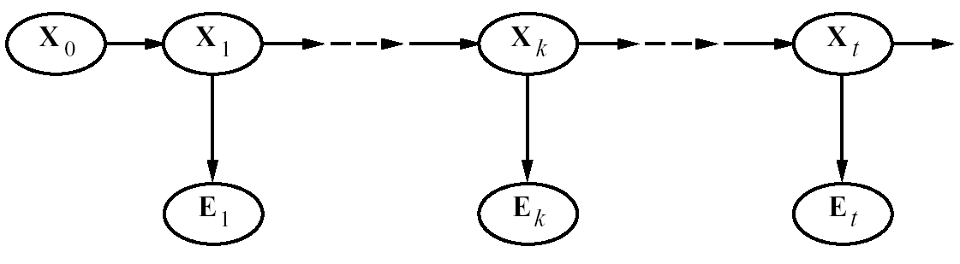





HMMs : most likely sequence
Natural Language Processing: e.g., Speech Recognition
States: phoneme \ word
Observations: acoustic signal \ phoneme
Bioinformatics: Gene Finding
States: coding / non-coding region
Observations: DNA Sequences
For these problems the critical inference is:
find the most likely sequence of states given a sequence of observations
Most Likely Sequence: argmax_{x1:T} P(X_{1:T} | e_{1:T})
Notes:
ahone is a speech sound

Slide 4
Part-of-Speech (PoS) Tagging
Given a text in natural language, label (tag) each word with its syntactic category
  E.g, Noun, verb, pronoun, preposition, adjective, adverb, article, conjunction
Input
  Brainpower, not physical plant, is now a firm's chief asset.
Output
  Brainpower_NN ,_, not_RB physical_JJ plant_NN ,_, is_VBZ now_RB a_DT firm_NN 's_POS chief_JJ asset_NN ._.
Tag meanings
NNP (Proper Noun singular), RB (Adverb), JJ (Adjective), NN (Noun sing. or mass), VBZ (Verb, 3 person singular present), DT (Determiner), POS (Possessive ending), . (sentence-final punctuation)

Slide 5
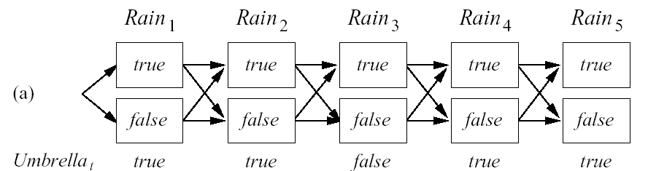







Most Likely Sequence (Explanation)
Most Likely Sequence: argmax_{x1:T} P(X_{1:T} | e_{1:T})
Idea
  find the most likely path to each state in X_{T}
  Then pick the one with highest probability
  (As for filtering etc. let’s try to develop a recursive solution)
Notes:
5
Different than sequence of most likely states

Slide 6




Joint vs. Conditional Prob
You have two binary random variables X and Y
argmax_{x} P(X | Y=t) ? argmax_{x} P(X , Y=t)
A. Different x
B. Same x
C. It depends
X | Y | P(X , Y)
t | t | .4
f | t | .2
t | f | .1
f | f | .3
Notes:
Evidence influences the choice of downstream variables, but not upstream ones (C isn’t more likely to get a value matching the evidence)

Slide 7
High level rationale
The sequence that is maximizing the conditional prob is the same that is maximizing the joint (see previous clicker question)
We will compute the max for the joint, and by doing that we can then reconstruct the sequence that is maximizing the joint
Which is the same that is maximizing the conditional prob

Slide 8
Most Likely Sequence: Formal Derivation (step 2: compute the max for the joint )
max _{x1,...xt} P(x₁,.... x_{t} ,x_{t+1}, e_{1:t+1})= max _{x1,...xt} P(x₁,.... x_{t} ,x_{t+1},e_{1:t,} e_{t+1})=
= max _{x1,...xt} P(e_{t+1}|e_{1:t,} x₁,.... x_{t} ,x_{t+1}) P(x₁,.... x_{t} ,x_{t+1},e_{1:t})=
= max _{x1,...xt} P(e_{t+1}|x_{t+1}) P(x₁,.... x_{t} ,x_{t+1},e_{1:t})=
= max _{x1,...xt} P(e_{t+1}|x_{t+1}) P(x_{t+1}| x₁,.... x_{t} , e_{1:t})P(x₁,.... x_{t} , e_{1:t})=
= max _{x1,...xt} P(e_{t+1} |x_{t+1}) P(x_{t+1}|x_{t}) P(x₁,.... x_{t-1} ,x_{t}, e_{1:t}) =
P(e_{t+1} |x_{t+1}) max _{xt} (P(x_{t+1}|x_{t}) max _{x1,...xt-1} P(x₁,.... x_{t-1} ,x_{t}, e_{1:t}))
Cond. Prob
Markov Assumption
Cond. Prob
Markov Assumption
Move outside the max
Notes:
8
Recursive relationship between most likely path to state x_{t+1} and most likely path to state x_{t,} which we can express as
Because of the Markov assumption, this is
The most likely path to state X_{t} at step t
the state x_{t}, at step t that maximizes the path to X_{t+1}.
It is the backbone for applications that deal with sequences of noisy observations
Predict the probability of a sequence of actual words from captured speech signals
two main problems: high space complexity if states are large and sequences arelong, as I have to store the forward message for t steps
In on-line applications, one needs to recomputed the sequence everytime new evidence comes. usually one does not recompute the whole sequence but just a predefined lag of d steps before t

Slide 9
Most Likely Sequence: Formal Derivation (step 2: compute the max for the joint )
max _{x1,...xt} P(x₁,.... x_{t} ,x_{t+1}, e_{1:t+1})= max _{x1,...xt} P(x₁,.... x_{t} ,x_{t+1},e_{1:t,} e_{t+1})=
= max _{x1,...xt} P(e_{t+1}|e_{1:t,} x₁,.... x_{t} ,x_{t+1}) P(x₁,.... x_{t} ,x_{t+1},e_{1:t})=
= max _{x1,...xt} P(e_{t+1}|x_{t+1}) P(x₁,.... x_{t} ,x_{t+1},e_{1:t})=
= max _{x1,...xt} P(e_{t+1}|x_{t+1}) P(x_{t+1}| x₁,.... x_{t} , e_{1:t})P(x₁,.... x_{t} , e_{1:t})=
= max _{x1,...xt} P(e_{t+1} |x_{t+1}) P(x_{t+1}|x_{t}) P(x₁,.... x_{t-1} ,x_{t}, e_{1:t}) =
P(e_{t+1} |x_{t+1}) max _{xt} (P(x_{t+1}|x_{t}) max _{x1,...xt-1} P(x₁,.... x_{t-1} ,x_{t}, e_{1:t}))
Cond. Prob
Markov Assumption
Cond. Prob
Markov Assumption
Move outside the max
Notes:
9
Recursive relationship between most likely path to state x_{t+1} and most likely path to state x_{t,} which we can express as
Because of the Markov assumption, this is
The most likely path to state X_{t} at step t
the state x_{t}, at step t that maximizes the path to X_{t+1}.
It is the backbone for applications that deal with sequences of noisy observations
Predict the probability of a sequence of actual words from captured speech signals
two main problems: high space complexity if states are large and sequences arelong, as I have to store the forward message for t steps
In on-line applications, one needs to recomputed the sequence everytime new evidence comes. usually one does not recompute the whole sequence but just a predefined lag of d steps before t

Slide 10



Intuition behind solution
P(e_{t+1} |x_{t+1}) max _{xt} (P(x_{t+1}|x_{t}) max _{x1,...xt-1} P(x₁,.... x_{t-1} ,x_{t},e_{1:t}))

Slide 11
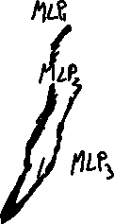

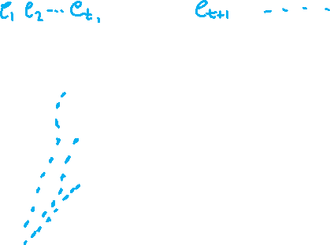

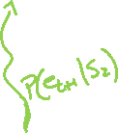
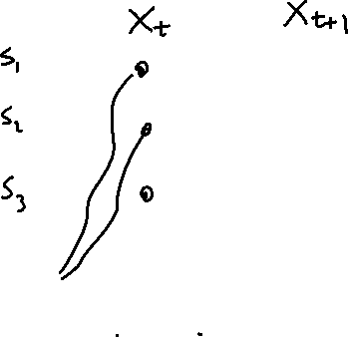

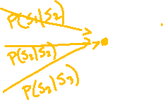
P(e_{t+1} |x_{t+1}) max _{xt} (P(x_{t+1}|x_{t}) max _{x1,...xt-1} P(x₁,.... x_{t-1} ,x_{t},e_{1:t}))
The probability of the most likely path to S₂ at time t+1 is:

Slide 12
Most Likely Sequence
Identical to filtering (notation warning: this is expressed for X_{t+1} instead of X_{t} , it does not make any difference!)
  P(X_{t+1} | e_{1:t+1}) = α P(e_{t+1} | X_{t+1}) ∑_{xt} P(X_{t+1} | x_{t} ) P( x_{t}| e_{1:t} )‏
  max _{x1,...xt} P(x₁,.... x_{t} ,X_{t+1},e_{1:t+1})
= P(e_{t+1} |X_{t+1}) max _{xt} (P(X_{t+1}|x_{t}) max _{x1,...xt-1} P(x₁,.... x_{t-1} ,x_{t},e_{1:t})
f_{1:t} = P(X_{t} |e_{1:t} ) is replaced by
  m_{1:t} = max _{x1,...xt-1} P(x₁,.... x_{t-1} ,X_{t},e_{1:t}) (*)‏
the summation in the filtering equations is replaced by maximization in the most likely sequence equations
Recursive call
Notes:
12

Slide 13
Rain Example
  max _{x1,...xt} P(x₁,.... x_{t} ,X_{t+1},e_{1:t+1}) = P(e_{t+1} |X_{t+1}) max _{xt} [(P(X_{t+1}|x_{t}) m _{1:t}]
m _{1:t} = max_{x1,...xt-1} P(x₁,.... x_{t-1} ,X_{t},e_{1:t})
0.818
0.515
0.182
0.049
m _{1:1} is just P(R₁|u) = <0.818,0.182>
m _{1:2} =
P(u₂|R₂) <max [P(r₂|r₁) * 0.818, P(r₂| ┐r₁) 0.182], max [P(┐r₂|r₁) * 0.818, P(┐r₂| ┐r₁) 0.182]=
= <0.9,0.2><max(0.7*0.818, 0.3*0.182), max(0.3*0.818, 0.7*0.182)=
=<0.9,0.2>*<0.573, 0.245>= <0.515, 0.049>
Notes:
13

Slide 14
Updating this with evidence from for t =1 (umbrella appeared) gives
  P(R₁| u₁) = α P(u₁ | R₁) P(R₁) =
  α<0.9, 0.2><0.5,0.5> = α<0.45, 0.1> ~ <0.818, 0.182>

Slide 15
Rain Example
0.818
0.515
0.036
0.182
0.049
0.124
m _{1:3} =
P(┐u₃|R₃) <max [P(r₃|r₂) * 0.515, P(r₃| ┐r₂) *0.049], max [P(┐ r₃|r₂) * 0.515, P(┐r₃| ┐r₂) 0.049)=
= <0.1,0.8><max(0.7* 0.515, 0.3* 0.049), max(0.3* 0.515, 0.7* 0.049)=
=<0.1,0.8>*<0.36, 0.155>= <0.036, 0.124>
Notes:
15

Slide 16
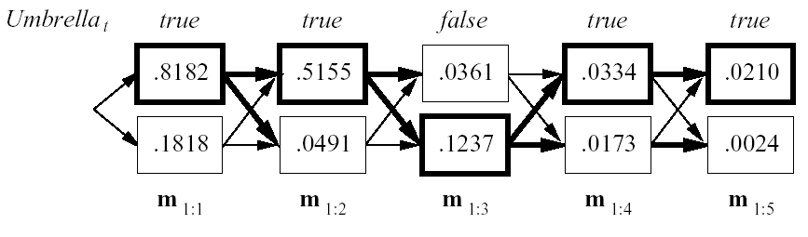
Viterbi Algorithm
Computes the most likely sequence to X_{t+1} by
  running forward along the sequence
  computing the m message at each time step
  Keep back pointers to states that maximize the function
  in the end the message has the prob. Of the most likely sequence to each of the final states
  we can pick the most likely one and build the path by retracing the back pointers
Notes:
16

Slide 17
Viterbi Algorithm: Complexity
T = number of time slices
S = number of states
Time complexity?
Space complexity
A. O(T² S)
B. O(T S²)
C. O(T² S²)
A. O(T S)
B. O(T² S)
C. O(T² S²)
Notes:
17
The space is also linear in t, because the algorithm needs to save the pointers indicating the best sequence to each state

Slide 18
Lecture Overview
Probabilistic temporal Inferences
Filtering
Prediction
Smoothing (forward-backward)
Most Likely Sequence of States (Viterbi)
Approx. Inference In Temporal Models (Particle Filtering)

Slide 19
Limitations of Exact Algorithms
HMM has very large number of states
Our temporal model is a Dynamic Belief Network with several “state” variables
Exact algorithms do not scale up ☹
What to do?

Slide 20
Approximate Inference
Basic idea:
  Draw N samples from known prob. distributions
  Use those samples to estimate unknown prob. distributions
Why sample?
  Inference: getting N samples is faster than computing the right answer (e.g. with Filtering)

Slide 21
Simple but Powerful Approach:
Particle Filtering
  Idea from Exact Filtering: should be able to compute P(X_{t+1} | e_{1:t+1}) from P( X_{t} | e_{1:t} )‏
  “.. One slice from the previous slice…”
Idea from Likelihood Weighting
  Samples should be weighted by the probability of evidence given parents
New Idea: run multiple samples simultaneously through the network

Slide 22
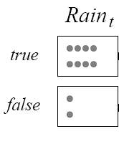
Particle Filtering
Run all N samples together through the network, one slice at a time
STEP 0: Generate a population on N initial-state samples by sampling from initial state distribution P(X₀)
N = 10
Notes:
Form of filtering, where the N samples are the forward message
Essentially use the sample themselves as an approximation of the current state distribution
No need to unroll the network, all needed is current and next slice => “constant” update per time step

Slide 23
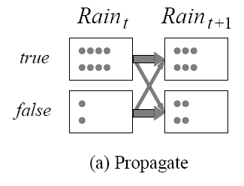
Particle Filtering
STEP 1: Propagate each sample for x_{t} forward by sampling the next state value x_{t+1} based on P(X_{t+1} |X_{t} )
R_{t} | P(R_{t+1}=t)
t f | 0.7 0.3

Slide 24
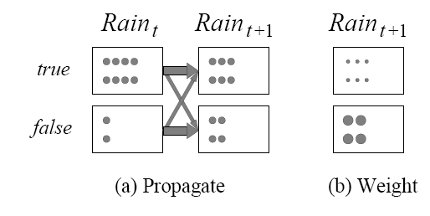
Particle Filtering
STEP 2: Weight each sample by the likelihood it assigns to the evidence
  E.g. assume we observe not umbrella at t+1
R_{t} | P(u_{t}) | P(┐u_{t})
t f | 0.9 0.2 | 0.1 0.8

Slide 25
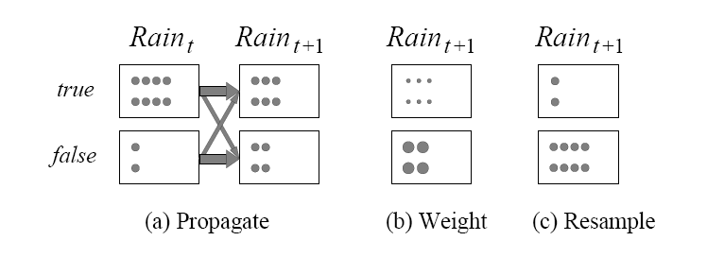
Particle Filtering
STEP 3: Create a new population from the population at X_{t+1,} i.e.
resample the population so that the probability that each sample is selected is proportional to its weight
Start the Particle Filtering cycle again from the new sample
Notes:
Weighted sample with replacement (ie “we can pick the same sample multiple times”)

Slide 26
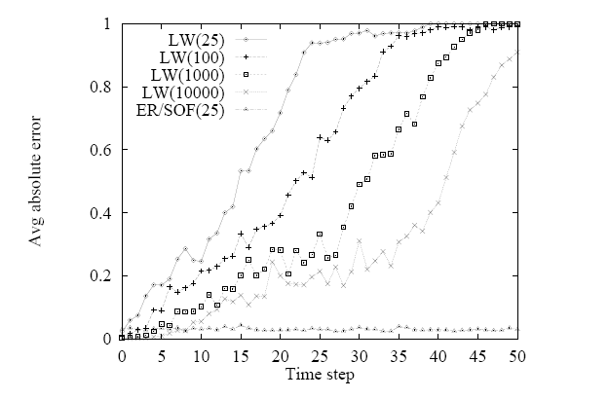
Is PF Efficient?
In practice, approximation error of particle filtering remains bounded overtime
It is also possible to prove that the approximation maintains bounded error with high probability
(with specific assumption: probs in transition and sensor models >0 and <1)
Notes:
Approximation error of particle filtering remains bounded over time, at least empirically—theoretical analysis is difficult
Probabilities in the transition and sensor models are strictly less that 1 and greater than 0
In statistics, efficiency is a term used in the comparison of various statistical procedures ……] Essentially, a more efficient estimator, experiment, or test needs fewer observations than a less efficient one to achieve a given performance.

Slide 27
StarAI (statistical relational AI)
Hybrid: Det +Sto
422 big picture
Prob CFG
Prob Relational Models
Markov Logics
Deterministic
Stochastic
Belief Nets
Logics
Approx. : Gibbs
First Order Logics
Markov Chains and HMMs
Ontologies
Forward, Viterbi….
Approx. : Particle Filtering
Query
Full Resolution
SAT
Undirected Graphical Models
Markov Networks
Conditional Random Fields
Markov Decision Processes and
Partially Observable MDP
Planning
Value Iteration
Approx. Inference
Reinforcement Learning
Representation
Applications of AI
Reasoning
Technique
Notes:
Breadth and Depth

Slide 28
Learning Goals for today’s class
You can:
Describe the problem of finding the most likely sequence of states (given a sequence of observations), derive its solution (Viterbi algorithm) by manipulating probabilities and applying it to a temporal model
Describe and apply Particle Filtering for approx. inference in temporal models.

Slide 29
TODO for Wed
Keep working on Assignment-2: due Mon March 1
Midterm : Mon March 8

Slide 30
TODO for Fri
Keep working on Assignment-2: due Fri Oct 18
Midterm : October 25

