Slide 1
Intelligent Systems (AI-2)
Computer Science cpsc422, Lecture 14
Feb, 10, 2021
Slide credit: some slides adapted from Stuart Russell (Berkeley)

Slide 2
StarAI (statistical relational AI)
Hybrid: Det +Sto
422 big picture
Prob CFG
Prob Relational Models
Markov Logics
Deterministic
Stochastic
Belief Nets
Logics
Approx. : Gibbs
First Order Logics
Markov Chains and HMMs
Ontologies
Forward, Viterbi….
Approx. : Particle Filtering
Query
Full Resolution
SAT
Undirected Graphical Models
Markov Networks
Conditional Random Fields
Markov Decision Processes and
Partially Observable MDP
Planning
Value Iteration
Approx. Inference
Reinforcement Learning
Representation
Applications of AI
Reasoning
Technique
Notes:
Breadth and Depth

Slide 3
Lecture Overview
(Temporal Inference)
Filtering (posterior distribution over the current state given evidence to date)
  From intuitive explanation to formal derivation
  Example
  Prediction (posterior distribution over a future state given evidence to date)
(start) Smoothing (posterior distribution over a past state given all evidence to date)
Notes:
Filtering (posterior distribution over the current state given evidence to date)
Prediction (posterior distribution over a future state given evidence to date
Smoothing (posterior distribution over a past state given all evidence to date)
Most Likely Sequence (given the evidence seen so far)

Slide 4
Markov Models
Markov Chains
Hidden Markov Model
Partially Observable Markov Decision Processes (POMDPs)
Markov Decision Processes (MDPs)

Slide 5
Hidden Markov Model
A Hidden Markov Model (HMM) starts with a Markov chain, and adds a noisy observation/evidence about the state at each time step:
|domain(X)| = k
|domain(E)| = h
P (X₀) specifies initial conditions
P (X_{t+1}|X_{t}) specifies the dynamics
P (E_{t} |S_{t}) specifies the sensor model

Slide 6
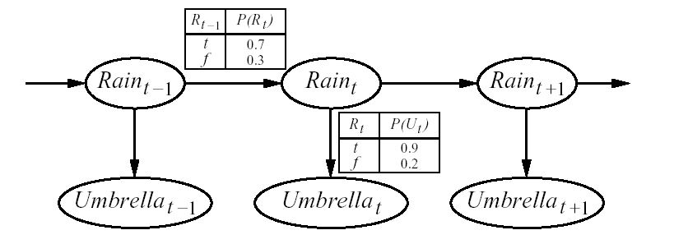
Simple Example
(We’ll use this as a running example)
Guard stuck in a high-security bunker
Would like to know if it is raining outside
Can only tell by looking at whether his boss comes into the bunker with an umbrella every day
Transition model
State
variables
Observation model
Observable variables
Notes:
6
Temporal step size?

Slide 7
Useful inference in HMMs
In general (Filtering): compute the posterior distribution over the current state given all evidence to date
P(X_{t} | e_{0:t} )
Notes:
7

Slide 8
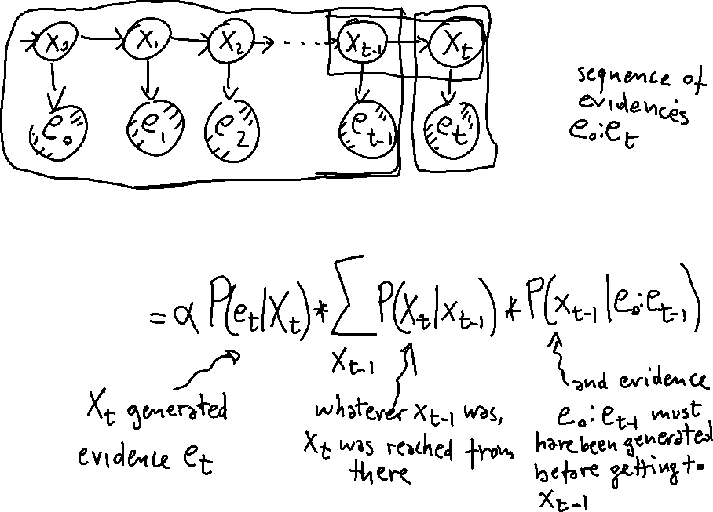
Intuitive Explanation for filtering recursive formula
P(X_{t} | e_{0:t} )
Notes:
8
We will examine this more formally when we discuss temporal models

Slide 9

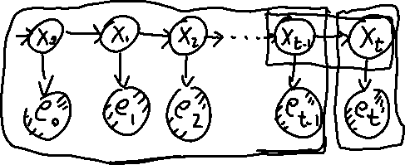
Filtering
Idea: recursive approach
  Compute filtering up to time t-1, and then include the evidence for time t (recursive estimation)‏
P(X_{t} | e_{0:t}) = P(X_{t} | e_{0:t-1},e_{t} ) dividing up the evidence
= α P(e_{t} | X_{t}, e_{0:t-1} ) P(X_{t} | e_{0:t-1} ) WHY?
= α P(e_{t} | X_{t}) P(X_{t} | e_{0:t-1} ) WHY?
  A. Bayes Rule
  B. Cond. Independence
  C. Product Rule
One step prediction of current state given evidence up to t-1
Inclusion of new evidence: this is available from..
P(A,B) = P(A|B)*P(B)
So we only need to compute P(X_{t} | e_{0:t-1} )
P(A|B) = α P(B|A)*P(A)
Notes:
9
It is bayes but using a general form (not the standard one) and also the “normalized” form
This is a clicker question for two questions, the two WHY
Product Rule, just the definition of conditional probability (see lectures in 322!) P(A,B) = P(A|B)*P(B)

Slide 12
Filtering
why?
Prove it?
Compute P(X_{t} | e_{0:t-1} )
  P(X_{t} | e_{0:t-1} ) = ∑_{xt-1} P(X_{t}, x_{t-1} |e_{0:t-1} ) = ∑_{xt-1} P(X_{t} | x_{t-1} , e_{0:t-1} ) P( x_{t-1} | e_{0:t-1} ) =
  = ∑_{xt-1} P(X_{t} | x_{t-1} ) P( x_{t-1} | e_{0:t-1} ) because of..
Transition model!
Filtering at time t-1
Putting it all together, we have the desired recursive formulation
P(X_{t} | e_{0:t}) = = α P(e_{t} | X_{t}) P(X_{t} | e_{0:t-1} ) (previous slide)
P(X_{t} | e_{0:t}) = α P(e_{t} | X_{t}) ∑_{xt-1} P(X_{t} | x_{t-1} ) P( x_{t-1} | e_{0:t-1} )
Inclusion of new evidence
(sensor model)‏
Filtering at time t-1
Propagation to time t
P( X_{t-1} | e_{0:t-1} ) can be seen as a message f_{0:t-1} that is propagated forward along the sequence, modified by each transition and updated by each observation
Notes:
12

Slide 13
“moving” the conditioning

Slide 14
Filtering
Thus, the recursive definition of filtering at time t in terms of filtering at time t-1 can be expressed as a FORWARD procedure
  f_{0:t} = α FORWARD (f_{0:t-1}, e_{t})
which implements the update described in
P(X_{t} | e_{0:t}) = α P(e_{t} | X_{t}) ∑_{xt-1} P(X_{t} | x_{t-1} ) P( x_{t-1} | e_{0:t-1} )
Filtering at time t-1
Inclusion of new evidence
(sensor model)
Propagation to time t
Notes:
14

Slide 15
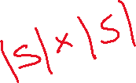
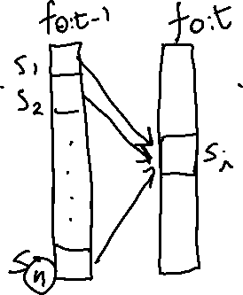
Analysis of Filtering
Because of the recursive definition in terms for the forward message, when all variables are discrete the time for each update is constant (i.e. independent of t )
The constant depends of course on the size of the state space
Notes:
15
and the type of temporal model (more subtle)

Slide 16
Rain Example
Suppose our security guard came with a prior belief of 0.5 that it rained on day 0, just before the observation sequence started.
Without loss of generality, this can be modelled with a fictitious state R₀ with no associated observation and P(R₀) = <0.5, 0.5>
Day 1: umbrella appears (u₁). Thus
  P(R₁ | e_{0:t-1} ) = P(R₁) = ∑_{r0} P(R₁ | r₀ ) P(r₀ )
  = <0.7, 0.3> * 0.5 + <0.3,0.7> * 0.5 = <0.5,0.5>
0.5
0.5
TRUE 0.5
FALSE 0.5
Rain₀
Rain₁
Rain₂
R_{t-1} | P(R_{t})
t f | 0.7 0.3
R_{t} | P(U_{t})
t f | 0.9 0.2
Umbrella₁
Umbrella₂
Notes:
16

Slide 17
Rain Example
Updating this with evidence from for t =1 (umbrella appeared) gives
  P(R₁| u₁) = α P(u₁ | R₁) P(R₁) =
  α<0.9, 0.2><0.5,0.5> = α<0.45, 0.1> ~ <0.818, 0.182>
Day 2: umbella appears (u₂). Thus
  P(R₂ | e_{0:t-1} ) = P(R₂ | u₁ ) = ∑_{r1} P(R₂ | r₁ ) P(r₁ | u₁) =
  = <0.7, 0.3> * 0.818 + <0.3,0.7> * 0.182 ~ <0.627,0.373>
0.5
0.5
0.627
0.373
TRUE 0.5
FALSE 0.5
0.818
0.182
Rain₀
Rain₁
Rain₂
R_{t-1} | P(R_{t})
t f | 0.7 0.3
R_{t} | P(U_{t})
t f | 0.9 0.2
Umbrella₁
Umbrella₂
Notes:
17

Slide 18
Rain Example
Updating this with evidence from for t =2 (umbrella appeared) gives
  P(R₂| u₁ , u₂) = α P(u₂ | R₂) P(R₂| u₁) =
  α<0.9, 0.2><0.627,0.373> = α<0.565, 0.075> ~ <0.883, 0.117>
Intuitively, the probability of rain increases, because the umbrella appears twice in a row
0.5
0.5
0.627
0.373
TRUE 0.5
FALSE 0.5
0.818
0.182
0.883
0.117
Rain₀
Rain₁
Rain₂
Umbrella₁
Umbrella₂
Notes:
18

Slide 19
Practice exercise (home)
Compute filtering at t₃ if the 3rd observation/evidence is no umbrella (will put solution on inked slides)

Slide 20
Lecture Overview
Filtering (posterior distribution over the current state given evidence to date)
  From intuitive explanation to formal derivation
  Example
  Prediction (posterior distribution over a future state given evidence to date)
(start) Smoothing (posterior distribution over a past state given all evidence to date)
Notes:
Filtering (posterior distribution over the current state given evidence to date)
Prediction (posterior distribution over a future state given evidence to date
Smoothing (posterior distribution over a past state given all evidence to date)
Most Likely Sequence (given the evidence seen so far)

Slide 21
Prediction P(X_{t+k+1} | e_{0:t} )
Can be seen as filtering without addition of new evidence
In fact, filtering already contains a one-step prediction
  P(X_{t} | e_{0:t}) = α P(e_{t} | X_{t}) ∑_{xt-1} P(X_{t} | x_{t-1} ) P( x_{t-1} | e_{0:t-1} )
Filtering at time t-1
Inclusion of new evidence
(sensor model)‏
Propagation to time t
We need to show how to recursively predict the state at time t+k +1 from a prediction for state t + k
  P(X_{t+k+1} | e_{0:t} ) = ∑_{xt+k} P(X_{t+k+1}, x_{t+k} |e_{0:t} ) = ∑_{xt+k} P(X_{t+k+1} | x_{t+k} , e_{0:t} ) P( x_{t+k} | e_{0:t} ) =
  = ∑_{xt+k} P(X_{t+k+1} | x_{t+k} ) P( x_{t+k} | e_{0:t} )
Let‘s continue with the rain example and compute the probability of Rain on day four after having seen the umbrella in day one and two: P(R₄| u₁ , u₂)
Prediction for state t+ k
Transition model
Notes:
21

Slide 22

Prediction P(X_{t+k+1} | e_{0:t} )
Can be seen as filtering without addition of new evidence
We need to show how to recursively predict the state at time t+k +1 from a prediction for state t + k
  P(X_{t+k+1} | e_{0:t} ) = ∑_{xt+k} P(X_{t+k+1}, x_{t+k} |e_{0:t} ) = ∑_{xt+k} P(X_{t+k+1} | x_{t+k} , e_{0:t} ) P( x_{t+k} | e_{0:t} ) =
  = ∑_{xt+k} P(X_{t+k+1} | x_{t+k} ) P( x_{t+k} | e_{0:t} )
Let‘s continue with the rain example and compute the probability of Rain on day four after having seen the umbrella in day one and two: P(R₄| u₁ , u₂)
Prediction for state t+ k
Transition model
Notes:
22

Slide 23
Rain Example
Prediction from day 2 to day 3
  P(X₃ | e_{1:2} ) = ∑_{x2} P(X₃ | x₂ ) P( x₂ | e_{1:2} ) = ∑_{r2} P(R₃ | r₂ ) P( r₂ | u₁ u₂ ) =
  = <0.7,0.3>*0.883 + <0.3,0.7>*0.117 = <0.618,0.265> + <0.035, 0.082>
  = <0.653, 0.347>
Prediction from day 3 to day 4
  P(X₄ | e_{1:2} ) = ∑_{x3} P(X₄ | x₃ ) P( x₃ | e_{1:2} ) = ∑_{r3} P(R₄ | r₃ ) P( r₃ | u₁ u₂ ) =
  = <0.7,0.3>*0.653 + <0.3,0.7>*0.347= <0.457,0.196> + <0.104, 0.243>
  = <0.561, 0.439>
0.5
0.5
0.627
0.373
0.653
0.347
0.561
0.439
0.5
0.5
0.818
0.182
0.883
0.117
Rain₀
Rain₁
Rain₂
Rain₃
Rain₄
R_{t-1} | P(R_{t})
t f | 0.7 0.3
Umbrella₁
Umbrella₂
Umbrella₃
Umbrella₄
Notes:
23

Slide 24
Lecture Overview
Filtering (posterior distribution over the current state given evidence to date)
  From intuitive explanation to formal derivation
  Example
  Prediction (posterior distribution over a future state given evidence to date)
(start) Smoothing (posterior distribution over a past state given all evidence to date)
Notes:
Filtering (posterior distribution over the current state given evidence to date)
Prediction (posterior distribution over a future state given evidence to date
Smoothing (posterior distribution over a past state given all evidence to date)
Most Likely Sequence (given the evidence seen so far)

Slide 25
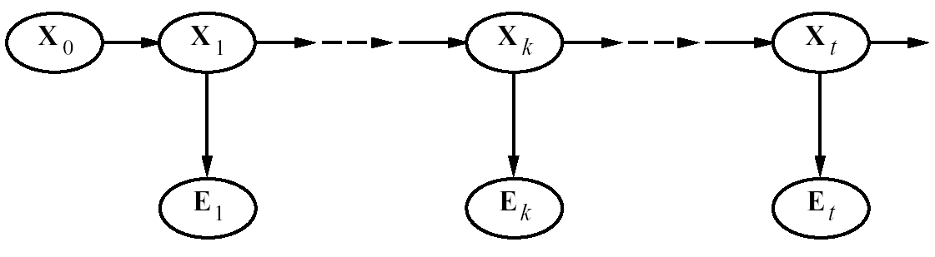
Smoothing
Smoothing: Compute the posterior distribution over a past state given all evidence to date
  P(X_{k} | e_{0:t} ) for 1 ≤ k < t
E₀
Notes:
25

Slide 26
Smoothing
P(X_{k} | e_{0:t}) = P(X_{k} | e_{0:k},e_{k+1:t} ) dividing up the evidence
= α P(X_{k} | e_{0:k} ) P(e_{k+1:t} | X_{k}, e_{0:k} ) using…
= α P(X_{k} | e_{0:k} ) P(e_{k+1:t} | X_{k}) using…
forward message from filtering up to state k,
f _{0:k}
backward message,
b _{k+1:t}
computed by a recursive process that runs backwards from t
Notes:
26

Slide 27
Smoothing
P(X_{k} | e_{0:t}) = P(X_{k} | e_{0:k},e_{k+1:t} ) dividing up the evidence
= α P(X_{k} | e_{0:k} ) P(e_{k+1:t} | X_{k}, e_{0:k} ) using Bayes Rule
= α P(X_{k} | e_{0:k} ) P(e_{k+1:t} | X_{k}) By Markov assumption on evidence
forward message from filtering up to state k,
f _{0:k}
backward message,
b _{k+1:t}
computed by a recursive process that runs backwards from t
Notes:
27
Conditional independence

Slide 28
Learning Goals for today’s class
You can:
Describe Filtering and derive it by manipulating probabilities
Describe Prediction and derive it by manipulating probabilities
Describe Smoothing and derive it by manipulating probabilities

Slide 29
TODO for Fri
Revised today’s slides carefully
Keep Reading Textbook Chp 8.5
Keep working on assignment-2 (due on Mon, Mar 1)

