Slide 1
Intelligent Systems (AI-2)
Computer Science cpsc422, Lecture 12
Feb, 5, 2021
Slide credit: some slides adapted from Stuart Russell (Berkeley)

Slide 2
Lecture Overview
Recap of Forward and Rejection Sampling
Likelihood Weighting
Monte Carlo Markov Chain (MCMC) – Gibbs Sampling
Application Requiring Approx. reasoning

Slide 3
Sampling
The building block on any sampling algorithm is the generation of samples from a known (or easy to compute, like in Gibbs) distribution
We then use these samples to derive estimates of probabilities hard-to-compute exactly
And you want consistent sampling methods... More samples... Closer to...

Slide 4



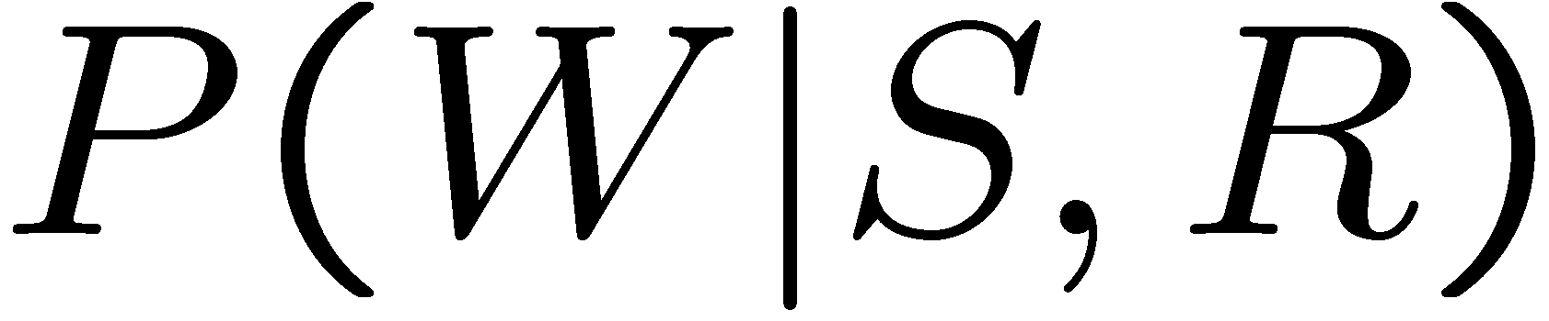
Prior Sampling
+
-
+c | 0.5
-c | 0.5
Cloudy
Cloudy
+c | +s | 0.1
 | -s | 0.9
-c | +s | 0.5
 | -s | 0.5
+c | +r | 0.8
 | -r | 0.2
-c | +r | 0.2
 | -r | 0.8
Sprinkler
Sprinkler
Rain
Rain
WetGrass
WetGrass
Samples:
+s | +r | +w | 0.99
 |  | -w | 0.01
 | -r | +w | 0.90
 |  | -w | 0.10
-s | +r | +w | 0.90
 |  | -w | 0.10
 | -r | +w | 0.01
 |  | -w | 0.99
+c, -s, +r, +w
-c, +s, -r, +w
…

Slide 5





Example
We’ll get a bunch of samples from the BN:
  +c, -s, +r, +w
  +c, +s, +r, +w
  -c, +s, +r, -w
  +c, -s, +r, +w
  -c, -s, -r, +w
Cloudy
Sprinkler
Rain
WetGrass
From these samples you can compute any distribution involving the four vars... P(W), P(S)…P(S,R)..
Notes:
<+w:0.8, -w:0.2>

Slide 6
Example
  Can estimate anything else from the samples, besides P(W), P(S) , etc:
  +c, -s, +r, +w
  +c, +s, +r, +w
  -c, +s, +r, -w
  +c, -s, +r, +w
  -c, -s, -r, +w
  What about P(C| +w)? P(C| +r, +w)? P(C| +r, -w)?
Cloudy
Sprinkler
Rain
WetGrass
  Can use/generate fewer samples when we want to estimate a probability conditioned on evidence?
Notes:
P(C| +w)? P(C| +r, +w)? P(C| -r, -w)?

Slide 7

Rejection Sampling
C
Let’s say we want P(W| +s)
  ignore (reject) samples which don’t have S=+s
  This is called rejection sampling
  It is also consistent for conditional probabilities (i.e., correct in the limit)
S
R
W
  +c, -s, +r, +w
  +c, +s, +r, +w
  -c, +s, +r, -w
  +c, -s, +r, +w
  -c, -s, -r, +w
  But what happens if +s is rare?
  And if the number of evidence vars grows...
  A. Less samples will be rejected
  B. More samples will be rejected
  C. The same number of samples will be rejected
Notes:
He biggest problem with rejection sampling is that it end up rejecting so many samples!
The number of samples consistent with the evidence e drops exponentially as the number of
Evidence variables grows – unusable for complex problems

Slide 8
Likelihood Weighting
Problem with rejection sampling:
  If evidence is unlikely, you reject a lot of samples
  You don’t exploit your evidence as you sample
  Consider P(B|+a)
Idea: fix evidence variables and sample the rest
Problem?: sample distribution not consistent!
Solution: weight by probability of evidence given parents
  -b, -a
  -b, -a
  -b, -a
  -b, -a
  +b, +a
Burglary
Alarm
  -b +a
  -b, +a
  -b, +a
  -b, +a
  +b, +a
Burglary
Alarm
Notes:
An example of Importance Sampling!

Slide 9


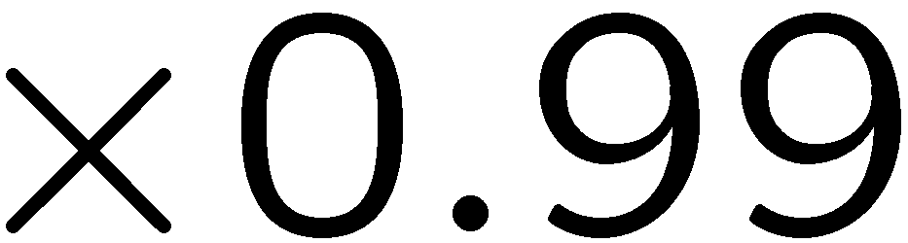
Likelihood Weighting
+
-
+
evidence
+c | 0.5
-c | 0.5
-
Cloudy
Cloudy
+c | +s | 0.1
 | -s | 0.9
-c | +s | 0.5
 | -s | 0.5
+c | +r | 0.8
 | -r | 0.2
-c | +r | 0.2
 | -r | 0.8
Sprinkler
Sprinkler
Rain
Rain
WetGrass
Samples:
WetGrass
+s | +r | +w | 0.99
 |  | -w | 0.01
 | -r | +w | 0.90
 |  | -w | 0.10
-s | +r | +w | 0.90
 |  | -w | 0.10
 | -r | +w | 0.01
 |  | -w | 0.99
+c
+s
+r
+w
…
Notes:
Initial weight is 1

Slide 10
Likelihood Weighting
+
-
+c | 0.5
-c | 0.5
+
evidence
-
Cloudy
+c | +s | 0.1
 | -s | 0.9
-c | +s | 0.5
 | -s | 0.5
+c | +r | 0.8
 | -r | 0.2
-c | +r | 0.2
 | -r | 0.8
Sprinkler
Sprinkler
Rain
Rain
WetGrass
What would be the weight for this sample?
+s | +r | +w | 0.99
 |  | -w | 0.01
 | -r | +w | 0.90
 |  | -w | 0.10
-s | +r | +w | 0.90
 |  | -w | 0.10
 | -r | +w | 0.01
 |  | -w | 0.99
+c, +s, -r, +w
  A 0.08
  B 0.02
  C. 0.005
Notes:
Initial weight is 1

Slide 11
Likelihood Weighting
Likelihood weighting is good
  We have taken evidence into account as we generate the sample
  All our samples will reflect the state of the world suggested by the evidence
  Uses all samples that it generates (much more efficient than rejection sampling)
Cloudy
C
S
Rain
R
Likelihood weighting doesn’t solve all our problems
  Evidence influences the choice of downstream variables, but not upstream ones (C isn’t more likely to get a value matching the evidence)
  Degradation in performance with large number of evidence vars -> each sample small weight
We would like to consider evidence when we sample every variable
W
Notes:
Because LW keeps using all the samples that it generates, it is much more efficient that Rejection Sampling
But performance still degrades when number of evidence variables increase
The more evidence variables, the more samples will have small weight
If one does not generate enough samples, the weighted estimate will be dominated by the small fraction of sample with substantial weight
One possible approach is to sample some of the variables, while using exact inference to generate the posterior probability for others

Slide 12
Lecture Overview
Recap of Forward and Rejection Sampling
Likelihood Weighting
Monte Carlo Markov Chain (MCMC) – Gibbs Sampling
Application Requiring Approx. reasoning

Slide 13
Markov Chain Monte Carlo
We would like to consider evidence when we sample every variable
Idea: instead of sampling from scratch, create samples that are each like the last one (only randomly change one var).
Initialize: assign all non-evidence variables randomly and fix evidence ones. E.g., for P(B|+c) assign A and B randomly and C to +c
B
A
C
+b
+a
+c
+b, +a, +c
Notes:
To flip a var in a fully instantiated BN you only need to multiply the prob of the var given its parents times the probs of all its children given their parents. Number of multiplication required is equal to the number of children

Slide 14
Markov Chain Monte Carlo
Idea: instead of sampling from scratch, create samples that are each like the last one (only randomly change one var).
Procedure: resample one variable at a time, conditioned on all the rest, but keep evidence fixed. E.g., for P(B|+c):
B
A
C
+b
+a
+c
-b
+a
+c
-b
-a
+c
+b, +a, +c
Sample a
Sample b
- b, +a, +c
- b, -a, +c
Sample b
Sample a
+ b, -a, +c
- b, -a, +c
Sample b
- b, -a, +c
Notes:
To flip a var in a fully instantiated BN you only need to multiply the prob of the var given its parents times the probs of all its children given their parents. Number of multiplication required is equal to the number of children

Slide 15
Markov Chain Monte Carlo
Properties: Now samples are not independent (in fact they’re nearly identical), but sample averages are still consistent estimators! And can be computed efficiently
What’s the point: when you sample a variable conditioned on all the rest, both upstream and downstream variables condition on evidence.
Open issue: what does it mean to sample a variable conditioned on all the rest ?
Notes:
To flip a var in a fully instantiated BN you only need to multiply the prob of the var given its parents times the probs of all its children given their parents. Number of multiplication required is equal to the number of children

Slide 16
Sample for X is conditioned on all the rest
A. I need to consider all the other nodes
B. I only need to consider its Markov Blanket
C. I only need to consider all the nodes not in the Markov Blanket
Notes:
A node is conditionally independent from all the other nodes in the network, given its parents, children, and children’s parents (i.e., its Markov Blanket )

Slide 17
Sample conditioned on all the rest
A node is conditionally independent from all the other nodes in the network, given its parents, children, and children’s parents (i.e., its Markov Blanket ) Configuration B

Slide 18
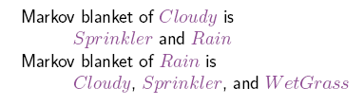
We want to sample Rain
Rain’ s Markov Blanket is
Cloudy
Cloudy
Sprinkler
Sprinkler
Rain
WetGrass
WetGrass
Note: need to sample a different prob.
Distribution for each configuration of the markov blanket

Slide 19
We want to sample Rain
+c | 0.5
-c | 0.5
Cloudy
Cloudy
+c | +s | 0.1
 | -s | 0.9
-c | +s | 0.5
 | -s | 0.5
+c | +r | 0.8
 | -r | 0.2
-c | +r | 0.2
 | -r | 0.8
Sprinkler
Sprinkler
Rain
WetGrass
WetGrass
+s | +r | +w | 0.99
 |  | -w | 0.01
 | -r | +w | 0.90
 |  | -w | 0.10
-s | +r | +w | 0.90
 |  | -w | 0.10
 | -r | +w | 0.01
 |  | -w | 0.99

Slide 20
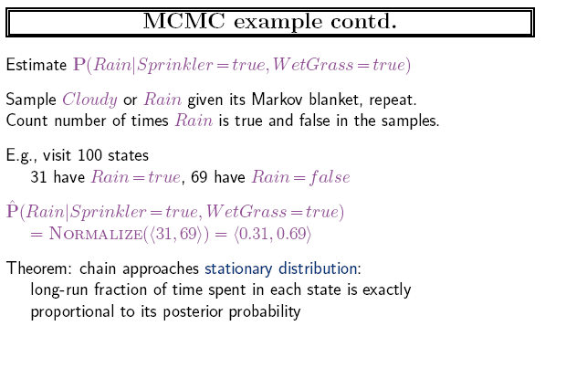
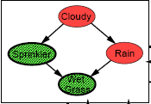
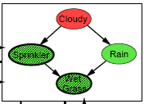
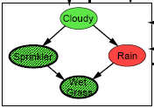
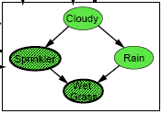
MCMC Example
Do it 100 times

Slide 21
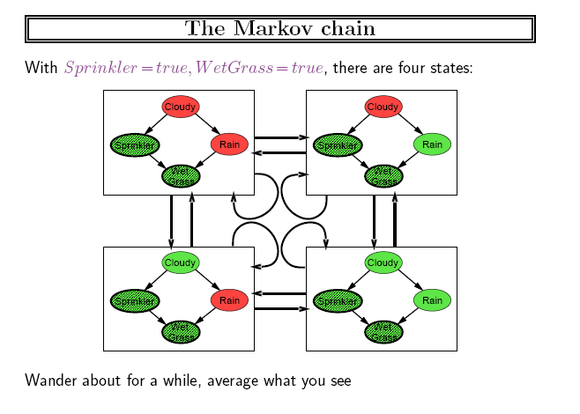
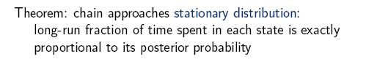
Why it is called Markov Chain MC
States of the chain are possible
samples (fully instantiated Bnet)
..given the evidence

Slide 22

Hoeffding’s inequality
Suppose p is the true probability and s is the sample average from n independent samples.
  p above can be the probability of any event for random variable X = {X₁,…X_{n}} described by a Bayesian network
If you want an infinitely small probability of having an error greater than ε, you need infinitely many samples
But if you settle on something less than infinitely small, let’s say δ, then you just need to set
So you pick
  the error ε you can tolerate,
  the frequency δ with which you can tolerate it
And solve for n, i.e., the number of samples that can ensure this performance
(1)‏
Notes:
However, if you are willing to have an error greater than ε in δ of the cases

Slide 23
Hoeffding’s inequality
Examples:
  You can tolerate an error greater than 0.1 only in 5% of your cases
  Set ε =0.1, δ = 0.05
  Equation (1) gives you n > 184
(1)‏
If you can tolerate the same error (0.1) only in 1% of the cases, then you need 265 samples
If you want an error greater than 0.01 in no more than 5% of the cases, you need 18,445 samples

Slide 24
Learning Goals for today’s class
You can:
Describe and justify the Likelihood Weighting sampling method
Describe and justify Markov Chain Monte Carlo sampling method
Describe and Apply Hoeffding’s inequality

Slide 25
TODO for Mon
Next research paper: Using Bayesian Networks to Manage Uncertainty in Student Modeling. Journal of User Modeling and User-Adapted Interaction 2002 Dynamic BN (required only up to page 400, do not have to answer the question “How was the system evaluated?)
Very influential paper 500+ citations
Follow instructions on course WebPage
<Readings>
Start working on assignment-2 (due on Mon, Mar 1)

Slide 26
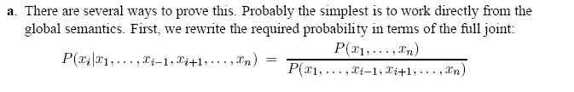
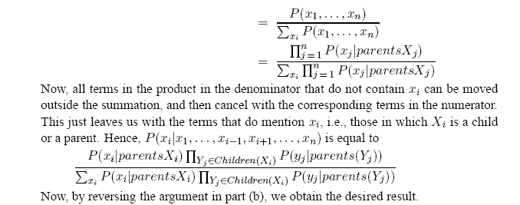
Not Required for 422
Proof for the formula computing the probability of a node given its markov blanket (which is the one you sample in Gibbs)

