Slide 1
Intelligent Systems (AI-2)
Computer Science cpsc422, Lecture 11
Feb, 03, 2021

Slide 2
StarAI (statistical relational AI)
Hybrid: Det +Sto
422 big picture
Parsing
Prob CFG
Prob Relational Models
Markov Logics
Deterministic
Stochastic
Belief Nets
Logics
Approx. : Gibbs
First Order Logics
Markov Chains and HMMs
Ontologies
Forward, Viterbi….
Approx. : Particle Filtering
Query
Full Resolution
SAT
Undirected Graphical Models
Markov Networks
Conditional Random Fields
Markov Decision Processes and
Partially Observable MDP
Planning
Value Iteration
Approx. Inference
Reinforcement Learning
Representation
Applications of AI
Reasoning
Technique
Notes:
Breadth and Depth

Slide 3
Lecture Overview
  Recap of BNs Representation and Exact Inference
  Start Belief Networks Approx. Reasoning
    Intro to Sampling
    First Naïve Approx. Method: Forward Sampling
    Second Method: Rejection Sampling (probably on Fri)

Slide 4



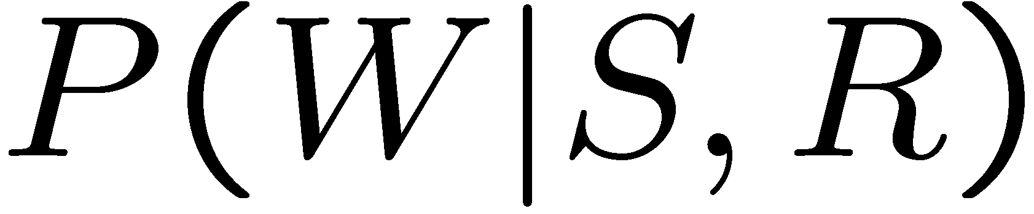
Bnet basic example: structure + cond. Prob.
+c | 0.5
-c | 0.5
Cloudy
+c | +s | 0.1
 | -s | 0.9
-c | +s | 0.5
 | -s | 0.5
+c | +r | 0.8
 | -r | 0.2
-c | +r | 0.2
 | -r | 0.8
Sprinkler
Rain
WetGrass
+s | +r | +w | 0.99
 |  | -w | 0.01
 | -r | +w | 0.90
 |  | -w | 0.10
-s | +r | +w | 0.90
 |  | -w | 0.10
 | -r | +w | 0.01
 |  | -w | 0.99

Slide 5
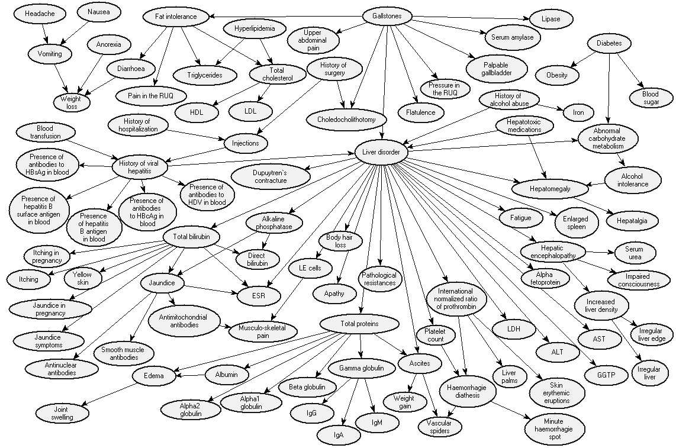
Realistic BNet: Liver Diagnosis
Source: Onisko et al., 1999

Slide 6
Revise (in)dependencies……

Slide 7
Conditional Independencies
Or, blocking paths for probability propagation. Three ways in which a path between X to Y can be blocked, (1 and 2 given evidence E )
Y
E
X
1
Z
Z
2
3
Z
  Note that, in 3, X and Y become dependent as soon as I get evidence on Z or on any of its descendants
Notes:
this is intuitive

Slide 8













Bnet basic example: independence
Cloudy
Sprinkler
Rain
WetGrass

Slide 9

Independence (Markov Blanket)
What is the minimal set of nodes that must be observed in order to make node X independent from all the non-observed nodes in the network

Slide 10
Independence (Markov Blanket)
A node is conditionally independent from all the other nodes in the network, given its parents, children, and children’s parents (i.e., its Markov Blanket ) Configuration B

Slide 11
Variable elimination algorithm: Summary
P(Z, Y₁…,Y_{j} , Z₁…,Z_{j} )
To compute P(Z| Y₁=v₁ ,… ,Y_{j}=v_{j} ) :
Construct a factor for each conditional probability.
Set the observed variables to their observed values.
Given an elimination ordering, simplify/decompose sum of products
  For all Z_{i} : Perform products and sum out Z_{i}
Multiply the remaining factors (all in ? )
Normalize: divide the resulting factor f(Z) by ∑_{Z} f(Z) .
Z
Notes:
They are all going to be only in Q

Slide 12





Variable elimination ordering
Is there only one way to simplify?
P(G,D=t) = ∑_{A,B,C,} f(A,G) f(B,A) f(C,G,A) f(B,C)
P(G,D=t) = ∑_{A} f(A,G) ∑_{B} f(B,A) ∑_{C} f(C,G,A) f(B,C)
P(G,D=t) = ∑_{A} f(A,G) ∑_{C} f(C,G,A) ∑_{B} f(B,C) f(B,A)
Notes:
The order in which the variables are summed out is called the elimination ordering
From textbook “Finding an elimination ordering that results in the smallest treewidth is NP-hard. However, some good heuristics exist. The most common is
min-factor: at each stage, select the variable that results in the smallest relation (factor). “

Slide 13
Complexity: Just Intuition…..
Tree-width of a network given an elimination ordering: max number of variables in a factor created while running VE.
Tree-width of a belief network : min tree-width over all elimination orderings (only on the graph structure and is a measure of the sparseness of the graph)
The complexity of VE is exponential in the tree-width ☹ and linear in the number of variables.
Also, finding the elimination ordering with minimum tree-width is NP-hard ☹ (but there are some good elimination ordering heuristics)
Notes:
The complexity of the algorithm depends on a measure of complexity of the network.
The size of a tabular representation of a factor is exponential in the number of variables in the factor.
In worst case scenario (e.g. fully connected network) exact inference is NP-hard
However space/time complexity is very sensitive to topology
In singly connected graphs (single path from any two nodes), time complexity of exact inference is polynomial in the number of nodes
Tree-width of a belief network : min tree-width over all elimination orderings? (only on the graph structure and is a measure of the sparseness of the graph)?

Slide 14
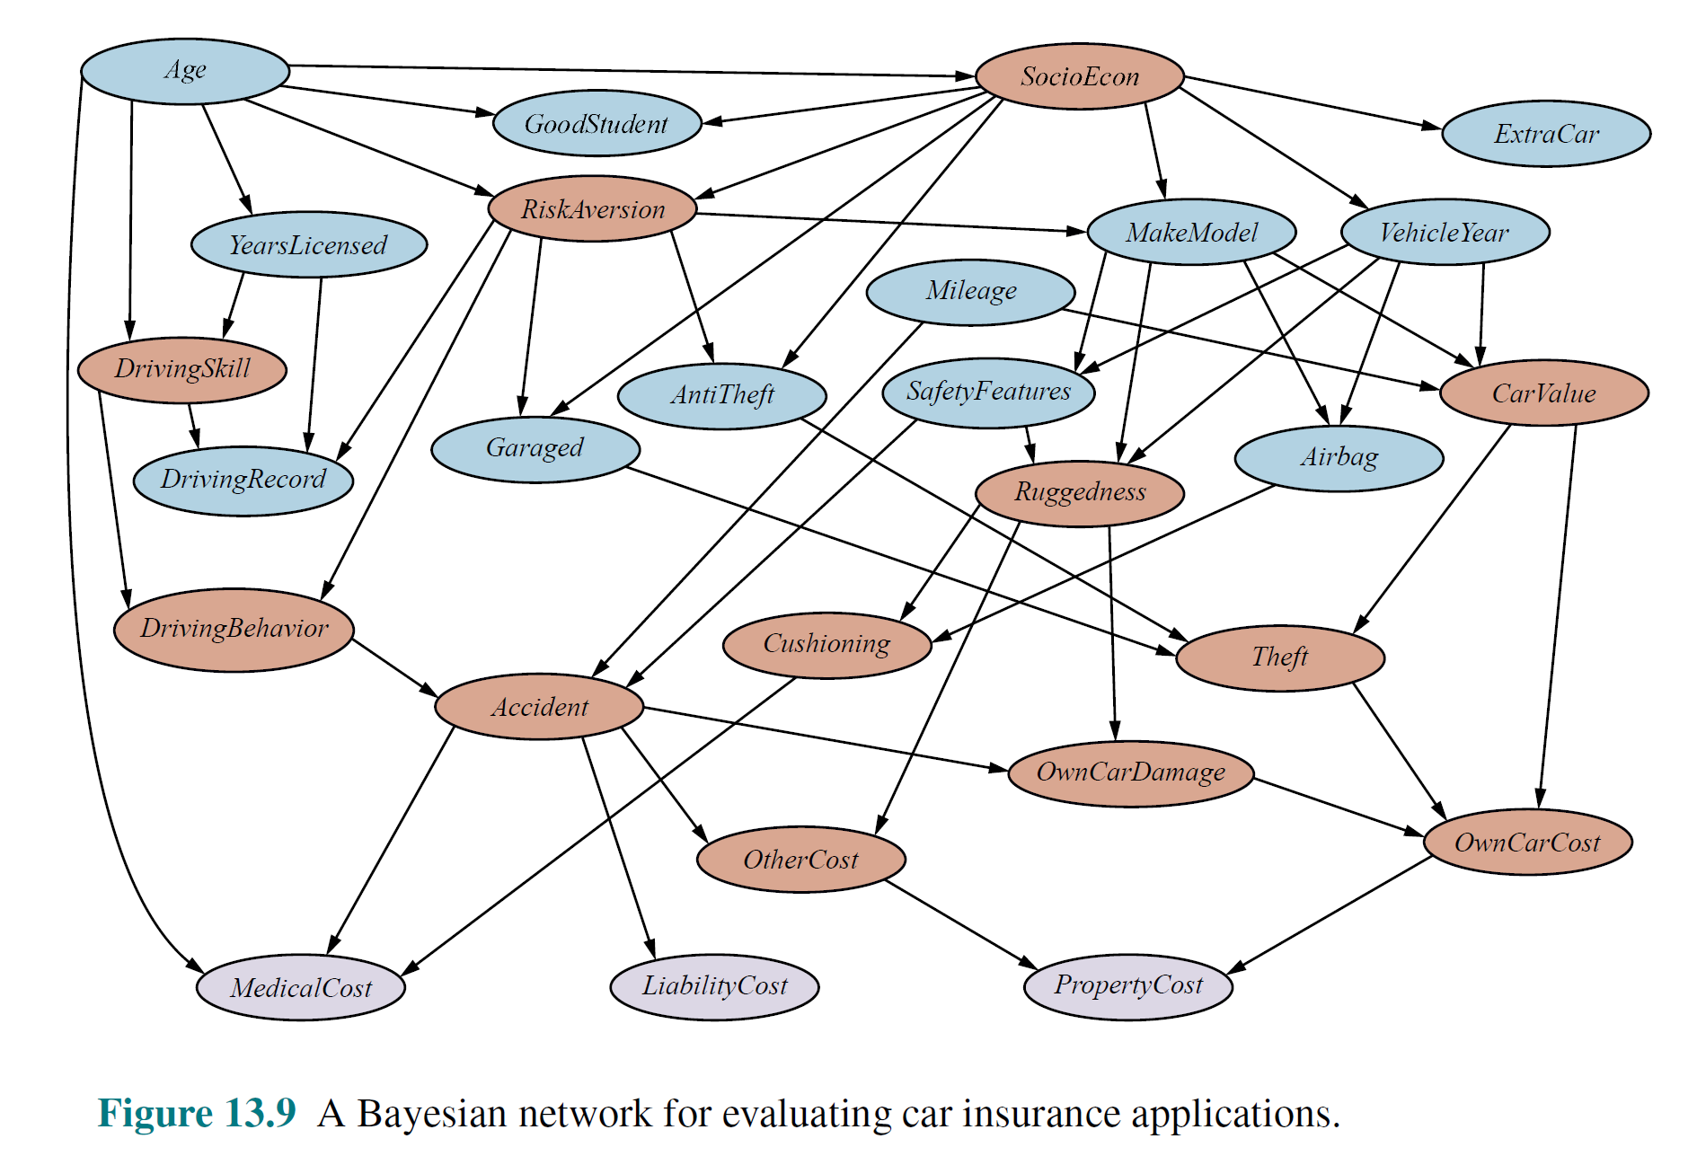
AIMA 4th Edition (Russell and Norvig) 2020

Slide 15
Lecture Overview
  Recap of BNs Representation and Exact Inference
  Start Belief Networks Approx. Reasoning
    Intro to Sampling
    First Naïve Approx. Method: Forward Sampling
    Second Method: Rejection Sampling
Notes:
In worst case scenario (e.g. fully connected network) exact inference is NP-hard
However space/time complexity is very sensitive to topology
In singly connected graphs (single path from any two nodes), time complexity of exact inference is polynomial in the number of nodes

Slide 16
Approximate Inference
Basic idea:
  Draw N samples from known prob. distributions
  Use those samples to estimate unknown prob. distributions
Why sample?
  Inference: getting a sample is faster than computing the right answer (e.g. with variable elimination)

Slide 17
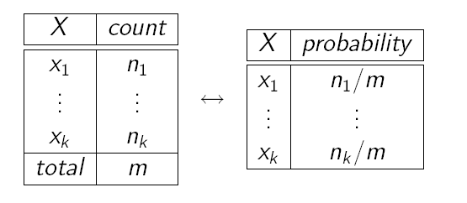
Sampling: What is it?
Idea: Estimate probabilities from sample data (samples) of the (unknown) probabilities distribution
Use frequency of each event in the sample data to approximate its probability
Frequencies are good approximations only if based on large samples
  we will see why and what “large” means
How do we get the samples?

Slide 18
We use Sampling
Sampling is a process to obtain samples adequate to estimate an unknown probability
How do we get samples?
Known prob. distribution(s)
Samples
Estimates for unknown (hard to compute) distribution(s)
Notes:
Sampling is a process to obtain samples adequate to estimate an unknown probability
The samples are generated from known probabilities distributions

Slide 19
Sampling
The building block on any sampling algorithm is the generation of samples from a know distribution
We then use these samples to derive estimates of probabilities hard-to-compute exactly

Slide 20
Generating Samples from a Known Distribution
For a random variable X with
  values {x₁,…,x_{k}}
  Probability distribution P(X) = {P(x₁),…,P(x_{k})}
Partition the interval [0, 1] into k intervals p_{i} , one for each x_{i} , with length P(x_{i} )
To generate one sample
    Randomly generate a value y in [0, 1] (i.e. generate a value from a uniform distribution over [0, 1].
    Select the value of the sample based on the interval p_{i} that includes y
From probability theory:
Notes:
Actually (0,1] interval of real numbers excluding 0 and including 1
(but this maybe confusing at first so let’s ignore it)

Slide 21
Sampling a discrete probability distribution (from 322)

Slide 22
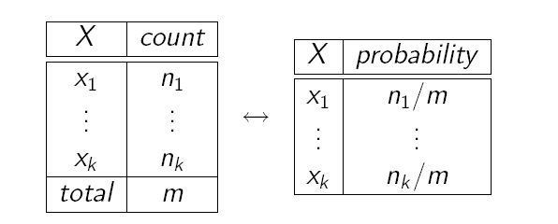
From Samples to Probabilities
Count total number of samples m
Count the number n_{i} of samples x_{i}
Generate the frequency of sample x_{i} as n_{i} / m
This frequency is your estimated probability of x_{i}

Slide 23
Sampling for Bayesian Networks
OK, but how can we use all this for probabilistic inference in Bayesian networks?
As we said earlier, if we can’t use exact algorithms to update the network, we need to resort to samples and frequencies to compute the probabilities we are interested in
We generate these samples by relying on the mechanism we just described

Slide 24
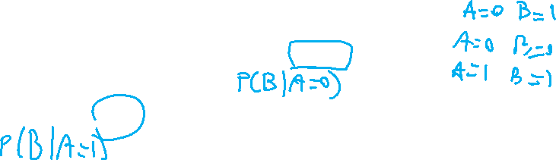

Sampling for Bayesian Networks (N)
Suppose we have the following BN with two binary variables
  P(A)
A=1 | 0.3
A=0 | 0.7
A
A=1 | B=1 | 0.7
 | B=0 | 0.3
A-0 | B=1 | 0.1
 | B=0 | 0.9
  P(B|A)
B
It corresponds to the joint probability distribution
  P(A,B) =P(B|A)P(A)
To sample from P(A,B) i.e., unknown distribution
  we first sample from P(A). Suppose we get A = 0.
  In this case, we then sample from….
  If we had sampled A = 1, then in the second step we would have sampled from
Notes:
It represents P(A,B) in a compact way
How can we generate samples for P(A,B)
First sample P(A) and depending on the value you obtain then sample the corresponding distribution in P(B|A)

Slide 25
Prior (Forward) Sampling
+
-
+c | 0.5
-c | 0.5
Cloudy
Cloudy
+c | +s | 0.1
 | -s | 0.9
-c | +s | 0.5
 | -s | 0.5
+c | +r | 0.8
 | -r | 0.2
-c | +r | 0.2
 | -r | 0.8
Sprinkler
Sprinkler
Rain
Rain
WetGrass
WetGrass
Samples:
+s | +r | +w | 0.99
 |  | -w | 0.01
 | -r | +w | 0.90
 |  | -w | 0.10
-s | +r | +w | 0.90
 |  | -w | 0.10
 | -r | +w | 0.01
 |  | -w | 0.99
+c, -s, +r, +w
-c, +s, -r, +w
…

Slide 26
Example
We’ll get a bunch of samples from the BN:
  +c, -s, +r, +w
  +c, +s, +r, +w
  -c, +s, +r, -w
  +c, -s, +r, +w
  -c, -s, -r, +w
If we want to know P(W)
  We have counts <+w:4, -w:1>
  Normalize to get P(W) =
  This will get closer to the true distribution with more samples
Cloudy
Sprinkler
Rain
WetGrass
Notes:
<+w:0.8, -w:0.2>

Slide 27
Example
  Can estimate anything else from the samples, besides P(W), P(R) , etc:
  +c, -s, +r, +w
  +c, +s, +r, +w
  -c, +s, +r, -w
  +c, -s, +r, +w
  -c, -s, -r, +w
  What about P(C| +w)? P(C| +r, +w)? P(C| -r, -w)?
Cloudy
Sprinkler
Rain
WetGrass
  Can use/generate fewer samples when we want to estimate a probability conditioned on evidence?
Notes:
P(C| +w)? P(C| +r, +w)? P(C| -r, -w)?

Slide 28

Rejection Sampling
C
Let’s say we want P(S| +r, +w)
  Ignore (reject) samples which don’t have W=+w
  This is called rejection sampling
  It is also consistent for conditional probabilities (i.e., correct in the limit)
S
R
W
  +c, -s, -r, +w
  +c, +s, +r, +w
  -c, +s, +r, -w
  +c, -s, +r, +w
  -c, -s, -r, +w
  See any problem as the number of evidence vars increases?
  Or the evidence is rare…
Notes:
He biggest problem with rejection sampling is that it end up rejecting so many samples!
The number of samples consistent with the evidence e drops exponentially as the number of
Evidence variables grows – unusable for complex problems
Let’s say we want P(S)
No point keeping all samples around
Just tally counts of S as we go

Slide 29
Rejection Sampling
C
Let’s say we want P(S| +w)
  Ignore (reject) samples which don’t have W=+w
  This is called rejection sampling
  It is also consistent for conditional probabilities (i.e., correct in the limit)
S
R
W
  +c, -s, +r, +w
  +c, +s, +r, +w
  -c, +s, +r, -w
  +c, -s, +r, +w
  -c, -s, -r, +w
  See any problem as the number of evidence vars increases?
Notes:
He biggest problem with rejection sampling is that it end up rejecting so many samples!
The number of samples consistent with the evidence e drops exponentially as the number of
Evidence variables grows – unusable for complex problems
Let’s say we want P(S)
No point keeping all samples around
Just tally counts of S as we go

Slide 30
References to applications to climate change and healthcare……..

Slide 31
Bnets to assess and manage Climate Change
Journal of Environmental Management
Volume 202, Part 1, 1 November 2017, Pages 320-331
Reviewing Bayesian Networks potentials for climate change impacts assessment and management: A multi-risk perspective
AnnaSperotto^{ab}José LuisMolina^{c}SilviaTorresan^{ab}AndreaCritto^{ab}AntonioMarcomini^{ab}
Notes:
Highlights
•Bayesian Networks applications for environmental management are critically reviewed.
•Potentials of Bayesian Networks for climate change multi-risk assessment are discussed.
•Main limitations are highlighted and future developments suggested.
Abstract
The evaluation and management of climate change impacts on natural and human systems required the adoption of a multi-risk perspective in which the effect of multiple stressors, processes and interconnections are simultaneously modelled. Despite Bayesian Networks (BNs) are popular integrated modelling tools to deal with uncertain and complex domains, their application in the context of climate change still represent a limited explored field. The paper, drawing on the review of existing applications in the field of environmental management, discusses the potential and limitation of applying BNs to improve current climate change risk assessment procedures. Main potentials include the advantage to consider multiple stressors and endpoints in the same framework, their flexibility in dealing and communicate with the uncertainty of climate projections and the opportunity to perform scenario analysis. Some limitations (i.e. representation of temporal and spatial dynamics, quantitative validation), however, should be overcome to boost BNs use in climate change impacts assessment and management.

Slide 32
One Recent Example from that review
Environmental Modelling & Software Journal
Volume 80, June 2016, Pages 132-142
A Bayesian Belief Network to assess rate of changes in coral reef ecosystems
Coral Reef Research Unit, University of Essex, United Kingdom
St. George's University, Grenada
Department of Computer Science, Brunel University, United Kingdom

Slide 33
Carbonate Budget BBN (CARBNET)
We propose a Bayesian Belief Network (BBN) approach, which offers a methodological framework to address uncertainty (Bennett et al., 2013, Kelly et al., 2013).
Can aid sustainable coral reef management and prevent further decline.
Help evaluate effects of anthropogenic and climatic disturbances on the reef framework
Consider impacts of implementing management interventions or decision options in order to maximize their benefit (Uusitalo et al., 2015).
CARBNET: developed to evaluate coral reef CaCO₃ (carbonate) balance under changing environmental conditions and across reef bioregions.
Notes:
A comprehensive approach that integrates uncertainty, can aid sustainable coral reef management and prevent further decline. Although, it is impossible to predict with certainty the result of management decisions, it is important to provide decision-makers with models that consider the impacts of implementing management interventions or decision options in order to maximize their benefit (Uusitalo et al., 2015). Therefore, to evaluate the effects of anthropogenic and climatic disturbances on the reef framework, we propose a Bayesian Belief Network (BBN) approach, which offers a methodological framework to address uncertainty (Bennett et al., 2013, Kelly et al., 2013).
The graphical structure of BBNs is particularly relevant in ecosystem management since it facilitates a participatory approach during the development of the model and provides a user-friendly framework to communicate the results (Marcot et al., 2001, Borsuk et al., 2004, Jakeman et al., 2006, Aguilera et al., 2011, Chen and Pollino, 2012, Vilizzi et al., 2013). Extensive reviews of the use of BBN for environmental modelling can be found in Aguilera et al. (2011) and Chen and Pollino (2012).
The Carbonate Budget BBN (CARBNET) was developed to evaluate coral reef carbonate balance under changing environmental conditions and across reef bioregions. The aim was to identify those disturbances and pressures that exert the greatest influence in modifying the reef framework CaCO₃ (carbonate) budgetary state.

Slide 34
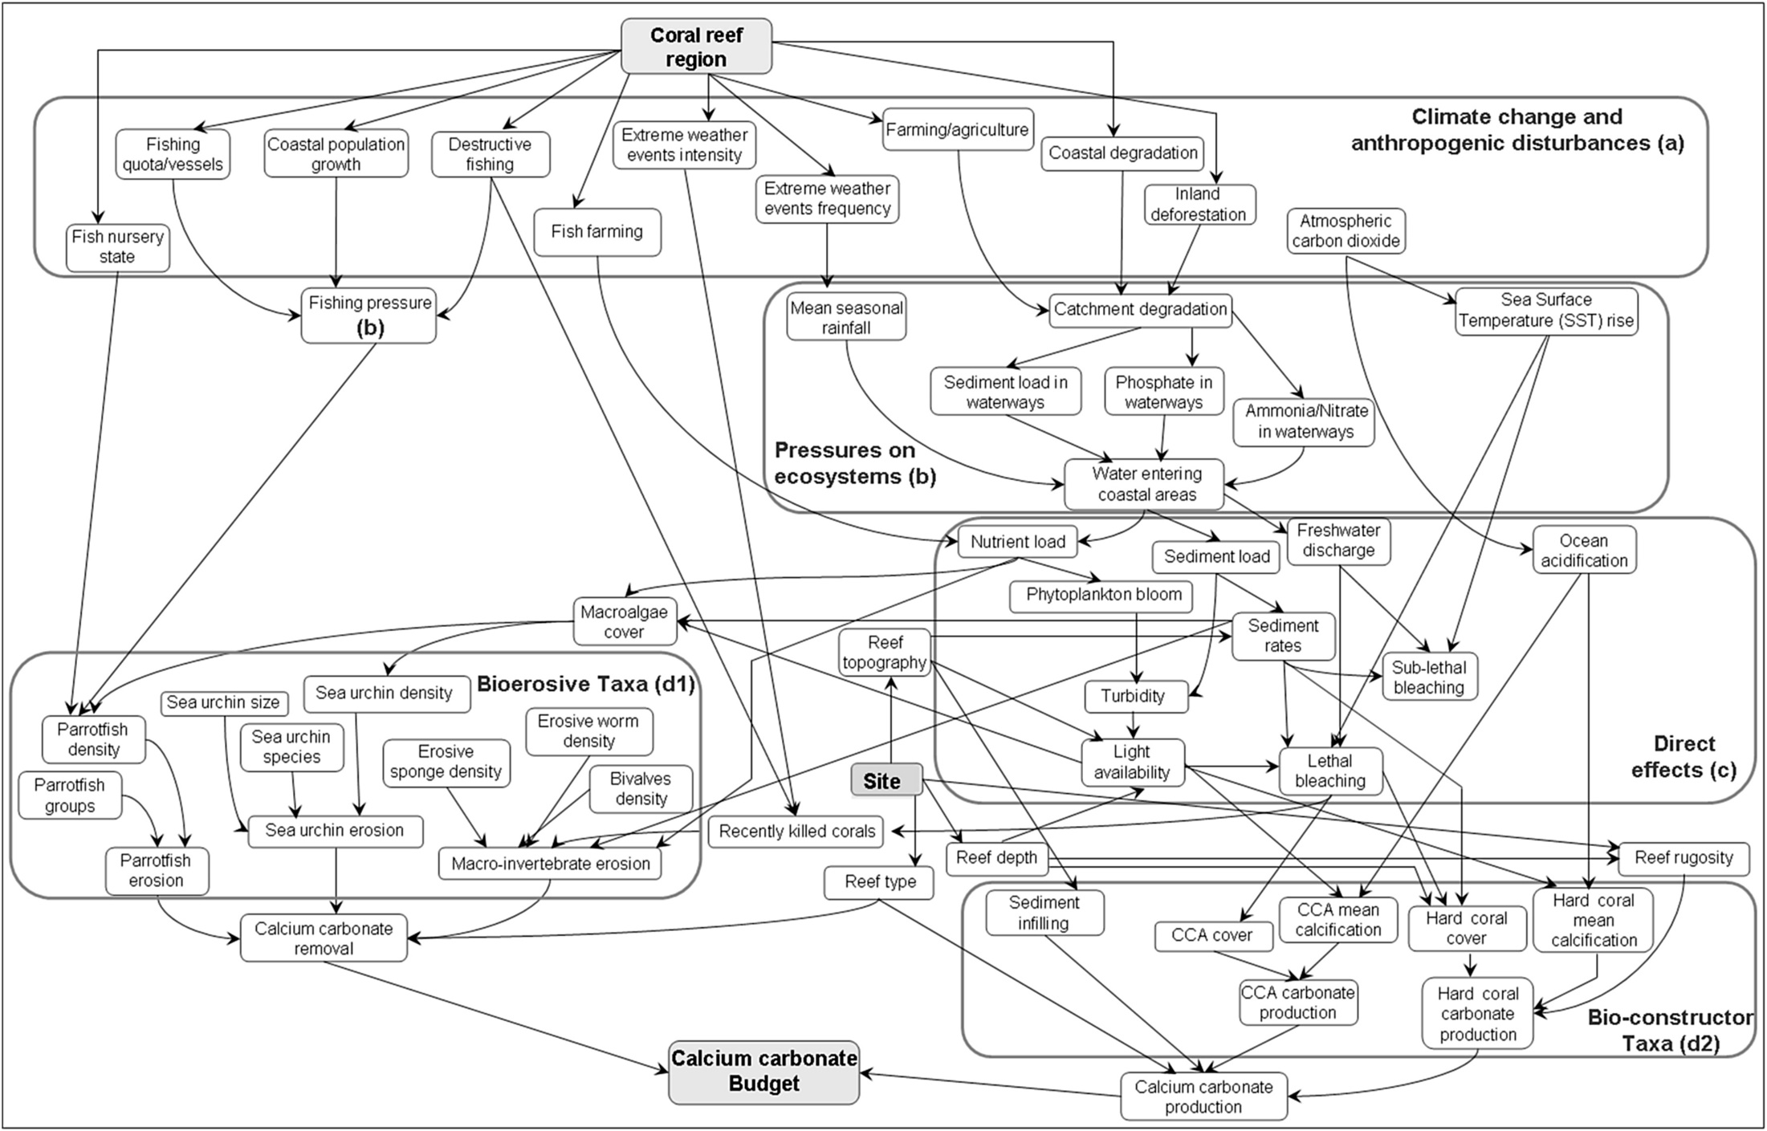
58 nodes and 94 cause-effects links.

Slide 35
CARBNET Engineering
Variables identified through literature search
Nodes representing different levels of spatial resolution were used to capture changes that may occur at different spatial scales.
Presence/absence of reef-building and erosive organisms or reef growth and erosion processes are captured at the smallest scale of reef depth, but also for an entire reef (‘Site’), sub-region (‘Reef type’, ‘Reef topography’) or region (‘Coral reef region’).
The CARBNET conceptualisation was proposed to twenty experts in the field of coral reef management and ecology to identify flaws in the network structure and address structural bias before model parameterisation.
Notes:
2.1.1. Identification of the variables composing CARBNET network
In CARBNET, variables contributing to coral reef framework growth and destruction were identified through a literature search with the key words ‘carbonate budget + coral reef’, ‘CaCO₃ budget + coral reef’ and ‘calcium carbonate budget + coral reef’ conducted in ISI Web of Science (Reuters) and Reefbase (http://www.reefbase.org) between November 2010 and January 2011. The variables composing the network were selected among those that defined the quantitative contribution of the reef-building and bioerosive taxa to the reef carbonate budget (see Appendix A). Reef-building organisms were identified as calcifying organisms (i.e. hard corals, crustose coralline algae and epibionts) that contribute to biogenic carbonate production and deposition. Bioeroders were identified as organisms contributing to chemical or mechanical removal of carbonate from the reef framework while grazing on (i.e. sea urchins and parrotfish) or boring into (i.e. sponges, bivalves, sipunculans, polychaetes and euendoliths) the reef substrate.
Climatic and anthropogenic disturbances and pressures were also included in the network to determine the extent to which impacts affect reef preservation and carbonate balance. In this paper we refer to disturbances as ‘actions’ (e.g. logging) that can translate into increasing pressures (e.g. sedimentation and eutrophication) on the ecosystem, leading to likely changes in the state of the reef communities (response), that as a consequence, may impact reef framework functionality. Many of these disturbances included those arising from climate change, such as sea surface temperature rise, ocean acidification and increasing occurrence of hurricane or cyclones, as well as disturbances from human activities including destructive fishing practices, inland deforestation, coastal degradation and fish farming. In light of increasing regional and global anthropogenic and climate change disturbances, features giving information on the effects of disturbances on reef ecosystem and communities, allowed for ‘what if’ analysis, providing the basis to underpin changes in the framework CaCO₃ budgetary state (Cooper et al., 2009, Burke et al., 2011), as well as illustrating the effects that implemented management interventions may have on preserving coral reef framework. Disturbance and pressure variables were identified among the carbonate budget studies that assessed changes in the CaCO₃ budgetary state, relative to climatic and anthropogenic impacts (Table A.2, Appendix A), as well as from the Reefs at Risk tool (Burke et al., 2002, Burke and Maidens, 2004, Burke et al., 2011, Burke et al., 2012) where threats to the world's coral reefs are described through map-based indicators (Table A.3, Appendix A).
As part of this review, the information was conceptualised in a diagram (not shown) in which dependencies were identified among variables including the ‘Calcium carbonate budget’ response node.

Slide 36
Rate of changes of the reef framework have been largely investigated through carbonate budget assessments that estimate contribution from reef-building (e.g. hermatypic corals, crustose coralline algae) and bioerosive (e.g. sea urchins, sponges, parrotfish) organisms (Eakin, 1996, Eakin, 2001, Edinger et al., 2000, Hubbard et al., 1990, Mallela and Perry, 2007, Perry et al., 2013, Stearn and Scoffin, 1977). Coral reef structural integrity is associated with positive budgets that occur when calcium carbonate production exceeds the rate of erosion, whereas negative budgets occur generally as a result of changes in the natural reef processes (Perry et al., 2008, Kennedy et al., 2013).

Slide 37
In light of increasing regional and global anthropogenic and climate change disturbances, features giving information on the effects of disturbances on reef ecosystem and communities, allowed for ‘what if’ analysis, providing the basis to underpin changes in the framework CaCO₃ budgetary state (Cooper et al., 2009, Burke et al., 2011), as well as illustrating the effects that implemented management interventions may have on preserving coral reef framework.
2.1.2. CARBNET structure evaluation
The CARBNET conceptualisation was proposed to twenty experts in the field of coral reef management and ecology to identify flaws in the network structure and address structural bias before model parameterisation.

Slide 38
Nodes representing different levels of spatial resolution were used to capture changes that may occur at different spatial scales. Presence/absence of reef-building and erosive organisms or reef growth and erosion processes are captured at the smallest scale of reef depth, but also for an entire reef (‘Site’), sub-region (‘Reef type’, ‘Reef topography’) or region (‘Coral reef region’). For instance, the node ‘depth’ (states: shallow, mid and deep), relates depth-specific reef responses to reef growth and erosion, whilst the node ‘Reef topography’ relates the same processes to whole reef systems. The final model is composed of 58 nodes and 94 cause-effects links.

Slide 39
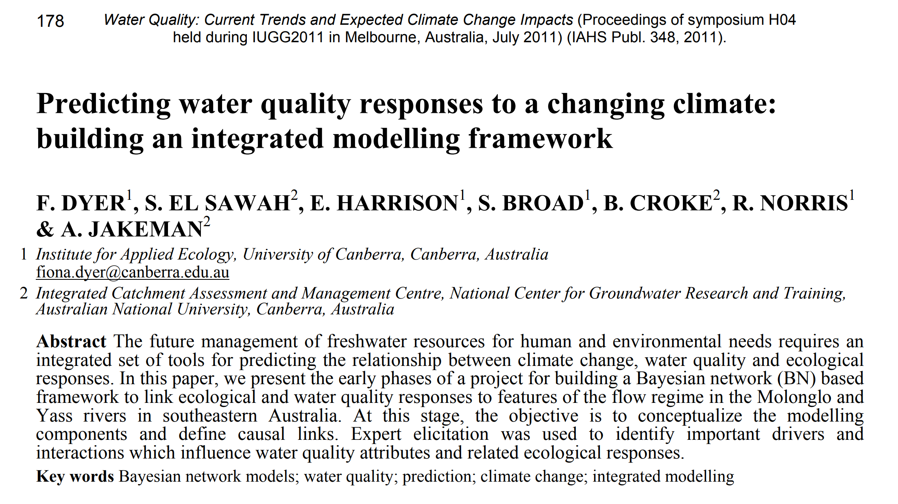
Another Example

Slide 40
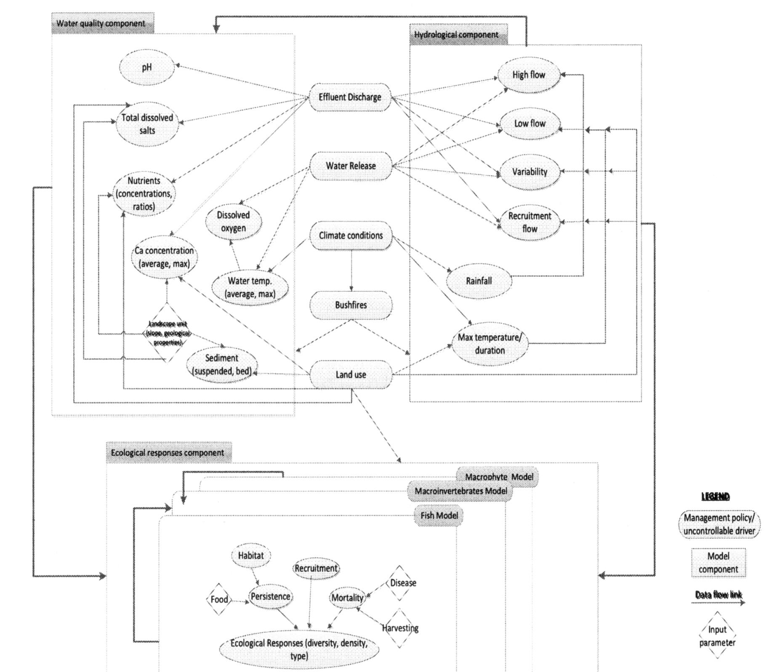
Corresponding BNet
A group of 14 experts and decision makers were involved in a half-day workshop to define the important variables, links and states of variables.
Notes:
The next phase of the project involves using available data to construct the conditional probability tables and populate the BN structure.

Slide 41
Many applications in Health Care
McLachlan S, Dube K, Hitman GA, Fenton NE, Kyrimi E ( 2020 ) . Bayesian networks in healthcare: Distribution by medical condition . Artificial Intelligence in Medicine vol. 107 , Article 101912 , 101912 - 101912 .10.1016/j.artmed.2020.101912
https://qmro.qmul.ac.uk/xmlui/handle/123456789/65190
Notes:
Martin Neil, Norman Fenton, Magda Osman & Scott McLachlan (2020) Bayesian network analysis of Covid-19 data reveals higher infection prevalence rates and lower fatality rates than widely reported, Journal of Risk Research, 23:7-8, 866-879, DOI: 10.1080/13669877.2020.1778771

Slide 42
Learning Goals for today’s class
You can:
Motivate the need for approx. inference in Bnets
Describe and compare Sampling from a single random variable
Describe and Apply Forward Sampling in BN
Describe and Apply Rejection Sampling

Slide 43
TODO for Fri
Read textbook
  8.6.3 Rejection Sampling
  8.6.4 Likelihood Weighting
Assignment-2 will be out tonight…
Next research paper will be this coming Mon

Slide 44

Hoeffding’s inequality
Suppose p is the true probability and s is the sample average from n independent samples.
  p above can be the probability of any event for random variable X = {X₁,…X_{n}} described by a Bayesian network
If you want an infinitely small probability of having an error greater than ε, you need infinitely many samples
But if you settle on something less than infinitely small, let’s say δ, then you just need to set
So you pick
  the error ε you can tolerate,
  the frequency δ with which you can tolerate it
And solve for n, i.e., the number of samples that can ensure this performance
(1)‏
Notes:
However, if you are willing to have an error greater than ε in δ of the cases

Slide 45
Hoeffding’s inequality
Examples:
  You can tolerate an error greater than 0.1 only in 5% of your cases
  Set ε =0.1, δ = 0.05
  Equation (1) gives you n > 184
(1)‏
If you can tolerate the same error (0.1) only in 1% of the cases, then you need 265 samples
If you want an error greater than 0.01 in no more than 5% of the cases, you need 18,445 samples

