Slide 1
Intelligent Systems (AI-2)
Computer Science cpsc422, Lecture 10
Feb, 1, 2021

Slide 2
Lecture Overview
Finish Reinforcement learning
Exploration vs. Exploitation
On-policy Learning (SARSA)
Scalability

Slide 6
Also keep the α_{κ}

Slide 7
What Does Q-Learning learn
Q-learning does not explicitly tell the agent what to do….
Given the Q-function the agent can……
…. either exploit it or explore more….
Any effective strategy should be greedy in the limit of infinite exploration (GLIE)
Try each action an unbounded number of times
Choose the predicted best action in the limit
We will look at two exploration strategies
ε-greedy
soft-max
Notes:
Q-learning does not explicitly tell the agent what to do
just computes a Q-function Q[s,a] that allows the agent to see, for every state, which is the action with the highest expected reward
Given a Q-function, there are two things that the agent can do:
Exploit the knowledge accumulated so far, and chose the action that maximizes Q[s,a] in a given state (greedy behavior)
Explore new actions, hoping to improve its estimate of the optimal Q-function, i.e. *do not chose* the action suggested by the current Q[s,a]
When to explore and when the exploit?
Never exploring may lead to being stuck in a suboptimal course of actions
Exploring too much is a waste of the knowledge accumulated via experience
MUST FIND A COMPROMISE

Slide 8
ε-greedy
Choose a random action with probability ε and choose best action with probability 1- ε
First GLIE condition (try every action an unbounded number of times) is satisfied via the ε random selection
What about second condition?
Select predicted best action in the limit.
reduce ε overtime!
Notes:
It always chooses the non-optimal action with probability ε, while ideally you would want to explore more at the beginning and become greedier as estimates become more accurate
But it is rather slow
It always chooses the non-optimal action with probability ε, while ideally you would want to do it less and less frequently overtime

Slide 9
Soft-Max
Takes into account improvement in estimates of expected reward function Q[s,a]
Choose action a in state s with a probability proportional to current estimate of Q[s,a]
Notes:
Tau is called a temperature parameter (in allusion to chemical kinetics). For high temperatures (tau -> infinite), all actions have nearly the same probability and the lower the temperature, the more expected rewards affect the probability. For a low temperature (tau -> 0), the probability of the action with the highest expected reward tends to 1.

Slide 10
Soft-Max
When in state s, Takes into account improvement in estimates of expected reward function Q[s,a] for all the actions
Choose action a in state s with a probability proportional to current estimate of Q[s,a]
τ (tau) in the formula above influences how randomly values should be chosen
if τ is high, >> Q[s,a]?
A. It will mainly exploit
B. It will mainly explore
C. It will do both with equal probability
Notes:
Tau to change the proportion of exploration exploitation over time

Slide 11
Lecture Overview
Finish Reinforcement learning
Exploration vs. Exploitation
On-policy Learning (SARSA)
RL scalability

Slide 12
Learning before vs. during deployment
Our learning agent can:
act in the environment to learn how it works (before deployment)
Learn as you go (after deployment)
If there is time to learn before deployment, the agent should try to do its best to learn as much as possible about the environment
even engage in locally suboptimal behaviors, because this will guarantee reaching an optimal policy in the long run
If learning while “at work”, suboptimal behaviors could be costly
Notes:
As we saw earlier, there are two possible modus operandi for our learning agents
act in the environment to learn how it works:
first learn an optimal policy, then use this policy to act (there is a learning phase before deployment)
Learn as you go:
start operating in the environment right away and learn from actions (learning happens during deployment)
If there is time to learn before deployment, the agent should try to do its best to learn as much as possible about the environment
even engage in locally suboptimal behaviors, because this will guarantee reaching an optimal policy in the long run
If learning while “at work”, suboptimal behaviors could be costly

Slide 13
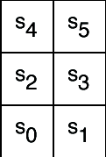
Example
Six possible states <s₀,..,s₅>
4 actions:
UpCareful: moves one tile up unless there is wall, in which case stays in same tile. Always generates a penalty of -1
Left: moves one tile left unless there is wall, in which case
stays in same tile if in s₀ or s₂
Is sent to s₀ if in s₄
Right: moves one tile right unless there is wall, in which case stays in same tile
Up: 0.8 goes up unless there is a wall, 0.1 like Left, 0.1 like Right
-1
-1
+ 10
-1
-100
-1
-1
-1
Reward Model:
-1 for doing UpCareful
Negative reward when hitting a wall, as marked on the picture
+10 for left in s₄

Slide 14
Example
Consider, for instance, our sample grid game:
the optimal policy is to go up in S₀
But if the agent includes some exploration in its policy (e.g. selects 20% of its actions randomly), exploring in S₂ could be dangerous because it may cause hitting the -100 wall
No big deal if the agent is not deployed yet, but not ideal otherwise
-1
-1
+ 10
-1
-100
-1
-1
-1
Q-learning would not detect this problem
It does off-policy learning, i.e., it focuses on the optimal policy
On-policy learning addresses this problem

Slide 15
On-policy learning: SARSA
On-policy learning learns the value of the policy being followed.
e.g., act greedily 80% of the time and act randomly 20% of the time
Better to be aware of the consequences of exploration has it happens, and avoid outcomes that are too costly while acting, rather than looking for the true optimal policy
SARSA
So called because it uses <state, action, reward, state, action> experiences rather than the <state, action, reward, state> used by Q-learning
Instead of looking for the best action at every step, it evaluates the actions suggested by the current policy
Uses this info to revise it

Slide 16
On-policy learning: SARSA
In Q-learning we assume that the agent in s’ will follow the optimal policy….
Given an experience <s,a,r,s’,a’ >, SARSA updates Q[s,a] seeing that the current policy has selected a’… so how we update?

Slide 17
-1
-1
+ 10
-1
Q[s,a] | s₀ | s₁ | s₂ | s₃ | s₄ | s₅
upCareful | 0 | 0 | 0 | 0 | 0 | 0
Left | 0 | 0 | 0 | 0 | 0 | 0
Right | 0 | 0 | 0 | 0 | 0 | 0
Up | 0 | 0 | 0 | 0 | 0 | 0
-100
-1
k=1
k=1
-1
-1
Only immediate rewards
are included in the update,
as with Q-learning

Slide 18
-1
-1
+ 10
-1
-100
-1
Q[s,a] | s₀ | s₁ | s₂ | s₃ | s₄ | s₅
upCareful | 0 | -1 | 0 | -1 | 0 | 0
Left | 0 | 0 | 0 | 0 | 10 | 0
Right | 0 | 0 | 0 | 0 | 0 | 0
Up | 0 | 0 | 0 | 0 | 0 | 0
k=1
k=2
-1
-1
SARSA backs up the expected reward of the next action, rather than the max expected reward

Slide 19
Comparing SARSA and Q-learning
For the little 6-states world
Policy learned by Q-learning 80% greedy is to go up in s₀ to reach s₄ quickly and get the big +10 reward
Iterations | Q[s₀,Up] | Q[s₁,Up] | Q[s₂,UpC] | Q[s₃,Up] | Q[s₄,Left] | Q[s₅,Left]
40000000 | 19.1 | 17.5 | 22.7 | 20.4 | 26.8 | 23.7
-1
-1
+ 10
-1
-100
-1
-1
-1
Notes:
However, if the agent is exploring, this may not be a good thing to do because exploring from state s₂ is very dangerous. If the agent is carrying out the policy that includes exploration, "when in state s, 80% of the time select the action a that maximizes Q[s,a], and 20% of the time select an action at random," going up from s₀ is not optimal. An on-policy learner will try to optimize the policy the agent is following, not the optimal policy that does not include exploration.

Slide 20
Comparing SARSA and Q-learning
Policy learned by SARSA 80% greedy is to go right in s₀
Safer because avoid the chance of getting the -100 reward in s₂
but non-optimal => lower Q-values
Iterations | Q[s₀,Right] | Q[s₁,Up] | Q[s₂,UpC] | Q[s₃,Up] | Q[s₄,Left] | Q[s₅,Left]
40000000 | 6.8 | 8.1 | 12.3 | 10.4 | 15.6 | 13.2
-1
-1
+ 10
-1
-100
-1
-1
-1

Slide 21
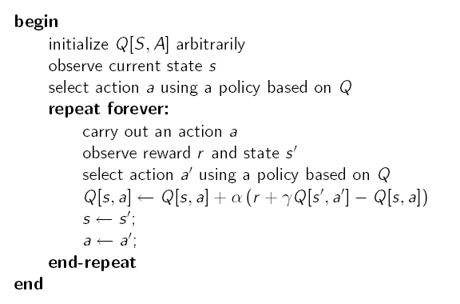
SARSA Algorithm
This could be, for instance any ε-greedy strategy:
Choose random ε times, and max the rest

Slide 22
Another Example
Gridworld with:
Deterministic actions up, down, left, right
Start from S and arrive at G (terminal state with reward > 0)
Reward is -1 for all transitions, except those into the region marked “Cliff”
Falling into the cliff causes the agent to be sent back to start: r = -100
S |  |  |  |  |  |  |  |  |  |  | G
Notes:
Bouncing back does not cost anything

Slide 23
With an ε-greedy strategy (e.g., ε =0.1)
A. SARSA will learn policy p1 while Q-learning will learn p2
B. Q-learning will learn policy p1 while SARSA will learn p2
C. They will both learn p1
D. They will both learn p2
S |  |  |  |  |  |  |  |  |  |  | G

Slide 24
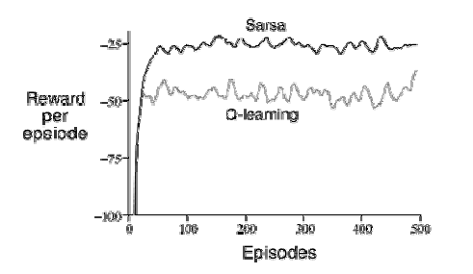
Q-learning vs. SARSA
Q-learning learns the optimal policy, but because it does so without taking exploration into account, it does not do so well while the agent is exploring
It occasionally falls into the cliff, so its reward per episode is not that great
SARSA has better on-line performance (reward per episode), because it learns to stay away from the cliff while exploring
But note that if ε→0, SARSA and Q-learning would asymptotically converge to the optimal policy

Slide 25
Final Recommendation
If agent is not deployed it should do ….
random all the time (ε=1) and Q-learning
When Q values have converged then deploy
If the agent is deployed it should
apply one of the explore/exploit strategies (e.g., ε=.5) and do Sarsa
Decreasing ε over time

Slide 26
RL scalability: Policy Gradient Methods (not for 422)
Problems for most value-function methods (like Q-L, SARSA)
Continuous states and actions in high dimensional spaces
Uncertainty on the state information
Convergence
Popular Solution: Policy Gradient Methods…. But still limited
On-policy by definition (like SARSA)
Find Local maximum (while global for value-function methods)
Open Parameter: learning rate (to be set empirically)
Notes:
Policy gradient methods
Jan Peters (2010), Scholarpedia, 5(11):3698.doi:10.4249/scholarpedia.3698revision #137199 [link to/cite this article]
Curator and Contributors 1.00 - Jan Peters
Prof. Jan Peters, Max-Planck Institute, Germany & University of Southern California, USC
Policy gradient methods are a type of reinforcement learning techniques that rely upon optimizing parametrized policies with respect to the expected return (long-term cumulative reward) by gradient descent. They do not suffer from many of the problems that have been marring traditional reinforcement learning approaches such as the lack of guarantees of a value function, the intractability problem resulting from uncertain state information and the complexity arising from continuous states & actions.
Contents
[hide]
1 Introduction
2 Assumptions and Notation
3 Approaches to Policy Gradient Estimation
3.1 Finite-difference Methods
3.2 Likelihood Ratio Methods and REINFORCE
3.3 Natural Policy Gradients
4 Conclusion
5 References
6 See also
Introduction
Reinforcement learning is probably the most general framework in which reward-related learning problems of animals, humans or machine can be phrased. However, most of the methods proposed in the reinforcement learning community are not yet applicable to many problems such as robotics, motor control, etc. This inapplicability may result from problems with uncertain state information. Thus, those systems need to be modeled as partially observable Markov decision problems which often results in excessive computational demands. Most traditional reinforcement learning methods have no convergence guarantees and there exist even divergence examples. Continuous states and actions in high dimensional spaces cannot be treated by most off-the-shelf reinforcement learning approaches.
Policy gradient methods differ significantly as they do not suffer from these problems in the same way. For example, uncertainty in the state might degrade the performance of the policy (if no additional state estimator is being used) but the optimization techniques for the policy do not need to be changed. Continuous states and actions can be dealt with in exactly the same way as discrete ones while, in addition, the learning performance is often increased. Convergence at least to a local optimum is guaranteed.
The advantages of policy gradient methods for real world applications are numerous. Among the most important ones are that the policy representations can be chosen so that it is meaningful for the task and can incorporate domain knowledge, that often fewer parameters are needed in the learning process than in value-function based approaches and that there is a variety of different algorithms for policy gradient estimation in the literature which have a rather strong theoretical underpinning. Additionally, policy gradient methods can be used either model-free or model-based as they are a generic formulation.
Of course, policy gradients are not the salvation to all problems but also have significant problems. They are by definition on-policy (note that tricks like importance sampling can slightly alleviate this problem) and need to forget data very fast in order to avoid the introduction of a bias to the gradient estimator. Hence, the use of sampled data is not very efficient. In tabular representations, value function methods are guaranteed to converge to a global maximum while policy gradients only converge to a local maximum and there may be many maxima in discrete problems. Policy gradient methods are often quite demanding to apply, mainly because one has to have considerable knowledge about the system one wants to control to make reasonable policy definitions. Finally, policy gradient methods always have an open parameter, the learning rate, which may decide over the order of magnitude of the speed of convergence, these have led to new approaches inspired by expectation-maximization (see, e.g., Vlassis et al., 2009; Kober & Peters, 2008).
Nevertheless, due to their advantages stated above, policy gradient methods have become particularly interesting for robotics applications as these have both continuous actions and states. For example, there has been a series of successful applications in robot locomotion, where good policy parametrizations such as CPGs are known. Benbrahim & Franklin (1997) already explored 2D dynamic biped walking, Tedrake et al. (2004) extended these results to 3D passive dynamics-based walkers and Endo (2005) showed that a full-body gait with sensory feedback can be learned with policy gradients. Kohl & Stone (2004) were able to apply policy gradients to optimize quadruped gaits. There have also been various applications in skill learning starting with the peg-in-a-hole tasks learned by Gullapalli et al. (1994) and ranging to Peters & Schaals' optimizations of discrete movements primitives such as T-Ball swings.
Note that in most applications, there exist many local maxima; for example, if we were told build a high jumping robot, there is a multitude of styles. Current policy gradient methods would be helpful for improving a jumping style of a teacher, let's say the classical straddle jump. However, discovering a Fosbery flop when starting with a basic straddle jump policy is probably not possible with policy gradient methods.

Slide 27
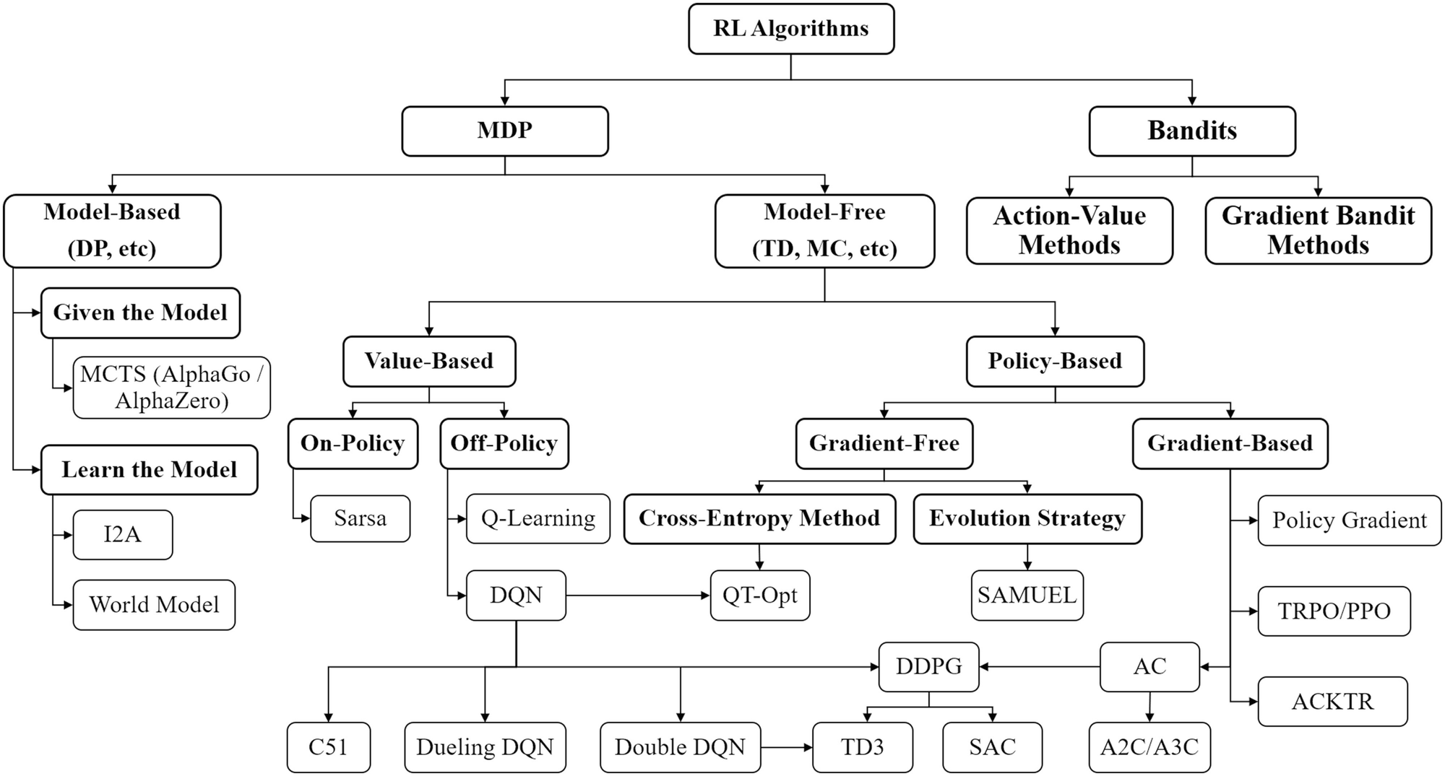
NOT REQUIRED for 422! Map of reinforcement learning algorithms. Boxes with thick lines denote different categories, others denote specific algorithms
Notes:
Map of reinforcement learning algorithms. Boxes with thick lines denote different categories, others denote specific algorithms
Deep Reinforcement Learning pp 125-133| Cite as
Taxonomy of Reinforcement Learning Algorithms
Authors
Authors and affiliations
Hongming Zhang
Tianyang Yu
ChapterFirst Online: 30 June 2020

Slide 28
StarAI (statistical relational AI)
Hybrid: Det +Sto
422 big picture
Parsing
Prob CFG
Prob Relational Models
Markov Logics
Deterministic
Stochastic
Belief Nets
Logics
Approx. : Gibbs
First Order Logics
Markov Chains and HMMs
Ontologies
Forward, Viterbi….
Approx. : Particle Filtering
Query
Full Resolution
SAT
Undirected Graphical Models
Markov Networks
Conditional Random Fields
Markov Decision Processes and
Partially Observable MDP
Planning
Value Iteration
Approx. Inference
Reinforcement Learning
Representation
Applications of AI
Reasoning
Technique
Notes:
Breadth and Depth

Slide 29
Learning Goals for today’s class
You can:
Describe and compare techniques to combine exploration with exploitation
On-policy Learning (SARSA)
Discuss trade-offs in RL scalability (not required)

Slide 30
TODO for Wed
Read textbook 6.4.2
Next research paper will be next Mon
Practice Ex 11.B
Assignment 1 due on Wed

