Slide 1
Intelligent Systems (AI-2)
Computer Science cpsc422, Lecture 34
Apr, 14, 2021
Notes:
Lecture 35

Slide 2
Teaching Evaluations
Please complete the teaching evaluations on Canvas
We will start the actual class at 4:10
Thank you!

Slide 3

Lecture Overview
IBM Watson... And Debater
After 422...
(422) Highlights from conferences
Final Exam: how to prepare…

Slide 4

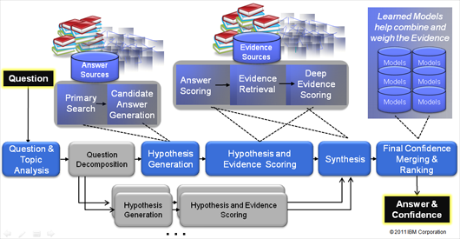
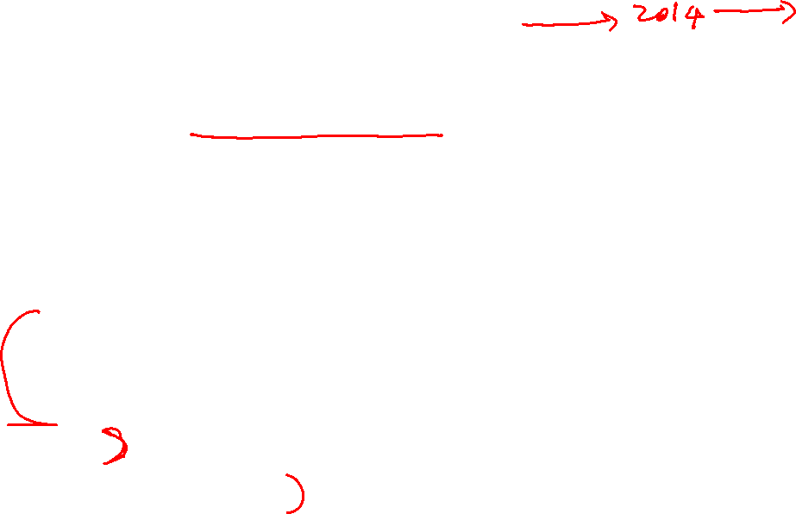
Watson : analyzes natural language questions and content well enough and fast enough to compete and win against champion players at Jeopardy!
Clue: “This Drug has been shown to relieve the symptoms of ADD with relatively few side effects."
Answer: “What is Retail ?”
1000s of algorithms and KBs
3 secs
Massive parallelism
Source: IBM
Notes:
The correct Jeopardy! response would be "What is Ritalin?“
This is no easy task for a computer, given the need to perform over an enormously broad domain,
with consistently high precision and amazingly accurate confidence estimations in the correctness of its answers.
Watson’s performance on Jeopardy! is just the opening salvo for a research mission built on decades of
experience in deep Content Analysis, Natural Language Processing, Information Retrieval, Machine Learning and Artificial Intelligence.
Rich natural language questions covering a broad range of general knowledge. It is widely recognized as an entertaining game requiring smart, knowledgeable and quick players.
Computer systems that can directly and accurately answer questions over a broad domain of human knowledge have been envisioned by scientists and writers since the advent of computers themselves. Open domain question answering holds tremendous promise for facilitating informed decision making over vast volumes of natural language content. Applications in business intelligence, healthcare, customer support, enterprise knowledge management, social computing, science and government would all benefit from deep language processing. The DeepQA project is aimed at exploring how advancing and integrating Natural Language Processing (NLP), Information Retrieval (IR), Machine Learning (ML), massively parallel computation and Knowledge Representation and Reasoning (KR&R) can advance open-domain automatic Question Answering. One proof-point in this challenge is to develop a computer system that can successfully compete against top human players at the Jeopardy! quiz show (www.jeopardy.com). Attaining champion-level performance in Jeopardy! requires a computer system to rapidly and accurately answer rich open-domain questions, and to assess its own confidence in a category or question. The system must deliver high degrees of precision and confidence over a very broad range of knowledge and natural language content within a very short 3-second response time. The need for speed and high precision demands a massively parallel computing platform capable of generating, evaluating and combing thousands of hypotheses and their associated evidence. In this talk I will introduce the audience to the Jeopardy! Challenge and the techniques used to tackle it.

Slide 5

AI techniques in 422 / Watson
Parsing (PCFGs)
Shallow parsing (NP segmentation with CRFs)
Entity and relation Detection (NER with CRFs)
Logical Form Generation and Matching
Logical Temporal and Spatial Reasoning
Leveraging many databases, taxonomies, and ontologies (help only 25% of questions)
Confidence… Probabilities (Bnets to rank)
Strategy for playing Jeopardy…statistical models of players and games, game-theoretic analyses … .. and application of reinforcement-learning (Buzz-in - Bets)
Notes:
parsing, question classification, question decomposition, automatic source acquisition and evaluation, entity and relation detection, logical form generation, and knowledge representation and reasoning.
These challenges drove the construction of statistical models of players and games, game-theoretic analyses of particular game scenarios and strategies, and the development and application of reinforcement-learning techniques for Watson to learn its strategy for playing Jeopardy.
Dbpedia
Leveraging many loosely formed ontologies
Also databases, taxonomies, and ontologies, such as dbPedia, WordNet, and the Yago⁸ ontology.
a is a crowd-sourced community effort to extract structured information from Wikipedia and make this information available on the Web.
- The authors of Watson report that using Freebase, a large knowledge base about several domains, can at best help with only 25% of the questions, forcing Watson to rely on textual sources alone for
the remaining questions.
The workhorse of strategic decisions is the buzz-in decision, which is required for every non–Daily Double clue on the board. This is where DeepQA’s ability to accurately estimate its confidence in its answer is critical, and Watson considers this confidence along with other game-state factors in making the final determination whether to buzz. Another strategic decision, Final Jeopardy wagering, generally receives the most attention and analysis from those interested in game strategy, and there exists a growing catalogue of heuristics such as “Clavin’s Rule” or the “Two-Thirds Rule” (Dupee 1998) as well as identification of those critical score boundaries at which particular strategies may be used (by no means does this make it easy or rote; despite this attention, we have found evidence that contestants still occasionally make irrational Final Jeopardy bets). Daily Double betting turns out to be less studied but just as challenging since the player must consider opponents’ scores and predict the likelihood of getting the question correct just as in Final Jeopardy. After a Daily Double, however, the game is not over, so evaluation of a wager requires forecasting the effect it will have on the distant, final outcome of the game.
These challenges drove the construction of statistical models of players and games, game-theoretic analyses of particular game scenarios and strategies, and the development and application of reinforcement-learning techniques for Watson to learn its strategy for playing Jeopardy. Fortunately, moderate amounts of historical data are available to serve as training data for learning techniques. Even so, it requires extremely careful modeling and game-theoretic evaluation as the game of Jeopardy has incomplete information and uncertainty to model, critical score boundaries to recognize, and savvy, competitive players to account for. It is a game where one faulty strategic choice can lose the entire match.

Slide 6


From silly project to $1 billion investment
2005-6 “IT’S a silly project to work on, it’s too gimmicky, it’s not a real computer-science test, and we probably can’t do it anyway.” These were reportedly the first reactions of the team of IBM researchers challenged to build a computer system capable of winning “Jeopardy”!
………after 8-9 years…
On January 9th 2014, with much fanfare, the computing giant announced plans to invest $1 billion in a new division, IBM Watson Group. By the end of the year, the division expects to have a staff of 2,000 plus an army of external app developers …..Mike Rhodin, who will run the new division, calls it “one of the most significant innovations in the history of our company.” Ginni Rometty, IBM’s boss since early 2012, has reportedly predicted that it will be a $10 billion a year business within a decade.
Notes:
“IT’S a silly project to work on, it’s too gimmicky, it’s not a real computer-science test, and we probably can’t do it anyway.” These were reportedly the first reactions of the team of IBM researchers challenged to build a computer system capable of winning “Jeopardy!
……
On January 9th, with much fanfare, the computing giant announced plans to invest $1 billion in a new division, IBM Watson Group. By the end of the year, the division expects to have a staff of 2,000 plus an army of external app developers working within its “open Watson ecosystem”. It also unveiled a raft of new projects under development, on top of the handful already revealed in health care, financial services and retailing with firms such as WellPoint and the Cleveland Clinic. Mike Rhodin, who will run the new division, calls it “one of the most significant innovations in the history of our company.” Ginni Rometty, IBM’s boss since early 2012, has reportedly predicted that it will be a $10 billion a year business within a decade.

Slide 7
DeepQA components
Each of the scorers implemented in Watson, how they work, how they interact, and their independent impact on Watson’s performance deserves its own research paper.
At this point no one algorithm dominates.
Important and lasting contribution of this work
  DeepQA’s facility for absorbing these algorithms
  Tools for exploring their interactions and effects
Notes:
Each of the scorers implemented in Watson, how they work, how they interact, and their independent impact on Watson’s performance deserves its own research paper. We cannot do this work justice here. It is important to note, however, at this point no one algorithm dominates. In fact we believe DeepQA’s facility for absorbing these algorithms, and the tools we have created for exploring their interactions and effects, will represent an important and lasting contribution of this work.

Slide 8
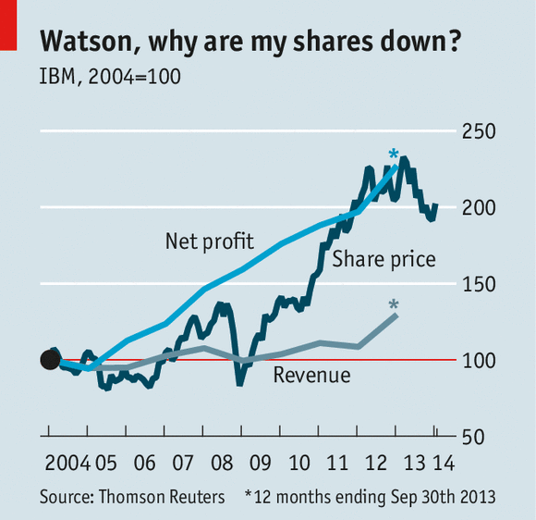
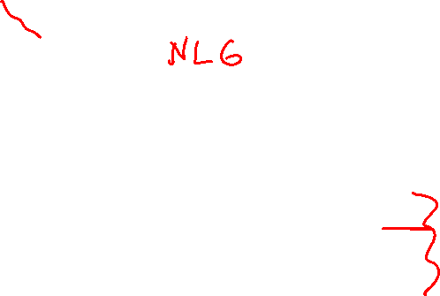
More complex questions in the future....
Or something like: “Should Europe reduce its energy dependency from Russia and what would it take?”
And interactive, collaborative question-answering / problem solving

Slide 9
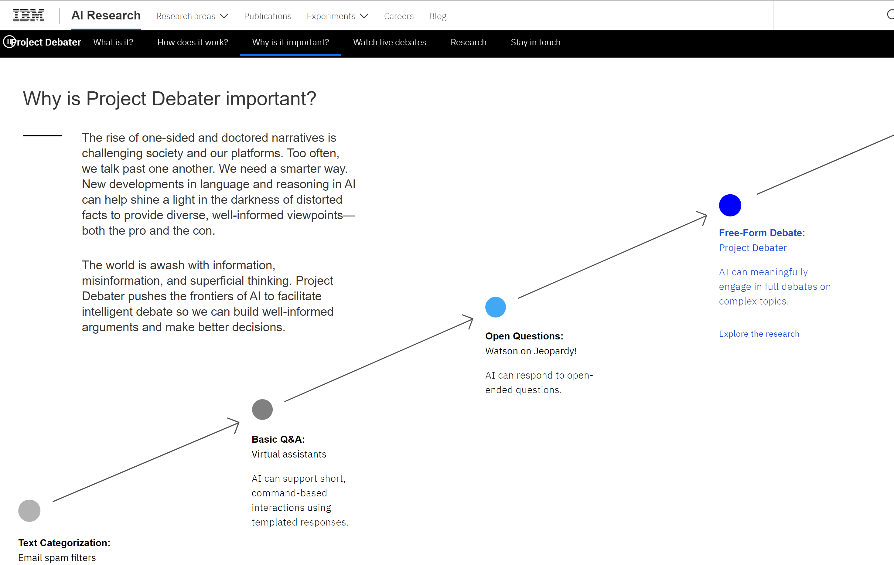
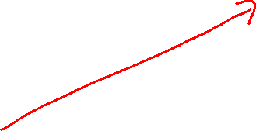




Notes:
Expert Stance Graphs for Computational Argumentation
Orith Toledo-Ronen et al.
ArgMining @ ACL, 2016
Wordnet
including the output of
the ESG syntactic parser (McCord, 1990; McCord
et al., 2012), the TagMe Wikifier (Ferragina and
Scaiella, 2010), named entities recognized with
the Stanford NER (Finkel et al., 2005) and multiword
expressions in WordNet.
First, we train a linear
SVM2 on the PPMI vectors of the words

Slide 10
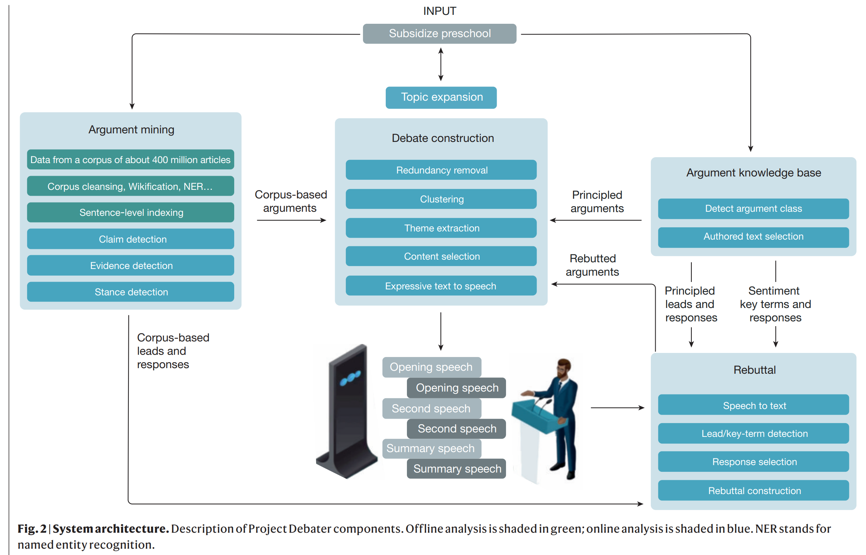

IBM Debater Architecture

Slide 11
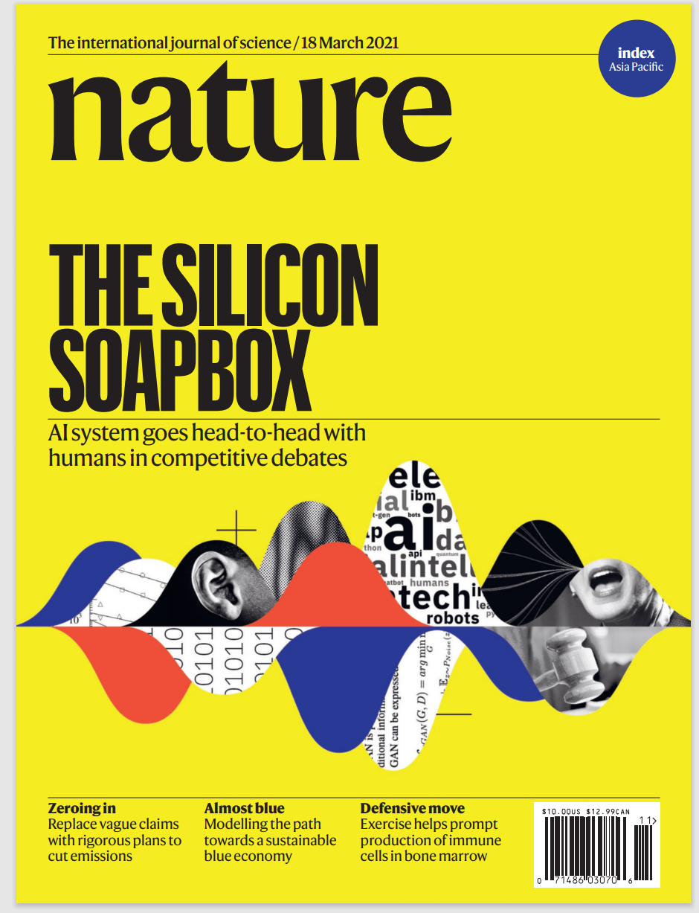

https://www.ibm.com/blogs/research/2021/03/project-debater-api/
https://www.research.ibm.com/artificial-intelligence/project-debater/

Slide 12
AI applications.........
DeepQA
Personal Assistants
Robotics
Search Engines
Games
Tutoring Systems
Medicine / Finance / …
……
Most companies are investing in AI and/or developing/adopting AI technologies

Slide 13
Lecture Overview
TA Evaluations / Teaching Evaluations
IBM Watson...
After 422...
(422) Highlights from conferences
Final Exam: how to prepare…

Slide 14
422 big picture
StarAI (statistical relational AI)
Hybrid: Det +Sto
Prob CFG
Prob Relational Models
Markov Logics
Deterministic
Stochastic
Logics
Full Propositional
Belief Nets
Approx. : Gibbs
First Order Logics
Markov Chains and HMMs
Ontologies – Knowledge Graphs
Forward, Viterbi….
Approx. : Particle Filtering
Query
Full Resolution
SAT
Concept Similarity
Markov Networks
Conditional Random Fields
Markov Decision Processes and
Partially Observable MDP
Planning
Value Iteration
Approx. Inference
Reinforcement Learning
Q-learning, SARSA
Representation
Applications of AI
Reasoning
Technique
Notes:
Breadth and Depth

Slide 15
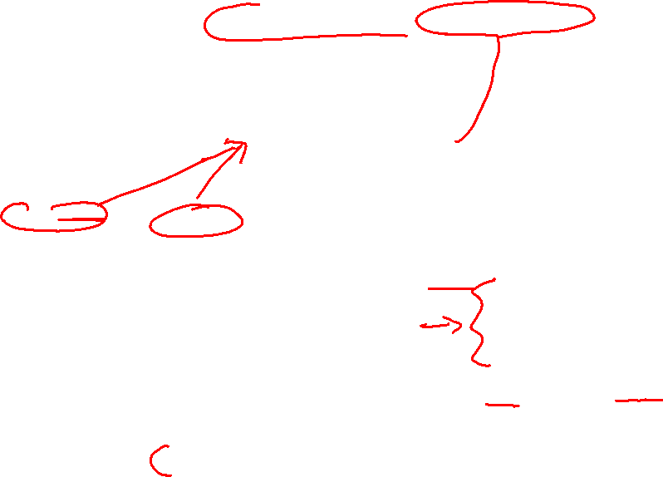
After 422…..
Machine Learning + Neural Models
Knowledge Acquisition
Preference Elicitation
StarAI (statistical relational AI)
Hybrid: Det +Sto
Prob CFG
Prob Relational Models
Markov Logics
Where are the components of our representations coming from?
Deterministic
Stochastic
Logics
Full Propositional
Belief Nets
Approx. : Gibbs
First Order Logics
Markov Chains and HMMs
The probabilities?
The utilities?
The logical formulas?
Ontologies – Knowledge Graphs
Forward, Viterbi….
Approx. : Particle Filtering
Query
Full Resolution
SAT
Concept Similarity
Markov Networks
Conditional Random Fields
Markov Decision Processes and
Partially Observable MDP
From people and from data!
Planning
Value Iteration
Approx. Inference
Reinforcement Learning
Q-learning, SARSA
Representation
Applications of AI
Reasoning
Technique
Notes:
Breadth and Depth

Slide 16

Some of our Grad Courses
522: Artificial Intelligence II : Reasoning and Acting Under Uncertainty
Sample Advanced Topics…..
Relational Reinforcement Learning for Agents in Worlds with Objects, relational learning.
- Probabilistic Relational Learning and Inductive Logic Programming at a Global Scale,

Slide 17

Some of our Grad Courses
503: Computational Linguistics I / Natural Language Processing
Sample Advanced Topics…..
Topic Modeling (LDA) – Large Scale Graphical Models – Gibbs Sampling
Discourse Parsing by Distant Supervision (CKY + Neural Nets) (third 422 reading)
Abstractive Summarization (Neural Nets + Concept similarity)

Slide 18
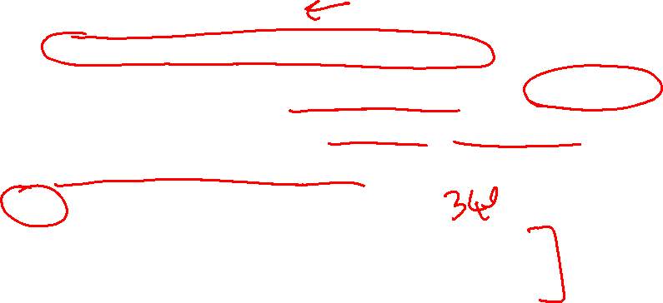
Other AI Grad Courses: check them out
532: Topics in Artificial Intelligence (different courses)
Human-Centered AI
Foundations of Multiagent Systems
Deep Learning for Computer Vision and Graphics
Multimodal Learning with Vision, Language and Sound
Probabilistic Programming
540: Machine Learning
505: Image Understanding I: Image Analysis
525: Image Understanding II: Scene Analysis
515: Computational Robotics
Notes:
532L 201 Topics in AI: Multimodal Learning with Vision, Language and Sound TR 11:00-12:30 ICCS 246 Leonid Sigal 532R 201 Topics in AI: Graphical Models TR 15:30-17:00 DMP 101 Siamak Ravanbakhsh

Slide 19
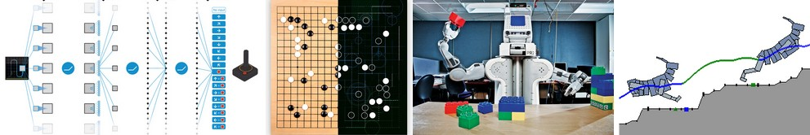
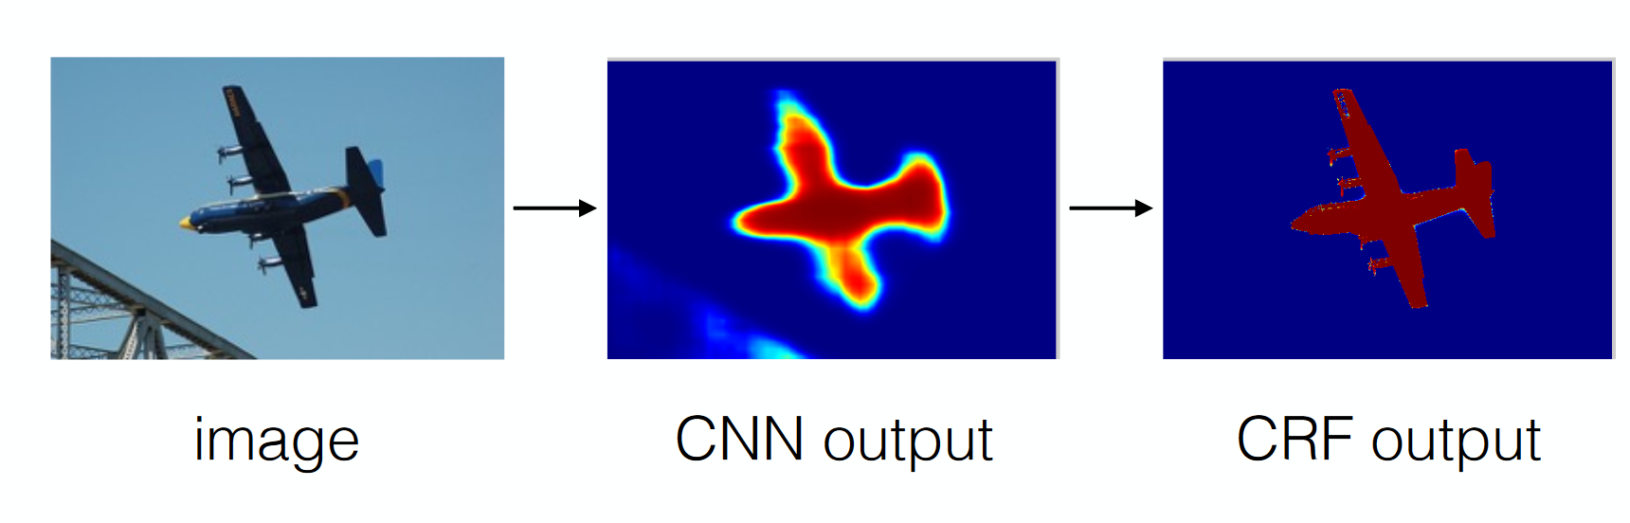
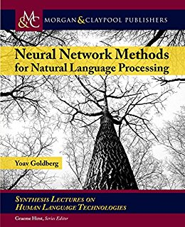

Connection with Neural Models /
Deep-Learning
NN +Reinforcement Learning: e.g. Alpha-Go (Deep Mind)
http://karpathy.github.io/2016/05/31/rl/
NN (rough prediction) + CRF (refine prediction): Vision (Google paper)
NN + CRF + CKY for NLP (Goldberg book. 2017, Pag 224)
Notes:
sure there are... ***not material for 422*** but if you are curious...
policy gradient methods can deal with belief states
http://rll.berkeley.edu/deeprlcourse/docs/lec2.pdf
for an intuitive explanation of policy gradient and its application to Neural RL
http://karpathy.github.io/2016/05/31/rl/
As for RL in non-stationary environments, I have not found any recent, certified reference.
there was some interesting work in the 90s
https://www.cs.rice.edu/~devika/
but could not find anything comprehensive, more recent from top centers
something here https://www.cs.toronto.edu/~duvenaud/courses/csc2541/slides/model-based-RL-deepmind.pdf
>what pro/cons I have when choosing one or another
this is still an open research question. It can be argued that CRFs are more transparent, in the sense that their predictions could be easier to interpret. another consideration is the amount of training data (you need massive annotated datasets for neural models, possibly less so for CFRs). Finally often you do not need to choose, but you can try to ensemble different models in creative ways. e.g., from using both and averaging, to more complex semi-supervised schemes.
Finally (and possibly orthogonally) as in the case of the paper we briefly discussed, one model can be more suitable for one task and the other model for another and you need to perform both tasks to solve your problem (see below)
> Why in the slide 23 they decided to use those two models in that way? Why one of those models wasn't enough?
see slide 4 http://vision.cs.utexas.edu/381V-fall2016/slides/kelle_paper.pdf
(definitely beyond 422, but great to know you are interested in these topics... as I said this is ongoing research in AI ! )
Hi!
Just wanted to leave this here as I found it very interesting. Today was published a paper from Deep Mind in which it is described a new version of AlfaGo. AlfaGo uses a combination of deep neural network, reinforcement learning, and look-ahead to outperform human-level in Go. The great thing now is that they improve the architecture and the algorithm doesn't need human data to learn, just the rules and self-playing! They even outperformed their previous version. So great things can be achieved with RL-based architectures :)

Slide 20

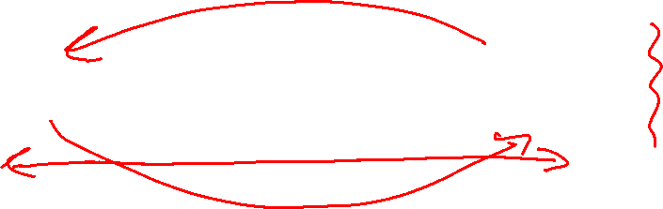

AI Representation & Reasoning & Learning future in a nutshell
(according to me)
Notes:
sure there are... ***not material for 422*** but if you are curious...
policy gradient methods can deal with belief states
http://rll.berkeley.edu/deeprlcourse/docs/lec2.pdf
for an intuitive explanation of policy gradient and its application to Neural RL
http://karpathy.github.io/2016/05/31/rl/
As for RL in non-stationary environments, I have not found any recent, certified reference.
there was some interesting work in the 90s
https://www.cs.rice.edu/~devika/
but could not find anything comprehensive, more recent from top centers
something here https://www.cs.toronto.edu/~duvenaud/courses/csc2541/slides/model-based-RL-deepmind.pdf
>what pro/cons I have when choosing one or another
this is still an open research question. It can be argued that CRFs are more transparent, in the sense that their predictions could be easier to interpret. another consideration is the amount of training data (you need massive annotated datasets for neural models, possibly less so for CFRs). Finally often you do not need to choose, but you can try to ensemble different models in creative ways. e.g., from using both and averaging, to more complex semi-supervised schemes.
Finally (and possibly orthogonally) as in the case of the paper we briefly discussed, one model can be more suitable for one task and the other model for another and you need to perform both tasks to solve your problem (see below)
> Why in the slide 23 they decided to use those two models in that way? Why one of those models wasn't enough?
see slide 4 http://vision.cs.utexas.edu/381V-fall2016/slides/kelle_paper.pdf
(definitely beyond 422, but great to know you are interested in these topics... as I said this is ongoing research in AI ! )
Hi!
Just wanted to leave this here as I found it very interesting. Today was published a paper from Deep Mind in which it is described a new version of AlfaGo. AlfaGo uses a combination of deep neural network, reinforcement learning, and look-ahead to outperform human-level in Go. The great thing now is that they improve the architecture and the algorithm doesn't need human data to learn, just the rules and self-playing! They even outperformed their previous version. So great things can be achieved with RL-based architectures :)

Slide 21
AI R&R&L future in a nutshell
(according to me)
How to manage multi-tasking for an increasing number of tasks? Multi-task
Machine Translation, Text Summarization, Event recognition in videos
Notes:
sure there are... ***not material for 422*** but if you are curious...
policy gradient methods can deal with belief states
http://rll.berkeley.edu/deeprlcourse/docs/lec2.pdf
for an intuitive explanation of policy gradient and its application to Neural RL
http://karpathy.github.io/2016/05/31/rl/
As for RL in non-stationary environments, I have not found any recent, certified reference.
there was some interesting work in the 90s
https://www.cs.rice.edu/~devika/
but could not find anything comprehensive, more recent from top centers
something here https://www.cs.toronto.edu/~duvenaud/courses/csc2541/slides/model-based-RL-deepmind.pdf
>what pro/cons I have when choosing one or another
this is still an open research question. It can be argued that CRFs are more transparent, in the sense that their predictions could be easier to interpret. another consideration is the amount of training data (you need massive annotated datasets for neural models, possibly less so for CFRs). Finally often you do not need to choose, but you can try to ensemble different models in creative ways. e.g., from using both and averaging, to more complex semi-supervised schemes.
Finally (and possibly orthogonally) as in the case of the paper we briefly discussed, one model can be more suitable for one task and the other model for another and you need to perform both tasks to solve your problem (see below)
> Why in the slide 23 they decided to use those two models in that way? Why one of those models wasn't enough?
see slide 4 http://vision.cs.utexas.edu/381V-fall2016/slides/kelle_paper.pdf
(definitely beyond 422, but great to know you are interested in these topics... as I said this is ongoing research in AI ! )
Hi!
Just wanted to leave this here as I found it very interesting. Today was published a paper from Deep Mind in which it is described a new version of AlfaGo. AlfaGo uses a combination of deep neural network, reinforcement learning, and look-ahead to outperform human-level in Go. The great thing now is that they improve the architecture and the algorithm doesn't need human data to learn, just the rules and self-playing! They even outperformed their previous version. So great things can be achieved with RL-based architectures :)

Slide 22
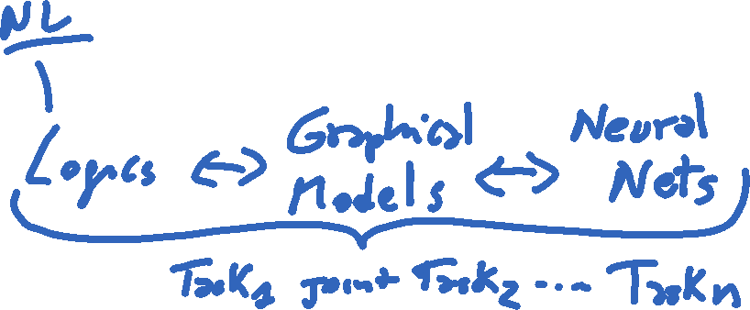
AI R&R&L future in a nutshell
(according to me)
How to manage multi-tasking for an increasing number of tasks?
Multi-task R&R&L
Machine Translation, Text Summarization, Event recognition in videos
In different domains
Medicine, Transportation, Politics, Law…
Transfer learning
Notes:
sure there are... ***not material for 422*** but if you are curious...
policy gradient methods can deal with belief states
http://rll.berkeley.edu/deeprlcourse/docs/lec2.pdf
for an intuitive explanation of policy gradient and its application to Neural RL
http://karpathy.github.io/2016/05/31/rl/
As for RL in non-stationary environments, I have not found any recent, certified reference.
there was some interesting work in the 90s
https://www.cs.rice.edu/~devika/
but could not find anything comprehensive, more recent from top centers
something here https://www.cs.toronto.edu/~duvenaud/courses/csc2541/slides/model-based-RL-deepmind.pdf
>what pro/cons I have when choosing one or another
this is still an open research question. It can be argued that CRFs are more transparent, in the sense that their predictions could be easier to interpret. another consideration is the amount of training data (you need massive annotated datasets for neural models, possibly less so for CFRs). Finally often you do not need to choose, but you can try to ensemble different models in creative ways. e.g., from using both and averaging, to more complex semi-supervised schemes.
Finally (and possibly orthogonally) as in the case of the paper we briefly discussed, one model can be more suitable for one task and the other model for another and you need to perform both tasks to solve your problem (see below)
> Why in the slide 23 they decided to use those two models in that way? Why one of those models wasn't enough?
see slide 4 http://vision.cs.utexas.edu/381V-fall2016/slides/kelle_paper.pdf
(definitely beyond 422, but great to know you are interested in these topics... as I said this is ongoing research in AI ! )
Hi!
Just wanted to leave this here as I found it very interesting. Today was published a paper from Deep Mind in which it is described a new version of AlfaGo. AlfaGo uses a combination of deep neural network, reinforcement learning, and look-ahead to outperform human-level in Go. The great thing now is that they improve the architecture and the algorithm doesn't need human data to learn, just the rules and self-playing! They even outperformed their previous version. So great things can be achieved with RL-based architectures :)

Slide 23


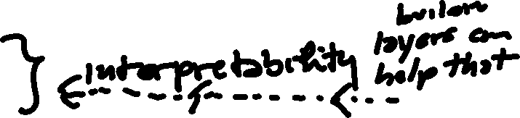

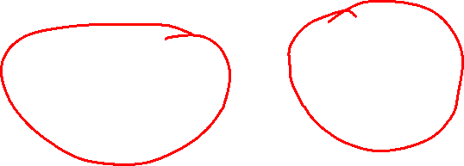
Building layers that can support that
AI R&R&L future in a nutshell
(according to me)
How to manage multi-tasking for an increasing number of tasks?
Multi-task
Machine Translation, Text Summarization, Event recognition in videos
In different domains
Medicine, Transportation, Politics, Law…
Transfer learning
Notes:
sure there are... ***not material for 422*** but if you are curious...
policy gradient methods can deal with belief states
http://rll.berkeley.edu/deeprlcourse/docs/lec2.pdf
for an intuitive explanation of policy gradient and its application to Neural RL
http://karpathy.github.io/2016/05/31/rl/
As for RL in non-stationary environments, I have not found any recent, certified reference.
there was some interesting work in the 90s
https://www.cs.rice.edu/~devika/
but could not find anything comprehensive, more recent from top centers
something here https://www.cs.toronto.edu/~duvenaud/courses/csc2541/slides/model-based-RL-deepmind.pdf
>what pro/cons I have when choosing one or another
this is still an open research question. It can be argued that CRFs are more transparent, in the sense that their predictions could be easier to interpret. another consideration is the amount of training data (you need massive annotated datasets for neural models, possibly less so for CFRs). Finally often you do not need to choose, but you can try to ensemble different models in creative ways. e.g., from using both and averaging, to more complex semi-supervised schemes.
Finally (and possibly orthogonally) as in the case of the paper we briefly discussed, one model can be more suitable for one task and the other model for another and you need to perform both tasks to solve your problem (see below)
> Why in the slide 23 they decided to use those two models in that way? Why one of those models wasn't enough?
see slide 4 http://vision.cs.utexas.edu/381V-fall2016/slides/kelle_paper.pdf
(definitely beyond 422, but great to know you are interested in these topics... as I said this is ongoing research in AI ! )
Hi!
Just wanted to leave this here as I found it very interesting. Today was published a paper from Deep Mind in which it is described a new version of AlfaGo. AlfaGo uses a combination of deep neural network, reinforcement learning, and look-ahead to outperform human-level in Go. The great thing now is that they improve the architecture and the algorithm doesn't need human data to learn, just the rules and self-playing! They even outperformed their previous version. So great things can be achieved with RL-based architectures :)

Slide 24
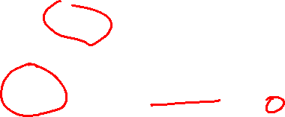
Key to interpretability
Language + mathematical abstractions
+ Visualization
(we have a ugrad and a grad course)

Slide 25
Lecture Overview
TA Evaluations / Teaching Evaluations
IBM Watson….
After 422….
(422) Highlights from IUI conferences and more….
Final Exam: how to prepare……

Slide 26
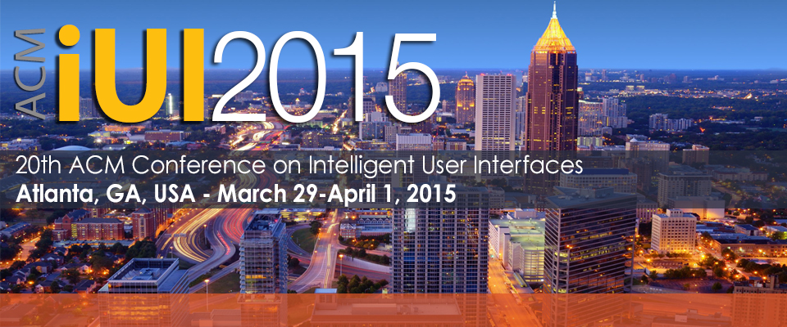
AI and HCI meet
Keynote Speaker:
Prof. Dan Weld, University of Washington
Intelligent Control of Crowdsourcing
Crowd-sourcing labor markets (e.g., Amazon Mechanical Turk) are booming, …… use of Partially-Observable Markov Decision Processes (POMDPs) to control voting on binary-choice questions and iterative improvement workflows.
… applications range from photo tagging to audio-visual transcription and interlingual translation
Notes:
Crowd-sourcing labor markets (e.g., Amazon Mechanical Turk) are booming, because they enable rapid construction of complex workflows that seamlessly mix human computation with computer automation. Example applications range from photo tagging to audio-visual transcription and interlingual translation. Similarly, workflows on citizen science sites (e.g. GalaxyZoo) have allowed ordinary people to pool their effort and make interesting discoveries. Unfortunately, constructing a good workflow is difficult, because the quality of the work performed by humans is highly variable. Typically, a task designer will experiment with several alternative workflows to accomplish a task, varying the amount of redundant labor, until she devises a control strategy that delivers acceptable performance.
Fortunately, this control challenge can often be formulated as an automated planning problem ripe for algorithms from the probabilistic planning and reinforcement learning literature. I describe our recent work on the decision-theoretic control of crowd sourcing and suggest open problems for future research. In particular, I discuss the use of partially-observable Markov decision Processes (POMDPs) to control voting on binary-choice questions and iterative improvement workflows.
Decision-theoretic methods that dynamically switch between alternative workflows in a way that improves on traditional (static) A-B testing.
A novel workflow for crowdsourcing the construction of a taxonomy — a challenging problem since it demands a global perspective of the input data when no one worker sees more than a tiny fraction.
Methods for optimizing the acquisition of labeled training data for use in machine learning applications; this an important special case, since data annotation is often crowd-sourced.
named entity
recognition, document categorization, sentiment
analysis, semantic relatedness and social tagging.

Slide 27
Some papers from IUI
Unsupervised Modeling of Users' Interests from their Facebook Profiles and Activities
Preeti Bhargava (University of Maryland)
Oliver Brdiczka (Vectra Networks, Inc.)
Michael Roberts (Palo Alto Research Center)
named entity recognition, document categorization, sentiment analysis, semantic relatedness and social tagging
Semantic Textual Similarity (STS) system [13] for computing the SR scores. STS is based on LSA along with WordNet knowledge and is trained on LDC Gigawords and Stanford Webbase corpora

Slide 28
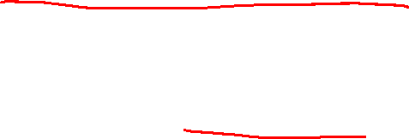
Some papers from IUI-15
BayesHeart: A Probabilistic Approach for Robust, Low-Latency Heart Rate Monitoring on Camera Phones
Xiangmin Fan (University of Pittsburgh)
Jingtao Wang (University of Pittsburgh)
BayesHeart is based on an adaptive hidden Markov model, requires minimal training data and is user-independent.
Two models, one with 2 states and one with 4 states, work in combination….
…. measuring people’s heart rates through commodity cameras by capturing users’ skin transparency changes, color changes, or involuntary motion
Applications: gaming, learning, and fitness training
Notes:
Recent technological advances have demonstrated the (http://mips.lrdc.pitt.edu/publications/)
feasibility of measuring people’s heart rates through
commodity cameras by capturing users’ skin transparency
changes, color changes, or involuntary motion. However,
such raw image data collected during everyday interactions
(e.g. gaming, learning, and fitness training) is often noisy
and intermittent, especially in mobile contexts. Such
interference causes increased error rates, latency, and even
detection failures for most existing algorithms. In this
paper, we present BayesHeart, a probabilistic algorithm that
extracts both heart rates and distinct phases of the cardiac
cycle directly from raw fingertip transparency signals
captured by camera phones. BayesHeart is based on an
adaptive hidden Markov model, requires minimal training
data and is user-independent. Through a comparative study
of twelve state-of-the-art algorithms covering the design
space of noise reduction and pulse counting, we found that
BayesHeart outperforms existing algorithms in both
accuracy and speed for noisy, intermittent signals.

Slide 29

Paper for IUI 2017
Analyza: Exploring Data with Conversation (Google research)
Applied in two systems
Question answering for a spreadsheet product.
provides convenient access to a revenue/inventory database for a large sales force.....
Support users who do not necessarily have coding skills....
We also derive an additional
lexicon for entities in our knowledge base by joining with a much larger knowledge graph
We use a context-free grammar to parse the annotated query. The grammar rules are written in terms of semantic types.
We used multiple ways of establishing semantic similarity between a question term and the lexicon.
Notes:
The goal of this paper is to describe how
a natural language interface that may be integrated into
a multi-modal tool for data exploration, in such a way
that users are protected against loss of precision and may
freely transition between different modes of interaction.

Slide 30
Another IUI 2017 paper
"How May I Help You?": Modeling Twitter Customer ServiceConversations Using Fine-Grained Dialogue Acts
(IBM, U of California..)
We develop an SVM-HMM model to identify dialogue acts in a conversation, in a real-time setting, and using a novel multi-label approach to capture different dialogic intents contained in a single turn.
Notes:
Hidden Markov Support Vector Machines (2003)
ICML
by Yasemin Altun , Ioannis Tsochantaridis , Thomas Hofmann (Brown University)

Slide 31

RL is booming… (2020)
Applied in CS itself… eg inSoftware Engineering (she was a ugrad here at UBC and finishing her PhD at Berkeley ;-)
Sameer Reddy, Caroline Lemieux, Rohan Padhye, Koushik Sen. Quickly Generating Diverse Valid Test Inputs with Reinforcement Learning. In Proceedings of the 42nd International Conference on Software Engineering, ICSE 2020. pdf, slides, video.
Understanding basic RL and underlying representations MDPs POMDPS is critical !

Slide 32

Last Clicker Question
I would like to learn more about AI....
Yes
Maybe
No

Slide 33
Lecture Overview
TA Evaluations / Teaching Evaluations
IBM Watson….
After 422….
(422) Highlights from IUI conferences
Final Exam: how to prepare……

Slide 34

Final Exam
Time: Fri Apr 23 12:00 PM 2:30
Location: zoom
How to prepare….
Learning Goals (posted on Connect): Each LG corresponds to one or more possible questions
Revise all the clicker questions, practice exercises, assignments and midterm !
Will post more practice material ......
Office Hours – My and TA office hours usual schedule. May add a few closer to exam
Post Questions on Piazza
Can use a letter sized sheet of paper with anything written on it (double sided)
Notes:
What about allowing to bring into the exam a letter sized sheet of paper with anything written on it (double sided).

