Slide 1
Intelligent Systems (AI-2)
Computer Science cpsc422, Lecture 4
Sep, 11, 2019

Slide 2
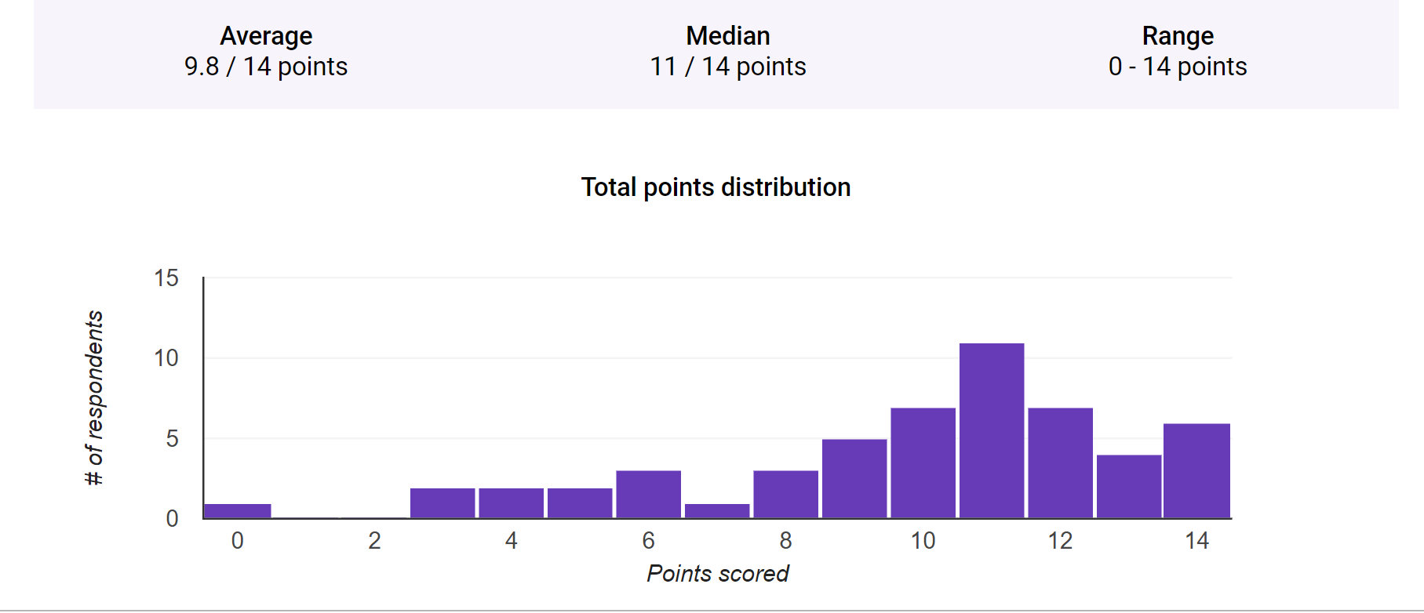




Announcements
322 Review Exam (54 submissions)
Discussions on Piazza (84%) - Signup Link:
piazza.com/ubc.ca/winterterm12019/cpsc422101
Office Hours have been posted
Giuseppe Carenini ICICS (CICSR) 105 Wed 1-2
Grigorii Guz ICCS X 237, Th 2-3 (already starting this week!)
Daniele Reda ICCS X 237, Tu 4-5
Matthew Wilson ICCS X 237, Mon 5-6 (right after class)
What to do with readings? In a few lectures we will discuss the first research paper. Instructions on what to do are available on the course webpage.
Notes:
Thursday, 2:00pm to 3:00pm | Grigorii | Room ICCSX237
Monday, 5:00pm to 6:00pm | Matthew Wilson | Room ICCSX237
Tuesday, 4:00pm to 5:00pm | Daniele Reda | Room ICCSX237
I am especially interested in applications of artificial intelligence that support human-driven decision making, either by automatically generating and evaluating potential solutions, or providing betters tools for humans to evaluate solutions themselves. I am also curious about the potential for machine learning to contribute to human decision making instead of its traditional application to computer decision making, such as in game playing.
Driver-less cars
Finding ways to solve NP-Complete problems
none
Game theory.
Not sure about what things can be applied from this course.
-
Video games development is my area of specialty, so I'm very interested in applications in that field!
Computer Graphics, Computer Vision
Object identification in images
To be honest I am interested in ANY application examples. It doesn't matter what the topic is, as long as it's kind of cool/interesting (such as humorous situations or perhaps software failure examples that caused issues for the creators.) Also, pictures or videos will make it feel more engaging. Pure text isn't quite as effective.
A.I. and Quantum Computing.
I would be very interested in doing a fintech applicable ai such as your last example of online commerce and trading, or the natural language processing.
AI in computer vision for pattern recognition in self-driving cars.
scenarios where there's multiple agents - ie: security (computer or physical) intelligent agents for moderating online communities/discussions
Psychiatric Support, learning/socializing systems targeted for those with Autism Spectrum Disorder or other behavioral/developmental problems.
Music performance
Voice/image recognition, applications to human kinetics
None
N/A
Motion Tracking
-
Neural networks and deep learning

Slide 3


Just and example of popularity of these R&R methods: In 2016 I was program co-chair of the SigDial Conference
Four papers using
(PO)MDP & Reinforcement Learning!
Four papers in 2017 as well……

Slide 4
Lecture Overview
Markov Decision Processes
Some ideas and notation
Finding the Optimal Policy
  Value Iteration
From Values to the Policy
Rewards and Optimal Policy

Slide 5
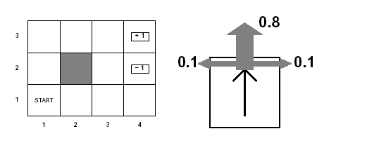
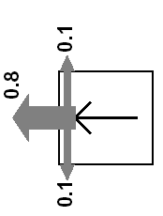
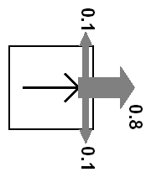
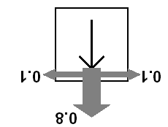
Example MDP: Scenario and Actions
Agent moves in the above grid via actions Up, Down, Left, Right
Each action has:
  0.8 probability to reach its intended effect
  0.1 probability to move at right angles of the intended direction
  If the agents bumps into a wall, it says there
Eleven states
Two terminal states (4,3) and (4,2)

Slide 6
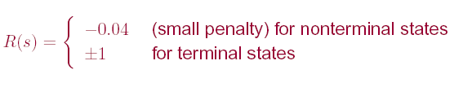
Example MDP: Rewards
Notes:
Example of Stochastic Shortest-PathMDP
Where (3,4) is the goal state? (see MDP book Chp2)

Slide 7
MDPs: Policy
The robot needs to know what to do as the decision process unfolds…
It starts in a state, selects an action, ends up in another state selects another action….
Needs to make the same decision over and over: Given the current state what should I do?
So a policy for an MDP is a single decision function π(s) that specifies what the agent should do for each state s
Notes:
So what is the best sequence of actions for our Robot?
There is no best sequence of actions!
Minimizes cost
(you do not know how the world will be when you’ll need to make the decision)

Slide 8
Sketch of ideas to find the optimal policy for a MDP (Value Iteration)
We first need a couple of definitions
  V ^{п}(s): the expected value of following policy π in state s
  Q ^{п}(s, a), where a is an action: expected value of performing a in s, and then following policy π.
We have, by definition
  Q ^{п}(s, a)=
reward obtained in s
states reachable
from s by doing a
Probability of getting to s’ from s via a
expected value of following policy π in s’
Discount factor

Slide 9
Value of a policy and Optimal policy
We can also compute V ^{п}(s) in terms of Q ^{п}(s, a)
action indicated by π in s
Expected value of following π in s
Expected value of performing the action indicated by π in s and following π after that
For the optimal policy π * we also have
Notes:
This is true for any policy, so it is also true for the optimal one

Slide 10
Value of Optimal policy
Remember for any policy π
But the Optimal policy π* is the one that gives the action that maximizes the future reward for each state
So…

Slide 11
Value of Optimal policy
Remember for any policy π
But the Optimal policy π * is the one that gives the action that maximizes the future reward for each state
So…

Slide 12

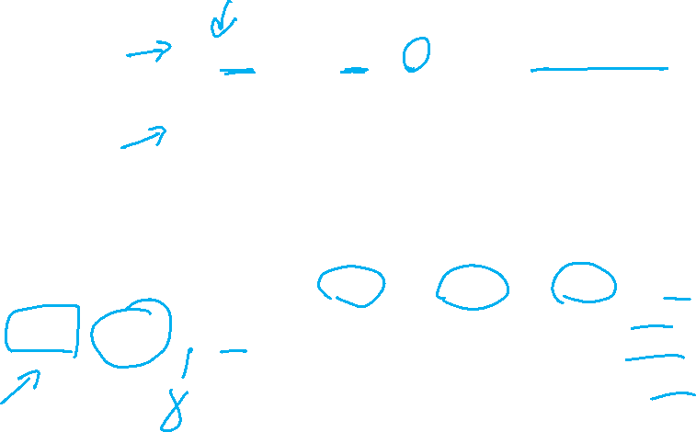

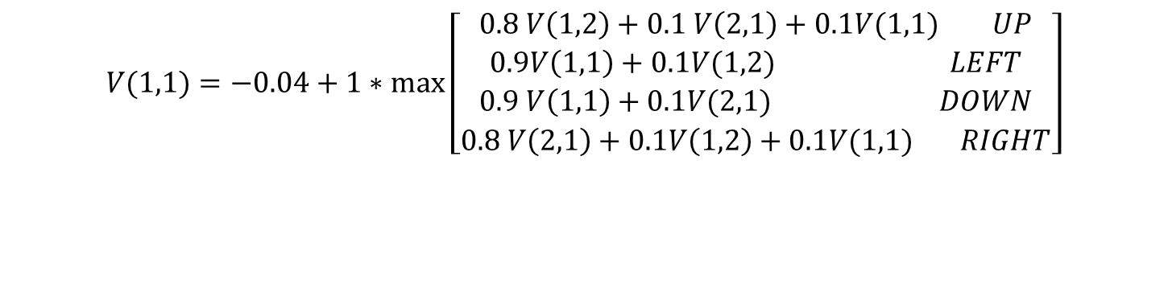

Value Iteration Rationale
Given N states, we can write an equation like the one below for each of them
Example for state (1,1)
$$V(1,1)=−0.04+1∗\max\left[\begin{aligned}0.8 V\left(1,2\right)+0.1 V\left(2,1\right)+0.1V(1,1) UP \\ 0.9V\left(1,1\right)+0.1V(1,2) LEFT \\ 0.9 V\left(1,1\right)+0.1V(2,1) DOWN \\ 0.8 V\left(2,1\right)+0.1V\left(1,2\right)+0.1V(1,1) RIGHT\end{aligned}\right]$$

Slide 13
Value Iteration Rationale
Given N states, we can write an equation like the one below for each of them
Each equation contains N unknowns – the V values for the N states
N equations in N variables (Bellman equations): It can be shown that they have a unique solution: the values for the optimal policy
Unfortunately the N equations are non-linear, because of the max operator: Cannot be easily solved by using techniques from linear algebra
Value Iteration Algorithm: Iterative approach to find the V values and the corresponding
optimal policy

Slide 14
Value Iteration in Practice
Let V^{(i)}(s) be the utility of state s at the i^{th} iteration of the algorithm
Start with arbitrary utilities on each state s: V⁽⁰⁾(s)
Repeat simultaneously for every s until there is “no change”
True “no change” in the values of V(s) from one iteration to the next are guaranteed only if run for infinitely long.
  In the limit, this process converges to a unique set of solutions for the Bellman equations
  They are the total expected rewards (utilities) for the optimal policy

Slide 15
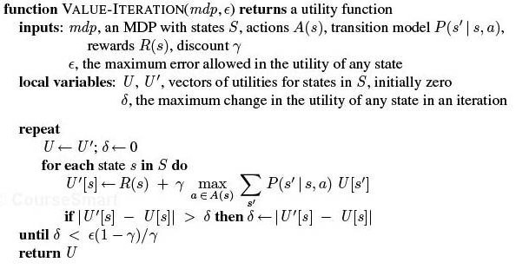
VI algorithm

Slide 16
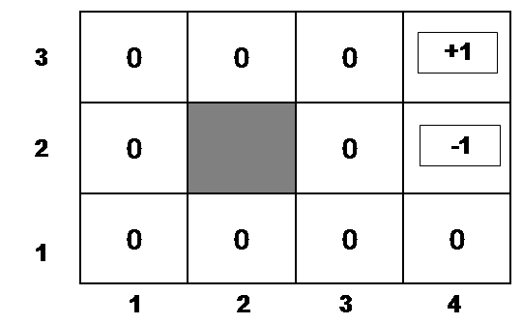
Example
Suppose, for instance, that we start with values V⁽⁰⁾(s) that are all 0
Iteration 0
Iteration 1
3
2
1
0 | 0 | 0
0 |  | 0
0 | 0 | 0 | 0
+1
-1
-0.04
1 2 3 4

Slide 17
Example (cont’d)
Let’s compute V⁽¹⁾(3,3)
Iteration 0
Iteration 1
3
2
1
0 | 0 | 0
0 |  | 0
0 | 0 | 0 | 0
0.76
+1
-1
-0.04
-0.4
1 2 3 4

Slide 18
Example (cont’d)
Let’s compute V⁽¹⁾(4,1)
Iteration 0
Iteration 1
3
2
1
0 | 0 | 0
0 |  | 0
0 | 0 | 0 | 0
.76
+1
-1
-0.04
-0.04
1 2 3 4

Slide 19
After a Full Iteration
Iteration 1
3
2
1
-.04 | -.04 | 0.76
-.04 |  | -.04
-.04 | -.04 | -.04 | -.04
+1
-1
1 2 3 4
Only the state one step away from a positive reward (3,3) has gained value, all the others are losing value
Notes:
?because of the cost of moving?
Because at best they are all one step from states with 0 value

Slide 20
Some steps in the second iteration
Iteration 1
Iteration 2
3
2
1
-.04 | -.04 | 0.76
-.04 |  | -.04
-.04 | -.04 | -.04 | -.04
3
2
1
-.04 | -.04 | 0.76
-.04 |  | -.04
-.04 | -.04 | -.04 | -.04
+1
+1
-1
-1
-0.08
1 2 3 4
1 2 3 4

Slide 21
Example (cont’d)
Let’s compute V⁽²⁾(2,3)
Steps two moves away from positive rewards start increasing their value
Iteration 2
Iteration 1
-.04 | -.04 | 0.76
-.04 |  | -.04
-.04 | -.04 | -.04 | -.04
0.56
+1
3
2
1
-.04 | -.04 | 0.76
-.04 |  | -.04
-.04 | -.04 | -.04 | -.04
+1
-1
-1
-0.08
1 2 3 4
1 2 3 4

Slide 22
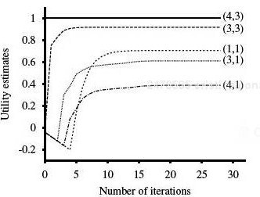
State Utilities as Function of Iteration #
 |  | (3,3) | (4,3)
 |  |  | (4,2)
(1,1) |  | (3,1) | (4,1)
Note that values of states at different distances from (4,3) accumulate negative rewards until a path to (4,3) is found

Slide 23

Value Iteration: Computational Complexity
Value iteration works by producing successive approximations of the optimal value function.
What is the complexity of each iteration?
…or faster if there is sparsity in the transition function.
A. O(|A|²|S|)
B. O(|A||S|²)
C. O(|A|²|S|²)
Notes:
Computational Complexity
Value iteration works by producing successive approximations of the optimal value function. Each iteration can be performed in O(|A||S|²) steps, or faster if there is sparsity in the transition function. However, the number of iterations required can grow exponentially in the discount factor [27]; as the discount factor approaches 1, the decisions must be based on results that happen farther and farther into the future. In practice, policy iteration converges in fewer iterations than value iteration, although the per-iteration costs of O(|A||S|² ⁺ |S|³ ) can be prohibitive. There is no known tight worst-case bound available for policy iteration [66]. Modified policy iteration [91] seeks a trade-off between cheap and effective iterations and is preferred by some practictioners [96].

Slide 24
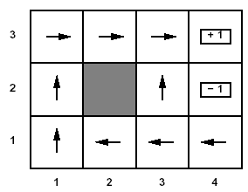
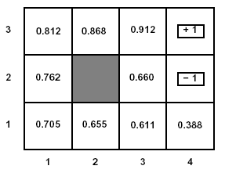
U(s) and R(s)
Note that U(s) and R(s) are quite different quantities
  R(s) is the short term reward related to s
  U(s) is the expected long term total reward from s onward if following л*
Example: U(s) for the optimal policy we found for the grid problem with R(s non-terminal) = -0.04 and γ =1

Slide 25

Relevance to state of the art MDPs
FROM : Planning with Markov Decision Processes: An AI Perspective Mausam (UW), Andrey Kolobov (MSResearch) Synthesis Lectures on Artificial Intelligence and Machine Learning Jun 2012
Free online through UBC
“ Value Iteration (VI) forms the basis of most of the advanced MDP algorithms that we discuss in the rest of the book. ……..”

Slide 26
Lecture Overview
Markov Decision Processes
……
Finding the Optimal Policy
  Value Iteration
From Values to the Policy
Rewards and Optimal Policy

Slide 27
Value Iteration: from state values V to л*
Now the agent can chose the action that implements the MEU principle: maximize the expected utility of the subsequent state

Slide 28
Value Iteration: from state values V to л*
Now the agent can chose the action that implements the MEU principle: maximize the expected utility of the subsequent state
expected value of following policy л* in s’
states reachable
from s by doing a
Probability of getting to s’ from s via a

Slide 29
Example: from state values V to л*
To find the best action in (1,1)

Slide 30
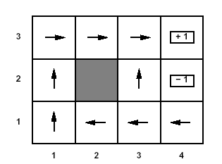
Optimal policy
This is the policy that we obtain….

Slide 31
Learning Goals for today’s class
You can:
Define/read/write/trace/debug the Value Iteration (VI) algorithm. Compute its complexity.
Compute the Optimal Policy given the output of VI
Explain influence of rewards on optimal policy

Slide 32
TODO for Mon
Read Textbook 9.5.6 Partially Observable MDPs
Also Do Practice Ex. 9.C
http://www.aispace.org/exercises.shtml

