Slide 1
Intelligent Systems (AI-2)
Computer Science cpsc422, Lecture 29
Nov, 18, 2019
Slide source: from Pedro Domingos UW
Notes:
Lecture 29

Slide 2
StarAI (statistical relational AI)
Hybrid: Det +Sto
422 big picture
Prob CFG
Prob Relational Models
Markov Logics
Deterministic
Stochastic
Belief Nets
Logics
Approx. : Gibbs
First Order Logics
Markov Chains and HMMs
Ontologies
Forward, Viterbi….
Approx. : Particle Filtering
Query
Full Resolution
SAT
Undirected Graphical Models
Markov Networks
Conditional Random Fields
Markov Decision Processes and
Partially Observable MDP
Planning
Value Iteration
Approx. Inference
Reinforcement Learning
Representation
Applications of AI
Reasoning
Technique
Notes:
Breadth and Depth

Slide 3
Lecture Overview
Statistical Relational (Star-AI) Models (for us aka Hybrid)
Recap Markov Networks and log-linear models
Markov Logic

Slide 4
Statistical Relational Models
Goals:
Combine (subsets of) logic and probability into a single language (R&R system)
Develop efficient inference algorithms
Develop efficient learning algorithms
Apply to real-world problems
L. Getoor & B. Taskar (eds.), Introduction to Statistical
Relational Learning, MIT Press, 2007.

Slide 5
Plethora of Approaches
Knowledge-based model construction [Wellman et al., 1992]
Stochastic logic programs [Muggleton, 1996]
Probabilistic relational models [Friedman et al., 1999]
Relational Markov networks [Taskar et al., 2002]
Bayesian logic [Milch et al., 2005]
Markov logic [Richardson & Domingos, 2006]
And many others….!

Slide 6
Prob. Rel. Models vs. Markov Logic

Slide 7
Lecture Overview
Statistical Relational Models (for us aka Hybrid)
Recap Markov Networks and log-linear models
Markov Logic
Markov Logic Network (MLN)

Slide 8
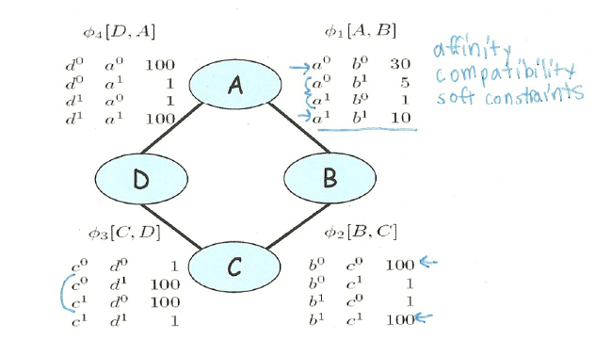
Parameterization of Markov Networks
X
X
Factors define the local interactions (like CPTs in Bnets)
What about the global model? What do you do with Bnets?
Notes:
Not conditional probabilities – capture the affinities between related variables
Also called clique potentials or just potentials
D and A and BC tend to agree. DC tend to disagree
Table values are typically nonnegative
Table values have no other restrictions
Not necessarily probabilities
Not necessarily < 1

Slide 9
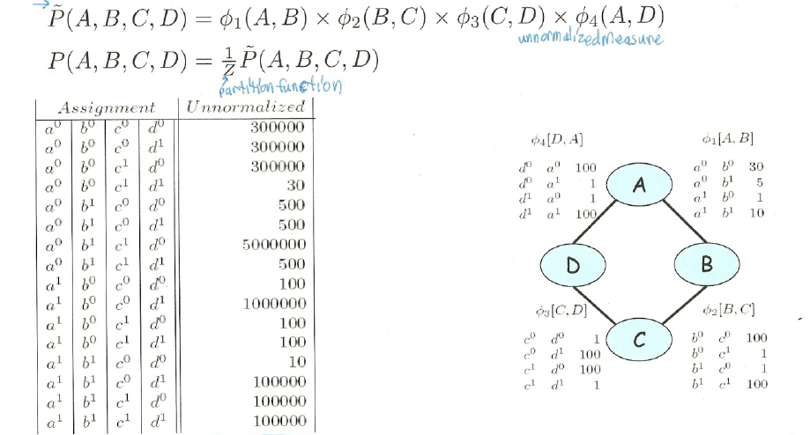
How do we combine local models?
As in BNets by multiplying them!
Notes:
This is the joint distribution from which I can compute any

Slide 10
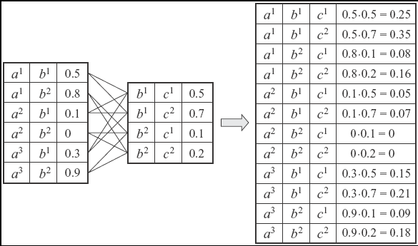
Multiplying Factors (same seen in 322 for VarElim)
Notes:
Deliberately chosen factors that do not correspond to prob or to conditional prob. To emphasize the generality of this operation
You have seen this in VarElimination

Slide 11
Markov Networks
Undirected graphical models
Smoking
Cancer
Asthma
Cough
Factors/Potential-functions defined over cliques
Smoking | Cancer | Ф(S,C)
F | F | 4.5
F | T | 4.5
T | F | 2.7
T | T | 4.5

Slide 12
Markov Networks :log-linear model
Smoking
Cancer
Log-linear model:
Asthma
Cough
Weight of Feature i
Feature i
Notes:
Markov networks are often conveniently represented as log-linear models, with each clique potential replaced by an exponentiated
weighted sum of features of the state

Slide 13
Lecture Overview
Statistical Relational Models (for us aka Hybrid)
Recap Markov Networks
Markov Logic

Slide 14
Markov Logic: Intuition(1)
A logical KB is a set of hard constraints on the set of possible worlds
Notes:
Possible / Impossible / Cannot Tell

Slide 15
Markov Logic: Intuition(1)
A logical KB is a set of hard constraints on the set of possible worlds
Let’s make them soft constraints: When a world violates a formula, the world becomes less probable, not impossible
Notes:
Possible / Impossible / Cannot Tell

Slide 16
Markov Logic: Intuition (2)
The more formulas in the KB a possible world satisfies the more it should be likely
Give each formula a weight
Adopting a log-linear model, by design, if a possible world satisfies a formula its probability should go up proportionally to exp(the formula weight).
That is, if a possible world satisfies a formula its log probability should go up proportionally to the formula weight.
Notes:
The fewer formulas a world violates the more probable it is
The higher the weight the greater is the difference in log prob between a world that satisfies the formula and one
That does not, other things being equal

Slide 17
Markov Logic: Definition
A Markov Logic Network (MLN) is
a set of pairs (F, w) where
F is a formula in first-order logic
w is a real number
Together with a set C of constants,
It defines a Markov network with
One binary node for each grounding of each predicate in the MLN
One feature/factor for each grounding of each formula F in the MLN, with the corresponding weight w
Grounding: substituting vars with constants
Notes:
Without loss of generality we can assume that all weights are non-negative (a formula with a negative weight w can be replaced with its negation (the negation of that formula) with weight –w)

Slide 18
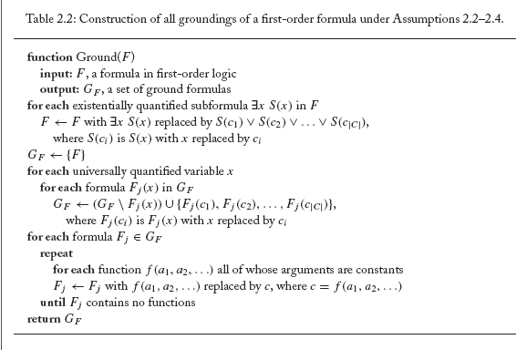
(not required)consider Existential and functions

Slide 19
Example: Friends & Smokers

Slide 20
Example: Friends & Smokers

Slide 21
Example: Friends & Smokers

Slide 22
Example: Friends & Smokers
Two constants: Anna (A) and Bob (B)

Slide 23
MLN nodes
Two constants: Anna (A) and Bob (B)
One binary node for each grounding of each predicate in the MLN
Grounding: substituting vars with constants
Smokes(A)
Smokes(B)
Cancer(A)
Cancer(B)
Any nodes missing?
Notes:
Anyone missing?

Slide 24
MLN nodes (complete)
Two constants: Anna (A) and Bob (B)
One binary node for each grounding of each predicate in the MLN
Friends(A,B)
Friends(A,A)
Smokes(A)
Smokes(B)
Friends(B,B)
Cancer(A)
Cancer(B)
Friends(B,A)

Slide 25
MLN features
Two constants: Anna (A) and Bob (B)
Edge between two nodes iff the corresponding ground predicates appear together in at least one grounding of one formula
Friends(A,B)
Grounding: substituting vars with constants
Friends(A,A)
Smokes(A)
Smokes(B)
Friends(B,B)
Cancer(A)
Cancer(B)
Friends(B,A)
Which edge should not be there?
Notes:
there is an edge between two nodes of ML,C iff the corresponding ground predicates appear together in at least one grounding
of one formula in L.

Slide 26
MLN features
Two constants: Anna (A) and Bob (B)
Edge between two nodes iff the corresponding ground predicates appear together in at least one grounding of one formula
Friends(A,B)
Friends(A,A)
Smokes(A)
Smokes(B)
Friends(B,B)
Cancer(A)
Cancer(B)
Friends(B,A)
Notes:
there is an edge between two nodes of ML,C iff the corresponding ground predicates appear together in at least one grounding
of one formula in L.

Slide 27
MLN features
Two constants: Anna (A) and Bob (B)
Friends(A,B)
Friends(A,A)
Smokes(A)
Smokes(B)
Friends(B,B)
Cancer(A)
Cancer(B)
Friends(B,A)
One feature/factor for each grounding of each formula F in the MLN

Slide 28
MLN: parameters
For each formula i we have a factor

Slide 29
MLN: prob. of possible world
Two constants: Anna (A) and Bob (B)
Friends(A,B)
Friends(A,A)
Smokes(A)
Smokes(B)
Friends(B,B)
Cancer(A)
Cancer(B)
Friends(B,A)

Slide 30
MLN: prob. of possible world
Two constants: Anna (A) and Bob (B)
Friends(A,B)
Friends(A,A)
Smokes(A)
Smokes(B)
Friends(B,B)
Cancer(A)
Cancer(B)
Friends(B,A)

Slide 31
MLN: prob. Of possible world
Probability of a world pw:
Weight of formula i
No. of true groundings of formula i in pw
Friends(A,B)
Friends(A,A)
Smokes(A)
Smokes(B)
Friends(B,B)
Cancer(A)
Cancer(B)
Friends(B,A)
Notes:
Typed variables and constants greatly reduce size of ground Markov net (only people can be friends, not houses)
Can deal effectively with: Functions, existential quantifiers, etc. AND Infinite and continuous domains
MLN is template for ground Markov nets

Slide 32
Learning Goals for today’s class
You can:
Describe the intuitions behind the design of a Markov Logic
Define and Build a Markov Logic Network
Justify and apply the formula for computing the probability of a possible world

Slide 33
Next class on Wed
Markov Logic
-relation to FOL
- Inference (MAP and Cond. Prob)
Assignment-4 will be posted this evening, due on Nov 29

Slide 34
Relation to First-Order Logic
Example pag 17
Infinite weights ⇒ First-order logic
Satisfiable KB, positive weights ⇒ Satisfying assignments = Modes of distribution
Markov logic allows contradictions between formulas

Slide 35
Relation to Statistical Models
Special cases:
Markov networks
Markov random fields
Bayesian networks
Log-linear models
Exponential models
Max. entropy models
Gibbs distributions
Boltzmann machines
Logistic regression
Hidden Markov models
Conditional random fields
Obtained by making all predicates zero-arity
Markov logic allows objects to be interdependent (non-i.i.d.)

Slide 36
MAP Inference
Problem: Find most likely state of world given evidence
Query
Evidence

Slide 37
MAP Inference
Problem: Find most likely state of world given evidence

Slide 38
MAP Inference
Problem: Find most likely state of world given evidence

Slide 39
MAP Inference
Problem: Find most likely state of world given evidence
This is just the weighted MaxSAT problem
Use weighted SAT solver (e.g., MaxWalkSAT [Kautz et al., 1997]

Slide 40
The MaxWalkSAT Algorithm
for i ← 1 to max-tries do
solution = random truth assignment
for j ← 1 to max-flips do
if ∑ weights(sat. clauses) > threshold then
return solution
c ← random unsatisfied clause
with probability p
flip a random variable in c
else
flip variable in c that maximizes
∑ weights(sat. clauses)
return failure, best solution found

Slide 41
Computing Probabilities
P(Formula|MLN,C) = ?
Brute force: Sum probs. of worlds where formula holds
MCMC: Sample worlds, check formula holds
P(Formula1|Formula2,MLN,C) = ?
Discard worlds where Formula 2 does not hold
In practice: More efficient alternatives

Slide 42
Directed Models vs.
Undirected Models
Parent
Friend 1
Child
Friend 2
P(Child|Parent)
φ(Friend1,Friend2)

Slide 43
Undirected Probabilistic Logic Models
Upgrade undirected propositional models to relational setting
Markov Nets → Markov Logic Networks
Markov Random Fields → Relational Markov Nets
Conditional Random Fields → Relational CRFs

Slide 44
Markov Logic Networks (Richardson & Domingos)
Soften logical clauses
A first-order clause is a hard constraint on the world
Soften the constraints so that when a constraint is violated, the world is less probably, not impossible
Higher weight ⇒ Stronger constraint
Weight of ⇒ first-order logic
Probability( World S ) = ( 1 / Z ) × exp { Σ weight _{i} x numberTimesTrue(f _{i}, S) }

Slide 45
Example: Friends & Smokers
Two constants: Anna (A) and Bob (B)
Friends(A,B)
Friends(A,A)
Smokes(A)
Smokes(B)
Friends(B,B)
Cancer(A)
Cancer(B)
Friends(B,A)

Slide 46
Alphabetic Soup => Endless Possibilities
Probabilistic Relational Models (PRM)
Bayesian Logic Programs (BLP)
PRISM
Stochastic Logic Programs (SLP)
Independent Choice Logic (ICL)
Markov Logic Networks (MLN)
Relational Markov Nets (RMN)
CLP-BN
Relational Bayes Nets (RBN)
Probabilistic Logic Progam (PLP)
ProbLog
….
Web data (web)
Biological data (bio)
Social Network Analysis (soc)
Bibliographic data (cite)
Epidimiological data (epi)
Communication data (comm)
Customer networks (cust)
Collaborative filtering problems (cf)
Trust networks (trust)
…
Fall 2003– Dietterich @ OSU, Spring 2004 –Page @ UW, Spring 2007-Neville @ Purdue, Fall 2008 – Pedro @ CMU

Slide 47
Recent Advances in SRL Inference
Preprocessing for Inference
FROG – Shavlik & Natarajan (2009)
Lifted Exact Inference
Lifted Variable Elimination – Poole (2003), Braz et al(2005) Milch et al (2008)
Lifted VE + Aggregation – Kisynski & Poole (2009)
Sampling Methods
MCMC techniques – Milch & Russell (2006)
Logical Particle Filter – Natarajan et al (2008), ZettleMoyer et al (2007)
Lazy Inference – Poon et al (2008)
Approximate Methods
Lifted First-Order Belief Propagation – Singla & Domingos (2008)
Counting Belief Propagation – Kersting et al (2009)
MAP Inference – Riedel (2008)
Bounds Propagation
Anytime Belief Propagation – Braz et al (2009)

Slide 48
Conclusion
Inference is the key issue in several SRL formalisms
FROG - Keeps the count of unsatisfied groundings
Order of Magnitude reduction in number of groundings
Compares favorably to Alchemy in different domains
Counting BP - BP + grouping nodes sending and receiving identical messages
Conceptually easy, scaleable BP algorithm
Applications to challenging AI tasks
Anytime BP – Incremental Shattering + Box Propagation
Only the most necessary fraction of model considered and shattered
Status – Implementation and evaluation

