Slide 1
Intelligent Systems (AI-2)
Computer Science cpsc422, Lecture 18
Oct, 16, 2019
Slide Sources
Raymond J. Mooney University of Texas at Austin
D. Koller, Stanford CS - Probabilistic Graphical Models

Slide 2
Lecture Overview
Probabilistic Graphical models
Recap Markov Networks
Recap one application
Inference in Markov Networks (Exact and Approx.)
Conditional Random Fields

Slide 3
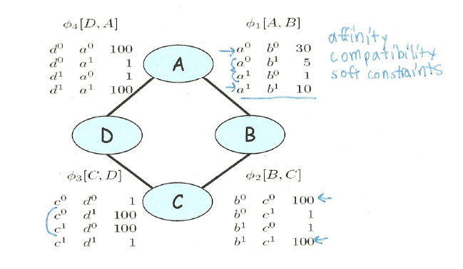
Parameterization of Markov Networks
X
X
Factors define the local interactions (like CPTs in Bnets)
What about the global model? What do you do with Bnets?
Notes:
Not conditional probabilities – capture the affinities between related variables
Also called clique potentials or just potentials
D and A and BC tend to agree. DC tend to disagree
Table values are typically nonnegative
Table values have no other restrictions
Not necessarily probabilities
Not necessarily < 1

Slide 4
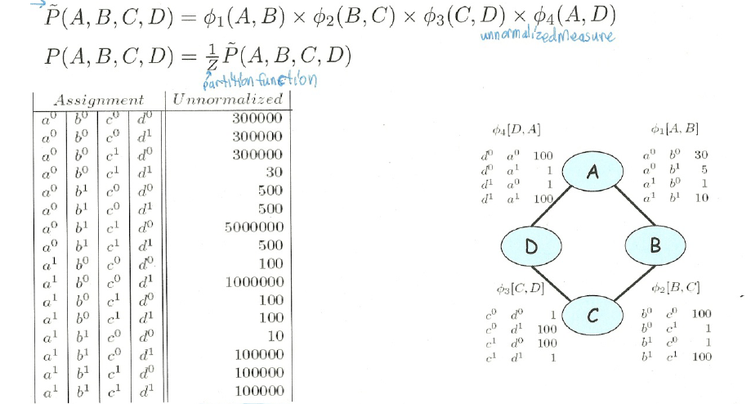
How do we combine local models?
As in BNets by multiplying them!
Notes:
This is the joint distribution from which I can compute any

Slide 5
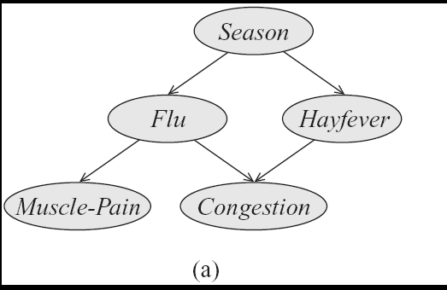
Step Back…. From structure to factors/potentials
In a Bnet the joint is factorized….
In a Markov Network you have one factor for each maximal clique
Notes:
a clique in an undirected graph is a subset of its vertices such that every two vertices in the subset are connected by an edge.

Slide 6
General definitions
Two nodes in a Markov network are independent if and only if every path between them is cut off by evidence
eg for A C
So the markov blanket of a node is…?
eg for C

Slide 7
Lecture Overview
Probabilistic Graphical models
Recap Markov Networks
Applications of Markov Networks
Inference in Markov Networks (Exact and Approx.)
Conditional Random Fields

Slide 8
Markov Networks Applications (1): Computer Vision
Called Markov Random Fields
Stereo Reconstruction
Image Segmentation
Object recognition
Typically pairwise MRF
Each vars correspond to a pixel (or superpixel )
Edges (factors) correspond to interactions between adjacent pixels in the image
  E.g., in segmentation: from generically penalize discontinuities, to road under car
Notes:
Features are extracted from the image for each pixel or superpixel
… include stats over color, texture and location
The features used in the model are then soft-cluster assignments or local classifier outputs for each superpixel
See pag 113

Slide 9
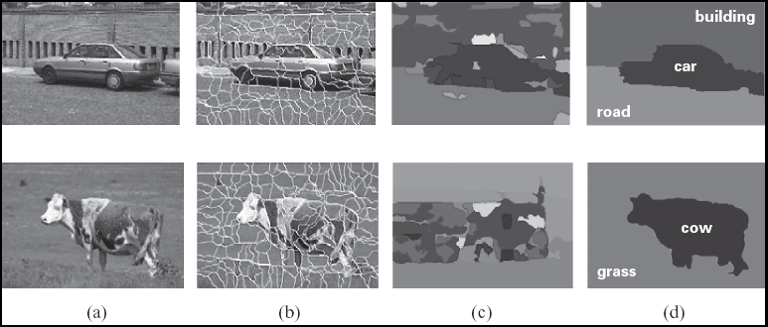
Image segmentation

Slide 10
Image segmentation
See related slides in
Previous lecture

Slide 11
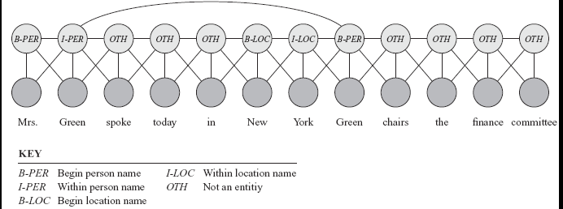
Markov Networks Applications (2): Sequence Labeling in NLP and BioInformatics
Conditional random fields
Notes:
A skip chain CRF for named entity recognition, with connection between adjacent words and long rang connection between multiple occurrences of the same word

Slide 12
Lecture Overview
Probabilistic Graphical models
Recap Markov Networks
Applications of Markov Networks
Inference in Markov Networks (Exact and Approx.)
Conditional Random Fields

Slide 13
Variable elimination algorithm for Bnets
Given a network for P(Z, Y₁,… ,Y_{j} Z₁,… ,Z_{i}), :
To compute P(Z| Y₁=v₁ ,… ,Y_{j}=v_{j} ) :
Construct a factor for each conditional probability.
Set the observed variables to their observed values.
Given an elimination ordering, simplify/decompose sum of products
Perform products and sum out Z_{i}
Multiply the remaining factors Z
Normalize: divide the resulting factor f(Z) by ∑_{Z} f(Z) .
Variable elimination algorithm for Markov Networks…..
Notes:
They are all going to be only in Q

Slide 14
Variable Elimination on MN: Example
Notes:
Not conditional probabilities – capture the affinities between related variables
Also called clique potentials or just potentials
D and A and BC tend to agree. DC tend to disagree
Table values are typically nonnegative
Table values have no other restrictions
Not necessarily probabilities
Not necessarily < 1

Slide 15

Gibbs sampling for Markov Networks
Example: P(D | C=0)
Resample non-evidence variables in a pre-defined order or a random order
Suppose we begin with A
  Note: never change evidence!
What do we need to sample?
  A. P(A | B=0)
  B. P(A | B=0, C=0)
  C. P( B=0, C=0| A)
A | B | C | D | E | F
1 | 0 | 0 | 1 | 1 | 0
  Initial assigmnet
Notes:
B and C are Markov blanket of A
Calculate P(A | B,C)
Use current Gibbs sampling value for B & C

Slide 16
Gibbs sampling MN: what to sample
For Bnets
For Markov Networks just the product of the factors (normalized)
Resample probability distribution of P(A|BC)
B=0 ; C=0
 | A=1 | A=0
C=1 | 1 | 2
C=0 | 3 | 4
 | A=1 | A=0
B=1 | 1 | 5
B=0 | 4.3 | 0.2
A | B | C | D | E | F
1 | 0 | 0 | 1 | 1 | 0
? | 0 | 0 | 1 | 1 | 0
A=1 | A=0
12.9 | 0.8
Normalized result =
A=1 | A=0
0.95 | 0.05

Slide 17
Example: Gibbs sampling
Resample probability distribution of B given A D
 | A=1 | A=0
B=1 | 1 | 5
B=0 | 4.3 | 0.2
A | B | C | D | E | F
1 | 0 | 0 | 1 | 1 | 0
1 | 0 | 0 | 1 | 1 | 0
1 | ? | 0 | 1 | 1 | 0
 | D=1 | D=0
B=1 | 1 | 2
B=0 | 2 | 1
B=1 | B=0
1 | ??
Normalized result =
B=1 | B=0
0.11 | 0.89
  A. 10
  B. 0.4
  C. 8.6

Slide 18
Lecture Overview
Probabilistic Graphical models
Recap Markov Networks
Applications of Markov Networks
Inference in Markov Networks (Exact and Approx.)
Conditional Random Fields

Slide 19
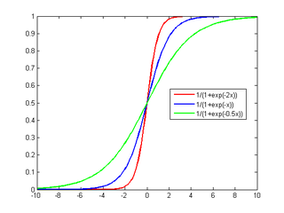
We want to model P(Y₁| X₁.. X_{n})
… where all the X_{i} are always observed
MN
BN
Y₁
Y₁
…
…
X₁
X₂
X_{n}
X₁
X₂
X_{n}
Which model is simpler, MN or BN?
Naturally aggregates the influence of different parents
Notes:
Number of param w_{i} is linear instead of exponential in the number of parents
Natural model for many real-world applications
Naturally aggregates the influence of different parents

Slide 20
  Conditional Random Fields (CRFs)
Model P(Y₁ .. Y_{k} | X₁.. X_{n})
Special case of Markov Networks where all the X_{i} are always observed
  Simple case P(Y₁| X₁…X_{n})
Notes:
To have the network structure and parametrization correspond naturally to a conditional distribution, we want to avoid representing a probabilistic model over X. We therefore disallow potentials that involve only variables in X
IT WOULD PROBABLY HAVE BEEN BETTER TO USE T and F as the two values

Slide 21















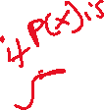








Some notation
exp and indicator function
Notes:
Prime 2 3 5 set of 3 elements
Even 2 4 set of 2 elemts

Slide 22
What are the Parameters?

Slide 23
Let’s derive the probabilities we need
Y₁
…
X₁
X₂
X_{n}

Slide 24
Let’s derive the probabilities we need
Y₁
…
X₁
X₂
X_{n}

Slide 25
Let’s derive the probabilities we need
Y₁
…
X₁
X₂
X_{n}
0

Slide 26
Let’s derive the probabilities we need
Y₁
…
X₁
X₂
X_{n}

Slide 27
Let’s derive the probabilities we need
Y₁
…
X₁
X₂
X_{n}

Slide 28
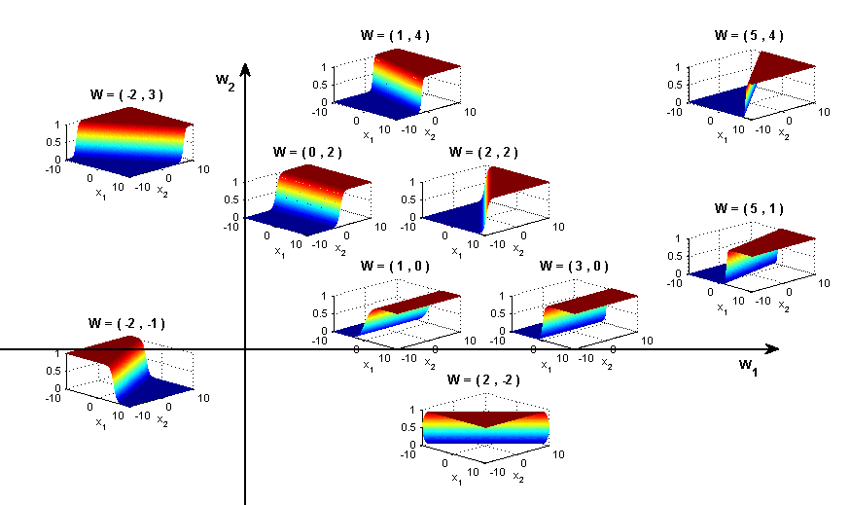
Sigmoid Function used in Logistic Regression
Y₁
Y₁
Great practical interest
Number of param w_{i} is linear instead of exponential in the number of parents
Natural model for many real-world applications
Naturally aggregates the influence of different parents
…
…
X₁
X₂
X_{n}
X₁
X₂
X_{n}

Slide 29
Logistic Regression as a Markov Net (CRF)
Logistic regression is a simple Markov Net (a CRF) aka naïve markov model
Y
…
X₁
X₂
X_{n}
But only models the conditional distribution, P(Y | X ) and not the full joint P(X,Y )

Slide 30
Learning Goals for today’s class
You can:
Perform Exact and Approx. Inference in Markov Networks
Describe a few applications of Markov Networks
Describe a natural parameterization for a Naïve Markov model (which is a simple CRF)
Derive how P(Y|X) can be computed for a Naïve Markov model
Explain the discriminative vs. generative distinction and its implications

Slide 31
Next class Fri
Linear-chain CRFs
To Do
Revise generative temporal models (HMM)
Midterm, Fri, Oct 25,
we will start at 4pm sharp
How to prepare….
Go to Office Hours
Learning Goals (look at the end of the slides for each lecture – complete list has been posted)
Revise all the clicker questions and practice exercises
More practice material will be posted
Check questions and answers on Piazza

