Slide 1
Intelligent Systems (AI-2)
Computer Science cpsc422, Lecture 13
Oct, 2, 2019

Slide 2
Cited by 623
Using Bayesian networks to manage uncertainty in student modeling
C Conati, A Gertner, K Vanlehn - User modeling and user-adapted …, 2002 - Springer
When a tutoring system aims to provide students with interactive help, it needs to know what
knowledge the student has and what goals the student is currently trying to achieve. That is,
it must do both assessment and plan recognition. These modeling tasks involve a high level

Slide 3
Some recent citations
Integrating enhanced peer assessment features in moodle learning management system
G Badea, E Popescu, A Sterbini… - Foundations and Trends in …, 2019 - Springer
Peer assessment has increasingly proven its benefits for the learning process and several
educational platforms have been proposed to support it. Rather than developing yet another
standalone tool, in this paper we aim to integrate an existing Bayesian Network-based peer …
Cited by 1 Related articles All 3 versions
Insights into Learning Competence Through Probabilistic Graphical Models
A Saranti, B Taraghi, M Ebner, A Holzinger - International Cross-Domain …, 2019 - Springer
One-digit multiplication problems is one of the major fields in learning mathematics at the
level of primary school that has been studied over and over. However, the majority of related
work is focusing on descriptive statistics on data from multiple surveys. The goal of our …
All 3 versions
[PDF] ieee.orgUBC eLink
Multilevel Learner Modeling in Training Environments for Complex Decision Making
G Biswas, R Rajendran, N Mohammed… - IEEE Transactions …, 2019 - ieeexplore.ieee.org
Intelligent learning environments (ILEs) can be designed to support the development of
learners cognitive skills, strategies, and metacognitive processes as they work on complex
decision-making and problem-solving tasks. However, the complexity of the tasks may …
[PDF] cmu.edu
[PDF] Using Knowledge Component Modeling to Increase Domain Understanding in a Digital Learning Game
H Nguyen, Y Wang, J Stamper, BM McLaren - cs.cmu.edu
Knowledge components (KCs) define the underlying skill model of intelligent educational
software, and they are critical to understanding and improving the efficacy of learning
technology. In this research, we show how learning curve analysis is used to fit a KC model …
All 4 versions

Slide 4
Other citations 2017
IRT-based adaptive hints to scaffold learning in programming
M Ueno, Y Miyazawa - IEEE Transactions on Learning …, 2017 - ieeexplore.ieee.org
35 days ago - Over the past few decades, many studies conducted in the field of learning
science have described that scaffolding plays an important role in human learning. To
scaffold a learner efficiently, a teacher should predict how much support a learner must have
Leveraging CPTs in a Bayesian Approach to Grade Open Ended Answers
M De Marsico, A Sterbini… - … (ICALT), 2017 IEEE 17th …, 2017 - ieeexplore.ieee.org
52 days ago - Here we discuss a framework (OpenAnswer) providing support to the teacher's
activity of grading answers to open ended questions. OpenAnswer implements a teacher
mediated peer-evaluation approach: the marking results obtained from peer assessments
Classification and prediction of port variables using Bayesian Networks
BM Serrano, N González-Cancelas, F Soler-Flores… - Transport Policy, 2017 - Elsevier
58 days ago - Abstract Many variables are included in planning and management of port
terminals. They can be economic, social, environmental and institutional. Agent needs to
know relationship between these variables to modify planning conditions. Use of Bayesian
Learner Modeling for Integration Skills
Y Huang, J Guerra-Hollstein, J Barria-Pineda… - Proceedings of the 25th …, 2017 - dl.acm.org
83 days ago - Abstract Complex skill mastery requires not only acquiring individual basic
component skills, but also practicing integrating such basic skills. However, traditional
approaches to knowledge modeling, such as Bayesian knowledge tracing, only trace
Predicting Learner's Deductive Reasoning Skills Using a Bayesian Network
A Tato, R Nkambou, J Brisson, S Robert - International Conference on …, 2017 - Springer
92 days ago - Abstract Logic-Muse is an Intelligent Tutoring System (ITS) that helps improve
deductive reasoning skills in multiple contexts. All its three main components (The learner,
the tutor and the expert models) have been developed while relying on the help of experts
Exploring Learner Model Differences Between Students
M Eagle, A Corbett, J Stamper, BM McLaren… - … Conference on Artificial …, 2017 - Springer
92 days ago - Abstract Bayesian Knowledge Tracing (BKT) has been employed successfully
in intelligent learning environments to individualize curriculum sequencing and help
messages. Standard BKT employs four parameters, which are estimated separately for
All 4 versions

Slide 5
ILE: Challenges
Representing the instructional domain (expert model)
Understanding the student (student model)
Providing adequate help and instruction (tutoring model)

Slide 6
ANDES: an ITS for Coached problem solving
The tutor monitors the student’s solution and intervenes when the student needs help.
  Gives feedback on correctness of student solution entries
  Provides hints when student is stuck
N
Fw = mc*g
Think about the direction of N…

Slide 7
Student Model for Coached Problem Solving
Three main functions
  Assess from the student’s actions her domain knowledge, to decide which concepts the student needs help on (knowledge tracing)
  Infer from student’s actions the solution being followed, to understand what the student is trying to do (plan recognition)
  Predict what further actions should be suggested to the student, to provide meaningful suggestions (adaptive procedural help)

Slide 8
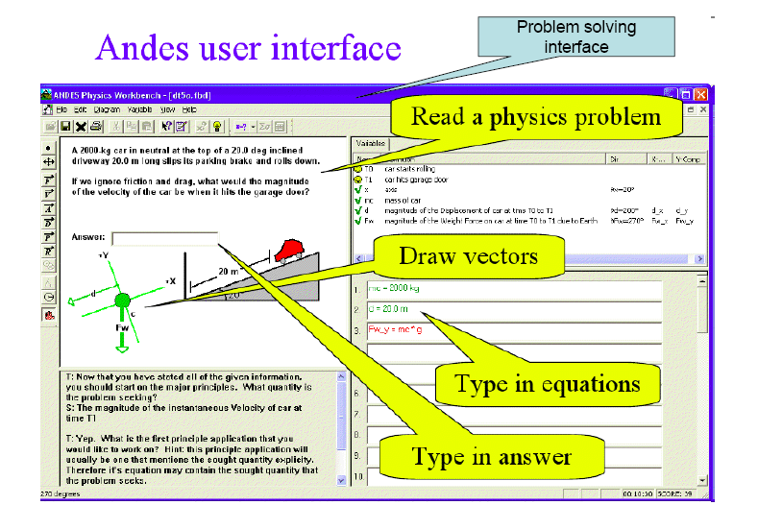

Slide 9
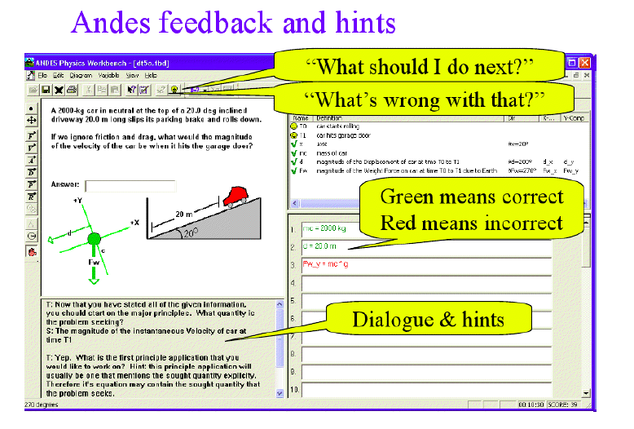

Slide 10
Several sources of uncertainty
Same action can belong to different solutions
Often much of the reasoning behind the student’s actions is hidden from the tutor
Correct answers can be achieved through guessing
Errors can be due to slips
System’s help affects learning
In many domains, there is flexible solution step order
Andes deals with this uncertainty by using Bayesian Networks

Slide 11
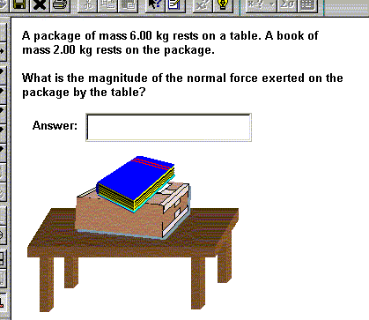
Example 1
A block of mass m = 2kg slides on a frictionless table
pulled by a force Fp = 5N.
Find the acceleration of the block
Correct solution
ΣFt = W + N + Fp = m*a
ΣFt_{x} = Fp = m*a_{x}
a = 5/2
Incorrect solution
Fp = m*a
a = 5/2
N
W
If the student only types a = 5/2 m/sec, what line of reasoning did she follow?

Slide 12
Example 2
Solution
Find the velocity by applying the kinematics equation
Vt_{x}² = V0_{x}² + 2d_{x}*a_{x}
Find the acceleration of the car by applying
Newton's 2nd law
ΣF_{x} = W_{x} + N_{x} = m*a_{x}
If the student draws the axes and then gets stuck, is she
  trying to write the kinematics equations to find V?
  trying to find the car acceleration by applying Newton’s laws

Slide 13
Architecture
Andes
Workbench
Help System
Domain
Rules
Domain General
Student
Model
Problem
Solver
Solution Graph
Assessor
Problem
Statement
Task Specific
Student Model

Slide 14
Components of Andes’ Student Model
Domain General
  Reflects the content of Andes’ rules
  Defined once along with Andes’ KB
  Maintained across problems
  Assesses the student’s domain knowledge
Task Specific
  Automatically built when a new problem is opened
  Assesses the student’s task specific knowledge and problem solving behavior

Slide 15
Domain General Bnet
Rule nodes
  represent knowledge of generic physics and planning rules
  P(R = T): probability that the student knows the rule (how to apply it in any context)
Context rule nodes
  Represent rules in specific problem solving contexts
  P(CR = T): probability that the student can use the rule in the corresponding context
..
Notes:
A rule can be more/less difficult to apply in different problems

Slide 16
Construction of the task specific BNet
problem definition
car(A)
On_incline(A, road)
Frictionless(road)
mass(A) = 2000kg
Inclined(road, 20)
……….
Goal (velocity-of A at t1)
Physics and planning rules
Problem solver
Andes long term student’s model
Network structure-> Solution Graph
Directed graph: how solution steps
derive from rules and their antecedents
Prior probabilities for all rules+
CPT parameters
Workbench
Assessor
Student’s actions
Initial BNet
Assessor
Updated BNet
Probabilities assessing
knowledge changes
And solutions pursued

Slide 17
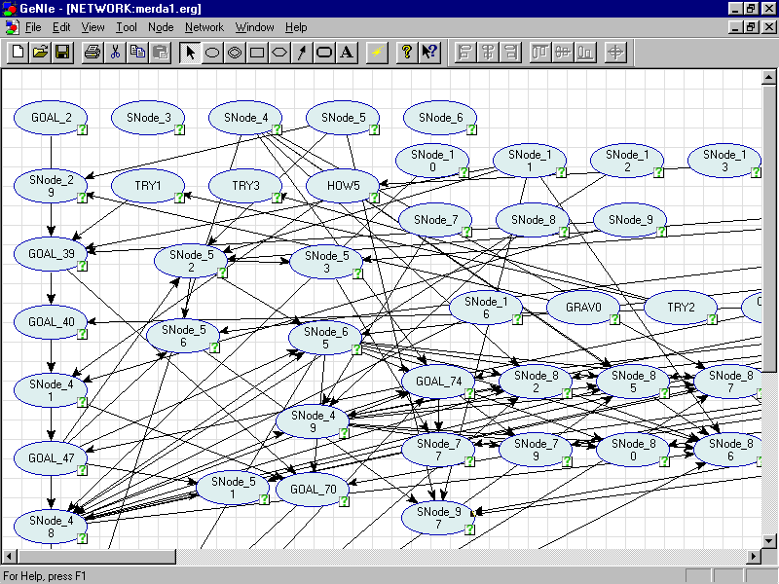
Importance of Automatic Generation

Slide 18
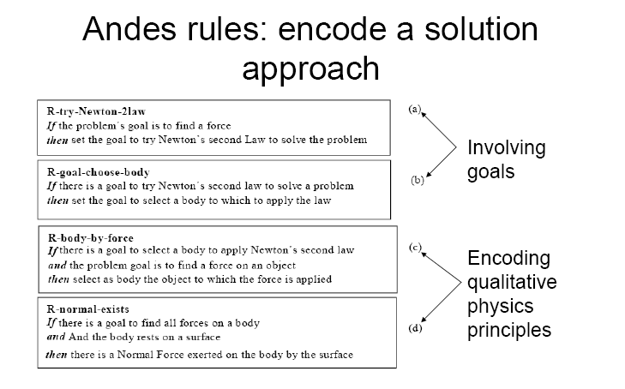
Sample rules
If the goal is to find a velocity along a direction D
Then set the goal to try the kinematics equation for velocity along D
If the goal is to try the kinematics equation for velocity along D
Then choose reference axis to find the equation components
If the goal is to try the kinematics equation for velocity along D
And the goal is to choose reference axis for the equation components
Then choose X axis with direction D
If the goal is to find all the forces on a body
And the body rests on a surface
Then there is a Normal Force exerted on the body by the surface

Slide 19
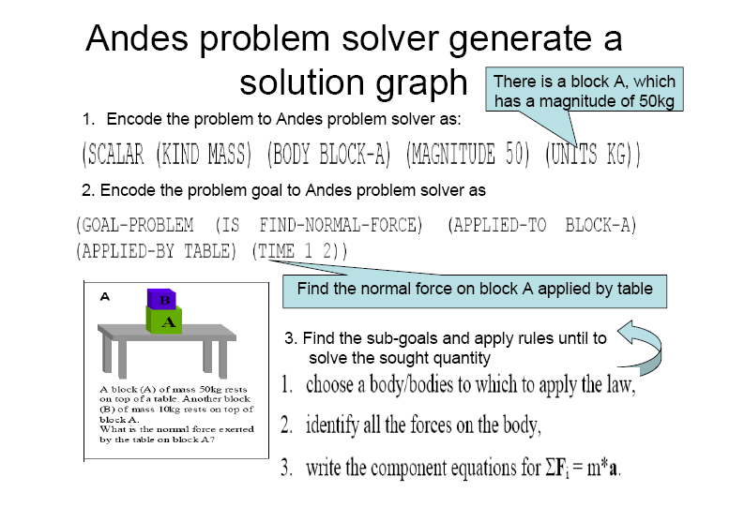
Sample rules
If the goal is to find a velocity along a direction D
Then set the goal to try the kinematics equation for velocity along D
If the goal is to try the kinematics equation for velocity along D
Then choose reference axis to find the equation components
If the goal is to try the kinematics equation for velocity along D
And the goal is to choose reference axis for the equation components
Then choose X axis with direction D
If the goal is to find all the forces on a body
And the body rests on a surface
Then there is a Normal Force exerted on the body by the surface

Slide 20
R -try-Newton-2law
G_goal_car-acceleration?
R -try-kinematics-for-velocity
G_goal_car-velocity?
0.95
0.5
0.68
0.9
R- choose-axis-for-Newton
G-try-Newton-2law
0.4
0.5
/ 0.6
G-try-kinematics
R- choose-axis-for-kinematics
0.83
0.8
/ 0.9
R-find-all-forces-on-body
0.5
R-find-kinematics quantities
0.7
G-find-axis-for-kinematics
G-find-axis-for-newton
F-N-is-normal-force-on-car
0.9
0.72
0.2
F-axis-is 20°
F-D-is-car-displacement
1.0
0.9
F-A-is-car-acceleration
R
Rule
0.5
F/G
Fact/Goal
CPTs
RA
Rule Application

Slide 21
Conditional Probabilities in the Task Specific BNet

Slide 22

Strategy Nodes
If a given goal is involved in generating two alternative solutions, evidence that a student is following one solution should decrease the probability of the other solution
This does not happen with the basic Andes’ Bnet. Actually, evidence of a solution would increase the probability of any other alternative solution that shares a goal with it
Notes:
?In 2008 this was discussed during the slides on Bnets, because they came after the lecture where we discussed andes?

Slide 23
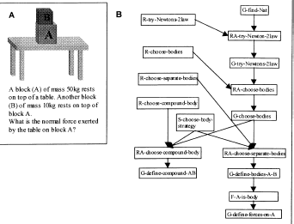
Example

Slide 24
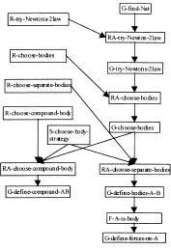
Notes:
Not shown in 2008

Slide 25
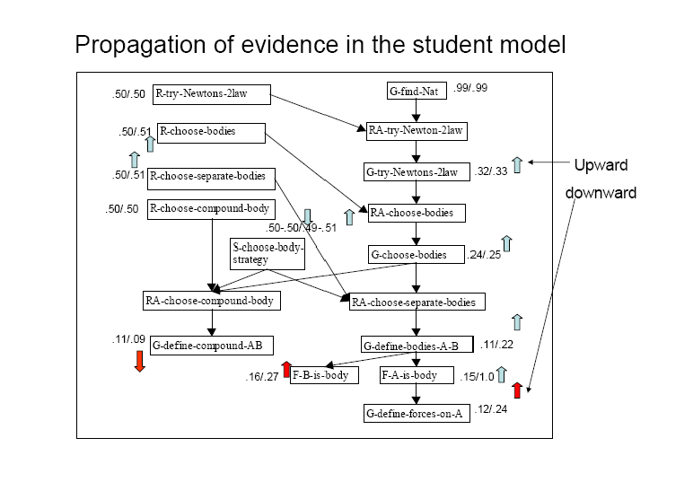

Slide 26
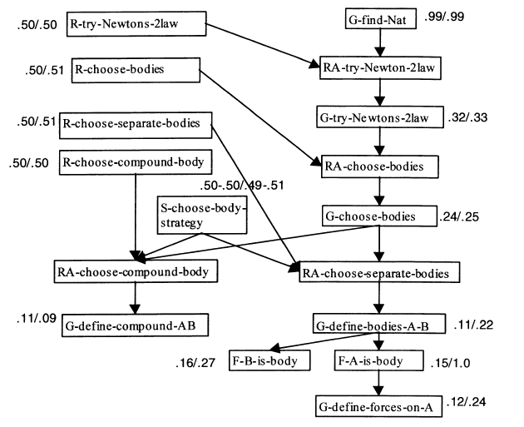
The network before and after observing F-A-is-a-body.
Notes:
The network before and after observing A-is-a-body. The first number given for each node
shows the probability of that node before observing A-is-a-body. The second number shows how the probability
changes after observing A-is-a-body.

Slide 27
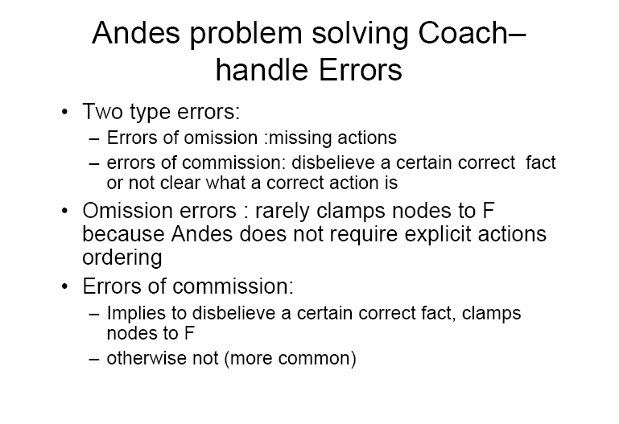

Slide 28
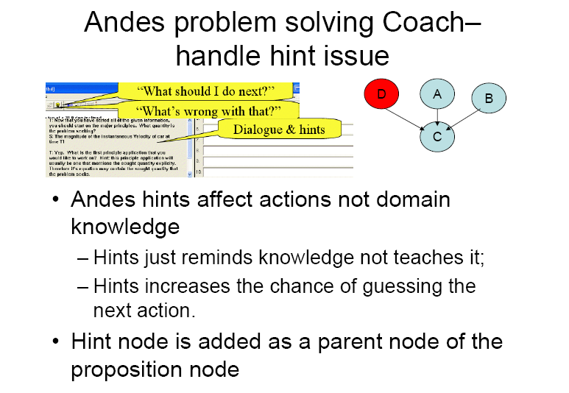
Hint
Notes:
Oura pproach implements a simple theory of hints directly in the Bayesian network.
The theory is based on two assumptions: ￠rst, hints are worded so as to remind
the student of the requisite knowledge, rather than teach it. (Teaching missing pieces
of knowledge is handled by the Conceptual Help system (Albacete and VanLehn,
2000), which is not discussed here.) Thus, procedural hints do not directly cause students
to masterk nowledge. Second, a strong hint increases the chance that the student
can guess the next action rather than derive it from knowledge. Thus, a hint can
cause an entry directly. In other words, hints a!ect actions directly but not domain
knowledge.

Slide 29
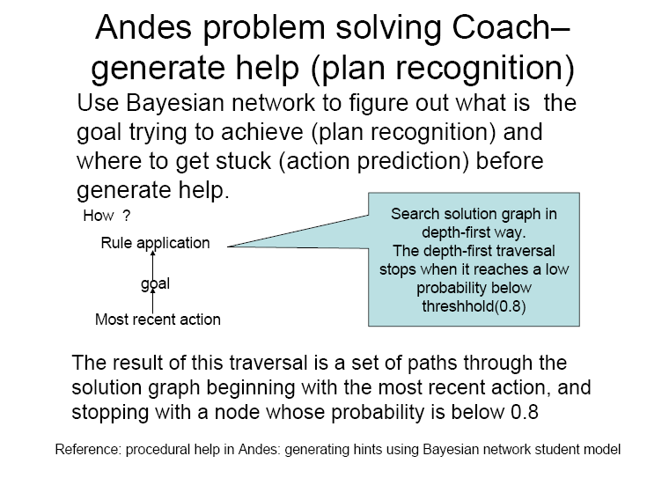
Notes:
1998) starts fromthe mostrecentlyobserved node intheBayesian network
and searches upward, looking for a goal that the student is most likely to be pursuing.
It then searches downward from that goal node, looking for a rule application with
a low probability of being performed. Such a rule application is probably where the
student is stuck forl ack of knowledge, so it becomes the focus of the coach’s hint

Slide 30
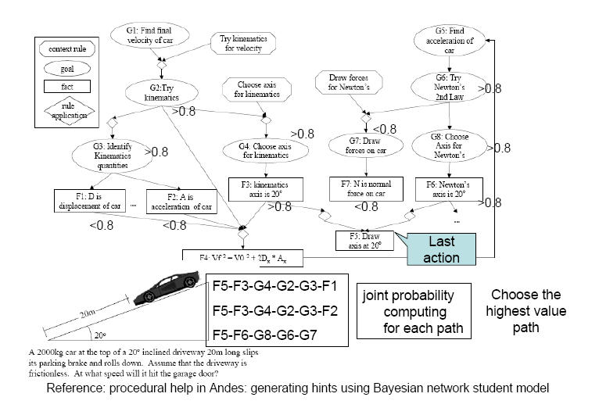

Slide 31
Andes Dynamic Bayesian Network
P(Rule-N|what student did in problem i)
P(Rule-N|what student did in problem j)
Rule-N
Rule-N
Network
for problem_{i}
Network
for problem_{j}
What is the granularity of a time-slice in Andes?

Slide 32
Evaluation
Andes tutor for physics is currently in use at the US Naval Academy
Informal studies have shown positive effect on learning
Continuously updated through students’ feedback

Slide 33
Outline
ILE, background.
Probabilistic student modeling for coached problem solving.
Probabilistic student modeling to support learning from examples.

Slide 34
ILE - a step beyond
Most ILE targets problem solving and domain specific knowledge
Andes’ SE-Coach - a framework to
  support learning from examples
  coach self-explanation(SE)
    generate explanations to oneself to clarify an example solution

Slide 35
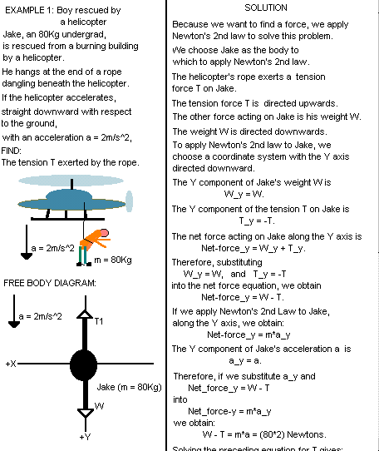
Sample physics example
Problem
Statement
Worked out
solution
Situation
Diagram
Free Body
Diagram

Slide 36
Why examples and self-explanation?
Students who self-explain learn more
Many students do not self-explain
  Fail to detect their lack of understanding
  Unable to use knowledge to self-explain
Human tutors can guide self-explanation

Slide 37
SE-Coach: individualized support to SE
Monitor students as they study examples
Guide self-explanation to improve students’ understanding
Challenge: only prompt self-explanations that improve students’ understanding

Slide 38
SE-Coach Architecture
Andes
Workbench
SE-Coach interface
SE-Coach Help
Domain
Rules
Model of correct SE
Problem
Solver
Solution graph
Domain General
student
model
Assessor
Problem
Statement
SE-Coach
Task-Specific
Student Model

Slide 39
The SE-Coach Workbench
Masking interface
  Helps students focus attention and SE-Coach monitor it
Prompts for relevant self-explanations
  Justify solution steps in terms of domain principles
  Explain role of a step in the underlying solution plan
Menu based tools to generate self-explanations

Slide 40
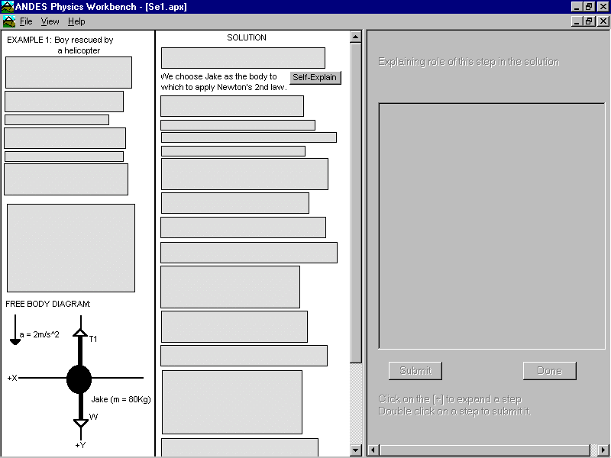
The Workbench - Masking Interface
Helps students focus attention and SE-Coach monitor it

Slide 41
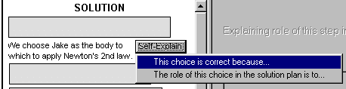
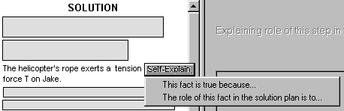
Prompts to Self-Explain
Stimulate self-questioning on relevant explanations

Slide 42
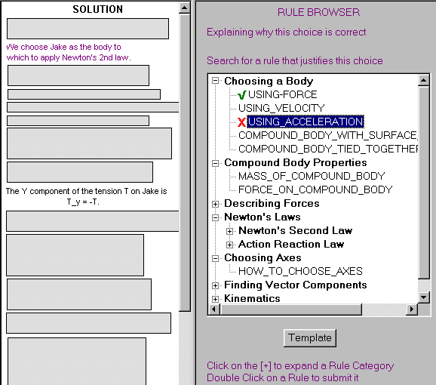
Justify Solution Steps: Rule Browser

Slide 43
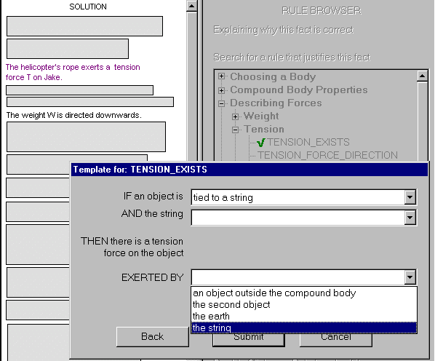
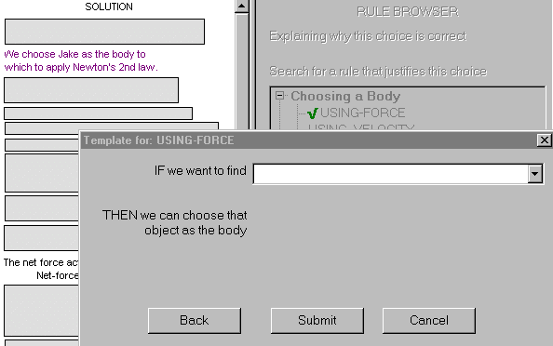
Justify Solution Steps: Rule Templates
Help students generate principle definitions

Slide 44
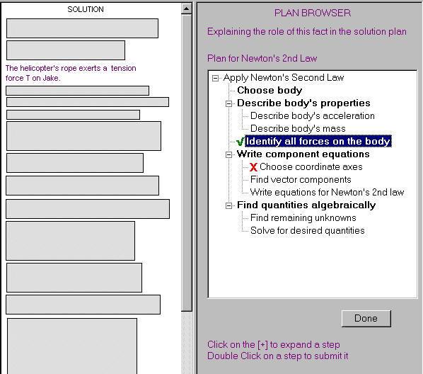
Identify Goal Structure - Plan Browser
Encodes abstract solution plan

Slide 45
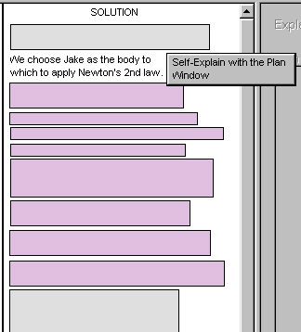
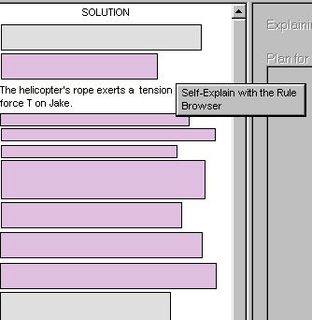
SE-Coach Hints

Slide 46
Probabilistic Student Model
Based on a Bayesian network to deal with various sources of uncertainty involved in the modeling task
Detecting spontaneous self-explanation from
  Reading time
  Student’s knowledge
Some students study examples by reasoning forward.
Assessing learning from using the interface menu-based tools

Slide 47

From SE model to initial Bnet
Long term
student model
Model of correct
self-explanation
R -try-Newton-2law
G-force-on-Jake
0.0
Assessor
0.95
RA-try-Newton-2law
Initial BNet
0.0
Find the force exerted
on Jake by the rope.
R-goal- choose-body
G-try-Newton-2law
0.5
0.0
Noisy-AND
P(RA| parents) = 1−α
P(RA|∃ ¬parent ) = 0
To solve this problem, we
choose Jake as the body.
RA-goal-choose-body
0.0
R- body-by-force
G-goal-choose-body
0.5
0.0
R
Rule
RA-body-by-force
F/G
Fact/Goal
0.0
RA
Rule Application
F-Jake-is-the-body
0.0

Slide 48
Student Actions
Student actions
Initial BNet
Updated BNet
Read nodes: duration of attention to example parts
RULE-APPL
Knows RULE | Knows Goal/Fact | READ
 |  | LOW | OK | LONG
T | T | p₁ = 1- α | p₂ = 1- α | p₃>max{p_{2,}0.9}
otherwise |  | 0 | 0 | 0
read-PROP
PROP
READ |  | LOW | OK | LONG
RULE- APPL | T | 1.0 | 1.0 | 1.0
 | F | p₁ < 0.5 | p₂ > 0.9 | p₃>p₂
SE nodes: actions with Plan Browser and Templates
R-GOAL
pb-GOAL
R- RULE
temp-RULE

Slide 49
After Reading and Plan Browser Selection
read
Find force on Jake
G-force-on-Jake
R -try-Newton-2law
0.95
ok
0.95
RA-try-Newton-2law
Find the force exerted
on Jake by the rope.
0.91
pb-GOAL
R-goal-choose-body
G-try-Newton-2law
To solve this problem,
choose Jake as the body.
1.0
0.5 / 0.82
0.91
R
Rule
RA-goal-choose-body
R- body-by-force
0.79
F/G
Fact/Goal
0.5
RA
Rule Application
G-goal-choose-body
0.79
read
choose Jake as the body
RA-body-by-force
0.25
long
F-Jake-is-the-body
0.99
Notes:
pb plan browser

Slide 50
After Filling Template and Closing
read
Find force on Jake
G-force-on-Jake
R -try-Newton-2law
0.95
ok
0.95
RA-try-Newton-2law
0.91
pb-choose-body
R-goal-choose-body
G-try-Newton-2law
1.0
0.82
0.91
RA-goal-choose-body
Domain
General
student
Model
temp-body-by-force
R- body-by-force
0.79
1.0
0.5 / 0.8
G-goal-choose-body
0.79
read
choose Jake as the body
RA-body-by-force
0.77
long
F-Jake-is-the-body
0.99
Notes:
RA-nodes represents probabilities of self-explanation

Slide 51
After Reading and Plan Browser Selection
read
Find force on Jake
G-force-on-Jake
R -try-Newton-2law
0.95
ok
0.95
RA-try-Newton-2law
0.91
pb-GOAL
R-goal-choose-body
G-try-Newton-2law
1.0
0.82
0.91
RA-goal-choose-body
R- body-by-force
0.3
0.95
G-goal-choose-body
0.3
read
choose Jake as the body
RA-body-by-force
0.15
low
F-Jake-is-the-body
0.99

Slide 52
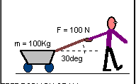
Transfer to a new example
read
Find force on wagon
G-force-on-wagon
R -try-Newton-2law
0.95
long
0.95
RA-try-Newton-2law
0.91
R-goal-choose-body
G-try-Newton-2law
Find the force N exerted
on the wagon by the ground.
0.82
0.91
We choose the wagon as the body.
RA-goal-choose-body
R- body-by-force
0.79
0.82
G-goal-choose-body
0.79
read
choose Jake as the body
RA-body-by-force
0.77
long
F-wagon-is-the-body
0.99

Slide 53
Empirical Evaluation
Subjects - 56 students taking Introductory Physics
Pretest - 4 problems on Newton’s second law
Treatment
  Experimental (29): studied examples with complete SE-Coach
  Control (27): studied examples with Masking interface and Plan Window, no feedback nor coaching
Posttest - 4 problems analogous to pretest

Slide 54
Evaluation of the SE-Coach
Interface easy to use and generally successful at stimulating SE.
Overall effectiveness seems to depend on learning stage
  The SE-Coach was more effective for the subjects that had just started learning the examples topic (late-start subjects).
Student model: guides interventions that positively correlate with learning (p < 0.05)
Prompt Type |  |  | Max. | Generated | Followed
Use Rule Browser/Templ. |  |  | 43 | 22.6 | 38.6%
Use Plan Browser |  |  | 34 | 22.4 | 42%
Read More Carefully |  |  | 43 | 7 | 34%

Slide 55
Results: Hints to self-explain
Prompt Type |  |  | Max. | Generated | Followed
Use Rule Browser/Templ. |  |  | 43 | 22.6 | 38.6%
Use Plan Browser |  |  | 34 | 22.4 | 42%
Read More Carefully |  |  | 43 | 7 | 34%
All hints positively correlated with posttest (p < 0.0.5)

Slide 56
Results: Learning
P < (0.03)
P > (0.1)
Late-start
early-start
Late-start early-start
Late-start subjects in SE condition more motivated to learn from Workbench tools?
  Significantly more (p = 0.01) attempts before abandoning template explanation
  Larger correlation (r = 0.3 vs. r = 0.03) between learned rules and posttest
Early-start subjects control spontaneously self-explained?
  Mean and St.Dev. # of line accesses correlate with posttest (p < 0.08)
  Pitt-USNA classes started semester earlier => More recall to self-explain spontaneously

Slide 57
Conclusions
Probabilistic student modeling for
Coached problem solving
  On-line knowledge tracing, plan recognition and action prediction to improve the effectiveness of the tutor’s interventions
Learning from examples
  Assessment of the understanding of written instructional material
  Takes into account student’s attention patterns

Slide 58
Andes Bnet inference
Andes’ networks include anywhere between 100 and 1000 nodes
Update needs to happen in real time
  Starts each time a student performs a new action
  Needs to be done when the student asks for help
Exact when feasible
Otherwise Approximate
Notes:
On a few physics problems, updating the Bayesian network using the exact algorithm
sometimes took longer than 40 seconds on the 400MHz Pentium computers
that were used in the fall 2000 evaluation. Thus, on some problems, we directed Andes
to use approx. evaluation of the networks and to stop when 40 seconds were reached.
On other problems, the update was completely turned off!. Hopefully, advances in
the Bayesian network update algorithms will allow us to remove these expediencies.

Slide 59
Several questions about…
Why Bnets and not MDPs or POMDPs?
Actions of the agent and action of the student …..
What would be a state?..... Transition probabilities? Data for reinforcement learning
reason for not modelling it as a planning problem because there would be a large number of states due to fact that Andes stresses that the order of solving the problem is not strict

Slide 60
Assumptions
The paper states that subjective judgments were used to set most parameters; what were these judgments based on?
What is the “knowledge-based model construction approach to building Bayesian networks”?
Why describe the knowledge level of a student as either mastered or unmastered? Wouldn't using numerical scale be more meaningful?
What decides mastery, and is problem difficulty taken into account?
Regarding reading latency, why is it assumed that longer reading times may be evidence of self-explanation? Other explanations could be difficulty in reading comprehension
Notes:
For instance, most students taking introductory
physics understand whether they need to apply Newton’s 2nd law as soon as
they read a problem’s statement. Thus, the Context-rule R-try-Newton-2law in
Figure 11b is generally associated with a low a .
However, the longer the student viewed an example item,
the higher the probability that the student self-explained it, provided that the student
has su⁄cient knowledge to do so

Slide 61
Computational Cost of the Model
How computationally expensive are the operations, for example calculating conditional probabilities of nodes in Bayesian networks of this size?
How responsive is the Andes interface? Is it realtime?
For about 100 problems, it sometimes takes longer than 40 seconds to update the BN. What happens to the run time as the number of problems is increased? Memory space?
How can we reduce the runtime when the domain knowledge becomes larger and larger? Any tricks to get these models to scale up?
Is it possible to accurately quantify the data required to make such an application work given the wide range of possible qualitative and quantitative reasoning?

Slide 62
Technical detail questions:
What is a Dynamic Bayesian Network (DBN) vs. a standard BN?
What is the benefit of predicting student actions, and why was it not done previously if they already had a belief network?
Do we assume that mastering each rule is independent from mastering another?
Can Hoeffding’s inequality be applied to Andes student problem to better address the credit assignment problem?

Slide 63
Progress Since Then: NLP, BNs, ITS, Hardware
What advances in NLP have there been? Could they benefit this system? Perhaps in examining student self-explanation? Incorporating them into Bayes Net?
How has the Andes system specifically evolved?
What do modern ITS’s look like? How have they been improved?
What alternative approaches have been used in building other ITS’s?

Slide 64
Progress Since Then: NLP, BNs, ITS, Hardware
The Bayesian Network updates took quite a long time to run. How much would the ~20 years of Moore’s law hardware improvements help?
Would modern machine learning tools help with the scalability and better predicting student knowledge? e.g. RNN to process sequential data? approximate inference?
Has there been any effort towards automating the problem domain / knowledge base creation stage? The paper describes the system as having 540 manually created rules installed that can solve about 120 mechanics problems. To generalize this tutoring approach to larger domains than just Newtonian mechanics would require a significant amount of effort if all domain knowledge must manually, explicitly be entered.

Slide 65
Future Directions
NLP: There has been huge advancement in natural language processing since the year this paper was accepted in 2002. How would expressing self-explanations work if we were to replace the interface discussed in this paper with current available natural language processing technology? Still not “easy”…. Very specific, simple proposal….
Lehman, B., Mills, C., D'Mello, S., & Graesser, A. (2012). Automatic Evaluation of Learner Self-Explanations and Erroneous Responses for Dialogue-Based ITSs. In. S. A. Cerri, & B. Clancey (Eds.), Proceedings of 11th International Conference on Intelligent Tutoring Systems (ITS 2012) (pp. 544-553). Berlin: Springer-Verlag.
NLP: What parts of the system can be changed with better natural language processing? …..
Eye tracking: With today's eye tracking technologies, can we train a separate model which is able to classify whether student is confused or satisfied on a particular problem from student's eye movement? Then, we can integrate this feature as a prior probability to student's actions in the bayesian network, as it may provide accurate information for the student model to infer student's action and generate help. Yes
Does taking into account other student’s tendencies and patterns help create a better algorithm for future students?
It could

Slide 66
How to model different learning scenarios?
How to model partner / group work and learning?
How to model and tailor learning for different types of students:
  different learning styles
  poor reading / english comprehension skills
  mental health issues, learning disabilities, or visual impairments
How to detect if a student is missing prereq material? And then direct them to learn the prior material you think they are missing (e.g., prereq math material for physics)?
How to handle guessing better? Informed guesses vs. random?
How to detect cheating?

Slide 67
Criticisms:
How practical is this method when creating new problems? Could it be used by other teachers and set up by other teachers effectively? Or are there too many hardcoded assumptions such that adapting this to a different course is involved?
How generalizable can this model be if so many of its elements depend on the ITS application? (for example, not every ITS application has a self-explanation section, or every ITS may have different ways of triggering/allowing users to see hints/solutions)
Does this type of system have a market? Our problem-solving abilities already allow us to use self-evaluation to find weaknesses in our knowledge and approaches. Maybe this system is better suited to teach other machines how to solve problems.
Is there any data to back up the concept of linking students’ reading times to whether they were self-explaining? Or were there any studies/questionnaires performed afterwards to determine this?

Slide 68
What if we wanted to teach in other areas besides Newtonian physics?
Different areas:
  higher level physics classes
  history, philosophy, english
  less logical, more creative areas like art, music
If you wanted to teach multiple subjects, would it be better to have a combined BN for physics and english tutoring, or would it be better to have separate BNs?
For more abstract organic problems, would other machine learning methods be more suitable, as representations are not so easily generated and manipulated?

Slide 69
Broader Impact:
How have BNs and AI more broadly played a role in modern education systems?
Andes interprets a student’s reading time by measuring it (just like UBC canvas can collect that kind of data); could that be considered an invasion of privacy?
Could an ITS be used to replace traditional classes and instructors?

Slide 70
Inference
Can the model be extended to Reinforcement learning model based on the observations of user behaviors in the practice questions?
Is the paper using Approximate Inference at all? It may be implied somewhere but I can't find a concrete example.
Yes exact inference in some cases was taking seconds… too much for an interactive system
Selecting the problem
As a first/second year physics tutor for many years, I’ve seen a lot of students becoming completely lost when the problem incorporate more than 2 or more physics theories/concepts. In the paper, it says Andes will choose a problem with an appropriate complexity that involves only a few rules that the student has not yet mastered, how exactly does Andes generate such problem and how does it know what is the appropriate complexity for the student?

Slide 71
Student modeling…..
At what point will the Andes Student model determine that a Student has mastered a rule?
How does this model handle with different difficulty levels of questions with same rule applied to decide the mastery of this rule? For example, two questions might use the same rule but one of them is extremely tricky and students may fail to do this one while it cannot say they do not master the rule.
Was the approach able to predict the effect of outside knowledge affecting students answers? In the case of a student having sufficient knowledge in calculus and linear equations the majority of Newtonian mechanics is simplistic, but would not provide diagramming skills.
No
What happens if a student interacts with the system and the network learns about the student but then the student completely changes his behaviour in some way …..Will it take a long time for the system to re-adapt to this?
Yes… probably the same for a human ;-)

Slide 72
Student modeling…..
What happens if a rule of some sort is created by the teacher (e.g. these two are mutually exclusive strategies to solve a problem), realizes it's incorrect after some students …….
It seems as if the probability of knowing a rule is based on the student's reading ability. However since the AI tutor is using time as the only reference, how will it take into account if the student had opened the application and did not immediately start reading?
Self explaining
Error due to input mistake: there is a prob for that
Error due to language mistake: ESL student might …
Not covered by Andes

Slide 73
Problem Solving Interface
Can the students view information the system has on them, such as how likely the system thinks they are likely to self-explain, or what topics they are likely to not yet have mastered?
No but this is an interesting possibility
How do students actually use the “hint” feature? The hint is encoded so that the probability of mastery is not raised as much when a hint is given but perhaps students use the hint to confirm their solutions as opposed to solely for when they have not mastered the rule. Is there evidence that the “hint” feature is encoded in the way that is actually used by students?
?? Given that mutual exclusivity is a big issue with Newtonian physics, how does the system handle this when presenting problems to students and generating the probability distribution?

Slide 74
Bnet structure
Many of the nodes are described to have binary domains. Although the paper provides reasoning for this choice, is it common practice to do this for Bayesian networks due to the increase in complexity with having to maintain bigger probability tables if more domain values are available?
No I would say you try to model your domain as close as possible
Domain-general part
  Is there a problem with making general rule nodes observable with perhaps a simple question about a definition?
  No, could be an interesting extension
  How are Context-rule nodes corresponding to a template for student’s self-explanation created and how does their input get translated into Bayesian Network probabilities required for building their student model?
This is encoded in the Bayesian network by linking the SE node for a template filling action with the Context-rule node corresponding to that template’s content.
  Dependencies among rules
  Not captured in Andes

Slide 75
Task / Probabilities
  ……. It would be very useful if particular dominant strategies could be identified - e.g. if a problem can be solved in multiple ways, but those who solved it in one particular way were more or less likely to solve a separate problem.
  Not sure this analysis was ever done. But it would be interesting and possible for similar systems
  On page 387, then definition of a slip is presented. Would something still be considered a slip if all preconditions were known and two rules were mastered, but one was chosen instead of the other? (i.e. is there an idea of a "best" action to take, or are all the correct actions really just as good as each other?). No
  The approach to implement Leaky-OR relationship to address the case where the student might be guessing is really interesting. What are other potential or actual usage for this in the industry? to make them seem more random and human like?
  I would say yes.
  How are alpha and beta determined in ‘slipping’ and ‘guessing’ (i.e., Leaky-OR and Noisy-AND)?
Conditional/ Prior Probability Where do prior probabilities come from? Default to 0.5? Are there better starting values? Learn probabilities from more data on the student (Educational Data Mining)

Slide 76
Task / Probabilities
series of correct guesses? Wouldn’t the model have no way to know/recover from that?
What about humans?
Reading latency
How did they end up tackling the problem of deciding what is happening during the student latency time period?
Student modeling for example studying
It is discussed that reading latency is used to evaluate the probability of self-explanation without requiring self-explanation explicitly, and an equation modeling this was provided. How is this probability value scaled compared to explicit self-explanation?
Student learning in practice
"Has this tutoring system had an impact on student learning in practice?"
Notes:
The basic hypothesis
we implemented in the student model is that the probability of self-explaining
a rule application is a function of both the time a student spends studying an example
line derived from that rule application and the probability that the student knows
the rule and its preconditions.

Slide 77
Adaptation to new tasks/domains
How difficult would it be to add more physics problems to Andes system?
Could this model be applied to different learning domains such as language learning, literature analysis or history?
What are the limitations of expanding this system to other problem domains?
How difficult is it to extend the system? For example, by adding new rules and problem types.
other applications exists for the Andes? Is it possible to use it in a literature class environment? Since there are multiple interpretation of a book/paragraph/essay/paper, how would Andes handle such high level of variety in the student’s response? strictly model for student in mathematics and theorem related courses?
The ITS, Andes, studied in this paper is using in the subject of physics. Physics involves a lot of problem solving and formula applying, and it is a good field to apply ITS to improve self-learning. However, this tutoring model may not be good for other subject such as Philosophy and Business where the answer can be various due to different point of view. These could cause a even higher uncertainty and hard to make a educated guess.
What about chemistry, assess comprehension in the arts?

Slide 78
Future Directions
NLP: There has been huge advancement in natural language processing since the year this paper was accepted in 2002. How would expressing self-explanations work if we were to replace the interface discussed in this paper with current available natural language processing technology? Still not “easy”…. Very specific, simple proposal….
Lehman, B., Mills, C., D'Mello, S., & Graesser, A. (2012). Automatic Evaluation of Learner Self-Explanations and Erroneous Responses for Dialogue-Based ITSs. In. S. A. Cerri, & B. Clancey (Eds.), Proceedings of 11th International Conference on Intelligent Tutoring Systems (ITS 2012) (pp. 544-553). Berlin: Springer-Verlag.
NLP: What parts of the system can be changed with better natural language processing? …..
Eye tracking: With today's eye tracking technologies, can we train a separate model which is able to classify whether student is confused or satisfied on a particular problem from student's eye movement? Then, we can integrate this feature as a prior probability to student's actions in the bayesian network, as it may provide accurate information for the student model to infer student's action and generate help. Yes
Does taking into account other student’s tendencies and patterns help create a better algorithm for future students?
It could

Slide 79
Previous Approaches
Off-line knowledge assessment
On-line knowledge assessment and limited plan recognition
  Limit the acceptable solutions
  Make the student express all solution steps
  Ask the student
  Knowledge not taken into account to predict the student’s plans

Slide 80
Probabilistic Student Model
Based on the probabilistic reasoning framework of Bayesian networks
Performs on-line knowledge assessment, plan recognition and prediction of students’ goals and actions
Performs plan recognition by integrating information about the available solutions and the student’s knowledge

Slide 81
TODO for Fri
Reading Textbook Chp. 6.5
Keep working on assignment-2 (due on Fri, Oct 18)

