Slide 1
Intelligent Systems (AI-2)
Computer Science cpsc422, Lecture 25
Nov, 8, 2017
Notes:
Lecture 26

Slide 2
NLP: Knowledge-Formalisms Map
(including probabilistic formalisms)
State Machines (and prob. versions)
(Finite State Automata, Finite State Transducers, Markov Models)
Morphology
Machine Learning
Neural Models, Neural Sequence Modeling
Syntax
Rule systems (and prob. versions)
(e.g., (Prob.) Context-Free Grammars)
Semantics
Pragmatics
Discourse and Dialogue
Logical formalisms (First-Order Logics, Prob. Logics)
AI planners (MDP Markov Decision Processes)
Notes:
My Conceptual map - This is the master plan
Markov Models used for part-of-speech and dialog
Syntax is the study of formal relationship between words
How words are clustered into classes (that determine how they group and behave)
How they group with they neighbors into phrases

Slide 3
NLP Practical Goal for FOL: the ultimate Web question-answering system?
  Map NL queries and the Web into FOL so that answers can be effectively computed
What African countries are not on the Mediterranean Sea?
Was 2007 the first El Nino year after 2001?
Notes:
We didn’t assume much about the meaning of words when we talked about sentence meanings
Verbs provided a template-like predicate argument structure
Nouns were practically meaningless constants
There has be more to it than that
View assuming that words by themselves do not refer to the world, cannot be
Judged to be true or false…

Slide 4
Today Nov 8
English Syntax
Context Free Grammars
Parsing

Slide 5
Syntax of Natural Languages
Def. The study of how sentences are formed by grouping and ordering words
Part of speech: Noun, Verb….
It is so …… The…… is
Example:
Ming and Sue prefer morning flights
* Ming Sue flights morning and prefer
Groups behave as single unit wrt
Substitution they, it, do so
Movement: passive, question
Coordination …. and ……
Notes:
Sentence formation how symbols of the language can be grouped and ordered together
Part of speech: whether a word is a noun, verb or an adjective
Based on Meaning/Inflection/Distribution
An Adjective is a word that can fill the blank in:
It’s so __________.
A Noun is a word that can be marked as plural.
A Noun is a word that can fill the blank in:
the __________ is
What is green?
It’s so green.
Both greens could work for the walls.
The green is a little much given the red rug.
Constituency: groups of words behave as a single unit or
Based on:
<Substitution Test (they, it, do so)>
<Movement Test>
<Coordination Test>
Words/phrases order (English SVO)

Slide 6
Syntax: Useful tasks
Why should you care?
  Grammar checkers
  Basis for semantic interpretation
    Question answering
    Information extraction
    Summarization
  Discourse Parsing
  Machine translation
  ……

Slide 7
Key Constituents – with heads
(English)
(Specifier) X (Complement)
Noun phrases
Verb phrases
Prepositional phrases
Adjective phrases
Sentences
(Det) N (PP)
(Qual) V (NP)
(Deg) P (NP)
(Deg) A (PP)
(NP) (I) (VP)
Some simple specifiers
Category Typical function Examples
Determiner specifier of N the, a, this, no..
Qualifier specifier of V never, often..
Degree word specifier of A or P very, almost..
Complements?
Notes:
All group/phrases share the same structure!
Sequence of words surrounding at least one noun
They appear in similar “environments” Before a verb
Substitution for PP location :“there”
Specifiers much more complex in general
There are also Adjuncts: Adjuncts are head modifiers which may be added infinitely. For example, there is no limit on the number of adjectives which may be added to a noun: the big long red gruesome . . . limosine. The same is true of adverbs: Tweeky ran quickly, surreptitiously, . . . and unsuspectingly into Lance's arms.
The adjunct phrase is an X' node which contains an X' node. This allows for infinite recursivity, which distinguishes adjuncts from specifiers and complements.

Slide 8
Key Constituents: Examples
Noun phrases
Verb phrases
Prepositional phrases
Adjective phrases
Sentences
(Det) N (PP)
the cat on the table
(Qual) V (NP)
never eat a cat
(Deg) P (NP)
almost in the net
(Deg) A (PP)
very happy about it
(NP) (-) (VP)
a mouse -- ate it
Notes:
Sequence of words surrounding at least one noun
They appear in similar “environments” Before a verb
Substitution for PP location :“there”

Slide 9
Context Free Grammar (Example)
Start-symbol
S -> NP VP
NP -> Det NOMINAL
NOMINAL -> Noun
VP -> Verb
Det -> a
Noun -> flight
Verb -> left
Non-terminal
Terminal
Backbone of many models of syntax
Parsing is tractable
Notes:
CFG are the backbone of many models of syntax
Powerful enough to express sophisticated relations among the words in a sentence
Parsing is computationally tractable
A CFG consist of a set of productions or rules
Each rule how symbol in the language can be grouped and ordered together
Terminal correspond to “words” in the language

Slide 10
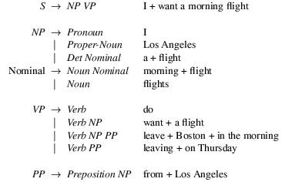
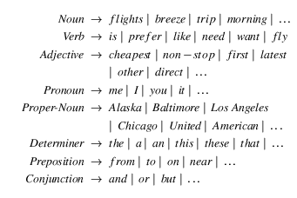
CFG more complex Example
Grammar with example phrases
Lexicon
Notes:
A CFG consist of a set of productions or rules
Each rule how symbol in the language can be grouped and ordered together
Terminal correspond to “words” in the language
S -> NP VP
says
that there are units called S, NP, and VP in this language
that an S consists of an NP followed immediately by a VP
but does not say
that that’s the only kind of S
that this is the only place that NPs and VPs occur
In linguistics, the term nominal refers to a category used to group together nouns and adjectives based on shared properties. The motivation for nominal grouping is that in many languages nouns and adjectives share a number of morphological and syntactic properties.

Slide 11
CFGs
Define a Formal Language (un/grammatical sentences)
Generative Formalism
  Generate strings in the language
  Reject strings not in the language
  Impose structures (trees) on strings in the language
Notes:
As with FSAs and FSTs you can view these rules as either analysis or synthesis machines

Slide 12
CFG: Formal Definitions
4-tuple (non-term., term., productions, start)
(N, ∑, P, S)
P is a set of rules A→α; A∈N, α∈(∑∪N)*
A derivation is the process of rewriting α₁ into α _{m} (both strings in (∑∪N)*) by applying a sequence of rules: α₁ ⇒* α _{m}
L _{G} = W|w∈∑* and S ⇒* w

Slide 13
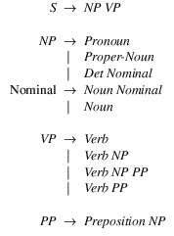
Derivations as Trees
Nominal
Nominal
flight
Context Free?
Notes:
Slight mismatch between grammar and derivation tree ☺
The notion of context in CFGs has nothing to do with the ordinary meaning of the word context in language.
All it really means is that the non-terminal on the left-hand side of a rule is out there all by itself
A -> B C
Means that I can rewrite an A as a B followed by a C regardless of the context in which A is found

Slide 14
Common Sentence-Types
Declaratives: A plane left
  S -> NP VP
Imperatives: Leave!
  S -> VP
Yes-No Questions: Did the plane leave?
  S -> Aux NP VP
WH Questions:
Which flights serve breakfast?
  S -> WH NP VP
When did the plane leave?
  S -> WH Aux NP VP

Slide 15
NP: more details
NP -> Specifiers N Complements
NP -> (Predet)(Det)(Card)(Ord)(Quant) (AP) Nom
e.g., all the other cheap cars
Nom -> Nom PP (PP) (PP)
e.g., reservation on BA456 from NY to YVR
Nom -> Nom GerundVP
e.g., flight arriving on Monday
Nom -> Nom RelClause
Nom RelClause ->(who | that) VP
e.g., flight that arrives in the evening
Notes:
Quant : many, few, several

Slide 16
Conjunctive Constructions
S -> S and S
  John went to NY and Mary followed him
NP -> NP and NP
  John went to NY and Boston
VP -> VP and VP
  John went to NY and visited MOMA
…
In fact the right rule for English is
  X -> X and X

Slide 17
CFG for NLP: summary
CFGs cover most syntactic structure in English.
Many practical computational grammars simply rely on CFG
Notes:
CFGs appear to be just about what we need to account for a lot of basic syntactic structure in English.
But there are problems
That can be dealt with adequately, although not elegantly, by staying within the CFG framework.
There are simpler, more elegant, solutions that take us out of the CFG framework (beyond its formal power)
LFG, HPSG, Construction grammar, XTAG, etc.
Chapter 15 explores the unification approach in more detail

Slide 18
Other Options
Regular languages (FSA) A→ xB or A→ x
  Too weak (e.g., cannot deal with recursion in a general way – no center-embedding)
CFGs A→ γ (also produce more understandable and “useful” structure)
Context-sensitive αAβ→ αγβ; γ≠ε
  Can be computationally intractable
Turing equiv. α→β; α≠ε
  Too powerful / Computationally intractable
Notes:
0 no restriction (but left side cannot be the empty string)
TAGs are context sensitive
A single non-terminal
α γ β any sequence of terminal and non-terminal
x any sequence of terminal
For many practical purposes a finite state approx of the underlying CFG is adequate.

Slide 19
Today Nov 8
Context Free Grammars / English Syntax
Parsing

Slide 20
Parsing with CFGs
Valid parse trees
Sequence of words
I prefer a morning flight
Parser
Nominal
CFG
Nominal
flight
Assign valid trees: covers all and only the elements of the input and has an S at the top
Notes:
Parsing with CFGs refers to the task of assigning correct trees to input strings
Correct here means a tree that covers all and only the elements of the input and has an S at the top
It doesn’t actually mean that the system can select the correct tree from among the possible trees

Slide 21
Parsing as Search
CFG
Search space of possible parse trees
S -> NP VP
S -> Aux NP VP
NP -> Det Noun
VP -> Verb
Det -> a
Noun -> flight
Verb -> left, arrive
Aux -> do, does
defines
Parsing: find all trees that cover all and only the words in the input
Notes:
As with everything of interest, parsing involves a search which involves the making of choices
Search space defined by the grammar
Two constraints should guide the search: the grammar (must be a tree with an S at the top) and the input (must cover all the words in the input)

Slide 22
Constraints on Search
Sequence of words
Valid parse trees
I prefer a morning flight
Parser
CFG
(search space)
Nominal
Nominal
flight
Search Strategies:
Top-down or goal-directed
Bottom-up or data-directed
Notes:
Parsing with CFGs refers to the task of assigning correct trees to input strings
Correct here means a tree that covers all and only the elements of the input and has an S at the top
It doesn’t actually mean that the system can select the correct tree from among the possible trees

Slide 23
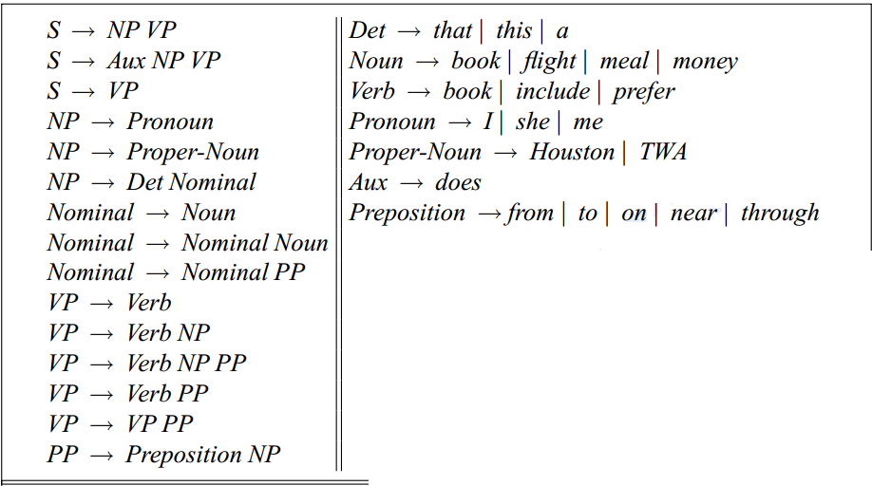
Context Free Grammar
(Used in parsing Example)
Notes:
The most commonly used mathematical system for modeling constituent structure in

Slide 24
Top-Down Parsing
Since we’re trying to find trees rooted with S (Sentences) start with the rules that rewrite S.
Then work your way down from there to the words.
Input:
flight
Notes:
We’ll start with some basic (meaning bad) methods before moving on to the one or two that you need to know

Slide 25
Next step: Top Down Space
Input:
flight
……..
……..
……..
When POS categories are reached, reject trees whose leaves fail to match all words in the input

Slide 26
Bottom-Up Parsing
Of course, we also want trees that cover the input words. So start with trees that link up with the words in the right way.
Then work your way up from there.
flight
flight
flight

Slide 27
Two more steps: Bottom-Up Space
……..
……..
……..
flight
flight
flight
flight
flight
flight
flight

Slide 28
Top-Down vs. Bottom-Up
Top-down
  Only searches for trees that can be answers
  But suggests trees that are not consistent with the words
Bottom-up
  Only forms trees consistent with the words
  Suggest trees that make no sense globally

Slide 29
So Combine Them (from here to slide 35 not required for 422 – just for your interest)
Top-down: control strategy to generate trees
Bottom-up: to filter out inappropriate parses
Top-down Control strategy:
Depth vs. Breadth first
Which node to try to expand next
Which grammar rule to use to expand a node
(left-most)
(textual order)
Notes:
There are a million ways to combine top-down expectations with bottom-up data to get more efficient searches
To incorporate input as soon as possible
3 choices to determine a control strategy
Natural forward incorporation of the input

Slide 30
Top-Down, Depth-First, Left-to-Right Search
Sample sentence: “Does this flight include a meal?”
Notes:
Search state a partial parse tree and the next word to match in []

Slide 31
Example
“Does this flight include a meal?”

Slide 32
Example
“Does this flight include a meal?”
flight
flight

Slide 33
Example
“Does this flight include a meal?”
flight
flight

Slide 34
Adding Bottom-up Filtering
The following sequence was a waste of time because an NP cannot generate a parse tree starting with an AUX
Aux
Aux
Aux
Aux
Notes:
You should not bother expanding a node if it cannot generate a parse tree matching the next word

Slide 35
Bottom-Up Filtering
Category | Left Corners
S | Det, Proper-Noun, Aux, Verb
NP | Det, Proper-Noun
Nominal | Noun
VP | Verb
Aux
Aux
Aux

Slide 36
Problems with TD-BU-filtering
Ambiguity
Repeated Parsing
SOLUTION: Earley Algorithm
(once again dynamic programming!)
Notes:
The number of valid parses can grow exponentially in the number of phrases
(most of them do not make sense semantically so we do not consider them)
Parser builds valid trees for portions of the input, then discards them during backtracking, only to find out that it has to rebuild them again

Slide 37
Effective Parsing
Top-down and Bottom-up can be effectively combined but still cannot deal with ambiguity and repeated parsing
PARTIAL SOLUTION: Dynamic Programming approaches (you’ll see one applied to Prob, CFG)
  Fills tables with solution to sub-problems
  Parsing: sub-trees consistent with the input, once discovered, are stored and can be reused
  Stores ambiguous parse compactly (but cannot select best one)
  Does not do (avoidable) repeated work
Notes:
There are a million ways to combine top-down expectations with bottom-up data to get more efficient searches
To incorporate input as soon as possible
3 choices to determine a control strategy
Natural forward incorporation of the input

Slide 38
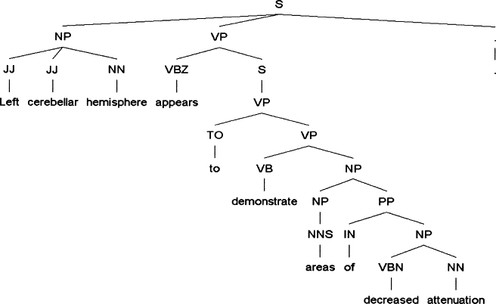
Example of relatively complex parse tree
Journal of the American Medical Informatics Association, 2005, Improved Identification of Noun Phrases in Clinical Radiology Reports ….
Notes:
Journal of the American Medical Informatics Association
Volume 12, Issue 3, May–June 2005, Pages 275–285
The Practice of Informatics
Improved Identification of Noun Phrases in Clinical Radiology Reports Using a High-Performance Statistical Natural Language Parser Augmented with the UMLS Specialist Lexicon
Yang Huang, MS, ,
Henry J. Lowe, MD,
Dan Klein, PhD,
Russell J. Cucina, MD, MS
Affiliations of the authors: Stanford Medical Informatics and Stanford Center for Clinical Informatics, Stanford University School of Medicine, Stanford, CA (YH, HJL); Computer Science Division, University of California at Berkeley, Berkeley, CA (DK); Department of Medicine, University of California, San Francisco, San Francisco, CA (RJC)

Slide 39
Check out demos on course web page
- Berkeley Parser with demo
- Stanford Parser with demo

Slide 40
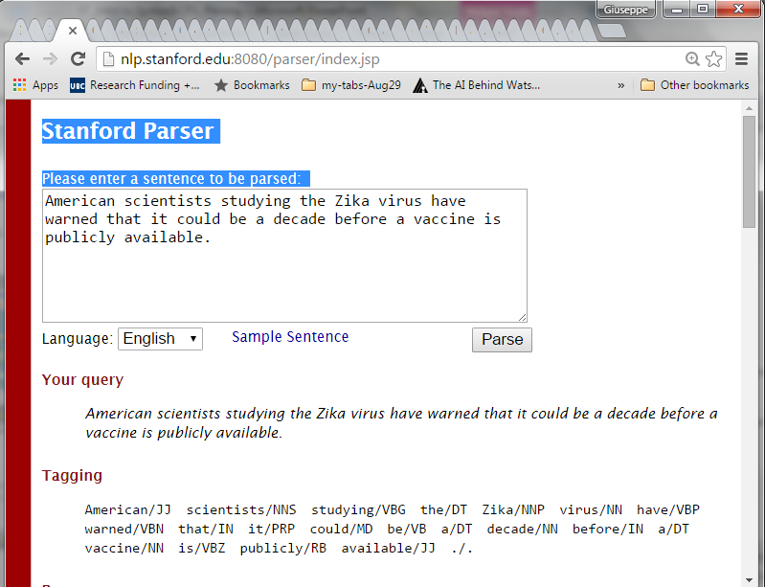
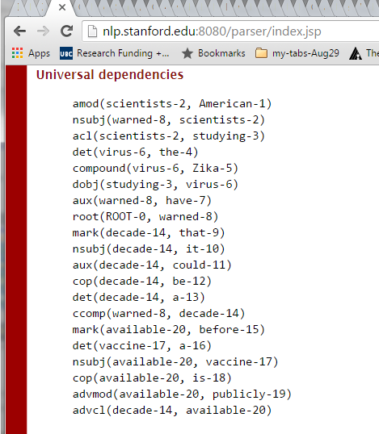
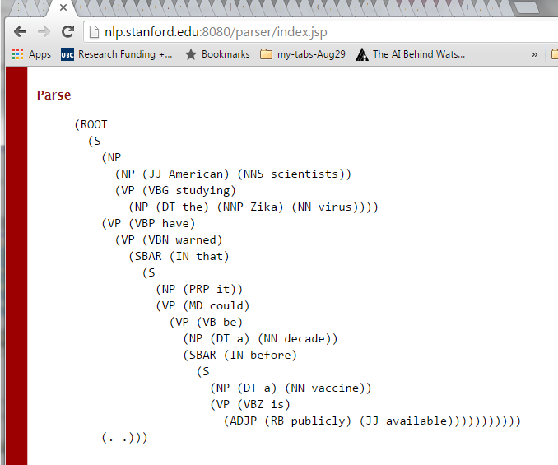
Notes:
Amazing speed
Groupings are meaningful (they can help semantic representation: objects events and their relationships)
Two types of structure: constituency vs. dependency

Slide 41
Learning Goals for today’s class
You can:
Explain what is the syntax of a Natural Language
Formally define a Context Free Grammar
Justify why a CFG is a reasonable model for the English Syntax
Apply a CFG as a Generative Formalism to
  Impose structures (trees) on strings in the language (i.e. Trace Top-down and Bottom-up parsing on sentence given a grammar)
  Reject strings not in the language (also part of parsing)
  Generate strings in the language given a CFG

Slide 42
Next class Fri
Probabilistic CFG…
Assignment-3 out – due Nov 20
(8-18 hours – working in pairs on programming parts is strongly advised)
Still have midterms – pick them up!

