Slide 1
Intelligent Systems (AI-2)
Computer Science cpsc422, Lecture 24
Nov, 6, 2017
Slide credit: Satanjeev Banerjee Ted Pedersen 2003, Jurfsky & Martin 2008-2016
Notes:
Lecture 24

Slide 2
Lecture Overview
Semantic Similarity/Distance
Concepts: Thesaurus/Ontology Methods
Words: Distributional Methods

Slide 3
Why words/concepts similarity is important ?
“fast” is similar to “rapid”
“tall” is similar to “height”
Question answering:
Q: “How tall is Mt. Everest?”
Candidate A: “The official height of Mount Everest is 29029 feet”
Extends to sentence/paragraph similarity
Summarization: identify and eliminate redundancy, aggregate similar phrase/sentences
………
Notes:
Applications
Information extraction, question answering, summarization (identify and eliminate redundancy) , language modeling (by clustering words)… extends to sentence / paragraph similarity … plagiarism detection

Slide 4
WordNet: entry for “table”
The noun "table" has 6 senses in WordNet.
table, tabular array (a set of data arranged in rows and columns) "see table 1"
table (a piece of furniture having a smooth flat top that is usually supported by one or more vertical legs) "it was a sturdy table"
table (a piece of furniture with tableware for a meal laid out on it) "I reserved a table at my favorite restaurant"
mesa, table (flat tableland with steep edges) "the tribe was relatively safe on the mesa but they had to descend into the valley for water"
table (a company of people assembled at a table for a meal or game) "he entertained the whole table with his witty remarks"
board, table (food or meals in general) "she sets a fine table"; "room and board"
The verb "table" has 1 sense in WordNet.
1. postpone, prorogue, hold over, put over,
table, shelve, set back, defer, remit, put off –
(hold back to a later time; "let's postpone the exam")
Notes:
Each blue list is a synset

Slide 5

WordNet Relations (between synsets!)
fi
Notes:
Key point: synsets are related not specific words
Adjectives (synonyms, antonyms)

Slide 6
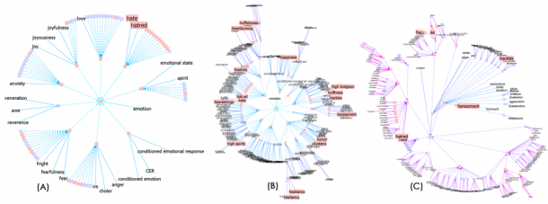
Visualizing Wordnet Relations
C. Collins, “WordNet Explorer: Applying visualization principles to lexical semantics,” University of Toronto, Technical Report kmdi 2007-2, 2007.
Notes:
(A)
Hyponymy of “emotion” filtered at depth
2
. Words starting with “h” and collapsed nodes containing search results
are highlighted in pink.
(B)
Graph from (A) changed so that subtree rooted at the synset containing “love” is the central focus node,
expanding its radial extent.
(C)
All highlighted search results from (A) expanded

Slide 7
Semantic Similarity/Distance: example
(n) table -- (a piece of furniture having a smooth flat top that is usually supported by one or more vertical legs)
(n) mesa, table -- (flat tableland with steep edges)
(n) lamp (a piece of furniture holding one or more electric light bulbs)
(n) hill (a local and well-defined elevation of the land)
Notes:
Each blue list is a synset

Slide 8

Semantic Similarity/Distance
Between two concepts in an ontology, e.g., between two senses in Wordnet
What would you use to compute it ?
  A. The distance between the two concepts in the underlying hierarchies / graphs
  B. The glosses of the concepts
  C. None of the above
  D. Both of the above
Notes:
Or semantic distance
More similar if they Share more features of meaning or are near synonyms
Applications
Information extraction, question answering, summarization, language modeling (by clustering words)

Slide 9
Gloss Overlaps ≈ Relatedness
Lesk’s (1986) idea: Related word senses are (often) defined using the same words. E.g:
  bank(1): “a financial institution”
  bank(2): “sloping land beside a body of water”
  lake: “a body of water surrounded by land”
Notes:
To compare across POS: use the glosses

Slide 10
Gloss Overlaps ≈ Relatedness
Lesk’s (1986) idea: Related word senses are (often) defined using the same words. E.g:
  bank(1): “a financial institution”
  bank(2): “sloping land beside a body of water”
  lake: “a body of water surrounded by land”

Slide 11
Gloss Overlaps ≈ Relatedness
Lesk’s (1986) idea: Related word senses are (often) defined using the same words. E.g:
  bank(1): “a financial institution”
  bank(2): “sloping land beside a body of water”
  lake: “a body of water surrounded by land”
Gloss overlaps = # content words common to two glosses ≈ relatedness
  Thus, relatedness (bank(2), lake) = 3
  And, relatedness (bank(1), lake) = 0

Slide 12
Limitations of (Lesk’s)
Gloss Overlaps
Most glosses are very short.
  So not enough words to find overlaps with.
Solution?
Extended gloss overlaps
  Add glosses of synsets connected to the input synsets.

Slide 13
Extending a Gloss
sentence: “the
penalty meted out to one
adjudged guilty”
bench: “persons
who hear cases in a
court of law”
# overlapped words = 0
Notes:
Benerjee and Pedersen 2003

Slide 14
Extending a Gloss
final judgment: “a
judgment disposing of the case
before the court of law”
hypernym
sentence: “the
penalty meted out to one
adjudged guilty”
bench: “persons
who hear cases in a
court of law”
# overlapped words = 0

Slide 15
Extending a Gloss
final judgment: “a
judgment disposing of the case
before the court of law”
hypernym
sentence: “the
penalty meted out to one
adjudged guilty”
bench: “persons
who hear cases in a
court of law”
# overlapped words = 2
Notes:
S: (n) final judgment, final decision (a judgment disposing of the case before the court; after the judgment (or an appeal from it) is rendered all that remains is to enforce the judgment)
direct hyponym / full hyponym
S: (n) conviction, judgment of conviction, condemnation,sentence ((criminal law) a final judgment of guilty in a criminal case and the punishment that is imposed) "the conviction came as no surprise"
S: (n) acquittal (a judgment of not guilty)

Slide 16
Creating the Extended Gloss Overlap Measure
How to measure overlaps?
Which relations to use for gloss extension?

Slide 17
How to Score Overlaps?
Lesk simply summed up overlapped words.
But matches involving phrases – phrasal matches – are rarer, and more informative
  E.g. “court of law” “body of water”
Aim: Score of n words in a phrase > sum of scores of n words in shorter phrases
Solution: Give a phrase of n words a score of
  “court of law” gets score of 9.
  bank(2): “sloping land beside a body of water”
  lake: “a body of water surrounded by land”
Notes:
Holonymy is the opposite of meronymy.

Slide 18
Which Relations to Use?
Typically include…
Hypernyms [ “car” → “vehicle” ]
Hyponyms [ “car” → “convertible” ]
Meronyms [ “car” → “accelerator” ]
…
Notes:
Holonymy is the opposite of meronyms
S: (n) car, railcar, railway car, railroad car (a wheeled vehicle adapted to the rails of railroad) "three cars had jumped the rails"
The following pointer types are usually used to indicate lexical relations: Antonym, Pertainym, Participle, Also See, Derivationally Related. The remaining pointer types are generally used to represent semantic relations.
Also-see relation [“enter” → “move in” ]
Attribute [ “measure” → “standard” ]
derivationally related form
W: (v) standardize [Related to: standard] "The weights and measures were standardized"
W: (v) standardise [Related to: standard] "The weights and measures were standardized"
W: (adj) criterial [Related to: criterion]
W: (adj) criterional [Related to: criterion]

Slide 19
Extended Gloss Overlap Measure
Input two synsets A and B
Find phrasal gloss overlaps between A and B
For each relation, compute phrasal gloss overlaps between every synset connected to A, and
every synset connected to B
Add phrasal scores to get relatedness of A and B
A and B can be from different parts of speech!
Notes:
One possibility in which the relations pairs is
Gloss gloss
Hyper hyper
Hypo hypo
(see paper for details)

Slide 20
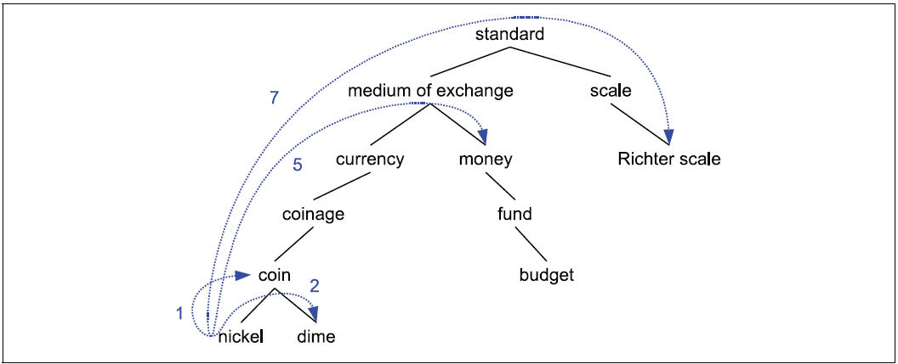
Distance: Path-length
Path-length sim based on is-a/hypernyms hierarchies
But this is assuming that all the links are the same…. Encode the same semantic distance….
Notes:
The lower the concept in the hierarchy the lower its probability
Animal
S: (n) cat, true cat (feline mammal usually having thick soft fur and no ability to roar: domestic cats; wildcats)
S: (n) guy, cat, hombre, bozo (an informal term for a youth or man) "a nice guy"; "the guy's only doing it for some doll"
S: (n) cat (a spiteful woman gossip) "what a cat she is!"
S: (n) kat, khat, qat, quat, cat, Arabian tea, African tea (the leaves of the shrub Catha edulis which are chewed like tobacco or used to make tea; has the effect of a euphoric stimulant) "in Yemen kat is used daily by 85% of adults"
S: (n) cat-o'-nine-tails, cat (a whip with nine knotted cords) "British sailors feared the cat"
S: (n) Caterpillar, cat (a large tracked vehicle that is propelled by two endless metal belts; frequently used for moving earth in construction and farm work)
S: (n) big cat, cat (any of several large cats typically able to roar and living in the wild)
S: (n) computerized tomography, computed tomography, CT, computerized axial tomography, computed axial tomography, CAT (a method of examining body organs by scanning them with X rays and using a computer to construct a series of cross-sectional scans along a single axis)

Slide 21
Probability of a concept/sense and its info content
probability
Information Content
Notes:
Or not all edges are equal….
The lower the concept in the hierarchy the lower its probability
Animal
S: (n) cat, true cat (feline mammal usually having thick soft fur and no ability to roar: domestic cats; wildcats)
S: (n) guy, cat, hombre, bozo (an informal term for a youth or man) "a nice guy"; "the guy's only doing it for some doll"
S: (n) cat (a spiteful woman gossip) "what a cat she is!"
S: (n) kat, khat, qat, quat, cat, Arabian tea, African tea (the leaves of the shrub Catha edulis which are chewed like tobacco or used to make tea; has the effect of a euphoric stimulant) "in Yemen kat is used daily by 85% of adults"
S: (n) cat-o'-nine-tails, cat (a whip with nine knotted cords) "British sailors feared the cat"
S: (n) Caterpillar, cat (a large tracked vehicle that is propelled by two endless metal belts; frequently used for moving earth in construction and farm work)
S: (n) big cat, cat (any of several large cats typically able to roar and living in the wild)
S: (n) computerized tomography, computed tomography, CT, computerized axial tomography, computed axial tomography, CAT (a method of examining body organs by scanning them with X rays and using a computer to construct a series of cross-sectional scans along a single axis)

Slide 22
Concept Distance: info content
Similarity should be proportional to the information that the two concepts share… what is that?
probability
Information
Lowest Common Subsumer
Notes:
Or not all edges are equal….
The lower the concept in the hierarchy the lower its probability
Animal
S: (n) cat, true cat (feline mammal usually having thick soft fur and no ability to roar: domestic cats; wildcats)
S: (n) guy, cat, hombre, bozo (an informal term for a youth or man) "a nice guy"; "the guy's only doing it for some doll"
S: (n) cat (a spiteful woman gossip) "what a cat she is!"
S: (n) kat, khat, qat, quat, cat, Arabian tea, African tea (the leaves of the shrub Catha edulis which are chewed like tobacco or used to make tea; has the effect of a euphoric stimulant) "in Yemen kat is used daily by 85% of adults"
S: (n) cat-o'-nine-tails, cat (a whip with nine knotted cords) "British sailors feared the cat"
S: (n) Caterpillar, cat (a large tracked vehicle that is propelled by two endless metal belts; frequently used for moving earth in construction and farm work)
S: (n) big cat, cat (any of several large cats typically able to roar and living in the wild)
S: (n) computerized tomography, computed tomography, CT, computerized axial tomography, computed axial tomography, CAT (a method of examining body organs by scanning them with X rays and using a computer to construct a series of cross-sectional scans along a single axis)

Slide 23
Given this measure of similarity
Are these two the same?
  A. Yes
  B. No
  C. Cannot tell
Is this reasonable?
  A. Yes
  B. No
  C. Cannot tell

Slide 24
Concept Distance: info content
One of best performers – Jiang-Conrath distance
How much information the two DO NOT share
Notes:
The lower the concept in the hierarchy the lower its probability
Animal
S: (n) cat, true cat (feline mammal usually having thick soft fur and no ability to roar: domestic cats; wildcats)
S: (n) guy, cat, hombre, bozo (an informal term for a youth or man) "a nice guy"; "the guy's only doing it for some doll"
S: (n) cat (a spiteful woman gossip) "what a cat she is!"
S: (n) kat, khat, qat, quat, cat, Arabian tea, African tea (the leaves of the shrub Catha edulis which are chewed like tobacco or used to make tea; has the effect of a euphoric stimulant) "in Yemen kat is used daily by 85% of adults"
S: (n) cat-o'-nine-tails, cat (a whip with nine knotted cords) "British sailors feared the cat"
S: (n) Caterpillar, cat (a large tracked vehicle that is propelled by two endless metal belts; frequently used for moving earth in construction and farm work)
S: (n) big cat, cat (any of several large cats typically able to roar and living in the wild)
S: (n) computerized tomography, computed tomography, CT, computerized axial tomography, computed axial tomography, CAT (a method of examining body organs by scanning them with X rays and using a computer to construct a series of cross-sectional scans along a single axis)

Slide 25
Concept Distance: info content
This is a measure of distance. Reciprocal for similarity!
Problem for measures working on hierarchies/graphs: only compare concepts associated with words of one part-of speech (typically nouns)
Notes:
The lower the concept in the hierarchy the lower its probability
Animal
S: (n) cat, true cat (feline mammal usually having thick soft fur and no ability to roar: domestic cats; wildcats)
S: (n) guy, cat, hombre, bozo (an informal term for a youth or man) "a nice guy"; "the guy's only doing it for some doll"
S: (n) cat (a spiteful woman gossip) "what a cat she is!"
S: (n) kat, khat, qat, quat, cat, Arabian tea, African tea (the leaves of the shrub Catha edulis which are chewed like tobacco or used to make tea; has the effect of a euphoric stimulant) "in Yemen kat is used daily by 85% of adults"
S: (n) cat-o'-nine-tails, cat (a whip with nine knotted cords) "British sailors feared the cat"
S: (n) Caterpillar, cat (a large tracked vehicle that is propelled by two endless metal belts; frequently used for moving earth in construction and farm work)
S: (n) big cat, cat (any of several large cats typically able to roar and living in the wild)
S: (n) computerized tomography, computed tomography, CT, computerized axial tomography, computed axial tomography, CAT (a method of examining body organs by scanning them with X rays and using a computer to construct a series of cross-sectional scans along a single axis)

Slide 26
Concept Distance: info content
One of best performers – Jiang-Conrath distance
How much information the two DO NOT share
This is a measure of distance. Reciprocal for similarity!
Problem for measures working on hierarchies/graphs: only compare concepts associated with words of one part-of speech (typically nouns)
Notes:
The lower the concept in the hierarchy the lower its probability
Animal
S: (n) cat, true cat (feline mammal usually having thick soft fur and no ability to roar: domestic cats; wildcats)
S: (n) guy, cat, hombre, bozo (an informal term for a youth or man) "a nice guy"; "the guy's only doing it for some doll"
S: (n) cat (a spiteful woman gossip) "what a cat she is!"
S: (n) kat, khat, qat, quat, cat, Arabian tea, African tea (the leaves of the shrub Catha edulis which are chewed like tobacco or used to make tea; has the effect of a euphoric stimulant) "in Yemen kat is used daily by 85% of adults"
S: (n) cat-o'-nine-tails, cat (a whip with nine knotted cords) "British sailors feared the cat"
S: (n) Caterpillar, cat (a large tracked vehicle that is propelled by two endless metal belts; frequently used for moving earth in construction and farm work)
S: (n) big cat, cat (any of several large cats typically able to roar and living in the wild)
S: (n) computerized tomography, computed tomography, CT, computerized axial tomography, computed axial tomography, CAT (a method of examining body organs by scanning them with X rays and using a computer to construct a series of cross-sectional scans along a single axis)

Slide 27
Concept Distance: info content
One of best performers – Jiang-Conrath distance
How much information the two DO NOT share
This is a measure of distance. Reciprocal for similarity!
Problem for measures working on hierarchies/graphs: only compare concepts associated with words of part part-of speech (typically nouns)
Notes:
The lower the concept in the hierarchy the lower its probability
Animal
S: (n) cat, true cat (feline mammal usually having thick soft fur and no ability to roar: domestic cats; wildcats)
S: (n) guy, cat, hombre, bozo (an informal term for a youth or man) "a nice guy"; "the guy's only doing it for some doll"
S: (n) cat (a spiteful woman gossip) "what a cat she is!"
S: (n) kat, khat, qat, quat, cat, Arabian tea, African tea (the leaves of the shrub Catha edulis which are chewed like tobacco or used to make tea; has the effect of a euphoric stimulant) "in Yemen kat is used daily by 85% of adults"
S: (n) cat-o'-nine-tails, cat (a whip with nine knotted cords) "British sailors feared the cat"
S: (n) Caterpillar, cat (a large tracked vehicle that is propelled by two endless metal belts; frequently used for moving earth in construction and farm work)
S: (n) big cat, cat (any of several large cats typically able to roar and living in the wild)
S: (n) computerized tomography, computed tomography, CT, computerized axial tomography, computed axial tomography, CAT (a method of examining body organs by scanning them with X rays and using a computer to construct a series of cross-sectional scans along a single axis)

Slide 29
Best Performers
Jiang-Conrath
Extended Lesk
(one of the first packages)
Wordnet::Similarity Package
Pedersen et al. 2004
Notes:
The lower the concept in the hierarchy the lower its probability
Animal
S: (n) cat, true cat (feline mammal usually having thick soft fur and no ability to roar: domestic cats; wildcats)
S: (n) guy, cat, hombre, bozo (an informal term for a youth or man) "a nice guy"; "the guy's only doing it for some doll"
S: (n) cat (a spiteful woman gossip) "what a cat she is!"
S: (n) kat, khat, qat, quat, cat, Arabian tea, African tea (the leaves of the shrub Catha edulis which are chewed like tobacco or used to make tea; has the effect of a euphoric stimulant) "in Yemen kat is used daily by 85% of adults"
S: (n) cat-o'-nine-tails, cat (a whip with nine knotted cords) "British sailors feared the cat"
S: (n) Caterpillar, cat (a large tracked vehicle that is propelled by two endless metal belts; frequently used for moving earth in construction and farm work)
S: (n) big cat, cat (any of several large cats typically able to roar and living in the wild)
S: (n) computerized tomography, computed tomography, CT, computerized axial tomography, computed axial tomography, CAT (a method of examining body organs by scanning them with X rays and using a computer to construct a series of cross-sectional scans along a single axis)

Slide 30
Lecture Overview
Semantic Similarity/Distance
Concepts: Thesaurus/Ontology Methods
Words: Distributional Methods – Word Similarity (WS)

Slide 31
Word Similarity: Distributional Methods
Do not have any thesauri/ontologies for target language (e.g., Russian)
If you have thesaurus/ontology, still
  Missing domain-specific (e.g., technical words)
  Poor hyponym knowledge (for V) and nothing for Adj and Adv
  Difficult to compare senses from different hierarchies (although extended Lesk can do this)
Solution: extract similarity from corpora
Basic idea: two words are similar if they appear in similar contexts

Slide 32
Intuition of distributional word similarity
Example: Suppose I asked you what is tesgüino?
    A bottle of tesgüino is on the table
    Everybody likes tesgüino
    Tesgüino makes you drunk
    We make tesgüino out of corn.
From context words humans can guess tesgüino means
  an alcoholic beverage like beer
Intuition for algorithm:
  Two words are similar if they have similar word contexts.

Slide 33

Word-Word matrix: Sample contexts $±$ 7 words
WS Distributional Methods (1)
…
…
…
Portion of matrix from the Brown corpus
…
…
Simple example of Vectors Models aka “embeddings”.
Model the meaning of a word by “embedding” in a vector space.
The meaning of a word is a vector of numbers

Slide 34
WS Distributional Methods (2)
More informative values (referred to as weights or measure of association in the literature)
Point-wise Mutual Information
t-test
Notes:
Ex 64 million word corpus

Slide 35
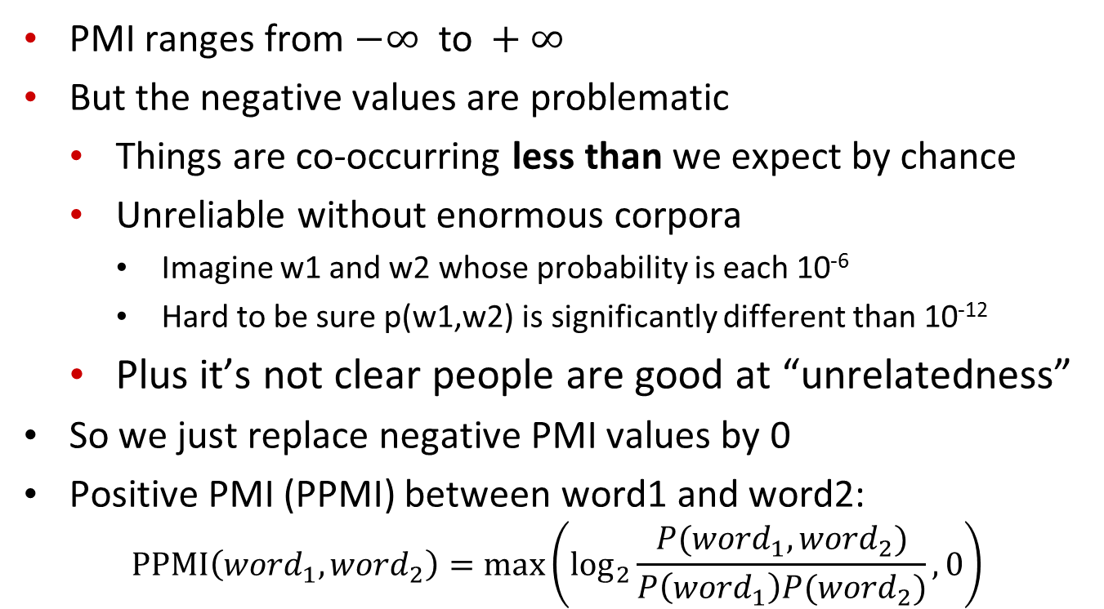
Positive Pointwise Mutual Information
  PMI ranges from $−∞ \text{to} +∞$
  But the negative values are problematic
    Things are co-occurring less than we expect by chance
    Unreliable without enormous corpora
      Imagine w1 and w2 whose probability is each 10⁻⁶
      Hard to be sure p(w1,w2) is significantly different than 10⁻¹²
    Plus it’s not clear people are good at “unrelatedness”
  So we just replace negative PMI values by 0
  Positive PMI (PPMI) between word1 and word2:
$$\text{PPMI}\left({word}_{1}, {word}_{2}\right)=\max\left({\text{log}}_{2}\frac{P({word}_{1}, {word}_{2})}{P\left({word}_{1}\right)P({word}_{2})},0\right)$$

Slide 36
PMI example

Slide 37
Other popular vector representations
Dense vector representations (less dimensions):
  Singular value decomposition applied to word-word PointWise-MI matrix
  Neural-Network-inspired models (skip-grams, CBOW)
Notes:
Less dimensions!
SVD to produce word embeddings:
applied to word-word PPMI matrix

Slide 38
WS Distributional Methods (3)
Similarity between vectors
v
α
w
Not sensitive to extreme values
Normalized (weighted) number of overlapping features
Notes:
Ex 64 million word corpus

Slide 39
Learning Goals for today’s class
You can:
Describe and Justify metrics to compute the similarity/distance of two concepts in an ontology
Describe and Justify distributional metrics to compute the similarity/distance of two words (or phrases) in a Natural Language

Slide 40
Next class Mon: Paper Discussion
Assignment-3 out – due Nov 20
(8-18 hours – working in pairs is strongly advised)
Next class Wed
Natural language Processing: Context free grammars and parsing

