Slide 1
Intelligent Systems (AI-2)
Computer Science cpsc422, Lecture 29
Nov, 17, 2017

Slide 2
422 big picture: Where are we?
Hybrid: Det +Sto
Prob CFG
Prob Relational Models
Markov Logics
Deterministic
Stochastic
Belief Nets
Logics
Approx. : Gibbs
First Order Logics
Markov Chains and HMMs
Ontologies
Forward, Viterbi….
Approx. : Particle Filtering
Query
Full Resolution
SAT
Undirected Graphical Models
Markov Networks
Conditional Random Fields
Markov Decision Processes and
Partially Observable MDP
Planning
Value Iteration
Approx. Inference
Reinforcement Learning
Representation
Applications of AI
Reasoning
Technique
Notes:
First Order Logics (will build a little on Prolog and 312)
Temporal reasoning from NLP 503 lectures
Reinforcement Learning (not done in 340, at least in the latest offering)
Markov decision process
Set of states S, set of actions A
Transition probabilities to next states P(s’| s, a′)
Reward functions R(s, s’, a)
RL is based on MDPs, but
Transition model is not known
Reward model is not known
While for MDPs we can compute an optimal policy
RL learns an optimal policy

Slide 3
NLP: Knowledge-Formalisms Map
(including probabilistic formalisms)
State Machines (and prob. versions)
(Finite State Automata, Finite State Transducers, Markov Models)
Morphology
Machine Learning
Neural Models, Neural Sequence Modeling
Syntax
Rule systems (and prob. versions)
(e.g., (Prob.) Context-Free Grammars)
Semantics
Pragmatics
Discourse and Dialogue
Logical formalisms (First-Order Logics, Prob. Logics)
AI planners (MDP Markov Decision Processes)
Notes:
My Conceptual map - This is the master plan
Markov Models used for part-of-speech and dialog
Syntax is the study of formal relationship between words
How words are clustered into classes (that determine how they group and behave)
How they group with they neighbors into phrases

Slide 4
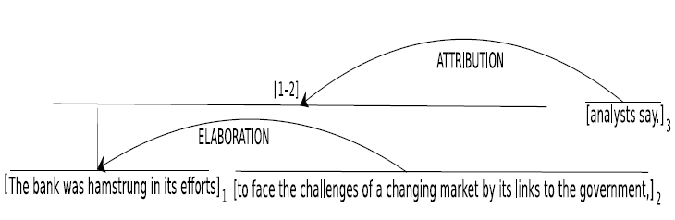
Discovering Discourse Structure: Computational Tasks
The bank was hamstrung in its efforts to face the challenges of a changing market by its links to the government, analysts say.
Discourse Segmentation
The bank was hamstrung in its efforts
to face the challenges of a changing
market by its links to the government,
analysts say.
1
2
3
Discourse Parsing
Notes:
Discourse analysis in RST involves two subtasks. 1. breaking the text into EDUs, known as discourse segmentation, 2. linking the EDUs into a labeled hierarchical tree structure, known as discourse parsing.

Slide 5
Some general points
Intelligent Systems are complex; often integrating many R&R systems + Machine Learning
Conditional random fields, Syntactic parsing / Wordnet / Lexical Chains, Logistic regression….
Discourse Parsing is a task we are very good at, here at UBC ;-)
  2 grad students working on/with it right now
  (several in the past)
Demo

Slide 6
Applications
Detect Controversiality in online asynchronous conversations - 2014
Summarize evaluative text (e.g., customer reviews) (journal paper 2016)
"Using Discourse Structure Improves Machine Translation Evaluation“ ACL 2014
Others ACL 2017 improvements in text categorization UofW
Coling 2016 – Semi-supervised data enrichment
SigDial 2017 – joint neural model with Sentiment
Some recent extensions

Slide 7
Current Work My group
Improve on Coling paper – using a framework called data programming (Smart ensembling based on graphical models)
Applied discourse features in detecting dementia from user generated text (did nto work ☹ )

Slide 8
State-of the art 2017

Slide 9
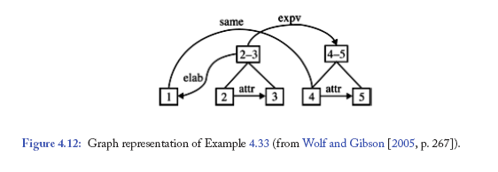
Graph Structure
Example 4.33 (1) Mr. Baker’s assistant for inter-American affairs, Bernard Aronson, (2) while maintaining (3) that the Sandinistas had also broken the cease-fire, (4) acknowledged: (5) “It’s never very clear who starts what.”
Notes:
There are two issues in particular that have prompted some researchers to opt for more general
representational devices, i.e., different types of graphs: crossing branches in the descriptions, and
nodes with multiple parents.

Slide 10
Some Questions

Slide 11
Some Questions
" Our discourse parser assumes that the input text has been already segmented into elementary discourse units. " Why do we need this kind of assumption?
What is is the disadvantage when using DCRFs for sequence modelling compared to Hidden Markov Models and MRFs?
method works for blogs or emails
Could this be easily modified to detect the unnecessary words/sentences of a body of text?
Discourse structure can also play important roles in sentiment analysis". Is there any work in progress in your lab that is related to this?

Slide 12
Some Questions
Features, n-grams,
also seperately parse for DT of distinct paragraphs before building the final K probable discourse trees for the document?
Graph structure of discourse
How can the document parser account for different writing styles? ie
aren't issues like "leaky boundaries" much more likely to arise in less formal writing, like a short story, than in a how-to-do manual?

Slide 13
Our Discourse Parser
Discourse Parsing State of the art limitations:
Structure and labels determined separately
Do not consider sequential dependency
Suboptimal algorithm to build structure
Our Discourse Parser addresses these limitations
Layered CRFs + CKY-like parsing
Notes:
a parsing model
assigns a probability to every possible DT, and
a parsing algorithm identifies the most probable
DT.
Very speculative!
Previous work on discourse analysis has been
quite successful in identifying what machine learning
approaches and what kinds of features are more
useful for automatic discourse segmentation and
parsing (e.g., (2003), (2005), (2009) and (2010)).
However, all the proposed solutions suffer from at
least one of the following two key limitations: first,
they make strong independence assumptions on the
structure and the labels of the resulting parse tree
and typically model the construction of the tree and
the labeling of the relations separately; second, they
apply a greedy, sub-optimal algorithm to build the
structure of the parse tree.
In this paper, we propose a new discourse parser
that effectively addresses both these limitations. The
crucial component of our parser is a probabilistic
discriminative parsing model, expressed as a dynamic
Conditional Random Field (Lafferty et al.,
2001). By representing the structure and the relation
of each parse tree constituent jointly and by
explicitly capturing the sequential and hierarchical
dependencies between constituents, our CRF
model does not make any independence assumptions
among these properties. Furthermore, our parsing
model supports a probabilistic CKY-like parsing algorithm
which is non-greedy and provably optimal.

Slide 14
Our Parsing Model
Model structure and label jointly
R₂
R₃
R_{j}
R_{k-1}
R_{k}
Relation at level i
R ϵ {1 .. M}
--
--
S₂
S₃
S_{j}
S_{k-1}
S_{k}
Structure at level i
S ϵ {0, 1}
--
--
W₁
W₂
W₃
--
W_{j}
--
W_{k-1}
W_{k}
Spans at level i
Dynamic Conditional Random Field (DCRF) [Sutton et al, 2007]
Models sequential dependencies
Notes:
Keeping all these requirements in mind we have come up with the following parsing model. Given this observed sequence of spans at level i of a DT, we put a hidden sequence of binary structure nodes where node S3 indicates whether spans W2 and W3 should be connected or not and so on. Then on top of that we put another hidden sequence of multinomial nodes. Here R3 indicates if W2 and W3 are connected then what should be the relation.

Slide 15
Discourse Parsing: Evaluation
Corpora/Datasets
RST-DT corpus
(Carlson & Marcu, 2001)
Instructional corpus
(Subba & Di-Eugenio, 2009)
385 news articles
-Train: 347 (7673 sentences)
-Test: 38 (991 sentences)
176 how-to-do manuals
  3430 sentences
Excellent Results (beat state-of-the-art by a wide margin): [EMNLP-2012, ACL-2013]

Slide 16
Discourse Parsing: Example
What is the main claim in a message and how it is expanded/supported by the other claims
“It would be great to hire Mary. Even though she may initially need some coaching , her background is perfect for the job.”
MAIN-CLAIM
EVIDENCE
It would be great to hire Mary.
her background is perfect for the job.
CONCESSION
Even though, she may initially need some coaching
Notes:
For each post

Slide 17
Discourse Parsing Task
Assume a text is already segmented into EDUs.
e₁
e₂
e₃
Discourse parsing
Label
Structure
Relation +
Nuclearity
r₁₋₃
r₂₋₃
e₁
e₂
e₃
e₁
e₂
e₃
e₁
e₂
e₃
Notes:
Let’s move on to our discourse parser. For now, assume that a sentence is already segmented into EDUs either by an automatic segmenter or manually. Let’s say we’ve three EDUs in a sentence. Now, the discourse parsing problem is to find the right structure of the DT. For example, here given these three EDUs, whether to connect EDU 2 and 3 first, then connect the resultant span with EDU1 or whether to connect EDU 1 and 2 first, then the larger span with 3. Then, finding the labels of the internal nodes. That is , the rhetorical relation and the nuclearity statuses of the spans.

Slide 18
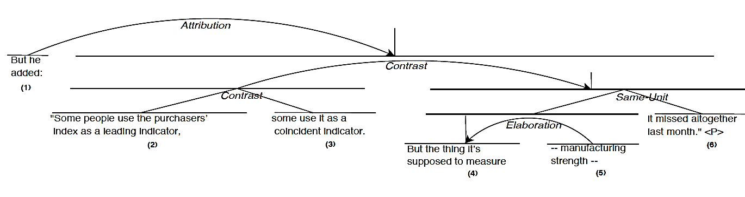
Observations (1)
Nb of valid trees grows exponentially with the Nb of EDUs.
?
Leaky
80% of the 5% merge with the adjacent sentences.
Sliding window: build DTs for two adjacent sentences.
More than 95% sentences have a well-defined DT.
Build DTs for sentences first, then build on top of those.

Slide 19
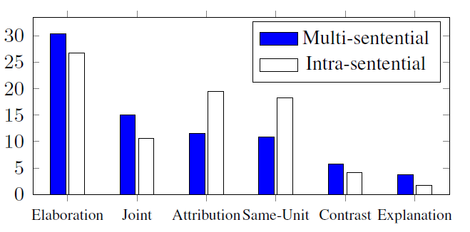
Observations (2)
Single model or two different models?
Relations are distributed differently.
Features don’t generalize.

Slide 20
Outline
Previous work
Discourse analysis framework
Corpora/datasets
Evaluation metrics
Experiments
Conclusion and future work

Slide 21
Previous Work (1)
Soricut & Marcu, (2003)
Hernault et al. (2010)
SPADE
Segmenter
&
Parser
HILDA
Segmenter
&
Parser
Sentence
level
Document
level
Generative approach √
Lexico-syntactic features √
Structure & Label dependent Х
Sequential dependencies Х
Hierarchical dependencies Х
Discriminative approach √
Structure & Label Jointly Х
Optimal Х
Sequential dependencies Х
Separate models Х
Newspaper (WSJ) articles
Notes:
Let me briefly describe the previous work in this context…

Slide 22
Previous Work (2)
Feng & Hirst, (2012)
Subba & Di-Eugenio, (2009)
HILDA
Shift-reduce
Only
Parser
More linguistic features
Sentence + Document level
ILP-based classifier √
Compositional semantics √
Optimal Х
Sequential dependencies Х
Hierarchical dependencies Х
Separate models Х
Dependency & constituency
Contextual
Discourse rules
Lexical similarity
Cue phrases
WSJ articles
Instructional manuals

Slide 23
Requirements from Our Parser
Joint modeling of structure and relation
Sequential and hierarchical dependencies
Discriminate intra- vs. multi-sentential parsing
Handle leaky sentence boundaries
Optimal parsing algorithm
Support k-best discourse parsing and reranking

Slide 24
Our Discourse Analysis Framework: CODRA
Parser
Segmenter
Segmentation
model
(MaxEnt)
Alg.
Alg.
Doc
EDUs
DT
Model
Model
Intra-
Sentential
Multi-
Sentential
Human: 98.3 (F-score)
Our (state-of-the-art): 90.1

Slide 25
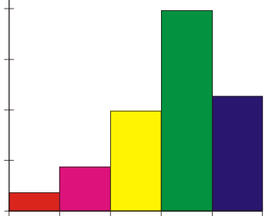
Our Discourse Parser
Parsing model (different for intra- and multi-sentential)
Assign probabilities to candidate DTs and their constituents.
R₁₋₃
R₁₋₃
R ranges over set of relations
R₂₋₃
R₁₋₂
e₁
e₂
e₃
e₁
e₂
e₃
Parsing algorithm (same for intra- and multi-sentential)
r₁₋₃
Find the (k-)most probable DT(s)
r₁₋₂
e₁
e₂
e₃

Slide 26
The Sentence-level Parsing Model
Structure and label jointly
Sequential dependencies
R₂
R₃
R_{j}
R_{t-1}
R_{t}
Relation at level i
R ϵ {1 .. M}
--
--
S₂
S₃
S_{j}
S_{t-1}
S_{t}
Structure at level i
S ϵ {0, 1}
--
--
W₁
W₂
W₃
W_{j}
W_{t-1}
W_{t}
Units at level i
--
--
Dynamic Conditional Random Field (DCRF) [Sutton et al, 2007]
Notes:
Keeping all these requirements in mind we have come up with the following parsing model. Given this observed sequence of spans at level i of a DT, we put a hidden sequence of binary structure nodes where node S3 indicates whether spans W2 and W3 should be connected or not and so on. Then on top of that we put another hidden sequence of multinomial nodes. Here R3 indicates if W2 and W3 are connected then what should be the relation.

Slide 27
Obtaining Probabilities (Sentence-level)
Apply DCRF recursively at different levels and compute posterior marginals of relation-structure pairs
R₂
R₃
R₄
P(R₂,S₂=1|e1,e2,e3,e4, Ɵ)
Level 1
P(R₃,S₃=1|e1,e2,e3,e4, Ɵ)
S₂
S₃
S₄
P(R₄,S₄=1|e1,e2,e3,e4, Ɵ)
Level 2
e₁
e₂
e₃
e₄
R₃
R₄
R₂₋₃
R₄
R₂
R₃₋₄
S₃
S₄
S₂₋₃
S₄
S₂
S₃₋₄
e₁₋₂
e₃
e₄
e₁
e₂₋₃
e₄
e₁
e₂
e₃₋₄

Slide 28
Obtaining Probabilities (Sentence-level)
Apply DCRF recursively at different levels and compute posterior marginals of relation-structure pairs
Level 3
R₄
R₂₋₄
R₃₋₄
S₄
S₂₋₄
S₃₋₄
e₁₋₃
e₄
e₁
e₂₋₄
e₁₋₂
e₃₋₄

Slide 29
Multi-sentential Parsing
Why not the same model used for intra-sentential?
“Fat” chain-structure=> exact inference=> Forwards-backwards
Forwards-backwards costs O(TM²) for a sequence.
# of possible sequences for a doc. with n sentences: O(n³)
Total training cost: O(D TM² n³)
Not scalable to document-level
Notes:
Keeping all these requirements in mind we have come up with the following parsing model. Given this observed sequence of spans at level i of a DT, we put a hidden sequence of binary structure nodes where node S3 indicates whether spans W2 and W3 should be connected or not and so on. Then on top of that we put another hidden sequence of multinomial nodes. Here R3 indicates if W2 and W3 are connected then what should be the relation.

Slide 30
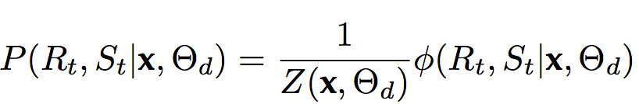
Multi-sentential Parsing Model
Model structure and label jointly
Relation
R ϵ {1 .. M}
R_{t}
Break the chain-structure
Structure
S ϵ {0, 1}
S_{t}
CRF
Units at level i
W_{t-1}
W_{t}
Inference costs O(M²)
Allows balancing
Dramatically reduces learning time
Notes:
Keeping all these requirements in mind we have come up with the following parsing model. Given this observed sequence of spans at level i of a DT, we put a hidden sequence of binary structure nodes where node S3 indicates whether spans W2 and W3 should be connected or not and so on. Then on top of that we put another hidden sequence of multinomial nodes. Here R3 indicates if W2 and W3 are connected then what should be the relation.

Slide 31
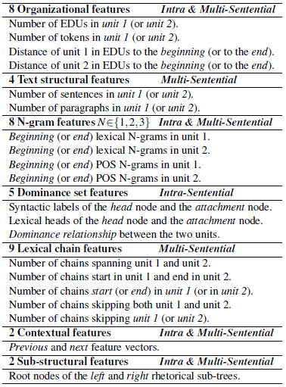
Features Used in Parsing Models
Hierarchical dependencies

Slide 32
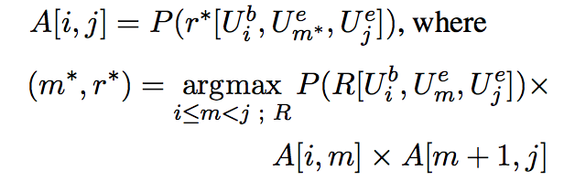
Parsing Algorithm (1)
Probabilistic CKY-like bottom-up algorithm
4Х4
4 EDUs
A
R ranges over set of relations
Finds global optimal
Notes:
Given that we know the prob of all possible DT constituents, the job of the parsing algorithm is to find the most probable DT.

Slide 33
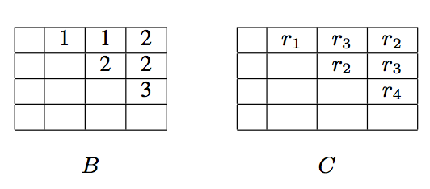
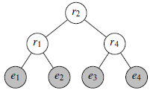
Parsing Algorithm (2)
A
Notes:
Given that we know the prob of all possible DT constituents, the job of the parsing algorithm is to find the most probable DT.

Slide 34
k-best Parsing
Extension to k-best is straight-forward
Store and keep track of k-best candidates at each step
Complexity for n discourse units and M relations
1-best parsing
k-best parsing
Time: O(n³M)
Space: O(n²)
Time: O(n³Mk²log k) Space: O(n²k)
See (Huang and Chiang, 2005) for cleverer ways to reduce the complexity.
Notes:
Given that we know the prob of all possible DT constituents, the job of the parsing algorithm is to find the most probable DT.

Slide 35
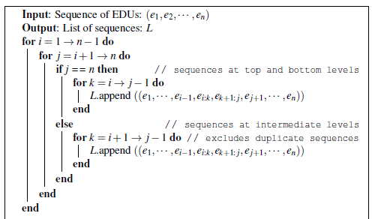

Slide 36
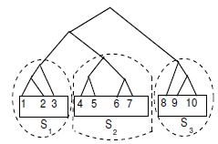
Combining Intra and Multi-sentential (1)
Most sentences have a well-defined DT.
Build DTs for sentences first, then build on top of those
Multi-sentential
1S-1S
Intra-sentential

Slide 37
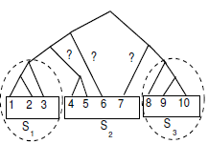
Combining Intra- and Multi-sentential (2)
leaky
5% sentences have leaky boundaries in RST-DT.
12% sentences have leaky boundaries in Instructional domain.
80% of the 5% merge with the adjacent sentences in RST-DT.
75% of the 12% merge with the adjacent sentences in Inst. dom.

Slide 38
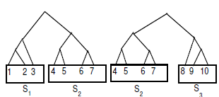
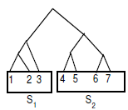
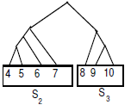
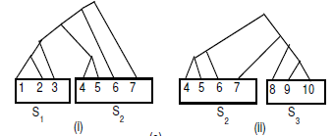
Combining Intra- and Multi-sentential (3)
Apply intra-sentential parser to each window of 2 sentences and consolidate the decisions to generate sentence-level sub-trees.
Sliding Window
Consolidation:
a) Same in both DTs.
b) Different but no cross.
c) Cross.

Slide 39
Experiments: Corpora/Datasets
RST-DT corpus
(Carlson & Marcu, 2001)
Instructional corpus
(Subba & Di-Eugenio, 2009)
385 news articles
-Train: 347 (7673 sent.)
-Test: 38 (991 sent.)
176 how-to-do manuals
  3430 sentences
Relations
26 primary relations
Reversal of non-commutative as separate relations
76 with Nucleus-Satellite
Relations
18 relations
41 with Nucleus-Satellite

Slide 40
Experiments: Intra-sentential Parsing
Results based on manual segmentation
 | RST-DT |  |  |  | Instructional
 | Test set |  | 10-fold | Doubly | S&E | 10-fold
Scores | SPADE | OUR | OUR | Human | ILP | OUR
Span | 93.5 | 96.5 | 95.7 | 95.7 | 92.9 | 98.3
Nuclearity | 85.8 | 89.4 | 88.6 | 90.4 | 71.8 | 89.4
Relation | 67.6 | 79.8 | 78.9 | 83.0 | 63.0 | 75.8
Our model outperforms the state-of-the-art by a wide margin, especially on relation labeling

Slide 41
Experiments: Intra-sentential Parsing
Parsing based on automatic segmentation
 | RST-DT |  |  | Instructional
 | Test set |  | 10-fold | 10-fold
Scores | SPADE | DCRF | DCRF | DCRF
Span | 76.7 | 82.4 | 80.1 | 76.9
Nuclearity | 70.2 | 76.6 | 75.2 | 67.6
Relation | 58.0 | 67.5 | 66.8 | 57.5
Our model outperforms SPADE by a wide margin
Inaccuracies in segmentation affects parsing on
Instructional corpus

Slide 42
Experiments: Document-level Parsing
Results based on manual segmentation
 | RST-DT |  |  |  | Instructional
Scores | HILDA | OUR (1-1) | OUR (SW) | Human | ILP | OUR (1-1) | OUR (SW)
Span | 74.7 | 82.6 | 83.8 | 88.7 | 70.4 | 80.7 | 82.5
Nuclearity | 60.0 | 68.3 | 68.9 | 77.7 | 49.5 | 63.0 | 64.8
Relation | 44.3 | 55.8 | 55.9 | 65.8 | 35.4 | 43.5 | 44.3
Our model outperforms the state-of-the-art by a wide margin.
Not significant difference between 1S-1S and SW in RST-DT.

Slide 43
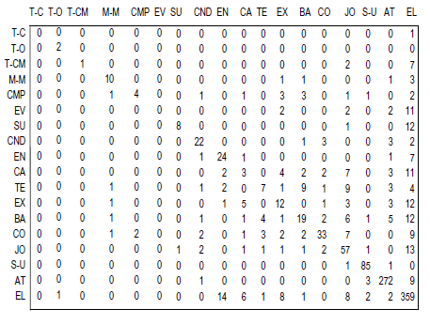
Error Analysis: Relation Labeling
Most frequent ones confuse less frequent ones
Hard to distinguish semantically similar relations
Notes:
especially the ones which are semantically similar (e.g., Explanation, Background)
and less frequent (e.g., Summary, Evaluation). Furthermore, our models sometimes fail
to distinguish relations that are semantically similar (e.g., Temporal vs. Background, Cause
vs. Explanation).

Slide 44
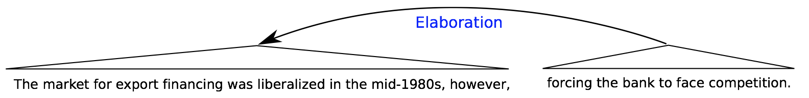
Error Analysis: Examples
Confusion between Cause/Background and Elaboration
Cause
Background
Notes:
Figure 21 presents two examples where our parser mistakenly labels Background and
Cause as Elaboration. However, notice that the two discourse relations (i.e., Background
vs. Elaboration and Cause vs. Elaboration) in these examples are semantically very close,
and arguably both can be applicable.

Slide 45
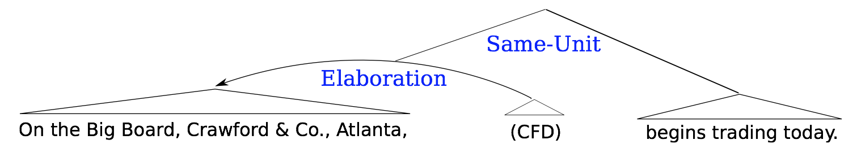
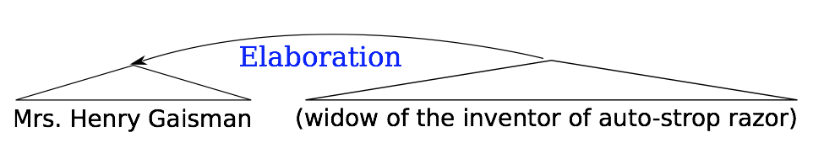
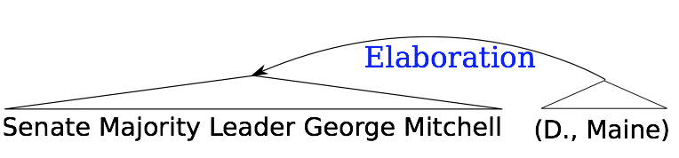
Error Analysis: Examples
Confusion between Summary and Elaboration
Summary

Slide 46
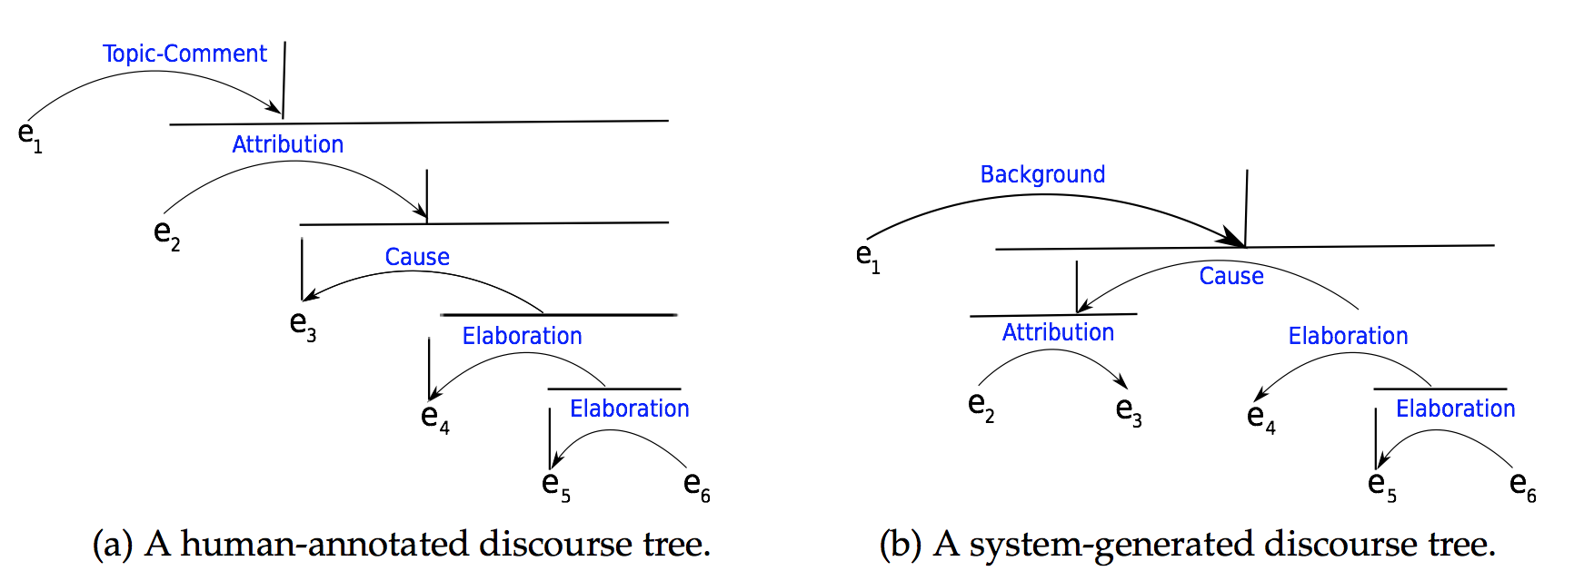
Error Analysis: Examples
Long range structural dependencies
K-best reranking with Tree Kernels

Slide 47

A Novel Discriminative Framework for Sentence-Level Discourse Analysis
Shafiq Joty
In collaboration with
Giuseppe Carenini, Raymond T. Ng
Notes:
In this talk, I will present a novel discriminative framework for sentence-level discourse analysis. But as we will see our approach can easily be extended to multi-sentential text.

Slide 48
Discourse Analysis in RST
The bank was hamstrung in its efforts to face the challenges of a changing market by its links to the government, analysts say.
Nucleus
Relation
Satellite
Relation
Nucleus
Satellite
EDU
EDU
EDU
Notes:
Rhetorical structure theory posits a tree structure of discourse called a DT. The leaves of a DT correspond to contiguous atomic textual spans, also called EDUs. The adjacent EDUs and larger textual spans are connected by a rhetorical relation. A span linked by a relation can be either nucleus or satellite depending on how central the message is to the author.

Slide 49
Motivation
Text summarization (Marcu, 2000)
Text generation (Prasad et al., 2005)
Sentence compression (Sporleder & Lapata, 2005)
Question Answering (Verberne et al., 2007)
Notes:
So why do we care about discourse parsing? It has been

Slide 50
Outline
Previous work
Discourse parser
Discourse segmenter
Corpora/datasets
Evaluation metrics
Experiments
Conclusion and future work

Slide 51
Previous Work (1)
Soricut & Marcu, (2003)
Hernault et al. (2010)
SPADE
Segmenter
&
Parser
HILDA
Segmenter
&
Parser
Sentence
level
Document
level
Generative approach √
Lexico-syntactic features √
Structure & Label dependent Х
Sequential dependencies Х
Hierarchical dependencies Х
SVMs √
Large feature set √
Optimal Х
Sequential dependencies Х
Hierarchical dependencies √
Newspaper articles

Slide 52
Previous Work (2)
Subba & Di-Eugenio, (2009)
Fisher & Roark (2007)
Shift-reduce
Only
Parser
Binary log-linear
Only
Segmenter
Sentence + Document level
State-of-the-art performance
Parse-tree features are important
ILP-based classifier √
Compositional semantics √
Optimal Х
Sequential dependencies Х
Hierarchical dependencies Х
Instructional manuals

Slide 53
Discourse Parsing
Assume a sentence is already segmented into EDUs.
e₁
e₂
e₃
Discourse parsing
Label
Structure
Relation +
Nuclearity
e₁₋₃
e₁₋₃
r₁₋₃
e₂₋₃
e₁₋₂
r₂₋₃
e₁
e₂
e₃
e₁
e₂
e₃
e₁
e₂
e₃
Notes:
Let’s move on to our discourse parser. For now, assume that a sentence is already segmented into EDUs either by an automatic segmenter or manually. Let’s say we’ve three EDUs in a sentence. Now, the discourse parsing problem is to find the right structure of the DT. For example, here given these three EDUs, whether to connect EDU 2 and 3 first, then connect the resultant span with EDU1 or whether to connect EDU 1 and 2 first, then the larger span with 3. Then, finding the labels of the internal nodes. That is , the rhetorical relation and the nuclearity statuses of the spans.

Slide 54
Our Discourse Parser
Parsing model
R₁₋₃
R₁₋₃
R ranges over set of relations
Assign probabilities to DTs.
R₂₋₃
R₁₋₂
e₁
e₂
e₃
e₁
e₂
e₃
Parsing algorithm
r₁₋₃
Find the most probable DT
r₁₋₂
e₁
e₂
e₃

Slide 55
Requirements for Our Parsing Model
Discriminative
Joint model for Structure and Label
Sequential dependencies
Hierarchical dependencies
Should support an optimal parsing algorithm

Slide 56
Our Parsing Model
Model structure and label jointly
R₂
R₃
R_{j}
R_{k-1}
R_{k}
Relation at level i
R ϵ {1 .. M}
--
--
S₂
S₃
S_{j}
S_{k-1}
S_{k}
Structure at level i
S ϵ {0, 1}
--
--
W₁
W₂
W₃
--
W_{j}
--
W_{k-1}
W_{k}
Spans at level i
Dynamic Conditional Random Field (DCRF) [Sutton et al, 2007]
Models sequential dependencies
Notes:
Keeping all these requirements in mind we have come up with the following parsing model. Given this observed sequence of spans at level i of a DT, we put a hidden sequence of binary structure nodes where node S3 indicates whether spans W2 and W3 should be connected or not and so on. Then on top of that we put another hidden sequence of multinomial nodes. Here R3 indicates if W2 and W3 are connected then what should be the relation.

Slide 57
Obtaining probabilities
Apply DCRF recursively at different levels and compute posterior marginals of relation-structure pairs
R₂
R₃
R₄
Level 1
S₂
S₃
S₄
Level 2
e₁
e₂
e₃
e₄
R₃
R₄
R₂₋₃
R₄
R₂
R₃₋₄
S₃
S₄
S₂₋₃
S₄
S₂
S₃₋₄
e₁₋₂
e₃
e₄
e₁
e₂₋₃
e₄
e₁
e₂
e₃₋₄

Slide 58
Obtaining probabilities
Apply DCRF recursively at different levels and compute posterior marginals of relation-structure pairs
Level 3
R₄
R₂₋₄
R₃₋₄
S₄
S₂₋₄
S₃₋₄
e₁₋₃
e₄
e₁
e₂₋₄
e₁₋₂
e₃₋₄

Slide 59
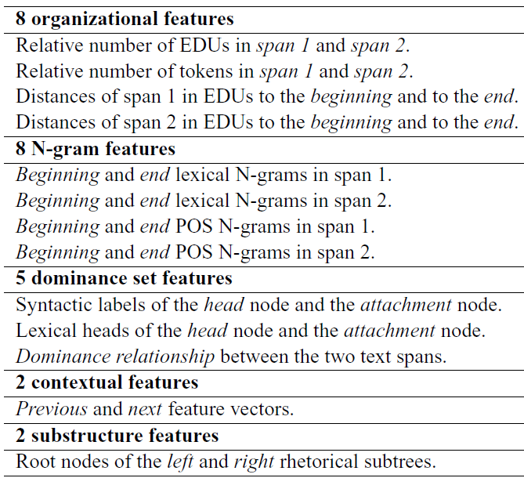
Features Used in Parsing Model
(SPADE)
Hierarchical dependencies

Slide 60

Parsing Algorithm
Probabilistic CKY-like bottom-up algorithm
4Х4
4 EDUs
DPT
D
Finds global optimal
Notes:
Given that we know the prob of all possible DT constituents, the job of the parsing algorithm is to find the most probable DT.

Slide 61
Outline
Previous work
Discourse parser
Discourse segmenter
Corpora/datasets
Evaluation metrics
Experiments
Conclusion and future work

Slide 62
Discourse Segmentation
The bank was hamstrung in its efforts to face the challenges of a changing market by its links to the government, analysts say.
Discourse Segmentation
The bank was hamstrung in its efforts
to face the challenges of a changing
market by its links to the government,
analysts say.
EDU
EDU
EDU
Segmentation is the primary source of inaccuracy (Soricut & Marcu, 2003)
Notes:
Discourse analysis in RST involves two subtasks. 1. breaking the text into EDUs, known as discourse segmentation, 2. linking the EDUs into a labeled hierarchical tree structure, known as discourse parsing.

Slide 63
Our Discourse Segmenter
Binary classification: boundary or no-boundary
Logistic Regression with L₂ regularization
Bagging to deal with sparse boundary tags
Features used
SPADE features
Chunk and POS features
Positional features
Contextual features

Slide 64
Corpora/Datasets
RST-DT corpus
(Carlson & Marcu, 2001)
Instructional corpus
(Subba & Di-Eugenio, 2009)
385 news articles
-Train: 347 (7673 sentences)
-Test: 38 (991 sentences)
176 how-to-do manuals
  3430 sentences
Relations
26 primary relations
Reversal of non-commutative as separate relations
70 with Nucleus-Satellite
Relations
18 relations
39 with Nucleus-Satellite

Slide 65
Evaluation Metrics
Metrics for parsing accuracy
(Marcu, 2000)
Unlabeled (Span)
Labeled (Nuclearity, Relation)
Precision, Recall
F-measure
Metric for segmentation accuracy
(Soricut & Marcu, 2003; Fisher & Roark, 2007)
Precision, Recall
F-measure
Intra-sentence EDU boundary
Notes:
To measure the parsing accuracy, we are using the unlabeled and labelled precision, recall and f-measure as described in Marcu’s book, these metrics are actually adopted from the syntactic parsing area. To measure the segmentation accuracy we are measuring the agreement based on intra-sentence EDU boundary. If a sentence contains 3 EDUs which correspond to 2 intra-sentence EDU boundaries, We measure the model’s ability to find these 2 boundaries.

Slide 66
Experiments (1)
Parsing based on manual segmentation
 | RST-DT |  |  |  | Instructional
 | Test set |  | 10-fold | Doubly | S&E | 10-fold
Scores | SPADE | DCRF | DCRF | Human | ILP | DCRF
Span | 93.5 | 94.6 | 93.7 | 95.7 | 92.9 | 97.7
Nuclearity | 85.8 | 86.9 | 85.2 | 90.4 | 71.8 | 87.2
Relation | 67.6 | 77.1 | 75.4 | 83.0 | 63.0 | 73.6
Our model outperforms the state-of-the-art by a wide margin, especially on relation labeling

Slide 67
Experiments (2)
Discourse segmentation
 | RST-DT |  |  |  |  |  | Instructional
 | Test set |  |  |  | 10-fold |  | 10-fold | 10-fold
Scores | HILDA | SPADE | F&R | LR | SPADE | LR | SPADE | LR
Precision | 77.9 | 83.8 | 91.3 | 88.0 | 83.7 | 87.5 | 65.1 | 73.9
Recall | 70.6 | 86.8 | 89.7 | 92.3 | 86.2 | 89.9 | 82.8 | 89.7
F-measure | 74.1 | 85.2 | 90.5 | 90.1 | 84.9 | 88.7 | 72.8 | 80.9
Human agreement (F-measure): 98.3
Our model outperforms SPADE and comparable to F&R
We use fewer features than F&R
Notes:
HILDA performs very poorly.

Slide 68
Experiments (3)
Parsing based on automatic segmentation
 | RST-DT |  |  | Instructional
 | Test set |  | 10-fold | 10-fold
Scores | SPADE | DCRF | DCRF | DCRF
Span | 76.7 | 80.3 | 78.7 | 71.9
Nuclearity | 70.2 | 73.6 | 72.2 | 64.3
Relation | 58.0 | 65.4 | 64.2 | 54.8
Our model outperforms SPADE by a wide margin
Inaccuracies in segmentation affects parsing on
Instructional corpus

Slide 69
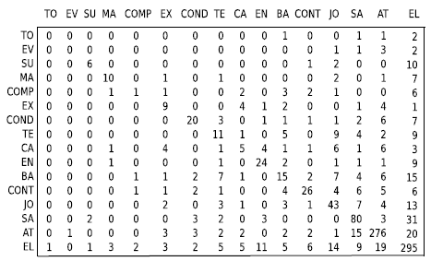
Error analysis (Relation labeling)
Most frequent ones confuse less frequent ones
Hard to distinguish semantically similar relations

Slide 70
Conclusion
Discriminative framework for discourse analysis.
Our parsing model:
  Discriminative
  Structure and label jointly
  Sequential and hierarchical dependencies
  Supports an optimal parsing algorithm
Our approach outperforms the state-of-the-art by a wide margin.

Slide 71
Future Work
Extend to multi-sentential text.
Can segmentation and parsing be done jointly?

