Slide 1
Intelligent Systems (AI-2)
Computer Science cpsc422, Lecture 11
Oct, 2, 2017

Slide 2
UBC Department of Computer Science
Undergraduate Events
More details @ https://my.cs.ubc.ca/students/development/events
Bloomberg LP Info Session
Mon. Oct. 2nd
6:00pm-7:30pm
I.K.B Room 261
Google Internship Panel
Mon. Oct. 2nd
5:45pm – 7:00pm
DMP 110
Free Cube Breakfast
Tues. Oct. 3rd
9:00am – 11:00am
ICICS 021
Move (Realtor.com) Info Session
Thurs. Oct. 5th
5:30pm – 7:00pm
DMP 101
Eventbase Job Fair
Wed. Oct. 11th
6:00pm – 8:30pm
Eventbase Downtown Office
Tesla Motors
Wed. Oct. 11th
6:00pm-8:00pm
I.K.B Room 182
Ericsson Innovation Awards Competition
Deadline: Wed. Nov. 15th, 2017
https://www.ericsson.com/en/events/eia-2018
David L. Squire Scholarship
Deadline: Wed. Nov. 15th, 2017
http://www.iticanada.ca/index.php/about-us/scholarships-closed

Slide 3
StarAI (statistical relational AI)
Hybrid: Det +Sto
422 big picture: Where are we?
Prob CFG
Prob Relational Models
Markov Logics
Deterministic
Stochastic
Belief Nets
Logics
Approx. : Gibbs
First Order Logics
Markov Chains and HMMs
Ontologies
Temporal rep.
Forward, Viterbi….
Approx. : Particle Filtering
Query
Full Resolution
SAT
Undirected Graphical Models
Markov Networks
Conditional Random Fields
Markov Decision Processes and
Partially Observable MDP
Planning
Value Iteration
Approx. Inference
Reinforcement Learning
Representation
Applications of AI
Reasoning
Technique
Notes:
First Order Logics (will build a little on Prolog and 312)
Temporal reasoning from NLP 503 lectures
Reinforcement Learning (not done in 340, at least in the latest offering)
Markov decision process
Set of states S, set of actions A
Transition probabilities to next states P(s’| s, a′)
Reward functions R(s, s’, a)
RL is based on MDPs, but
Transition model is not known
Reward model is not known
While for MDPs we can compute an optimal policy
RL learns an optimal policy

Slide 4
Lecture Overview
  Recap of BNs Representation and Exact Inference
  Start Belief Networks Approx. Reasoning
    Intro to Sampling
    First Naïve Approx. Method: Forward Sampling
    Second Method: Rejection Sampling

Slide 5
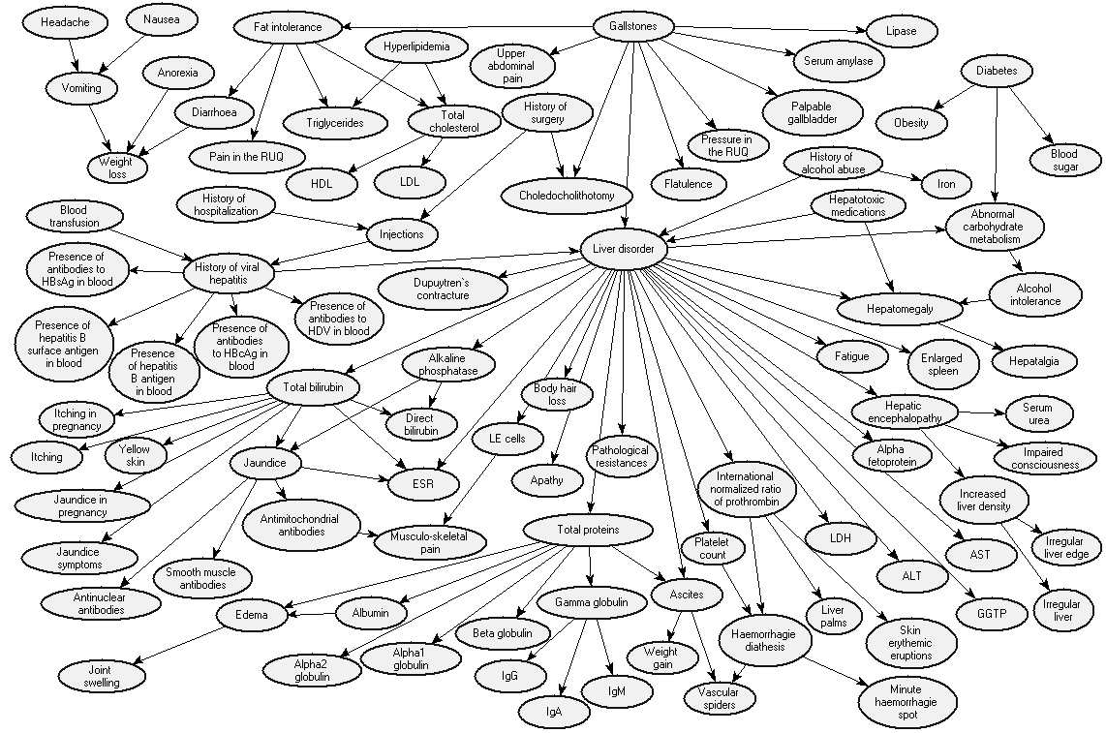
Realistic BNet: Liver Diagnosis
Source: Onisko et al., 1999

Slide 6
Revise (in)dependencies……

Slide 7
Conditional Independencies
Or, blocking paths for probability propagation. Three ways in which a path between X to Y can be blocked, (1 and 2 given evidence E )
Y
E
X
1
Z
Z
2
3
Z
  Note that, in 3, X and Y become dependent as soon as I get evidence on Z or on any of its descendants
Notes:
this is intuitive

Slide 8

Independence (Markov Blanket)
What is the minimal set of nodes that must be observed in order to make node X independent from all the non-observed nodes in the network

Slide 9
Independence (Markov Blanket)
A node is conditionally independent from all the other nodes in the network, given its parents, children, and children’s parents (i.e., its Markov Blanket ) Configuration B

Slide 10
Variable elimination algorithm: Summary
P(Z, Y₁…,Y_{j} , Z₁…,Z_{j} )
To compute P(Z| Y₁=v₁ ,… ,Y_{j}=v_{j} ) :
Construct a factor for each conditional probability.
Set the observed variables to their observed values.
Given an elimination ordering, simplify/decompose sum of products
  For all Z_{i} : Perform products and sum out Z_{i}
Multiply the remaining factors (all in ? )
Normalize: divide the resulting factor f(Z) by ∑_{Z} f(Z) .
Z
Notes:
They are all going to be only in Q

Slide 11
Variable elimination ordering
Is there only one way to simplify?
P(G,D=t) = ∑_{A,B,C,} f(A,G) f(B,A) f(C,G,A) f(B,C)
P(G,D=t) = ∑_{A} f(A,G) ∑_{B} f(B,A) ∑_{C} f(C,G,A) f(B,C)
P(G,D=t) = ∑_{A} f(A,G) ∑_{C} f(C,G,A) ∑_{B} f(B,C) f(B,A)
Notes:
The order in which the variables are summed out is called the elimination ordering
From textbook “Finding an elimination ordering that results in the smallest treewidth is NP-hard. However, some good heuristics exist. The most common is
min-factor: at each stage, select the variable that results in the smallest relation (factor). “

Slide 12
Complexity: Just Intuition…..
Tree-width of a network given an elimination ordering: max number of variables in a factor created while running VE.
Tree-width of a belief network : min tree-width over all elimination orderings (only on the graph structure and is a measure of the sparseness of the graph)
The complexity of VE is exponential in the tree-width ☹ and linear in the number of variables.
Also, finding the elimination ordering with minimum tree-width is NP-hard ☹ (but there are some good elimination ordering heuristics)
Notes:
The complexity of the algorithm depends on a measure of complexity of the network.
The size of a tabular representation of a factor is exponential in the number of variables in the factor.
In worst case scenario (e.g. fully connected network) exact inference is NP-hard
However space/time complexity is very sensitive to topology
In singly connected graphs (single path from any two nodes), time complexity of exact inference is polynomial in the number of nodes
Tree-width of a belief network : min tree-width over all elimination orderings? (only on the graph structure and is a measure of the sparseness of the graph)?

Slide 13
Lecture Overview
  Recap of BNs Representation and Exact Inference
  Start Belief Networks Approx. Reasoning
    Intro to Sampling
    First Naïve Approx. Method: Forward Sampling
    Second Method: Rejection Sampling
Notes:
In worst case scenario (e.g. fully connected network) exact inference is NP-hard
However space/time complexity is very sensitive to topology
In singly connected graphs (single path from any two nodes), time complexity of exact inference is polynomial in the number of nodes

Slide 14
Approximate Inference
Basic idea:
  Draw N samples from known prob. distributions
  Use those samples to estimate unknown prob. distributions
Why sample?
  Inference: getting a sample is faster than computing the right answer (e.g. with variable elimination)

Slide 15
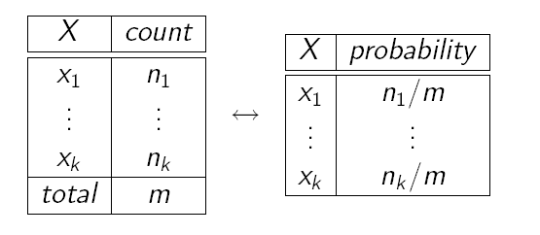
Sampling: What is it?
Idea: Estimate probabilities from sample data (samples) of the (unknown) probabilities distribution
Use frequency of each event in the sample data to approximate its probability
Frequencies are good approximations only if based on large samples
  we will see why and what “large” means
How do we get the samples?

Slide 16
We use Sampling
Sampling is a process to obtain samples adequate to estimate an unknown probability
How do we get samples?
Known prob. distribution(s)
Samples
Estimates for unknown (hard to compute) distribution(s)
Notes:
Sampling is a process to obtain samples adequate to estimate an unknown probability
The samples are generated from known probabilities distributions

Slide 17
Sampling
The building block on any sampling algorithm is the generation of samples from a know distribution
We then use these samples to derive estimates of probabilities hard-to-compute exactly

Slide 18
Generating Samples from a Known Distribution
For a random variable X with
  values {x₁,…,x_{k}}
  Probability distribution P(X) = {P(x₁),…,P(x_{k})}
Partition the interval [0, 1] into k intervals p_{i} , one for each x_{i} , with length P(x_{i} )
To generate one sample
    Randomly generate a value y in [0, 1] (i.e. generate a value from a uniform distribution over [0, 1].
    Select the value of the sample based on the interval p_{i} that includes y
From probability theory:
Notes:
Actually (0,1] interval of real numbers excluding 0 and including 1
(but this maybe confusing at first so let’s ignore it)

Slide 19
Sampling a discrete probability distribution (from 322)

Slide 20
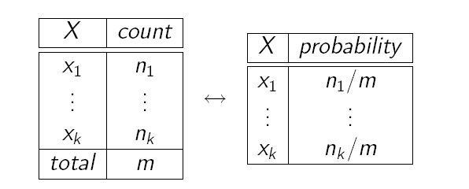
From Samples to Probabilities
Count total number of samples m
Count the number n_{i} of samples x_{i}
Generate the frequency of sample x_{i} as n_{i} / m
This frequency is your estimated probability of x_{i}

Slide 21
Sampling for Bayesian Networks
OK, but how can we use all this for probabilistic inference in Bayesian networks?
As we said earlier, if we can’t use exact algorithms to update the network, we need to resort to samples and frequencies to compute the probabilities we are interested in
We generate these samples by relying on the mechanism we just described

Slide 22
Sampling for Bayesian Networks (N)
Suppose we have the following BN with two binary variables
A
P(A=1)‏
0.3
A
P(B=1|A)‏
B
1
0
0.7
0.1
It corresponds to the joint probability distribution
  P(A,B) =P(B|A)P(A)
To sample from P(A,B) i.e., unknown distribution
  we first sample from P(A). Suppose we get A = 0.
  In this case, we then sample from….
  If we had sampled A = 1, then in the second step we would have sampled from
Notes:
It represents P(A,B) in a compact way
How can we generate samples for P(A,B)
First sample P(A) and depending on the value you obtain then sample the corresponding distribution in P(B|A)

Slide 23



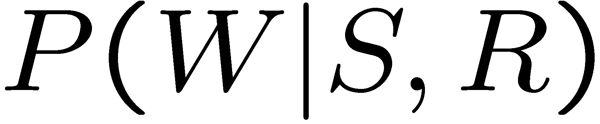
Prior (Forward) Sampling
+
-
+c | 0.5
-c | 0.5
Cloudy
Cloudy
+c | +s | 0.1
 | -s | 0.9
-c | +s | 0.5
 | -s | 0.5
+c | +r | 0.8
 | -r | 0.2
-c | +r | 0.2
 | -r | 0.8
Sprinkler
Sprinkler
Rain
Rain
WetGrass
WetGrass
Samples:
+s | +r | +w | 0.99
 |  | -w | 0.01
 | -r | +w | 0.90
 |  | -w | 0.10
-s | +r | +w | 0.90
 |  | -w | 0.10
 | -r | +w | 0.01
 |  | -w | 0.99
+c, -s, +r, +w
-c, +s, -r, +w
…

Slide 24
Example
We’ll get a bunch of samples from the BN:
  +c, -s, +r, +w
  +c, +s, +r, +w
  -c, +s, +r, -w
  +c, -s, +r, +w
  -c, -s, -r, +w
If we want to know P(W)
  We have counts <+w:4, -w:1>
  Normalize to get P(W) =
  This will get closer to the true distribution with more samples
Cloudy
Sprinkler
Rain
WetGrass
Notes:
<+w:0.8, -w:0.2>

Slide 25
Example
  Can estimate anything else from the samples, besides P(W), P(R) , etc:
  +c, -s, +r, +w
  +c, +s, +r, +w
  -c, +s, +r, -w
  +c, -s, +r, +w
  -c, -s, -r, +w
  What about P(C| +w)? P(C| +r, +w)? P(C| -r, -w)?
Cloudy
Sprinkler
Rain
WetGrass
  Can use/generate fewer samples when we want to estimate a probability conditioned on evidence?
Notes:
P(C| +w)? P(C| +r, +w)? P(C| -r, -w)?

Slide 26
Rejection Sampling
C
Let’s say we want P(S| +w)
  Ignore (reject) samples which don’t have W=+w
  This is called rejection sampling
  It is also consistent for conditional probabilities (i.e., correct in the limit)
S
R
W
  +c, -s, +r, +w
  +c, +s, +r, +w
  -c, +s, +r, -w
  +c, -s, +r, +w
  -c, -s, -r, +w
  See any problem as the number of evidence vars increases?
Notes:
He biggest problem with rejection sampling is that it end up rejecting so many samples!
The number of samples consistent with the evidence e drops exponentially as the number of
Evidence variables grows – unusable for complex problems
Let’s say we want P(S)
No point keeping all samples around
Just tally counts of S as we go

Slide 27

Hoeffding’s inequality
Suppose p is the true probability and s is the sample average from n independent samples.
  p above can be the probability of any event for random variable X = {X₁,…X_{n}} described by a Bayesian network
If you want an infinitely small probability of having an error greater than ε, you need infinitely many samples
But if you settle on something less than infinitely small, let’s say δ, then you just need to set
So you pick
  the error ε you can tolerate,
  the frequency δ with which you can tolerate it
And solve for n, i.e., the number of samples that can ensure this performance
(1)‏
Notes:
However, if you are willing to have an error greater than ε in δ of the cases

Slide 28
Hoeffding’s inequality
Examples:
  You can tolerate an error greater than 0.1 only in 5% of your cases
  Set ε =0.1, δ = 0.05
  Equation (1) gives you n > 184
(1)‏
If you can tolerate the same error (0.1) only in 1% of the cases, then you need 265 samples
If you want an error greater than 0.01 in no more than 5% of the cases, you need 18,445 samples

Slide 29
Learning Goals for today’s class
You can:
Motivate the need for approx inference in Bnets
Describe and compare Sampling from a single random variable
Describe and Apply Forward Sampling in BN
Describe and Apply Rejection Sampling
Apply Hoeffding's inequality to compute number of samples needed

Slide 30
TODO for Wed
Read textbook 6.4.2
Assignment-2 will be out today: Start working on it
Next research paper will be this coming Fri

