Slide 1
Intelligent Systems (AI-2)
Computer Science cpsc422, Lecture 9
Sep, 28, 2016

Slide 2
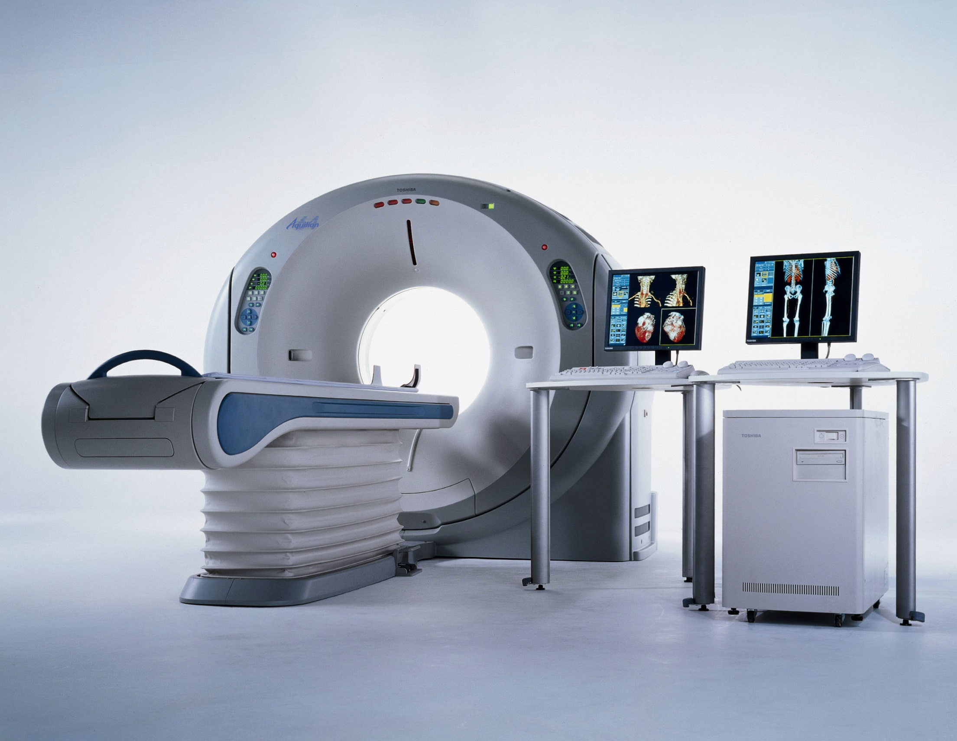
An MDP Approach to Multi-Category Patient Scheduling in a Diagnostic Facility
Adapted from: Matthew Dirks

Slide 3
Goal / Motivation
To develop a mathematical model for multi-category patient scheduling decisions in computed tomography (CT), and to investigate associated trade-offs from economic and operational perspectives.
Contributions to AI, OR and radiology

Slide 4
Types of patients:
Emergency Patients (EP)
  Critical (CEP)
  Non-critical (NCEP)
Inpatients (IP)
Outpatients
  Scheduled OP
  Add-on OP: Semi-urgent (OP)
(Green = Types used in this model)
Notes:
In facilities that perform CT scans there are varying degrees of urgency.
Assumptions:
Arriving CEPs scanned immediately (so no decision can be made here)
Scheduled OPs are scanned by a dedicated scanner (so, a 3rd scanner we don’t have access to)
Question: What if more than 2 CEPs? ?This model is not realistic, and is good only for theoretical/statistical analysis?
Scanning an OP first might lead to extra hospitalization for IP.
And IP staying overnight incurs cost penalty. Preferring IP over OP may lead to perceived loss of service-quality for the OP.

Slide 5
Proposed Solution
Finite-horizon MDP
Non-stationary arrival probabilities for IPs and EPs
Performance objective: Max $
Notes:
FINITE
Finite-Horizon MDPs are often used to model quantitative decision-making problems. Because guaranteed to find optimal policy whereas infinite can only approach optimality
Policies for infinite-horizon cases are actually simpler than those for finite-horizon cases because with no time-limit there is no reason to behave differently in the same state at different times, so the optimal policy is stationary.
So in this case, I think Finite-Horizon better suits since the day does have a finite length, and optimal policy may be different an hour before closing than at 9am
(b/c patients come in a varying probabilities)
THEY USE
Non-stationary arrival probabilities used for IP and EP
PERFORMANCE OBJECTIVE
Maximize expected net revenue over a work-day

Slide 6

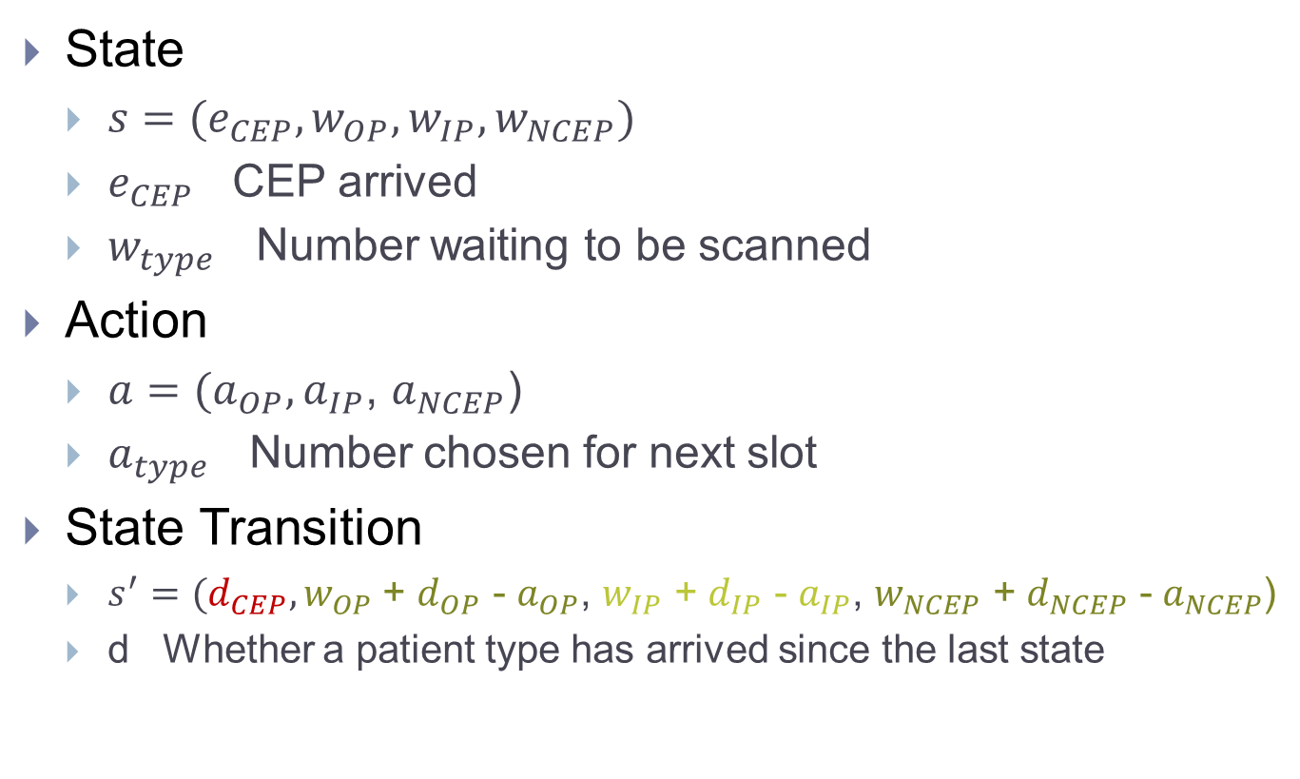
MDP Representation
State
  $s=(e_{CEP}, w_{OP}, w_{IP}, w_{NCEP})$
  $e_{CEP}$ CEP arrived
  $w_{type}$ Number waiting to be scanned
Action
  $a=(a_{OP},a_{IP}$, $a_{NCEP}$)
  $a_{type}$ Number chosen for next slot
State Transition
  $s^{′}=(d_{CEP},w_{OP}$ + $d_{OP}$ - $a_{OP}$, $w_{IP}$ + $d_{IP}$ - $a_{IP}$, $w_{NCEP}$ + $d_{NCEP}$ - $a_{NCEP}$)
  d Whether a patient type has arrived since the last state
Notes:
//Q: Would the optimal policy calculation change at all if critical emergency patients (CEP’s) were removed from the patient type domain?
Regarding CEPs. I don’t think the policy would change if they were removed, since the rule for CEPs is set in stone.
But it WOULD change # of slots available, and thus affect the results.
So, we don’t have to make a choice about whether to scan a CEP, but we do lose slots to those CEPs.

Slide 7
MDP Representation (cont’)
Transition Probabilities
Notes:
They also considered these in their analysis

Slide 8
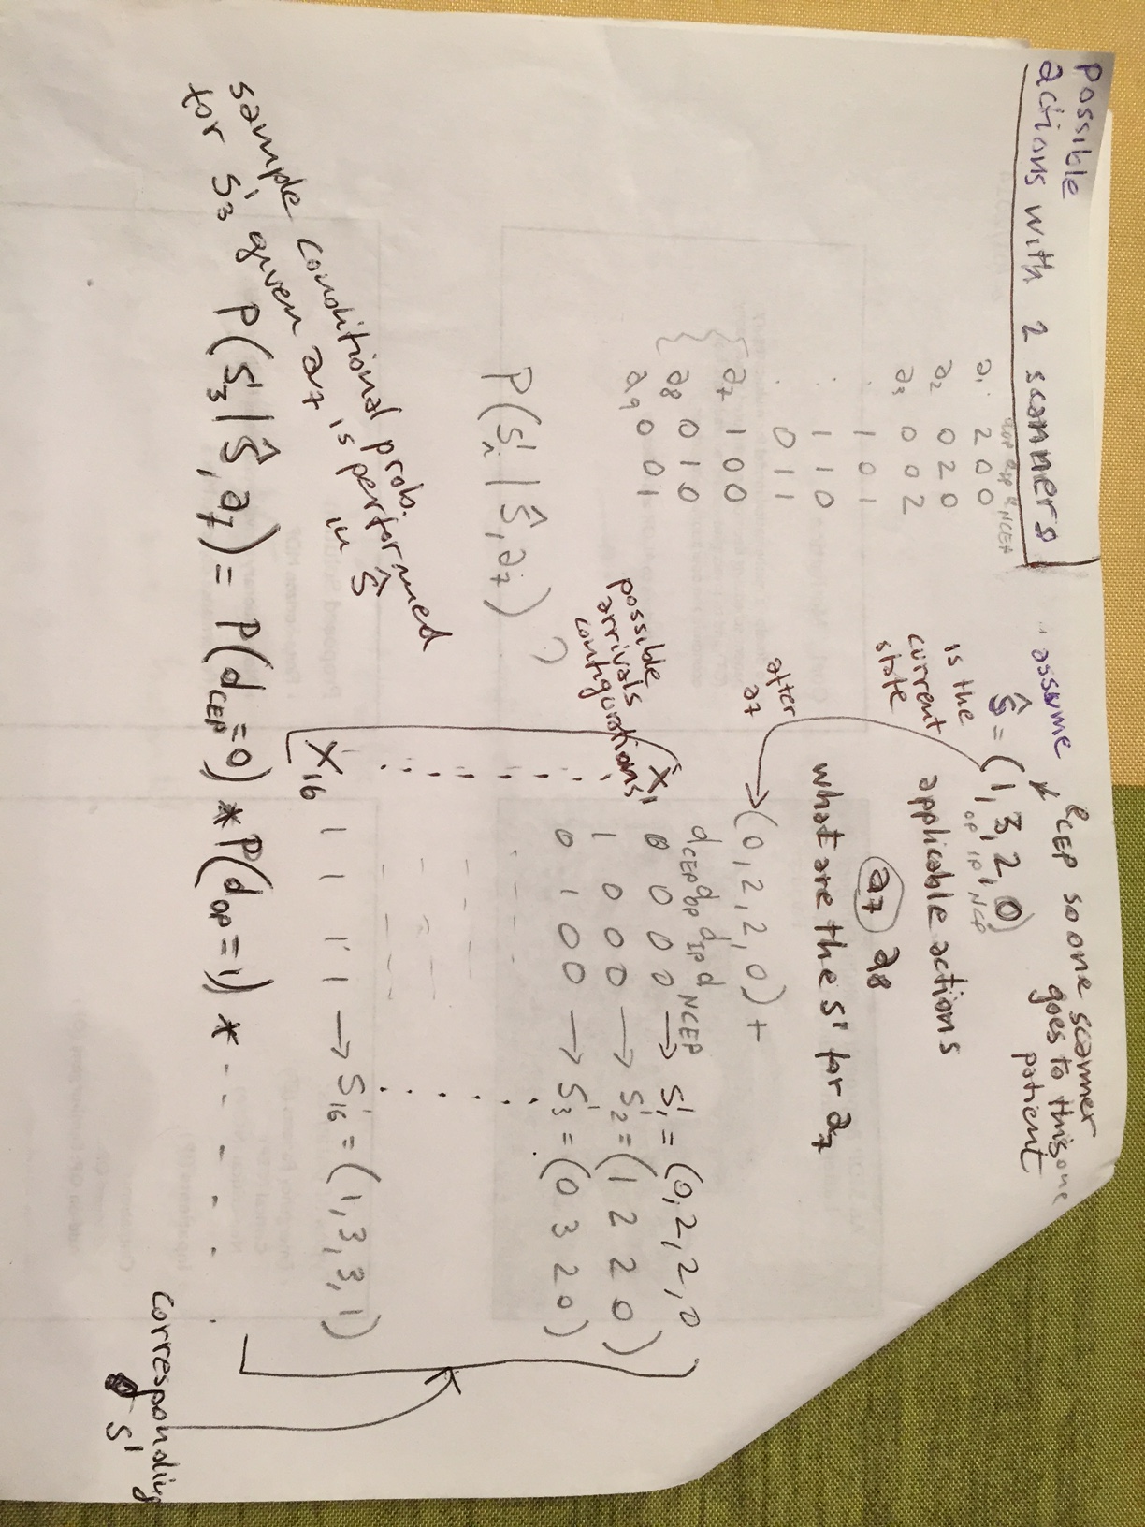
example

Slide 9
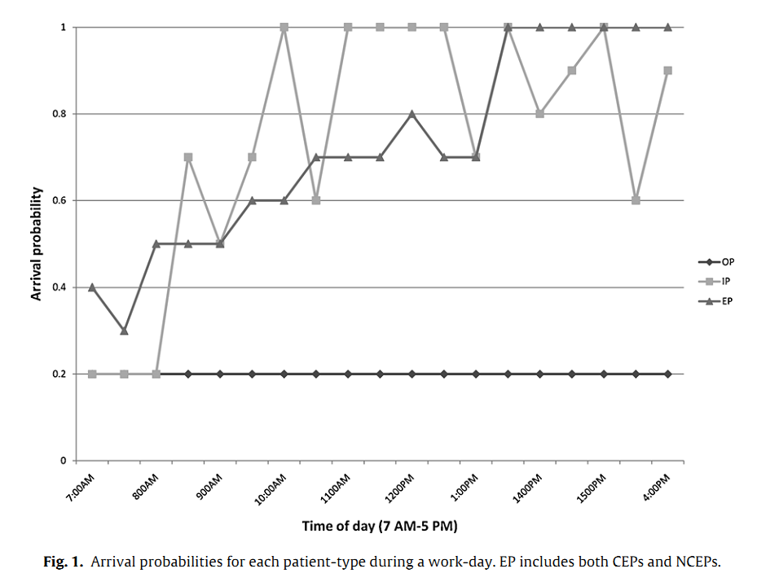
Notes:
Arrival probabilities
As you can see, it varies over the time of day

Slide 10

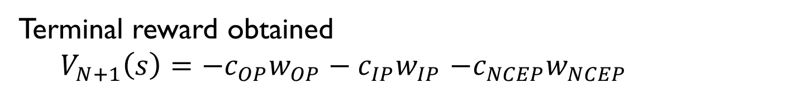
Performance Metrics (over 1 work-day)
Expected net CT revenue
Average waiting-time
Average # patients not scanned by day’s end
Rewards
Terminal reward obtained
  $V_{N+1}\left(s\right)=−c_{OP}w_{OP}−c_{IP}w_{IP}$ $−c_{NCEP}w_{NCEP}$
Discount factor? 1
Notes:
They also considered these in their analysis

Slide 11
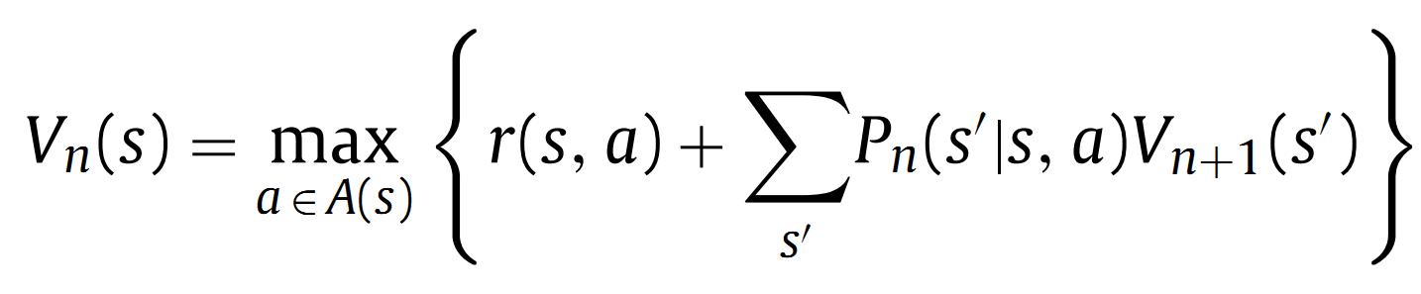
Maximize total expected revenue
Optimal Policy
  Solving this gives the policy for each state, n, in the day
Finite Horizon MDP
The recursive equation (3) has value of current state Vn calculated based on future state Vn+1, this contradicts with the equation given during class, where Vn+1 depends on Vn?
The one in class was Value Iteration (the n index was for the iteration) here we have a finite horizon. We know the Vs at the end so we can compute all the Vs backward. n is an index for the time slice
Notes:
Expected Revenue is the “Total penalty cost incurred for arriving patients who are not scanned by the end of the day”
This is BAD – so we incur the cost at the end of the day, but then these patients just disappear and we start fresh the next day?

Slide 12
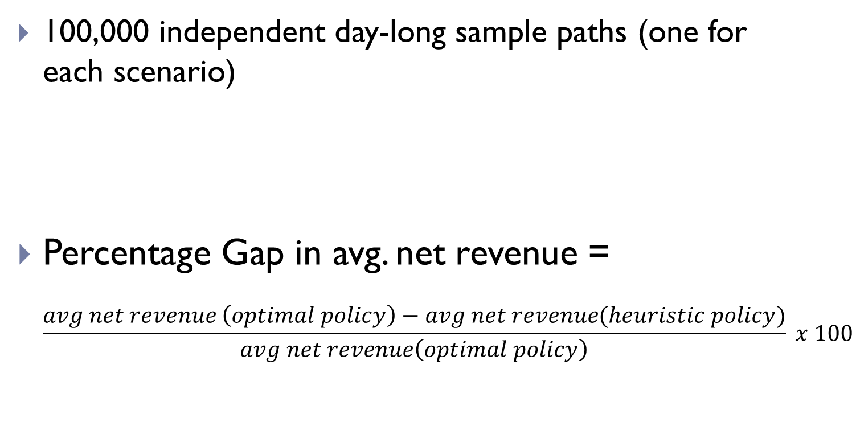
Evaluation: Comparison of MDP with Heuristic Policies
100,000 independent day-long sample paths (one for each scenario)
Percentage Gap in avg. net revenue =
$\frac{avg net revenue \left(optimal policy\right)−avg net revenue(heuristic policy)}{avg net revenue\left(optimal policy\right)} x 100$
Result Metric

Slide 13
Heuristics
FCFS: First come first serve
R-1: One patient from randomly chosen type is scanned
R-2: One patient randomly chosen from all waiting patients (favors types with more people waiting)
O-1: Priority
  OP
  NCEP
  IP
O-2: Priority:
  OP
  IP
  NCEP
Notes:
These are the heuristics used to compare their optimal policy against
…
O-2: Intuition here is that Ips have higher penalty, so prioritizing them may be beneficial

Slide 14
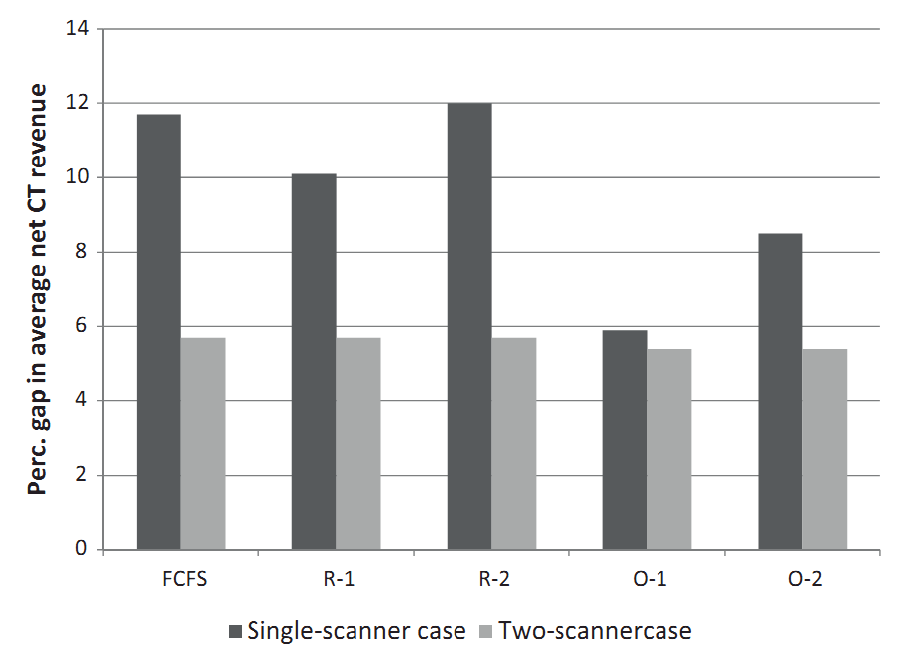
Notes:
This just says that their method did better than the heuristics in every case.
But by varying amounts, most notably for the single-scanner cases

Slide 15
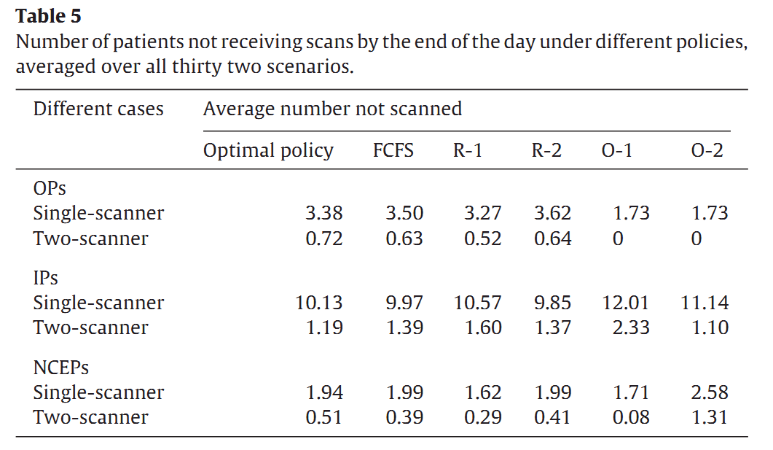
Number of patients not scanned
Notes:
Theirs performed better in some cases, but not by much in some cases
Ok, so # patients not receiving scans wasn’t improved very much. (In fact, in no case did Optimal perform the BEST)
The average number of patients not scanned by the end of the day, and the average waiting time of
a patient before service under the optimal policy are both nearly
80% smaller in the two-scanner case.

Slide 16
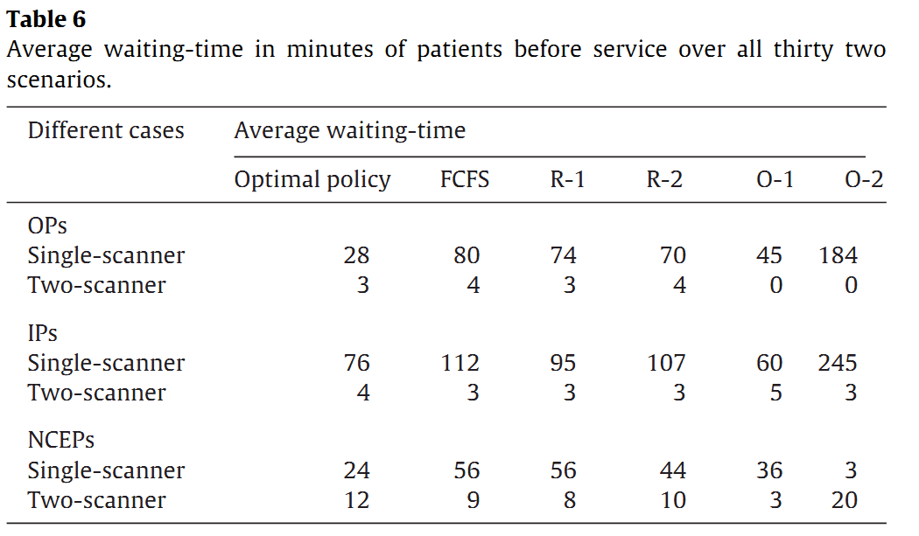
Waiting-time
Notes:
While optimal outperforms all heuristic rules in terms of net revenues, it is sometimes inferior in other performance metrics

Slide 17
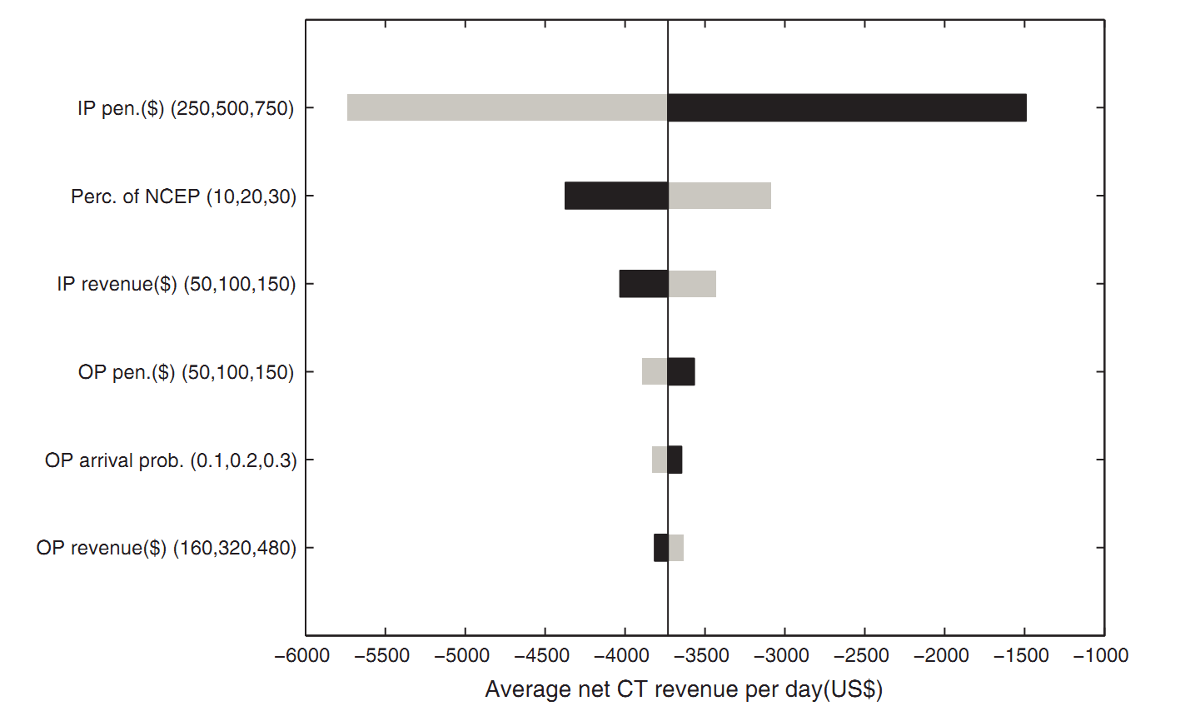
Single-scanner
Notes:
The avg net revenue is most sensitive to changes in IP penalty cost in the single scanner case. It is more sensitive to IP revenue and OP revenue when a second scanner is available
Here the IP penalty is most significant, because with 1 scanner you just can’t scan enough people in a given day.
This means that with 1 scanner, you’re best off favoring IPs

Slide 18
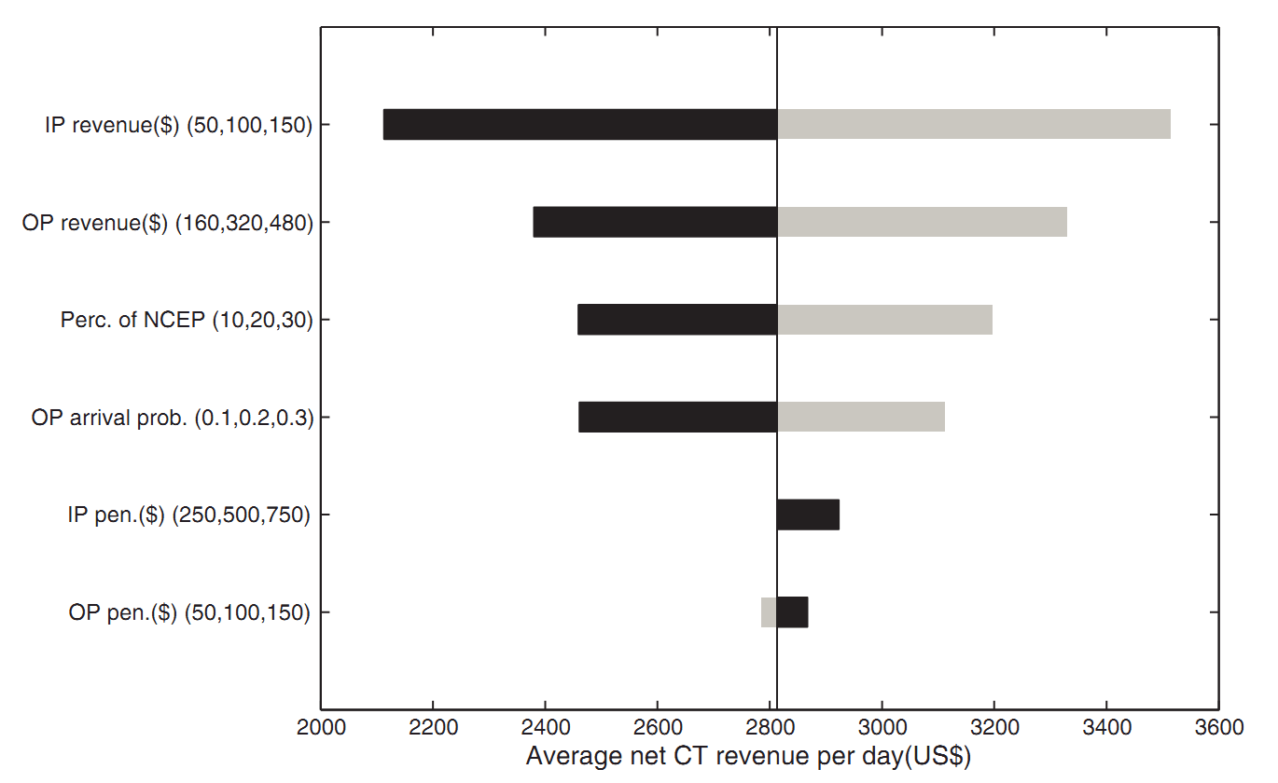
Two-scanner
Notes:
The avg net revenue is most sensitive to changes in IP penalty cost in the single scanner case. It is more sensitive to IP revenue and OP revenue when a second scanner is available
Why do we need a sensitivity analysis?
The answer to QUESTION is: shows how much each part of the expected cost will vary based on the param value.
It could be used to simplify the problem by removing things that don’t vary much, and could be used to raise awareness about which things you need to be sure are precise and accurate.
e.g. If we change the IP revenue by just a little bit (+- 50), the result is drastic revenue differences. So, this tells us that this value is important to get right, and perhaps should be modeled to reflect the differences per patient.

Slide 19
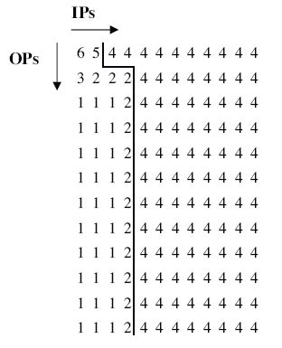
Sample Policy n=12, NCEP=5

Slide 20
Question Types from students
Finite vs. infinite
  Simplicity. Lots of uncertainty about what can happen overnight
  Non stationary process – best action depends on time
Arrival Probabilities
More scanners
Modeling more patient types (urgency) / different hospital….. can easily extend the model, Only data from one Hospital (general?)
Uniform slot length (realistic?)
the probability distribution of the time for CT scans to be completed rather than to make the assumption that they are all of fixed duration? Finer granularity of the time slots
Operational Cost of Implementing the policy (take into account): compute the policy vs. apply the policy
Modeling even more uncertainty “Accidents happen randomly without any pattern.” “Scanner not working”
2 patients at once (need to collect all the prob and consider those in the transition prob)
P-value
Why no VI?
Used in practice ?
Notes:
the probability distribution of the time for CT scans to be completed rather than to make the assumption that they are all of fixed duration?
Can we also determine how many more CT scanner will increase revenue before having diminishing revenue.
Accidents happen randomly without any pattern. Different patients have different health situation. Would Q-learning be a more suitable tool for patient scheduling as the model improves over unbounded learning over time? Why or why not?
You can always envision more and more sophisticated models but do you have the data to learn their params?
Rewards Would it be
a better policy if we also incorporate the "longest waiting time" in
each patient group? Is this idea easy to implement?
for facilities that are open 24/7, wouldn't an infinite MDP be better? If the goal is economic optimality, would the discount factor need to be related to current interest rates? How would the economic benefit projections change with variations in those interest rates?

Slide 21
Other models: Is it better to use continuous Markov Chain and queuing theory in analyzing this scheduling problem?
How would this model handle two CEPs that came in at the same time? Randomly Push one to the next slot ☹
How does approximate dynamic programming compare to value iteration? (approximate method, can deal with bigger models but not optimal)
Transfer model to other facilities? Yes…
Discount factor 1? Yes
This work failed to take into account human suffering, or the urgency of of scans for in and out patients. Could the reward function to tailored to include such nebulous concepts or is it beyond the capabilities of the model?
This model is specific to the target hospital
I think outperforming other MDP-based models can better illustrate the effectiveness of this model's features, so are the choices of comparison methods good in this paper?
First step showing that sound probabilistic models can be build and outperform heuristics then you can do the above

