Slide 1
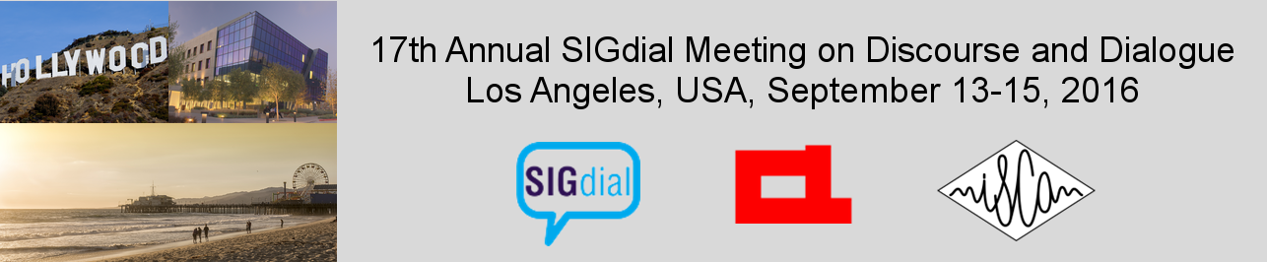
Intelligent Systems (AI-2)
Computer Science cpsc422, Lecture 3
Sep, 12 2016
Lecture on Wed is cancelled

Slide 2
Lecture Overview
Markov Decision Processes
Formal Specification and example
Policies and Optimal Policy
Intro to Value Iteration

Slide 3
Combining ideas for Stochastic planning
What is a key limitation of decision networks?
What is an advantage of Markov models?
Represent (and optimize) only a fixed number of decisions
The network can extend indefinitely
Goal: represent (and optimize) an indefinite sequence of decisions

Slide 4
Decision Processes
Often an agent needs to go beyond a fixed set of decisions – Examples?
  Would like to have an ongoing decision process
Infinite horizon problems: process does not stop
Indefinite horizon problem: the agent does not know when the process may stop
Finite horizon: the process must end at a give time N
Notes:
Helper of a senior
Monitoring system (of a plant)
Treatment of a chronic disease

Slide 5
Markov Models
Markov Chains
Hidden Markov Model
Partially Observable Markov Decision Processes (POMDPs)
Markov Decision Processes (MDPs)

Slide 6
Summary Decision Processes: MDPs
To manage an ongoing (indefinite… infinite) decision process, we combine….
Markovian
Stationary
Utility not just at the end
Sequence of rewards
Fully Observable
Notes:
forget the proper sequence of tasks that need to be completed
they lose track of the steps that they have already completed.
At any stage of the process
The agent decides which action to perform
The new state of the world depends on the previous state(s) as well as the action(s) performed
The agent receives rewards or punishments at various points in the process
Aim: maximize the reward received

Slide 7
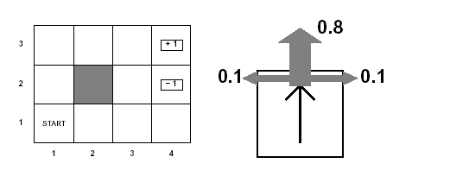
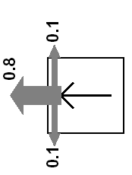
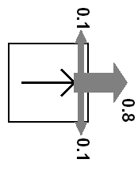
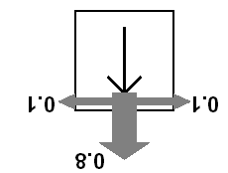
Example MDP: Scenario and Actions
Agent moves in the above grid via actions Up, Down, Left, Right
Each action has:
  0.8 probability to reach its intended effect
  0.1 probability to move at right angles of the intended direction
  If the agents bumps into a wall, it says there
How many states?
There are two terminal states (3,4) and (2,4)

Slide 8
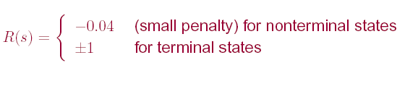
Example MDP: Rewards
Notes:
Example of Stochastic Shortest-PathMDP
Where (3,4) is the goal state? (see MDP book Chp2)

Slide 9
Example MDP: Underlying info structures
Four actions Up, Down, Left, Right
Eleven States: {(1,1), (1,2)…… (3,4)}
2,1

Slide 10

Example MDP: Sequence of actions
The sequence of actions [Up, Up, Right, Right, Right ] will take the agent in terminal state (3,4)…
A. always
B. never
C. Only sometimes
With what probability?
A. (0.8)⁵
B. (0.8)⁵+ ((0.1)⁴ x 0.8)
C. ((0.1)⁴ x 0.8)
Notes:
Yes, with probability 0.8⁵=0.3278
yes, going the other way around with prob. 0.1⁴ x 0.8

Slide 11
Example MDP: Sequence of actions
Can the sequence [Up, Up, Right, Right, Right ] take the agent in terminal state (3,4)?
Can the sequence reach the goal in any other way?
Notes:
Yes, with probability 0.8⁵=0.3278
yes, going the other way around with prob. 0.1⁴ x 0.8

Slide 12
MDPs: Policy
The robot needs to know what to do as the decision process unfolds…
It starts in a state, selects an action, ends up in another state selects another action….
Needs to make the same decision over and over: Given the current state what should I do?
So a policy for an MDP is a single decision function π(s) that specifies what the agent should do for each state s
Notes:
So what is the best sequence of actions for our Robot?
There is no best sequence of actions!
Minimizes cost
(you do not know how the world will be when you’ll need to make the decision)

Slide 13
How to evaluate a policy
A policy can generate a set of state sequences with different probabilities
Each state sequence has a corresponding reward. Typically the (discounted) sum of the rewards for each state in the sequence
Notes:
Because of the stochastic nature of the environment,

Slide 14
MDPs: expected value/total reward of a policy and optimal policy
  Each sequence of states (environment history) associated with a policy has
  a certain probability of occurring
  a given amount of total reward as a function of the rewards of its individual states
Expected value /total reward
For all the sequences of states generated by the policy
Optimal policy is the policy that maximizes expected total reward
Notes:
Because of the stochastic nature of the environment,
Minimizes cost
(you do not know how the world will be when you’ll need to make the decision)

Slide 15
Lecture Overview
Markov Decision Processes
Formal Specification and example
Policies and Optimal Policy
Intro to Value Iteration

Slide 16
Sketch of ideas to find the optimal policy for a MDP (Value Iteration)
We first need a couple of definitions
  V^{π}(s): the expected value of following policy π in state s
  Q^{π} (s, a), where a is an action: expected value of performing a in s, and then following policy π.
Can we express Q^{π} (s, a) in terms of V^{π} (s) ?
  Q^{π} (s, a)=
A.
B.
  Q^{π} (s, a)=
  Q ^{п}(s, a)=
C.
X: set of states reachable from s by doing a
D. None of the above

Slide 17
Discounted Reward Function
Suppose the agent goes through states s₁, s₂,...,s_{k} and receives rewards r₁, r₂,...,r_{k}
We will look at discounted reward to define the reward for this sequence, i.e. its utility for the agent

Slide 18
Sketch of ideas to find the optimal policy for a MDP (Value Iteration)
We first need a couple of definitions
  V ^{п}(s): the expected value of following policy π in state s
  Q ^{п}(s, a), where a is an action: expected value of performing a in s, and then following policy π.
We have, by definition
  Q ^{п}(s, a)=
reward obtained in s
states reachable
from s by doing a
Probability of getting to s’ from s via a
expected value of following policy π in s’
Discount factor

Slide 19
Value of a policy and Optimal policy
We can also compute V ^{п}(s) in terms of Q ^{п}(s, a)
action indicated by π in s
Expected value of following π in s
Expected value of performing the action indicated by π in s and following π after that
For the optimal policy π * we also have
Notes:
This is true for any policy, so it is also true for the optimal one

Slide 20
Value of Optimal policy
Remember for any policy π
But the Optimal policy π * is the one that gives the action that maximizes the future reward for each state
So…

Slide 21
Value Iteration Rationale
Given N states, we can write an equation like the one below for each of them
Each equation contains N unknowns – the V values for the N states
N equations in N variables (Bellman equations): It can be shown that they have a unique solution: the values for the optimal policy
Unfortunately the N equations are non-linear, because of the max operator: Cannot be easily solved by using techniques from linear algebra
Value Iteration Algorithm: Iterative approach to find the optimal policy and corresponding values

Slide 22
Value Iteration in Practice
Let V^{(i)}(s) be the utility of state s at the i^{th} iteration of the algorithm
Start with arbitrary utilities on each state s: V⁽⁰⁾(s)
Repeat simultaneously for every s until there is “no change”
True “no change” in the values of V(s) from one iteration to the next are guaranteed only if run for infinitely long.
  In the limit, this process converges to a unique set of solutions for the Bellman equations
  They are the total expected rewards (utilities) for the optimal policy

Slide 23
Learning Goals for today’s class
You can:
Compute the probability distribution on states given a sequence of actions in an MDP
Define a policy for an MDP
Define and Justify a discounted reward function
Derive the Bellman equations on which Value Iteration is based (we will likely finish this in the next lecture)

Slide 24
For Fro:
Lecture on Wed is cancelled ☹
Read textbook
  9.5.3 Value Iteration
TODO for Fri
Notes:
I'll show some pictures of cool applications in that class, and will give you an opportunity to discuss the applications that you discovered

Slide 25
MDPs: optimal policy
Because of the stochastic nature of the environment, a policy can generate a set of environment histories with different probabilities
Optimal policy maximizes expected total reward, where
  Each environment history associated with that policy has a given amount of total reward
  Total reward is a function of the rewards of its individual states
Notes:
Minimizes cost
(you do not know how the world will be when you’ll need to make the decision)

