Slide 1
Intelligent Systems (AI-2)
Computer Science cpsc422, Lecture 8
Sep, 26, 2016

Slide 2
Lecture Overview
Finish Q-learning
Algorithm Summary
Example
Exploration vs. Exploitation
Notes:
POMDPs were initially formalized by the control theory and operations research communities
to optimally control stochastic dynamical systems.
More recently, the articial intelligence community also considered POMDPs for planning
under uncertainty. To date, a wide range of sequential decision problems
such as robot navigation, preference elicitation, stochastic resource
allocation, maintenance scheduling, spoken-dialog systems
and many others have been modeled using POMDPs.

Slide 4
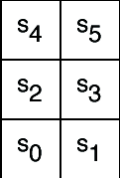
Example
Six possible states <s₀,..,s₅>
4 actions:
UpCareful: moves one tile up unless there is wall, in which case stays in same tile. Always generates a penalty of -1
Left: moves one tile left unless there is wall, in which case
stays in same tile if in s₀ or s₂
Is sent to s₀ if in s₄
Right: moves one tile right unless there is wall, in which case stays in same tile
Up: 0.8 goes up unless there is a wall, 0.1 like Left, 0.1 like Right
-1
-1
+ 10
-1
-100
-1
-1
-1
Reward Model:
-1 for doing UpCareful
Negative reward when hitting a wall, as marked on the picture

Slide 5
Example
-1
-1
+ 10
-1
The agent knows about the 6 states and 4 actions
Can perform an action, fully observe its state and the reward it gets
Does not know how the states are configured, nor what the actions do
no transition model, nor reward model
-100
-1
-1
-1

Slide 6
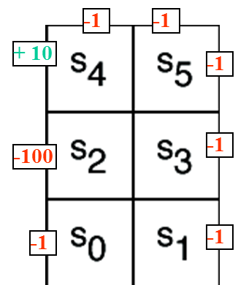
Example (variable α_{k})
Suppose that in the simple world described earlier, the agent has the following sequence of experiences
<s₀, right, 0, s₁, upCareful, -1, s₃, upCareful, -1, s₅, left, 0, s₄, left, 10, s₀>
And repeats it k times (not a good behavior for a Q-learning agent, but good for didactic purposes)
Table shows the first 3 iterations of Q-learning when
Q[s,a] is initialized to 0 for every a and s
α_{k}= 1/k, γ= 0.9
For full demo, see http://artint.info/demos/rl/tGame.html

Slide 7
-1
-1
+ 10
-1
Q[s,a] | s₀ | s₁ | s₂ | s₃ | s₄ | s₅
upCareful | 0 | 0 | 0 | 0 | 0 | 0
Left | 0 | 0 | 0 | 0 | 0 | 0
Right | 0 | 0 | 0 | 0 | 0 | 0
Up | 0 | 0 | 0 | 0 | 0 | 0
-100
-1
k=1
k=1
-1
-1
Only immediate rewards
are included in the update
in this first pass

Slide 8
-1
-1
+ 10
-1
Q[s,a] | s₀ | s₁ | s₂ | s₃ | s₄ | s₅
upCareful | 0 | -1 | 0 | -1 | 0 | 0
Left | 0 | 0 | 0 | 0 | 10 | 0
Right | 0 | 0 | 0 | 0 | 0 | 0
Up | 0 | 0 | 0 | 0 | 0 | 0
-100
-1
k=1
k=2
-1
-1
1 step backup from previous positive reward in s4

Slide 9
-1
-1
+ 10
-1
Q[s,a] | s₀ | s₁ | s₂ | s₃ | s₄ | s₅
upCareful | 0 | -1 | 0 | -1 | 0 | 0
Left | 0 | 0 | 0 | 0 | 10 | 4.5
Right | 0 | 0 | 0 | 0 | 0 | 0
Up | 0 | 0 | 0 | 0 | 0 | 0
-100
-1
k=1
0.35
k=3
6
-1
-1
The effect of the positive reward in s4 is felt two steps earlier at the 3rd iteration

Slide 10
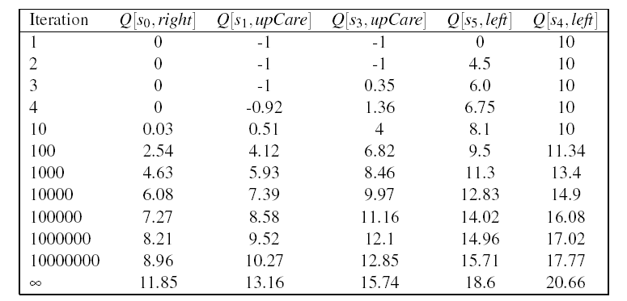
Example (variable α_{k})
-1
-1
+ 10
-1
-100
-1
-1
-1
As the number of iterations increases, the effect of the positive reward achieved by moving left in s₄ trickles further back in the sequence of steps
Q[s₄,left] starts changing only after the effect of the reward has reached s₀ (i.e. after iteration 10 in the table)
Notes:
Why 10 and not 6?
Because before s0 feels a positive effect, the Q value in s1 need to become positive, otherwise the actions that bring to states with Q = 0 get picked first

Slide 11
Example (Fixed α=1)
First iteration same as before, let’s look at the second
-1
-1
+ 10
-1
Q[s,a] | s₀ | s₁ | s₂ | s₃ | s₄ | s₅
upCareful | 0 | -1 | 0 | -1 | 0 | 0
Left | 0 | 0 | 0 | 0 | 10 | 0
Right | 0 | 0 | 0 | 0 | 0 | 0
Up | 0 | 0 | 0 | 0 | 0 | 0
-100
-1
k=2
-1
-1
New evidence is given much more weight than original estimate
Notes:
Note that each Q(s,a) corresponds to a different TD equation. Thus the value of k in each update depends upon how many times that specific (s,a) pair has been visited. Need a separate K counter for each (s,a) pair

Slide 12
-1
-1
+ 10
-1
Q[s,a] | s₀ | s₁ | s₂ | s₃ | s₄ | s₅
upCareful | 0 | -1 | 0 | -1 | 0 | 0
Left | 0 | 0 | 0 | 0 | 10 | 9
Right | 0 | 0 | 0 | 0 | 0 | 0
Up | 0 | 0 | 0 | 0 | 0 | 0
-100
-1
k=1
k=3
-1
-1
Same here
No change from previous iteration, as all the reward from the step ahead was included there

Slide 13
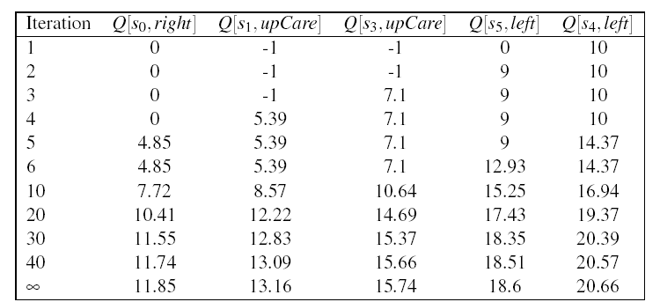
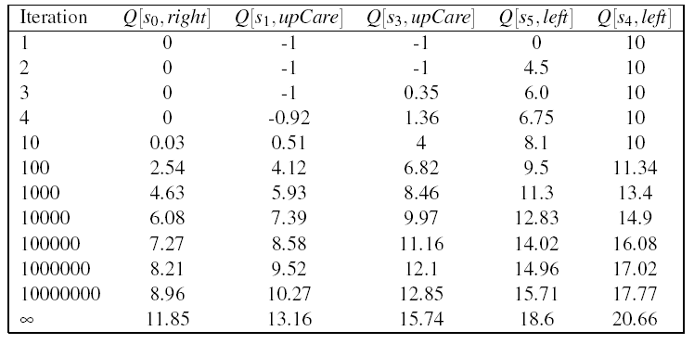
Comparing fixed α and …
Fixed α generates faster update:
all states see some effect of the
positive reward from <s4, left> by
the 5th iteration
Each update is much larger
Gets very close to final numbers by
iteration 40, while with variable α
still not there by iteration 10⁷
However:
Q-learning with fixed α is not guaranteed to converge
variable α

Slide 14
On the approximation…
True relation between Q(s.a) and Q(s’a’)
Q-learning approximation based on each individual experience <s, a, r, s’>
For the approximation to work…..
A. There is positive reward in most states
B. Q-learning tries each action an unbounded number of times
C. The transition model is not sparse
Notes:
Unlikely transitions will be observed much less frequently than likely ones, so their related updates will have limited impact in the long term

Slide 15
Why approximations work…
True relation between Q(s.a) and Q(s’a’)
Q-learning approximation based on each individual experience <s, a, s’>
Way to get around the missing transition model and reward model
Aren’t we in danger of using data coming from unlikely transition to make incorrect adjustments?
No, as long as Q-learning tries each action an unbounded number of times
Frequency of updates reflects transition model, P(s’|a,s)
Notes:
Unlikely transitions will be observed much less frequently than likely ones, so their related updates will have limited impact in the long term

Slide 16
Lecture Overview
Finish Q-learning
Algorithm
Example
Exploration vs. Exploitation
Notes:
POMDPs were initially formalized by the control theory and operations research communities
to optimally control stochastic dynamical systems.
More recently, the articial intelligence community also considered POMDPs for planning
under uncertainty. To date, a wide range of sequential decision problems
such as robot navigation, preference elicitation, stochastic resource
allocation, maintenance scheduling, spoken-dialog systems
and many others have been modeled using POMDPs.

Slide 17
What Does Q-Learning learn
Does Q-learning gives the agent an optimal policy?

Slide 18
Q values
 | s₀ | s₁ | … | s_{k}
a₀ | Q[s₀,a₀] | Q[s₁,a₀] | …. | Q[s_{k},a₀]
a₁ | Q[s₀,a₁] | Q[s₁,a₁] | … | Q[s_{k},a₁]
… | … | … | …. | …
a_{n} | Q[s₀,a_{n}] | Q[s₁,a_{n}] | …. | Q[s_{k},a_{n}]

Slide 19
Exploration vs. Exploitation
Q-learning does not explicitly tell the agent what to do
just computes a Q-function Q[s,a] that allows the agent to see, for every state, which is the action with the highest expected reward
Given a Q-function the agent can :
Exploit the knowledge accumulated so far, and chose the action that maximizes Q[s,a] in a given state (greedy behavior)
Explore new actions, hoping to improve its estimate of the optimal Q-function, i.e. *do not chose* the action suggested by the current Q[s,a]
Notes:
Q-learning does not explicitly tell the agent what to do
just computes a Q-function Q[s,a] that allows the agent to see, for every state, which is the action with the highest expected reward
Given a Q-function, there are two things that the agent can do:
Exploit the knowledge accumulated so far, and chose the action that maximizes Q[s,a] in a given state (greedy behavior)
Explore new actions, hoping to improve its estimate of the optimal Q-function, i.e. *do not chose* the action suggested by the current Q[s,a]

Slide 20
Exploration vs. Exploitation
When to explore and when the exploit?
Never exploring may lead to being stuck in a suboptimal course of actions
Exploring too much is a waste of the knowledge accumulated via experience
A. Only (1) is true
B. Only (2) is true
C. Both are true
D. Both are false
Notes:
When to explore and when the exploit?
Never exploring may lead to being stuck in a suboptimal course of actions
Exploring too much is a waste of the knowledge accumulated via experience

Slide 21
Exploration vs. Exploitation
When to explore and when the exploit?
Never exploring may lead to being stuck in a suboptimal course of actions
Exploring too much is a waste of the knowledge accumulated via experience
Must find the right compromise
Notes:
When to explore and when the exploit?
Never exploring may lead to being stuck in a suboptimal course of actions
Exploring too much is a waste of the knowledge accumulated via experience

Slide 22
Exploration Strategies
Hard to come up with an optimal exploration policy (problem is widely studied in statistical decision theory)
But intuitively, any such strategy should be greedy in the limit of infinite exploration (GLIE), i.e.
Try each action an unbounded number of times, to avoid the possibility of missing an optimal action because of an unusually bad series of outcomes
Choose the predicted best action when, in the limit, it has found the optimal value function/policy
We will look at two exploration strategies
ε-greedy
soft-max

Slide 23
Exploration Strategies
Hard to come up with an optimal exploration policy (problem is widely studied in statistical decision theory)
But intuitively, any such strategy should be greedy in the limit of infinite exploration (GLIE), i.e.
Choose the predicted best action in the limit
Try each action an unbounded number of times
We will look at two exploration strategies
ε-greedy
soft-max
Notes:
…, to avoid the possibility of missing an optimal action because of an unusually bad series of outcomes
…. Choose the predicted best action when, in the limit, it has found the optimal value function/policy

Slide 24
ε-greedy
Choose a random action with probability ε and choose best action with probability 1- ε
First GLIE condition (try every action an unbounded number of times) is satisfied via the ε random selection
What about second condition?
Select predicted best action in the limit.
reduce ε overtime!
Notes:
It always chooses the non-optimal action with probability ε, while ideally you would want to explore more at the beginning and become greedier as estimates become more accurate
But it is rather slow
It always chooses the non-optimal action with probability ε, while ideally you would want to do it less and less frequently overtime

Slide 25
Soft-Max
Takes into account improvement in estimates of expected reward function Q[s,a]
Choose action a in state s with a probability proportional to current estimate of Q[s,a]
τ (tau) in the formula above influences how randomly actions should be chosen
if τ is high, the exponentials approach 1, the fraction approaches 1/(number of actions), and each action has approximately the same probability of being chosen ( exploration or exploitation?)
as τ → 0, the exponential with the highest Q[s,a] dominates, and the current best action is always chosen (exploration or exploitation?)
Notes:
Tau is called a temperature parameter (in allusion to chemical kinetics). For high temperatures (tau -> infinite), all actions have nearly the same probability and the lower the temperature, the more expected rewards affect the probability. For a low temperature (tau -> 0), the probability of the action with the highest expected reward tends to 1.

Slide 26
Learning Goals for today’s class
You can:
Explain, trace and implement Q-learning
Describe and compare techniques to combine exploration with exploitation

Slide 27
TODO for Wed
Carefully read : A Markov decision process approach to multi-category patient scheduling in a diagnostic facility, Artificial Intelligence in Medicine Journal, 2011
Follow instructions on course WebPage
<Readings>
Keep working on assignment-1 (due next Mon)

Slide 28
Overview (NOT FOR 422)
Introduction
Q-learning
Exploration vs. Exploitation
Evaluating RL algorithms
On-Policy Learning: SARSA
Model-based Q-learning

Slide 29
Learning before vs. during deployment
As we saw earlier, there are two possible modus operandi for our learning agents
act in the environment to learn how it works:
first learn an optimal policy, then use this policy to act (there is a learning phase before deployment)
Learn as you go:
start operating in the environment right away and learn from actions (learning happens during deployment)
If there is time to learn before deployment, the agent should try to do its best to learn as much as possible about the environment
even engage in locally suboptimal behaviors, because this will guarantee reaching an optimal policy in the long run
If learning while “at work”, suboptimal behaviors could be costly

Slide 30
Example
-1
-1
Consider, for instance, our sample grid game:
the optimal policy is to go up in S₀
But if the agent includes some exploration in its policy (e.g. selects 20% of its actions randomly), exploring in S₂ could be dangerous because it may cause hitting the -100 wall
No big deal if the agent is not deployed yet, but not ideal otherwise
+ 10
-1
-100
-1
-1
-1
Q-learning would not detect this problem
It does off-policy learning, i.e., it focuses on the optimal policy
On-policy learning addresses this problem

Slide 31
On-policy learning: SARSA
On-policy learning learns the value of the policy being followed.
e.g., act greedily 80% of the time and act randomly 20% of the time
Better to be aware of the consequences of exploration has it happens, and avoid outcomes that are too costly while acting, rather than looking for the true optimal policy
SARSA
So called because it uses <state, action, reward, state, action> experiences rather than the <state, action, reward, state> used by Q-learning
Instead of looking for the best action at every step, it evaluates the actions suggested by the current policy
Uses this info to revise it

Slide 32
On-policy learning: SARSA
Given an experience <s,a,r,s’,a’>, SARSA updates Q[s,a] as follows
What’s different from Q-learning?

Slide 33
On-policy learning: SARSA
Given an experience <s ,a, r, s’, a’>, SARSA updates Q[s,a] as follows
While Q-learning was using
There is no more MAX operator in the equation, there is instead the Q-value of the action suggested by the policy

Slide 34
On-policy learning: SARSA
Does SARSA remind you of any other algorithm we have seen before?

Slide 35
Policy Iteration
Algorithm
π ← an arbitrary initial policy, U ← A vector of utility values, initially 0
2. Repeat until no change in π
Compute new utilities given π and current U (policy evaluation)
(b) Update π as if utilities were correct (policy improvement)
Expected value of following another action in s
Expected value of following current пi from s
Policy
Improvement
step

Slide 36
-1
-1
+ 10
-1
Q[s,a] | s₀ | s₁ | s₂ | s₃ | s₄ | s₅
upCareful | 0 | 0 | 0 | 0 | 0 | 0
Left | 0 | 0 | 0 | 0 | 0 | 0
Right | 0 | 0 | 0 | 0 | 0 | 0
Up | 0 | 0 | 0 | 0 | 0 | 0
-100
-1
k=1
k=1
-1
-1
Only immediate rewards
are included in the update,
as with Q-learning

Slide 37
-1
-1
+ 10
-1
-100
-1
Q[s,a] | s₀ | s₁ | s₂ | s₃ | s₄ | s₅
upCareful | 0 | -1 | 0 | -1 | 0 | 0
Left | 0 | 0 | 0 | 0 | 10 | 0
Right | 0 | 0 | 0 | 0 | 0 | 0
Up | 0 | 0 | 0 | 0 | 0 | 0
k=1
k=2
-1
-1
SARSA backs up the expected reward of the next action, rather than the max expected reward

Slide 38
Comparing SARSA and Q-learning
For the little 6-states world
Policy learned by Q-learning 80% greedy is to go up in s₀ to reach s₄ quickly and get the big +10 reward
-1
-1
+ 10
-1
-100
-1
-1
-1

Slide 39
Comparing SARSA and Q-learning
Policy learned by SARSA 80% greedy is to go left in s₀
Safer because avoid the chance of getting the -100 reward in s₂
but non-optimal => lower q-values
-1
-1
+ 10
-1
-100
-1
-1
-1

Slide 40
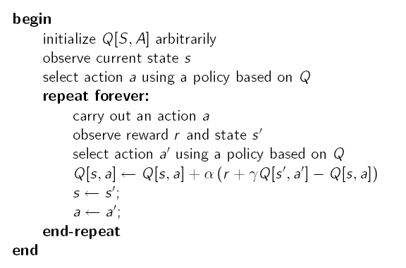
SARSA Algorithm
This could be, for instance any ε-greedy strategy:
Choose random ε times, and max the rest
This could be, for instance any ε-greedy strategy:
- Choose random ε times, and max the rest
If the random step is chosen here, and has a bad negative reward, this will affect the value of Q[s,a].
Next time in s, a’ may no longer be the action selected because of its lowered Q value

Slide 41
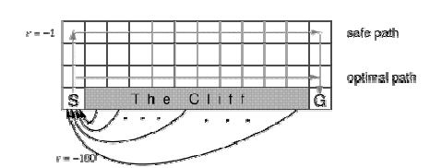
Another Example
Gridworld with:
Deterministic actions up, down, left, right
Start from S and arrive at G
Reward is -1 for all transitions, except those into the region marked “Cliff”
Falling into the cliff causes the agent to be sent back to start: r = -100

Slide 42
Another Example
Because of negative reward for every step taken, the optimal policy over the four standard actions is to take the shortest path along the cliff
But if the agents adopt an ε-greedy action selection strategy with ε=0.1, walking along the cliff is dangerous
The optimal path that considers exploration is to go around as far as possible from the cliff

Slide 43
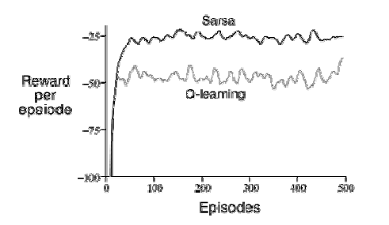
Q-learning vs. SARSA
Q-learning learns the optimal policy, but because it does so without taking exploration into account, it does not do so well while the agent is exploring
It occasionally falls into the cliff, so its reward per episode is not that great
SARSA has better on-line performance (reward per episode), because it learns to stay away from the cliff while exploring
But note that if ε→0, SARSA and Q-learning would asymptotically converge to the optimal policy

Slide 44
Problem with Model-free methods
Q-learning and SARSA are model-free methods
What does this mean?

Slide 45
Problems With Model-free Methods
Q-learning and SARSA are model-free methods
They do not need to learn the transition and/or reward model, they are implicitly taken into account via experiences
Sounds handy, but there is a main disadvantage:
How often does the agent get to update its Q-estimates?

Slide 46
Problems with Model-free Methods
Q-learning and SARSA are model-free methods
They do not need to learn the transition and/or reward model, they are implicitly taken into account via experiences
Sounds handy, but there is a main disadvantage:
How often does the agent get to update its Q-estimates?
Only after a new experience comes in
Great if the agent acts very frequently, not so great if actions are sparse, because it wastes computation time

Slide 47
Model-based methods
Idea
learn the MDP and interleave acting and planning.
After each experience,
update probabilities and the reward,
do some steps of value iteration (asynchronous ) to get better estimates of state utilities U(s) given the current model and reward function
Remember that there is the following link between Q values and utility values

Slide 48
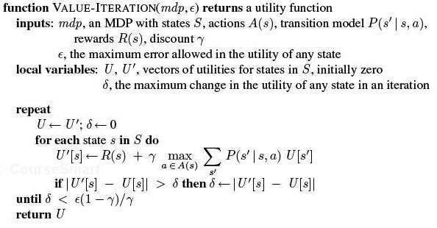
VI algorithm

Slide 49
Asynchronous Value Iteration
The “basic” version of value iteration applies the Bellman update to all states at every iteration
This is in fact not necessary
On each iteration we can apply the update only to a chosen subset of states
Given certain conditions on the value function used to initialize the process, asynchronous value iteration converges to an optimal policy
Main advantage
one can design heuristics that allow the algorithm to concentrate on states that are likely to belong to the optimal policy
Much faster convergence

Slide 50
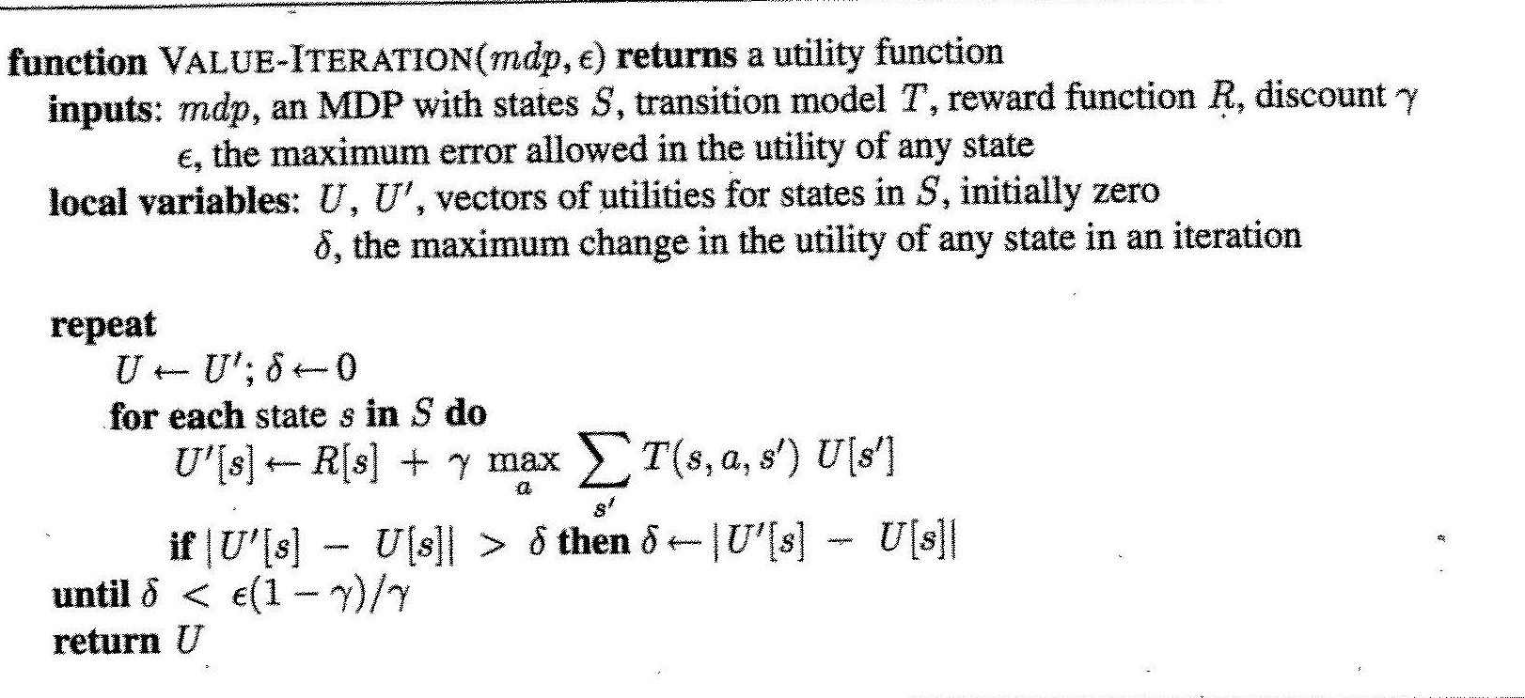
Asynchronous VI algorithm
for some

Slide 51
Model-based RL algorithm
Model Based Reinfortcement Learner
inputs:
S is a set of states, A is a set of actions, γ the discount, c is a prior count
internal state:
real array Q[S,A], R[S,A, S’]
integer array T[S,A, S’]
previous state s
previous action a

Slide 52
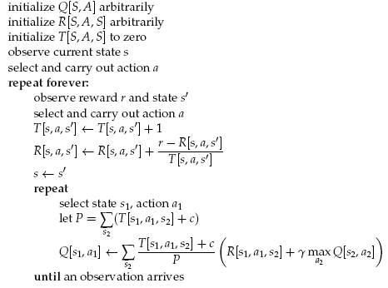
Counts of events when action a performed in s generated s’
TD-based estimate of R(s,a,s’)
Asynchronous value iteration steps
What is this c for?
Why is the reward inside the summation?
Frequency of transition from s₁ to s₂ via a₁
Notes:
Assumes a reward function as general as possible, i.e. depending on all of s,a,s’

Slide 53
Discussion
Which Q values should asyncronous VI update?
At least s in which the action was generated
Then either select states randomly, or
States that are likely to get their Q-values changed because they can reach states with Q-values that have changed the most
How many steps of asynchronous value-iteration to perform?

Slide 54
Discussion
Which states to update?
At least s in which the action was generated
Then either select states randomly, or
States that are likely to get their Q-values changed because they can reach states with Q-values that have changed the most
How many steps of asynchronous value-iteration to perform?
As many as can be done before having to act again

Slide 55
Q-learning vs. Model-based
Is it better to learn a model and a utility function or an action value function with no model?
Still an open-question
Model-based approaches require less data to learn well, but they can be computationally more expensive (time per iteration)
Q-learning takes longer because it does not enforce consistency among Q-values via the model
Especially true when the environment becomes more complex
In games such as chess and backgammon, model-based approaches have been more successful that q-learning methods
Cost/ease of acting needs to be factored in

Slide 56
Reinforcement Learning

Slide 57
Overview
Introduction
Q-learning
Exploration Exploitation
Evaluating RL algorithms
On-Policy learning: SARSA
Model-based Q-learning

Slide 58
Overview
Introduction
Q-learning
Exploration vs. Exploitation
Evaluating RL algorithms
On-Policy Learning: SARSA
Model-based Q-learning

Slide 59
Evaluating RL Algorithms
Two possible measures
Quality of the optimal policy
Reward received while looking for the policy
If there is a lot of time for learning before the agent is deployed, then quality of the learned policy is the measure to consider
If the agent has to learn while being deployed, it may not get to the optimal policy for a along time
Reward received while learning is the measure to look at, e.g, plot cumulative reward as a function of number of steps
One algorithm dominates another if its plot is consistently above

Slide 60
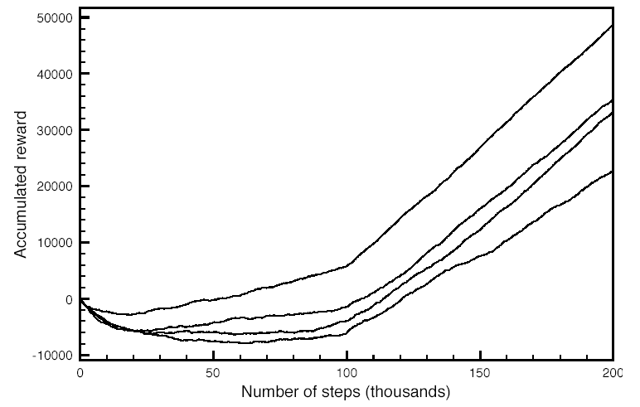
Evaluating RL Algorithms
Plots for example 11.8 in textbook (p. 464), with
Either fixed or variable α
Different initial values for Q[s,a]

Slide 61
Evaluating RL Algorithms
Lots of variability in each algorithm for different runs
for fair comparison, run each algorithm several times and report average behavior
Relevant statistics of the plot
Asymptotic slopes: how good the policy is after the algorithm stabilizes
Plot minimum: how much reward must be sacrificed before starting to gain (cost of learning)
zero-crossing: how long it takes for the algorithm to recuperate its cost of learning

