Slide 1
Intelligent Systems (AI-2)
Computer Science cpsc422, Lecture 15
Oct, 14, 2016

Slide 2
Lecture Overview
Probabilistic temporal Inferences
Filtering
Prediction
Smoothing (forward-backward)
Most Likely Sequence of States (Viterbi)

Slide 3
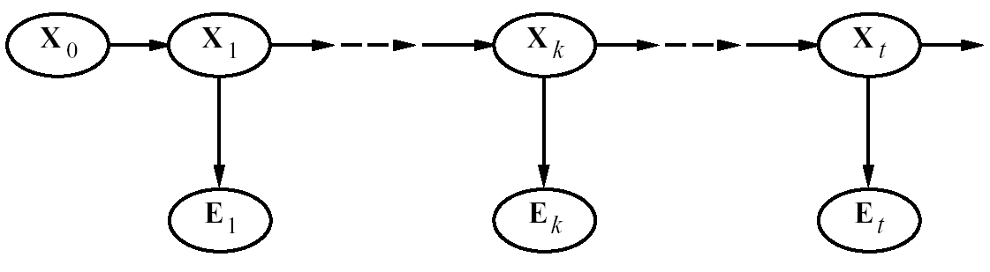
Smoothing
Smoothing: Compute the posterior distribution over a past state given all evidence to date
  P(X_{k} | e_{0:t} ) for 1 ≤ k < t
E₀
To revise your estimates in the past based on more recent evidence
Notes:
3

Slide 4

Smoothing
P(X_{k} | e_{0:t}) = P(X_{k} | e_{0:k},e_{k+1:t} ) dividing up the evidence
= α P(X_{k} | e_{0:k} ) P(e_{k+1:t} | X_{k}, e_{0:k} ) using…
= α P(X_{k} | e_{0:k} ) P(e_{k+1:t} | X_{k}) using…
  A. Bayes Rule
  B. Cond. Independence
forward message from filtering up to state k,
f _{0:k}
  C. Product Rule
backward message,
b _{k+1:t}
computed by a recursive process that runs backwards from t
Notes:
4

Slide 5
Smoothing
P(X_{k} | e_{0:t}) = P(X_{k} | e_{0:k},e_{k+1:t} ) dividing up the evidence
= α P(X_{k} | e_{0:k} ) P(e_{k+1:t} | X_{k}, e_{0:k} ) using Bayes Rule
= α P(X_{k} | e_{0:k} ) P(e_{k+1:t} | X_{k}) By Markov assumption on evidence
forward message from filtering up to state k,
f _{0:k}
backward message,
b _{k+1:t}
computed by a recursive process that runs backwards from t
Notes:
5

Slide 6
Backward Message
Product Rule
P(e_{k+1:t} | X_{k}) = ∑_{xk+1} P(e_{k+1:t} , x_{k+1} | X_{k}) = ∑_{xk+1} P(e_{k+1:t} |x_{k+1} , X_{k}) P( x_{k+1} | X_{k}) =
= ∑_{xk+1} P(e_{k+1:t} |x_{k+1} ) P( x_{k+1} | X_{k}) by Markov assumption on evidence
= ∑_{xk+1} P(e_{k+1},e_{k+2:t} |x_{k+1} ) P( x_{k+1} | X_{k})
= ∑_{xk+1} P(e_{k+1}|x_{k+1} , e_{k+2:t}) P(e_{k+2:t} |x_{k+1} ) P( x_{k+1} | X_{k})
= ∑_{xk+1} P(e_{k+1}|x_{k+1} ) P(e_{k+2:t} |x_{k+1} ) P( x_{k+1} | X_{k})
Product Rule
because e_{k+1} and e_{k+2:t}, are conditionally independent given x_{k+1}
sensor model
recursive call
transition model
In message notation
b_{k+1:t} = BACKWARD (b_{k+2:t}, e_{k+1})
Notes:
6
As with the forward recursion, the time and space for each backward update is independent of t

Slide 7
Proof of equivalent statements

Slide 8
More Intuitive Interpretation (Example with three states)
P(e_{k+1:t} | X_{k}) = ∑_{xk+1} P( x_{k+1} | X_{k})P(e_{k+1}|x_{k+1} ) P(e_{k+2:t} |x_{k+1} )

Slide 9
Forward-Backward Procedure
Thus,
  P(X_{k} | e_{0:t}) = α f_{0:k} b_{k+1:t}
and this value can be computed by recursion through time, running forward from 0 to k and backwards from t to k+1
Notes:
9

Slide 10
How is it Backward initialized?
The backwards phase is initialized with making an unspecified observation e_{t+1} at t+ 1……
b_{t+1:t} = P(e_{t+1}| X_{t} ) = P( unspecified | X_{t} ) = ?
  A. 0
  B. 0.5
  C. 1
Notes:
10

Slide 11
How is it Backward initialized?
The backwards phase is initialized with making an unspecified observation e_{t+1} at t+ 1……
b_{t+1:t} = P(e_{t+1}| X_{t} ) = P( unspecified | X_{t} ) = 1
You will observe something for sure! It is only when you put some constraints on the observations that the probability becomes less than 1
Notes:
11

Slide 12
Rain Example
Let’s compute the probability of rain at t = 1, given umbrella observations at t=1 and t =2
From P(X_{k} | e_{1:t}) = α P(X_{k} | e_{1:k} ) P(e_{k+1:t} | X_{k}) we have
  P(R₁| e_{1:2}) = P(R₁| u_{1:}u₂) = α P(R₁| u₁) P(u₂ | R₁)
P(R₁| u₁) = <0.818, 0.182> as it is the filtering to t =1 that we did in lecture 14
forward message from filtering up to state 1
backward message for propagating evidence backward from time 2
0.5
0.5
TRUE 0.5
FALSE 0.5
0.818
0.182
Rain₀
Rain₁
Rain₂
Umbrella₁
Umbrella₂
Notes:
12
.5 * .9 = .45
.5 * .2 = .01
And normalize

Slide 13
Rain Example
From P(e_{k+1:t} | X_{k}) = ∑_{xk+1} P(e_{k+1}|x_{k+1} ) P(e_{k+2:t} |x_{k+1} ) P( x_{k+1} | X_{k})
P(u₂ | R₁) = ∑ P(u₂|r ) P(|r ) P( r | R₁) =
P(u₂|r₂ ) P(|r₂ ) <P( r₂ | r₁), P( r₂ | ┐r₁) > +
P(u₂| ┐r₂ ) P(| ┐r₂ ) <P(┐r₂ | r₁), P(┐r₂ | ┐r₁)>
= (0.9 * 1 * <0.7,0.3>) + (0.2 * 1 * <0.3, 0.7>) = <0.69,0.41>
Thus
α P(R₁| u₁) P(u₂ | R₁) = α<0.818, 0.182> * <0.69, 0.41> ~ <0.883, 0.117>
Term corresponding to the Fictitious unspecified observation sequence e_{3:2}
0.5
0.5
0.818
0.182
0.69
0.41
TRUE 0.5
FALSE 0.5
0.883
0.117
Rain₀
Rain₁
Rain₂
Umbrella₁
Umbrella₂
Notes:
13

Slide 14
Forward-Backward Algorithm
Simple smoothing estimates the posterior of a single state given past and future evidence
But the procedure can be used to estimate the posterior distribution of the complete sequence of states.
One way to do this is to (not the most efficient)
  compute and store the results of forward filtering over the whole sequence.
  compute and store the results of backward procedure over the whole sequence
  Combine the two
Notes:
14
efficiently

Slide 16
Lecture Overview
Probabilistic temporal Inferences
Filtering
Prediction
Smoothing (forward-backward)
Most Likely Sequence of States (Viterbi)

Slide 17
Most Likely Sequence
Suppose that in the rain example we have the following umbrella observation sequence
  [true, true, false, true, true]
Is the most likely state sequence?
  [rain, rain, no-rain, rain, rain]
In this case you may have guessed right… but if you have more states and/or more observations, with complex transition and observation models…..
Notes:
17

Slide 18
HMMs : most likely sequence (from 322)
Natural Language Processing: e.g., Speech Recognition
States: phoneme \ word
Observations: acoustic signal \ phoneme
Bioinformatics: Gene Finding
States: coding / non-coding region
Observations: DNA Sequences
For these problems the critical inference is:
find the most likely sequence of states given a sequence of observations
Notes:
ahone is a speech sound

Slide 19
Part-of-Speech (PoS) Tagging
Given a text in natural language, label (tag) each word with its syntactic category
  E.g, Noun, verb, pronoun, preposition, adjective, adverb, article, conjunction
Input
  Brainpower, not physical plant, is now a firm's chief asset.
Output
  Brainpower_NN ,_, not_RB physical_JJ plant_NN ,_, is_VBZ now_RB a_DT firm_NN 's_POS chief_JJ asset_NN ._.
Tag meanings
NNP (Proper Noun singular), RB (Adverb), JJ (Adjective), NN (Noun sing. or mass), VBZ (Verb, 3 person singular present), DT (Determiner), POS (Possessive ending), . (sentence-final punctuation)

Slide 20
POS Tagging is very useful
  As a basis for parsing in NL understanding
  Information Retrieval
    Quickly finding names or other phrases for information extraction
    Select important words from documents (e.g., nouns)
  Word-sense disambiguation
    I made her duck (how many meanings does this sentence have)?
  Speech synthesis: Knowing PoS produce more natural pronunciations
    E.g,. Content (noun) vs. content (adjective); object (noun) vs. object (verb)

Slide 21
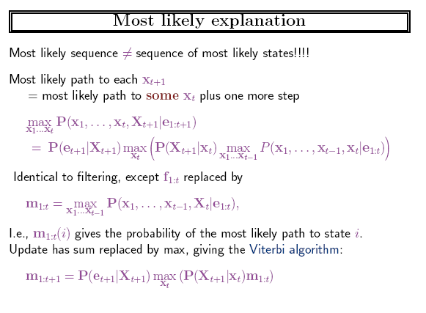

Slide 22
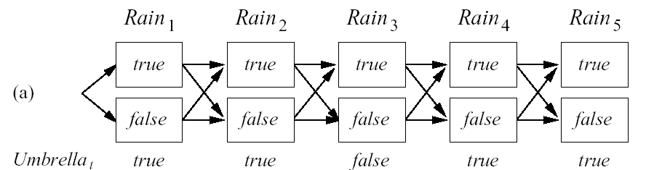
Most Likely Sequence (Explanation)
Most Likely Sequence: argmax_{x1:T} P(X_{1:T} | e_{1:T})
Idea
  find the most likely path to each state in X_{T}
  As for filtering etc. we will develop a recursive solution
Notes:
22
Different than sequence of most likely states

Slide 23
Most Likely Sequence (Explanation)
Most Likely Sequence: argmax_{x1:T} P(X_{1:T} | e_{1:T})
Idea
  find the most likely path to each state in X_{T}
  As for filtering etc. let’s try to develop a recursive solution
Notes:
23
Different than sequence of most likely states

Slide 24
Joint vs. Conditional Prob
You have two binary random variables X and Y
argmax_{x} P(X | Y=t) ? argmax_{x} P(X , Y=t)
A. Always equal
B. Always different
X | Y | P(X , Y)
t | t | .4
f | t | .2
t | f | .1
f | f | .3
C. It depends
Notes:
Evidence influences the choice of downstream variables, but not upstream ones (C isn’t more likely to get a value matching the evidence)

Slide 25
Most Likely Sequence: Formal Derivation
Most Likely Sequence: argmax_{x1:T} P(X_{1:T} | e_{1:T})
=> argmax_{x1:T} P(X_{1:T} , e_{1:T})
Let’s focus on finding the prob. of the most likely path to state x_{t+1} with evidence e_{1:t+1}.
max _{x1,...xt} P(x₁,.... x_{t} ,x_{t+1}, e_{1:t+1})= max _{x1,...xt} P(x₁,.... x_{t} ,x_{t+1},e_{1:t,} e_{t+1})=
= max _{x1,...xt} P(e_{t+1}|e_{1:t,} x₁,.... x_{t} ,x_{t+1}) P(x₁,.... x_{t} ,x_{t+1},e_{1:t})=
= max _{x1,...xt} P(e_{t+1}|x_{t+1}) P(x₁,.... x_{t} ,x_{t+1},e_{1:t})=
= max _{x1,...xt} P(e_{t+1}|x_{t+1}) P(x_{t+1}| x₁,.... x_{t} , e_{1:t})P(x₁,.... x_{t} , e_{1:t})=
= max _{x1,...xt} P(e_{t+1} |x_{t+1}) P(x_{t+1}|x_{t}) P(x₁,.... x_{t-1} ,x_{t}, e_{1:t}) =
Cond. Prob
Markov Assumption/Indep.
Cond. Prob
Markov Assumption/Indep
P(e_{t+1} |x_{t+1}) max _{xt} (P(x_{t+1}|x_{t}) max _{x1,...xt-1} P(x₁,.... x_{t-1} ,x_{t}, e_{1:t}))
Notes:
25
Recursive relationship between most likely path to state x_{t+1} and most likely path to state x_{t,} which we can express as
Because of the Markov assumption, this is
The most likely path to state X_{t} at step t
the state x_{t}, at step t that maximizes the path to X_{t+1}.
It is the backbone for applications that deal with sequences of noisy observations
Predict the probability of a sequence of actual words from captured speech signals
two main problems: high space complexity if states are large and sequences arelong, as I have to store the forward message for t steps
In on-line applications, one needs to recomputed the sequence everytime new evidence comes. usually one does not recompute the whole sequence but just a predefined lag of d steps before t

Slide 26
Learning Goals for today’s class
You can:
Describe the smoothing problem and derive a solution by manipulating probabilities
Describe the problem of finding the most likely sequence of states (given a sequence of observations)
Derive recursive solution (if time)

Slide 27
TODO for Mon
Keep working on Assignment-2: new due date Fri Oct 21
Midterm : October 26

