Slide 1
Reasoning under Uncertainty: Marginalization, Conditional Prob., and Bayes
Computer Science cpsc322, Lecture 25
(Textbook Chpt 6.1.3.1-2)
June, 13, 2017

Slide 2
Lecture Overview
  Recap Semantics of Probability
  Marginalization
  Conditional Probability
  Chain Rule
  Bayes' Rule

Slide 3
Recap: Possible World Semantics for Probabilities
Probability is a formal measure of subjective uncertainty.
Random variable and probability distribution
Model Environment with a set of random vars
Probability of a proposition f
Notes:
Exhaustive and mutual exclusive

Slide 4

Joint Distribution and Marginalization
cavity | toothache | catch | µ(w)
T | T | T | .108
T | T | F | .012
T | F | T | .072
T | F | F | .008
F | T | T | .016
F | T | F | .064
F | F | T | .144
F | F | F | .576
Given a joint distribution, e.g. P(X,Y, Z) we can compute distributions over any smaller sets of variables
cavity | toothache | P(cavity , toothache)
T | T | .12
T | F | .08
F | T | .08
F | F | .72
Notes:
Become fixed or prevented from moving

Slide 5

Joint Distribution and Marginalization
cavity | toothache | catch | µ(w)
T | T | T | .108
T | T | F | .012
T | F | T | .072
T | F | F | .008
F | T | T | .016
F | T | F | .064
F | F | T | .144
F | F | F | .576
Given a joint distribution, e.g. P(X,Y, Z) we can compute distributions over any smaller sets of variables
A.
B.
C.
cavity | catch | P(cavity , catch) | P(cavity , catch) | P(cavity , catch)
T | T | .12 | .18 | .18
T | F | .08 | .02 | .72
F | T | … | …. | ….
F | F | … | …. | ….
Notes:
Become fixed or prevented from moving

Slide 6
Joint Distribution and Marginalization
cavity | toothache | catch | µ(w)
T | T | T | .108
T | T | F | .012
T | F | T | .072
T | F | F | .008
F | T | T | .016
F | T | F | .064
F | F | T | .144
F | F | F | .576
Given a joint distribution, e.g. P(X,Y, Z) we can compute distributions over any smaller sets of variables
A.
B.
C.
cavity | catch | P(cavity , catch) | P(cavity , catch) | P(cavity , catch)
T | T | .12 | .18 | .18
T | F | .08 | .02 | .72
F | T | …
F | F | …
Notes:
Become fixed or prevented from moving

Slide 7
Why is it called Marginalization?
cavity | toothache | P(cavity , toothache)
T | T | .12
T | F | .08
F | T | .08
F | F | .72
 | Toothache = T | Toothache = F
Cavity = T | .12 | .08
Cavity = F | .08 | .72

Slide 8
Lecture Overview
  Recap Semantics of Probability
  Marginalization
  Conditional Probability
  Chain Rule
  Bayes' Rule
  Independence

Slide 9
Conditioning
(Conditional Probability)
We model our environment with a set of random variables.
Assume have the joint, we can compute the probability of…….
Are we done with reasoning under uncertainty?
What can happen?
Think of a patient showing up at the dentist office. Does she have a cavity?

Slide 10
Conditioning
(Conditional Probability)
Probabilistic conditioning specifies how to revise beliefs based on new information.
You build a probabilistic model (for now the joint) taking all background information into account. This gives the prior probability.
All other information must be conditioned on.
If evidence e is all of the information obtained subsequently, the conditional probability P(h|e) of h given e is the posterior probability of h.

Slide 11
Conditioning Example
Prior probability of having a cavity
P(cavity = T)
Should be revised if you know that there is toothache
P(cavity = T | toothache = T)
It should be revised again if you were informed that the probe did not catch anything
P(cavity =T | toothache = T, catch = F)
What about ?
P(cavity = T | sunny = T)

Slide 12
How can we compute P(h|e)
What happens in term of possible worlds if we know the value of a random var (or a set of random vars)?
Some worlds are . The other become ….
cavity | toothache | catch | µ(w) | µ_{e}(w)
T | T | T | .108
T | T | F | .012
T | F | T | .072
T | F | F | .008
F | T | T | .016
F | T | F | .064
F | F | T | .144
F | F | F | .576
e = (cavity = T)
Notes:
Some are ruled out by the evidence
So the others become more likely
How much more likely?

Slide 13
How can we compute P(h|e)
cavity | toothache | catch | µ(w) | µ_{cavity=T} (w)
T | T | T | .108
T | T | F | .012
T | F | T | .072
T | F | F | .008
F | T | T | .016
F | T | F | .064
F | F | T | .144
F | F | F | .576
Notes:
Some are ruled out by the evidence
So the others become more likely
How much more likely?

Slide 14
Semantics of Conditional Probability
The conditional probability of formula h given evidence e is

Slide 15
Semantics of Conditional Prob.: Example
e = (cavity = T)
cavity | toothache | catch | µ(w) | µ_{e}(w)
T | T | T | .108 | .54
T | T | F | .012 | .06
T | F | T | .072 | .36
T | F | F | .008 | .04
F | T | T | .016 | 0
F | T | F | .064 | 0
F | F | T | .144 | 0
F | F | F | .576 | 0
P(h | e) = P(toothache = T | cavity = T) =

Slide 16
Conditional Probability among Random Variables
P(X | Y) = P(X , Y) / P(Y)
P(X | Y) = P(toothache | cavity)
= P(toothache ∧ cavity) / P(cavity)
 | Toothache = T | Toothache = F
Cavity = T | .12 | .08
Cavity = F | .08 | .72
 | Toothache = T | Toothache = F
Cavity = T
Cavity = F
Notes:
It expresses the probability of each possible value on the left given each possible value on the right

Slide 17
Product Rule
Definition of conditional probability:
  P(X₁ | X₂) = P(X₁ , X₂) / P(X₂)
Product rule gives an alternative, more intuitive formulation:
  P(X₁ , X₂) = P(X₂) P(X₁ | X₂) = P(X₁) P(X₂ | X₁)
Product rule general form:
  P(X₁, …,X_{n}) =
  = P(X₁,...,X_{t}) P(X_{t+1}…. X_{n} | X₁,...,X_{t})
Notes:
if P(b) > 0

Slide 18
Chain Rule
Product rule general form:
  P(X₁, …,X_{n}) =
  = P(X₁,...,X_{t}) P(X_{t+1}…. X_{n} | X₁,...,X_{t})
Chain rule is derived by successive application of product rule:
  P(X₁, … X_{n-1} , X_{n}) =
  = P(X₁,...,X_{n-1}) P(X_{n} | X₁,...,X_{n-1})
  = P(X₁,...,X_{n-2}) P(X_{n-1} | X₁,...,X_{n-2}) P(X_{n} | X₁,...,X_{n-1}) = ….
  = P(X₁) P(X₂ | X₁) … P(X_{n-1} | X₁,...,X_{n-2}) P(X_{n} | X₁,.,X_{n-1})
  = ∏^{n}_{i= 1} P(X_{i} | X₁, … ,X_{i-1})
Notes:
if P(b) > 0

Slide 19
Chain Rule: Example
P(cavity , toothache, catch) =
P(toothache, catch, cavity) =
In how many other ways can this joint be decomposed using the chain rule?
A. 4
B. 1
C. 8
D. 0
Notes:
if P(b) > 0

Slide 20
Chain Rule: Example
P(cavity , toothache, catch) =
P(toothache, catch, cavity) =
Notes:
if P(b) > 0

Slide 21
Lecture Overview
  Recap Semantics of Probability
  Marginalization
  Conditional Probability
  Chain Rule
  Bayes' Rule
  Independence

Slide 22
Using conditional probability
Often you have causal knowledge (forward from cause to evidence):
  For example
    P(symptom | disease)
    P(light is off | status of switches and switch positions)
    P(alarm | fire)
  In general: P(evidence e | hypothesis h)
... and you want to do evidential reasoning (backwards from evidence to cause):
  For example
    P(disease | symptom)
    P(status of switches | light is off and switch positions)
    P(fire | alarm)
  In general: P(hypothesis h | evidence e)

Slide 23
Bayes Rule
By definition, we know that :
We can rearrange terms to write
But
From (1) (2) and (3) we can derive
Bayes Rule

Slide 24
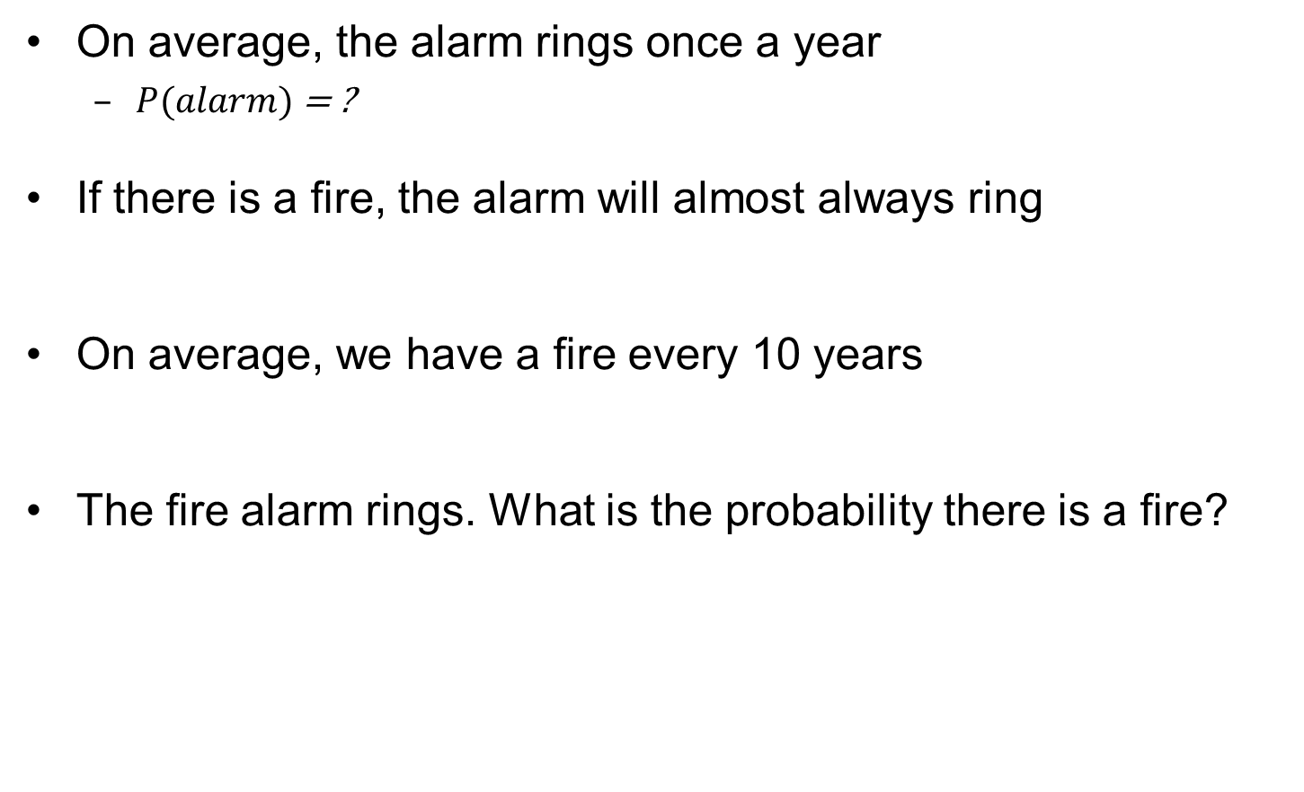
Example for Bayes rule

Slide 25
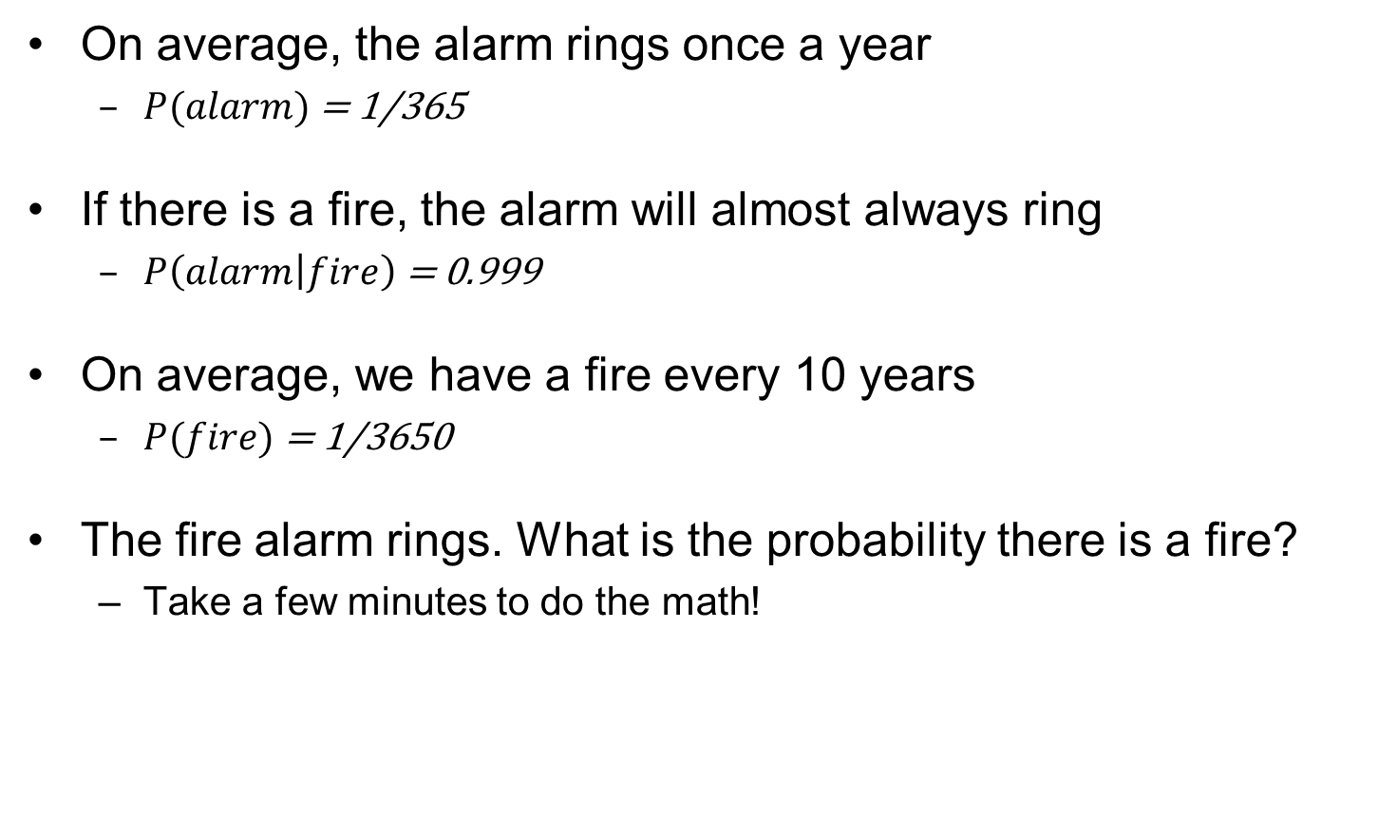
Example for Bayes rule
A. 0.999
B. 0.9
C. 0.0999
D. 0.1

Slide 26
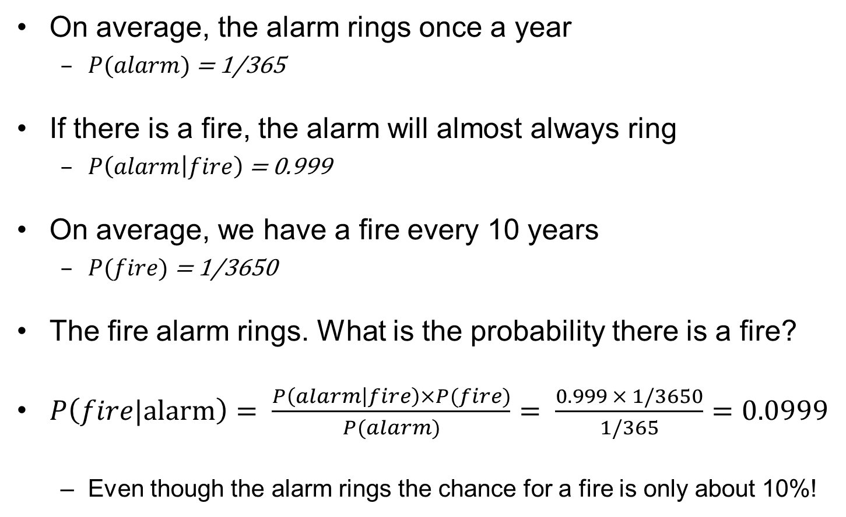
Example for Bayes rule

Slide 27
Learning Goals for today’s class
You can:
Given a joint, compute distributions over any subset of the variables
Prove the formula to compute P(h|e)
Derive the Chain Rule and the Bayes Rule

Slide 28
Next Class
Marginal Independence
Conditional Independence
Assignments
Assignment 3 has been posted : due jone 20th

Slide 29
Plan for this week
Probability is a rigorous formalism for uncertain knowledge
Joint probability distribution specifies probability of every possible world
Probabilistic queries can be answered by summing over possible worlds
For nontrivial domains, we must find a way to reduce the joint distribution size
Independence (rare) and conditional independence (frequent) provide the tools

Slide 30
Conditional probability
(irrelevant evidence)
New evidence may be irrelevant, allowing simplification, e.g.,
  P(cavity | toothache, sunny) = P(cavity | toothache)
  We say that Cavity is conditionally independent from Weather (more on this next class)
This kind of inference, sanctioned by domain knowledge, is crucial in probabilistic inference
Notes:
Not

