Slide 1
Planning: Representation and Forward Search
Computer Science cpsc322, Lecture 17
(Textbook Chpt 8.1 (Skip 8.1.1-2)- 8.2)
June, 1, 2017
Notes:
Lecture 17

Slide 2
Lecture Overview
Clarification
Where are we?
Planning
  Example
  STRIPS: a Feature-Based Representation
  Forward Planning

Slide 3
Sampling a discrete probability distribution

Slide 4
Lecture Overview
Clarifications
Where are we?
Planning
  Example
  STRIPS: a Feature-Based Representation
  Forward Planning

Slide 5
Modules we'll cover in this course: R&Rsys
Environment
Deterministic
Stochastic
Problem
Arc Consistency
Search
Constraint Satisfaction
Vars +
Constraints
SLS
Static
Belief Nets
Inference
Logics
Var. Elimination
Search
Sequential
Decision Nets
STRIPS
Var. Elimination
Planning
Search
Markov Processes
Representation
Value Iteration
Reasoning
Technique
Notes:
R&R Sys Representation and reasoning Systems
Each cell is a R&R system
STRIPS actions preconditions and effects

Slide 6
Standard Search vs. Specific R&R systems
Constraint Satisfaction (Problems)(A): (B: domain splitting ……..)
  State: assignments of values to a subset of the variables
  Successor function: assign values to a “free” variable
  Goal test: set of constraints
  Solution: possible world that satisfies the constraints
  Heuristic function: none (all solutions at the same distance from start)
Planning :
  State
  Successor function
  Goal test
  Solution
  Heuristic function
Inference
  State
  Successor function
  Goal test
  Solution
  Heuristic function
Notes:
Allows useful general-purpose algorithms with more power than standard search algorithms

Slide 7
Lecture Overview
Clarifications
Where are we?
Planning
  Example
  STRIPS representation and assumption
  Forward Planning

Slide 8
Planning as Search: State and Goal
How to select and organize a sequence of actions to achieve a given goal…
State: Agent is in a possible world (full assignments to a set of variables/features)
Goal: Agent wants to be in a possible world were some variables are given specific values

Slide 9
Planning as Search: Successor function and Solution
Actions : take the agent from one state to another
Solution: sequence of actions that when performed will take the agent from the current state to a goal state

Slide 10
Lecture Overview
Clarifications
Where are we?
Planning
  Example
  STRIPS representation and assumption
  Forward Planning

Slide 11
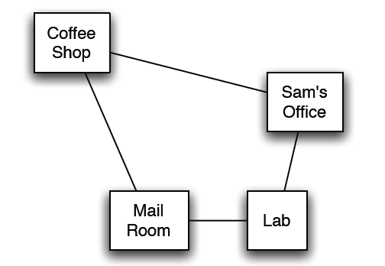
Delivery Robot Example (textbook)
  Consider a delivery robot named Rob, who must navigate the following environment, can deliver coffee and mail to Sam
  Another example will be available as a Practice Exercise:
  “Commuting to UBC”

Slide 12

Delivery Robot Example: States
  The state is defined by the following variables/features:
  RLoc - Rob's location
    domain: coffee shop (cs), Sam's office (off ), mail room (mr ),
    or laboratory (lab)
  RHC - Rob has coffee True/False.
  SWC - Sam wants coffee
  MW - Mail is waiting
  RHM - Rob has mail
  Example state:
  Number of states:
A. 32
B. 64
C. 48
D. 16

Slide 13
Delivery Robot Example:
Actions
  The robot’s actions are:
  Move - Rob's move action
    move clockwise (mc ), move anti-clockwise (mac ) not move (nm )
  PUC - Rob picks up coffee
    must be at the coffee shop
  DelC - Rob delivers coffee
    must be at the office, and must have coffee
  PUM - Rob picks up mail
    must be in the mail room, and mail must be waiting
  DelM - Rob delivers mail
    must be at the office and have mail

Slide 14
Lecture Overview
Clarifications
Were are we?
Planning
  Example
  STRIPS representation and assumption (STanford Research Institute Problem Solver )
  Forward Planning

Slide 15
STRIPS action representation
The key to sophisticated planning is modeling actions
In STRIPS, an action has two parts:
  1. Preconditions: a set of assignments to features that must be
  satisfied in order for the action to be legal
  2. Effects: a set of assignments to features that are caused by
  the action
Notes:
a logical test about

Slide 16
STRIPS actions: Example
STRIPS representation of the action pick up coffee, PUC :
  preconditions Loc = cs and RHC = F
  effects RHC = T
STRIPS representation of the action deliver coffee, DelC :
  preconditions Loc = and RHC =
  effects RHC = and SWC =
Note in this domain Sam doesn't have to want coffee for Rob to deliver it; one way or another, Sam doesn't want coffee after delivery.

Slide 17
STRIPS actions: MC and MAC
STRIPS representation of the action MoveClockwise ?

Slide 18
STRIPS Actions (cont’)
The STRIPS assumption: all features not explicitly changed by an action stay unchanged
So if the feature V has value v_{i} in state S_{i} , after action a has been performed,
  what can we conclude about a and/or the state of the world S_{i-1} ,immediately preceding the execution of a?
S_{i-1}
S_{i}
a
V = v_{i}

Slide 19
  What can we conclude about a and/or the state of the world S_{i-1} ,immediately preceding the execution of a?
S_{i-1}
S_{i}
a
V = v_{i}
A. V = v_{i} was TRUE in S_{i-1}
B. One of the effects of a is to set V = v_{i}
C. At least one of the above
D None of the above

Slide 20
  what can we conclude about a and/or the state of the world S_{i-1} ,immediately preceding the execution of a?
3 At least one of the above
S_{i-1}
S_{i}
a
V = v_{i}

Slide 21
Lecture Overview
Clarifications
Where are we?
Planning
  Example
  STRIPS representation and assumption (STanford Research Institute Problem Solver )
  Forward Planning

Slide 22
Forward Planning
To find a plan, a solution: search in the state-space graph.
  The states are the possible worlds
  The arcs from a state s represent all of the actions that are legal in state s.
  A plan is a path from the state representing the initial state to a state that satisfies the goal.
What actions a are legal/possible in a state s?
A. Those where a’s effects are satisfied in s
B. Those where a’s preconditions are satisfied in s
C. Those where the state s’ reached via a is on the way to the goal

Slide 23
Forward Planning
To find a plan, a solution: search in the state-space graph.
  The states are the possible worlds
  The arcs from a state s represent all of the actions that are legal in state s.
  A plan is a path from the state representing the initial state to a state that satisfies the goal.
What actions a are legal/possible in a state s?
Those where a’s preconditions are satisfied in s

Slide 24
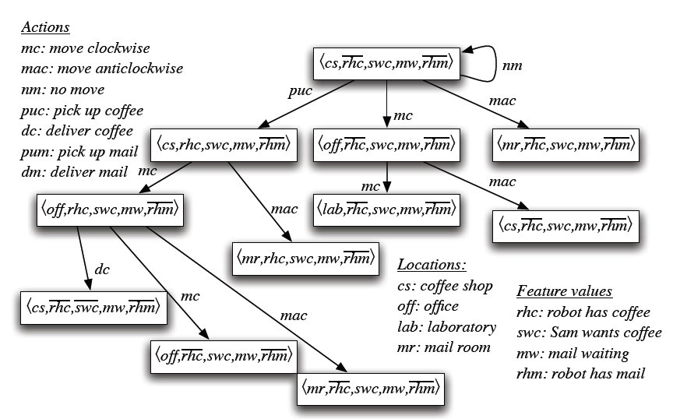
Example state-space graph: first level

Slide 25
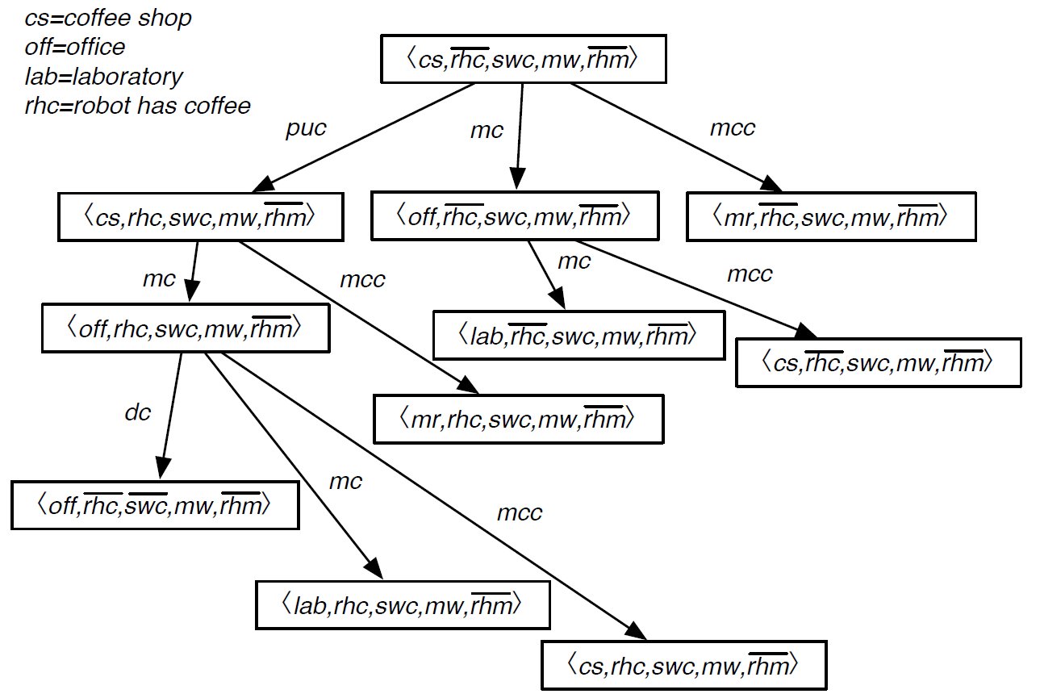
Example for state space graph
Goal:
Solution:
a sequence of actions
that gets us from the
start to a goal
What is a solution to
this planning problem?
A. (puc, mc)
B. (puc, mc, mc)
C. (puc, dc)
D. (puc, mc, dc)

Slide 26
Example state-space graph

Slide 27
Learning Goals for today’s class
You can:
Represent a planning problem with the STRIPS representation
Explain the STRIPS assumption
Solve a planning problem by search (forward planning). Specify states, successor function, goal test and solution.

Slide 28
Next class
Finish Planning (Chp 8)
Heuristics for planning (not on textbook)
Mapping planning problem into a CSP (8.4)
Course Announcements
Start working on Assignment2 (CSP) – due June 8
Work on Practice Exercises (under Aispace)

