Slide 1
Stochastic Local Search
Computer Science cpsc322, Lecture 15
(Textbook Chpt 4.8)
May, 30, 2017
Notes:
Lecture 15

Slide 2
Lecture Overview
Recap Local Search in CSPs
Stochastic Local Search (SLS)
Comparing SLS algorithms

Slide 3
Local Search: Summary
A useful method in practice for large CSPs
  Start from a possible world
  Generate some neighbors ( “similar” possible worlds)
  Move from current node to a neighbor, selected to minimize/maximize a scoring function which combines:
    Info about how many constraints are violated/satisfied
    Information about the cost/quality of the solution (you want the best solution, not just a solution)
Notes:
move from one node to another according to a function that scores how good each neighbor is
according to a function that scores how good each neighbor is
Number of unsatisfied constraints OR weighted count

Slide 5
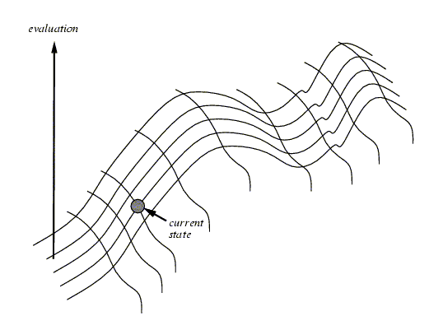
Hill Climbing
NOTE: Everything that will be said for Hill Climbing is also true for Greedy Descent
Notes:
One of the most obvious heuristics is to select the value that results in the minimum # of conflicts with the other variables - the min conflicts heuristics
Ex, in case of eight queen, it is the number of attacking queens.
Min conflict is surprising effective and can solve the million-queens problem in less than 50 steps. It has also been used to schedule the hubble telecope, reducing the time taken to schedule a week of observations from three weeks to around 10’

Slide 6
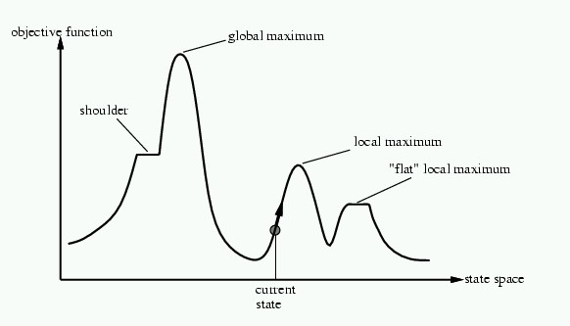
Problems with Hill Climbing
Local Maxima.
Plateau - Shoulders
(Plateau)
Notes:
No way to move from a plateau, could escape from a shoulder
With a randomly gerenated 8-queen initial state steepest ascent hill climbing gets stuck 86% of the times. Takes 4 steps on average to suceed and 3 to get stuck –good since there are 17 million states

Slide 7
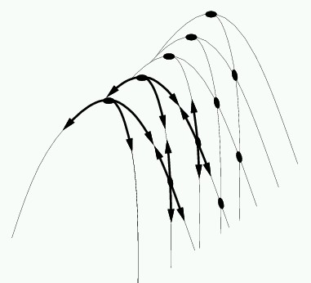
In higher dimensions…….
E.g., Ridges – sequence of local maxima not directly connected to each other
From each local maximum you can only
go downhill

Slide 8
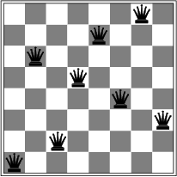
Corresponding problem for GreedyDescent
Local minimum example: 8-queens problem
A local minimum with h = 1

Slide 9
Lecture Overview
Recap Local Search in CSPs
Stochastic Local Search (SLS)
Comparing SLS algorithms

Slide 10
Stochastic Local Search
GOAL: We want our local search
  to be guided by the scoring function
  Not to get stuck in local maxima/minima, plateaus etc.
SOLUTION: We can alternate
  Hill-climbing steps
  Random steps: move to a random neighbor.
  Random restart: reassign random values to all variables.
Notes:
NOTE again: Everything that will be said for Hill Climbing is also true for Gradient Descent (max -> min)
Consider two methods to find a maximum value:
Hill climbing, starting from some position, keep moving uphill & report maximum value found
Pick values at random & report maximum value found
Which do you expect to work better to find a maximum?
hill climbing is good for finding local maxima
selecting random nodes is good for finding/exploring new parts of the search space
A mix of the two techniques can work even better

Slide 11
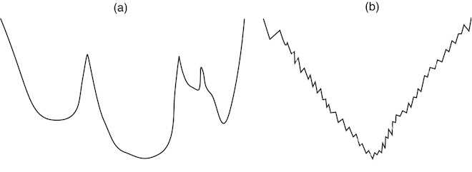

Which randomized method would work best in each of these two search spaces?
Evaluation function
X
Evaluation function
Y
State Space (1 variable)
State Space
(1 variable)
A. Greedy descent with random steps best on X
Greedy descent with random restart best on Y
B. Greedy descent with random steps best on Y
Greedy descent with random restart best on X
C. The two methods are equivalent on X and Y

Slide 12
Which randomized method would work best in each of the these two search spaces?
Evaluation function
A
Evaluation function
B
State Space (1 variable)
State Space
(1 variable)
Greedy descent with random steps best on B
Greedy descent with random restart best on A
But these examples are simplified extreme cases for illustration
  in practice, you don’t know what your search space looks like
Usually integrating both kinds of randomization works best

Slide 13
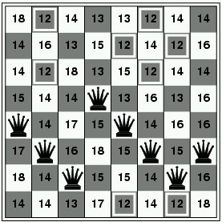
Random Steps (Walk)
Let’s assume that neighbors are generated as
  assignments that differ in one variable's value
How many neighbors there are given n variables with domains with d values?
One strategy to add randomness to the selection of the variable-value pair. Sometimes choose the pair
According to the scoring function
A random one
E.G in 8-queen
How many neighbors?
……..
Notes:
You may choose between a one or two stage heuristic.
In a one stage heuristic the variable and value are chosen together.
The pair that minimize the number of conflicts
In the two stage heuristic the variable is chosen first and then the
value. The variable with the greatest number of conflicts in it's
edges is chosen and then the value which resolves the highest number
of conflicts is chosen from this variable's set of values.

Slide 14
Random Steps (Walk): two-step
Another strategy: select a variable first, then a value:
  Sometimes select variable:
    that participates in the largest number of conflicts.
    at random, any variable that participates in some conflict.
    at random
  Sometimes choose value
    That minimizes # of conflicts
    at random
0
2
2
3
3
2
Aispace
2 a: Greedy Descent with Min-Conflict Heuristic
3
Notes:
Sometimes choose the variable which participates in the largest number of conflicts.
Sometimes choose, at random, any variable that participates in some conflict.
Sometimes choose a random variable.
Sometimes choose the best value for the chosen variable.
Sometimes choose a random value for the chosen variable.

Slide 15
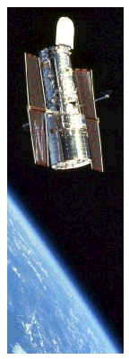
Successful application of SLS
Scheduling of Hubble Space Telescope: reducing time to schedule 3 weeks of observations:
from one week to around 10 sec.
Notes:
Generate feasible schedule that are not too suboptimal
Soft constraints
e.g., Minimize light from moon / sun
SPIKE treats schedule construction as a constrained optimization problem and uses a heuristic
repair-based scheduling search technique called multistart stochastic repair. This
technique consists of the following steps:
1. Trial assignment: make a trial assignment (“initial guess”) of activities to times, based
on heuristics to be discussed further below. Such a schedule will generally have temporal
or other constraint violations, as well as resource capacity overloads;
2. Repair: apply heuristic repair techniques to try to eliminate constraint violations, until
either a pre-established level of effort has been expended or there are no conflicts left;
3. Deconflict: eliminate conflicts by removing any activities with constraint violations, or
by relaxing constraints, until a feasible schedule remains.

Slide 16
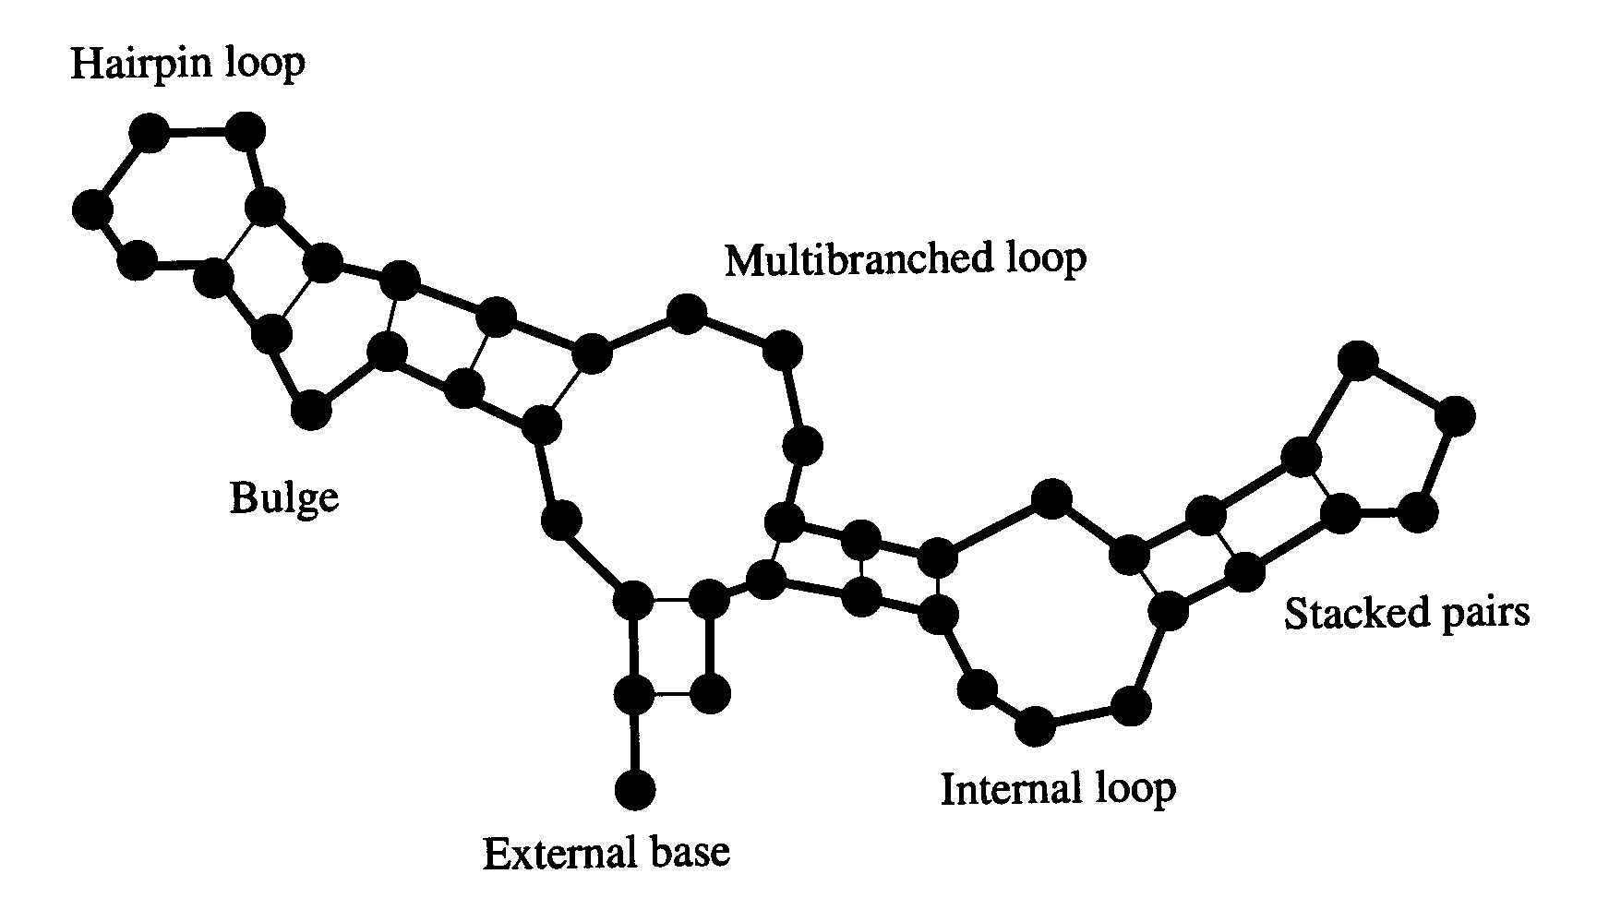
Example: SLS for RNA secondary structure design
RNA strand made up of four bases: cytosine (C), guanine (G), adenine (A), and uracil (U)
2D/3D structure RNA strand folds into
is important for its function
Predicting structure for a
strand is “easy”: O(n³)
But what if we want a strand that folds
into a certain structure?
  Local search over strands
    Search for one that folds
    into the right structure
  Evaluation function for a strand
    Run O(n³) prediction algorithm
    Evaluate how different the result is
    from our target structure
    Only defined implicitly, but can be
    evaluated by running the prediction algorithm
RNA strand
GUCCCAUAGGAUGUCCCAUAGGA
Easy
Hard
Secondary structure
  Best algorithm to date: Local search algorithm RNA-SSD developed at UBC
  [Andronescu, Fejes, Hutter, Condon, and Hoos, Journal of Molecular Biology, 2004]

Slide 17


CSP/logic: formal verification
Hardware verification Software verification
(e.g., IBM) (small to medium programs)
Most progress in the last 10 years based on:
Encodings into propositional satisfiability (SAT)

Slide 18
(Stochastic) Local search advantage: Online setting
When the problem can change (particularly important in scheduling)
E.g., schedule for airline: thousands of flights and thousands of personnel assignment
  Storm can render the schedule infeasible
Goal: Repair with minimum number of changes
This can be easily done with a local search starting form the current schedule
Other techniques usually:
  require more time
  might find solution requiring many more changes

Slide 19
SLS limitations
Typically no guarantee to find a solution even if one exists
  SLS algorithms can sometimes stagnate
    Get caught in one region of the search space and never terminate
  Very hard to analyze theoretically
Not able to show that no solution exists
  SLS simply won’t terminate
  You don’t know whether the problem is infeasible or the algorithm has stagnated

Slide 20
SLS Advantage: anytime algorithms
When should the algorithm be stopped ?
  When a solution is found
  (e.g. no constraint violations)
  Or when we are out of time: you have to act NOW
  Anytime algorithm:
    maintain the node with best h found so far (the “incumbent”)
    given more time, can improve its incumbent

Slide 21
Lecture Overview
Recap Local Search in CSPs
Stochastic Local Search (SLS)
Comparing SLS algorithms

Slide 22
Evaluating SLS algorithms
SLS algorithms are randomized
  The time taken until they solve a problem is a random variable
  It is entirely normal to have runtime variations of 2 orders of magnitude in repeated runs!
    E.g. 0.1 seconds in one run, 10 seconds in the next one
    On the same problem instance (only difference: random seed)
    Sometimes SLS algorithm doesn’t even terminate at all: stagnation
If an SLS algorithm sometimes stagnates, what is its mean runtime (across many runs)?
  Infinity!
  In practice, one often counts timeouts as some fixed large value X
  Still, summary statistics, such as mean run time or median run time, don't tell the whole story
    E.g. would penalize an algorithm that often finds a solution quickly but sometime stagnates

Slide 23
Comparing Stochastic Algorithms: Challenge
Summary statistics, such as mean run time, median run time, and mode run time don't tell the whole story
  What is the running time for the runs for which an algorithm never finishes (infinite? stopping time?)
% of solved runs
100%
0
10
20
30
…..
runtime / steps
Notes:
Summary stats for each algorithm are not effective…

Slide 24
First attempt….
How can you compare three algorithms when
  one solves the problem 30% of the time very quickly but doesn't halt for the other 70% of the cases
  one solves 60% of the cases reasonably quickly but doesn't solve the rest
  one solves the problem in 100% of the cases, but slowly?
% of solved runs
100%
Mean runtime / steps
of solved runs

Slide 25
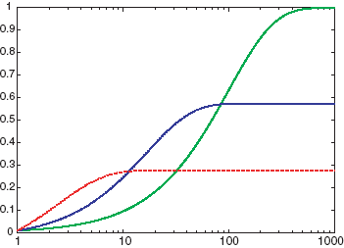
Runtime Distributions are even more effective
Plots runtime (or number of steps) and the proportion (or number) of the runs that are solved within that runtime.
  log scale on the x axis is commonly used
Fraction of
solved runs, i.e.
P(solved by
this # of steps/time)
# of steps
Notes:
Scheduling 1 problem
How many states (toy problem)
200 runs 1000 steps
Random sampling
Do it again different result

Slide 26
Comparing runtime distributions
x axis: runtime (or number of steps)
y axis: proportion (or number) of runs solved in that runtime
  Typically use a log scale on the x axis
Fraction of
solved runs, i.e.
P(solved by
this # of steps/time)
# of steps
Which algorithm is most likely to solve the problem within 7 steps?
A. blue
B. red
C. green

Slide 27
Comparing runtime distributions
Which algorithm has the best median performance?
  I.e., which algorithm takes the fewest number of steps to be successful in 50% of the cases?
A. blue
B. red
C. green
Fraction of
solved runs, i.e.
P(solved by
this # of steps/time)
# of steps

Slide 28
Comparing runtime distributions
x axis: runtime (or number of steps)
y axis: proportion (or number) of runs solved in that runtime
  Typically use a log scale on the x axis
Slow, but does not stagnate
Fraction of
solved runs, i.e.
P(solved by
this # of steps/time)
Crossover point:
if we run longer than 80 steps, green is the
best algorithm
57% solved after 80 steps, then stagnate
If we run less than 10 steps, red is the
best algorithm
28% solved after 10 steps, then stagnate
# of steps

Slide 29

Runtime distributions in AIspace
Let’s look at some algorithms and their runtime distributions:
  Greedy Descent
  Random Sampling
  Random Walk
  Greedy Descent with random walk
Simple scheduling problem 2 in AIspace:

Slide 30
What are we going to look at in AIspace
When selecting a variable first followed by a value:
  Sometimes select variable:
    that participates in the largest number of conflicts.
    at random, any variable that participates in some conflict.
    at random
  Sometimes choose value
    That minimizes # of conflicts
    at random
AIspace terminology
Random sampling
Random walk
Greedy Descent
Greedy Descent Min conflict
Greedy Descent with random walk
Greedy Descent with random restart
…..
Notes:
Sometimes choose the variable which participates in the largest number of conflicts.
Sometimes choose, at random, any variable that participates in some conflict.
Sometimes choose a random variable.
Sometimes choose the best value for the chosen variable.
Sometimes choose a random value for the chosen variable.
Random Sampling
At each step this algorithm randomly creates a new solution. For each variable a new value is randomly chosen.
Random Walk
At each step this algorithm randomly chooses a new solution from the set of neighbouring solutions. The set of neighbouring solutions is defined in this applet as the solutions where a single variable has a different value.
Options: You may choose between a one or two stage heuristic. In the first case, the variable and value are chosen together; in the second case, the variable is chosen first and then the value.
Greedy Descent
At each step this algorithm chooses a value which improves the graph.
Options: You may choose between a one or two stage heuristic. In a one stage heuristic the variable and value are chosen together. In the two stage heuristic the variable is chosen first and then the value. The variable with the greatest number of conflicts in its edges is chosen and then the value which resolves the highest number of conflicts is chosen from this variable's set of values.
Greedy Descent with the Min Conflict Heuristic
The Min Conflict Heuristic is one of the first heuristics used for constraint satisfaction problems. (Minton et Al, 1992). It chooses a variable randomly from the set of variables with conflicts (red edges). The value which results in the fewest conflicts is chosen from the possible assignments for this variable. This heuristic is almost identical to Greedy Descent with Random Walk with a two stage heuristic choosing any red node 100% and best value 100%. The only difference is the MCH may return to the previous assignment.
Greedy Descent with Random Walk
At each step this algorithm probabilistically decides whether or not to take a greedy step (change to the best neighbour) or to take a random walk (change to any neighbour)
Options: You may choose between a one or two stage heuristic. In the first case, the variable and value are chosen together; in the second case, the variable is chosen first and then the value. To increase the random walk percentage increase the "random ..." values.
Greedy Descent with Random Restart
This algorithm proceeds like the Greedy Descent algorithm but resets the variables to a new random solution at regular intervals.
Options: Reset Graph specifies the number of steps between random resets of the graph.
Greedy Descent with all Options

Slide 31
Stochastic Local Search
Key Idea: combine greedily improving moves with randomization
As well as improving steps we can allow a “small probability” of:
  Random steps: move to a random neighbor.
  Random restart: reassign random values to all variables.
Always keep best solution found so far
Stop when
  Solution is found (in vanilla CSP …………………………)
  Run out of time (return best solution so far)
Notes:
Key Idea: combine hill climbing (advantage: finds local maximum) with randomization (advantage: doesn't get stuck).
Limitations
Typically no guarantee they will find a solution even if one exists
Not able to show that no solution exists

Slide 32
Learning Goals for today’s class
You can:
Implement SLS with
  random steps (1-step, 2-step versions)
  random restart
Compare SLS algorithms with runtime distributions

Slide 33
Next Class
Assign-2
Will be out today – due June
Finish CSPs: More SLS variants Chp 4.9
Planning: Representations and Forward Search Chp 8.1 - 8.2
Planning: Heuristics and CSP Planning Chp 8.4

