Slide 1
Finish Search
Computer Science cpsc322, Lecture 10
(Textbook Chpt 3.6)
May, 25, 2017
Notes:
Lecture 10

Slide 2
Lecture Overview
Finish MBA*
Pruning Cycles and Repeated states Examples
Dynamic Programming
Search Recap

Slide 3

Heuristic value by look ahead
What is the most accurate admissible heuristic value for n, given only this info ?
7
5
2
8
Notes:
The oldest if they all have the same f-value
h(p)=min( (cost(pi) – cost(p)) + h(pi) ) underestimate!

Slide 4
Memory-bounded A*
Iterative deepening A* and B & B use a tiny amount of memory
what if we've got more memory to use?
keep as much of the fringe in memory as we can
if we have to delete something:
  delete the worst paths (with …………………………..)
  ``back them up'' to a common ancestor
p
p₁
p_{n}
Notes:
The oldest if they all have the same f-value
h(p)=min( (cost(pi) – cost(p)) + h(pi) ) underestimate!

Slide 5
MBA*: Compute New h(p)
p
p₁
p_{n}
Notes:
The oldest if they all have the same f-value
h(p)=min( (cost(pi) – cost(p)) + h(pi) ) underestimate!

Slide 6
Lecture Overview
Finish MBA*
Pruning Cycles and Repeated states Examples
Dynamic Programming
Search Recap

Slide 7
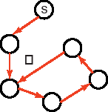
Cycle Checking
You can prune a path that ends in a node already on the path. This pruning cannot remove an optimal solution.
The time for checking is ………………… in path length.
Notes:
Using depth-first methods, with the graph explicitly stored, this can be done in constant time.??

Slide 8
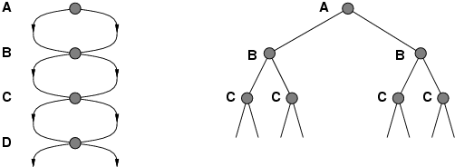
Repeated States / Multiple Paths
Failure to detect repeated states can turn a linear problem into an exponential one!

Slide 9
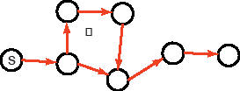
Multiple-Path Pruning
You can prune a path to node n that you have already found a path to
(if the new path is longer – more costly).
Notes:
This entails storing all nodes you have found paths to.
Multiple-path pruning subsumes cycle check.

Slide 10
Multiple-Path Pruning & Optimal Solutions
Problem: what if a subsequent path to n is shorter than the first path to n ?
You can remove all paths from the frontier that use the longer path. (as these can’t be optimal)
Notes:
You’ll have to regenerated them

Slide 11
Multiple-Path Pruning & Optimal Solutions
Problem: what if a subsequent path to n is shorter than the first path to n ?
You can change the initial segment of the paths on the frontier to use the shorter path.
Notes:
Can be computationally costly

Slide 12
Pruning Cycles
Example
Repeated States

Slide 13
Lecture Overview
Finish MBA*
Pruning Cycles and Repeated states Examples
Dynamic Programming
Search Recap

Slide 14
Dynamic Programming
Idea: for statically stored graphs, build a table of dist(n):
  The actual distance of the shortest path from node n to a goal g
  This is the perfect
  dist(g) = 0
  dist(z) = 1
  dist(c) = 3
  dist(b) = 4
  dist(k) = ?
  dist(h) = ?
How could we implement that?
f function
cost
heuristic
2
2
b
h
1
3
k
c
g
4
6
7
∞
1
z
6
7
∞

Slide 15
Dynamic Programming
This can be built backwards from the goal:
This can be built backwards from the goal:
all the neighbors m
g
b
c
a
2
d
2
b
2
g
1
1
a
c
3
3
Notes:
Dynamic programming is a general algorithm that will be used as a dual
to search algorithms in other parts of the book. The specific algorithm presented
here was invented by Dijkstra [1959]. See Cormen, Leiserson, Rivest,
and Stein [2001] for more details on the general class of dynamic programming
algorithms.
The idea of using dynamic programming as a source of heuristics for A
search was proposed by Culberson and Schaeffer [1998] and further developed
by Felner, Korf, and Hanan [2004].

Slide 16
Dynamic Programming
This can be used locally to determine what to do.
From each node n go to its neighbor which minimizes
4
2
d
2
b
2
2
g
1
1
3
a
c
3
3
3
But there are at least two main problems:
You need enough space to store the graph.
The dist function needs to be recomputed for each goal

Slide 17
Lecture Overview
Finish MBA*
Pruning Cycles and Repeated states Examples
Dynamic Programming
Search Recap

Slide 18
Recap Search
 | Selection | Complete | Optimal | Time | Space
DFS | LIFO | N | N | O(b^{m}) | O(mb)
BFS | FIFO | Y | Y | O(b^{m}) | O(b^{m})
IDS(C) | LIFO | Y | Y | O(b^{m}) | O(mb)
LCFS | min cost | Y | Y | O(b^{m}) | O(b^{m})
BFS | min h | N | N | O(b^{m}) | O(b^{m})
A* | min f | Y | Y | O(b^{m}) | O(b^{m})
B&B | LIFO + pruning | N | Y | O(b^{m}) | O(mb)
IDA* | LIFO | Y | Y | O(b^{m}) | O(mb)
MBA* | min f | N | Y | O(b^{m}) | O(b^{m})
Notes:
Many of these are qualified
Eg. LCFS optimal if costs are > 0
Eg. A* complete if h is admissible
E.G B&B optimal if there are no infinite path
E.G BDS complete if both searches are BFS (or A*)

Slide 19
Recap Search (some qualifications)
 | Complete | Optimal | Time | Space
DFS | N | N | O(b^{m}) | O(mb)
BFS | Y | Y | O(b^{m}) | O(b^{m})
IDS(C) | Y | Y | O(b^{m}) | O(mb)
LCFS | Y | Y ? | O(b^{m}) | O(b^{m})
BFS | N | N | O(b^{m}) | O(b^{m})
A* | Y | Y ? | O(b^{m}) | O(b^{m})
B&B | N | Y ? | O(b^{m}) | O(mb)
IDA* | Y | Y | O(b^{m}) | O(mb)
MBA* | N | Y | O(b^{m}) | O(b^{m})
Notes:
Many of these are qualified
Eg. LCFS optimal if costs are > 0
Eg. A* complete if h is admissible
E.G B&B optimal if there are no infinite path
E.G BDS complete if both searches are BFS (or A*)

Slide 20
Search in Practice
 | Complete | Optimal | Time | Space
DFS | N | N | O(b^{m}) | O(mb)
BFS | Y | Y | O(b^{m}) | O(b^{m})
IDS(C) | Y | Y | O(b^{m}) | O(mb)
LCFS | Y | Y | O(b^{m}) | O(b^{m})
BFS | N | N | O(b^{m}) | O(b^{m})
A* | Y | Y | O(b^{m}) | O(b^{m})
B&B | N | Y | O(b^{m}) | O(mb)
IDA* | Y | Y | O(b^{m}) | O(mb)
MBA* | N | Y | O(b^{m}) | O(b^{m})
BDS | Y | Y | O(b^{m/2}) | O(b^{m/2})

Slide 21
Search in Practice (cont’)
Informed?
Many paths to solution, no ∞ paths?
Large branching factor?
Notes:
Uninformed: IDS (many deep solutions – do not care about optimality)
Informed:
Infinite path (in practice paths so long that cannot be kept in memory)

Slide 22
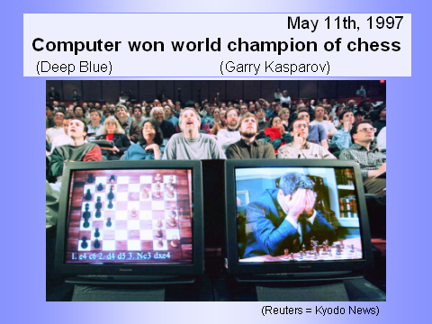
(Adversarial) Search: Chess
Deep Blue’s Results in the second tournament:
  second tournament: won 3 games, lost 2, tied 1
  30 CPUs + 480 chess processors
  Searched 126.000.000 nodes per sec
  Generated 30 billion positions per move reaching depth 14 routinely
  Iterative Deepening with evaluation function (similar to a heuristic) based on 8000 features (e.g., sum of worth of pieces: pawn 1, rook 5, queen 10)
Notes:
Winning machine was a parallel computer (30 CPUs) + 480 VLSI chess processors
Searched 126.000.000 nodes per sec
Generated 30 billion positions per move, reaching depth 14 routinely
Standard iterative deepening alpha beta search (with transposition table)
But key to success seems to be its ability to go deeper for sufficiently interesting lines of forced/forcing moves
Evaluation functions had over 8000 features
+ opening book with 4000 positions
+ solved positions with 5 pieces and many with 6 (to extend the effective depth of the search)
Deep Blue's evaluation function looks at four basic chess values: material, position, King safety and tempo. Material is based on the "worth" of particular chess pieces. For example, if a pawn is valued at 1, then the rook is worth 5 and the Queen is valued at 9. The King, of course, is beyond value because his loss means the loss of the game.
The simplest way to understand position is by looking at your pieces and counting the number of safe squares they can attack. King safety is a defensive aspect of position. It is determined by assigning a value to the safety of the King's position in order to know how to make a purely defensive move. Tempo is related to position but focuses on the race to develop control of the board. A player is said to "lose a tempo" if he dillydallies while the opponent is making more productive advances.

Slide 23
Modules we'll cover in this course: R&Rsys
Environment
Deterministic
Stochastic
Problem
Arc Consistency
Constraint Satisfaction
Vars +
Constraints
Search
Static
Belief Nets
Query
Logics
Var. Elimination
Search
Sequential
Decision Nets
STRIPS
Var. Elimination
Planning
Search
Markov Processes
Representation
Value Iteration
Reasoning
Technique
Notes:
R&R Sys Representation and reasoning Systems
Each cell is a R&R system
STRIPS actions preconditions and effects

Slide 24
Standard Search vs. Specific R&R systems
Constraint Satisfaction (Problems):
  State
  Successor function
  Goal test
  Solution
  Heuristic function
Planning :
  State
  Successor function
  Goal test
  Solution
  Heuristic function
Inference
  State
  Successor function
  Goal test
  Solution
  Heuristic function
Notes:
Allows useful general-purpose algorithms with more power than standard search algorithms

Slide 25
Next class
Start Constraint Satisfaction Problems (CSPs)
Textbook 4.1-4.3

