Slide 1
Heuristic Search: BestFS and A*
Computer Science cpsc322, Lecture 8
(Textbook Chpt 3.6)
May, 23, 2017
Notes:
Lecture 8

Slide 2
Lecture Overview
Recap / Finish Heuristic Function
Best First Search
A*

Slide 3

How to Combine Heuristics
If h₁(n) is admissible and h₂(n) is also admissible then
min( h₁(n), h₂(n)) is also admissible and dominates its components
sum( h₁(n), h₂(n)) is also admissible and dominates its components
avg( h₁(n), h₂(n)) is also admissible and dominates its components
None of the above
Notes:
Not looking inside state at the end of the path
Asking: How close is this to the goal?

Slide 4
Combining Admissible Heuristics
How to combine heuristics when there is no dominance?
If h₁(n) is admissible and h₂(n) is also admissible then
h(n)= ____________________________is also admissible
… and dominates all its components
Notes:
max (h₁(n) , h₂(n) )

Slide 5
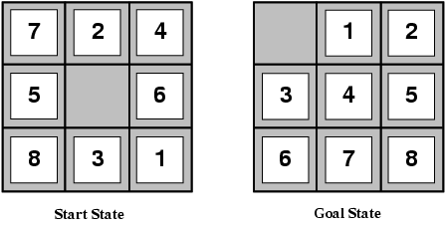
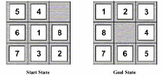
Example Heuristic Functions
Another one we can use the number of moves between each tile's current position and its position in the solution
1
2
3
4
5
6
7
8
1
2
3
4
5
6
7
8
Notes:
Which one is better?
E.g., for the 8-puzzle:
h₁(n) = number of misplaced tiles
h₂(n) = total Manhattan distance
(i.e., no. of squares from desired location of each tile)
h₁(S) = ? 8
h₂(S) = ? 3+1+2+2+2+3+3+2 = 18

Slide 6
Another approach to construct heuristics
Solution cost for a subproblem
Original Problem
SubProblem
 | 1 | 3
8 | 2 | 5
7 | 6 | 4
 | 1 | 3
@ | 2 | @
@ | @ | 4
Current node
1 | 2 | 3
8 |  | 4
7 | 6 | 5
1 | 2 | 3
@ |  | 4
@ | @ | @
Goal node
Notes:
Substantially more accurate than Manhattan distance in some cases
So the two can be combined as described before

Slide 7
Combining Heuristics: Example
In 8-puzzle, solution cost for the 1,2,3,4 subproblem is substantially more accurate than sum of Manhattan distance of each tile from its goal position in some cases
So…..
Notes:
Substantially more accurate than Manhattan distance in some cases
So the two can be combined as described before
L2 6
subp

Slide 8
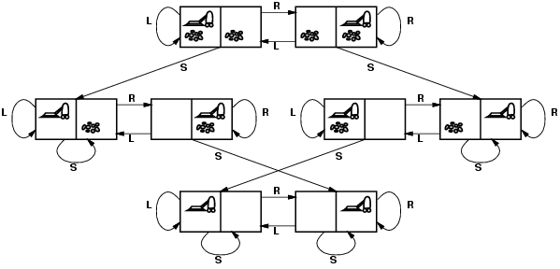
Admissible heuristic for Vacuum world?
states? Where it is dirty and robot location
actions? Left, Right, Suck
Possible goal test? no dirt at all locations
Notes:
States if the world had n locations?
Some simplifications wrt real world
Discrete location
Discrete dirt
Reliable cleaning
Room never gets messed up once cleaned

Slide 9
Admissible heuristic for Vacuum world?
states? Where it is dirty and robot location
actions? Left, Right, Suck
Possible goal test? no dirt at all locations
Notes:
States if the world had n locations?
Some simplifications wrt real world
Discrete location
Discrete dirt
Reliable cleaning
Room never gets messed up once cleaned

Slide 10
Lecture Overview
Recap Heuristic Function
Best First Search
A*

Slide 11
Best-First Search
Idea: select the path whose end is closest to a goal according to the heuristic function.
Best-First search selects a path on the frontier with minimal h-value (for the end node).
It treats the frontier as a priority queue ordered by h. (similar to ?)
This is a greedy approach: it always takes the path which appears locally best

Slide 12

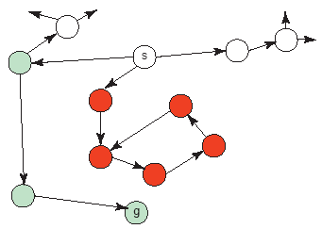
Analysis of Best-First Search
Not Complete : a low heuristic value can mean that a cycle gets followed forever.
Optimal: no (why not?)
Time complexity is O(b^{m})
Space complexity is O(b^{m})
Notes:
Misleading heuristic demo (sample Aispace problem)
Search with cost example, make MP a goal (USE FINE STEP!) !) KD heuristics 3.5 and also cost to goal from KD = 3.5

Slide 13
Lecture Overview
Recap Heuristic Function
Best First Search
A* Search Strategy

Slide 14
How can we effectively use h(n)
Maybe we should combine it with the cost. How?
Shall we select from the frontier the path p with:
Lowest cost(p) – h(p)
Highest cost(p) – h(p)
Highest cost(p)+h(p)
Lowest cost(p)+h(p)
Notes:
Not looking inside state at the end of the path
Asking: How close is this to the goal?

Slide 15
A* Search Algorithm
A* is a mix of:
  lowest-cost-first and
  best-first search
A* treats the frontier as a priority queue ordered by f(p)=
It always selects the node on the frontier with the ………….. estimated …………….distance.
Notes:
Lowest estimated total cost

Slide 16
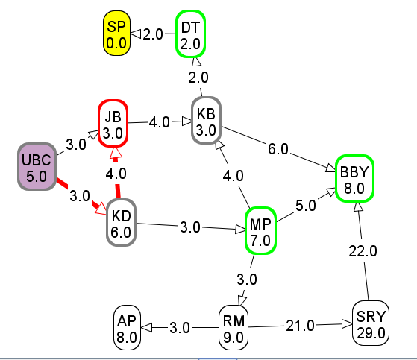
Computing f-values
f-value of UBC → KD→ JB?
6
9
10
11

Slide 17
Analysis of A*
If the heuristic is completely uninformative and the edge costs are all the same, A* is equivalent to….
BFS
LCFS
DFS
None of the Above
Notes:
Not looking inside state at the end of the path
Asking: How close is this to the goal?

Slide 18
Analysis of A*
Let's assume that arc costs are strictly positive.
Time complexity is O(b^{m})
  the heuristic could be completely uninformative and the edge costs could all be the same, meaning that A* does the same thing as….
Space complexity is O(b^{m}) like ….., A* maintains a frontier which grows with the size of the tree
Completeness: yes.
Optimality: ??
DFS
BFS
LCFS
Notes:
Complete it is always testing shorter underestimate of the total cost
So it is not missing anything

Slide 19
Optimality of A*
If A* returns a solution, that solution is guaranteed to be optimal, as long as
When
the branching factor is finite
arc costs are strictly positive
h(n) is an underestimate of the length of the shortest path from n to a goal node, and is non-negative
Theorem
If A* selects a path p as the solution,
p is the shortest (i.e., lowest-cost) path.

Slide 20
Why is A* optimal?
A* returns p
Assume for contradiction that some other path p' is actually the shortest path to a goal
Consider the moment when p is chosen from the frontier. Some part of path p' will also be on the frontier; let's call this partial path p''.
p''
p
p'

Slide 21
Why is A* optimal? (cont’)
p''
p
p'
Because p was expanded before p'',
Because p is a goal, Thus
Because h is admissible, cost(p'') + h(p'') ≤ for any path p' to a goal that extends p''
Thus for any other path p' to a goal.
This contradicts our assumption that p' is the shortest path.
Notes:
Because p was expanded before p'', f(p) ≤ f(p'').
Because p is a goal, h(p)=0. Thus cost(p) ≤ cost(p'') + h(p'').
Because h is admissible, cost(p'') + h(p'') ≤ cost(p') for any path p' to a goal that extends p''
Thus cost(p) ≤ cost(p') for any other path p' to a goal.
This contradicts our assumption that p' is the shortest path.

Slide 22
Optimal efficiency of A*
In fact, we can prove something even stronger about A*: in a sense (given the particular heuristic that is available) no search algorithm could do better!
Optimal Efficiency: Among all optimal algorithms that start from the same start node and use the same heuristic h, A* expands the minimal number of paths.
Notes:
In fact, we can prove something even stronger about A*: in a sense (given the particular heuristic that is available)
no search algorithm could do better!
problem: A* could be unlucky about how it breaks ties.
So let's define optimal efficiency as expanding the minimal number of paths p for which f(p) < f*, where f* is the cost of the optimal solution.

Slide 23
Samples A* applications
An Efficient A* Search Algorithm For Statistical Machine Translation. 2001
The Generalized A* Architecture. Journal of Artificial Intelligence Research (2007)
  Machine Vision … Here we consider a new compositional model for finding salient curves.
Factored A*search for models over sequences and trees International Conference on AI. 2003…. It starts saying… The primary challenge when using A* search is to find heuristic functions that simultaneously are admissible, close to actual completion costs, and efficient to calculate… applied to NLP and BioInformatics
Notes:
title: An Efficient A* Search Algorithm For Statistical Machine Translation
authors: Och, Franz Josef (RWTH Aachen University, Aachen Germany), Ueffing, Nicola (RWTH Aachen University, Aachen Germany), Ney, Hermann (RWTH Aachen University, Aachen Germany)
venue: Workshop On Data-Driven Methods In Machine Translation
year: 2001
Journal of Artificial Intelligence Research 29 (2007) 153-190 Submitted 10/06; published 06/07 The Generalized A* Architecture
Pedro F. Felzenszwalb pff@cs.uchicago.edu
Department of Computer Science University of Chicago Chicago, IL 60637
David McAllester mcallester@tti-c.org Toyota Technological Institute at Chicago Chicago, IL 60637
vision
Here we consider a new compositional model for finding salient curves.
Dan Klein and Chris Manning. 2003b. Factored A*
search for models over sequences and trees. In Proceedings
of the International Joint Conference on
Artificial Intelligence (IJCAI).
The primary challenge when using A* search is to find heuristic
functions that simultaneously are admissible, close to actual
completion costs, and efficient to calculate. In this paper,
we describe a family of tree and sequence models in
which path costs are either defined as or bounded by a combination
of simpler component models, each of which scores
some projection of the full structure. In such models, we can
exploit the decoupled behavior over each projection to give
sharp heuristics for the combined space. While we focus
on models of trees and sequences within NLP applications,
the approach can be applied more generally (and already has
been, in the case of biological sequencemodels). All the concrete
cases we consider here involve search over spaces which
are equivalent to dynamic programming lattices, though this
detail, too, is somewhat peripheral to the basic ideas.

Slide 24
Samples A* applications (cont’)
Aker, A., Cohn, T., Gaizauskas, R.: Multi-document summarization using A* search and discriminative training. Proceedings of the 2010 Conference on Empirical Methods in Natural Language Processing.. ACL (2010)

Slide 25
Samples A* applications (cont’)
EMNLP 2014 A* CCG Parsing with a Supertag-factored Model M. Lewis, M. Steedman
We introduce a new CCG parsing model which is factored on lexical category assignments. Parsing is then simply a deterministic search for the most probable category sequence that supports a CCG derivation. The parser is extremely simple, with a tiny feature set, no POS tagger, and no statistical model of the derivation or dependencies. Formulating the model in this way allows a highly effective heuristic for A∗ parsing, which makes parsing extremely fast. Compared to the standard C&C CCG parser, our model is more accurate out-of-domain, is four times faster, has higher coverage, and is greatly simplified. We also show that using our parser improves the performance of a state-of-the-art question answering system
Follow up ACL 2017 (main NLP conference – will be in Vancouver in August!)
A* CCG Parsing with a Supertag and Dependency Factored Model Masashi Yoshikawa, Hiroshi Noji, Yuji Matsumoto
Notes:
We introduce a new CCG parsing model which is factored on lexical category assignments. Parsing is then simply a deterministic search for the most probable category sequence that supports a CCG derivation. The parser is extremely simple, with a tiny feature set, no POS tagger, and no statistical model of the derivation or dependencies. Formulating the model in this way allows a highly effective heuristic for A∗ parsing, which makes parsing extremely fast. Compared to the standard C&C CCG parser, our model is more ac-curate out-of-domain, is four times faster, has higher coverage, and is greatly simplified. We also show that using our parser improves the performance of a state-of-the-art question answering system

Slide 26
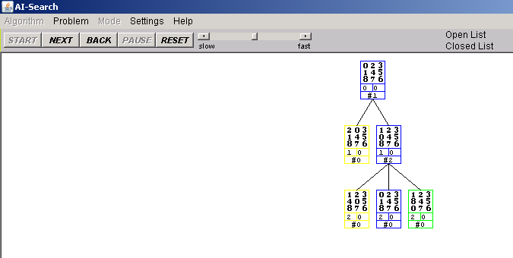
DFS, BFS, A* Animation Example
The AI-Search animation system
http://www.cs.rmit.edu.au/AI-Search/Product/
DEPRECATED ☹
To examine Search strategies when they are applied to the 8puzzle
Compare only DFS, BFS and A* (with only the two heuristics we saw in class )
With default start state and goal
DFS will find
Solution at depth 32
BFS will find
Optimal solution depth 6
A* will also find opt. sol. expanding much less nodes

Slide 27
nPuzzles are not always solvable
Half of the starting positions for the n-puzzle are impossible to solve (for more info on 8puzzle)
So experiment with the AI-Search animation system (DEPRECATED) with the default configurations.
If you want to try new ones keep in mind that you may pick unsolvable problems
Notes:
http://www.isle.org/~sbay/ics171/project/unsolvable
Here is a simple rule for telling if an 8 puzzle is solvable. We can call this violation of the order an "inversion". If the number of inversions is even then the puzzle is solvable. If the number of inversions is odd then the puzzle is unsolvable.

Slide 28
Learning Goals for today’s class
Define/read/write/trace/debug & Compare different search algorithms
  With / Without cost
  Informed / Uninformed
Formally prove A* optimality.

Slide 29
Next class
Finish Search (finish Chpt 3)
Branch-and-Bound
A* enhancements
Non-heuristic Pruning
Dynamic Programming

