Slide 1
Reasoning Under Uncertainty: More on BNets structure and construction
Computer Science cpsc322, Lecture 28
(Textbook Chpt 6.3)
June, 15, 2017

Slide 2
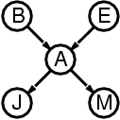
Belief networks Recap
By considering causal dependencies, we order variables in the joint.
Apply_______________________________ and simplify
Build a directed acyclic graph (DAG) in which the parents of each var X are those vars on which X directly depends.
By construction, a var is independent form it non-descendant given its parents.

Slide 3
Belief Networks: open issues
Independencies: Does a BNet encode more independencies than the ones specified by construction?
Compactness: We reduce the number of probabilities from to
In some domains we need to do better than that!
Still too many and often there are no data/experts for accurate assessment
Solution: Make stronger (approximate) independence assumptions

Slide 4
Lecture Overview
Implied Conditional Independence relations in a Bnet
Compactness: Making stronger Independence assumptions
Representation of Compact Conditional Distributions
Network structure( Naïve Bayesian Classifier)

Slide 5
Bnets: Entailed (in)dependencies
Indep(Report, Fire,{Alarm})?
Indep(Leaving, SeeSmoke,{Fire})?

Slide 6
Conditional Independencies
Or, blocking paths for probability propagation. Three ways in which a path between X to Y can be blocked, (1 and 2 given evidence E )
Y
E
X
1
Z
Z
2
3
Z
Note that, in 3, X and Y become dependent as soon as I get evidence on Z or on any of its descendants
Notes:
this is intuitive

Slide 7
Or ….Conditional Dependencies
Y
X
1
Z
Z
2
3
E
Z
Notes:
this is intuitive

Slide 8
In/Dependencies in a Bnet : Example 1
1
Y
E
X
Z
Z
2
3
Z
Is A conditionally independent of I given F?
Notes:
FALSE, because evidence from A reaches E via C.

Slide 9
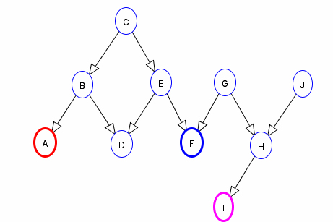
In/Dependencies in a Bnet : Example 2
1
Y
E
X
Z
Z
2
3
Z
Is A conditionally independent of I given F?
Notes:
FALSE, because evidence from A reaches E via C.

Slide 10
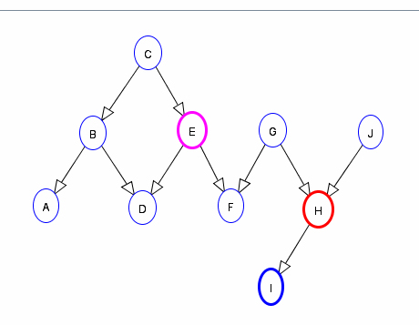
In/Dependencies in a Bnet : Example 3
1
Y
E
X
Z
Z
2
3
Z
Is H conditionally independent of E given I?
Notes:
yes

Slide 11
Lecture Overview
Implied Conditional Independence relations in a Bnet
Compactness: Making stronger Independence assumptions
Representation of Compact Conditional Distributions
Network structure( Naïve Bayesian Classifier)

Slide 12
More on Construction and Compactness: Compact Conditional Distributions
Once we have established the topology of a Bnet, we still need to specify the conditional probabilities
How?
From Data
From Experts
To facilitate acquisition, we aim for compact representations for which data/experts can provide accurate assessments
Notes:
Reduce to 8,254

Slide 13
More on Construction and Compactness: Compact Conditional Distributions
From JointPD to
But still, CPT grows exponentially with number of parents
In semi-realistic model of internal medicine with 448 nodes and 906 links 133,931,430 values are required!
And often there are no data/experts for accurate assessment
Notes:
Reduce to 8,254

Slide 14
Effect with multiple non-interacting causes
What do we need to specify?
Malaria
Flu
Cold
Malaria | Flu | Cold | P(Fever=T | ..) | P(Fever=F|..)
T | T | T
T | T | F
T | F | T
T | F | F
F | T | T
F | T | F
F | F | T
F | F | F
Fever
What do you think data/experts could easily tell you?
More difficult to get info to assess more complex conditioning….

Slide 15
Solution: Noisy-OR Distributions
Models multiple non interacting causes
Logic OR with a probabilistic twist.
Logic OR Conditional Prob. Table.
Malaria | Flu | Cold | P(Fever=T | ..) | P(Fever=F|..)
T | T | T
T | T | F
T | F | T
T | F | F
F | T | T
F | T | F
F | F | T
F | F | F

Slide 16
Solution: Noisy-OR Distributions
The Noisy-OR model allows for uncertainty in the ability of each cause to generate the effect (e.g.. one may have a cold without a fever)
Malaria | Flu | Cold | P(Fever=T | ..) | P(Fever=F|..)
T | T | T
T | T | F
T | F | T
T | F | F
F | T | T
F | T | F
F | F | T
F | F | F
Two assumptions
All possible causes a listed
For each of the causes, whatever inhibits it to generate the target effect is independent from the inhibitors of the other causes

Slide 17
Noisy-OR: Derivations
C₁
C_{k}
For each of the causes, whatever inhibits it to generate the target effect is independent from the inhibitors of the other causes
Effect
Independent Probability of failure q_{i} for each cause alone:
P(Effect=F | C_{i} = T, and no other causes) = q_{i}
P(Effect=F | C₁ = T,.. C_{j} = T, C_{j+1} = F,., C_{k} = F)=
A.
B.
C.
D. None of those

Slide 18
Noisy-OR: Derivations
C₁
C_{k}
Effect
For each of the causes, whatever inhibits it to generate the target effect is independent from the inhibitors of the other causes
Independent Probability of failure q_{i} for each cause alone:
P(Effect=F | C_{i} = T, and no other causes) = q_{i}
P(Effect=F | C₁ = T,.. C_{j} = T, C_{j+1} = F,., C_{k} = F)=
P(Effect=T | C₁ = T,.. C_{j} = T, C_{j+1} = F,., C_{k} = F) =

Slide 19
Noisy-OR: Example
Model of internal medicine
133,931,430 → 8,254
P(Fever=F| Cold=T, Flu=F, Malaria=F) = 0.6
P(Fever=F| Cold=F, Flu=T, Malaria=F) = 0.2
P(Fever=F| Cold=F, Flu=F, Malaria=T) = 0.1
P(Effect=F | C₁ = T,.. C_{j} = T, C_{j+1} = F,., C_{k} = F)= ∏^{j}_{i=1} q_{i}
Malaria | Flu | Cold | P(Fever=T | ..) | P(Fever=F|..)
T | T | T |  | 0.1 x 0.2 x 0.6 = 0.012
T | T | F |  | 0.2 x 0.1 = 0.02
T | F | T |  | 0.6 x 0.1=0.06
T | F | F | 0.9 | 0.1
F | T | T |  | 0.2 x 0.6 = 0.12
F | T | F | 0.8 | 0.2
F | F | T | 0.4 | 0.6
F | F | F |  | 1.0
Number of probabilities linear in …..

Slide 20
Lecture Overview
Implied Conditional Independence relations in a Bnet
Compactness: Making stronger Independence assumptions
Representation of Compact Conditional Distributions
Network structure ( Naïve Bayesian Classifier)

Slide 21
Naïve Bayesian Classifier
A very simple and successful Bnets that allow to classify entities in a set of classes C, given a set of attributes
Example:
Determine whether an email is spam (only two classes spam=T and spam=F)
Useful attributes of an email ?
Assumptions
The value of each attribute depends on the classification
(Naïve) The attributes are independent of each other given the classification
P(“bank” | “account” , spam=T) = P(“bank” | spam=T)
Notes:
Bnets do not need to be complex to be useful!

Slide 22
What is the structure?
Assumptions
The value of each attribute depends on the classification
(Naïve) The attributes are independent of each other given the classification
A.
Email Spam
Email contains
“free”
Email contains
“money”
Email contains
“ubc”
Email contains
“midterm”
Email Spam
B.
Email contains
“free”
Email contains
“money”
Email contains
“ubc”
Email contains
“midterm”
Email contains
“free”
Email contains
“money”
Email contains
“ubc”
Email contains
“midterm”
Email Spam
C.
Notes:
Bnets do not need to be complex to be useful!

Slide 23
Naïve Bayesian Classifier for Email Spam
Assumptions
The value of each attribute depends on the classification
(Naïve) The attributes are independent of each other given the classification
Email Spam
words
Email contains
“free”
Email contains
“money”
Email contains
“ubc”
Email contains
“midterm”
Number of parameters?
Easy to acquire?
If you have a large collection of emails for which you know if they are spam or not……
Notes:
Bnets do not need to be complex to be useful!

Slide 24
Most likely class given set of observations
NB Classifier for Email Spam: Usage
Is a given Email E spam?
“free money for you now”
Email Spam
Email contains
“free”
Email contains
“money”
Email contains
“ubc”
Email contains
“midterm”
Email is a spam if…….

Slide 25
For another example of naïve Bayesian Classifier
See textbook ex. 6.16
help system to determine what help page a user is interested in based on the keywords they give in a query to a help system.

Slide 26
Learning Goals for this class
You can:
Given a Belief Net, determine whether one variable is conditionally independent of another variable, given a set of observations.
Define and use Noisy-OR distributions. Explain assumptions and benefit.
Implement and use a naïve Bayesian classifier. Explain assumptions and benefit.

Slide 27
Next Class
Bayesian Networks Inference: Variable Elimination
Course Elements
Work on Practice Exercises 6A and 6B
Assignment 3 is due on Tue the 20th !
Assignment 4 will be available on the same day and due TBA as soon as I know when the final will be.

