Slide 1
Department of Computer Science
Undergraduate Events
More details @ https://www.cs.ubc.ca/students/undergrad/life/upcoming-events
Tri-mentoring Orientation
Date: Wed., Sept 11
Time: 5:15 pm
Location: DMP 110
TELUS Info Session
Date: Thurs., Sept 12
Time: 5:30 pm
Location: DMP 110
CSSS BBQ
Date: Tues., Sept 10
Time: 12 – 1:30 pm
Location: Outside Reboot Cafe
Microsoft Resume Clinic
Date: Tues., Sept 10
Time: 5:30 pm
Location: DMP 110

Slide 2
AI Applications
Computer Science cpsc322, Lecture 3
Sept, 9, 2013

Slide 3
Modules we'll cover in this course: R&Rsys
Environment
Deterministic
Stochastic
Problem
Arc Consistency
Constraint Satisfaction
Vars +
Constraints
Search
Static
Belief Nets
Query
Logics
Var. Elimination
Search
Sequential
Decision Nets
STRIPS
Var. Elimination
Planning
Search
Markov Processes
Representation
Value Iteration
Reasoning
Technique
Notes:
R&R Sys Representation and reasoning Systems
Each cell is a R&R system
STRIPS actions preconditions and effects

Slide 4
Modules we'll cover in this course: R&Rsys
Environment
Deterministic
Stochastic
Problem
Arc Consistency
Constraint Satisfaction
Vars +
Constraints
Search
Static
Belief Nets
Query
Logics
Var. Elimination
Search
Sequential
Decision Nets
STRIPS
Var. Elimination
Planning
Search
Markov Processes
Value Iteration
Notes:
R&R Sys Representation and reasoning Systems
Each cell is a R&R system
STRIPS actions preconditions and effects

Slide 5
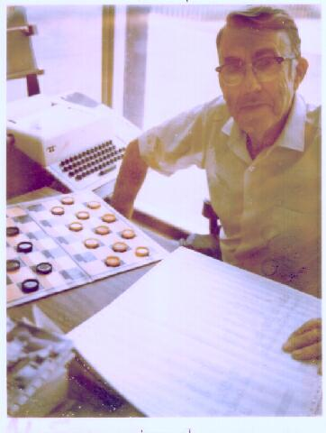
(Adversarial) Search: Checkers
Game playing was one of the first tasks undertaken in AI
Arthur Samuel at IBM wrote programs to play checkers (1950s)
  initially, they played at a strong amateur level
  however, they used some (simple) machine learning techniques, and soon outperformed Samuel
Source: IBM Research
Chinook’s program was declared the Man-Machine World Champion in checkers in 1994!
…and completely solved by a program in 2007!
Notes:
Chinook's program algorithm includes an opening book, a library of opening moves from games played by grandmasters; a deep search algorithm; a good move evaluation function; and an end-game database for all positions with eight pieces or fewer. The linear handcrafted evaluation function considers several features of the game board, including piece count, kings count, trapped kings, turn, runaway checkers (unimpeded path to be kinged) and other minor factors. All of Chinook's "knowledge" was programmed by its creators, rather than "learned"
Checkers was completely solved in 2007 by a computer which explored all reachable positions

Slide 6
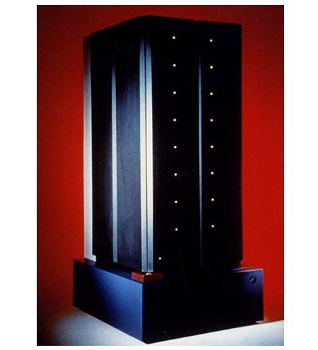
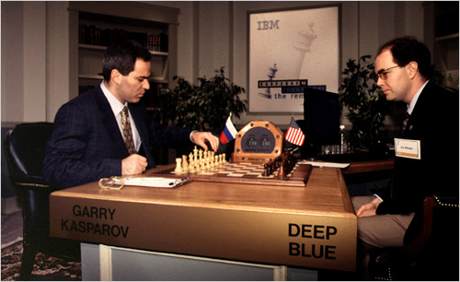
(Adversarial) Search: Chess
In 1996 and 1997, Gary Kasparov, the world chess grandmaster played two tournaments against Deep Blue, a program written by researchers at IBM
Source: IBM Research

Slide 7

(Adversarial) Search: Chess
Deep Blue’s Results in the first tournament:
  won 1 game, lost 3 and tied 1
    first time a reigning world champion lost to a computer
Source: CNN

Slide 8
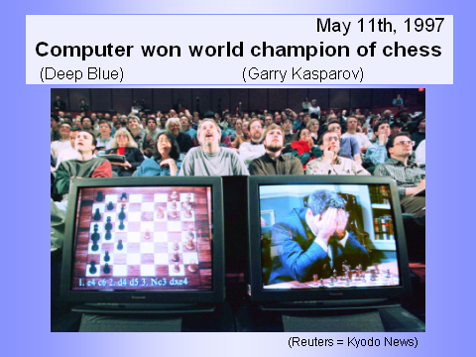
(Adversarial) Search: Chess
Deep Blue’s Results in the second tournament:
  second tournament: won 3 games, lost 2, tied 1
  30 CPUs + 480 chess processors
  Searched 126.000.000 nodes per sec
  Generated 30 billion positions per move reaching depth 14 routinely
Notes:
Winning machine was a parallel computer (30 CPUs) + 480 VLSI chess processors
Searched 126.000.000 nodes per sec
Generated 30 billion positions per move, reaching depth 14 routinely
Standard iterative deepening alpha beta search (with transposition table)
But key to success seems to be its ability to go deeper for sufficiently interesting lines of forced/forcing moves
Evaluation functions had over 8000 features
+ opening book with 4000 positions
+ solved positions with 5 pieces and many with 6 (to extend the effective depth of the search)

Slide 9
Sample A* applications
An Efficient A* Search Algorithm For Statistical Machine Translation. 2001
The Generalized A* Architecture. Journal of Artificial Intelligence Research (2007)
  Machine Vision … Here we consider a new compositional model for finding salient curves.
Factored A*search for models over sequences and trees International Conference on AI. 2003…. It starts saying… The primary challenge when using A* search is to find heuristic functions that simultaneously are admissible, close to actual completion costs, and efficient to calculate… applied to NLP and BioInformatics
Notes:
title: An Efficient A* Search Algorithm For Statistical Machine Translation
authors: Och, Franz Josef (RWTH Aachen University, Aachen Germany), Ueffing, Nicola (RWTH Aachen University, Aachen Germany), Ney, Hermann (RWTH Aachen University, Aachen Germany)
venue: Workshop On Data-Driven Methods In Machine Translation
year: 2001
Journal of Artificial Intelligence Research 29 (2007) 153-190 Submitted 10/06; published 06/07 The Generalized A* Architecture
Pedro F. Felzenszwalb pff@cs.uchicago.edu
Department of Computer Science University of Chicago Chicago, IL 60637
David McAllester mcallester@tti-c.org Toyota Technological Institute at Chicago Chicago, IL 60637
vision
Here we consider a new compositional model for finding salient curves.
Dan Klein and Chris Manning. 2003b. Factored A*
search for models over sequences and trees. In Proceedings
of the International Joint Conference on
Artificial Intelligence (IJCAI).
The primary challenge when using A* search is to find heuristic
functions that simultaneously are admissible, close to actual
completion costs, and efficient to calculate. In this paper,
we describe a family of tree and sequence models in
which path costs are either defined as or bounded by a combination
of simpler component models, each of which scores
some projection of the full structure. In such models, we can
exploit the decoupled behavior over each projection to give
sharp heuristics for the combined space. While we focus
on models of trees and sequences within NLP applications,
the approach can be applied more generally (and already has
been, in the case of biological sequencemodels). All the concrete
cases we consider here involve search over spaces which
are equivalent to dynamic programming lattices, though this
detail, too, is somewhat peripheral to the basic ideas.

Slide 10
Modules we'll cover in this course: R&Rsys
Environment
Deterministic
Stochastic
Problem
Arc Consistency
Constraint Satisfaction
Vars +
Constraints
Search
Static
Belief Nets
Query
Logics
Var. Elimination
Search
Sequential
Decision Nets
STRIPS
Var. Elimination
Planning
Search
Markov Processes
Value Iteration
Notes:
R&R Sys Representation and reasoning Systems
Each cell is a R&R system
STRIPS actions preconditions and effects

Slide 11
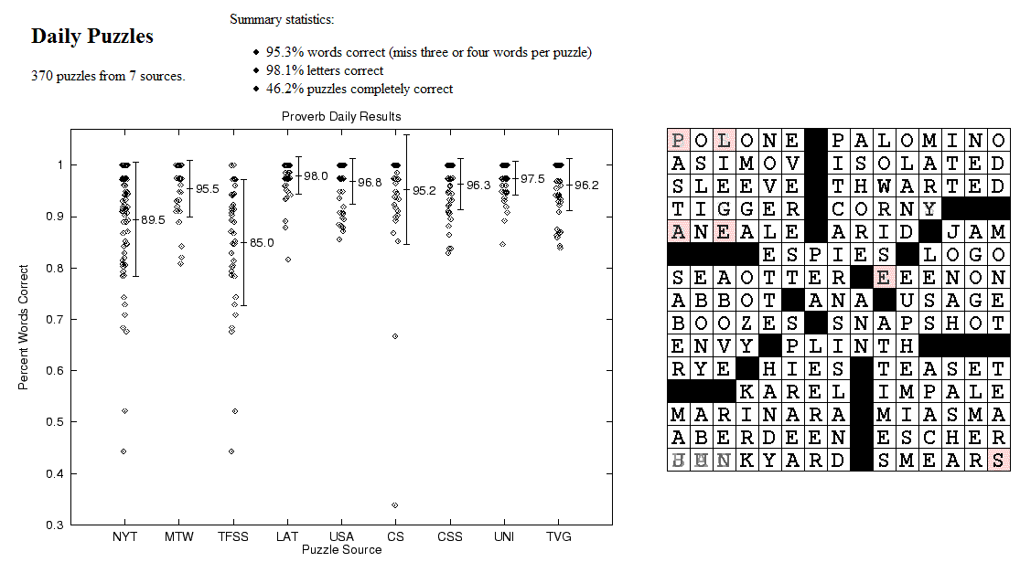
CSPs: Crossword Puzzles
Source: Michael Littman
Notes:
Variables are the places where word can go e.g. (1 across, 3 down)
Domains are words of the appropriate length (for 1 across in this example – length equals 6)
Constraints letter should be the same at the intersection
www.cs.rutgers.edu/~mlittman/papers/aaai99-solver.ps

Slide 12
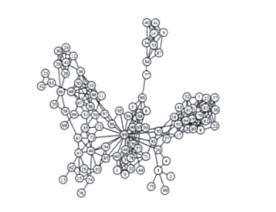
CSPs: Radio link frequency assignment
Assigning frequencies to a set of radio links defined between pairs of sites in order to avoid interferences.
Constraints on frequency depend on position of the links and on physical environment .
Source: INRIA
Sample Constraint network

Slide 13
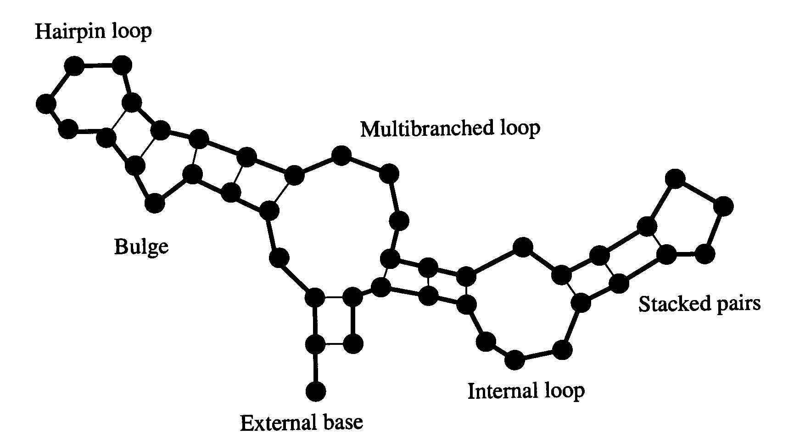
Example: RNA secondary structure design
RNA strand made up of four bases: cytosine (C), guanine (G), adenine (A), and uracil (U)
2D/3D structure RNA strand folds into
is important for its function
Predicting structure for a
strand is “easy”: O(n³)
But what if we want a strand that folds
into a certain structure?
RNA strand
GUCCCAUAGGAUGUCCCAUAGGA
Easy
Hard
Secondary structure
  On of the Best algorithm to date: Local search algorithm RNA-SSD developed at UBC
  [Andronescu, Fejes, Hutter, Condon, and Hoos, Journal of Molecular Biology, 2004]

Slide 14
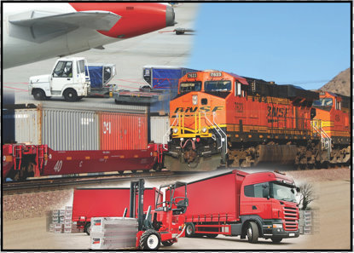
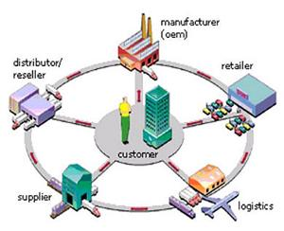
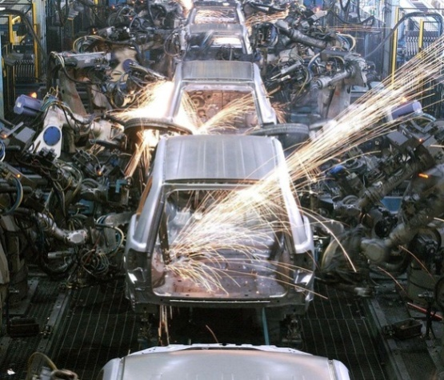
Constraint optimization problems
Optimization under constraints (similar to CSP)
E.g. mixed integer programming (software: IBM CPLEX)
  Linear program: max c^{T}x such that Ax ≤ b
  Mixed integer program: additional constraints, x_{i} ∈ Z (integers)
  NP-hard, widely used in operations research and in industry
Transportation/Logistics: Supply chain Production planning
SNCF, United Airlines management and optimization:
UPS, United States software: Airbus, Dell, Porsche,
Postal Service, … Oracle, Thyssen Krupp,
SAP,… Toyota, Nissan, ...

Slide 15
Modules we'll cover in this course: R&Rsys
Environment
Deterministic
Stochastic
Problem
Arc Consistency
Constraint Satisfaction
Vars +
Constraints
Search
Static
Belief Nets
Query
Logics
Var. Elimination
Search
Sequential
Decision Nets
STRIPS
Var. Elimination
Planning
Search
Markov Processes
Value Iteration
Notes:
R&R Sys Representation and reasoning Systems
Each cell is a R&R system
STRIPS actions preconditions and effects

Slide 16


CSP/logic: formal verification
Hardware verification Software verification
(e.g., IBM) (small to medium programs)
Most progress in the last 10 years based on:
Encodings into propositional satisfiability (SAT)

Slide 17
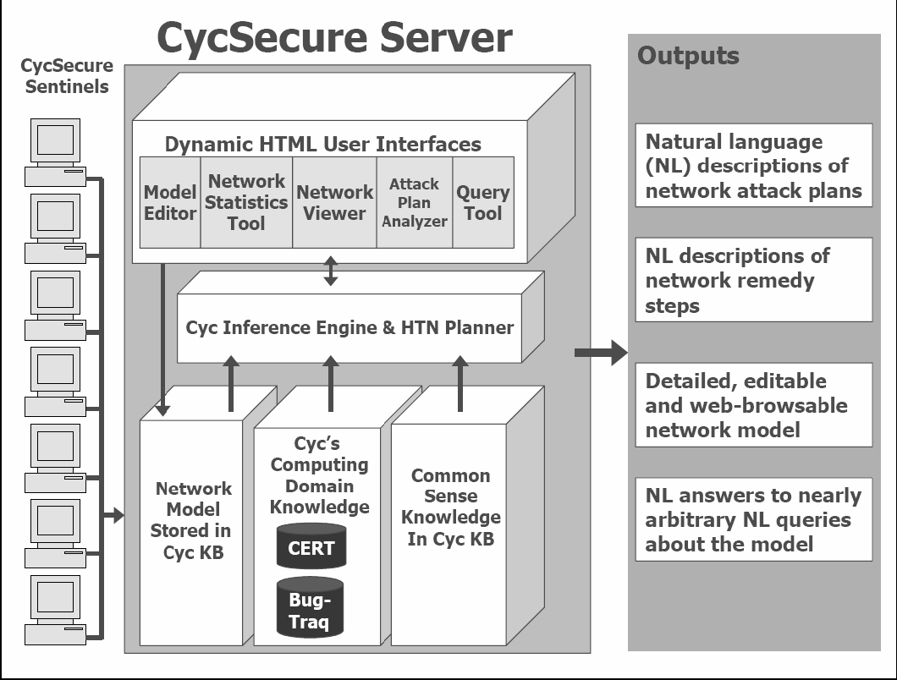
Logic: CycSecure
“scans a computer network to build a formal representation of the network, based on Cyc’s pre-existing ontology of networking, security, and computing concepts:
Excerpted from: Shepard et al., 2005
This formal representation also allows users to interact directly with the model of the network, allowing testing of proposed changes.”
Knowledge Representation
Web Mining & Semantic Web !
Notes:
information about what computers are on the network, what programs are installed or running on those computers, what privileges the running programs have, what users are logged into the computers, etc.

Slide 18
Modules we'll cover in this course: R&Rsys
Environment
Deterministic
Stochastic
Problem
Arc Consistency
Constraint Satisfaction
Vars +
Constraints
Search
Static
Belief Nets
Query
Logics
Var. Elimination
Search
Sequential
Decision Nets
STRIPS
Var. Elimination
Planning
Search
Markov Processes
Value Iteration
Notes:
R&R Sys Representation and reasoning Systems
Each cell is a R&R system
STRIPS actions preconditions and effects

Slide 19
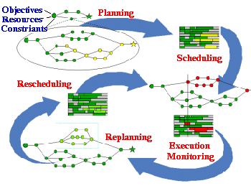
Planning & Scheduling: Logistics
Dynamic Analysis and Replanning Tool (Cross & Walker)
  logistics planning and scheduling for military transport
  used in the 1991 Gulf War by the US
  problems had 50,000 entities (e.g., vehicles); different starting points and destinations
Same techniques can be used for non-military applications:
e.g., Emergency Evacuation
Source: DARPA
Notes:
(Re)Planning done in hours instead of in weeks
ARPA stated that this single application paid back its 30years investments in AI

Slide 20
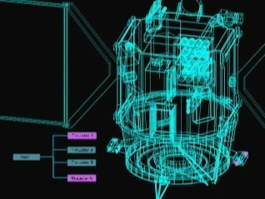
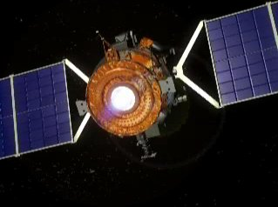
Planning: Spacecraft Control
NASA: Deep Space One spacecraft
operated autonomously for two days in May, 1999:
  determined its precise position using stars and asteriods
    despite a malfunctioning ultraviolet detector
  planned the necessary course adjustment
  fired the ion propulsion system to make this adjustment
For another space application see the Spike system for the Hubble
telescope
Source:
NASA
Notes:
The Spike scheduling system, developed for scheduling astronomical observations for NASA's Hubble Space Telescope (HST), AI techniques reduced to a few hours what used to take weeks

Slide 21

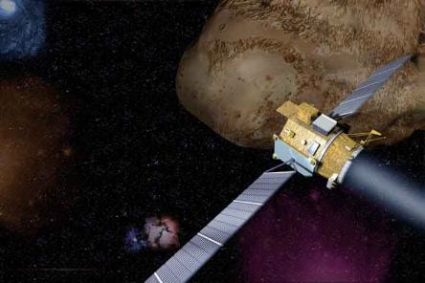
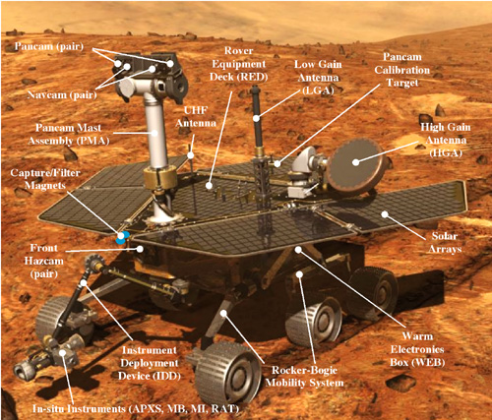
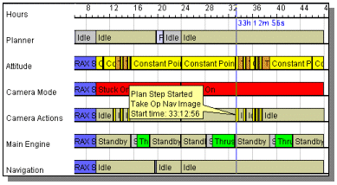
Source:
cs221 stanford

Slide 22
Modules we'll cover in this course: R&Rsys
Environment
Deterministic
Stochastic
Problem
Arc Consistency
Constraint Satisfaction
Vars +
Constraints
Search
Static
Belief Nets
Query
Logics
Var. Elimination
Search
Sequential
Decision Nets
STRIPS
Var. Elimination
Planning
Search
Markov Processes
Value Iteration
Notes:
R&R Sys Representation and reasoning Systems
Each cell is a R&R system
STRIPS actions preconditions and effects

Slide 23
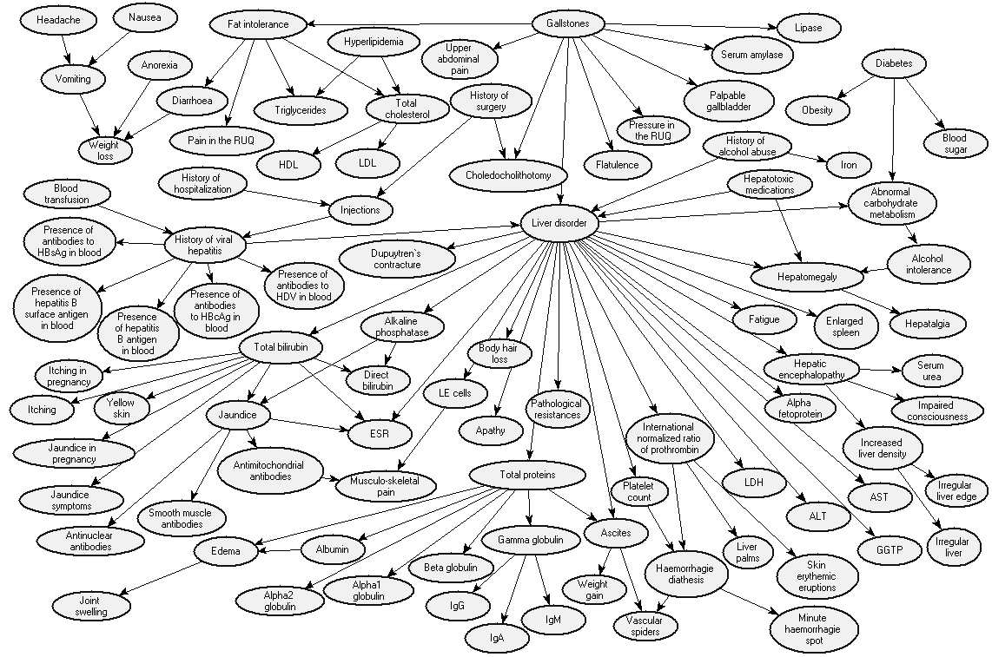
Reasoning under Uncertainty: Diagnosis
Bayes Net: to diagnose liver diseases
Source: Onisko et al., 99

Slide 24
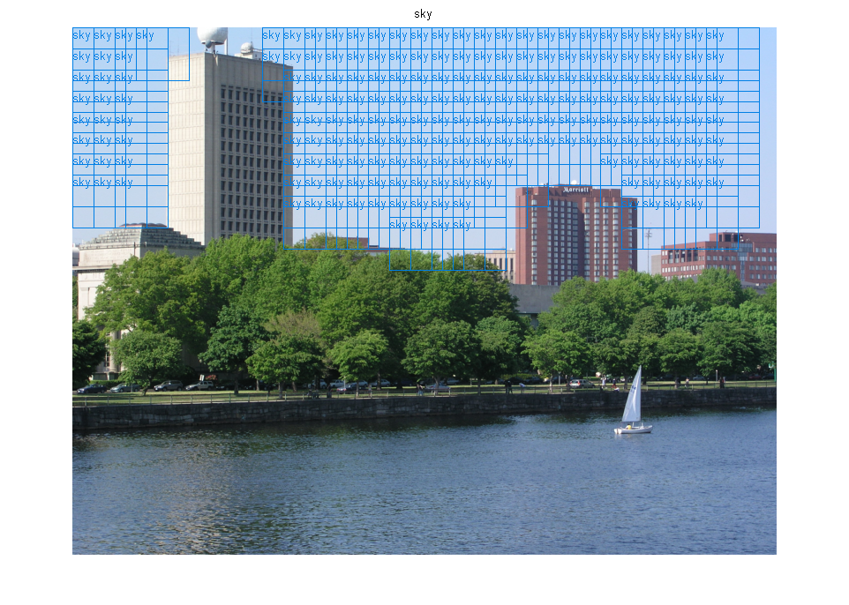
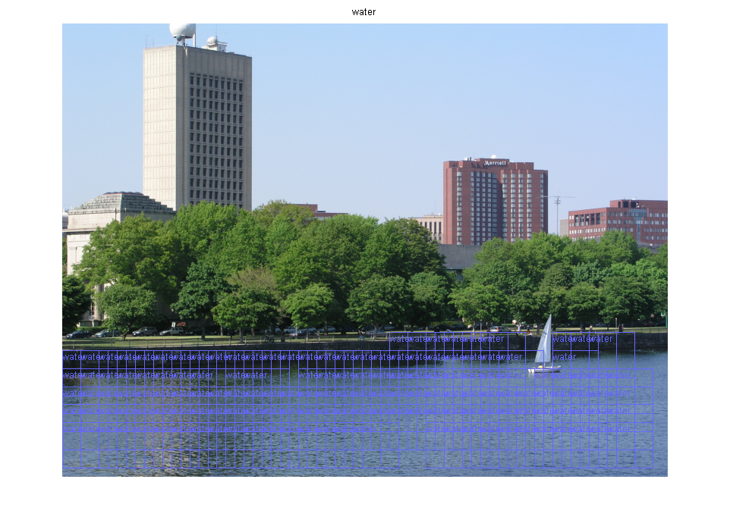
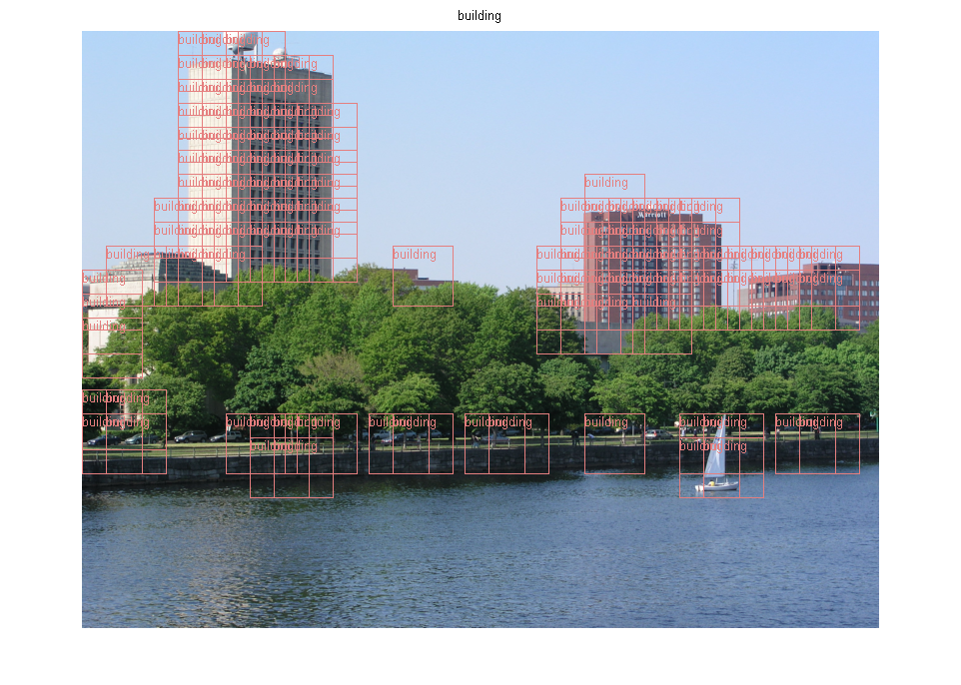
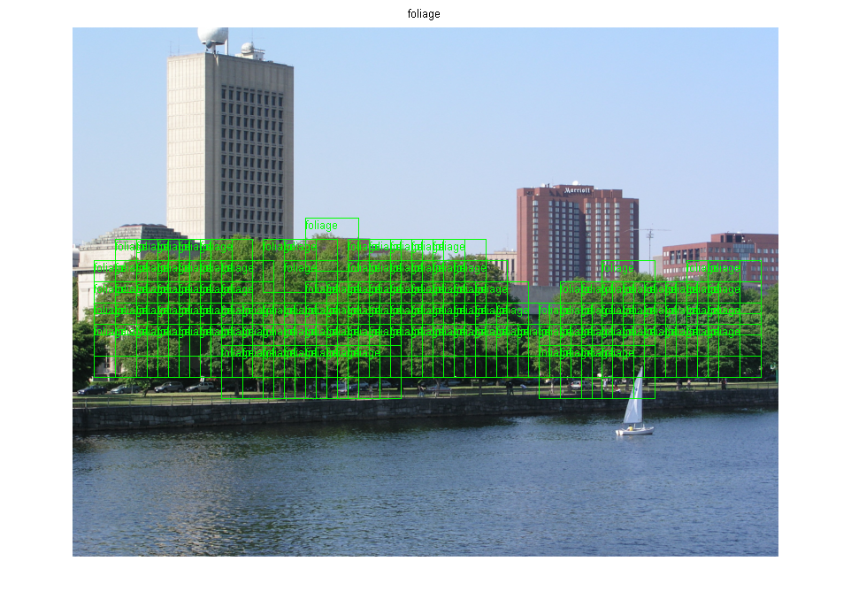
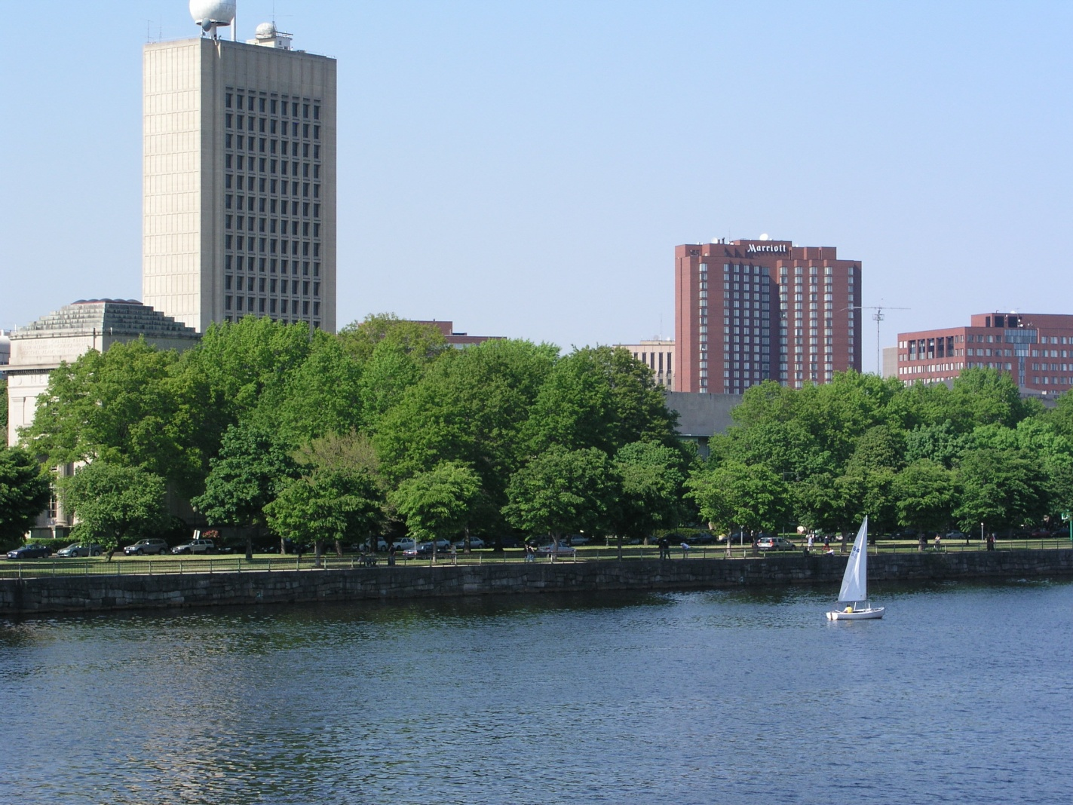
Reasoning Under Uncertainty
Texture classification using Support Vector Machines
  foliage, building, sky, water
Source: Mike Cora, UBC

Slide 25

Reasoning Under Uncertainty
E.g. motion tracking: track a hand and estimate activity:
  drawing, erasing/shading, other
Source:
Kevin Murphy,
UBC

Slide 26
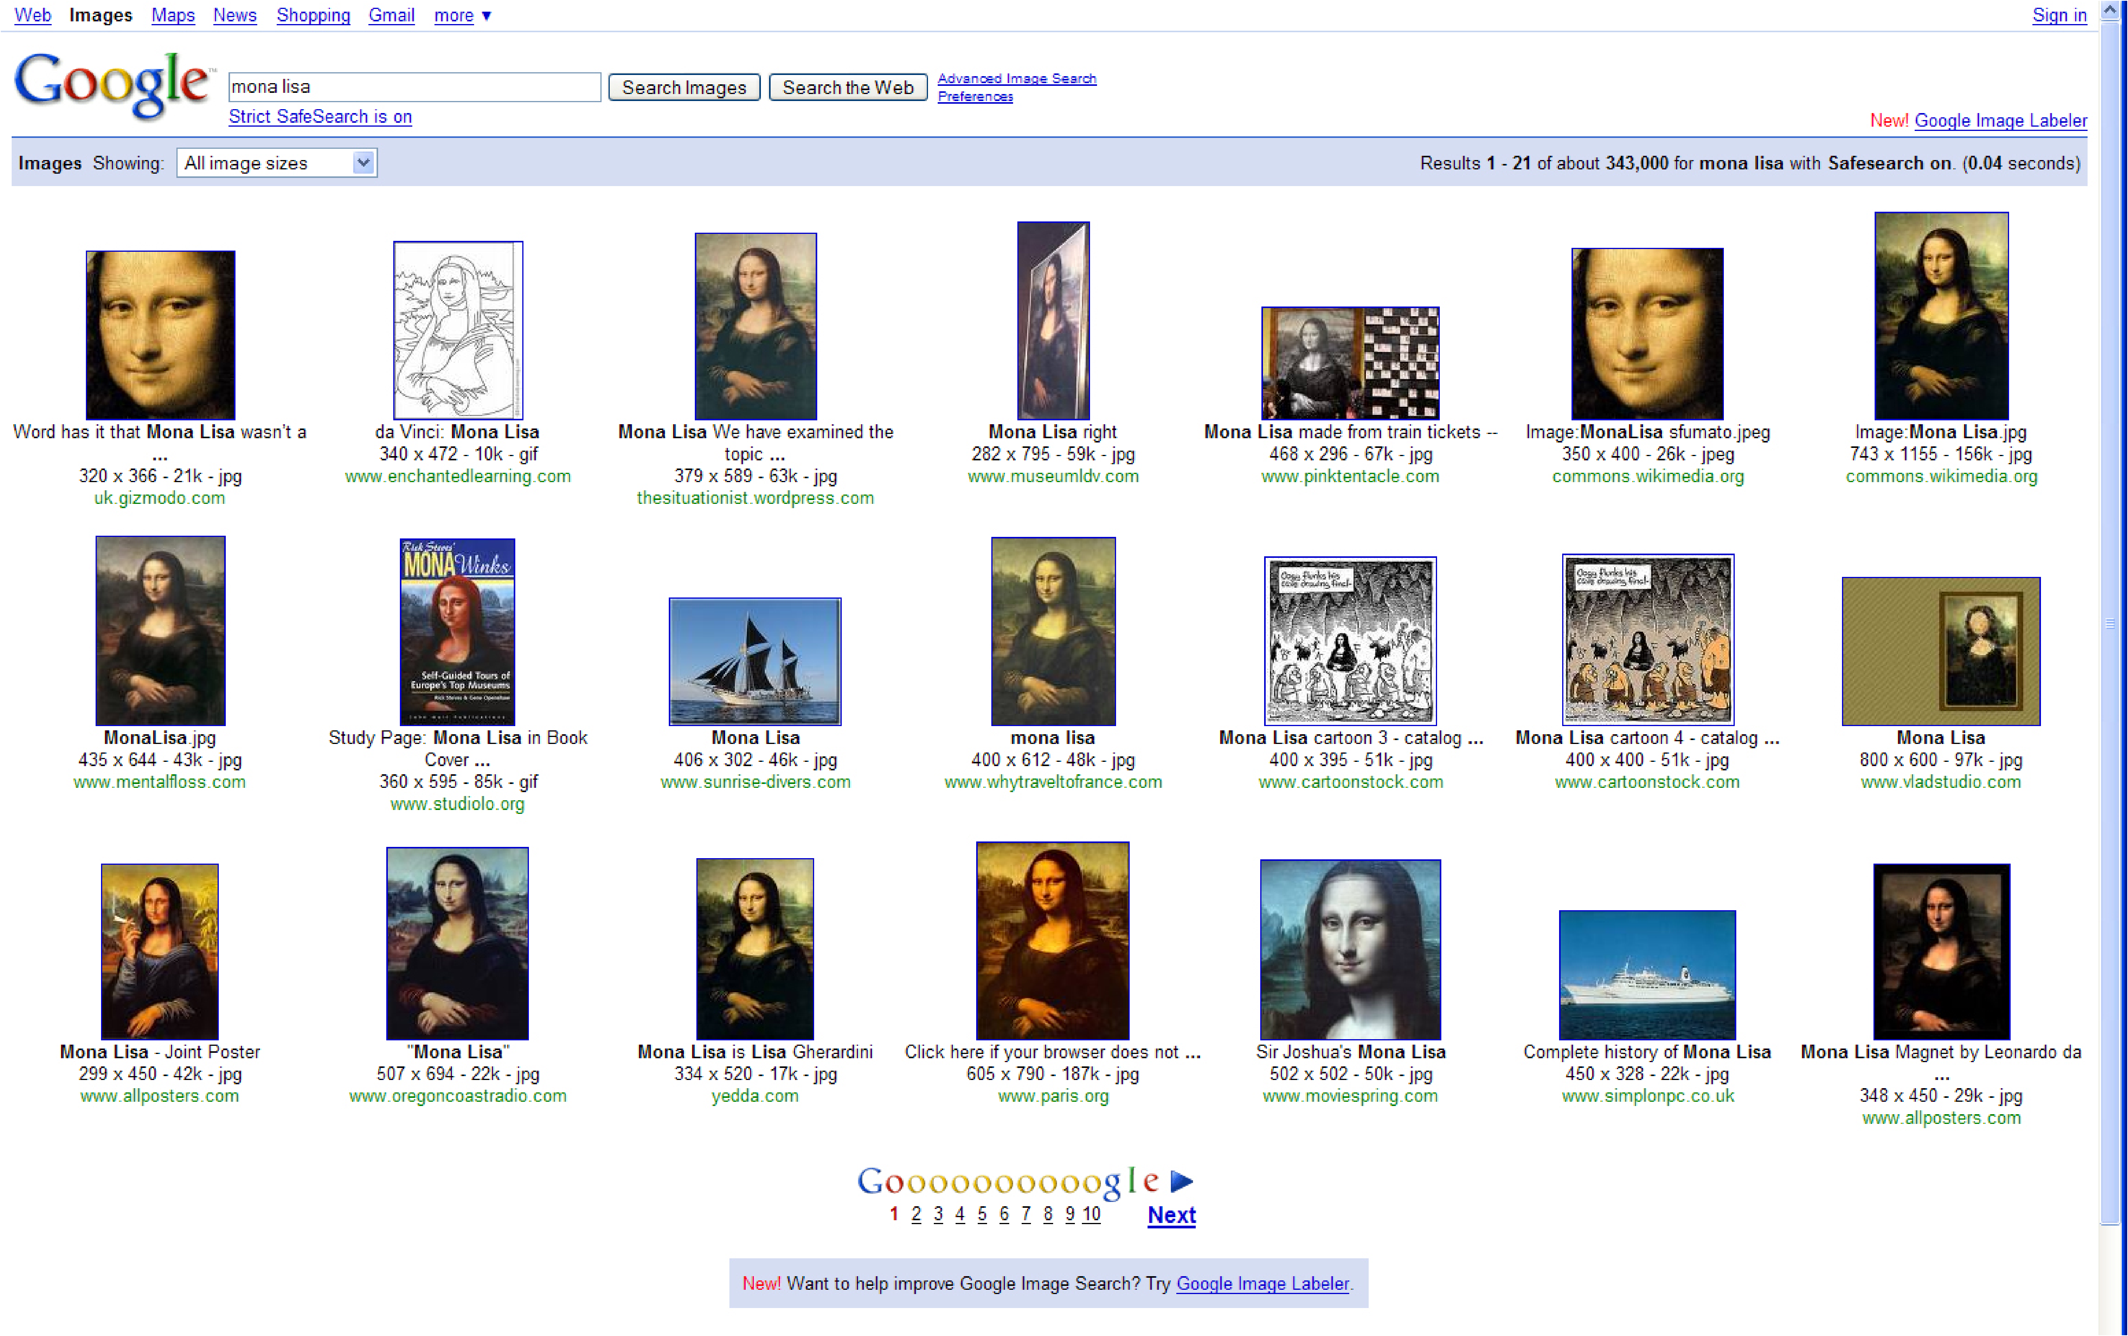
Computer Vision (not just for robots!)
Jing, Baluja, Rowley, Google:
Finding Canonical Images
Source:
cs221 stanford

Slide 27
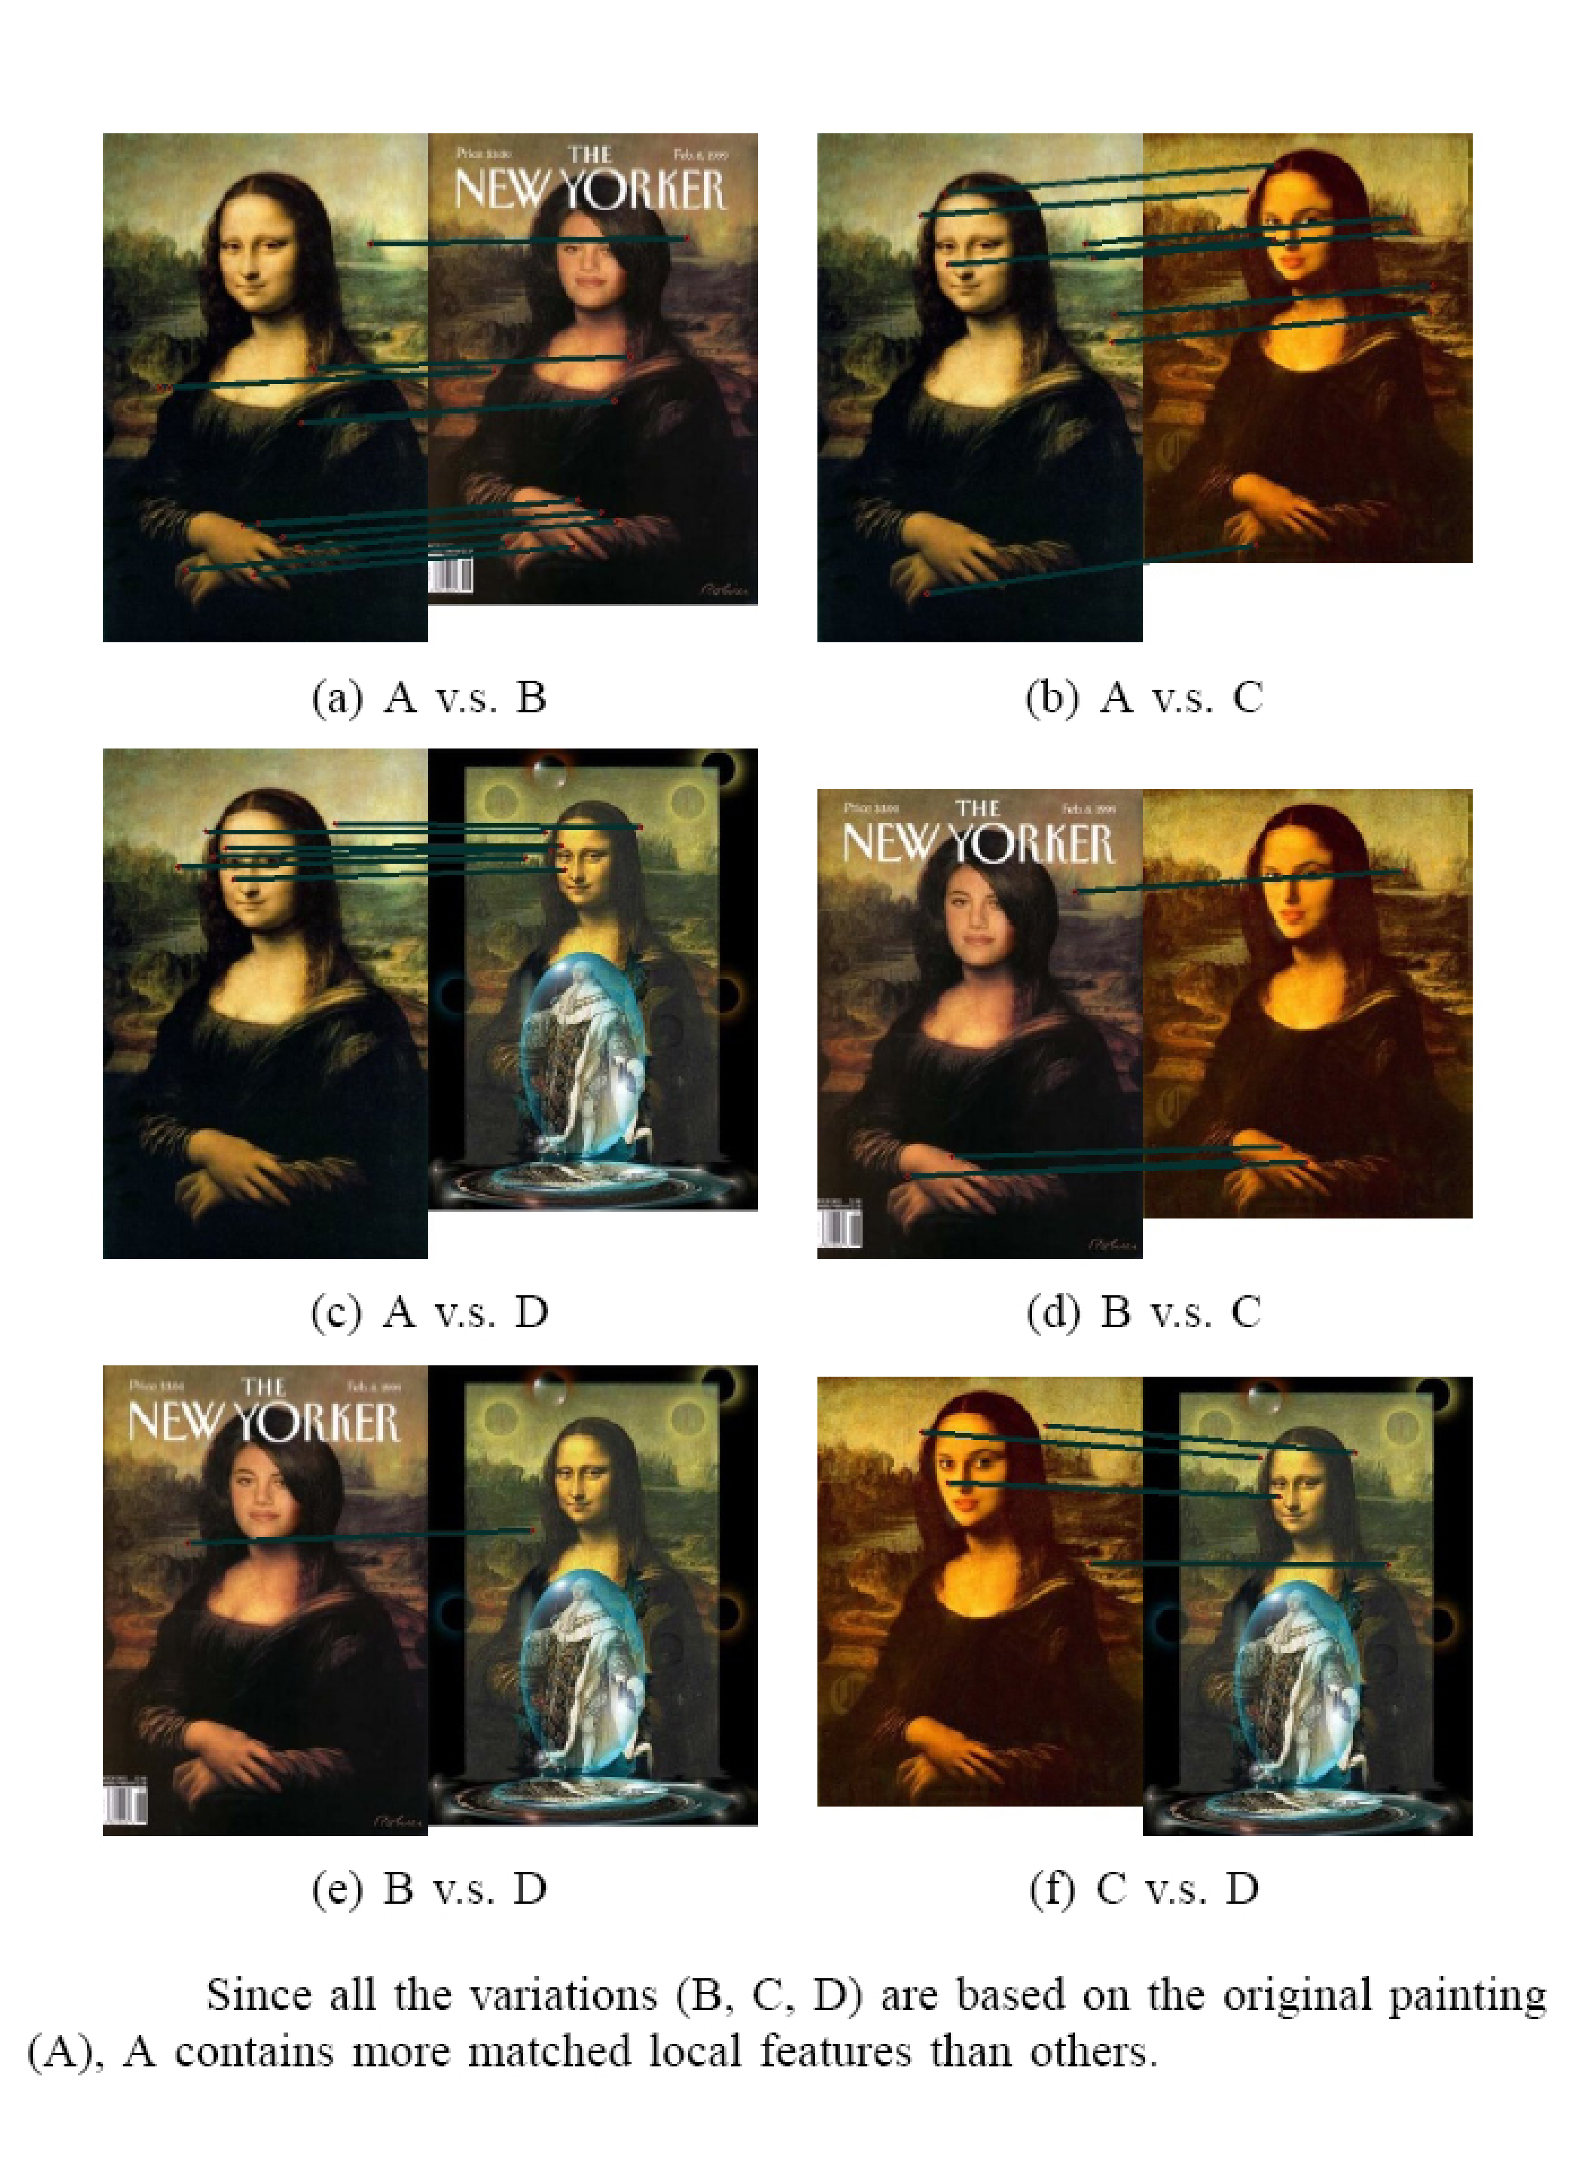
Compare low-level features
Source:
cs221 stanford

Slide 28
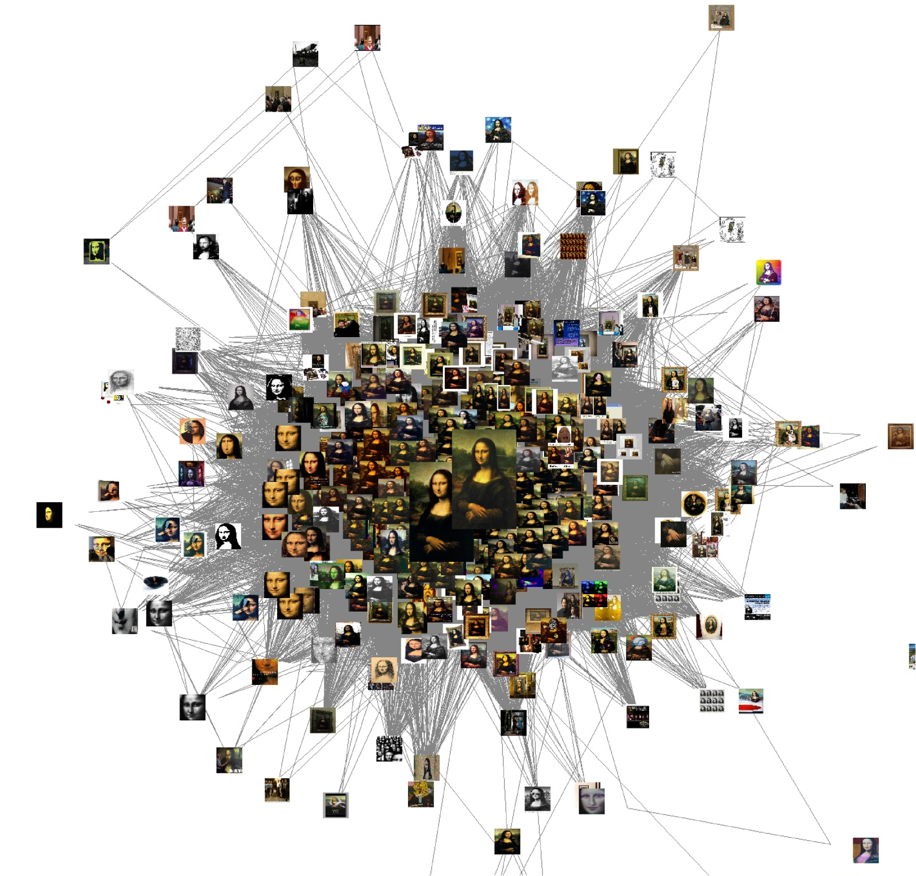
Induced Graph
Source:
cs221 stanford

Slide 29
AI - Machine Learning @google
Spam/Porn Detection
Which ad to place given a query
Train Speech to search on mobile
Machine Translation
…..
Highly Parallelizable EM + Map Reduce (simple code to write)
Stochastic Gradient Descent
Notes:
Machine learning research has often concentrated on more and more complex algorithms to extract the best models out of a limited number of training examples. In recent years, though, with the availability of cheaper computing resources, industries have started collecting very large databases (millions or even billions of examples, thousands or even millions of features, thousands or more classes, etc). Trying to apply classical machine learning algorithms on these large datasets is often a challenge. In this talk, I'll describe a few examples and challenges we recently faced at Google in order to adapt or develop machine learning algorithms for our ever larger datasets and problems. This includes examples such as speech recognition, machine translation, image and video annotation, natural language processing and more.

Slide 30

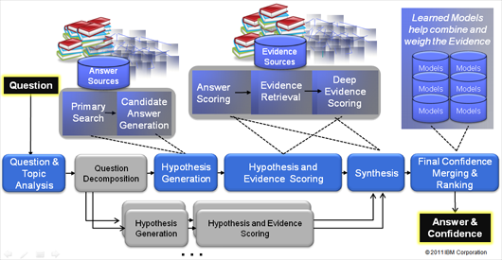
Watson : analyzes natural language questions and content well enough and fast enough to compete and win against champion players at Jeopardy!
“This Drug has been shown to relieve the symptoms of ADD with relatively few side effects."
3 secs
1000s of algorithms and KBs,
Source:
IBM
Notes:
The correct Jeopardy! response would be "What is Ritalin?“
This is no easy task for a computer, given the need to perform over an enormously broad domain,
with consistently high precision and amazingly accurate confidence estimations in the correctness of its answers.
Watson’s performance on Jeopardy! is just the opening salvo for a research mission built on decades of
experience in deep Content Analysis, Natural Language Processing, Information Retrieval, Machine Learning and Artificial Intelligence.
Rich natural language questions covering a broad range of general knowledge. It is widely recognized as an entertaining game requiring smart, knowledgeable and quick players.
Computer systems that can directly and accurately answer questions over a broad domain of human knowledge have been envisioned by scientists and writers since the advent of computers themselves. Open domain question answering holds tremendous promise for facilitating informed decision making over vast volumes of natural language content. Applications in business intelligence, healthcare, customer support, enterprise knowledge management, social computing, science and government would all benefit from deep language processing. The DeepQA project is aimed at exploring how advancing and integrating Natural Language Processing (NLP), Information Retrieval (IR), Machine Learning (ML), massively parallel computation and Knowledge Representation and Reasoning (KR&R) can advance open-domain automatic Question Answering. One proof-point in this challenge is to develop a computer system that can successfully compete against top human players at the Jeopardy! quiz show (www.jeopardy.com). Attaining champion-level performance in Jeopardy! requires a computer system to rapidly and accurately answer rich open-domain questions, and to assess its own confidence in a category or question. The system must deliver high degrees of precision and confidence over a very broad range of knowledge and natural language content within a very short 3-second response time. The need for speed and high precision demands a massively parallel computing platform capable of generating, evaluating and combing thousands of hypotheses and their associated evidence. In this talk I will introduce the audience to the Jeopardy! Challenge and the techniques used to tackle it.

Slide 31
Statistical Machine Translation
SEHR GEEHRTER GAST!
KUNST, KULTUR UND
KOMFORT IM HERZEN
BERLIN.
DEAR GUESTS,
ART, CULTURE AND
LUXURY IN THE HEART
OF BERLIN.
DIE ÖRTLICHE
NETZSPANNUNG BETRÄGT 220/240 VOLT BEI 50 HERTZ.
THE LOCAL VOLTAGE
IS 220/240 VOLTS 50 HZ.
EN
Source:
cs221 Stanford
DE

Slide 32
他 信 也 说 自己 仍 然 是 总理 , 拒 绝 辞 职 .
仍 然 是
continues to be
are still the main
would still be
continued to be
remains one of
remains one
continues to be the
still is
remains an area
still viewed by
are always one of
总理 , 拒绝
……
他
he
He
other
his
him
other
that he
he was
him to
he is
he has
of his
信
letter
trust
letters
believe
signal
a letter
believe that
letter of
confidence
是 总理
Prime Minister
the Prime Minister
is the Prime Minister
他 信
Thaksin
Thaksin Chinnawat
and Joint Communique
Dr Thaksin
Joint Communique
, Mr Thaksin
in his letter
his letter
others
说 自己
themselves
said that
say they
said he
say that
said they themselves
saying that he
would say that
said that she had
saying that he has
他 信 也
Thaksin also
辞 职 .
resign .
leaving their service .
of leaving their service .
resigned as counsel .
Source:
cs221 stanford

Slide 33

Zite: a personalized magazine
… that gets smarter as you use it

Slide 34
Modules we'll cover in this course: R&Rsys
Environment
Deterministic
Stochastic
Problem
Arc Consistency
Constraint Satisfaction
Vars +
Constraints
Search
Static
Belief Nets
Query
Logics
Var. Elimination
Search
Sequential
Decision Nets
STRIPS
Var. Elimination
Planning
Search
Markov Processes
Value Iteration
Notes:
R&R Sys Representation and reasoning Systems
Each cell is a R&R system
STRIPS actions preconditions and effects

Slide 35
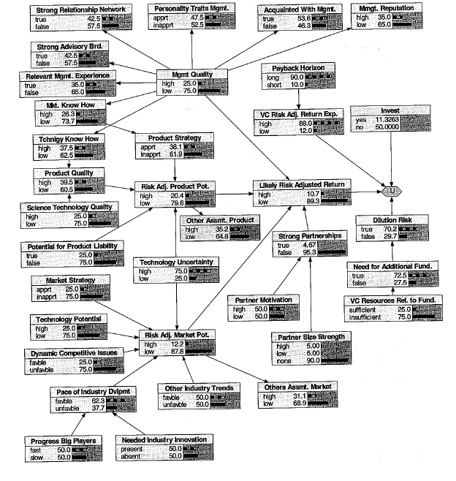
Decision Network in Finance for venture capital decision
Source: R.E. Neapolitan, 2007
Notes:
More on http://www.aaai.org/AITopics/html/applications.html (this is true in general)

Slide 36
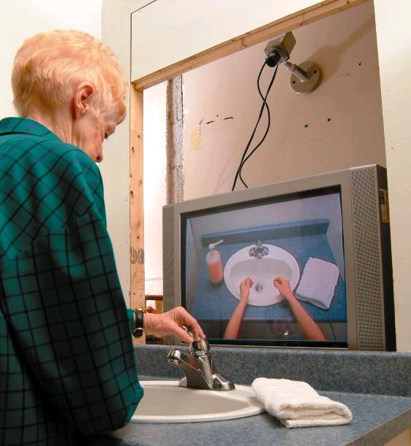
Planning Under Uncertainty
Learning and Using POMDP
models of Patient-Caregiver
Interactions During Activities
of Daily Living
Goal: Help Older adults living with
cognitive disabilities (such as Alzheimer's) when they:
forget the proper sequence of tasks that need to be completed
they lose track of the steps that they have already completed.
Source: Jesse Hoey UofT 2007
Notes:
Older adults living with cognitive disabilities (such as Alzheimer's disease or other forms of dementia) have
difficulty completing activities of daily living (ADLs). They forget the proper sequence of tasks that need
to be completed, or they lose track of the steps that they have already completed

Slide 37
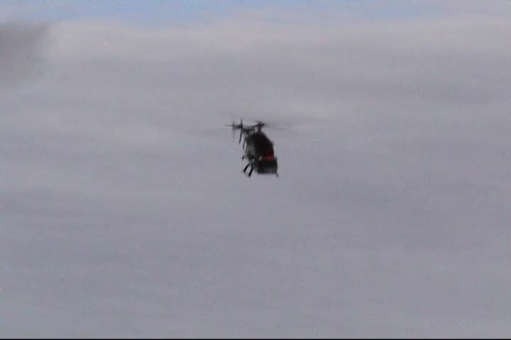
Planning Under Uncertainty
Helicopter control: MDP, reinforcement learning
States: all possible positions, orientations, velocities and angular velocities
Final solution involves
Deterministic search!
Source: Andrew Ng 2004
Notes:
To our knowledge, this is the first helicopter capable of sustained
inverted flight under computer control. A video of the helicopter in inverted
autonomous flight is also at
In our problem, S is the set of states (expressed in
world coordinates) comprising all possible helicopter positions, orientations,
velocities and angular velocities;
But using the Pegasus method (Ng and
Jordan, 2000), we can turn this stochastic optimization problem into an or-
dinary deterministic problem, so that any standard search algorithm can now
be applied.

Slide 38
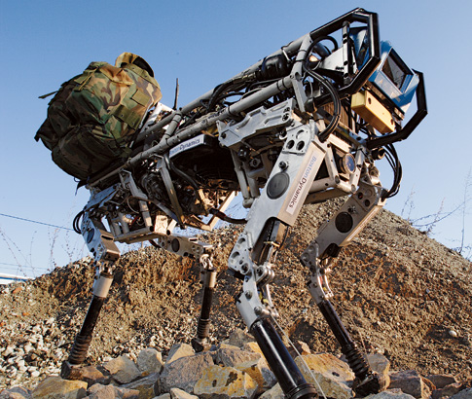
Military applications: ethical issues
Robot soldiers
  Existing: robot dog carrying heavy
  materials for soldiers in the field
  The technology is there
Unmanned airplanes
Missile tracking
Surveillance
…

Slide 39
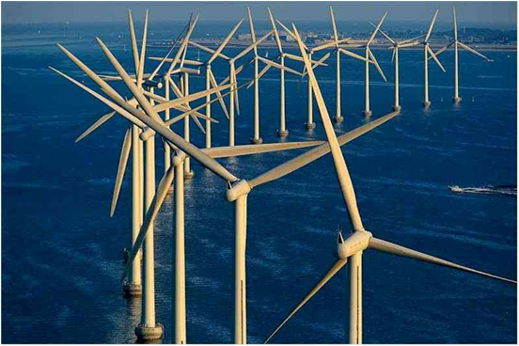
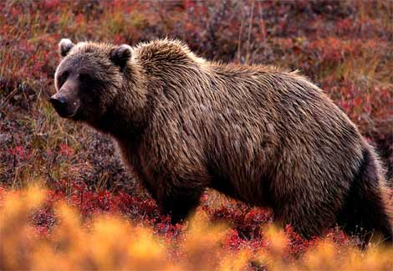
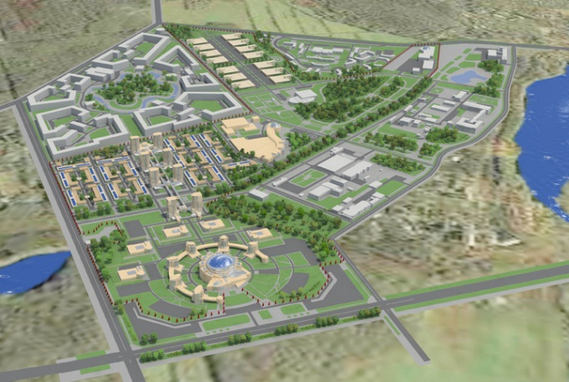
Decision Theory: Decision Support Systems
E.g., Computational Sustainability
New interdisciplinary field, AI is a key component
  Models and methods for decision making concerning the management and allocation of resources
  to solve most challenging problems related to sustainability
Often constraint optimization problems. E.g.
  Energy: when are where to produce green energy most economically?
  Which parcels of land to purchase to protect endangered species?
  Urban planning: how to use budget for best development in 30 years?
Source: http://www.computational-sustainability.org/

Slide 40
Dimensions of Representational Complexity in CPSC322
We've already discussed:
Deterministic versus stochastic domains
Static versus sequential domains
Some other important dimensions of complexity:
Explicit state or propositions or relations
Flat or hierarchical
Knowledge given versus knowledge learned from experience
Goals versus complex preferences
Single-agent vs. multi-agent
Notes:
begin{itemize}
% \item \alert{Key point}: ``stochastic world'' can mean that the world itself has stochastic dynamics, that the world is deterministic but imperfectly observed, or that the world has stochastic dynamics \emph{and} is imperfectly observed.
%\end{itemize}

Slide 41

Multiagent Systems: Poker
Search Space: 1.2 quintillion nodes
“In full 10-player games Poki is better than a typical low-limit casino player and wins consistently; however, not as good as most experts
New programs being developed for the 2-player game are quite a bit better, and we believe they will very soon surpass all human players”
Source: The University of Alberta GAMES Group
Notes:
Q: How large is the search space for 2-player Texas Hold'em?
A: Short answer: about 1.2 quintillion nodes. Exact answer: the imperfect information game tree for limit Hold'em (with a maximum of four bets each per round) has 1,179,000,604,565,715,751 nodes in total, including dominated sequences (ie. folding to no bet). Almost all of these (1,176,023,515,434,768,000) involve all four betting rounds. The breakdown by type of node is:
406,551,932,608,867,500 terminal (fold) nodes,
364,972,815,134,928,000 showdown nodes,
203,275,966,304,433,750 decision nodes for each player, and
923,924,213,052,751 chance nodes.
Eliminating dominated sequences reduces the tree to a mere 1,097,690,218,045,566,601 nodes. (Thanks for asking! :)

Slide 42
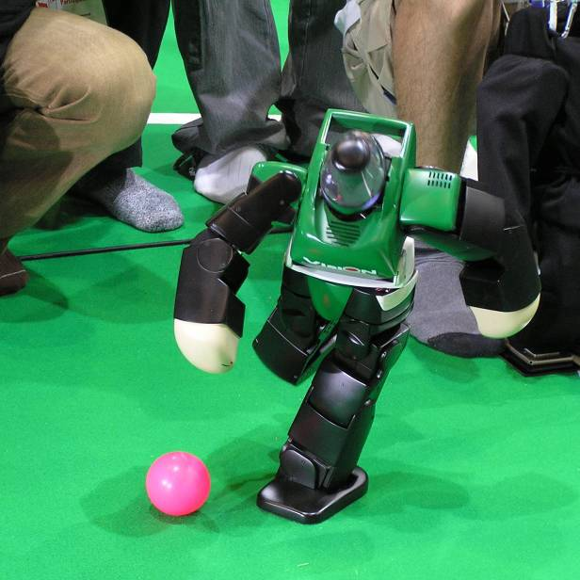
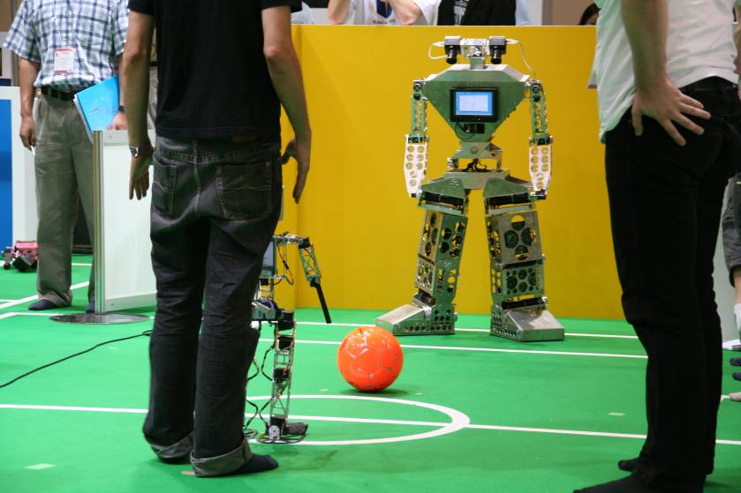
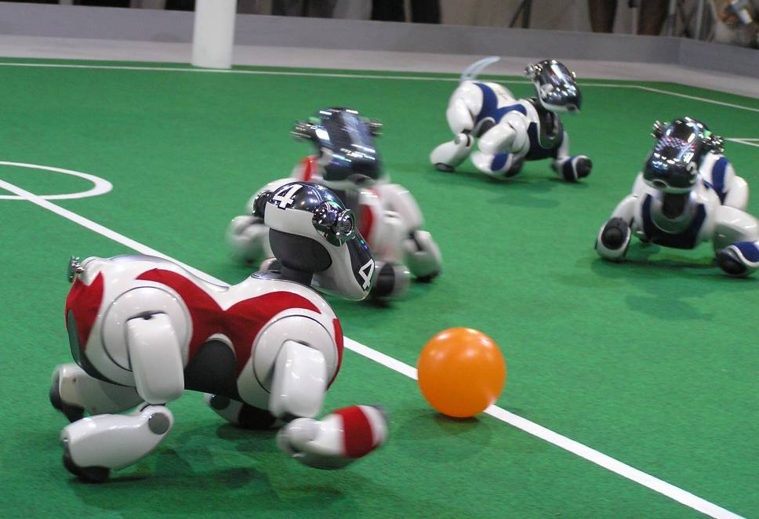
Multiagent Systems: Robot Soccer
Extremely complex
Stochastic
Sequence of actions
Multiagent
robotic soccer competition was proposed by LCI (UBC) in 1992 (which became Robocup in 1997).
Source: RoboCup web site

Slide 43
TO DO for Next class
Search: Start reading (Chpt 3 – sec 3.1 – 3.3)

Slide 44
CSPs: Radio link frequency assignment
Assigning frequencies to a set of radio links defined between pairs of sites in order to avoid interferences.
Source: INRIA
For each link two frequencies must be assigned

