Slide 1
Local Search
Computer Science cpsc322, Lecture 14
(Textbook Chpt 4.8)
Oct, 7, 2013
Notes:
Lecture 14

Slide 2
Department of Computer Science
Undergraduate Events
More details @ https://www.cs.ubc.ca/students/undergrad/life/upcoming-events
Samsung Info Session
Date: Wed., Oct 9
Time: 11:30 am – 1:30 pm
Location: McLeod Rm 254
Google Info Session/Tech Talk
Date: Thurs., Oct 10
Time: 5:30 pm
Location: DMP 110
Global Relay Info Session/Tech Talk
Date: Mon., Oct 7
Time: 5:30 pm
Location: DMP 301
Amazon Info Session/Tech Talk
Date: Tues., Oct 8
Time: 5:30 pm
Location: DMP 110
Go Global Experience Fair
Date: Wed., Oct 9
Time: 11 am – 5 pm
Location: Irving K. Barber Learning
Centre

Slide 3
Announcements
Assignment1 due now!
Assignment2 out next week

Slide 4
Lecture Overview
Recap solving CSP systematically
Local search
Constrained Optimization
Greedy Descent / Hill Climbing: Problems

Slide 5
Systematically solving CSPs: Summary
Build Constraint Network
Apply Arc Consistency
  One domain is empty →
  Each domain has a single value →
  Some domains have more than one value →
Apply Depth-First Search with Pruning
Search by Domain Splitting
  Split the problem in a number of disjoint cases
  Apply Arc Consistency to each case
Notes:
Otherwise, split a domain & apply arc consistency to each case.
Spiltting in half the variable with the smallest domain usually works best (who know why)
ACC: Show with Cispace, first “scheduling problem”, and then crossword 1 for splitting. What makes sense is to split the node with 6 vars to the right, show that it gets to an empty solution, backtrack, and do more s0plitting on the var with 2 values on the top-left. Done. WENT WELL

Slide 6
Lecture Overview
Recap
Local search
Constrained Optimization
Greedy Descent / Hill Climbing: Problems

Slide 7

Local Search motivation: Scale
Many CSPs (scheduling, DNA computing, more later) are simply too big for systematic approaches
If you have 10⁵ vars with dom(var_{i}) = 10⁴
Systematic Search
Arc Consistency
10⁵ * 10⁴
10¹⁰ * 10⁸
10¹⁰ * 10¹²
but if solutions are densely distributed…….

Slide 8
Local Search: General Method
  Remember , for CSP a solution is…..
  Start from a possible world
  Generate some neighbors ( “similar” possible worlds)
  Move from the current node to a neighbor, selected according to a particular strategy
  Example: A,B,C same domain {1,2,3}
Notes:
A useful method in practice for some consistency and optimization problems is local search
move from one node to another according to a function that scores how good each neighbor is
according to a function that scores how good each neighbor is

Slide 9
Local Search: Selecting Neighbors
How do we determine the neighbors?
Usually this is simple: some small incremental change to the variable assignment
  assignments that differ in one variable's value, by (for instance) a value difference of +1
  assignments that differ in one variable's value
  assignments that differ in two variables' values, etc.
  Example: A,B,C same domain {1,2,3}

Slide 10
Iterative Best Improvement
How to determine the neighbor node to be selected?
Iterative Best Improvement:
  select the neighbor that optimizes some evaluation function
Which strategy would make sense? Select neighbor with …
A. Maximal number of constraint violations
B. Similar number of constraint violations as current state
C. No constraint violations
D. Minimal number of constraint violations

Slide 11
Iterative Best Improvement
How to determine the neighbor node to be selected?
Iterative Best Improvement:
  select the neighbor that optimizes some evaluation function
Which strategy would make sense? Select neighbour with …
Evaluation function:
h(n): number of constraint violations in state n
Greedy descent: evaluate h(n) for each neighbour, pick the neighbour n with minimal h(n)
Hill climbing: equivalent algorithm for maximization problems
  Here: maximize the number of constraints satisfied
Minimal number of constraint violations

Slide 12
Selecting the best neighbor
  Example: A,B,C same domain {1,2,3} , (A=B, A>1, C≠3)
A common component of the scoring function (heuristic) => select the neighbor that results in the ……
- the min conflicts heuristics
Notes:
For example, if the goal is to find the highest point on a surface, the scoring function might be the height at the current point.

Slide 13
Example: N-Queens
Put n queens on an n × n board with no two queens on the same row, column, or diagonal (i.e attacking each other)
Positions a queen
can attack

Slide 14
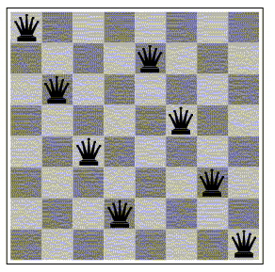
Example: N-queen as a local search problem
CSP: N-queen CSP
  One variable per column; domains {1,…,N} => row where the queen in the i^{th} column seats;
  Constraints: no two queens in the same row, column or diagonal
Neighbour relation: value of a single column differs
Scoring function: number of attacks
How many neighbors ?
100
90
200
9

Slide 15
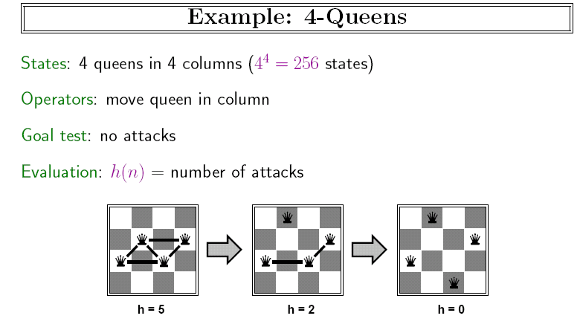
Example: n-queens
Put n queens on an n × n board with no two queens on the same row, column, or diagonal (i.e attacking each other)

Slide 16
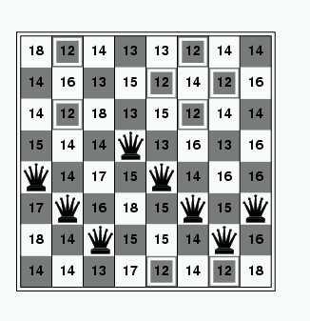
Example: Greedy descent for N-Queen
For each column, assign randomly each queen to a row
(a number between 1 and N)
Repeat
  For each column & each number: Evaluate how many constraint violations changing the assignment would yield
  Choose the column and number that leads to the fewest violated constraints; change it
Until solved

Slide 17
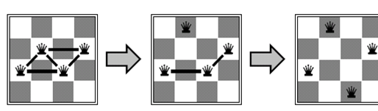
h = 5
h = ?
h = ?
1
0
2
3

Slide 18
n-queens, Why?
Why this problem?
Lots of research in the 90’ on local search for CSP was generated by the observation that the run-time of local search on n-queens problems is independent of problem size!
Notes:
It consists of an initial
search phase that starts during problem generation and a final search phase that removes conflicts During
the initial search function Initial Search an initial permutation of the row positions of the queens is
Generated
A random permutation of n queens would generate approximately .5n
collisions Since this number of collisions is very high the algorithm performance can be improved
signicantly if collisions in the initial permutation are minimized
During the final search procedure Final Search two queens are
chosen for conflict minimization If a swap (the row) of two queens reduces the number of collisions then two queens
are swapped Otherwise no action is taken The final search is repeated until all collisions are eliminated
The number of collisions on a diagonal line can be computed in constant time using a characterization
of diagonal lines

Slide 19
Lecture Overview
Recap
Local search
Constrained Optimization
Greedy Descent / Hill Climbing: Problems

Slide 20
Constrained Optimization Problems
So far we have assumed that we just want to find a possible world that satisfies all the constraints.
But sometimes solutions may have different values / costs
We want to find the optimal solution that
  maximizes the value or
  minimizes the cost
Notes:
It consists of an initial
search phase that starts during problem generation and a final search phase that removes conflicts During
the initial search function Initial Search an initial permutation of the row positions of the queens is
Generated
A random permutation of n queens would generate approximately .5n
collisions Since this number of collisions is very high the algorithm performance can be improved
signicantly if collisions in the initial permutation are minimized
During the final search procedure Final Search two queens are
chosen for conflict minimization If a swap (the row) of two queens reduces the number of collisions then two queens
are swapped Otherwise no action is taken The final search is repeated until all collisions are eliminated
The number of collisions on a diagonal line can be computed in constant time using a characterization
of diagonal lines

Slide 21
Constrained Optimization Example
  Example: A,B,C same domain {1,2,3} , (A=B, A>1, C≠3)
  Value = (C+A) so we want a solution that maximize that
The scoring function we’d like to maximize might be:
f(n) = (C + A) + #-of-satisfied-const
Hill Climbing means selecting the neighbor which best improves a (value-based) scoring function.
Greedy Descent means selecting the neighbor which minimizes a (cost-based) scoring function.
Notes:
For example, if the goal is to find the highest point on a surface, the scoring function might be the height at the current point.

Slide 22
Lecture Overview
Recap
Local search
Constrained Optimization
Greedy Descent / Hill Climbing: Problems

Slide 23
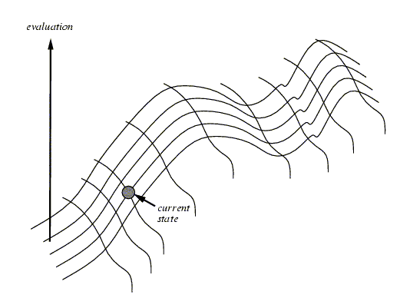
Hill Climbing
NOTE: Everything that will be said for Hill Climbing is also true for Greedy Descent
Notes:
One of the most obvious heuristics is to select the value that results in the minimum # of conflicts with the other variables - the min conflicts heuristics
Ex, in case of eight queen, it is the number of attacking queens.
Min conflict is surprising effective and can solve the million-queens problem in less than 50 steps. It has also been used to schedule the hubble telecope, reducing the time taken to schedule a week of observations from three weeks to around 10’

Slide 24
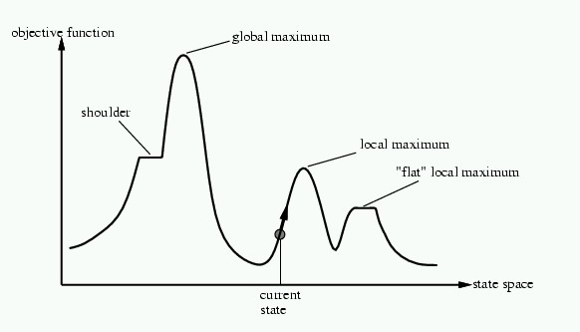
Problems with Hill Climbing
Local Maxima.
Plateau - Shoulders
(Plateau)
Notes:
No way to move from a plateau, could escape from a shoulder
With a randomly gerenated 8-queen initial state steepest ascent hill climbing gets stuck 86% of the times. Takes 4 steps on average to suceed and 3 to get stuck –good since there are 17 million states

Slide 25
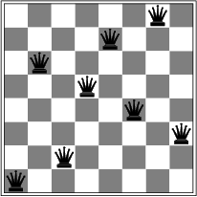
Corresponding problem for GreedyDescent
Local minimum example: 8-queens problem
A local minimum with h = 1

Slide 26
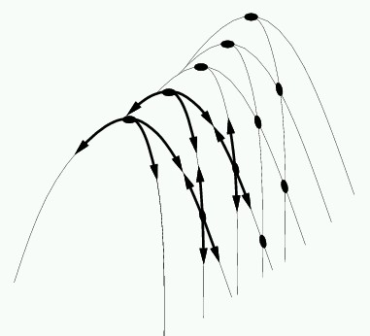
Even more Problems in higher dimensions
E.g., Ridges – sequence of local maxima not directly connected to each other
From each local maximum you can only
go downhill

Slide 27
Local Search: Summary
A useful method for large CSPs
  Start from a possible world
  Generate some neighbors ( “similar” possible worlds)
  Move from current node to a neighbor, selected to minimize/maximize a scoring function which combines:
    Info about how many constraints are violated
    Information about the cost/quality of the solution (you want the best solution, not just a solution)
Notes:
move from one node to another according to a function that scores how good each neighbor is
according to a function that scores how good each neighbor is
Number of unsatisfied constraints OR weighted count

Slide 28
Learning Goals for today’s class
You can:
Implement local search for a CSP.
  Implement different ways to generate neighbors
  Implement scoring functions to solve a CSP by local search through either greedy descent or hill-climbing.

Slide 29
Next Class
How to address problems with Greedy Descent / Hill Climbing?
Stochastic Local Search (SLS)

