Slide 1
Constraint Satisfaction Problems (CSPs)
Introduction
Computer Science cpsc322, Lecture 11
(Textbook Chpt 4.0 – 4.2)
Setp, 30, 2013

Slide 2
Announcements
Only one more week for assignment1
Post questions on Connect
Search wrap-up
Go back to learning goals (end of slides)
Make sure you understands the inked slides
More details or different examples on textbook
Work on the practice exercises
If still confused, come to office hours

Slide 3
Lecture Overview
Generic Search vs. Constraint Satisfaction Problems
Variables
Constraints
CSPs

Slide 4
Standard Search
To learn about search we have used it as the reasoning strategy for a simple goal-driven planning agent…..
Standard search problem: An agent can solve a problem by searching in a space of states
state is a "black box“ – any arbitrary data structure that supports three problem-specific routines
Solution?
Notes:
General but not arbitrary
General purpose rather than problem specific
successor function,
heuristic function
goal test
Deterministic, goal-driven agent
Agent is given a goal (subset of possible states)
Environment changes only when the agent acts
Agent perfectly knows:
what actions can be applied in any given state
the state it is going to end up in when an action is applied in a given state

Slide 5
Modules we'll cover in this course: R&Rsys
Environment
Deterministic
Stochastic
Problem
Arc Consistency
Constraint Satisfaction
Vars +
Constraints
Search
Static
Belief Nets
Query
Logics
Var. Elimination
Search
Sequential
Decision Nets
STRIPS
Var. Elimination
Planning
Search
Markov Processes
Representation
Value Iteration
Reasoning
Technique
Notes:
R&R Sys Representation and reasoning Systems
Each cell is a R&R system
STRIPS actions preconditions and effects

Slide 6
Standard Search vs. Specific R&R systems
Constraint Satisfaction (Problems):
State
Successor function
Goal test
Solution
Planning :
State
Successor function
Goal test
Solution
Inference
State
Successor function
Goal test
Solution
Notes:
Allows useful general-purpose algorithms with more power than standard search algorithms

Slide 7
Lecture Overview
Generic Search vs. Constraint Satisfaction Problems
Variables/Features
Constraints
CSPs

Slide 8
Variables/Features, domains and Possible Worlds
Variables / features
we denote variables using capital letters
each variable V has a domain dom(V) of possible values
Variables can be of several main kinds:
Boolean: |dom(V)| = 2
Finite: the domain contains a finite number of values
Infinite but Discrete: the domain is countably infinite
Continuous: e.g., real numbers between 0 and 1
Possible world: a complete assignment of values to a set of variables
Notes:
Countably infinite
Reduce infinite by simply bounding the the values of all variables
Continuous domains – operation research – linear programming

Slide 9
Example (lecture 2)
Mars Explorer Example
Weather
Temperature
Longitude
Latitude
One possible world (state)
Number of possible (mutually exclusive) worlds (states)
{S, C}
[-40, 40]
[0, 359]
[0, 179]
{S, -30, 320, 91}
2 x 81 x 360 x 180
Product of cardinality of each domain
… always exponential in the number of variables

Slide 10
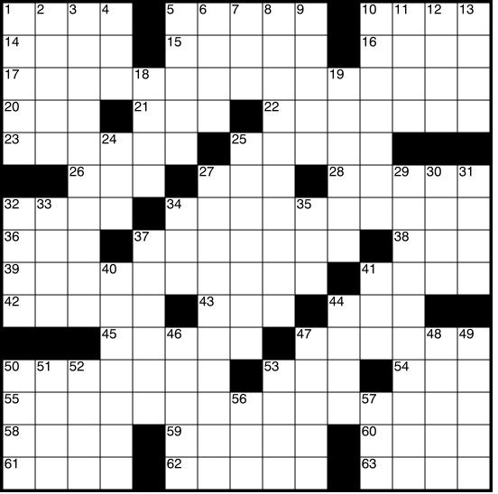
Examples
Crossword Puzzle:
variables are words that have to be filled in
domains are valid English words of required length
possible worlds: all ways of assigning words
Number of English words?
Number of words of length k ?
So, how many possible worlds?
A. 15,000*63 B. 63^{15,000} C. 15,000⁶³ D. 1,563⁶³
Notes:
~150,000
Variables are the places where word can go e.g. (1 across, 3 down)
Domains are words of the appropriate length (for 1 across in this example – length equals 6)
Constraints letter should be the same at the intersection

Slide 11
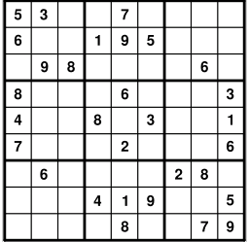
More Examples
Crossword 2:
variables are cells (individual squares)
domains are letters of the alphabet
possible worlds: all ways of assigning letters to cells
So, how many possible worlds?
Sudoku:
variables are empty cells
domains are numbers between 1 and 9
possible worlds: all ways of assigning numbers to cells
So, how many possible worlds?

Slide 12
More examples
n-Queens problem
variable: location of a queen on a chess board
there are n of them in total, hence the name
domains: grid coordinates
possible worlds: locations of all queens
Notes:
the number of ways that k things can be 'chosen' from a set of n things. Hence, is often read as "n choose k" and called the choose function of n and k
Task1 start-time
Task1 end-time
Task1 location

Slide 13
More examples
Scheduling Problem:
variables are different tasks that need to be scheduled (e.g., course in a university; job in a machine shop)
domains are the different combinations of times and locations for each task (e.g., time/room for course; time/machine for job)
possible worlds: time/location assignments for each task
Notes:
the number of ways that k things can be 'chosen' from a set of n things. Hence, is often read as "n choose k" and called the choose function of n and k
Task1 start-time
Task1 end-time
Task1 location

Slide 14
Scheduling possible world
how many possible worlds?

Slide 15
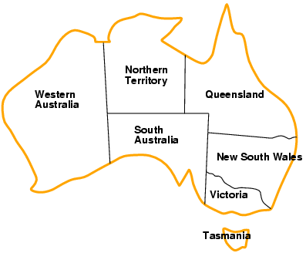
More examples….
Map Coloring Problem
variable: regions on the map
domains: possible colors
possible worlds: color assignments for each region
how many possible worlds?
Notes:
Task1 start-time
Task1 end-time
Task1 location

Slide 16
Lecture Overview
Generic Search vs. Constraint Satisfaction Problems
Variables/Features
Constraints
CSPs

Slide 17
Constraints
Constraints are restrictions on the values that one or more variables can take
Unary constraint: restriction involving a single variable
k-ary constraint: restriction involving the domains of k different variables
it turns out that k-ary constraints can always be represented as binary constraints, so we'll mainly only talk about this case
Constraints can be specified by
giving a function that returns true when given values for each variable which satisfy the constraint
giving a list of valid domain values for each variable participating in the constraint
Notes:
Unary constraint: restriction involving a single variable
of course, we could also achieve the same thing by using a smaller domain in the first place
k-ary constraints can always be represented as binary constraints
http://ai.uwaterloo.ca/~vanbeek/Publications/ai02.pdf
In the dual transformation, the constraints of the original formulation become variables
in the new representation. We refer to these variables, which represent the original
constraints, as the dual variables, and the variables in the original CSP as the ordinary
variables. The domain of each dual variable is exactly the set of tuples that are in the
original constraint relation. There is a binary constraint, called a dual constraint, between
two dual variables iff the two original constraints share some variables. A dual
constraint prohibits pairs of tuples that do not agree on the shared variables.
In the hidden transformation, the set of variables consists of all the ordinary variables
in the original formulation with their original domains plus all the dual variables
as defined by the dual transformation. There is a binary constraint, called a hidden
constraint, between a dual variable and each of the ordinary variables in the constraint
represented by the dual variable. A hidden constraint enforces the condition that a
value of the ordinary variable must be the same as the value assigned to it by the tuple
that is the value of the dual variable.

Slide 18
Example: Map-Coloring
Variables WA, NT, Q, NSW, V, SA, T
Domains D_{i} = {red,green,blue}
Constraints: adjacent regions must have different colors
e.g., WA ≠
or, NT(WA,NT) in {(red,green),(red,blue),(green,red), (green,blue),(blue,red),(blue,green)}

Slide 19
Constraints (cont.)
A possible world satisfies a set of constraints if the set of variables involved in each constraint take values that are consistent with that constraint
Variables: A,B,C domains [1 .. 10]
Possible world W: {A= 1 , B = 2, C = 10}
Constraint set1 {A = B, C>B}
Constraint set2 {A ≠ B, C>B, (A,C) in {(10,1),(1,10)}
W satisfies both set1 and set2
W satisfies set1 but not set2
W does not satisfy any of the two constraint sets
W satisfies set2 but not set1

Slide 20
Examples
Crossword Puzzle:
variables are words that have to be filled in
domains are valid English words
constraints: words have the same letters at points where they intersect
Crossword 2:
variables are cells (individual squares)
domains are letters of the alphabet
constraints: sequences of letters form valid English words

Slide 21
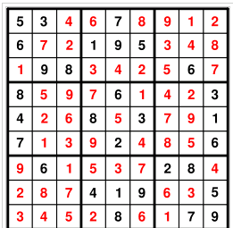
Examples
Sudoku:
variables are cells
domains are numbers between 1 and 9
constraints: rows, columns, boxes contain all different numbers

Slide 22
More examples
n-Queens problem
variable: location of a queen on a chess board
there are n of them in total, hence the name
domains: grid coordinates
constraints: no queen can attack another
Scheduling Problem:
variables are different tasks that need to be scheduled (e.g., course in a university; job in a machine shop)
domains are the different combinations of times and locations for each task (e.g., time/room for course; time/machine for job)
constraints:
tasks can't be scheduled in the same location at the same time;
certain tasks can be scheduled only in certain locations;
some tasks must come earlier than others; etc.

Slide 23
Lecture Overview
Generic Search vs. Constraint Satisfaction Problems
Variables/Features
Constraints
CSPs

Slide 24
Constraint Satisfaction Problems: definitions
Definition (Constraint Satisfaction Problem)
A constraint satisfaction problem consists of
a set of variables
a domain for each variable
a set of constraints
Definition (model / solution)
A model of a CSP is an assignment of values to variables that satisfies all of the constraints.
Notes:
A possible world satisfies a set of constraints if the set of variables involved in each constraint take
values that are consistent with that constraint

Slide 25
Example: Map-Coloring
Variables WA, NT, Q, NSW, V, SA, T
Domains D_{i} = {red,green,blue}
Constraints: adjacent regions must have different colors
e.g., WA ≠ NT, or
(WA,NT) in {(red,green),(red,blue),(green,red), (green,blue),(blue,red),(blue,green)}

Slide 26
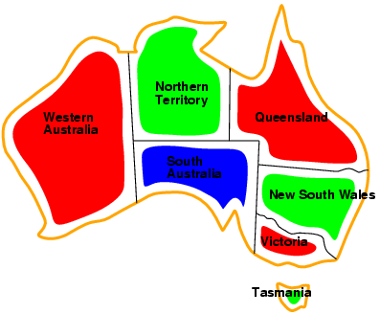
Example: Map-Coloring
Models / Solutions are complete and consistent assignments, e.g., WA = red, NT = green, Q = red, NSW = green, V = red,SA = blue, T = green

Slide 27
Constraint Satisfaction Problem: Variants
We may want to solve the following problems using a CSP
determine whether or not a model exists
find a model
find all of the models
count the number of the models
find the best model given some model quality
this is now an optimization problem
determine whether some properties of the variables hold in all models
Notes:
Get a “quick answer” then spend more time to find the model
Typical
To assess the difficulty of the problem
Same as above
If you want the largest regions to be red (can be encoded as additional constraints)
In all models do two variables have the same value? (even if it was not required by the constraints)

Slide 28
To summarize
Need to think of search beyond simple goal driven planning agent.
We started exploring the first AI Representation and Reasoning framework: CSPs
Next class
CSPs: Search and Arc Consistency
(Textbook Chpt 4.3-4.5)
Notes:
Standard search problem: An agent can solve a problem by searching in a space of states
state is a "black box“ – any arbitrary data structure that supports three problem-specific routines
successor function,
heuristic function
goal test
General but not arbitrary
General purpose rather than problem specific

Slide 29
Learning Goals for today’s class
Define possible worlds in term of variables and their domains.
Compute number of possible worlds on real examples
Specify constraints to represent real world problems differentiating between:
Unary and k-ary constraints
List vs. function format.
Verify whether a possible world satisfies a set of constraints (i.e., whether it is a model, a solution)

Slide 30
Extra slide (may be used here?)
Goal state: 9×9 grid completely
filled so that
each column,
each row, and
each of the nine 3×3 boxes
contains the digits from 1 to 9,
only one time each
A possible start state
(partially completed grid)
Notes:
Sudoku is a logic-based number placement puzzle. The objective is to fill a 9×9 grid so that each column, each row, and each of the nine 3×3 boxes (also called blocks or regions) contains the digits from 1 to 9, only one time each (that is, exclusively). The puzzle setter provides a partially completed grid.
Restate / justify that the following is true
Environment changes only when the agent acts
Agent can perfectly predict effect of its actions
Agent is given a goal

