Slide 1
Heuristic Search: BestFS and A*
Computer Science cpsc322, Lecture 8
(Textbook Chpt 3.6)
Sept, 21, 2010
Notes:
Lecture 8

Slide 2
Department of Computer Science Undergraduate Events More details @ https://www.cs.ubc.ca/students/undergrad/life/upcoming-events
Resume Drop-in Editing Session
Mon. Sept 24, 12 – 3 pm
Rm 253, ICICS/CS Bldg.
Global Relay Info Session
Mon. Sept 24, 5:30 pm
DMP 110
Google Info Session
Tues. Sept 25, 5:30 pm
Wesbrook 100
UBC Career Days
Wed. Sept 26 & Thurs. Sept 27
10 am – 4 pm
SUB
Microsoft Info Session
Wed. Sept 26, 5:30 pm
Wesbrook 100
Tri-mentoring Kick Off
(invitation only)
Thurs. Sept 27, 5:30 pm
X860, ICICS/CS Bldg.
Avanade Info Session
Fri. Sept 28, 12 – 2 pm
Rm 206, ICICS/CS Bldg.
ACM Programming Team Try Out
Sat. Sept 29, 12 – 5 pm
Rm 005, Rm 011, ICICS/CS Bldg.

Slide 3
Course Announcements
Marks for Assignment0: posted on Connect
Assignment1: posted
If you are confused on basic search algorithm, different search strategies….. Check learning goals at the end of lectures. Work on the Practice Exercises and Please come to office hours
Giuseppe Tue 2 pm, my office.
Nathaniel Tomer Fri 11am, X150 (Learning Center)
Tatsuro Oya Wed 2 pm, X150 (Learning Center)
Mehran Kazemi Mon 11 am, X150 (Learning Center)

Slide 4
Course Announcements
Inked Slides
At the end of each lecture I revise/clean-up the slides. Adding comments, improving writing… make sure you check them out

Slide 5
Lecture Overview
Recap Heuristic Function
Best First Search
A*

Slide 6
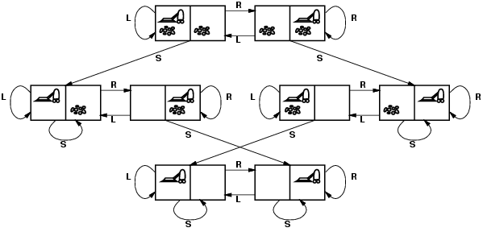
Admissible heuristic for Vacuum world?
states? Where it is dirty and robot location
actions? Left, Right, Suck
Possible goal test? no dirt at all locations
Notes:
States if the world had n locations?
Some simplifications wrt real world
Discrete location
Discrete dirt
Reliable cleaning
Room never gets messed up once cleaned

Slide 7
Lecture Overview
Recap Heuristic Function
Best First Search
A*

Slide 8
Best-First Search
Idea: select the path whose end is closest to a goal according to the heuristic function.
Best-First search selects a path on the frontier with minimal h-value (for the end node).
It treats the frontier as a priority queue ordered by h. (similar to ?)
This is a greedy approach: it always takes the path which appears locally best

Slide 9
Analysis of Best-First Search
Complete no: a low heuristic value can mean that a cycle gets followed forever.
Optimal: no (why not?)
Time complexity is O(b^{m})
Space complexity is O(b^{m})
Notes:
Misleading heuristic demo (sample Aispace problem)
Search with cost example, make MP a goal (USE FINE STEP!) !) KD heuristics 3.5 and also cost to goal from KD = 3.5

Slide 10
Lecture Overview
Recap Heuristic Function
Best First Search
A* Search Strategy

Slide 11
A* Search Algorithm
A* is a mix of:
lowest-cost-first and
best-first search
A* treats the frontier as a priority queue ordered by f(p)=
It always selects the node on the frontier with the ………….. estimated …………….distance.
Notes:
Lowest estimated total cost

Slide 12
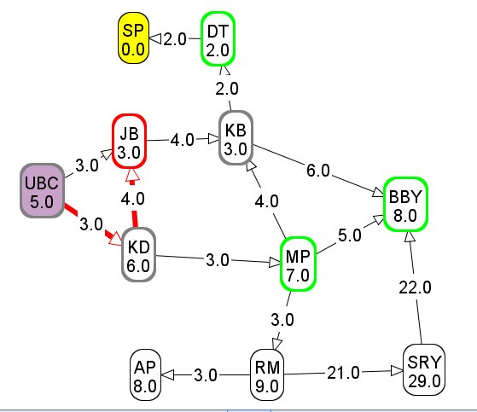
Computing f-values
f-value of UBC → KD→ JB?
6
9
10
11

Slide 13
Analysis of A*
Let's assume that arc costs are strictly positive.
Time complexity is O(b^{m})
the heuristic could be completely uninformative and the edge costs could all be the same, meaning that A* does the same thing as….
Space complexity is O(b^{m}) like ….., A* maintains a frontier which grows with the size of the tree
Completeness: yes.
Optimality: ??
DFS
BFS
LCFS
Notes:
Complete it is always testing shorter underestimate of the total cost
So it is not missing anything

Slide 14
Optimality of A*
If A* returns a solution, that solution is guaranteed to be optimal, as long as
When
the branching factor is finite
arc costs are strictly positive
h(n) is an underestimate of the length of the shortest path from n to a goal node, and is non-negative
Theorem
If A* selects a path p as the solution,
p is the shortest (i.e., lowest-cost) path.

Slide 15
Why is A* optimal?
A* returns p
Assume for contradiction that some other path p' is actually the shortest path to a goal
Consider the moment when p is chosen from the frontier. Some part of path p' will also be on the frontier; let's call this partial path p''.
p''
p
p'

Slide 16
Why is A* optimal? (cont’)
p''
p
p'
Because p was expanded before p'',
Because p is a goal, Thus
Because h is admissible, cost(p'') + h(p'') ≤ for any path p' to a goal that extends p''
Thus for any other path p' to a goal.
This contradicts our assumption that p' is the shortest path.
Notes:
Because p was expanded before p'', f(p) ≤ f(p'').
Because p is a goal, h(p)=0. Thus cost(p) ≤ cost(p'') + h(p'').
Because h is admissible, cost(p'') + h(p'') ≤ cost(p') for any path p' to a goal that extends p''
Thus cost(p) ≤ cost(p') for any other path p' to a goal.
This contradicts our assumption that p' is the shortest path.

Slide 17
Optimal efficiency of A*
In fact, we can prove something even stronger about A*: in a sense (given the particular heuristic that is available) no search algorithm could do better!
Optimal Efficiency: Among all optimal algorithms that start from the same start node and use the same heuristic h, A* expands the minimal number of paths.
Notes:
In fact, we can prove something even stronger about A*: in a sense (given the particular heuristic that is available)
no search algorithm could do better!
problem: A* could be unlucky about how it breaks ties.
So let's define optimal efficiency as expanding the minimal number of paths p for which f(p) < f*, where f* is the cost of the optimal solution.

Slide 18
Sample A* applications
An Efficient A* Search Algorithm For Statistical Machine Translation. 2001
The Generalized A* Architecture. Journal of Artificial Intelligence Research (2007)
Machine Vision … Here we consider a new compositional model for finding salient curves.
Factored A*search for models over sequences and trees International Conference on AI. 2003…. It starts saying… The primary challenge when using A* search is to find heuristic functions that simultaneously are admissible, close to actual completion costs, and efficient to calculate… applied to NLP and BioInformatics
Notes:
title: An Efficient A* Search Algorithm For Statistical Machine Translation authors: Och, Franz Josef (RWTH Aachen University, Aachen Germany), Ueffing, Nicola (RWTH Aachen University, Aachen Germany), Ney, Hermann (RWTH Aachen University, Aachen Germany) venue: Workshop On Data-Driven Methods In Machine Translation year: 2001
Journal of Artificial Intelligence Research 29 (2007) 153-190 Submitted 10/06; published 06/07 The Generalized A* Architecture
Pedro F. Felzenszwalb pff@cs.uchicago.edu
Department of Computer Science University of Chicago Chicago, IL 60637
David McAllester mcallester@tti-c.org Toyota Technological Institute at Chicago Chicago, IL 60637
vision
Here we consider a new compositional model for finding salient curves.
Dan Klein and Chris Manning. 2003b. Factored A*
search for models over sequences and trees. In Proceedings
of the International Joint Conference on
Artificial Intelligence (IJCAI).
The primary challenge when using A* search is to find heuristic
functions that simultaneously are admissible, close to actual
completion costs, and efficient to calculate. In this paper,
we describe a family of tree and sequence models in
which path costs are either defined as or bounded by a combination
of simpler component models, each of which scores
some projection of the full structure. In such models, we can
exploit the decoupled behavior over each projection to give
sharp heuristics for the combined space. While we focus
on models of trees and sequences within NLP applications,
the approach can be applied more generally (and already has
been, in the case of biological sequencemodels). All the concrete
cases we consider here involve search over spaces which
are equivalent to dynamic programming lattices, though this
detail, too, is somewhat peripheral to the basic ideas.

Slide 19
Sample A* applications (cont’)
Aker, A., Cohn, T., Gaizauskas, R.: Multi-document summarization using A* search and discriminative training. Proceedings of the 2010 Conference on Empirical Methods in Natural Language Processing.. ACL (2010)

Slide 20
DFS, BFS, A* Animation Example
The AI-Search animation system
http://www.cs.rmit.edu.au/AI-Search/Product/
To examine Search strategies when they are applied to the 8puzzle
Compare only DFS, BFS and A* (with only the two heuristics we saw in class )
With default start state and goal
DFS will find
Solution at depth 32
BFS will find
Optimal solution depth 6
A* will also find opt. sol. expanding much less nodes

Slide 21
nPuzzles are not always solvable
Half of the starting positions for the n-puzzle are impossible to resolve (for more info on 8puzzle) http://www.isle.org/~sbay/ics171/project/unsolvable
So experiment with the AI-Search animation system with the default configurations.
If you want to try new ones keep in mind that you may pick unsolvable problems
Notes:
http://www.isle.org/~sbay/ics171/project/unsolvable
Here is a simple rule for telling if an 8 puzzle is solvable. We can call this violation of the order an "inversion". If the number of inversions is even then the puzzle is solvable. If the number of inversions is odd then the puzzle is unsolvable.

Slide 22
Learning Goals for today’s class
Define/read/write/trace/debug & Compare different search algorithms
With / Without cost
Informed / Uninformed
Formally prove A* optimality.

Slide 23
Next class
Finish Search (finish Chpt 3)
Branch-and-Bound
A* enhancements
Non-heuristic Pruning
Dynamic Programming

