Slide 1
Search: Intro
Computer Science cpsc322, Lecture 4
(Textbook Chpt 3.0-3.4)
Sept, 12, 2012
Notes:
Lecture 4

Slide 2

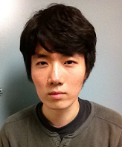

Office Hours
Giuseppe Carenini ( carenini@cs.ubc.ca; office CICSR 105)
Teaching Assistants (X150 Learning Center)
Nathan Tomer ntomer@cs.ubc.ca
Tatsuro Oya toya@cs.ubc.ca
Seyed M. Kazemi smkazemi@cs.ubc.ca
Notes:
Nathaniel Tomer ntomer@cs.ubc.ca Fri 11am, X150 (Learning Center)
Tatsuro Oya toya@cs.ubc.ca Wed 11am, X150 (Learning Center)
Seyed Mehran Kazemi smkazemi@cs.ubc.ca ?Mon 11am?, TBA, X150 (Learning Center)

Slide 3
Colored Cards
You need to have 4 colored index cards
  Come and get them from me if you still don’t have them
You will use these as voting cards
  Cheap low tech variant of clickers
  Please bring them to class every time

Slide 4
“Deterministic agent” means an agent that
Has perfect knowledge of its environment
Has perfect knowledge of the effect that its actions can have on the environment
Both of the above
None of the above

Slide 5
“Deterministic agent” means an agent that
Has perfect knowledge of its environment
Has perfect knowledge of the effect that its actions can have on the environment
Both of the above
None of the above

Slide 6
Modules we'll cover in this course: R&Rsys
Environment
Deterministic
Stochastic
Problem
Arc Consistency
Constraint Satisfaction
Vars +
Constraints
Search
Static
Belief Nets
Query
Logics
Var. Elimination
Search
Sequential
Decision Nets
STRIPS
Var. Elimination
Planning
Search
Markov Processes
Representation
Value Iteration
Reasoning
Technique
Notes:
R&R Sys Representation and reasoning Systems
Each cell is a R&R system
STRIPS actions preconditions and effects

Slide 7
Lecture Overview
Simple Agent and Examples
Search Space Graph
Search Procedure

Slide 8
Simple Planning Agent
Deterministic, goal-driven agent
Agent is in a start state
Agent is given a goal (subset of possible states)
Environment changes only when the agent acts
Agent perfectly knows:
  what actions can be applied in any given state
  the state it is going to end up in when an action is applied in a given state
The sequence of actions and their appropriate ordering is the solution
Notes:
AI agents can be very complex and sophisticated
Let’s start from a very simple one
GOAL: study search, a basic method underlying many intelligent agents

Slide 9
Three examples
A delivery robot planning the route it will take in a bldg. to get from one room to another
Solving an 8-puzzle
Vacuum cleaner world
Notes:
As we have seen

Slide 10
Example1: Delivery Robot
Notes:
explicit state or features
Restate / justify that the following is true
Environment changes only when the agent acts
Agent can perfectly predict effect of its actions
Agent is given a goal

Slide 11
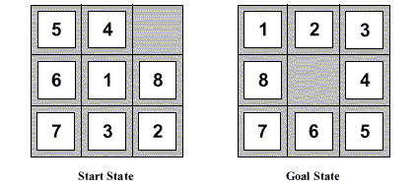
Eight Puzzle
States: each state specifies which number/blank occupies each of the 9 tiles
HOW MANY STATES ?
Operators: blank moves left, right, up down
Goal: configuration with numbers in right sequence
8⁹
2⁹
9⁹
9!

Slide 12
Eight Puzzle
States: each state specifies which number/blank occupies each of the 9 tiles
HOW MANY STATES ?
Operators: blank moves left, right, up down
Goal: configuration with numbers in right sequence
9!
Notes:
360 x 1000

Slide 13
Example 2: 8-Puzzle?
Possible start state
Goal state
Notes:
Restate / justify that the following is true
Environment changes only when the agent acts
Agent can perfectly predict effect of its actions
Agent is given a goal

Slide 14
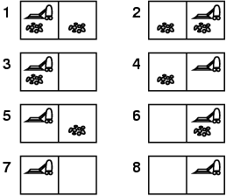
Example: vacuum world
States
  Two rooms: r1, r2
  Each room can be either dirty or not
  Vacuuming agent can be in either in r1 or r2
Possible start state
Possible goal state

Slide 15
Example: vacuum world
Possible start state
Goal state

Slide 16
…..
Suppose we have the same problem with k rooms.
The number of states is….
k³
k * 2k
k * 2^{k}
2 * k^{k}

Slide 17
…..
Suppose we have the same problem with k rooms.
The number of states is….
k * 2^{k}

Slide 18
Lecture Overview
Simple Agent and Examples
Search Space Graph
Search

Slide 19
How can we find a solution?
How can we find a sequence of actions and their appropriate ordering that lead to the goal?
Define underlying search space graph where nodes are states and edges are actions.
b4
o113
r113
o107
o109
o111
r107
r109
r111
Notes:
Check CIspace

Slide 20
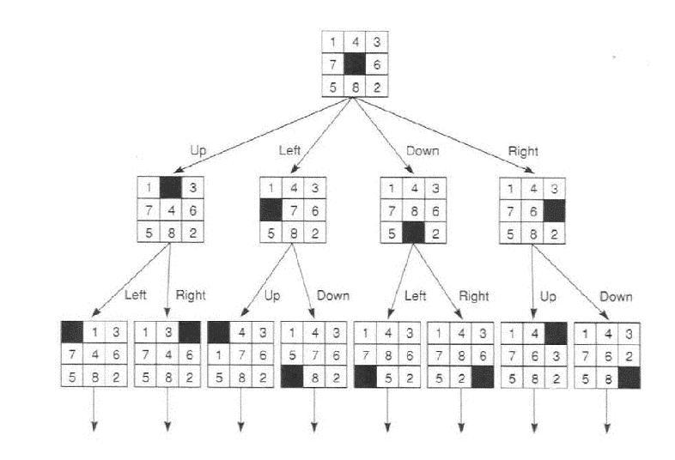
Search space for 8puzzle
Notes:
9 factorial = 362880 states

Slide 21
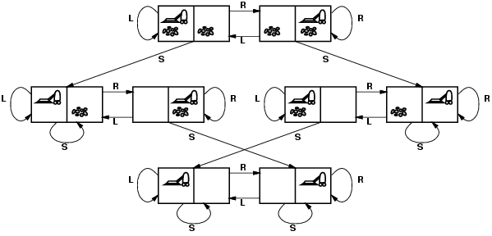
Vacuum world: Search space graph
states? Where it is dirty and robot location
actions? Left, Right, Suck
Possible goal test? no dirt at all locations
Notes:
States if the world had n locations?
Some simplifications wrt real world
Discrete location
Discrete dirt
Reliable cleaning
Room never gets messed up once cleaned

Slide 22
Lecture Overview
Simple Agent and Examples
State Space Graph
Search Procedure

Slide 23
Search: Abstract Definition
How to search
Start at the start state
Consider the effect of taking different actions starting from states that have been encountered in the search so far
Stop when a goal state is encountered
To make this more formal, we'll need review the formal definition of a graph...

Slide 24
Search Graph
A graph consists of a set N of nodes and a set A of ordered pairs of nodes, called arcs.
Node n₂ is a neighbor of n₁ if there is an arc from n₁ to n₂. That is, if ⟨ n₁, n₂ ⟩ ∈ A.
A path is a sequence of nodes n₀, n₁, n₂ ,.., n_{k} such that ⟨ n_{i-1}, n_{i} ⟩ ∈ A.
A cycle is a non-empty path such that the start node is the same as the end node
A directed acyclic graph (DAG) is a graph with no cycles
Given a start node and goal nodes, a solution is a path from a start node to a goal node.
Notes:
Many problem solving problems tasks can be transformed into the problem of finding paths in a graph. Searching in a graph is an appropriate level of abstraction that allows one to study search independently from the task domain

Slide 25
Examples for graph formal def.
a
b
c
d
e
f
g
h
i
j
k
l
n
Notes:
OLD example
Search Space:
neighbors(o103, [ts, l2d3, o109])
neighbors(ts, [mail])
neighbors(mail, [])
neighbors(o109, [o111, o119])
neighbors(o111, [])
neighbors(storage, [])
.
.
.
Goal: is_goal(r123)
Start: is_start(o103).

Slide 26
Examples of solution
Start state b4, goal r113
Solution <b4, o107, o109, o113, r113>
b4
o113
r113
o107
o109
o111
r107
r109
r111
Notes:
Check CIspace
There are many other solutions! But of lesser quality

Slide 27
Graph Searching
Generic search algorithm: given a graph, start node, and goal node(s), incrementally explore paths from the start node(s).
Maintain a frontier of paths from the start node that have been explored.
As search proceeds, the frontier expands into the unexplored nodes until (hopefully!) a goal node is encountered.
The way in which the frontier is expanded defines the search strategy.

Slide 28
Generic Search Algorithm
Input: a graph, a start node, Boolean procedure goal(n) that tests if n is a goal node
frontier:= [<s>: s is a start node];
While frontier is not empty:
select and remove path <n_{o},….,n_{k}> from frontier;
If goal(n_{k})
return <n_{o},….,n_{k}>;
  For every neighbor n of n_{k}
  add <n_{o},….,n_{k}, n> to frontier;
end
Notes:
Show simplestExample in AIspace USE FINE STEP

Slide 29
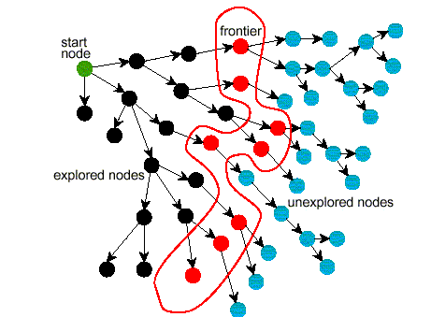
Problem Solving by Graph Searching
Ends of frontier
Notes:
MAKE TRANSPARENCY

Slide 30
Branching Factor
The forward branching factor of a node is the number of arcs going out of the node
The backward branching factor of a node is the number of arcs going into the node
If the forward branching factor of any node is b and the graph is a tree, how many nodes are n steps away from a node?
nb
b^{n}
n^{b}
n/b

Slide 31
Lecture Summary
Search is a key computational mechanism in many AI agents
We will study the basic principles of search on the simple deterministic planning agent model
Generic search approach:
  define a search space graph,
  start from current state,
  incrementally explore paths from current state until goal state is reached.
The way in which the frontier is expanded defines the search strategy.

Slide 32
Learning Goals for today’s class
Identify real world examples that make use of deterministic, goal-driven planning agents
Assess the size of the search space of a given search problem.
Implement the generic solution to a search problem.

Slide 33
Next class (Fri)
Uninformed search strategies
(read textbook Sec. 3.5)
First Practice Exercise 3.A
http://www.aispace.org/exercises.shtml

