Slide 1
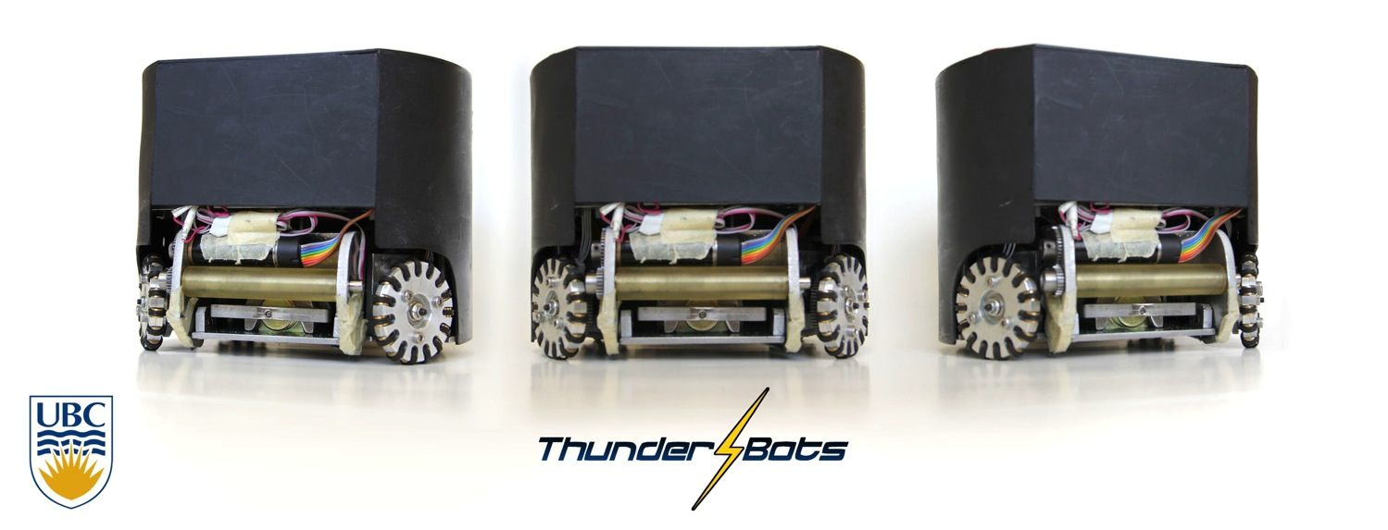
UBC Thunderbots

Slide 2
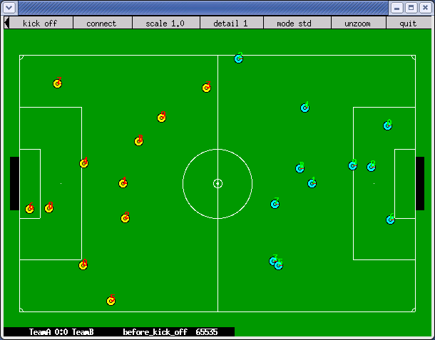
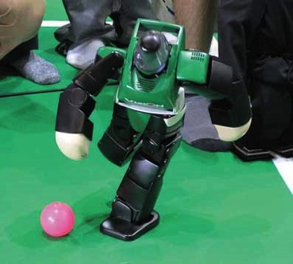
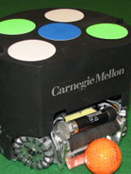
What Is RoboCup?
“ International research and education initiative...An attempt to foster AI and intelligent robotics research”
Est. 1997

Slide 3
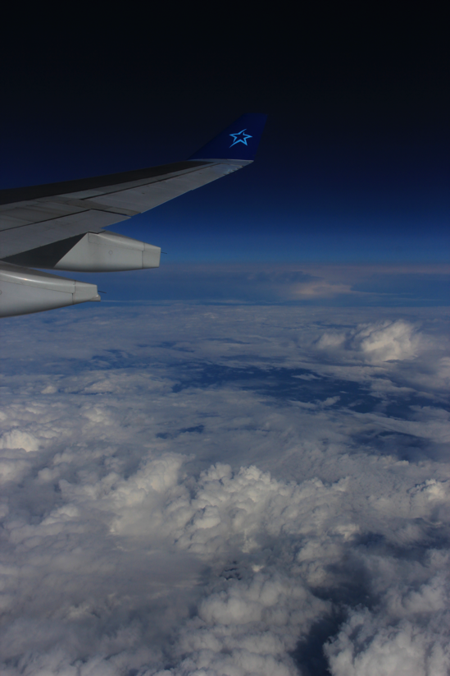
Competitions
Annual international competition
2009: Graz
2010: Singapore
2011: Istanbul
2012: Mexico City
2013: Eindhoven

Slide 4
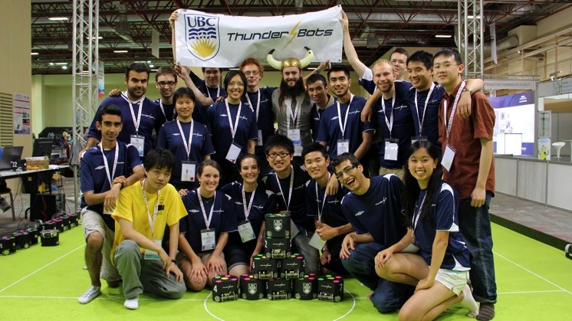
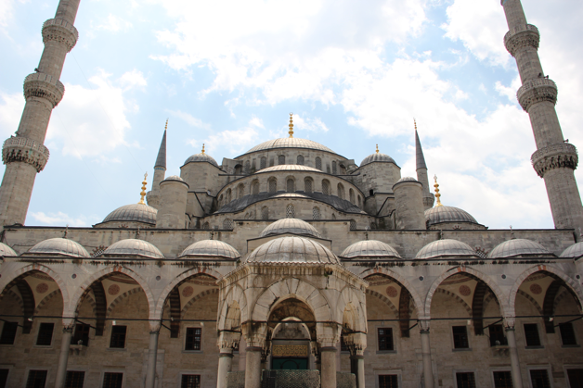
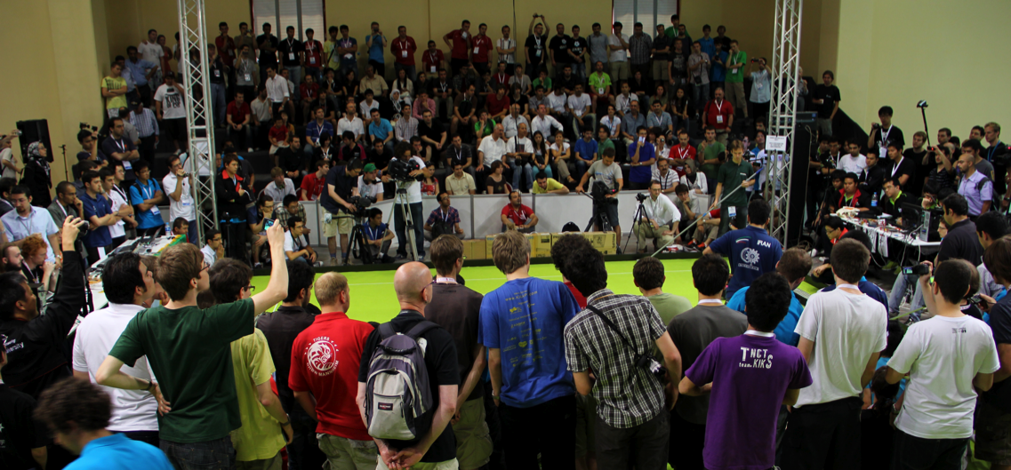
Istanbul, Turkey – 2011

Slide 5
Thunderbots FC
Robot Soccer
Fully Autonomous
Global Vision
Centralized Intel.
Local Sensing and Control
Fast-Paced

Slide 6
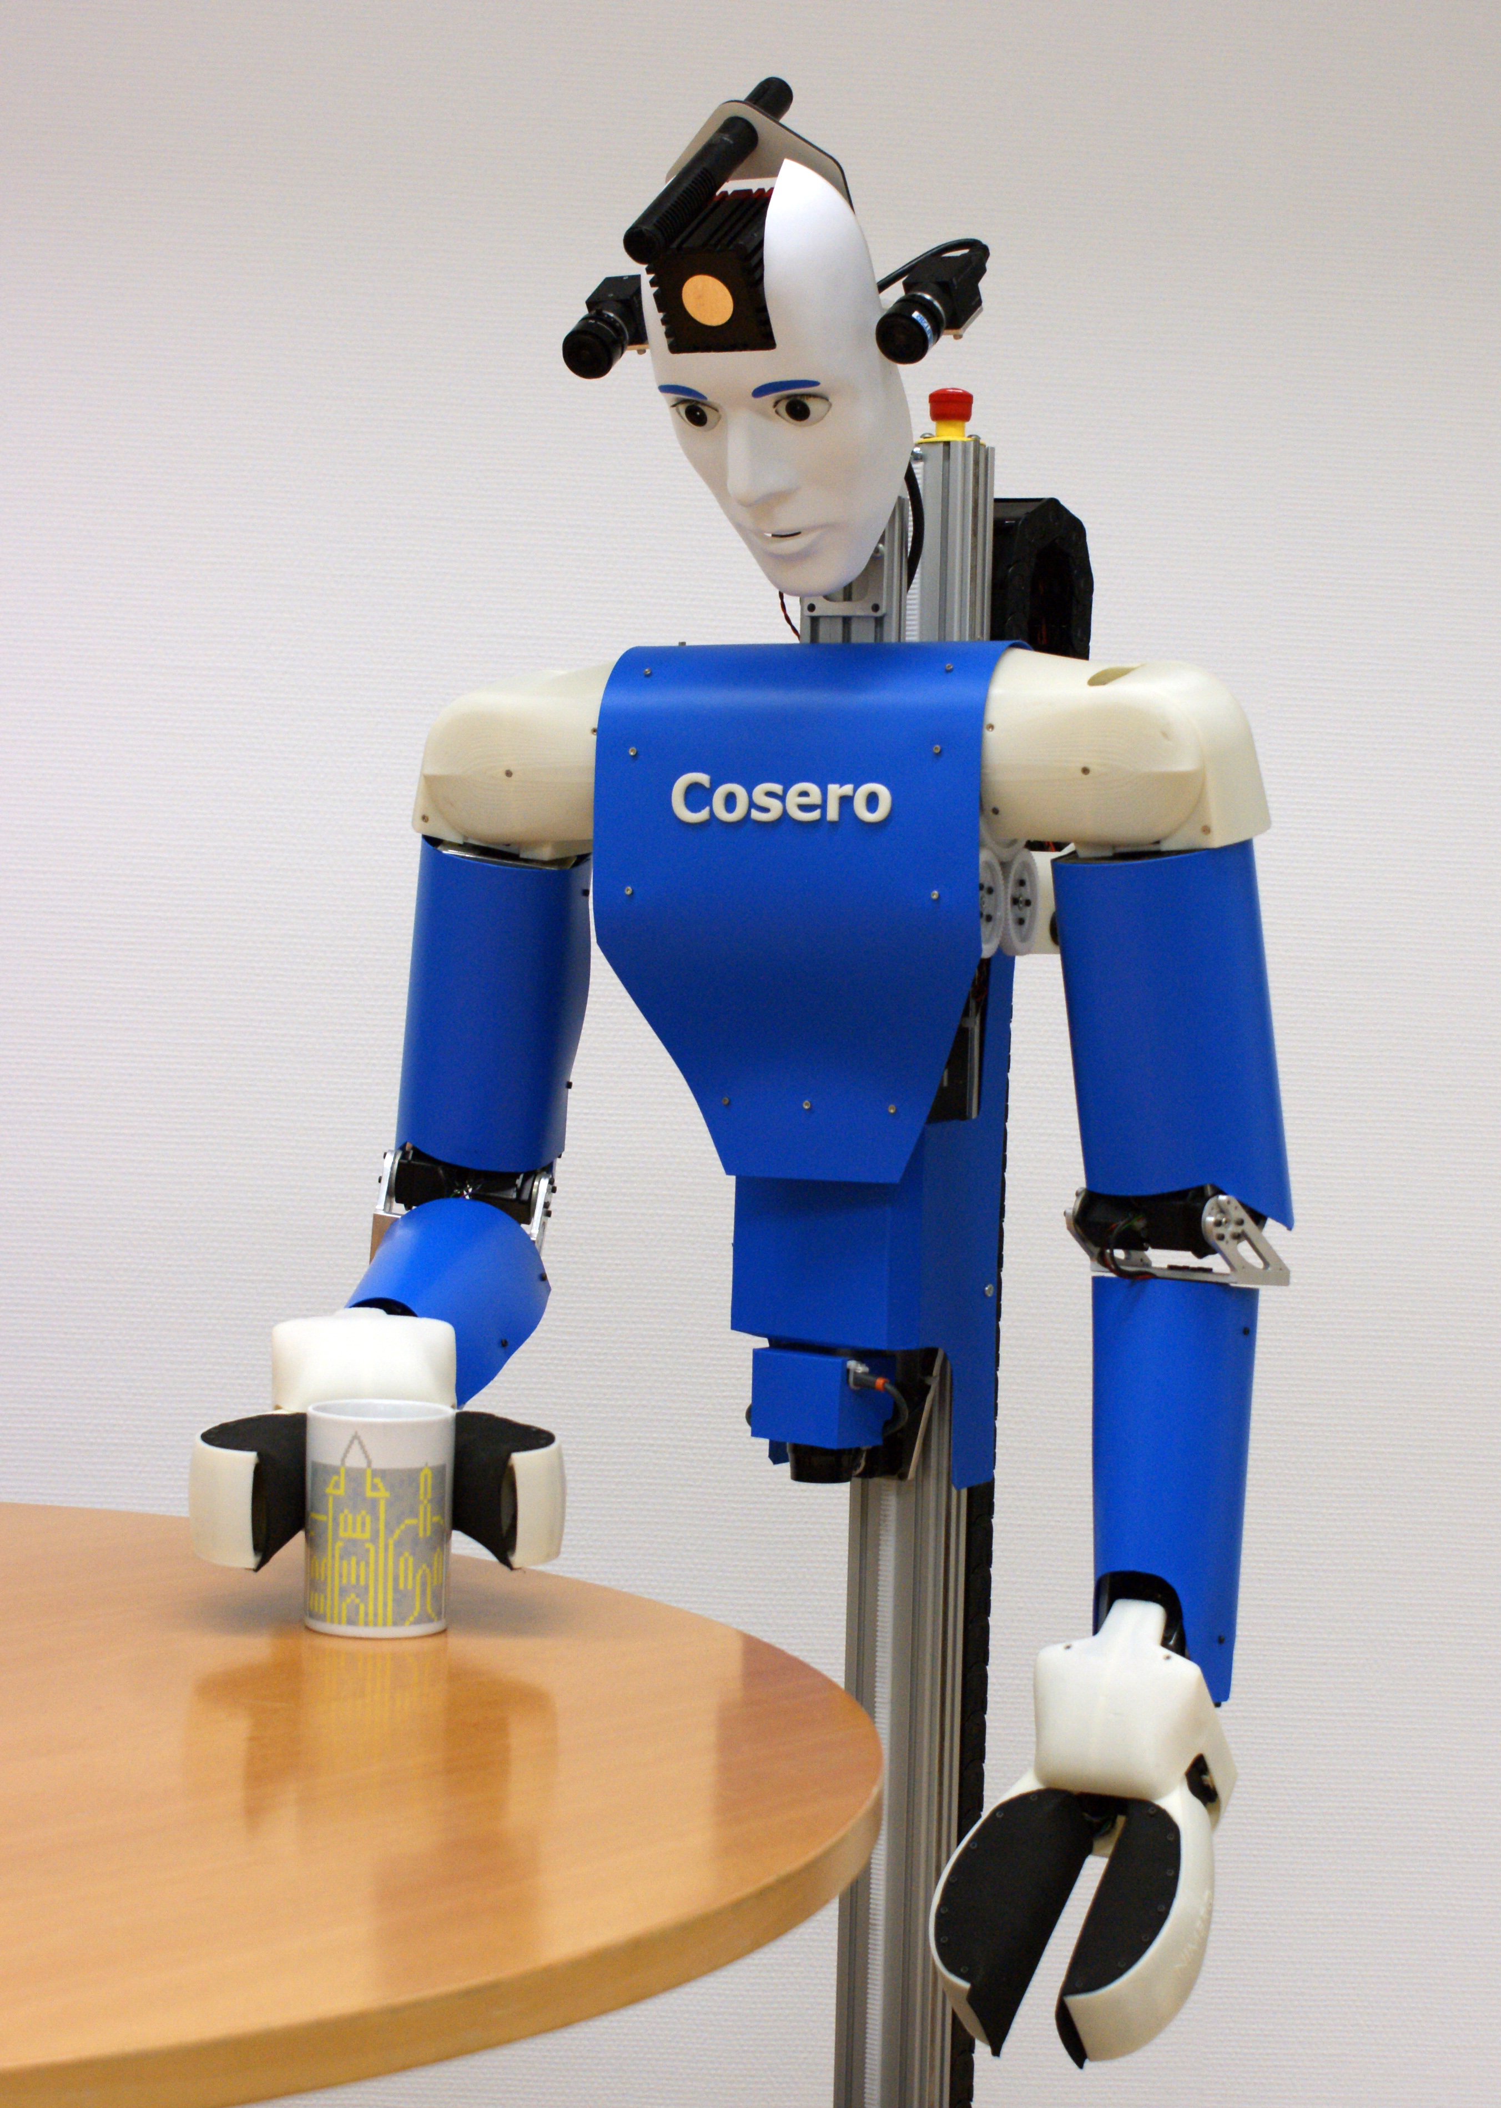
Thunderbots@Home

Slide 7
Thunderbots Simulation

Slide 8
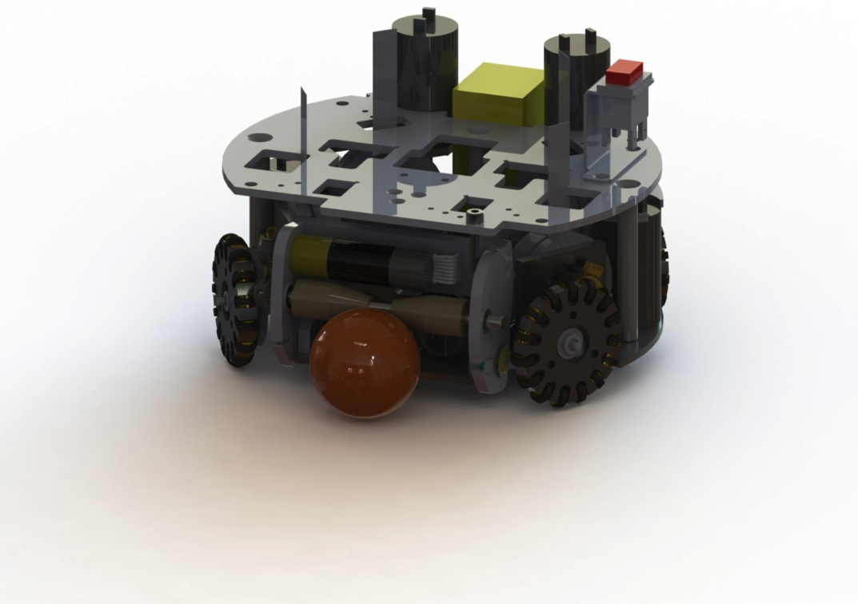
Mechanical Team
Notes:
Design Process
Design for Manufacturing
Tolerance considerations
Solidworks
Lathing
Milling
Water-jetting
Drilling
Etc...
Scheduling
Budgeting
Communication
Interdisciplinary team work
International outsourcing
Working with Machine shops
Product Costing

Slide 9
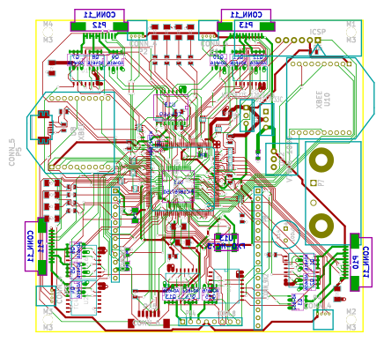
Electrical Team

Slide 10
Software Team

Slide 11
Who joins Thunderbots?
Mechanical
Mechatronics
ECE
Eng. Phys.
Commerce
IGEN
Materials
Mining
Computer Science
Graphic Artists
“Hardworking individuals who want to learn and apply engineering principles.”

Slide 12
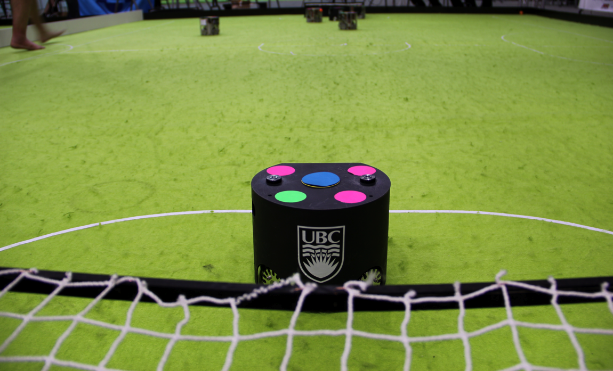
Where do I sign up!
www.ubcthunderbots.ca/join
info@ubcthunderbots.ca

