Slide 1
Arc Consistency and
Domain Splitting in CSPs
CPSC 322 – CSP 3
Textbook Poole and Mackworth: § 4.5 and 4.6
Lecturer: Alan Mackworth
October 3, 2012

Slide 2
Lecture Overview
Solving Constraint Satisfaction Problems (CSPs)
  Recap: Generate & Test
  Recap: Graph search
Arc consistency
  GAC algorithm
  Complexity analysis
  Domain splitting

Slide 3
Constraint Satisfaction Problems (CSPs): Definition
Definition:
A constraint satisfaction problem (CSP) consists of:
  a set of variables V
  a domain dom(V) for each variable V ∈V
  a set of constraints C
Definition:
A possible world of a CSP is an assignment of
values to all of its variables.
Definition:
A model of a CSP is a possible world that satisfies all constraints.
An example CSP:
V = {V₁,V₂}
  dom(V₁) = {1,2,3}
  dom(V₂) = {1,2}
C = {C₁,C₂,C₃}
  C₁: V₂ ≠ 2
  C₂: V₁ + V₂ < 5
  C₃: V₁ > V₂
Possible worlds for this CSP:
{V₁=1, V₂=1}
{V₁=1, V₂=2}
{V₁=2, V₂=1} (one model)
{V₁=2, V₂=2}
{V₁=3, V₂=1} (another model)
{V₁=3, V₂=2}

Slide 4
Generate and Test (G&T) Algorithms
Generate and Test:
  Generate possible worlds one at a time.
  Test constraints for each one.
Example: 3 variables A,B,C
Simple, but slow:
  k variables, each domain size d, c constraints: O(cd^{k})
For a in dom(A)
For b in dom(B)
For c in dom(C)
if {A=a, B=b, C=c} satisfies all constraints
return {A=a, B=b, C=c}
fail

Slide 5
Lecture Overview
Solving Constraint Satisfaction Problems (CSPs)
  Recap: Generate & Test
  Recap: Graph search
Arc consistency
  GAC algorithm
  Complexity analysis
  Domain splitting

Slide 6
Backtracking algorithms
Explore search space via DFS but evaluate each constraint as soon as all its variables are bound.
Any partial assignment that doesn’t satisfy the constraint can be pruned.
Example:
  3 variables A, B,C, each with domain {1,2,3,4}
  {A = 1, B = 1} is inconsistent with constraint A ≠ B
  regardless of the value of the other variables
    ⇒ Fail. Prune!

Slide 7
CSP as Graph Searching
Check unary constraints on V₁
If not satisfied ⇒ PRUNE
{}
V₁ = v₁
V₁ = v_{k}
Check constraints on V₁
and V₂ If not satisfied
⇒ PRUNE
V₁ = v₁
V₂ = v_{k}
V₁ = v₁
V₂ = v₁
V₁ = v₁
V₂ = v₂
V₁ = v₁
V₂ = v₁
V₃ = v₁
V₁ = v₁
V₂ = v₁
V₃ = v₂

Slide 8
Standard Search vs. Specific R&R systems
Constraint Satisfaction (Problems):
  State: assignments of values to a subset of the variables
  Successor function: assign values to a ‘free’ variable
  Goal test: all variables assigned a value and all constraints satisfied?
  Solution: possible world that satisfies the constraints
  Heuristic function: none (all solutions at the same distance from start)
Planning :
  State
  Successor function
  Goal test
  Solution
  Heuristic function
Inference
  State
  Successor function
  Goal test
  Solution
  Heuristic function

Slide 9
CSP as Graph Searching
Check unary constraints on V₁
If not satisfied ⇒ PRUNE
{}
V₁ = v₁
V₁ = v_{k}
Check constraints on V₁
and V₂ If not satisfied
⇒ PRUNE
V₁ = v₁
V₂ = v_{k}
V₁ = v₁
V₂ = v₁
V₁ = v₁
V₂ = v₂
V₁ = v₁
V₂ = v₁
V₃ = v₁
V₁ = v₁
V₂ = v₁
V₃ = v₂
Problem?
Performance heavily depends
on the order in which variables are considered.
E.g. only 2 constraints:
V_{n}=V_{n-1} and V_{n}≠ V_{n-1}

Slide 10
CSP as a Search Problem: another formulation
States: partial assignment of values to variables
Start state: empty assignment
Successor function: states with the next variable assigned
  Assign any previously unassigned variable
  A state assigns values to some subset of variables:
    E.g. {V₇ = v_{1,} V₂ = v₁, V₁₅ = v₁}
    Neighbors of node {V₇ = v_{1,} V₂ = v₁, V₁₅ = v₁}:
    nodes {V₇ = v_{1,} V₂ = v₁, V₁₅ = v₁, V_{x} = y}
    for some variable V_{x} ∈V \ {V₇, V₂, V₁₅} and all values y∈dom(V_{x})
Goal state: complete assignments of values to variables that satisfy all constraints
  That is, models
Solution: assignment (the path doesn’t matter)

Slide 11
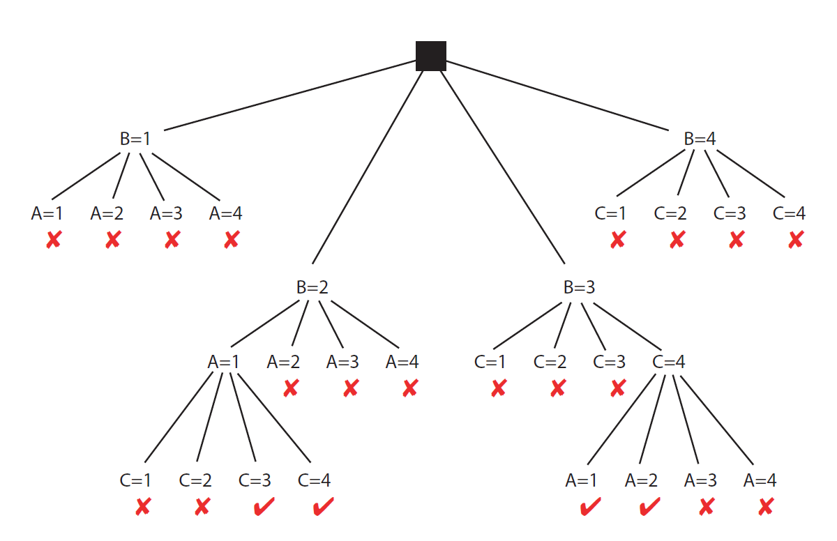
CSP as Graph Searching
3 Variables: A,B,C. All with domains = {1,2,3,4}
Constraints: A<B, B<C

Slide 12
Selecting variables in a smart way
Backtracking relies on one or more heuristics to select which variables to consider next.
  E.g. variable involved in the largest number of constraints: “If you are going to fail on this branch, fail early!”
  Can also be smart about which values to consider first
This is a different use of the word ‘heuristic’!
  Still true in this context
    Can be computed cheaply during the search
    Provides guidance to the search algorithm
  But not true anymore in this context
    ‘Estimate of the distance to the goal’
Both meanings are used frequently in the AI literature.
‘heuristic’ means ‘serves to discover’: goal-oriented.
Does not mean ‘unreliable’!

Slide 13
Learning Goals for solving CSPs so far
Verify whether a possible world satisfies a set of constraints
i.e. whether it is a model - a solution.
Implement the Generate-and-Test Algorithm.
Explain its disadvantages.
Solve a CSP by search (specify neighbors, states, start state, goal state). Compare strategies for CSP search. Implement pruning for DFS search in a CSP.

Slide 14
Lecture Overview
Solving Constraint Satisfaction Problems (CSPs)
  Recap: Generate & Test
  Recap: Graph search
Arc consistency
  GAC algorithm
  Complexity analysis
  Domain splitting

Slide 15
Can we do better than Search?
  Key idea
prune the domains as much as possible before searching for a solution.
Example: dom(V₂) = {1, 2, 3, 4}. V₂ ≠ 2
Variable V₂ is not domain consistent.
  It is domain consistent once we remove 2 from its domain.
Trivial for unary constraints. Trickier for k-ary ones.
Def.: A variable is domain consistent if no value of its domain is ruled impossible by any unary constraints.

Slide 16
Graph Searching Repeats Work
3 Variables: A,B,C. All with domains = {1,2,3,4}
Constraints: A<B, B<C
A ≠ 4 is rediscovered 3 times. So is C ≠ 1
  Solution: remove values from A’s domain and C’s, once and for all

Slide 17
Constraint network: definition
Example:
  Two variables X and Y
  One constraint: X<Y
Def. A constraint network is defined by a graph, with
  one node for every variable (drawn as circle)
  one node for every constraint (drawn as rectangle)
  undirected edges running between variable nodes and constraint nodes whenever a given variable is involved in a given constraint.
X
X< Y
Y

Slide 18
Constraint network: definition
Def. A constraint network is defined by a graph, with
  one node for every variable (drawn as circle)
  one node for every constraint (drawn as rectangle)
  Edges/arcs running between variable nodes and constraint nodes whenever a given variable is involved in a given constraint.
Whiteboard example: 3 Variables A,B,C
  3 Constraints: A<B, B<C, A+3=C
  6 edges/arcs in the constraint network:
    〈A,A<B〉 , 〈B,A<B〉
    〈B,B<C〉 , 〈C,B<C〉
    〈A, A+3=C〉 , 〈C,A+3=C〉

Slide 19
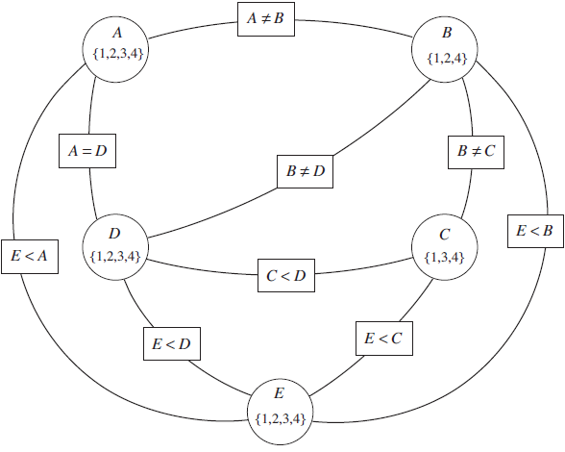
A more complicated example
How many variables are there in this constraint network?
  Variables are
  drawn as circles
How many
constraints
are there?
  Constraints are drawn as rectangles
5
6
9
14
5
6
9
14

Slide 20
Arc Consistency
      Definition:
      An arc <x, r(x,y)> is arc consistent if for each value x in dom(X) there is some value y in dom(Y) such that r(x,y) is satisfied.
      A network is arc consistent if all its arcs are arc consistent.
A
B
1,2,3
A< B
2,3
Not arc consistent:
No value in domain of B that satisfies A<B if A=3
Arc consistent: Both B=2 and B=3 have ok values for A (e.g. A=1)
Is this arc consistent?
T
F
T
F
A
B
2,5,7
A< B/2
2,3,13

Slide 21

How can we enforce Arc Consistency?
  If an arc <X, r(X,Y)> is not arc consistent
    Delete all values x in dom(X) for which there is no corresponding value in dom(Y)
    This deletion makes the arc <X, r(X,Y)> arc consistent.
      This removal can never rule out any models/solutions
        Why?
    Run this example: http://cs.ubc.ca/~mack/CS322/AIspace/simple-network.xml
    in ( (Save to a local file and open file.)
X
Y
2,3,4
X< Y
1,2,3

Slide 22
Lecture Overview
Solving Constraint Satisfaction Problems (CSPs)
  Recap: Generate & Test
  Recap: Graph search
Arc consistency
  GAC algorithm
  Complexity analysis
  Domain splitting

Slide 23
Arc Consistency Algorithm: high level strategy
Consider the arcs in turn, making each arc consistent
  Reconsider arcs that could be made inconsistent again by this pruning of the domains
Eventually reach a ‘fixed point’: all arcs consistent
Run ‘simple problem 1’ in AIspace for an example:

Slide 24
Which arcs need to be reconsidered?
When we reduce the domain of a variable X to make an arc ⟨X,c⟩ arc consistent, which arcs do we need to reconsider?
You do not need to reconsider other arcs
  If arc ⟨Y,c⟩ was arc consistent before, it will still be arc consistent
  If an arc ⟨X,c'⟩ was arc consistent before, it will still be arc consistent
  Nothing changes for arcs of constraints not involving X
every arc ⟨Z,c'⟩ where c’ ≠ c involves Z and X:
Z₁
T
H
E
S
E
c₁
Z₂
X
c
Y
c₂
Z₃
c₃
c₄
A

Slide 25
Which arcs need to be reconsidered?
Consider the arcs in turn, making each arc consistent
  Reconsider arcs that could be made inconsistent again by this pruning
DO trace on ‘simple problem 1’ and on
‘scheduling problem 1’, trying to predict
which arcs are not consistent and
which arcs need to be reconsidered after each removal
in

Slide 26
Arc consistency algorithm (for binary constraints)
Procedure GAC(V,dom,C)
Inputs
V: a set of variables
dom: a function such that dom(X) is the domain of variable X
C: set of constraints to be satisfied
Output
arc-consistent domains for each variable
Local
D_{X} is a set of values for each variable X
TDA is a set of arcs
1: for each variable X do
2: D_{X} ←dom(X)
3: TDA ←{〈X,c〉| X ∈ V, c ∈ C and X ∈ scope(c)}
4: while (TDA ≠ {})
5: select 〈X,c〉 ∈TDA
6: TDA ←TDA \ {〈X,c〉}
7: ND_{X} ←{x| x ∈ D_{X} and ∃ y ∈ D_{Y} s.t. (x, y) satisfies c}
8: if (ND_{X} ≠ D_{X}) then
9: TDA ←TDA ∪ { 〈Z,c'〉 | X ∈ scope(c'), c' ≠ c, Z ∈ scope(c') \ {X} }
10: D_{X} ←ND_{X}
11: return {D_{X}| X is a variable}
Scope of constraint c is the set of variables involved in that constraint
TDA:
ToDoArcs,
blue arcs
in AIspace
X’s domain changed:
⇒ arcs (Z,c’) for variables Z sharing a
constraint c’ with X could become inconsistent
ND_{X}: values x for X for which there a value for y supporting x

Slide 27
Arc Consistency Algorithm: Interpreting Outcomes
Three possible outcomes
(when all arcs are arc consistent):
  Each domain has a single value, e.g.
    http://www.cs.ubc.ca/~mack/CS322/AIspace/simple-network.xml
    (Download the file and load it as a local file in AIspace)
    We have a (unique) solution.
  At least one domain is empty, e.g.
    http://www.cs.ubc.ca/~mack/CS322/AIspace/simple-infeasible.xml
    No solution! All values are ruled out for this variable.
  Some domains have more than one value, e.g.
  built-in example “simple problem 2”
    There may be a solution, multiple ones, or none
    Need to solve this new CSP (usually simpler) problem:
    same constraints, domains have been reduced
Notes:
Otherwise, split a domain & apply arc consistency to each case.
Spiltting in half the variable with the smallest domain usually works best (who know why)
ACC: Show with Cispace, first “scheduling problem”, and then crossword 1 for splitting. What makes sense is to split the node with 6 vars to the right, show that it gets to an empty solution, backtrack, and do more s0plitting on the var with 2 values on the top-left. Done. WENT WELL

Slide 28
Lecture Overview
Solving Constraint Satisfaction Problems (CSPs)
  Recap: Generate & Test
  Recap: Graph search
Arc consistency
  GAC algorithm
  Complexity analysis
  Domain splitting

Slide 29
Arc Consistency Algorithm: Complexity
Worst-case complexity of arc consistency procedure on a problem with N variables
  let d be the max size of a variable domain
  let c be the number of constraints
  How often will we prune the domain
  of variable V? O(d) times
  How many arcs will be put on the
  ToDoArc list when pruning domain of variable V?
    O(degree of variable V)
    In total, across all variables: sum of degrees of all variables =
      2*number of constraints, i.e. 2*c
  Together: we will only put O(dc) arcs on the ToDoArc list
  Checking consistency is O(d²) for each of them
Overall complexity: O(cd³)
Compare to O(d^{N}) of DFS!! Arc consistency is MUCH faster
Notes:
Every time a domain value is removed
Some special cases are faster
e.g., if the constraint graph is a tree, arc consistency is O(ed)
I DO NOT THINK SO
It is linear in the number of variables n (not quadratic as the general case) check with David and Kevin

Slide 30
Lecture Overview
Solving Constraint Satisfaction Problems (CSPs)
  Recap: Generate & Test
  Recap: Graph search
Arc consistency
  GAC algorithm
  Complexity analysis
  Domain splitting

Slide 31
Can we have an arc consistent network with non-empty domains that has no solution?
YES
NO
Example: vars A, B, C with domain {1, 2} and constraints A ≠ B, B ≠ C, A ≠ C
Or see AIspace CSP applet Simple Problem 2
Notes:
Otherwise, split a domain & apply arc consistency to each case.
Spiltting in half the variable with the smallest domain usually works best (who know why)
ACC: Show with Cispace, first “scheduling problem”, and then crossword 1 for splitting. What makes sense is to split the node with 6 vars to the right, show that it gets to an empty solution, backtrack, and do more s0plitting on the var with 2 values on the top-left. Done. WENT WELL

Slide 32
Domain splitting (or case analysis)
Arc consistency ends: Some domains have more than one value → may or may not have a solution
  Apply Depth-First Search with Pruning or
  Split the problem in a number of disjoint cases:
  CSP with dom(X) = {x₁, x₂, x₃, x₄} becomes
  CSP₁ with dom(X) = {x₁, x₂} and
  CSP₂ with dom(X) = {x₃, x₄}
Solution to CSP is the union of solutions to CSP_{i}
Notes:
Otherwise, split a domain & apply arc consistency to each case.
Spiltting in half the variable with the smallest domain usually works best (who know why)
ACC: Show with Cispace, first “scheduling problem”, and then crossword 1 for splitting. What makes sense is to split the node with 6 vars to the right, show that it gets to an empty solution, backtrack, and do more s0plitting on the var with 2 values on the top-left. Done. WENT WELL

Slide 33
Domain splitting
Each smaller CSP is easier to solve
  Arc consistency might already solve it
For each subCSP, which arcs have to be on the ToDoArcs list when we get the subCSP by splitting the domain of X?
  arcs <Z, r(Z,X)>
  arcs <Z, r(Z,X)> and <X, r(Z,X)>
All arcs
A₁
T
H
E
S
E
c₁
T
H
IS
A₂
X
c
Y
c₂
A₃
c₃
c₄
A

Slide 34
Domain splitting in action
Trace it on “simple problem 2”

Slide 35
Searching by domain splitting
CSP, apply AC
If domains with multiple values
Split on one
CSP₁, apply AC
CSP₂, apply AC
If domains with multiple values
Split on one
If domains with multiple values…..Split on one
How many CSPs do we need to keep around at a time?
With depth m and 2 children at each split: O(2m). It’s a DFS.
Notes:
Combining Arc Consistency and
Domain Splitting
Otherwise, split a domain & apply arc consistency to each case.
Spiltting in half the variable with the smallest domain usually works best (who know why)
ACC: Show with Cispace, first “scheduling problem”, and then crossword 1 for splitting. What makes sense is to split the node with 6 vars to the right, show that it gets to an empty solution, backtrack, and do more s0plitting on the var with 2 values on the top-left. Done. WENT WELL

Slide 36
Learning Goals for today’s class
Define/read/write/trace/debug the arc consistency algorithm. Compute its complexity and assess its possible outcomes
Define/read/write/trace/debug domain splitting and its integration with arc consistency
Coming up: local search, Section 4.8

