Slide 1
Solving Constraint Satisfaction Problems (CSPs) using Search
CPSC 322 – CSP 2
Textbook Poole and Mackworth: Sections §4.3-4.4
Lecturer: Alan Mackworth
October 1, 2012

Slide 2
Lecture Overview
Constraint Satisfaction Problems (CSPs): Definition and Recap
CSPs: Motivation
Solving CSPs
Generate & Test
Graph search

Slide 3
Course Overview
Course Module
Representation
Environment
Reasoning
Technique
Deterministic
Stochastic
Problem Type
Arc
Consistency
Constraint Satisfaction
Variables +
Constraints
Search
Static
Bayesian Networks
Logic
Logics
Search
Variable Elimination
Uncertainty
Sequential
Decision Networks
STRIPS
Planning
Variable Elimination
Decision
Theory
Planning
Search
Now focus on CSPs
Markov Processes
Value Iteration

Slide 4
Standard Search vs. CSP
First studied general state space search in isolation
Standard search problem: search in a state space
State is a “black box” - any arbitrary data structure that supports three problem-specific routines:
goal test: goal(state)
finding successor nodes: neighbors(state)
if applicable, heuristic evaluation function: h(state)
We’ll see more specialized versions of search for various problems

Slide 5
Search in Specific R&R Systems
Constraint Satisfaction Problems:
State
Successor function
Goal test
Solution
Heuristic function
Planning :
State
Successor function
Goal test
Solution
Heuristic function
Inference
State
Successor function
Goal test
Solution
Heuristic function

Slide 6
Constraint Satisfaction Problems (CSPs): Definition
Definition: A constraint satisfaction problem (CSP) consists of:
a set of variables V
a domain dom(V) for each variable V ∈V
a set of constraints C
Simple example:
V = {V₁}
dom(V₁) = {1,2,3,4}
C = {C₁,C₂}
C₁: V₁ ≠ 2
C₂: V₁ > 1
Another example:
V = {V₁,V₂}
dom(V₁) = {1,2,3}
dom(V₂) = {1,2}
C = {C₁,C₂,C₃}
C₁: V₂ ≠ 2
C₂: V₁ + V₂ < 5
C₃: V₁ > V₂

Slide 7
Constraint Satisfaction Problems (CSPs): Definition
Definition: A constraint satisfaction problem (CSP) consists of:
a set of variables V
a domain dom(V) for each variable V ∈V
a set of constraints C
Definition:
A model of a CSP is an assignment of values to all of its variables that satisfies all of its constraints.
Simple example:
V = {V₁}
dom(V₁) = {1,2,3,4}
C = {C₁,C₂}
C₁: V₁ ≠ 2
C₂: V₁ > 1
All models for this CSP:
{V₁ = 3}
{V₁ = 4}

Slide 8
Constraint Satisfaction Problems (CSPs): Definition
Definition: A constraint satisfaction problem (CSP) consists of:
a set of variables V
a domain dom(V) for each variable V ∈V
a set of constraints C
Definition:
A model of a CSP is an assignment of values to all of its variables that satisfies all of its constraints.
Another example:
V = {V₁,V₂}
dom(V₁) = {1,2,3}
dom(V₂) = {1,2}
C = {C₁,C₂,C₃}
C₁: V₂ ≠ 2
C₂: V₁ + V₂ < 5
C₃: V₁ > V₂
Which are models for this CSP?
{V₁=1, V₂=1}
{V₁=2, V₂=1}
{V₁=3, V₂=1}
{V₁=3, V₂=2}

Slide 9
Possible Worlds
Definition:
A possible world of a CSP is an assignment of values to all of its variables.
i.e. a model is a possible world that satisfies all constraints
Definition:
A model of a CSP is an assignment of values to all of its variables that satisfies all of its constraints.
Another example:
V = {V₁,V₂}
dom(V₁) = {1,2,3}
dom(V₂) = {1,2}
C = {C₁,C₂,C₃}
C₁: V₂ ≠ 2
C₂: V₁ + V₂ < 5
C₃: V₁ > V₂
Possible worlds for this CSP:
{V₁=1, V₂=1} {V₁=1, V₂=2} {V₁=2, V₂=1} (a model)
{V₁=2, V₂=2}
{V₁=3, V₂=1} (a model)
{V₁=3, V₂=2}

Slide 10
Constraints
Constraints are restrictions on the values that one or more variables can take
Unary constraint: restriction involving a single variable
E.g.: V₂ ≠ 2
k-ary constraint: restriction involving k different variables
E.g. binary (k=2): V₁ + V₂ < 5
E.g. 3-ary: V₁ + V₂ + V₄ < 5
We will mostly deal with binary constraints
Constraints can be specified by
listing all combinations of valid domain values for the variables participating in the constraint
E.g. for constraint V₁ > V₂ and dom(V₁) = {1,2,3} and dom(V₂) = {1,2}:
giving a function (predicate) that returns true if given values for each variable which satisfy the constraint else false: V₁ > V₂
V₁ | V₂
2 | 1
3 | 1
3 | 2

Slide 11
Constraints
A possible world satisfies a set of constraints
if the values for the variables involved in each constraint are consistent with that constraint
They are elements of the list of valid domain values
Function returns true for those values
Examples
{V₁=1, V₂=1} (does not satisfy above constraint)
{V₁=3, V₂=1} (satisfies above constraint)
V₁ | V₂
2 | 1
3 | 1
3 | 2

Slide 12
Scope of a constraint
Definition:
The scope of a constraint is the set of variables that are involved in the constraint
Examples:
V₂ ≠ 2 has scope {V₂}
V₁ > V₂ has scope {V₁,V₂}
V₁ + V₂ + V₄ < 5 has scope {V₁,V₂,V₄}
How many variables are in the scope of a k-ary constraint ?
k variables

Slide 13
Finite Constraint Satisfaction Problem: Definition
Definition: A finite constraint satisfaction problem (FCSP) is a CSP with a finite set of variables and a finite domain for each variable.
We will only study finite CSPs here but many of the techniques carry over to countably infinite and continuous domains. We use CSP here to refer to FCSP.
The scope of each constraint is automatically finite since it is a subset of the finite set of variables.

Slide 14
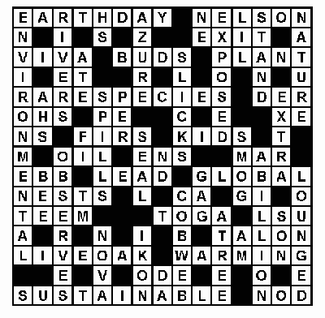
Examples: variables, domains, constraints
Crossword Puzzle:
variables are words that have to be filled in
domains are English words of correct length
(binary) constraints: words have the same
letters at cells where they intersect
Crossword 2:
variables are cells (individual squares)
domains are letters of the alphabet
k-ary constraints: sequences of letters form valid English words
(k= 2,3,4,5,6,7,8,9)

Slide 15
Examples: variables, domains, constraints
Sudoku
variables are cells
domain of each variable is {1,2,3,4,5,6,7,8,9}
constraints: rows, columns, boxes contain all different numbers
How many possible worlds are there? (say, 53 empty cells)
How many models are there in a typical Sudoku?
53*9
53⁹
9⁵³
About 2⁵³
1
9⁵³

Slide 16
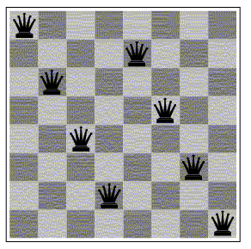
Examples: variables, domains, constraints
Scheduling Problem:
variables are different tasks that need to be scheduled (e.g., course in a university; job in a machine shop)
domains are the different combinations of times and locations for each task (e.g., time/room for course; time/machine for job)
constraints: tasks can't be scheduled in the same location at the same time; certain tasks can't be scheduled in different locations at the same time; some tasks must come earlier than others; etc.
n-Queens problem
variable: location of a queen on a chess board
there are n of them in total, hence the name
domains: grid coordinates
constraints: no queen can attack another

Slide 17
Constraint Satisfaction Problems: Variants
We may want to solve the following problems with a CSP:
determine whether or not a model exists
find a model
find all of the models
count the number of models
find the best model, given some measure of model quality
this is now an optimization problem
determine whether some property of the variables holds in all models

Slide 18
Solving Constraint Satisfaction Problems
Even the simplest problem of determining whether or not a model exists in a general CSP with finite domains is NP-hard
There is no known algorithm with worst case polynomial runtime.
We can't hope to find an algorithm that is polynomial for all CSPs.
However, we can try to:
find efficient (polynomial) consistency algorithms that reduce the size of the search space
identify special cases for which algorithms are efficient
work on approximation algorithms that can find good solutions quickly, even though they may offer no theoretical guarantees
find algorithms that are fast on typical (not worst case) cases

Slide 19
Lecture Overview
Constraint Satisfaction Problems (CSPs): Definition and Recap
Constraint Satisfaction Problems (CSPs): Motivation
Solving Constraint Satisfaction Problems (CSPs)
Generate & Test
Graph search

Slide 20
CSP/logic: formal verification
Hardware verification Software verification
(e.g., IBM) (small to medium programs)
Most progress in the last 10 years based on:
Encodings into propositional satisfiability (SAT)

Slide 21
The Propositional Satisfiability Problem (SAT)
Formula in propositional logic
i.e. it only contains propositional (Boolean) variables
Shorthand notation: x for X=true, and ¬x for X=false
Literal: x, ¬x
In so-called conjunctive normal form (CNF)
Conjunction of clauses (disjunctions of literals)
E.g., F = (x₁ ∨ x₂ ∨ x₃) ∧ (¬x₁ ∨ ¬x₂ ∨ ¬x₃) ∧ (¬x₁ ∨ ¬x₂ ∨ x₃)
Let’s write F as a CSP:
3 variables: X₁, X₂, X₃
Domains: for all variables {true, false}
Constraints (clauses):
(x₁ ∨ x₂ ∨ x₃)
(¬x₁ ∨ ¬x₂ ∨ ¬x₃)
(¬x₁ ∨ ¬x₂ ∨ x₃)
One of the models: X₁ = true, X₂ = false, X₃ = true

Slide 22
Importance of SAT
Similar problems as in CSPs
Decide whether F has a model
Find a model of F
First problem shown to be NP-hard problem (3-SAT)
One of the most important problems in theoretical computer science
Is there an efficient (i.e. worst-case polynomial) algorithm for SAT?
I.e., is NP = P?
SAT is a deceptively simple problem!
Important in practice: encodings of formal verification problems
Software verification: finding bugs in Windows etc.
Hardware verification: verify computer chips (IBM, Intel big players)

Slide 23
SAT Solvers
Building algorithms and software that perform well in practice
On the type of instances they face
Software and hardware verification instances
100,000s of variables, millions of constraints
Runtime: seconds!
But: there are classes of instances where current algorithms fail
International SAT competition (http://www.satcompetition.org/)
About 40 solvers from around the world compete, bi-yearly
Best solver in 2007 and 2009:
SATzilla: a SAT solver monster
(combines many other SAT solvers)
Lin Xu, Frank Hutter, Holger Hoos, and Kevin Leyton-Brown
(all from UBC)

Slide 24
Lecture Overview
Constraint Satisfaction Problems (CSPs): Definition and Recap
Constraint Satisfaction Problems (CSPs): Motivation
Solving Constraint Satisfaction Problems (CSPs)
Generate & Test
Graph search

Slide 25
Generate and Test (GT) Algorithms
Systematically check all possible worlds
Possible worlds: cross product of domains dom(V₁) × dom(V₂) × ... × dom(V_{n})
# possible worlds =
|dom(V₁)| × |dom(V₂)| × ... × |dom(V_{n})|
Generate and Test:
Generate possible worlds one at a time
Test constraints for each one.
Example: 3 variables A,B,C
For a in dom(A)
For b in dom(B)
For c in dom(C)
if {A=a, B=b, C=c} satisfies all constraints
return {A=a, B=b, C=c} %This possible world is a model
fail

Slide 26
Generate and Test (GT) Algorithms
If there are k variables, each with domain size d, and there are c constraints, the (worst-case time) complexity of Generate & Test is
There are d^{k} possible worlds
For each one need to check c constraints
O(ckd)
O(ck^{d})
O(cd^{k})
O(d^{ck})

Slide 27
Lecture Overview
Constraint Satisfaction Problems (CSPs): Definition and Recap
Constraint Satisfaction Problems (CSPs): Motivation
Solving Constraint Satisfaction Problems (CSPs)
Generate & Test
Graph search

Slide 28
CSP as a Search Problem: one formulation
States: partial assignment of values to variables
Start state: empty assignment
Successor function: states with the next variable assigned
E.g., follow a total order of the variables V₁, …, V_{n}
A state assigns values to the first k variables:
{V₁ = v₁,…,V_{k} = v_{k} }
Neighbors of node {V₁ = v₁,…,V_{k} = v_{k} }: nodes {V₁ = v₁,…,V_{k} = v_{k,} V_{k+1} = x} for each x ∈ dom(V_{k+1})
Goal state: complete assignments of values to variables that satisfy all constraints
That is, models
Solution: assignment {V₁ = v₁,…,V_{n} = v_{n} } (the path doesn’t matter)

Slide 29
Which search algorithm would be most appropriate for this formulation of CSP?
Depth First Search
Least Cost First Search
A *
None of the above

Slide 30
Relationship To Search
The path to a goal isn’t important, only the solution is
Heuristic function: “none”
All goals are at the same depth
CSP problems can be huge
Thousands of variables
Exponentially more search states
Exhaustive search is typically infeasible
Many algorithms exploit the structure provided by the goal ⇒ set of constraints, *not* black box

Slide 31
Backtracking algorithms
Explore search space via DFS but evaluate each constraint as soon as all its variables are bound.
Any partial assignment that doesn’t satisfy the constraint can be pruned.
Example:
3 variables A, B, C each with domain {1,2,3,4}
{A = 1, B = 1} is inconsistent with constraint A ≠ B regardless of the value of the other variables
⇒ Fail! Prune!

Slide 32
CSP as Graph Searching
Check unary constraints on V₁
If not satisfied = PRUNE
{}
V₁ = v₁
V₁ = v_{k}
Check constraints on V₁
and V₂ If not satisfied = PRUNE
V₁ = v₁
V₂ = v_{k}
V₁ = v₁
V₂ = v₁
V₁ = v₁
V₂ = v₂
V₁ = v₁
V₂ = v₁
V₃ = v₁
V₁ = v₁
V₂ = v₁
V₃ = v₂

Slide 33
CSP as Graph Searching
Check unary constraints on V₁
If not satisfied = PRUNE
{}
V₁ = v₁
V₁ = v_{k}
Check constraints on V₁
and V₂ If not satisfied = PRUNE
V₁ = v₁
V₂ = v_{k}
V₁ = v₁
V₂ = v₁
V₁ = v₁
V₂ = v₂
V₁ = v₁
V₂ = v₁
V₃ = v₁
V₁ = v₁
V₂ = v₁
V₃ = v₂
Problem?
Performance heavily depends
on the order in which variables are considered. E.g. only 2 constraints: V_{n}=V_{n-1} and V_{n}≠ V_{n-1}

Slide 34
CSP as a Search Problem: another formulation
States: partial assignment of values to variables
Start state: empty assignment
Successor function: states with the next variable assigned
Assign any previously unassigned variable
A state assigns values to some subset of variables:
E.g. {V₇ = v_{1,} V₂ = v₁, V₁₅ = v₁}
Neighbors of node {V₇ = v_{1,} V₂ = v₁, V₁₅ = v₁}: nodes {V₇ = v_{1,} V₂ = v₁, V₁₅ = v₁, V_{x} = y} for any variable V_{x} ∈V \ {V₇, V₂, V₁₅} and all values y∈dom(V_{x})
No fixed variable ordering for this search variant
Goal state: complete assignments of values to variables that satisfy all constraints
That is, models
Solution: assignment (the path doesn’t matter)

Slide 35
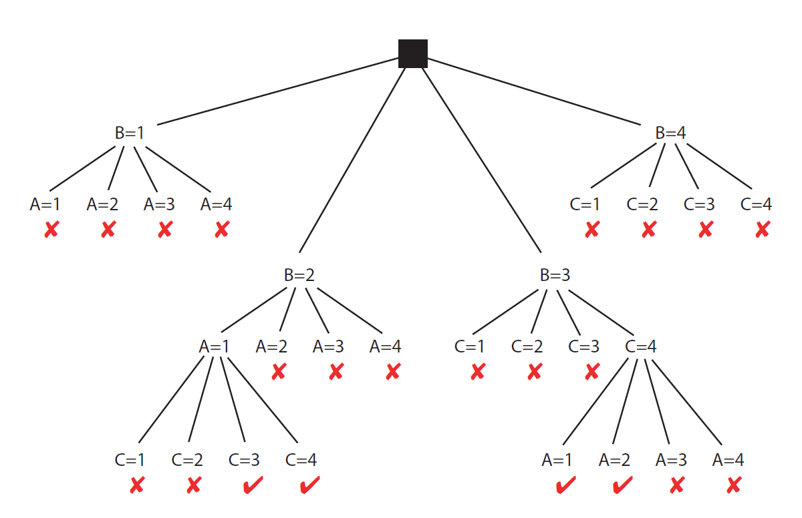
CSP Solving as Graph Searching
3 Variables: A,B,C. All with domains = {1,2,3,4}
Constraints: A<B, B<C

Slide 36
Selecting variables in a smart way
Backtracking relies on one or more heuristics to select which variable to consider next.
E.g, variable involved in the largest number of constraints: “If you are going to fail on this branch, fail early!”
Can also be smart about which values to consider first
This is a different use of the word ‘heuristic’!
Still true in this context
Can be computed cheaply during the search
Provides guidance to the search algorithm
But not true anymore in this context
‘Estimate of the distance to the goal’
Both meanings are used frequently in the AI literature.
‘heuristic’ means ‘serves to discover’: goal-oriented.
Does not mean ‘unreliable’!

Slide 37
Standard Search vs. Specific R&R systems
Constraint Satisfaction (Problems):
State: assignments of values to a subset of the variables
Successor function: assign values to a “free” variable
Goal test: all variables assigned a value and all constraints satisfied?
Solution: possible world that satisfies the constraints
Heuristic function: none (all solutions at the same distance from start)
Planning :
State
Successor function
Goal test
Solution
Heuristic function
Inference
State
Successor function
Goal test
Solution
Heuristic function

Slide 38
Learning Goals for today’s class
Define possible worlds in term of variables and their domains
Compute number of possible worlds on real examples
Specify constraints to represent real world problems differentiating between:
Unary and k-ary constraints
List vs. function format
Verify whether a possible world satisfies a set of constraints (i.e., whether it is a model, a solution)
Implement the Generate-and-Test Algorithm. Explain its disadvantages.
Solve a CSP by search (specify neighbors, states, start state, goal state). Compare strategies for CSP search. Implement pruning for DFS search in a CSP.
Coming up: Arc consistency and domain splitting
Read Sections 4.5-4.6
Assignment 1 is due this Friday

