Slide 1
Constraint Satisfaction Problems (CSPs)
CPSC 322 – CSP 1
Poole & Mackworth textbook: Sections §4.0-4.2
Lecturer: Alan Mackworth
September 28, 2012

Slide 2
Course Overview
Course Module
Representation
Environment
Reasoning
Technique
Deterministic
Stochastic
Problem Type
Arc
Consistency
Constraint Satisfaction
Variables +
Constraints
Search
Static
Bayesian Networks
Logic
Logics
Search
Variable Elimination
Uncertainty
Sequential
Decision Networks
STRIPS
Planning
Variable Elimination
Decision
Theory
Planning
Search
We’ll now focus on CSPs
Markov Processes
Value Iteration

Slide 3
Lecture Overview
Representations: States vs. Features (Variables)
Variables and Possible Worlds
Constraints
Constraint Satisfaction Problems (CSPs)

Slide 4
Main Representational Dimensions (Lecture 2)
Domains can be classified by the following dimensions:
1. Uncertainty
Deterministic vs. stochastic domains
2. How many actions does the agent need to perform?
Static vs. sequential domains
An important design choice is:
3. Representation scheme
Explicit states vs. features (vs. relations)

Slide 5
Explicit State vs. Features (Lecture 2)
How do we model the environment?
You can enumerate the possible states of the world
A state can be described in terms of features
Assignment to (one or more) variables
Often the more natural description
30 binary features can represent 2³⁰ =1,073,741,824 states

Slide 6
Lecture Overview
Representations: States vs. Features (Variables)
Variables and Possible Worlds
Constraints
Constraint Satisfaction Problems (CSPs)

Slide 7
Variables/Features and Possible Worlds
Variable: a synonym for feature
We denote variables using capital letters
Each variable V has a domain dom(V) of possible values
Variables can be of several main kinds:
Boolean: |dom(V)| = 2 e.g. {true, false}
Finite: |dom(V)| is finite e.g. {1, 2, 3, 4, 5}
Infinite but discrete: the domain is countably infinite e.g. the positive integers, {1, 2, 3, …}
Continuous: e.g., real numbers from 0 to 1, [0,1]
Possible world
Complete assignment of values to each variable
In contrast, states also include partial assignments

Slide 8
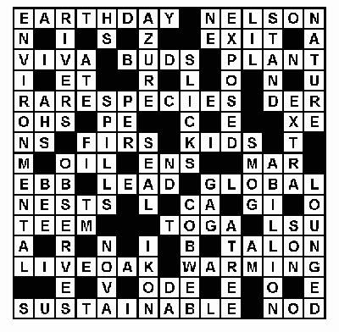
Examples: variables, domains, possible worlds
Crossword Puzzle:
variables are words that have to be filled in
domains are English words of correct length
possible worlds: all ways of assigning words
Crossword 2:
variables are cells (individual squares)
domains are letters of the alphabet
possible worlds: all ways of assigning letters to cells

Slide 9
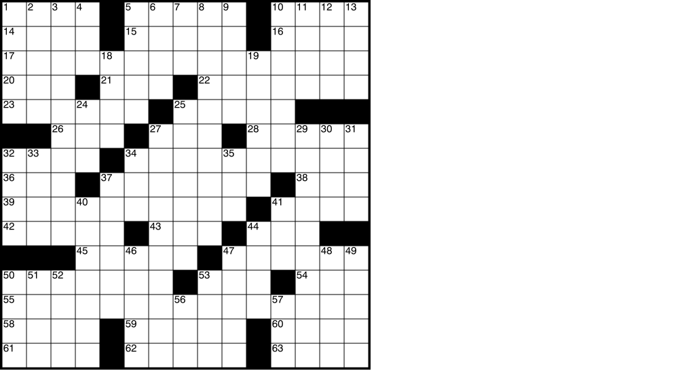
How many possible worlds?
Crossword Puzzle:
variables are words that have to be filled in
domains are English words of correct length
possible worlds: all ways of assigning words
Number of English words? Let’s say 150,000
Of the right length? Assume for simplicity: 15,000 for each word
Number of words to be filled in? 63
How many possible worlds? (assume any combination is ok)
15000*63
15000⁶³
63¹⁵⁰⁰⁰

Slide 10
How many possible worlds?
Crossword 2:
variables are cells (individual squares)
domains are letters of the alphabet
possible worlds: all ways of assigning letters to cells
Number of empty cells? 15*15 – 32 = 193
Number of letters in the alphabet? 26
How many possible worlds? (assume any combination is ok)
In general: (domain size) ^{#variables} (only an upper bound)
193*26
193²⁶
26¹⁹³

Slide 11
Examples: variables, domains, possible worlds
Sudoku
variables are cells
domains are numbers between 1 and 9
possible worlds: all ways of assigning numbers to cells

Slide 12
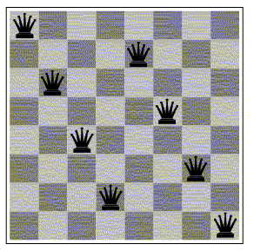
Examples: variables, domains, possible worlds
Scheduling Problem:
variables are different tasks that need to be scheduled (e.g., course in a university; job in a machine shop)
domains are the different combinations of times and locations for each task (e.g., time/room for course; time/machine for job)
possible worlds: time/location assignments for each task
n-Queens problem
variable: location of a queen on a chess board
there are n of them in total, hence the name
domains: grid coordinates
possible worlds: locations of all queens

Slide 13
Lecture Overview
Representations: States vs. Features (Variables)
Variables and Possible Worlds
Constraints
Constraint Satisfaction Problems (CSPs)

Slide 14
Constraints 1
Constraints are restrictions on the values that one or more variables can take
Unary constraint: restriction involving a single variable
of course, we could also achieve the same thing by using a smaller domain in the first place
k-ary constraint: restriction involving k different variables
We will mostly deal with binary constraints (k=2 variables)
Constraints can be specified by
listing all combinations of valid domain values for the variables participating in the constraint (or listing all invalid combinations)
giving a function (predicate) that returns true when given values for each variable which satisfy the constraint

Slide 15
Constraints 2
A possible world satisfies a set of constraints
If, in that possible world, the values for the variables involved in each constraint are consistent with that constraint:
either:
Elements of the list of valid domain values
or:
Function returns true for those values

Slide 16
Examples: variables, domains, constraints
Crossword Puzzle:
variables are words that have to be filled in
domains are English words of correct length
(binary) constraints: two words have the same letter at character where they intersect
Crossword 2:
variables are cells (individual squares)
domains are letters of the alphabet
(k-ary) constraints: sequences of letters form valid English words

Slide 17
Examples: variables, domains, constraints
Sudoku
variables are cells
domains are numbers between 1 and 9
constraints: rows, columns, boxes contain all different numbers: they are each a permutation of {1, 2, 3, 4, 5, 6, 7, 8, 9}

Slide 18
Examples: variables, domains, constraints
Scheduling Problem:
variables are different tasks that need to be scheduled (e.g., course in a university; job in a machine shop)
domains are the different combinations of times and locations for each task (e.g., time/room for course; time/machine for job)
constraints: tasks can't be scheduled in the same location at the same time; certain tasks can't be scheduled in different locations at the same time; some tasks must come earlier than others; etc.
n-Queens problem
variable: location of a queen on a chess board
there are n of them in total, hence the name
domains: grid coordinates
constraints: no queen can attack another

Slide 19
Lecture Overview
Representations: States vs. Features (Variables)
Variables and Possible Worlds
Constraints
Constraint Satisfaction Problems (CSPs)

Slide 20
Constraint Satisfaction Problems: Definition
Definition: A constraint satisfaction problem (CSP) consists of:
a set of variables
a domain for each variable
a set of constraints
Definition:
A model of a CSP is an assignment of values to all of its variables that satisfies all of its constraints.

Slide 21
Constraint Satisfaction Problems: Variants
We may want to solve the following problems with a CSP:
determine whether or not a model exists
find a model
find all of the models
count the number of models
find the best model, given some measure of model quality
this is now an optimization problem
determine whether some property of the variables holds in all models

Slide 22
Constraint Satisfaction Problems: Game Plan
Even the simplest problem of determining whether or not a model exists in a general CSP with finite domains is NP-hard
There is no known algorithm with worst case polynomial runtime
We can't hope to find an algorithm that is efficient for all CSPs
However, we can try to:
find consistency algorithms that reduce the size of the search space
identify special cases for which algorithms are efficient (polynomial)
work on approximation algorithms that can find good solutions quickly, even though they may offer no theoretical guarantees
find algorithms that are fast on typical cases

Slide 23
Constraint Satisfaction Problems (CSPs): Definition
Definition: A constraint satisfaction problem (CSP) consists of:
a set of variables V
a domain dom(V) for each variable V ∈V
a set of constraints C
Simple example:
V = {V₁}
dom(V₁) = {1,2,3,4}
C = {C₁,C₂}
C₁: V₁ ≠ 2
C₂: V₁ > 1
Another example:
V = {V₁,V₂}
dom(V₁) = {1,2,3}
dom(V₂) = {1,2}
C = {C₁,C₂,C₃}
C₁: V₂ ≠ 2
C₂: V₁ + V₂ < 5
C₃: V₁ > V₂

Slide 24
Constraint Satisfaction Problems (CSPs): Definition
Definition: A constraint satisfaction problem (CSP) consists of:
a set of variables V
a domain dom(V) for each variable V ∈V
a set of constraints C
Definition:
A model of a CSP is an assignment of values to all of its variables that satisfies all of its constraints.
Simple example:
V = {V₁}
dom(V₁) = {1,2,3,4}
C = {C₁,C₂}
C₁: V₁ ≠ 2
C₂: V₁ > 1
All models for this CSP:
{V₁ = 3}
{V₁ = 4}

Slide 25
Constraint Satisfaction Problems (CSPs): Definition
Definition: A constraint satisfaction problem (CSP) consists of:
a set of variables V
a domain dom(V) for each variable V ∈V
a set of constraints C
Definition:
A model of a CSP is an assignment of values to all of its variables that satisfies all of its constraints.
Another example:
V = {V₁,V₂}
dom(V₁) = {1,2,3}
dom(V₂) = {1,2}
C = {C₁,C₂,C₃}
C₁: V₂ ≠ 2
C₂: V₁ + V₂ < 5
C₃: V₁ > V₂
Which are models for this CSP?
{V₁=1, V₂=1}
{V₁=2, V₂=1}
{V₁=3, V₂=1}
{V₁=3, V₂=2}

Slide 26
Possible Worlds
Definition:
A possible world of a CSP is an assignment of values to all of its variables.
i.e. a model is a possible world that satisfies all constraints
Definition:
A model of a CSP is an assignment of values to all of its variables that satisfies all of its constraints.
Another example:
V = {V₁,V₂}
dom(V₁) = {1,2,3}
dom(V₂) = {1,2}
C = {C₁,C₂,C₃}
C₁: V₂ ≠ 2
C₂: V₁ + V₂ < 5
C₃: V₁ > V₂
Possible worlds for this CSP:
{V₁=1, V₂=1} {V₁=1, V₂=2} {V₁=2, V₂=1} (a model)
{V₁=2, V₂=2}
{V₁=3, V₂=1} (a model)
{V₁=3, V₂=2}

Slide 27
Constraints
Constraints are restrictions on the values that one or more variables can take
Unary constraint: restriction involving a single variable
E.g.: V₂ ≠ 2
k-ary constraint: restriction involving k different variables
E.g. binary (k=2): V₁ + V₂ < 5
E.g. 3-ary: V₁ + V₂ + V₄ < 5
We will mostly deal with binary constraints
Constraints can be specified by
listing all combinations of valid domain values for the variables participating in the constraint
E.g. for constraint V₁ > V₂ and dom(V₁) = {1,2,3} and dom(V₂) = {1,2}:
giving a function (predicate) that returns true if given values for each variable which satisfy the constraint else false: V₁ > V₂
V₁ | V₂
2 | 1
3 | 1
3 | 2

Slide 28
Constraints
A possible world satisfies a set of constraints
if the values for the variables involved in each constraint are consistent with that constraint
They are elements of the list of valid domain values
Function returns true for those values
Examples
{V₁=1, V₂=1} (does not satisfy above constraint)
{V₁=3, V₂=1} (satisfies above constraint)
V₁ | V₂
2 | 1
3 | 1
3 | 2

Slide 29
Scope of a constraint
Definition:
The scope of a constraint is the set of variables that are involved in the constraint
Examples:
V₂ ≠ 2 has scope {V₂}
V₁ > V₂ has scope {V₁,V₂}
V₁ + V₂ + V₄ < 5 has scope {V₁,V₂,V₄}
How many variables are in the scope of a k-ary constraint ?
k variables

Slide 30
Finite Constraint Satisfaction Problem: Definition
Definition: A finite constraint satisfaction problem (FCSP) is a CSP with a finite set of variables and a finite domain for each variable.
We will only study finite CSPs here but many of the techniques carry over to countably infinite and continuous domains. We use CSP here to refer to FCSP.
The scope of each constraint is automatically finite since it is a subset of the finite set of variables.

Slide 31
Learning Goals for CSP so far
Define possible worlds in term of variables and their domains
Compute number of possible worlds on real examples
Specify constraints to represent real world problems differentiating between:
Unary and k-ary constraints
List vs. function format
Verify whether a possible world satisfies a set of constraints (i.e., whether it is a model, a solution)
Coming up: CSP as search
Read Sections 4.3-2
Get busy with assignment 1 (Due: Friday, October 5)

