Slide 1
Finish Logics
Start Stochastic Environments
Computer Science cpsc322, Lecture 8
Textbook Chpt 5.2 & Chpt 12
Chpt 6.1
May, 31, 2012
Notes:
Lecture 8

Slide 2
Lecture Overview
Finish Logics
  Recap Top Down + TD as Search
  Datalog
Start Stochastic Environments
Intro to Probability
  Semantics of Probability
  Marginalization
  Conditional Probability and Chain Rule
  Bayes' Rule and Independence

Slide 3
Top-down Ground Proof Procedure
Key Idea: search backward from a query G to determine if it can be derived from KB.
Notes:
Single inference rule that yields a complete inference algorithm when coupled with any complete search algorithm
"SL resolution with Definite clauses".
For SL http://en.wikipedia.org/wiki/SLD_resolution (not really critical for this lecture)

Slide 4
Top-down Proof Procedure: Basic elements
Notation: An answer clause is of the form:
yes ← a₁ ∧ a₂ ∧ … ∧ a_{m}
Express query as an answer clause (e.g., query a₁ ∧ a₂ ∧ … ∧ a_{m} )
yes ←
Rule of inference (called SLD Resolution)
Given an answer clause of the form:
yes ← a₁ ∧ a₂ ∧ … ∧ a_{m}
and the clause:
a_{i} ← b₁ ∧ b₂ ∧ … ∧ b_{p}
You can generate the answer clause
yes ← a₁ ∧ … ∧ a_{i-1} ∧ b₁ ∧ b₂ ∧ … ∧ b_{p} ∧ a_{i+1} ∧ … ∧ a_{m}
Notes:
Answer clause means the antecedent are true
SLD Resolution of this answer clause on atom a_{i}

Slide 5
Successful Derivation: When by applying the inference rule you obtain the answer clause yes ← .
a ← e ∧ f. a ← b ∧ c. b ← k ∧ f.
c ← e. d ← k. e.
f ← j ∧ e. f ← c. j ← c.
Query: a (two ways)
yes ← a.
yes ← a.
Notes:
Sound and complete
When it has derived the answer, you can read a bottom-up proof in the
opposite direction. Every top-down derivation corresponds to a bottom-up
proof, and every bottom-up proof has a corresponding top-down derivation.
This equivalence can be used to show the soundness and completeness
of the derivation procedure.

Slide 6
Lecture Overview
Finish Logics
  Recap Top Down + TD as Search
  Datalog
Start Stochastic Environments
Intro to Probability
  Semantics of Probability
  Marginalization
  Conditional Probability and Chain Rule
  Bayes' Rule and Independence

Slide 7
Systematic Search in different R&R systems
Constraint Satisfaction (Problems):
  State: assignments of values to a subset of the variables
  Successor function: assign values to a “free” variable
  Goal test: set of constraints
  Solution: possible world that satisfies the constraints
  Heuristic function: none (all solutions at the same distance from start)
Planning (forward) :
  State possible world
  Successor function states resulting from valid actions
  Goal test assignment to subset of vars
  Solution sequence of actions
  Heuristic function empty-delete-list (solve simplified problem)
Logical Inference (top Down)
  State answer clause
  Successor function states resulting from substituting one atom with all the clauses of which it is the head
  Goal test empty answer clause
  Solution start state
  Heuristic function ………………..
Notes:
Allows useful general-purpose algorithms with more power than standard search algorithms

Slide 8

Search Graph
KB
a ← b ∧ c. a ← g.
a ← h. b ← j.
b ← k. d ← m.
d ← p. f ← m.
f ← p. g ← m.
g ← f. k ← m.
h ←m. p.
Prove: ?← a ∧ d.
Heuristics?

Slide 9
Search Graph
KB
a ← b ∧ c. a ← g.
a ← h. b ← j.
b ← k. d ← m.
d ← p. f ← m.
f ← p. g ← m.
g ← f. k ← m.
h ←m. p.
Prove: ?← a ∧ d.
Possible Heuristic?
Number of atoms in the answer clause
Admissible?
Yes
No

Slide 10
Standard Search vs. Specific R&R systems
Constraint Satisfaction (Problems):
  State: assignments of values to a subset of the variables
  Successor function: assign values to a “free” variable
  Goal test: set of constraints
  Solution: possible world that satisfies the constraints
  Heuristic function: none (all solutions at the same distance from start)
Planning :
  State possible world
  Successor function states resulting from valid actions
  Goal test assignment to subset of vars
  Solution sequence of actions
  Heuristic function empty-delete-list (solve simplified problem)
Logical Inference
  State answer clause
  Successor function states resulting from substituting one atom with all the clauses of which it is the head
  Goal test empty answer clause
  Solution start state
  Heuristic function number of atoms in given state
Notes:
Allows useful general-purpose algorithms with more power than standard search algorithms

Slide 11
Lecture Overview
Finish Logics
  Recap Top Down + TD as Search
  Datalog
Start Stochastic Environments
Intro to Probability
  Semantics of Probability
  Marginalization
  Conditional Probability and Chain Rule
  Bayes' Rule and Independence

Slide 12
Representation and Reasoning in Complex domains
In complex domains expressing knowledge with propositions can be quite limiting
It is often natural to consider individuals and their properties
up_s₂
up_s₃
ok_cb₁
ok_cb₂
live_w₁
connected_w₁_w₂
up( s₂ )
up( s₃ )
ok( cb₁ )
ok( cb₂ )
live( w₁)
connected( w₁ , w₂ )
There is no notion that
up_s₂
up_s₃
live_w₁
connected_w₁_w₂
Notes:
the propositions up s2, up s3,
ok s2 have no internal structure. There is no notion that the proposition
up s2 and up s3 are about the same relation, but with different individuals,
or that up s2 and ok s2 are about the same switch. There is no notion
of individuals and relations.
An alternative is to explicitly represent the individual switches s1,
s2, s3, and the properties or relations, up and ok. Using this representation,
“switch s2 is up” is represented as up(s2). A binary relation, like
connected to, can be used to relate two individuals, such as connected to(w1, s1)

Slide 13
What do we gain….
By breaking propositions into relations applied to individuals?
Express knowledge that holds for set of individuals (by introducing )
live(W) <- connected_to(W,W1) ∧ live(W1) ∧ wire(W) ∧ wire(W1).
We can ask generic queries (i.e., containing )
? connected_to(W, w₁)
Notes:
Economy of symbols: 10 individuals and 1 binary relation can express….
connected_to(X,Y)
1000 wires

Slide 14
Datalog vs PDCL (better with colors)

Slide 15
Datalog: a relational rule language
Datalog expands the syntax of PDCL….
A variable is a symbol starting with an upper case letter
Examples: X, Y
A constant is a symbol starting with lower-case letter or a sequence of digits.
Examples: alan, w1
A term is either a variable or a constant.
Examples: X, Y, alan, w1
A predicate symbol is a symbol starting with a lower-case letter.
Examples: live, connected, part-of, in

Slide 16
Datalog Syntax (cont’d)
An atom is a symbol of the form p or p(t₁ …. t_{n}) where p is a predicate symbol and t_{i} are terms
Examples: sunny, in(alan,X)
A definite clause is either an atom (a fact) or of the form:
h ← b₁ ∧… ∧ b_{m}
where h and the b_{i} are atoms (Read this as ``h if b.'')
Example: in(X,Z) ← in(X,Y) ∧ part-of(Y,Z)
A knowledge base is a set of definite clauses

Slide 17
Datalog: Top Down Proof Procedure
in(alan, r123).
part_of(r123,cs_building).
in(X,Y) ← part_of(Z,Y) & in(X,Z).
Extension of Top-Down procedure for PDCL.
How do we deal with variables?
  Idea:
    Find a clause with head that matches the query
    Substitute variables in the clause with their matching constants
  Example:
  We will not cover the formal details of this process, called unification. See P&M Section 12.4.2, p. 511 for the details.
Query: yes ← in(alan, cs_building).
in(X,Y) ← part_of(Z,Y) & in(X,Z).
with Y = cs_building
X = alan
yes ← part_of(Z,cs_building), in(alan, Z).

Slide 18
Example proof of a Datalog query
in(alan, r123).
part_of(r123,cs_building).
in(X,Y) ← part_of(Z,Y) & in(X,Z).
Query: yes ← in(alan, cs_building).
Using clause: in(X,Y) ←
part_of(Z,Y) & in(X,Z),
with Y = cs_building
X = alan
yes ← part_of(Z,cs_building), in(alan, Z).
Using clause:
part_of(r123,cs_building)
with Z = r123
yes ← in(alan, r123).
Using clause:
in(alan, r123).
Using clause: in(X,Y) ←
part_of(Z,Y) & in(X,Z).
With X = alan
Y = r123
yes ←.
yes ← part_of(Z, r123), in(alan, Z).
No clause with matching head: part_of(Z,r123).
fail

Slide 19
Tracing Datalog proofs in AIspace
You can trace the example from the last slide in the AIspace Deduction Applet at http://aispace.org/deduction/ using file ex-Datalog available in course schedule
Question 4 of assignment 3 asks you to use this applet

Slide 20
Datalog: queries with variables
in(alan, r123).
part_of(r123,cs_building).
in(X,Y) ← part_of(Z,Y) & in(X,Z).
Query: in(alan, X1).
yes(X1) ← in(alan, X1).
What would the answer(s) be?

Slide 21
Datalog: queries with variables
in(alan, r123).
part_of(r123,cs_building).
in(X,Y) ← part_of(Z,Y) & in(X,Z).
Query: in(alan, X1).
yes(X1) ← in(alan, X1).
What would the answer(s) be?
yes(r123).
yes(cs_building).
Again, you can trace the SLD derivation for this query
in the AIspace Deduction Applet

Slide 22
Logics in AI: Similar slide to the one for planning
Propositional Definite Clause Logics
Semantics and Proof Theory
Propositional Logics
First-Order Logics
Satisfiability Testing (SAT)
Description Logics
Hardware Verification
Production Systems
Product Configuration
Ontologies
Cognitive Architectures
Semantic Web
Video Games
Summarization
Tutoring Systems
Information Extraction

Slide 23
Learning Goals for today’s class
You can:
Define/read/write/trace/debug the TopDown proof procedure (as a search problem)
Represent simple domains in Datalog
Apply TopDown proof procedure in Datalog

Slide 24
Lecture Overview
Finish Logics
  Recap Top Down + TD as Search
  Datalog
Start Stochastic Environments
Intro to Probability
  Semantics of Probability
  Marginalization
  Conditional Probability and Chain Rule
  Bayes' Rule and Independence

Slide 25
Big Picture: R&R systems
Environment
Deterministic
Stochastic
Problem
Arc Consistency
Search
Constraint Satisfaction
Vars +
Constraints
SLS
Static
Belief Nets
Query
Logics
Var. Elimination
Search
Sequential
Decision Nets
STRIPS
Var. Elimination
Planning
Search
Markov Processes
Representation
Value Iteration
Reasoning
Technique
Notes:
R&R Sys Representation and reasoning Systems
Each cell is a R&R system
STRIPS actions preconditions and effects

Slide 26
Answering Query under Uncertainty
Probability Theory
Dynamic Bayesian Network
Static Bayesian Network & Variable Elimination
Hidden Markov Models
Monitoring
(e.g credit cards)
Student Tracing in tutoring Systems
Natural Language Processing
Diagnostic Systems (e.g., medicine)
Email spam filters

Slide 27
Intro to Probability (Motivation)
Will it rain in 10 days? Was it raining 98 days ago?
Right now, how many people are in this room? in this building (DMP)? At UBC? ….Yesterday?
AI agents (and humans ☹) are not omniscient
And the problem is not only predicting the future or “remembering” the past

Slide 28
Intro to Probability (Key points)
Are agents all ignorant/uncertain to the same degree?
Should an agent act only when it is certain about relevant knowledge?
(not acting usually has implications)
So agents need to represent and reason about their ignorance/ uncertainty
Notes:
Epistemological not ontological
Subjective
Raining outside… who can look outside the window…..
Who can look at who is looking outside the window…

Slide 29
Probability as a formal measure of uncertainty/ignorance
Belief in a proposition f (e.g., it is raining outside, there are 31 people in this room) can be measured in terms of a number between 0 and 1 – this is the probability of f
  The probability f is 0 means that f is believed to be
  The probability f is 1 means that f is believed to be
  Using 0 and 1 is purely a convention.

Slide 30
Random Variables
A random variable is a variable like the ones we have seen in CSP and Planning, but the agent can be uncertain about its value.
As usual
  The domain of a random variable X, written dom(X), is the set of values X can take
  values are mutually exclusive and exhaustive
Examples (Boolean and discrete)
Notes:
Similarly to Constraint satisfaction
Boolean random variables
e.g., Cavity (do I have a cavity?)
Discrete random variables
e.g., Weather is one of <sunny,rainy,cloudy,snow>

Slide 31
Random Variables (cont’)
A tuple of random variables <X₁ ,…., X_{n}> is a complex random variable with domain..
Assignment X=x means X has value x
A proposition is a Boolean formula made from assignments of values to variables
Examples
Notes:
Constraint satisfaction
Use OR AND and NOT

Slide 32
Lecture Overview
Finish Logics
  Recap Top Down + TD as Search
  Datalog
Start Stochastic Environments
Intro to Probability
  Semantics of Probability
  Marginalization
  Conditional Probability and Chain Rule
  Bayes' Rule and Independence

Slide 33
Possible Worlds
A possible world specifies an assignment to each random variable
E.g., if we model only two Boolean variables Cavity and Toothache, then there are 4 distinct possible worlds:
    Cavity = T ∧Toothache = T
    Cavity = T ∧ Toothache = F
    Cavity = F ∧ Toothache = T
    Cavity = T ∧ Toothache = T
cavity | toothache
T | T
T | F
F | T
F | F
As usual, possible worlds are mutually exclusive and exhaustive
w╞ X=x means variable X is assigned value x in world w
Notes:
Example: number the worlds above

Slide 34
Semantics of Probability
The belief of being in each possible world w can be expressed as a probability µ(w)
For sure, I must be in one of them……so
µ(w) for possible worlds generated by three Boolean variables: cavity, toothache, catch (the probe caches in the tooth)
cavity | toothache | catch | µ(w)
T | T | T | .108
T | T | F | .012
T | F | T | .072
T | F | F | .008
F | T | T | .016
F | T | F | .064
F | F | T | .144
F | F | F | .576
Notes:
Example: number the worlds above

Slide 35

Probability of proposition
What is the probability of a proposition f ?
cavity | toothache | catch | µ(w)
T | T | T | .108
T | T | F | .012
T | F | T | .072
T | F | F | .008
F | T | T | .016
F | T | F | .064
F | F | T | .144
F | F | F | .576
For any f, sum the prob. of the worlds where it is true:
P(f )=Σ _{w╞ f} µ(w)
Ex: P(toothache = T) =
Notes:
Inference by enumeration

Slide 36
Probability of proposition
What is the probability of a proposition f ?
cavity | toothache | catch | µ(w)
T | T | T | .108
T | T | F | .012
T | F | T | .072
T | F | F | .008
F | T | T | .016
F | T | F | .064
F | F | T | .144
F | F | F | .576
For any f, sum the prob. of the worlds where it is true:
P(f )=Σ _{w╞ f} µ(w)
P(cavity=T and toothache=F) =
Notes:
Inference by enumeration

Slide 37
Probability of proposition
What is the probability of a proposition f ?
cavity | toothache | catch | µ(w)
T | T | T | .108
T | T | F | .012
T | F | T | .072
T | F | F | .008
F | T | T | .016
F | T | F | .064
F | F | T | .144
F | F | F | .576
For any f, sum the prob. of the worlds where it is true:
P(f )=Σ _{w╞ f} µ(w)
P(cavity or toothache) = 0.108 + 0.012 + 0.016 + 0.064 +
+ 0.072+0.08 = 0.28
Notes:
Inference by enumeration

Slide 38
One more example
  Weather, with domain {sunny, cloudy)
  Temperature, with domain {hot, mild, cold}
  There are now 6
  possible worlds:
  What’s the probability of it
  being cloudy or cold?
Weather | Temperature | µ(w)
sunny | hot | 0.10
sunny | mild | 0.20
sunny | cold | 0.10
cloudy | hot | 0.05
cloudy | mild | 0.35
cloudy | cold | 0.20
1
0.6
0.3
0.7
Remember
  The probability of proposition f is defined by: P(f )=Σ _{w╞ f} µ(w)
  sum of the probabilities of the worlds w in which f is true

Slide 39
One more example
Weather, with domain {sunny, cloudy)
Temperature, with domain {hot, mild, cold}
  There are now 6
  possible worlds:
  What’s the probability of it
  being cloudy or cold?
  µ(w3) + µ(w4) + µ(w5) + µ(w6) =
  0.7
 | Weather | Temperature | µ(w)
w1 | sunny | hot | 0.10
w2 | sunny | mild | 0.20
w3 | sunny | cold | 0.10
w4 | cloudy | hot | 0.05
w5 | cloudy | mild | 0.35
w6 | cloudy | cold | 0.20
Remember
  The probability of proposition f is defined by: P(f )=Σ _{w╞ f} µ(w)
  sum of the probabilities of the worlds w in which f is true

Slide 40
Probability Distributions
A probability distribution P on a random variable X is a function dom(X) - > [0,1] such that
x -> P(X=x)
cavity?
cavity | toothache | catch | µ(w)
T | T | T | .108
T | T | F | .012
T | F | T | .072
T | F | F | .008
F | T | T | .016
F | T | F | .064
F | F | T | .144
F | F | F | .576
Notes:
Similarly to Constraint satisfaction
Boolean random variables
e.g., Cavity (do I have a cavity?)
Discrete random variables
e.g., Weather is one of <sunny,rainy,cloudy,snow>

Slide 41
Probability distribution (non binary)
A probability distribution P on a random variable X is a function dom(X) - > [0,1] such that
x -> P(X=x)
Number of people in this room at this time

Slide 42
Joint Probability Distributions
When we have multiple random variables, their joint distribution is a probability distribution over the variable Cartesian product
  E.g., P(<X₁ ,…., X_{n}> )
  Think of a joint distribution over n variables as an n-dimensional table
  Each entry, indexed by X₁ ₌ x₁,…., X_{n}= x_{n} corresponds to P(X₁ ₌ x₁ ∧ …. ∧ X_{n}= x_{n} )
  The sum of entries across the whole table is 1
Notes:
Similarly to Constraint satisfaction
Boolean random variables
e.g., Cavity (do I have a cavity?)
Discrete random variables
e.g., Weather is one of <sunny,rainy,cloudy,snow>

Slide 43
Question
  If you have the joint of n variables. Can you compute the probability distribution for each variable?
Notes:
If you have the probability distribution for n variables. Can you compute their joint?

Slide 44
Learning Goals for today’s class
You can:
Define and give examples of random variables, their domains and probability distributions.
Calculate the probability of a proposition f given µ(w) for the set of possible worlds.
Define a joint probability distribution

Slide 45
Recap: Possible World Semantics for Probabilities
Probability is a formal measure of subjective uncertainty.
Random variable and probability distribution
Model Environment with a set of random vars
Probability of a proposition f
Notes:
Exhaustive and mutual exclusive

Slide 46
Lecture Overview
Finish Logics
  Recap Top Down + TD as Search
  Datalog
Start Stochastic Environments
Intro to Probability
  Semantics of Probability
  Marginalization
  Conditional Probability and Chain Rule
  Bayes' Rule and Independence

Slide 47
Joint Distribution and Marginalization
cavity | toothache | catch | µ(w)
T | T | T | .108
T | T | F | .012
T | F | T | .072
T | F | F | .008
F | T | T | .016
F | T | F | .064
F | F | T | .144
F | F | F | .576
Given a joint distribution, e.g. P(X,Y, Z) we can compute distributions over any smaller sets of variables
cavity | toothache | P(cavity , toothache)
T | T | .12
T | F | .08
F | T | .08
F | F | .72
Notes:
Become fixed or prevented from moving

Slide 48
Why is it called Marginalization?
cavity | toothache | P(cavity , toothache)
T | T | .12
T | F | .08
F | T | .08
F | F | .72
 | Toothache = T | Toothache = F
Cavity = T | .12 | .08
Cavity = F | .08 | .72

Slide 49
Marginalization
Can we also marginalize over more than one variable at once?
E.g. go from P(Wind, Weather, Temperature) to P (Weather)?
Wind | Weather | Temperature | µ(w)
yes | sunny | hot | 0.04
yes | sunny | mild | 0.09
yes | sunny | cold | 0.07
yes | cloudy | hot | 0.01
yes | cloudy | mild | 0.10
yes | cloudy | cold | 0.12
no | sunny | hot | 0.06
no | sunny | mild | 0.11
no | sunny | cold | 0.03
no | cloudy | hot | 0.04
no | cloudy | mild | 0.25
no | cloudy | cold | 0.08
i.e., Marginalization
over Temperature and Wind
Weather | µ(w)
sunny
cloudy

Slide 50
Marginalization
Can we also marginalize over more than one variable at once?
E.g. go from P(Wind, Weather, temperature) to P (Weather)?
Wind | Weather | Temperature | µ(w)
yes | sunny | hot | 0.04
yes | sunny | mild | 0.09
yes | sunny | cold | 0.07
yes | cloudy | hot | 0.01
yes | cloudy | mild | 0.10
yes | cloudy | cold | 0.12
no | sunny | hot | 0.06
no | sunny | mild | 0.11
no | sunny | cold | 0.03
no | cloudy | hot | 0.04
no | cloudy | mild | 0.25
no | cloudy | cold | 0.08
i.e., Marginalization
over Temperature and Wind
Weather | µ(w)
sunny | ???
cloudy
How can we compute P(Weather = sunny)?

Slide 51
Marginalization
We can also marginalize over more than one variable at once
P(X=x) = Σ_{z1∈dom(Z1),…, zn∈dom(Zn)} P(X=x, Z₁ = z₁, …, Z_{n} = z_{n})
Wind | Weather | Temperature | µ(w)
yes | sunny | hot | 0.04
yes | sunny | mild | 0.09
yes | sunny | cold | 0.07
yes | cloudy | hot | 0.01
yes | cloudy | mild | 0.10
yes | cloudy | cold | 0.12
no | sunny | hot | 0.06
no | sunny | mild | 0.11
no | sunny | cold | 0.03
no | cloudy | hot | 0.04
no | cloudy | mild | 0.25
no | cloudy | cold | 0.08
i.e., Marginalization
over Temperature and Wind
Weather | µ(w)
sunny | 0.40
cloudy

Slide 52
Marginalization
We can also get marginals for more than one variable
P(X=x,Y=y) = Σ_{z1∈dom(Z1),…, zn∈dom(Zn)} P(X=x, Y=y, Z₁ = z₁, …, Z_{n} = z_{n})
Wind | Weather | Temperature | µ(w)
yes | sunny | hot | 0.04
yes | sunny | mild | 0.09
yes | sunny | cold | 0.07
yes | cloudy | hot | 0.01
yes | cloudy | mild | 0.10
yes | cloudy | cold | 0.12
no | sunny | hot | 0.06
no | sunny | mild | 0.11
no | sunny | cold | 0.03
no | cloudy | hot | 0.04
no | cloudy | mild | 0.25
no | cloudy | cold | 0.08
Weather | Temperature | µ(w)
sunny | hot | 0.10
sunny | mild
sunny | cold
cloudy | hot
cloudy | mild
cloudy | cold

Slide 53
Lecture Overview
Finish Logics
  Recap Top Down + TD as Search
  Datalog
Start Stochastic Environments
Intro to Probability
  Semantics of Probability
  Marginalization
  Conditional Probability and Chain Rule
  Bayes' Rule and Independence

Slide 54
Conditioning
(Conditional Probability)
We model our environment with a set of random variables.
Assume have the joint, we can compute the probability …….
Are we done with reasoning under uncertainty?
What can happen?
Think of a patient showing up at the dentist office. Does she have a cavity?

Slide 55
Conditioning
(Conditional Probability)
Probabilistic conditioning specifies how to revise beliefs based on new information.
You build a probabilistic model (for now the joint) taking all background information into account. This gives the prior probability.
All other information must be conditioned on.
If evidence e is all of the information obtained subsequently, the conditional probability P(h|e) of h given e is the posterior probability of h.

Slide 56
Conditioning Example
Prior probability of having a cavity
P(cavity = T)
Should be revised if you know that there is toothache
P(cavity = T | toothache = T)
It should be revised again if you were informed that the probe did not catch anything
P(cavity =T | toothache = T, catch = F)
What about ?
P(cavity = T | sunny = T)

Slide 57
How can we compute P(h|e)
What happens in term of possible worlds if we know the value of a random var (or a set of random vars)?
Some worlds are . The other become ….
cavity | toothache | catch | µ(w) | µ_{e}(w)
T | T | T | .108
T | T | F | .012
T | F | T | .072
T | F | F | .008
F | T | T | .016
F | T | F | .064
F | F | T | .144
F | F | F | .576
e = (cavity = T)
Notes:
Some are ruled out by the evidence
So the others become more likely
How much more likely?

Slide 58
Semantics of Conditional Probability
The conditional probability of formula h given evidence e is

Slide 59
Semantics of Conditional Prob.: Example
e = (cavity = T)
cavity | toothache | catch | µ(w) | µ_{e}(w)
T | T | T | .108 | .54
T | T | F | .012 | .06
T | F | T | .072 | .36
T | F | F | .008 | .04
F | T | T | .016 | 0
F | T | F | .064 | 0
F | F | T | .144 | 0
F | F | F | .576 | 0
P(h | e) = P(toothache = T | cavity = T) =

Slide 60
Conditional Probability among Random Variables
P(X | Y) = P(X , Y) / P(Y)
P(X | Y) = P(toothache | cavity)
= P(toothache ∧ cavity) / P(cavity)
 | Toothache = T | Toothache = F
Cavity = T | .12 | .08
Cavity = F | .08 | .72
 | Toothache = T | Toothache = F
Cavity = T
Cavity = F
Notes:
It expresses the probability of each possible value on the left given each possible value on the right

Slide 61
Product Rule
Definition of conditional probability:
  P(X₁ | X₂) = P(X₁ , X₂) / P(X₂)
Product rule gives an alternative, more intuitive formulation:
  P(X₁ , X₂) = P(X₂) P(X₁ | X₂) = P(X₁) P(X₂ | X₁)
Product rule general form:
  P(X₁, …,X_{n}) =
  = P(X₁,...,X_{t}) P(X_{t+1}…. X_{n} | X₁,...,X_{t})
Notes:
if P(b) > 0

Slide 62
Chain Rule
Product rule general form:
  P(X₁, …,X_{n}) =
  = P(X₁,...,X_{t}) P(X_{t+1}…. X_{n} | X₁,...,X_{t})
Chain rule is derived by successive application of product rule:
  P(X₁, … X_{n-1} , X_{n}) =
  = P(X₁,...,X_{n-1}) P(X_{n} | X₁,...,X_{n-1})
  = P(X₁,...,X_{n-2}) P(X_{n-1} | X₁,...,X_{n-2}) P(X_{n} | X₁,...,X_{n-1}) = ….
  = P(X₁) P(X₂ | X₁) … P(X_{n-1} | X₁,...,X_{n-2}) P(X_{n} | X₁,.,X_{n-1})
  = ∏^{n}_{i= 1} P(X_{i} | X₁, … ,X_{i-1})
Notes:
if P(b) > 0

Slide 63
Chain Rule: Example
P(cavity , toothache, catch) =
P(toothache, catch, cavity) =
Notes:
if P(b) > 0

Slide 64
Lecture Overview
Finish Logics
  Recap Top Down + TD as Search
  Datalog
Start Stochastic Environments
Intro to Probability
  Semantics of Probability
  Marginalization
  Conditional Probability and Chain Rule
  Bayes' Rule and Independence

Slide 65
Using conditional probability
Often you have causal knowledge (forward from cause to evidence):
  For example
    P(symptom | disease)
    P(light is off | status of switches and switch positions)
    P(alarm | fire)
  In general: P(evidence e | hypothesis h)
... and you want to do evidential reasoning (backwards from evidence to cause):
  For example
    P(disease | symptom)
    P(status of switches | light is off and switch positions)
    P(fire | alarm)
  In general: P(hypothesis h | evidence e)

Slide 66
Bayes Rule
By definition, we know that :
We can rearrange terms to write
But
From (1) (2) and (3) we can derive
Bayes Rule

Slide 67
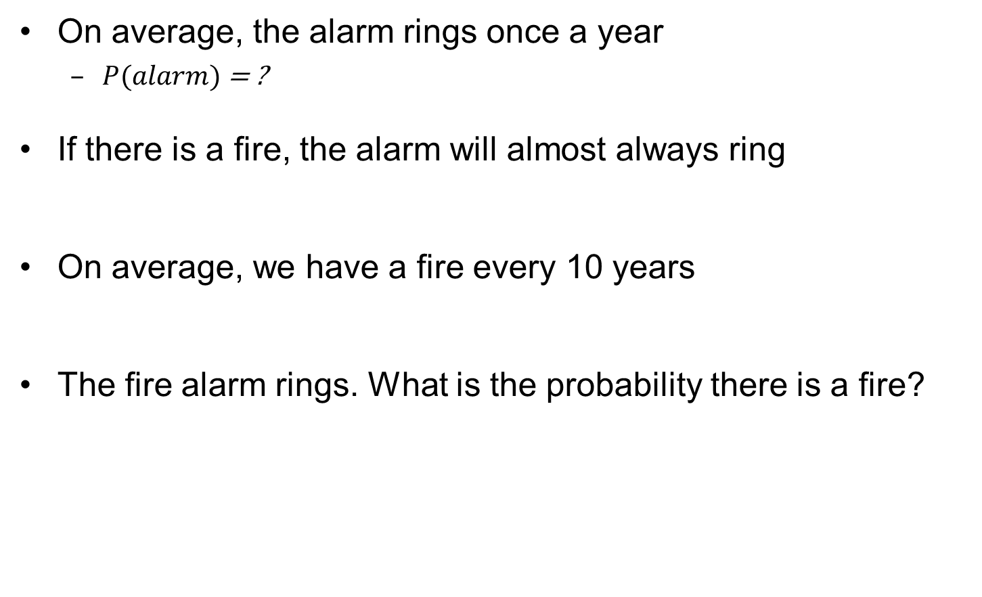
Example for Bayes rule

Slide 68
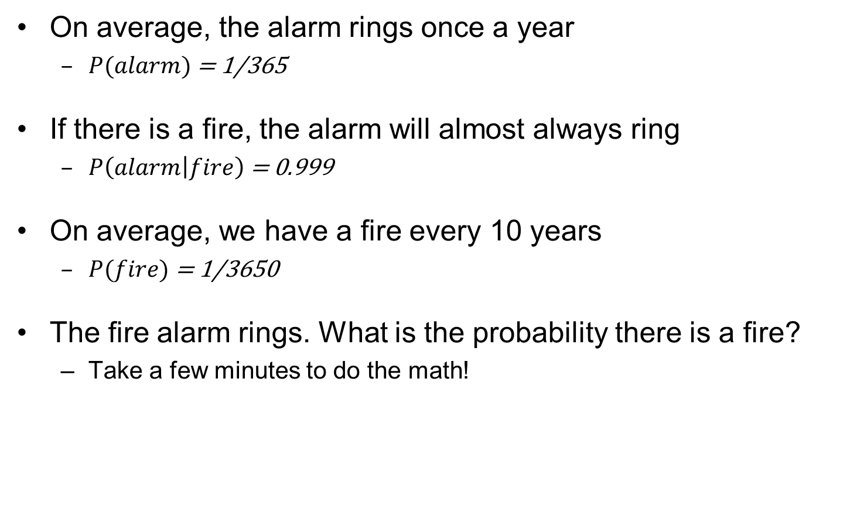
Example for Bayes rule
0.999
0.9
0.0999
0.1

Slide 69
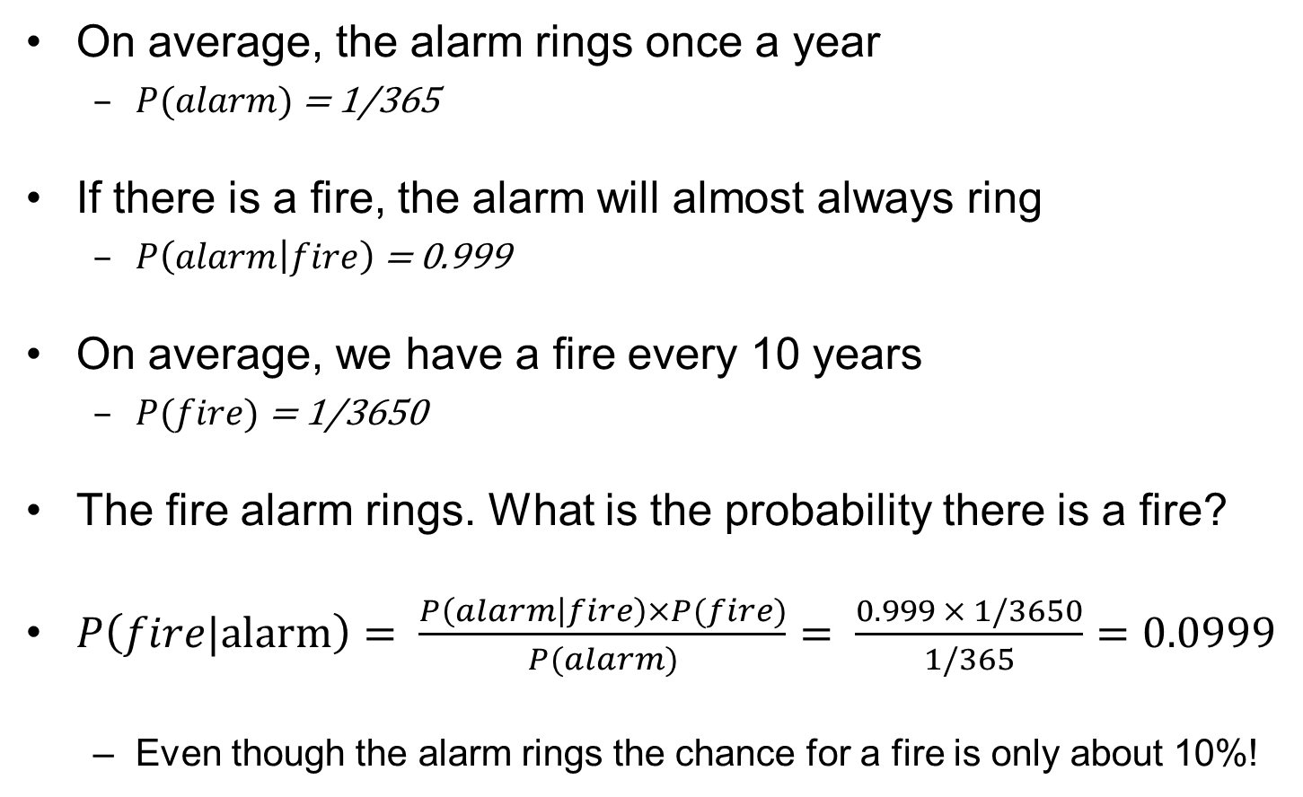
Example for Bayes rule

Slide 70
Do you always need to revise your beliefs?
…… when your knowledge of Y’s value doesn’t affect your belief in the value of X
DEF. Random variable X is marginal independent of random variable Y if, for all x_{i} ∈ dom(X), y_{k} ∈ dom(Y),
P( X= x_{i} | Y= y_{k}) = P(X= x_{i} )
Consequence:
P( X= x_{i} , Y= y_{k}) = P( X= x_{i} | Y= y_{k}) P( Y= y_{k}) =
= P(X= x_{i} ) P( Y= y_{k})

Slide 71
Marginal Independence: Example
X and Y are independent iff:
P(X|Y) = P(X) or P(Y|X) = P(Y) or P(X, Y) = P(X) P(Y)
That is new evidence Y(or X) does not affect current belief in X (or Y)
Ex: P(Toothache, Catch, Cavity, Weather)
  = P(Toothache, Catch, Cavity.
JPD requiring entries is reduced to two smaller ones ( and )
Notes:
A and B can be sets of random variables
Weather sunny cloudy rainy snowy

Slide 72
Learning Goals for today’s class
You can:
Given a joint, compute distributions over any subset of the variables
Prove the formula to compute P(h|e)
Derive the Chain Rule and the Bayes Rule
Define Marginal Independence

Slide 73
Midterm review
Average 77 ☺
Best 105
Four < 50%
How to learn more from midterm
Carefully examine your mistakes (and our feedback)
If you still do not see the correct answer/solution go back to your notes, the slides and the textbook
If you are still confused come to office hours with specific questions

Slide 74
Next Class
Conditional Independence
Belief Networks…….
Assignments
I will post Assignment 3 this evening
Assignment2
  If any of the TAs’ feedback is unclear go to office hours
  If you have questions on the programming part, office hours next Tue (Ken)

Slide 75
Plan for this week
Probability is a rigorous formalism for uncertain knowledge
Joint probability distribution specifies probability of every possible world
Probabilistic queries can be answered by summing over possible worlds
For nontrivial domains, we must find a way to reduce the joint distribution size
Independence (rare) and conditional independence (frequent) provide the tools

Slide 76
Conditional probability
(irrelevant evidence)
New evidence may be irrelevant, allowing simplification, e.g.,
  P(cavity | toothache, sunny) = P(cavity | toothache)
  We say that Cavity is conditionally independent from Weather (more on this next class)
This kind of inference, sanctioned by domain knowledge, is crucial in probabilistic inference
Notes:
Not

Slide 77
Bottom-up vs. Top-down
Key Idea of top-down: search backward from a query g to determine if it can be derived from KB.
Bottom-up
Top-down
Query Q
KB
C
KB
answer
g is proved if g ∈ C
When does BU look at the query q?
  Never
  It derives the same q
  regardless of the query
TD performs a backward search starting at q

Slide 78
Inference as Standard Search
Constraint Satisfaction (Problems):
  State: assignments of values to a subset of the variables
  Successor function: assign values to a “free” variable
  Goal test: set of constraints
  Solution: possible world that satisfies the constraints
  Heuristic function: none (all solutions at the same distance from start)
Planning :
  State: full assignment of values to features
  Successor function: states reachable by applying valid actions
  Goal test: partial assignment of values to features
  Solution: a sequence of actions
  Heuristic function: relaxed problem! E.g. “ignore delete lists”
Query (Top-down/SLD resolution)
  State: answer clause of the form yes ← a₁ ∧ ... ∧ a_{k}
  Successor function: all states resulting from substituting first
  atom a₁ with b₁ ∧ … ∧ b_{m} if there is a clause a₁ ← b₁ ∧ … ∧ b_{m}
  Goal test: is the answer clause empty (i.e. yes ←) ?
  Solution: the proof, i.e. the sequence of SLD resolutions
  Heuristic function: e.g. number of atoms in a given answer close

Slide 79
Sound and Complete?
When you have derived an answer, you can read a bottom up proof in the opposite direction.
Every top-down derivation corresponds to a bottom up proof and every bottom up proof has a top-down derivation.
We used this equivalence to prove the soundness and completeness of the SLD proof procedure.
Notes:
When you have derived an answer, you can read a bottom up proof in the opposite direction. Every top-down derivation corresponds to a bottom up proof and every botton up proof has a top-down derivation. This equivalence can be used to prove the soundness and completeness of the derivation procedure.
The procedure is sound, I.e. if KB |- g then KB |= g. In fact, if KB |-g there is a top down derivation for g and therefore a botton up derivation. Therefore g is in C and therefore |= g.
If KB |=g then we find a defivation for g. If KB |=g then we can find a botton-up derivation for g. Therefore there is a top-down derivation as well, which we can find because the search space is finite.

Slide 80
Lecture Overview
Recap of Lecture 26
DataLog
Logic Wrap up
Intro to Reasoning Under Uncertainty (time permitting)
  Motivation
  Introduction to Probability

Slide 81
One important Datalog detail
In its SLD resolution proof, Datalog always chooses the first clause with a matching head it finds in KB
What does that mean for recursive function definitions?
  The clause(s) defining your base case(s) have to appear first in KB
  Otherwise, you can get infinite recursions
  This is similar to recursion in imperative and functional programming languages
Datalog is a subset of Prolog (Programming in Logic)

Slide 82
Learning Goals For Logic
PDCL syntax & semantics
  Verify whether a logical statement belongs to the language of propositional definite clauses
  Verify whether an interpretation is a model of a PDCL KB.
  Verify when a conjunction of atoms is a logical consequence of a KB
Bottom-up proof procedure
  Define/read/write/trace/debug the Bottom Up (BU) proof procedure
  Prove that the BU proof procedure is sound and complete
Top-down proof procedure
  Define/read/write/trace/debug the Top-down (SLD) proof procedure
  Define it as a search problem
Datalog
  Represent simple domains in Datalog
  Apply the Top-down proof procedure in Datalog

Slide 83
Lecture Overview
Recap of Lecture 26
DataLog
Logic Wrap up
Intro to Reasoning Under Uncertainty (time permitting)
  Motivation
  Introduction to Probability

Slide 84
Logics: Big Picture
Propositional Definite Clause Logics
Semantics and Proof Theory
Propositional Logics
First-Order Logics
Satisfiability Testing (SAT)
Description Logics
Hardware Verification
Production Systems
Product Configuration
Ontologies
Cognitive Architectures
Semantic Web
Video Games
Summarization
Tutoring Systems
Information Extraction

Slide 85
Logics: Big picture
We only covered rather simple logics
  There are much more powerful representation and reasoning systems based on logics e.g.
    full first order logic (with negation, disjunction and function symbols)
    second-order logics
    non-monotonic logics, modal logics, …
There are many important applications of logic
  For example, software agents roaming the web on our behalf
    Based on a more structured representation: the semantic web
    This is just one example for how logics are used

Slide 86
Semantic Web: Extracting data
Examples for typical queries
  How much is a typical flight to Mexico for a given date?
  What’s the cheapest vacation package to some place in the Caribbean in a given week?
    Plus, the hotel should have a white sandy beach and scuba diving
If webpages are based on basic HTML
  Humans need to scout for the information and integrate it
  Computers are not reliable enough (yet?)
    Natural language processing (NLP) can be powerful (see Watson and Siri!)
    But some information may be in pictures (beach), or implicit in the text, so existing NLP techniques still don’t get all the info.

Slide 87
More structured representation: the Semantic Web
Beyond HTML pages only made for humans
Languages and formalisms based on description logics that allow websites to include rich, explicit information on
  relevant concepts, individual and their relationships \
  Goal: software agents that can roam the web and carry out sophisticated tasks on our behalf, based on these richer representations
Different than searching content for keywords and popularity.
  Infer meaning from content based on metadata and assertions that have already been made.
  Automatically classify and integrate information
For further material, P&M text, Chapter 13. Also
  the Introduction to the Semantic Web tutorial given at 2011 Semantic TechnologyConference http://www.w3.org/People/Ivan/CorePresentations/SWTutorial/

Slide 88
Examples of ontologies for the Semantic Web
“Ontology”: logic-based representation of the world
eClassOwl: eBusiness ontology
  for products and services
  75,000 classes (types of individuals) and 5,500 properties
National Cancer Institute’s ontology: 58,000 classes
Open Biomedical Ontologies Foundry: several ontologies
  including the Gene Ontology to describe
    gene and gene product attributes in any organism or protein sequence
OpenCyc project: a 150,000-concept ontology including
  Top-level ontology
    describes general concepts such as numbers, time, space, etc
  Hierarchical composition: superclasses and subclasses
  Many specific concepts such as “OLED display”, “iPhone”

Slide 89
A different example of applications of logic
Cognitive Tutors (http://pact.cs.cmu.edu/)
computer tutors for a variety of domains (math, geometry, programming, etc.)
  Provide individualized support to problem solving exercises, as good human tutors do
  Rely on logic-based, detailed computational models of skills and misconceptions underlying a learning domain.
CanergieLearning (http://www.carnegielearning.com/ ):
  a company that commercializes these tutors, sold to hundreds of thousands of high schools in the USA
Notes:
The research that I will discuss today is in the field of Intelligent tutoring systems, a strongly interdisciplinary field that combines research in Psychology, Education and computer science to develop computer based turors that can improve classroom instruction with the benefits of individualized tutoring.
In particular, applying AI techniques to improve the effectiveness of computer based instruction needs to devote a good amount of time to understanded the cognitive processes underslying learning and teaching to be able to build tutors that rely on these processes to enhance learning.

Slide 90
Inference as Standard Search
Constraint Satisfaction (Problems):
  State: assignments of values to a subset of the variables
  Successor function: assign values to a “free” variable
  Goal test: set of constraints
  Solution: possible world that satisfies the constraints
  Heuristic function: none (all solutions at the same distance from start)
Planning :
  State: full assignment of values to features
  Successor function: states reachable by applying valid actions
  Goal test: partial assignment of values to features
  Solution: a sequence of actions
  Heuristic function: relaxed problem! E.g. “ignore delete lists”
Query (Top-down/SLD resolution)
  State: answer clause of the form yes ← a₁ ∧ ... ∧ a_{k}
  Successor function: all states resulting from substituting first
  atom a₁ with b₁ ∧ … ∧ b_{m} if there is a clause a₁ ← b₁ ∧ … ∧ b_{m}
  Goal test: is the answer clause empty (i.e. yes ←) ?
  Solution: the proof, i.e. the sequence of SLD resolutions
  Heuristic function: ?????

Slide 91
One important Datalog detail
In its SLD resolution proof, Datalog always chooses the first clause with a matching head it finds in KB
What does that mean for recursive function definitions?
  The clause(s) defining your base case(s) have to appear first in KB
  Otherwise, you can get infinite recursions
  This is similar to recursion in imperative and functional programming languages
Datalog is a subset of Prolog (Programming in Logic)

