Slide 1
Planning + Intro Logics
Computer Science cpsc322, Lecture 6
(Textbook Chpt 8.1 -8.2, 8.4)
May, 23, 2012
Notes:
Lecture 6

Slide 2
Course Announcements
Assignment2 on CSPs due now !
MIDTERM: Mon May 28th – 3PM (room 310)
How to prepare: end of this lecture
CPSC 322, Lecture 5
Slide 2

Slide 3
Modules we'll cover in this course: R&Rsys
Environment
Deterministic
Stochastic
Problem
Arc Consistency
Search
Constraint Satisfaction
Vars +
Constraints
SLS
Static
Belief Nets
Inference
Logics
Var. Elimination
Search
Sequential
Decision Nets
STRIPS
Var. Elimination
Planning
Search
Markov Processes
Representation
Value Iteration
Reasoning
Technique
Notes:
R&R Sys Representation and reasoning Systems
Each cell is a R&R system
STRIPS actions preconditions and effects

Slide 4
Lecture Overview
Planning
Example
STRIPS: a Feature-Based Representation
Forward Planning
Heuristics
CSP Planning
Logic Intro
Propositional Definite Clause Logic: Syntax

Slide 5
Standard Search vs. Specific R&R systems
Constraint Satisfaction (Problems):
State: assignments of values to a subset of the variables
Successor function: assign values to a “free” variable
Goal test: set of constraints
Solution: possible world that satisfies the constraints
Heuristic function: none (all solutions at the same distance from start)
Planning :
State
Successor function
Goal test
Solution
Heuristic function
Inference
State
Successor function
Goal test
Solution
Heuristic function
Notes:
Allows useful general-purpose algorithms with more power than standard search algorithms

Slide 6
Planning as Search: State and Goal
How to select and organize a sequence of actions to achieve a given goal…
State: Agent is in a possible world (full assignments to a set of variables/features)
Goal: Agent wants to be in a possible world were some variables are given specific values

Slide 7
Planning as Search: Successor function and Solution
Actions : take the agent from one state to another
Solution: sequence of actions that when performed will take the agent from the current state to a goal state

Slide 8
Lecture Overview
Planning
Example
STRIPS: a Feature-Based Representation
Forward Planning
Heuristics
CSP Planning
Logic Intro
Propositional Definite Clause Logic: Syntax

Slide 9
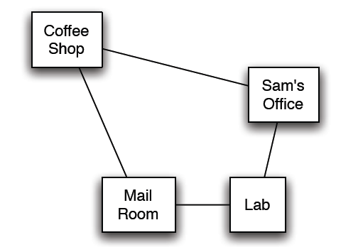
Delivery Robot Example (textbook)
Consider a delivery robot named Rob, who must navigate the following environment, can deliver coffee and mail to Sam
Another example is available as a Practice Exercise:
“Commuting to UBC”

Slide 10
Delivery Robot Example: States
The state is defined by the following variables/features:
RLoc - Rob's location
domain: coffee shop (cs), Sam's office (off ), mail room (mr ),
or laboratory (lab)
RHC - Rob has coffee True/False.
SWC - Sam wants coffee
MW - Mail is waiting
RHM - Rob has mail
Example state:
Number of states:
32
64
48
16

Slide 11
Delivery Robot Example: Actions
The robot’s actions are:
Move - Rob's move action
move clockwise (mc ), move anti-clockwise (mac ) not move (nm )
PUC - Rob picks up coffee
must be at the coffee shop
DelC - Rob delivers coffee
must be at the office, and must have coffee
PUM - Rob picks up mail
must be in the mail room, and mail must be waiting
DelM - Rob delivers mail
must be at the office and have mail

Slide 12
Lecture Overview
Planning
Example
STRIPS: a Feature-Based Representation
Forward Planning
Heuristics
CSP Planning
Logic Intro
Propositional Definite Clause Logic: Syntax
Notes:
STRIPS representation and assumption (STanford Research Institute Problem Solver )
70s 80s

Slide 13
STRIPS action representation
The key to sophisticated planning is modeling actions
In STRIPS, an action has two parts:
1. Preconditions: a set of assignments to features that must be
satisfied in order for the action to be legal
2. Effects: a set of assignments to features that are caused by
the action
Notes:
a logical test about

Slide 14
STRIPS actions: Example
STRIPS representation of the action pick up coffee, PUC :
preconditions Loc = cs and RHC = F
effects RHC = T
STRIPS representation of the action deliver coffee, DelC :
preconditions Loc = and RHC =
effects RHC = and SWC =
Note in this domain Sam doesn't have to want coffee for Rob to deliver it; one way or another, Sam doesn't want coffee after delivery.

Slide 15
STRIPS actions: MC and MAC
STRIPS representation of the action MoveClockwise ?

Slide 16
STRIPS Actions (cont’)
The STRIPS assumption: all features not explicitly changed by an action stay unchanged
So if the feature V has value v_{i} in state S_{i} , after action a has been performed,
what can we conclude about a and/or the state of the world S_{i-1} ,immediately preceding the execution of a?
S_{i-1}
S_{i}
a
V = v_{i}

Slide 17
what can we conclude about a and/or the state of the world S_{i-1} ,immediately preceding the execution of a?
1 V = v_{i} was TRUE in S_{i-1}
2 One of the effects of a is to set V = v_{i}
3 At least one of the above
4 None of the above
S_{i-1}
S_{i}
a
V = v_{i}

Slide 18
what can we conclude about a and/or the state of the world S_{i-1} ,immediately preceding the execution of a?
3 At least one of the above
S_{i-1}
S_{i}
a
V = v_{i}

Slide 19
Lecture Overview
Planning
Example
STRIPS: a Feature-Based Representation
Forward Planning
Heuristics
CSP Planning
Logic Intro
Propositional Definite Clause Logic: Syntax
Notes:
STRIPS representation and assumption (STanford Research Institute Problem Solver )
70s 80s

Slide 20
Forward Planning
To find a plan, a solution: search in the state-space graph.
The states are the possible worlds
The arcs from a state s represent all of the actions that are legal in state s.
A plan is a path from the state representing the initial state to a state that satisfies the goal.
What actions a are possible in a state s?
Those where a’s effects are satisfied in s
Those where the state s’ reached via a is on the way to the goal
Those where a’s preconditions are satisfied in s

Slide 21
Forward Planning
To find a plan, a solution: search in the state-space graph.
The states are the possible worlds
The arcs from a state s represent all of the actions that are legal in state s.
A plan is a path from the state representing the initial state to a state that satisfies the goal.
What actions a are possible in a state s?
Those where a’s preconditions are satisfied in s

Slide 22
Example state-space graph: first level

Slide 23
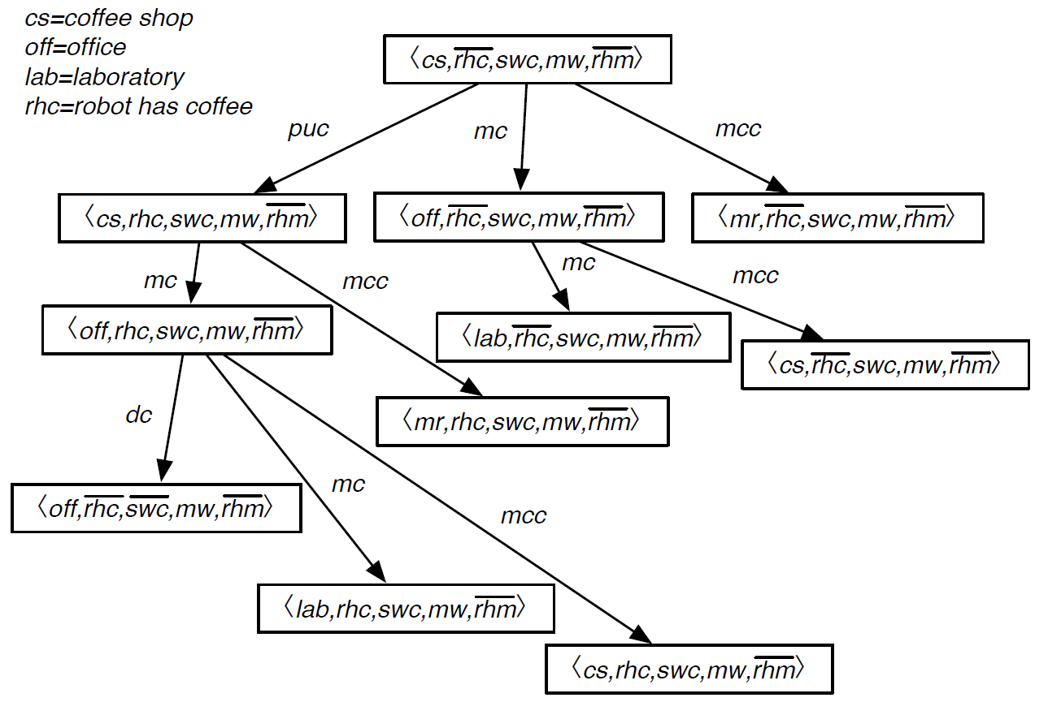
Example for state space graph
Goal:
Solution:
a sequence of actions that gets us from the start to a goal
(puc, mc)
(puc, mc, mc)
What is a solution to
this planning problem?
(puc, dc)
(puc, mc, dc)

Slide 24
Example for state space graph
Goal:
Solution:
a sequence of actions that gets us from the start to a goal
What is a solution to
this planning problem?
(puc, mc, dc)

Slide 25
Example state-space graph

Slide 26
Standard Search vs. Specific R&R systems
Constraint Satisfaction (Problems):
State: assignments of values to a subset of the variables
Successor function: assign values to a “free” variable
Goal test: set of constraints
Solution: possible world that satisfies the constraints
Heuristic function: none (all solutions at the same distance from start)
Planning :
State
Successor function
Goal test
Solution
Heuristic function
Inference
State
Successor function
Goal test
Solution
Heuristic function
Notes:
Allows useful general-purpose algorithms with more power than standard search algorithms

Slide 27
Lecture Overview
Planning
Example
STRIPS: a Feature-Based Representation
Forward Planning
Heuristics (not on textbook)
CSP Planning
Logic Intro
Propositional Definite Clause Logic: Syntax
Notes:
STRIPS representation and assumption (STanford Research Institute Problem Solver )
70s 80s

Slide 28
Heuristics for Forward Planning
Heuristic function: estimate of the distance form a state to the goal
In planning this is the……………….
Two simplifications in the representation:
All features are binary: T / F
Goals and preconditions can only be assignments to T
And a Def. a subgoal is a particular assignment in the goal e.g., if the goal is <A=T, B=T, C=T> then….
Notes:
Two simplifications. To let you know about the basic issues involved in developing heuristics
For planning while keeping the explanation manageable
Goals and preconditions can only be positive literals.
(Many problems are written with this convention. For problems that aren’t replace every negative literal in a goal or a precond. With a new positive one. From R&N 2010)
So a negative effect can only
make it harder to achieve a goal (or a precondition to an action that achieves the goal). Therefore,
eliminating all negative effects only makes a problem easier.
Identify relaxed version of the problem (remove some restrictions)
Solution cost for a subproblem
Solution for the problem is the sum of solutions for subproblems

Slide 29
Heuristics for Forward Planning: Any ideas?
Notes:
Because of a) and b) heuristic is inaccurate
Because of c heuristics is inadmissible
Identify relaxed version of the problem (remove some restrictions)
Solution cost for a subproblem
“cannot be achieved at all)
Inadmissible and (inaccurate for two reasons)
Precondition removal

Slide 30
Heuristics for Forward Planning (cont’)
What kind of simplifications of the actions would justify our proposal for h?
We have removed all …………….
We have removed all …………….
We assume no action can achieve…………………..
Notes:
Because of a) and b) heuristic is inaccurate
Because of c heuristics is inadmissible
Identify relaxed version of the problem (remove some restrictions)
Solution cost for a subproblem
“cannot be achieved at all)
Inadmissible and (inaccurate for two reasons)
Precondition removal

Slide 31
Heuristics for Forward Planning: empty-delete-list
We only relax the problem according to (…….)
i.e., we remove all the effects that make a variable F
Action a effects (B=F, C=T)
But then how do we compute the heuristic?
………………………………………….
This is often fast enough to be worthwhile
empty-delete-list heuristics with forward planning is currently considered a very successful strategy
Notes:
Do not need to worry about negative interactions between subplans
We need to actually run the planner on the simplified problem
(remember the 1,2,3,4,problem for the 8-puzzle)

Slide 32
Empty-delete in practice

Slide 33
Final Comment
You should view Forward Planning as one of the basic planning techniques (we’ll see another one after the break)
By itself, it cannot go far, but it can work very well in combination with other techniques, for specific domains
See, for instance, descriptions of competing planners in the presentation of results for the 2002 and 2008 planning competition (posted in the class schedule)

Slide 34
Learning Goals for today’s class – part-1
You can:
Represent a planning problem with the STRIPS representation
Explain the STRIPS assumption
Solve a planning problem by search (forward planning). Specify states, successor function, goal test and solution.
Construct and justify a heuristic function for forward planning.

Slide 35
Lecture Overview
Planning
Example
STRIPS: a Feature-Based Representation
Forward Planning
Heuristics
CSP Planning (Chp 8.4)
Logic Intro
Propositional Definite Clause Logic: Syntax

Slide 36
Planning as a CSP
An alternative approach to planning is to set up a planning problem as a CSP!
We simply reformulate a STRIPS model as a set of variables and constraints
Once this is done we can even express additional aspects of our problem (as additional constraints)
e.g., see Practice Exercise UBC commuting “careAboutEnvironment” constraint
Notes:
We don't have to worry about searching forwards
Particularly effective in domains for which we can get a reliable estimate of k
STanford Research Institute Problem Solver

Slide 37
Planning as a CSP: Variables
We need to “unroll the plan” for a fixed number of steps: this is called the horizon
To do this with a horizon of k:
construct a CSP variable for each STRIPS variable at each time step from 0 to k
construct a boolean CSP variable for each STRIPS action at each time step from 0 to k - 1.
Notes:
We don't have to worry about searching forwards
Particularly effective in domains for which we can get a reliable estimate of k

Slide 38
CSP Planning: Robot Example
Variables for actions ….
action (non) occurring at that step
Notes:
Do you see why CSP planning doesn't have to search forwards?

Slide 39
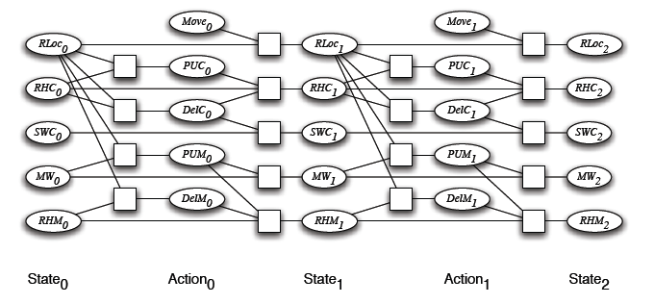
CSP Planning: Initial and Goal Constraints
initial state constraints constrain the state variables at time 0
goal constraints constrain the state variables at time k

Slide 40
CSP Planning: Prec. Constraints
As usual, we have to express the preconditions and effects of actions:
precondition constraints
hold between state variables at time t and action variables at time t
specify when actions may be taken
RLoc₀ | RHC₀ | PUC₀
cs | T | F
cs | F | T
cs | F | F
mr | * | F
lab | * | F
off | * | F
PUC₀

Slide 41
CSP Planning: Effect Constraints
effect constraints
between state variables at time t, action variables at time t and state variables at time t + 1
explain how a state variable at time t + 1 is affected by the action(s) taken at time t and by its own value at time t
RHC_{i} | DelC_{i} | PUC_{i} | RHC_{i+1}
T | T | T | T
T | T | F | F
T | F | T | T
… | … | … | …
… | … | … | …
Notes:
this includes both causal and frame axioms
basically, it goes back to the feature-centric representation the
book discusses before STRIPS
of course, solving the problem this way doesn't mean we can't
encode the problem using STRIPS

Slide 42
CSP Planning: Constraints Contd.
Other constraints we may want are action constraints:
specify which actions cannot occur simultaneously
these are sometimes called mutual exclusion (mutex) constraints
E.g., in the Robot domain
DelM and DelC can occur in any sequence (or simultaneously)
But we could change that…
DelM_{i} | DelC_{i}
Notes:
when the order between several actions doesn't matter, this is a good thing
T F
F T
F F
note that without these constraints, there's nothing to stop the planner from deciding to take several actions simultaneously

Slide 43
CSP Planning: Constraints Contd.
Other constraints we may want are state constraints
hold between variables at the same time step
they can capture physical constraints of the system (robot cannot hold coffee and mail)
they can encode maintenance goals
RHC_{i} | RHM_{i}
Notes:
Charge 100% 80% ….
Distance recharger 1 2 3 4 5
Charge – 20% distance >= 0

Slide 44
CSP Planning: Solving the problem
Map STRIPS Representation for horizon 1, 2, 3, …, until solution found
Run arc consistency and search or stochastic local search!
k = 0
Is State₀ a goal?
If yes, DONE!
If no,

Slide 45
CSP Planning: Solving the problem
Map STRIPS Representation for horizon k =1
Run arc consistency and search or stochastic local search!
k = 1
Is State₁ a goal
If yes, DONE!
If no,

Slide 46
CSP Planning: Solving the problem
Map STRIPS Representation for horizon k = 2
Run arc consistency, search, stochastic local search!
k = 2: Is State₂ a goal
If yes, DONE!
If no….continue

Slide 47
CSP Planning: Solving the problem
Map STRIPS Representation for horizon:
Run arc consistency, search, stochastic local search!
Plan: all actions with assignment T
In order to find a plan, we expand our constraint network one layer at the time, until a solution is found
Notes:
But remember that this representation is done for a fixed number of steps (the horizon)

Slide 48
Solve planning as CSP: pseudo code

Slide 49
State of the art planner
A similar process is implemented (more efficiently) in the Graphplan planner
Notes:
But remember that this representation is done for a fixed number of steps (the horizon)

Slide 50
STRIPS to CSP applet
Allows you:
to specify a planning problem in STRIPS
to map it into a CSP for a given horizon
the CSP translation is automatically loaded into the CSP applet where it can be solved
Practice exercise using STRIPS to CSP is available on AIspace

Slide 51
Learning Goals for planning – part-2
Translate a planning problem represented in STRIPS into a corresponding CSP problem (and vice versa)
Solve a planning problem with CPS by expanding the horizon (new one)

Slide 52
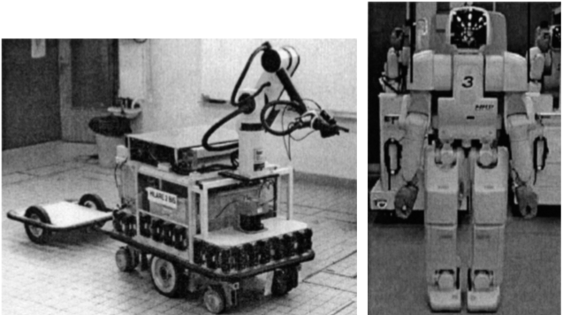
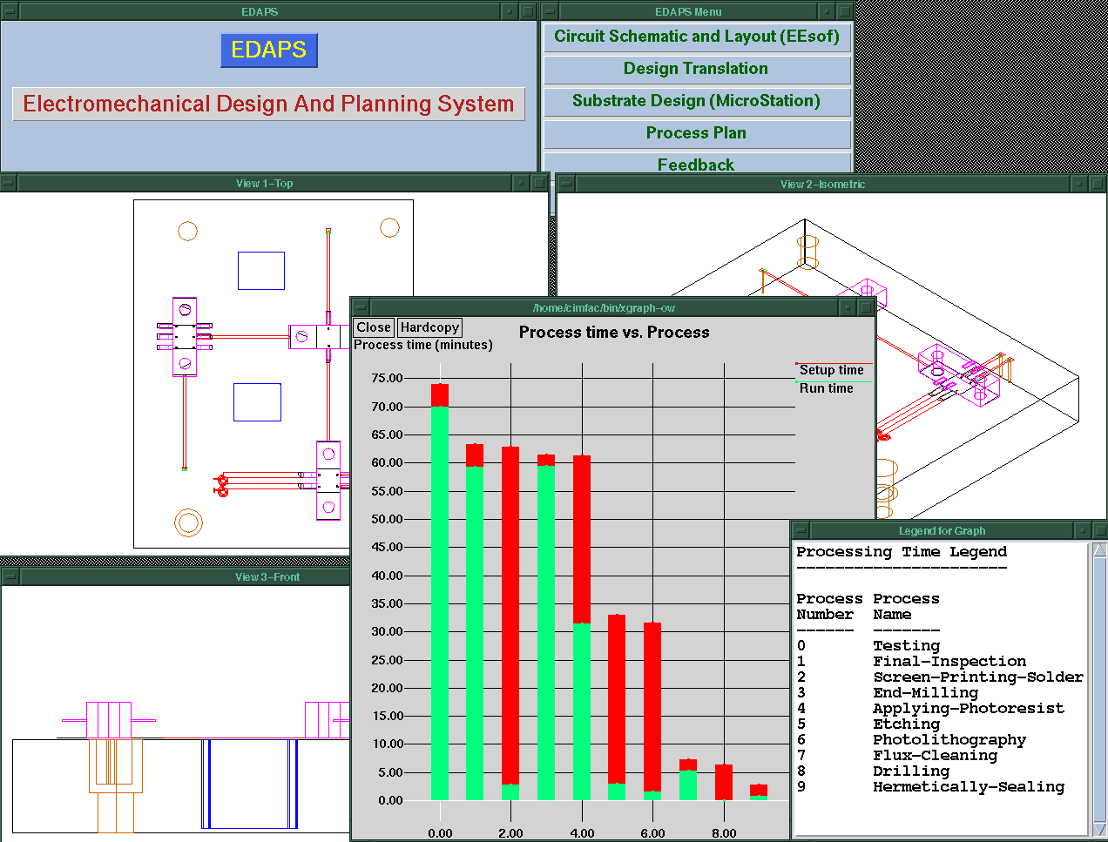
Now, do you know how to implement a planner for….
Emergency Evacuation?
Robotics?
Space Exploration?
Manufacturing Analysis?
Games (e.g., Bridge)?
Generating Natural language
Product Recommendations ….
★
Q
✦
9

A
◻
North
A
✦
7

K
◻
★
9
J
★
6

5
★
5

3
West
East

2

6

8

Q
South
Notes:
We don't have to worry about searching forwards
Particularly effective in domains for which we can get a reliable estimate of k
STanford Research Institute Problem Solver

Slide 53
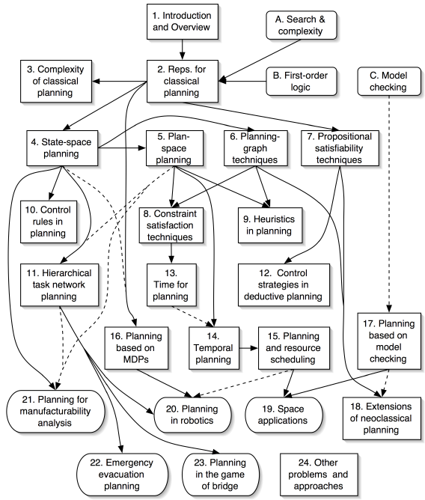
No ☹, but you (will) know the key ideas ☺!
Ghallab, Nau, and Traverso Automated Planning: Theory and Practice Morgan Kaufmann, May 2004 ISBN 1-55860-856-7
Web site:
http://www.laas.fr/planning
Notes:
Add also dialog managers and text planner as applications
of HTN and for dialogue also MDPs

Slide 54
Lecture Overview
Planning
Example
STRIPS: a Feature-Based Representation
Forward Planning
Heuristics
CSP Planning
Logic Intro (Chp 5.1- 5.1.1 )
Propositional Definite Clause Logic: Syntax
Notes:
STRIPS representation and assumption (STanford Research Institute Problem Solver )
70s 80s

Slide 55
Modules we'll cover in this course: R&Rsys
Environment
Deterministic
Stochastic
Problem
Arc Consistency
Search
Constraint Satisfaction
Vars +
Constraints
SLS
Static
Belief Nets
Inference
Logics
Var. Elimination
Search
Sequential
Decision Nets
STRIPS
Var. Elimination
Planning
Search
Markov Processes
Representation
Value Iteration
Reasoning
Technique
Notes:
R&R Sys Representation and reasoning Systems
Each cell is a R&R system
STRIPS actions preconditions and effects

Slide 56
Logics
Mostly only propositional…. This is the starting point for more complex ones ….
Natural to express knowledge about the world
What is true (boolean variables)
How it works (logical formulas)
Well understood formal properties
Boolean nature can be exploited for efficiency
……

Slide 57
Logics in AI: Similar slide to the one for planning
Propositional Definite Clause Logics
Semantics and Proof Theory
Propositional Logics
First-Order Logics
Satisfiability Testing (SAT)
Description Logics
Hardware Verification
Production Systems
Product Configuration
Ontologies
Cognitive Architectures
Semantic Web
Video Games
Summarization
Tutoring Systems
Information Extraction

Slide 58
What you already know about logic...
From programming: Some logical operators
If ((amount > 0) && (amount < 1000)) || !(age < 30)
...
You know what they mean in a “procedural” way
Logic is the language of Mathematics. To define formal structures (e.g., sets, graphs) and to proof statements about those
We are going to look at Logic as a Representation and Reasoning System that can be used to formalize a domain (e.g., an electrical system, an organization) and to reason about it
Notes:
There are many different, but equivalent, axiomatizations of Peano arithmetic. While some axiomatizations, such as the one just described, only describe the successor operation, other axiomatizations directly describe the arithmetical operations. One such axiomatization begins with the following axioms that describe a discrete ordered semiring.[7]
∈x, y, z ∈ N. (x + y) + z = x + (y + z), i.e., addition is associative.
∀x, y ∈ N. x + y = y + x, i.e., addition is commutative.
∀x, y, z ∈ N. (x · y) · z = x · (y · z), i.e., multiplication is associative
∀x, y ∈ N. x · y = y · x, i.e., multiplication is commutative.
∀x, y, z ∈ N. x · (y + z) = (x · y) + (x · z), i.e., the distributive law.
∀x ∈ N. x + 0 = x ∧ x · 0 = 0.
∀x ∈ N. x · 1 = x.
∀x, y, z ∈ N. x < y ∧ y < z ⊃ x < z.
∀x ∈ N. ¬ (x < x).
∀x, y ∈ N. x < y ∨ x = y ∨ x > y.
∀x, y, z ∈ N. x < y ⊃ x + z < y + z.
∀x, y, z ∈ N. 0 < z ∧ x < y ⊃ x · z < y · z.
∀x, y ∈ N. x < y ⊃ ∃z ∈ N. x + z = y.
0 < 1 ∧ ∀x ∈ N. x > 0 ⊃ x ≥ 1..
∀x ∈ N. x ≥ 0.

Slide 59
Logic: A general framework for representation & reasoning
Let's now think about how to represent an environment about which we have only partial (but certain) information
What do we need to represent?
Notes:
Everything we can express in natural language ?
Def1. Meaning: a representation that expresses the linguistic input in terms of objects, actions, events, time, space… beliefs, attitudes...relationships

Slide 60
Why Logics?
“Natural” to express knowledge about the world
(more natural than a “flat” set of variables & constraints)
“Every 322 student will pass the midterm”
It is easy to incrementally add knowledge
It is easy to check and debug knowledge
Provide language for asking complex queries
Well understood formal properties
Notes:
Def1. Meaning: a representation that expresses the linguistic input in terms of objects, actions, events, time, space… beliefs, attitudes...relationships
exists x Isa(x, midterm)
courseOf(x, 322)
Isa(322, course)
forall z Student(z) AND registred(z,322) -> pass(z,x.t) AND (t > Now)

Slide 61
Propositional Logic
We will study the simplest form of Logic: Propositional
The primitive elements are propositions: Boolean variables that can be {true, false}
The goal is to illustrate the basic ideas
This is a starting point for more complex logics (e.g., first-order logic)
Boolean nature can be exploited for efficiency.
Notes:
We'll be looking at problems that could still be represented using CSPs. Why use propositional logic
Propositional logic is the simplest logic – illustrates basic ideas
Logic can be extended to infinitely many “variables” (using logical quantification)

Slide 62
Propositional logic: Complete Language
The proposition symbols p₁, p₂ … etc are sentences
If S is a sentence, ¬S is a sentence (negation)
If S₁ and S₂ are sentences, S₁ ∧ S₂ is a sentence (conjunction)
If S₁ and S₂ are sentences, S₁ ∨ S₂ is a sentence (disjunction)
If S₁ and S₂ are sentences, S₁ ⇒ S₂ is a sentence (implication)
If S₁ and S₂ are sentences, S₁ ⇔ S₂ is a sentence (biconditional)
Notes:
Propositional logic is the simplest logic – illustrates basic ideas

Slide 63
Propositional Logics in practice
Agent is told (perceives) some facts about the world
Agent is told (already knows / learns) how the world works
Agent can answer yes/no questions about whether other facts must be true

Slide 64
Using Logics to make inferences…
Begin with a task domain.
Distinguish those things you want to talk about (the ontology).
Choose symbols in the computer to denote propositions
Tell the system knowledge about the domain.
Ask the system whether new statements about the domain are true or false.

Slide 65
Electrical Environment
/down
/ up
Notes:
1 Begin with a task domain.
Electrical environment
2 Distinguish those things you want to talk about (the ontology).
Lights switches
3Choose symbols in the computer to denote propositions
sw₃_up: switch is up
live_outside: there is power in the building
4Tell the system knowledge about the domain.
sw₃_up and live_w₃ -> live_w₄
5 Ask the system whether new statements about the domain are true or false.
live_l₂
l₂_broken: light l₂ is broken
sw₃_up: switch is up
power: there is power in the building
unlit_l₂: light l₂ isn't lit
lit_l₁: light l₁ is lit
Conclusion l₂_broken
Rules
l₂_broken ← sw₃_up
∧ power ∧ unlit_l₂.
sw₃_up.
power ← lit_l₁.
unlit_l₂.
lit_l₁.

Slide 66
Lecture Overview
Planning
Example
STRIPS: a Feature-Based Representation
Forward Planning
Heuristics
CSP Planning
Logic Intro
Propositional Definite Clause Logic: Syntax (Chp 5.2)
Notes:
STRIPS representation and assumption (STanford Research Institute Problem Solver )
70s 80s

Slide 67
Propositional Definite Clauses
Propositional Definite Clauses: our first logical representation and reasoning system.
(very simple!)
Only two kinds of statements:
that a proposition is true
that a proposition is true if one or more other propositions are true
Why still useful?
Adequate in many domains (with some adjustments)
Reasoning steps easy to follow by humans
Inference linear in size of your set of statements
Similar formalisms used in cognitive architectures
Notes:
To define this RSS, we'll need to specify:
syntax
semantics
proof procedure

Slide 68
Propositional Definite Clauses: Syntax
Definition (atom)
An atom is a symbol starting with a lower case letter
Definition (body)
A body is an atom or is of the form b₁ ∧ b₂ where b₁
and b₂ are bodies.
Definition (definite clause)
A definite clause is an atom or is a rule of the form h ← b where h is an atom and b is a body. (Read this as ``h if b.'')
Definition (KB)
A knowledge base is a set of definite clauses

Slide 69
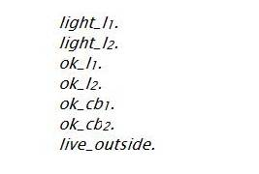
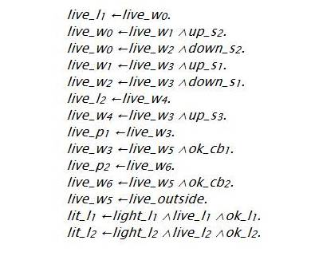
atoms
definite clauses, KB
rules

Slide 70
PDC Syntax: more examples
Definition (definite clause)
A definite clause is
an atom or
a rule of the form h ← b where h is an atom (‘head’) and b is a body. (Read this as ‘h if b.’)
Legal PDC clause
Not a legal PDC clause
ai_is_fun
ai_is_fun ∨ ai_is_boring
ai_is_fun ← learn_useful_techniques
ai_is_fun ← learn_useful_techniques ∧ notTooMuch_work
ai_is_fun ← learn_useful_techniques ∧ ¬ TooMuch_work
ai_is_fun ← f(time_spent, material_learned)
srtsyj ← errt ∧ gffdgdgd

Slide 71
PDC Syntax: more examples
Legal PDC clause
Not a legal PDC clause
ai_is_fun
ai_is_fun ∨ ai_is_boring
ai_is_fun ← learn_useful_techniques
ai_is_fun ← learn_useful_techniques ∧ notTooMuch_work
ai_is_fun ← learn_useful_techniques ∧ ¬ TooMuch_work
ai_is_fun ← f(time_spent, material_learned)
srtsyj ← errt ∧ gffdgdgd
Do any of these statements mean anything?
Syntax doesn't answer this question!

Slide 72
Learning Goals for today’s: Logic
You can:
Verify whether a logical statement belongs to the language of full propositional logics.
Verify whether a logical statement belongs to the language of propositional definite clauses.

Slide 73
Study for midterm (Mon May 28 – 3PM - rm 310)
Midterm: ~6 short questions (10pts each) + 2 problems (20pts each)
Study: textbook and inked slides
Work on all practice exercises and revise assignments!
While you revise the learning goals, work on review questions (will post them tomorrow)- I may even reuse some verbatim ☺
Will post a couple of problems from previous offering (maybe slightly more difficult /inappropriate for you because they were not informed by the learning goals) … but I’ll give you the solutions ☺

Slide 74
Next class
Definite clauses Semantics and Proofs (textbook 5.1, 5.2)

