Slide 1
(Stochastic) Local Search
Computer Science cpsc322, Lecture 5
(Textbook Chpt 4.8-4.9)
May, 22, 2012
Notes:
Lecture 5

Slide 2
Course Announcements
Posted on WebCT
Assignment2 on CSPs (due on Thurs!)
If you are confused about basic CSPs….. Check learning goals at the end of lectures. Please come to office hours
Work on CSPs Practice Ex:
  Exercise 4.A: arc consistency
  Exercise 4.B: constraint satisfaction problems
  Exercise 4.C: SLS for CSP
MIDTERM: Mon May 28th – 3PM (room TBA)

Slide 3
Systematically solving CSPs: Summary
Build Constraint Network
Apply Arc Consistency
  One domain is empty →
  Each domain has a single value →
  Some domains have more than one value →
Apply Depth-First Search with Pruning
Split the problem in a number of disjoint cases
  Apply Arc Consistency to each case
Notes:
Otherwise, split a domain & apply arc consistency to each case.
Spiltting in half the variable with the smallest domain usually works best (who know why)
ACC: Show with Cispace, first “scheduling problem”, and then crossword 1 for splitting. What makes sense is to split the node with 6 vars to the right, show that it gets to an empty solution, backtrack, and do more s0plitting on the var with 2 values on the top-left. Done. WENT WELL

Slide 4
Lecture Overview
Local search
  Constrained Optimization
  Greedy Descent / Hill Climbing: Problems
Stochastic Local Search (SLS)
  Comparing SLS algorithms
  SLS variants
    Tabu lists
    Simulated Annealing
  Population Based
    Beam search
    Genetic Algorithms

Slide 5
Local Search motivation: Scale
Many CSPs (scheduling, DNA computing, more later) are simply too big for systematic approaches
If you have 10⁵ vars with dom(var_{i}) = 10⁴
Systematic Search
Constraint Network
but if solutions are densely distributed…….

Slide 6
Local Search: General Method
  Remember , for CSP a solution is…..
  Start from a possible world
  Generate some neighbors ( “similar” possible worlds)
  Move from the current node to a neighbor, selected according to a particular strategy
  Example: A,B,C same domain {1,2,3}
Notes:
A useful method in practice for some consistency and optimization problems is local search
move from one node to another according to a function that scores how good each neighbor is
according to a function that scores how good each neighbor is

Slide 7
Local Search: Selecting Neighbors
How do we determine the neighbors?
Usually this is simple: some small incremental change to the variable assignment
  assignments that differ in one variable's value, by (for instance) a value difference of +1
  assignments that differ in one variable's value
  assignments that differ in two variables' values, etc.
  Example: A,B,C same domain {1,2,3}

Slide 8
Iterative Best Improvement
How to determine the neighbor node to be selected?
Iterative Best Improvement:
  select the neighbor that optimizes some evaluation function
Which strategy would make sense? Select neighbor with …
Maximal number of constraint violations
Similar number of constraint violations as current state
No constraint violations
Minimal number of constraint violations

Slide 9
Iterative Best Improvement
How to determine the neighbor node to be selected?
Iterative Best Improvement:
  select the neighbor that optimizes some evaluation function
Which strategy would make sense? Select neighbour with …
Evaluation function:
h(n): number of constraint violations in state n
Greedy descent: evaluate h(n) for each neighbour, pick the neighbour n with minimal h(n)
Hill climbing: equivalent algorithm for maximization problems
  Here: maximize the number of constraints satisfied
Minimal number of constraint violations

Slide 10
Selecting the best neighbor
  Example: A,B,C same domain {1,2,3} , (A=B, A>1, C≠3)
A common component of the scoring function (heuristic) => select the neighbor that results in the ……
- the min conflicts heuristics
Notes:
For example, if the goal is to find the highest point on a surface, the scoring function might be the height at the current point.

Slide 11
Example: N-Queens
Put n queens on an n × n board with no two queens on the same row, column, or diagonal (i.e attacking each other)
Positions a queen
can attack

Slide 12
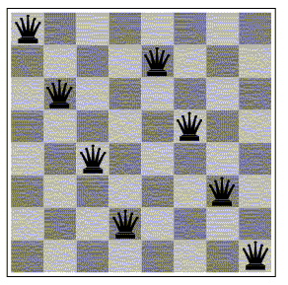
Example: N-queen as a local search problem
CSP: N-queen CSP
  One variable per column; domains {1,…,N} => row where the queen in the i^{th} column seats;
  Constraints: no two queens in the same row, column or diagonal
Neighbour relation: value of a single column differs
Scoring function: number of constraint violations (i..e, number of
attacks)

Slide 13
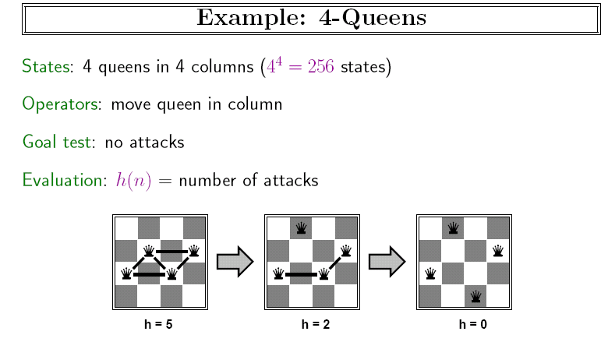
Example: n-queens
Put n queens on an n × n board with no two queens on the same row, column, or diagonal (i.e attacking each other)

Slide 14
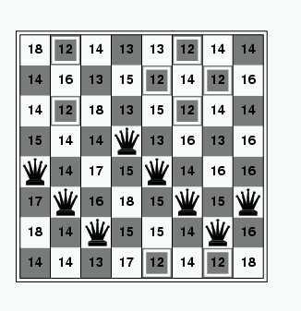
Example: Greedy descent for N-Queen
For each column, assign randomly each queen to a row
(a number between 1 and N)
Repeat
  For each column & each number: Evaluate how many constraint violations changing the assignment would yield
  Choose the column and number that leads to the fewest violated constraints; change it
Until solved

Slide 15
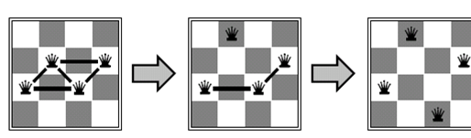
h = 5
h = ?
h = ?
1
0
2
3

Slide 16
n-queens, Why?
Why this problem?
Lots of research in the 90’ on local search for CSP was generated by the observation that the run-time of local search on n-queens problems is independent of problem size!
Notes:
It consists of an initial
search phase that starts during problem generation and a final search phase that removes conflicts During
the initial search function Initial Search an initial permutation of the row positions of the queens is
Generated
A random permutation of n queens would generate approximately .5n
collisions Since this number of collisions is very high the algorithm performance can be improved
signicantly if collisions in the initial permutation are minimized
During the final search procedure Final Search two queens are
chosen for conflict minimization If a swap (the row) of two queens reduces the number of collisions then two queens
are swapped Otherwise no action is taken The final search is repeated until all collisions are eliminated
The number of collisions on a diagonal line can be computed in constant time using a characterization
of diagonal lines

Slide 17
Lecture Overview
Local search
  Constrained Optimization
  Greedy Descent / Hill Climbing: Problems
Stochastic Local Search (SLS)
  Comparing SLS algorithms
  SLS variants
    Tabu lists
    Simulated Annealing
  Population Based
    Beam search
    Genetic Algorithms

Slide 18
Constrained Optimization Problems
So far we have assumed that we just want to find a possible world that satisfies all the constraints.
But sometimes solutions may have different values / costs
We want to find the optimal solution that
  maximizes the value or
  minimizes the cost
Notes:
It consists of an initial
search phase that starts during problem generation and a final search phase that removes conflicts During
the initial search function Initial Search an initial permutation of the row positions of the queens is
Generated
A random permutation of n queens would generate approximately .5n
collisions Since this number of collisions is very high the algorithm performance can be improved
signicantly if collisions in the initial permutation are minimized
During the final search procedure Final Search two queens are
chosen for conflict minimization If a swap (the row) of two queens reduces the number of collisions then two queens
are swapped Otherwise no action is taken The final search is repeated until all collisions are eliminated
The number of collisions on a diagonal line can be computed in constant time using a characterization
of diagonal lines

Slide 19
Constrained Optimization Example
  Example: A,B,C same domain {1,2,3} , (A=B, A>1, C≠3)
  Value = (C+A) so we want a solution that maximize that
The scoring function we’d like to maximize might be:
f(n) = (C + A) + #-of-satisfied-const
Hill Climbing means selecting the neighbor which best improves a (value-based) scoring function.
Greedy Descent means selecting the neighbor which minimizes a (cost-based) scoring function.
Notes:
For example, if the goal is to find the highest point on a surface, the scoring function might be the height at the current point.

Slide 20
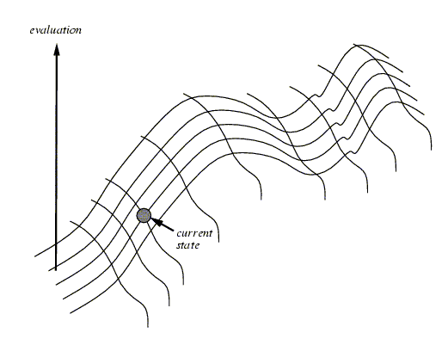
Hill Climbing
NOTE: Everything that will be said for Hill Climbing is also true for Greedy Descent
Notes:
One of the most obvious heuristics is to select the value that results in the minimum # of conflicts with the other variables - the min conflicts heuristics
Ex, in case of eight queen, it is the number of attacking queens.
Min conflict is surprising effective and can solve the million-queens problem in less than 50 steps. It has also been used to schedule the hubble telecope, reducing the time taken to schedule a week of observations from three weeks to around 10’

Slide 21
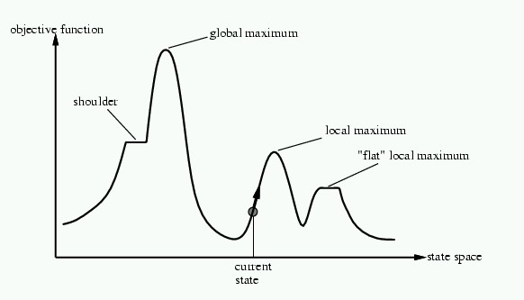
Problems with Hill Climbing
Local Maxima.
Plateau - Shoulders
(Plateau)
Notes:
No way to move from a plateau, could escape from a shoulder
With a randomly gerenated 8-queen initial state steepest ascent hill climbing gets stuck 86% of the times. Takes 4 steps on average to suceed and 3 to get stuck –good since there are 17 million states

Slide 22
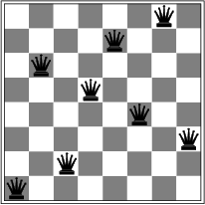
Corresponding problem for GreedyDescent
Local minimum example: 8-queens problem
A local minimum with h = 1

Slide 23
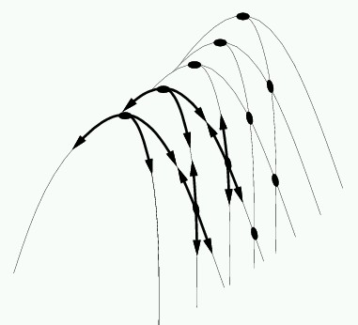
Even more Problems in higher dimensions
E.g., Ridges – sequence of local maxima not directly connected to each other
From each local maximum you can only
go downhill

Slide 24
Lecture Overview
Local search
  Constrained Optimization
  Greedy Descent / Hill Climbing: Problems
Stochastic Local Search (SLS)
  Comparing SLS algorithms
  SLS variants
    Tabu lists
    Simulated Annealing
  Population Based
    Beam search
    Genetic Algorithms
Notes:
How to address problems with Greedy Descent / Hill Climbing?
Stochastic Local Search (SLS)

Slide 25
Local Search: Summary
A useful method in practice for large CSPs
  Start from a possible world
  Generate some neighbors ( “similar” possible worlds)
  Move from current node to a neighbor, selected to minimize/maximize a scoring function which combines:
    Info about how many constraints are violated
    Information about the cost/quality of the solution (you want the best solution, not just a solution)
Notes:
move from one node to another according to a function that scores how good each neighbor is
according to a function that scores how good each neighbor is
Number of unsatisfied constraints OR weighted count

Slide 26
Stochastic Local Search
GOAL: We want our local search
  to be guided by the scoring function
  Not to get stuck in local maxima/minima, plateaus etc.
SOLUTION: We can alternate
  Hill-climbing steps
  Random steps: move to a random neighbor.
  Random restart: reassign random values to all variables.
Notes:
NOTE again: Everything that will be said for Hill Climbing is also true for Gradient Descent (max -> min)
Consider two methods to find a maximum value:
Hill climbing, starting from some position, keep moving uphill & report maximum value found
Pick values at random & report maximum value found
Which do you expect to work better to find a maximum?
hill climbing is good for finding local maxima
selecting random nodes is good for finding/exploring new parts of the search space
A mix of the two techniques can work even better

Slide 27
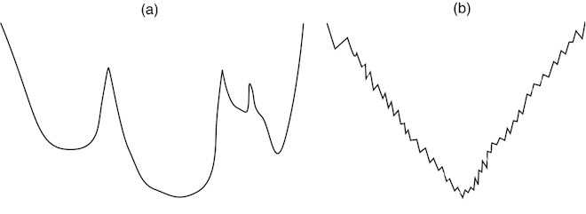
Which randomized method would work best in each of these two search spaces?
Evaluation function
A
Evaluation function
B
State Space (1 variable)
State Space
(1 variable)
Greedy descent with random steps best on A
Greedy descent with random restart best on B
Greedy descent with random steps best on B
Greedy descent with random restart best on A
equivalent

Slide 28
Which randomized method would work best in each of the these two search spaces?
Evaluation function
A
Evaluation function
B
State Space (1 variable)
State Space
(1 variable)
Greedy descent with random steps best on B
Greedy descent with random restart best on A
But these examples are simplified extreme cases for illustration
  in practice, you don’t know what your search space looks like
Usually integrating both kinds of randomization works best

Slide 29
Random Steps (Walk)
Let’s assume that neighbors are generated as
  assignments that differ in one variable's value
How many neighbors there are given n variables with domains with d values?
One strategy to add randomness to the selection variable-value pair. Sometimes choose the pair
According to the scoring function
A random one
E.G in 8-queen
How many neighbors?
……..
Notes:
You may choose between a one or two stage heuristic.
In a one stage heuristic the variable and value are chosen together.
The pair that minimize the number of conflicts
In the two stage heuristic the variable is chosen first and then the
value. The variable with the greatest number of conflicts in it's
edges is chosen and then the value which resolves the highest number
of conflicts is chosen from this variable's set of values.

Slide 30
Random Steps (Walk): two-step
Another strategy: select a variable first, then a value:
  Sometimes select variable:
    that participates in the largest number of conflicts.
    at random, any variable that participates in some conflict.
    at random
  Sometimes choose value
    That minimizes # of conflicts
    at random
0
2
2
3
3
2
Aispace
2 a: Greedy Descent with Min-Conflict Heuristic
3
Notes:
Sometimes choose the variable which participates in the largest number of conflicts.
Sometimes choose, at random, any variable that participates in some conflict.
Sometimes choose a random variable.
Sometimes choose the best value for the chosen variable.
Sometimes choose a random value for the chosen variable.

Slide 31
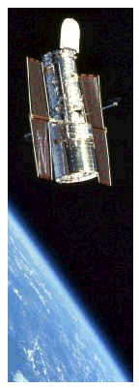
Successful application of SLS
Scheduling of Hubble Space Telescope: reducing time to schedule 3 weeks of observations:
from one week to around 10 sec.
Notes:
Generate feasible schedule that are not too suboptimal
Soft constraints
e.g., Minimize light from moon / sun
SPIKE treats schedule construction as a constrained optimization problem and uses a heuristic
repair-based scheduling search technique called multistart stochastic repair. This
technique consists of the following steps:
1. Trial assignment: make a trial assignment (“initial guess”) of activities to times, based
on heuristics to be discussed further below. Such a schedule will generally have temporal
or other constraint violations, as well as resource capacity overloads;
2. Repair: apply heuristic repair techniques to try to eliminate constraint violations, until
either a pre-established level of effort has been expended or there are no conflicts left;
3. Deconflict: eliminate conflicts by removing any activities with constraint violations, or
by relaxing constraints, until a feasible schedule remains.

Slide 32
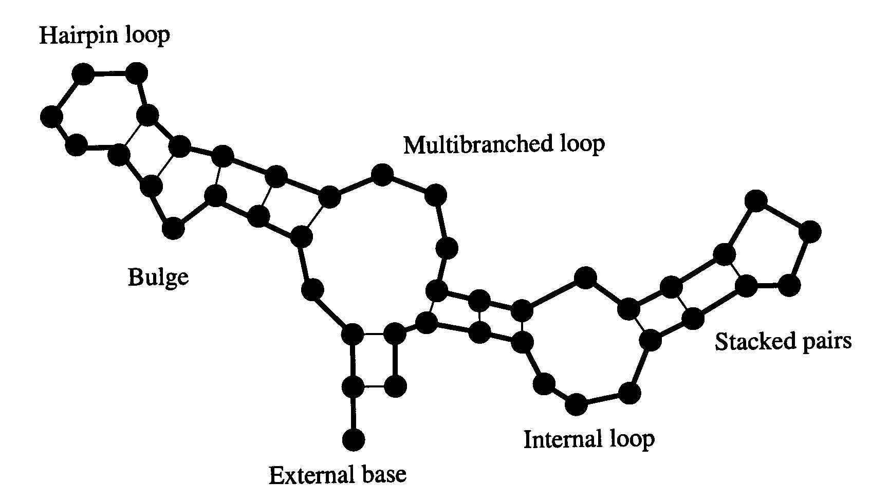
Example: SLS for RNA secondary structure design
RNA strand made up of four bases: cytosine (C), guanine (G), adenine (A), and uracil (U)
2D/3D structure RNA strand folds into
is important for its function
Predicting structure for a
strand is “easy”: O(n³)
But what if we want a strand that folds
into a certain structure?
  Local search over strands
    Search for one that folds
    into the right structure
  Evaluation function for a strand
    Run O(n³) prediction algorithm
    Evaluate how different the result is
    from our target structure
    Only defined implicitly, but can be
    evaluated by running the prediction algorithm
RNA strand
GUCCCAUAGGAUGUCCCAUAGGA
Easy
Hard
Secondary structure
  Best algorithm to date: Local search algorithm RNA-SSD developed at UBC
  [Andronescu, Fejes, Hutter, Condon, and Hoos, Journal of Molecular Biology, 2004]

Slide 33


CSP/logic: formal verification
Hardware verification Software verification
(e.g., IBM) (small to medium programs)
Most progress in the last 10 years based on:
Encodings into propositional satisfiability (SAT)

Slide 34
(Stochastic) Local search advantage: Online setting
When the problem can change (particularly important in scheduling)
E.g., schedule for airline: thousands of flights and thousands of personnel assignment
  Storm can render the schedule infeasible
Goal: Repair with minimum number of changes
This can be easily done with a local search starting form the current schedule
Other techniques usually:
  require more time
  might find solution requiring many more changes

Slide 35
SLS limitations
Typically no guarantee to find a solution even if one exists
  SLS algorithms can sometimes stagnate
    Get caught in one region of the search space and never terminate
  Very hard to analyze theoretically
Not able to show that no solution exists
  SLS simply won’t terminate
  You don’t know whether the problem is infeasible or the algorithm has stagnated

Slide 36
SLS Advantage: anytime algorithms
When should the algorithm be stopped ?
  When a solution is found
  (e.g. no constraint violations)
  Or when we are out of time: you have to act NOW
  Anytime algorithm:
    maintain the node with best h found so far (the “incumbent”)
    given more time, can improve its incumbent

Slide 37
Learning Goals for today’s class – part1
You can:
Implement local search for a CSP.
  Implement different ways to generate neighbors
  Implement scoring functions to solve a CSP by local search through either greedy descent or hill-climbing.
Implement SLS with
  random steps (1-step, 2-step versions)
  random restart

Slide 38
Lecture Overview
Local search
  Constrained Optimization
  Greedy Descent / Hill Climbing: Problems
Stochastic Local Search (SLS)
  Comparing SLS algorithms
  SLS variants
    Tabu lists
    Simulated Annealing
  Population Based
    Beam search
    Genetic Algorithms

Slide 39
Evaluating SLS algorithms
SLS algorithms are randomized
  The time taken until they solve a problem is a random variable
  It is entirely normal to have runtime variations of 2 orders of magnitude in repeated runs!
    E.g. 0.1 seconds in one run, 10 seconds in the next one
    On the same problem instance (only difference: random seed)
    Sometimes SLS algorithm doesn’t even terminate at all: stagnation
If an SLS algorithm sometimes stagnates, what is its mean runtime (across many runs)?
  Infinity!
  In practice, one often counts timeouts as some fixed large value X
  Still, summary statistics, such as mean run time or median run time, don't tell the whole story
    E.g. would penalize an algorithm that often finds a solution quickly but sometime stagnates

Slide 40
Comparing Stochastic Algorithms: Challenge
Summary statistics, such as mean run time, median run time, and mode run time don't tell the whole story
  What is the running time for the runs for which an algorithm never finishes (infinite? stopping time?)
% of solved runs
100%
0
10
20
30
…..
runtime / steps
Notes:
Summary stats for each algorithm are not effective…

Slide 41
First attempt….
How can you compare three algorithms when
  one solves the problem 30% of the time very quickly but doesn't halt for the other 70% of the cases
  one solves 60% of the cases reasonably quickly but doesn't solve the rest
  one solves the problem in 100% of the cases, but slowly?
% of solved runs
100%
Mean runtime / steps
of solved runs

Slide 42
Runtime Distributions are even more effective
Plots runtime (or number of steps) and the proportion (or number) of the runs that are solved within that runtime.
  log scale on the x axis is commonly used
Fraction of
solved runs, i.e.
P(solved by
this # of steps/time)
# of steps
Notes:
Scheduling 1 problem
How many states (toy problem)
200 runs 1000 steps
Random sampling
Do it again different result

Slide 43
Comparing runtime distributions
x axis: runtime (or number of steps)
y axis: proportion (or number) of runs solved in that runtime
  Typically use a log scale on the x axis
Fraction of
solved runs, i.e.
P(solved by
this # of steps/time)
# of steps
Which algorithm is most likely to solve the problem within 7 steps?
blue
red
green

Slide 44
Comparing runtime distributions
x axis: runtime (or number of steps)
y axis: proportion (or number) of runs solved in that runtime
  Typically use a log scale on the x axis
Fraction of
solved runs, i.e.
P(solved by
this # of steps/time)
# of steps
Which algorithm is most likely to solve the problem within 7 steps?
red

Slide 45
Comparing runtime distributions
Which algorithm has the best median performance?
  I.e., which algorithm takes the fewest number of steps to be successful in 50% of the cases?
blue
Fraction of
solved runs, i.e.
P(solved by
this # of steps/time)
# of steps

Slide 46
Comparing runtime distributions
Which algorithm has the best median performance?
  I.e., which algorithm takes the fewest number of steps to be successful in 50% of the cases?
blue
red
green
Fraction of
solved runs, i.e.
P(solved by
this # of steps/time)
# of steps

Slide 47
Comparing runtime distributions
x axis: runtime (or number of steps)
y axis: proportion (or number) of runs solved in that runtime
  Typically use a log scale on the x axis
Slow, but does not stagnate
Fraction of
solved runs, i.e.
P(solved by
this # of steps/time)
Crossover point:
if we run longer than 80 steps, green is the
best algorithm
57% solved after 80 steps, then stagnate
If we run less than 10 steps, red is the
best algorithm
28% solved after 10 steps, then stagnate
# of steps

Slide 48

Runtime distributions in AIspace
Let’s look at some algorithms and their runtime distributions:
  Greedy Descent
  Random Sampling
  Random Walk
  Greedy Descent with random walk
Simple scheduling problem 2 in AIspace:

Slide 49
Runtime Distributions
% of solved runs
100%
time t
Which one would you use if you could wait
t = t₁ ?
t = t₂ ?
t = t₃ ?

Slide 50
What are we going to look at in AIspace
When selecting a variable first followed by a value:
  Sometimes select variable:
    that participates in the largest number of conflicts.
    at random, any variable that participates in some conflict.
    at random
  Sometimes choose value
    That minimizes # of conflicts
    at random
AIspace terminology
Random sampling
Random walk
Greedy Descent
Greedy Descent Min conflict
Greedy Descent with random walk
Greedy Descent with random restart
…..
Notes:
Sometimes choose the variable which participates in the largest number of conflicts.
Sometimes choose, at random, any variable that participates in some conflict.
Sometimes choose a random variable.
Sometimes choose the best value for the chosen variable.
Sometimes choose a random value for the chosen variable.
Random Sampling
At each step this algorithm randomly creates a new solution. For each variable a new value is randomly chosen.
Random Walk
At each step this algorithm randomly chooses a new solution from the set of neighbouring solutions. The set of neighbouring solutions is defined in this applet as the solutions where a single variable has a different value.
Options: You may choose between a one or two stage heuristic. In the first case, the variable and value are chosen together; in the second case, the variable is chosen first and then the value.
Greedy Descent
At each step this algorithm chooses a value which improves the graph.
Options: You may choose between a one or two stage heuristic. In a one stage heuristic the variable and value are chosen together. In the two stage heuristic the variable is chosen first and then the value. The variable with the greatest number of conflicts in its edges is chosen and then the value which resolves the highest number of conflicts is chosen from this variable's set of values.
Greedy Descent with the Min Conflict Heuristic
The Min Conflict Heuristic is one of the first heuristics used for constraint satisfaction problems. (Minton et Al, 1992). It chooses a variable randomly from the set of variables with conflicts (red edges). The value which results in the fewest conflicts is chosen from the possible assignments for this variable. This heuristic is almost identical to Greedy Descent with Random Walk with a two stage heuristic choosing any red node 100% and best value 100%. The only difference is the MCH may return to the previous assignment.
Greedy Descent with Random Walk
At each step this algorithm probabilistically decides whether or not to take a greedy step (change to the best neighbour) or to take a random walk (change to any neighbour)
Options: You may choose between a one or two stage heuristic. In the first case, the variable and value are chosen together; in the second case, the variable is chosen first and then the value. To increase the random walk percentage increase the "random ..." values.
Greedy Descent with Random Restart
This algorithm proceeds like the Greedy Descent algorithm but resets the variables to a new random solution at regular intervals.
Options: Reset Graph specifies the number of steps between random resets of the graph.
Greedy Descent with all Options

Slide 51
Stochastic Local Search
Key Idea: combine greedily improving moves with randomization
As well as improving steps we can allow a “small probability” of:
  Random steps: move to a random neighbor.
  Random restart: reassign random values to all variables.
Always keep best solution found so far
Stop when
  Solution is found (in vanilla CSP …………………………)
  Run out of time (return best solution so far)
Notes:
Key Idea: combine hill climbing (advantage: finds local maximum) with randomization (advantage: doesn't get stuck).
Limitations
Typically no guarantee they will find a solution even if one exists
Not able to show that no solution exists

Slide 52
Lecture Overview
Local search
  Constrained Optimization
  Greedy Descent / Hill Climbing: Problems
Stochastic Local Search (SLS)
  Comparing SLS algorithms
  SLS variants
    Tabu lists
    Simulated Annealing
  Population Based
    Beam search
    Genetic Algorithms

Slide 53
Tabu lists
To avoid search to
  Immediately going back to previously visited candidate
  To prevent cycling
Maintain a tabu list of the k last nodes visited.
  Don't visit a poss. world that is already on the tabu list.
Cost of this method depends on…..
Notes:
SLS algorithms can get stuck in plateaus
To prevent cycling we can maintain a tabu list of the k last nodes visited.
Don't visit a node that is already on the tabu list.
If k=1, we don't allow the search to visit the same assignment twice in a row.
This method can be expensive if k is large.

Slide 54
Simulated Annealing
Key idea: Change the degree of randomness….
Annealing: a metallurgical process where metals are hardened by being slowly cooled.
  Analogy: start with a high ``temperature'': a high tendency to take random steps
  Over time, cool down: more likely to follow the scoring function
Temperature reduces over time, according to an annealing schedule
Notes:
High temperature -> random movements
Low temperature -> little randomness
Zero temperature -> hill climbing
It is an art to set a good annealing schedule!

Slide 55
Simulated Annealing: algorithm
Here's how it works (for maximizing):
  You are in node n. Pick a variable at random and a new value at random. You generate n'
  If it is an improvement i.e., , adopt it.
  If it isn't an improvement, adopt it probabilistically depending on the difference and a temperature parameter, T.
    we move to n' with probability e^{(h(n')-h(n))/T}
Notes:
On textbook for minimizing!

Slide 56
  If it isn't an improvement, adopt it probabilistically depending on the difference and a temperature parameter, T.
    we move to n' with probability e^{(h(n')-h(n))/T}

Slide 57
Properties of simulated annealing search
One can prove: If T decreases slowly enough, then simulated annealing search will find a global optimum with probability approaching 1
Widely used in VLSI layout, airline scheduling, etc.
Notes:
Often the most difficult step in the annealing process is the development of an
appropriate cooling schedule. To ensure the success of the optimization, the
temperature (control parameter) must be controlled so that it is large enough to move off
a local minimum, but small enough not to move off a global minimum. Due to the wide
variety and complicated nature of most combinational optimization problems, the
suitable cooling schedule will be unique for each problem. Ideally, the temperature
should be lowered slow enough to ensure that a good minimum is achieved, but also
quick enough so that computational time is minimized.

Slide 58
Lecture Overview
Local search
  Constrained Optimization
  Greedy Descent / Hill Climbing: Problems
Stochastic Local Search (SLS)
  Comparing SLS algorithms
  SLS variants
    Tabu lists
    Simulated Annealing
  Population Based
    Beam search
    Genetic Algorithms

Slide 59
Population Based SLS
Often we have more memory than the one required for current node (+ best so far + tabu list)
Key Idea: maintain a population of k individuals
At every stage, update your population.
Whenever one individual is a solution, report it.
Simplest strategy: Parallel Search
All searches are independent
Like k restarts
Notes:
Nothing more then running k random restarts in parallel instead then in sequence…
More memory but same power!
There's not really any reason to use this method (why not?), but it provides a framework for talking about what follows...
Like k restarts, but uses k times the minimum number of steps.

Slide 60
Population Based SLS: Beam Search
Non Stochastic
Like parallel search, with k individuals, but you choose the k best out of all of the neighbors.
Useful information is passed among the k parallel search thread
Troublesome case: If one individual generates several good neighbors and the other k-1 all generate bad successors….
Notes:
Quickly abandon unfruitful searches…
When k=1, it is hill climbing.
When k=∞, it is breadth-first search.
The value of k lets us limit space and parallelism.

Slide 61
Population Based SLS: Stochastic Beam Search
Non Stochastic Beam Search may suffer from lack of diversity among the k individual (just a more expensive hill climbing)
Stochastic version alleviates this problem:
  Selects the k individuals at random
  But probability of selection proportional to their value (according to scoring function)

Slide 62
Stochastic Beam Search: Advantages
  It maintains diversity in the population.
  Biological metaphor (asexual reproduction):
    each individual generates “mutated” copies of itself (its neighbors)
    The scoring function value reflects the fitness of the individual
    the higher the fitness the more likely the individual will survive (i.e., the neighbor will be in the next generation)

Slide 63
Population Based SLS: Genetic Algorithms
Start with k randomly generated individuals (population)
An individual is represented as a string over a finite alphabet (often a string of 0s and 1s)
A successor is generated by combining two parent individuals (loosely analogous to how DNA is spliced in sexual reproduction)
Evaluation/Scoring function (fitness function). Higher values for better individuals.
Produce the next generation of individuals by selection, crossover, and mutation

Slide 64
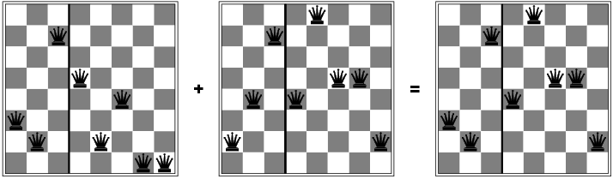
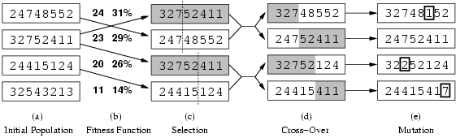
Genetic algorithms: Example
Representation and fitness function
State: string over finite alphabet
Fitness function: higher value better states
Notes:
Fitness function: number of non-attacking pairs of queens (min = 0, max = 8 × 7/2 = 28)

Slide 65
Genetic algorithms: Example
Selection: common strategy, probability of being chosen for reproduction is directly proportional to fitness score
24/(24+23+20+11) = 31%
23/(24+23+20+11) = 29% etc

Slide 66
Genetic algorithms: Example
Reproduction: cross-over and mutation
Notes:
When the two parent states are quite different the cross-over can produce a state that is long away from either parents
At the beginning when population is diverse takes big steps (like simulated annealing with high temperature

Slide 67
Genetic Algorithms: Conclusions
Their performance is very sensitive to the choice of state representation and fitness function
Extremely slow (not surprising as they are inspired by evolution!)

Slide 68
Learning Goals for today’s class part-2
You can:
Compare SLS algorithms with runtime distributions
Implement a tabu-list.
Implement the simulated annealing algorithm
Implement population based SLS algorithms:
  Beam Search
  Genetic Algorithms.
Explain pros and cons of different SLS algorithms .

Slide 69
Modules we'll cover in this course: R&Rsys
Environment
Deterministic
Stochastic
Problem
Arc Consistency
Search
Constraint Satisfaction
Vars +
Constraints
SLS
Static
Belief Nets
Query
Logics
Var. Elimination
Search
Sequential
Decision Nets
STRIPS
Var. Elimination
Planning
Search
Markov Processes
Representation
Value Iteration
Reasoning
Technique
Notes:
R&R Sys Representation and reasoning Systems
Each cell is a R&R system
STRIPS actions preconditions and effects

Slide 70
Next class
Posted on WebCT
Assignment2 on CSPs (due on Thurs!)
Planning (Chp 8.1-8.2, 8.4): How to select and organize a sequence of actions to achieve a given goal…
Start Logics (Chp 5-1-5.3)

Slide 71
Sampling a discrete probability distribution

Slide 72
Systematically solving CSPs: Summary
Build Constraint Network
Apply Arc Consistency
  One domain is empty →
  Each domain has a single value →
  Some domains have more than one value →
Apply Depth-First Search with Pruning
Split the problem in a number of disjoint cases
  Apply Arc Consistency to each case
Notes:
Otherwise, split a domain & apply arc consistency to each case.
Spiltting in half the variable with the smallest domain usually works best (who know why)
ACC: Show with Cispace, first “scheduling problem”, and then crossword 1 for splitting. What makes sense is to split the node with 6 vars to the right, show that it gets to an empty solution, backtrack, and do more s0plitting on the var with 2 values on the top-left. Done. WENT WELL

Slide 73
CSPs summary
Find a single variable assignment that satisfies all of our constraints (atemporal)
Systematic Search approach (search space …..?)
  Constraint network support
    inference e.g., Arc Consistency (can tell you if solution does not exist)
    Decomposition
  Heuristic Search (degree, min-remaining)
(Stochastic) Local Search (search space …..?)
  Huge search spaces and highly connected constraint network but solutions densely distributed
  No guarantee to find a solution (if one exists).
  Unable to show that no solution exists
Notes:
Diversification vs Intensification
I Goal-directed and randomised components of SLS strategy
need to be balanced carefully.
I Intensification: aims to greedily increase solution quality or
probability, e.g., by exploiting the evalution function.
I Diversification: aim to prevent search stagnation by preventing
search process from getting trapped in confined regions.
Examples:
I Iterative Improvement (II): intensification strategy.
I Uninformed Random Walk (URW): diversification strategy.
Balanced combination of intensification and diversification
mechanisms forms the basis for advanced SLS methods.

Slide 74
Local Search: Motivation
Solving CSPs is NP-hard
  Search space for many CSPs is huge
  Exponential in the number of variables
  Even arc consistency with domain splitting is often not enough
Alternative: local search
  use algorithms that search the space locally, rather than systematically
  Often finds a solution quickly, but are not guaranteed to find a solution if one exists (thus, cannot prove that there is no solution)

Slide 75
Local Search Problem: Definition
      Definition: A local search problem consists of a:
CSP: a set of variables, domains for these variables, and constraints on their joint values.
A node in the search space will be a complete assignment to all of the variables.
      Neighbour relation: an edge in the search space will exist
when the neighbour relation holds between a pair of nodes.
Scoring function: h(n), judges cost of a node (want to minimize)
- E.g. the number of constraints violated in node n.
- E.g. the cost of a state in an optimization context.

Slide 76
Example
Given the set of variables {V₁ ….,V_{n} }, each with domain Dom(V_{i})
The start node is any assignment {V₁ / v₁,…,V_{n} / v_{n} } .
The neighbors of node with assignment
A= {V₁ / v₁,…,V_{n} / v_{n} }
are nodes with assignments that differ from A for one value only

Slide 77
Search Space
V₁ = v₁ ,V₂ = v₁ ,.., V_{n} = v₁
V₁ = v₂ ,V₂ = v₁ ,.., V_{n} = v₁
V₁ = v₁ ,V₂ = v_{n} ,.., V_{n} = v₁
V₁ = v₄ ,V₂ = v₁ ,.., V_{n} = v₁
V₁ = v₄ ,V₂ = v₂ ,.., V_{n} = v₁
V₁ = v₄ ,V₂ = v₁ ,.., V_{n} = v₂
V₁ = v₄ ,V₂ = v₃ ,.., V_{n} = v₁
Only the current node is kept in memory at each step.
Very different from the systematic tree search approaches we
have seen so far!
Local search does NOT backtrack!

Slide 78
Example: Greedy descent for N-Queen
For each column, assign randomly each queen to a row
(a number between 1 and N)
Repeat
  For each column & each number: Evaluate how many constraint violations changing the assignment would yield
  Choose the column and number that leads to the fewest violated constraints; change it
Until solved

