Slide 1
Constraint Satisfaction Problems (CSPs)
Computer Science cpsc322, Lecture 4
(Textbook Chpt 4.0 – 4.6)
May, 17, 2012

Slide 2
Announcements
Search wrap-up
Go back to learning goals (end of slides)
Make sure you understands the inked slides
More details or different examples on textbook
Work on the practice exercises
Look at assignment 1 solutions
If still confused, come to office hours
MIDTERM: Mon May 28th – 3PM (room TBA)

Slide 3
Standard Search
To learn about search we have used it as the reasoning strategy for a simple goal-driven planning agent…..
Standard search problem: An agent can solve a problem by searching in a space of states
state is a "black box“ – any arbitrary data structure that supports three problem-specific routines
Solution?
Notes:
General but not arbitrary
General purpose rather than problem specific
successor function,
heuristic function
goal test
Deterministic, goal-driven agent
Agent is given a goal (subset of possible states)
Environment changes only when the agent acts
Agent perfectly knows:
what actions can be applied in any given state
the state it is going to end up in when an action is applied in a given state

Slide 4
Modules we'll cover in this course: R&Rsys
Environment
Deterministic
Stochastic
Problem
Arc Consistency
Constraint Satisfaction
Vars +
Constraints
Search
Static
Belief Nets
Query
Logics
Var. Elimination
Search
Sequential
Decision Nets
STRIPS
Var. Elimination
Planning
Search
Markov Processes
Representation
Value Iteration
Reasoning
Technique
Notes:
R&R Sys Representation and reasoning Systems
Each cell is a R&R system
STRIPS actions preconditions and effects

Slide 5
Standard Search vs. Specific R&R systems
Constraint Satisfaction (Problems):
State
Successor function
Goal test
Solution
Planning :
State
Successor function
Goal test
Solution
Inference
State
Successor function
Goal test
Solution
Notes:
Allows useful general-purpose algorithms with more power than standard search algorithms

Slide 6
Lecture Overview
Constraint Satisfaction Problems
Variables , Constraints, CSPs
CSPs Methods
Generate-and-Test
Search
Arc Consistency and AC Algorithm
Abstract strategy, Details
Complexity, Interpreting the output
Domain Splitting

Slide 7
Variables/Features, domains and Possible Worlds
Variables / features
we denote variables using capital letters
each variable V has a domain dom(V) of possible values
Variables can be of several main kinds:
Boolean: |dom(V)| = 2
Finite: the domain contains a finite number of values
Infinite but Discrete: the domain is countably infinite
Continuous: e.g., real numbers between 0 and 1
Possible world: a complete assignment of values to a set of variables
Notes:
Countably infinite
Reduce infinite by simply bounding the the values of all variables
Continuous domains – operation research – linear programming

Slide 8
Example (lecture 2)
Mars Explorer Example
Weather
Temperature
Longitude
Latitude
One possible world (state)
Number of possible (mutually exclusive) worlds (states)
{S, C}
[-40, 40]
[0, 359]
[0, 179]
{S, -30, 320, 91}
2 x 81 x 360 x 180

Slide 9
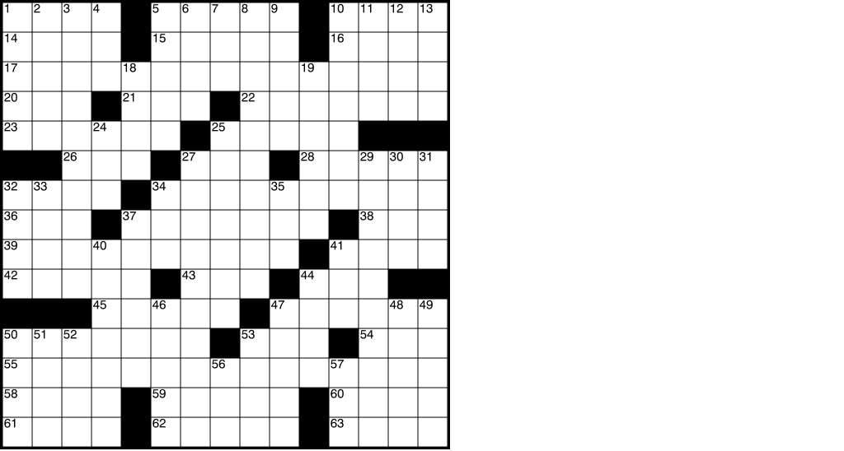
How many possible worlds?
Crossword 2:
variables are cells (individual squares)
domains are letters of the alphabet
possible worlds: all ways of assigning letters to cells
Number of empty cells?
Number of letters in the alphabet?
How many possible worlds? (assume any combination is ok)
193*26
193²⁶
26¹⁹³

Slide 10
Possible Worlds
Mars Explorer Example
Weather
Temperature
LocX LocY
Product of cardinality of each domain
… always exponential in the number of variables

Slide 11
Examples
Crossword Puzzle:
variables are words that have to be filled in
domains are valid English words of required length
possible worlds: all ways of assigning words
Number of English words?
Number of words of length k ?
So, how many possible worlds?
Notes:
~150,000
Variables are the places where word can go e.g. (1 across, 3 down)
Domains are words of the appropriate length (for 1 across in this example – length equals 6)
Constraints letter should be the same at the intersection

Slide 12
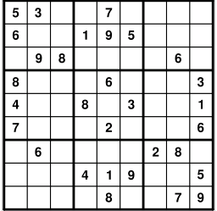
More Examples
Crossword 2:
variables are cells (individual squares)
domains are letters of the alphabet
possible worlds: all ways of assigning letters to cells
So, how many possible worlds?
Sudoku:
variables are empty cells
domains are numbers between 1 and 9
possible worlds: all ways of assigning numbers to cells
So, how many possible worlds?

Slide 13
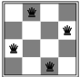
More examples
n-Queens problem
variable: location of a queen on a chess board
there are n of them in total, hence the name
domains: grid coordinates
possible worlds: locations of all queens
Notes:
the number of ways that k things can be 'chosen' from a set of n things. Hence, is often read as "n choose k" and called the choose function of n and k
Task1 start-time
Task1 end-time
Task1 location

Slide 14
More examples
Scheduling Problem:
variables are different tasks that need to be scheduled (e.g., course in a university; job in a machine shop)
domains are the different combinations of times and locations for each task (e.g., time/room for course; time/machine for job)
possible worlds: time/location assignments for each task
Notes:
the number of ways that k things can be 'chosen' from a set of n things. Hence, is often read as "n choose k" and called the choose function of n and k
Task1 start-time
Task1 end-time
Task1 location

Slide 15
Scheduling possible world
how many possible worlds?

Slide 16
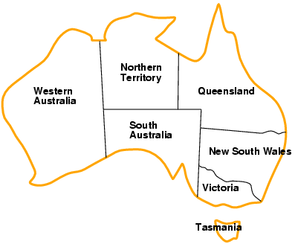
More examples….
Map Coloring Problem
variable: regions on the map
domains: possible colors
possible worlds: color assignments for each region
how many possible worlds?
Notes:
Task1 start-time
Task1 end-time
Task1 location

Slide 17
Lecture Overview
Constraint Satisfaction Problems
Variables , Constraints, CSPs
CSPs Methods
Generate-and-Test
Search
Arc Consistency and AC Algorithm
Abstract strategy, Details
Complexity, Interpreting the output
Domain Splitting

Slide 18
Constraints
Constraints are restrictions on the values that one or more variables can take
Unary constraint: restriction involving a single variable
k-ary constraint: restriction involving the domains of k different variables
it turns out that k-ary constraints can always be represented as binary constraints, so we'll mainly only talk about this case
Constraints can be specified by
giving a function that returns true when given values for each variable which satisfy the constraint
giving a list of valid domain values for each variable participating in the constraint
Notes:
Unary constraint: restriction involving a single variable
of course, we could also achieve the same thing by using a smaller domain in the first place
k-ary constraints can always be represented as binary constraints
http://ai.uwaterloo.ca/~vanbeek/Publications/ai02.pdf
In the dual transformation, the constraints of the original formulation become variables
in the new representation. We refer to these variables, which represent the original
constraints, as the dual variables, and the variables in the original CSP as the ordinary
variables. The domain of each dual variable is exactly the set of tuples that are in the
original constraint relation. There is a binary constraint, called a dual constraint, between
two dual variables iff the two original constraints share some variables. A dual
constraint prohibits pairs of tuples that do not agree on the shared variables.
In the hidden transformation, the set of variables consists of all the ordinary variables
in the original formulation with their original domains plus all the dual variables
as defined by the dual transformation. There is a binary constraint, called a hidden
constraint, between a dual variable and each of the ordinary variables in the constraint
represented by the dual variable. A hidden constraint enforces the condition that a
value of the ordinary variable must be the same as the value assigned to it by the tuple
that is the value of the dual variable.

Slide 19
Example: Map-Coloring
Variables WA, NT, Q, NSW, V, SA, T
Domains D_{i} = {red,green,blue}
Constraints: adjacent regions must have different colors
e.g., WA ≠
or, NT(WA,NT) in {(red,green),(red,blue),(green,red), (green,blue),(blue,red),(blue,green)}

Slide 20
Constraints (cont.)
A possible world satisfies a set of constraints if the set of variables involved in each constraint take values that are consistent with that constraint
A,B,C domains [1 .. 10]
A= 1 , B = 2, C = 10
Constraint set1 {A = B, C>B}
Constraint set2 {A ≠ B, C>B}

Slide 21
Examples
Crossword Puzzle:
variables are words that have to be filled in
domains are valid English words
constraints: words have the same letters at points where they intersect
Crossword 2:
variables are cells (individual squares)
domains are letters of the alphabet
constraints: sequences of letters form valid English words

Slide 22
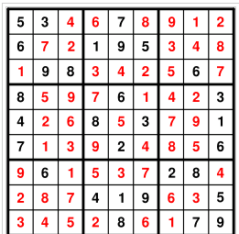
Examples
Sudoku:
variables are cells
domains are numbers between 1 and 9
constraints: rows, columns, boxes contain all different numbers

Slide 23
More examples
n-Queens problem
variable: location of a queen on a chess board
there are n of them in total, hence the name
domains: grid coordinates
constraints: no queen can attack another
Scheduling Problem:
variables are different tasks that need to be scheduled (e.g., course in a university; job in a machine shop)
domains are the different combinations of times and locations for each task (e.g., time/room for course; time/machine for job)
constraints:
tasks can't be scheduled in the same location at the same time;
certain tasks can be scheduled only in certain locations;
some tasks must come earlier than others; etc.

Slide 24
Lecture Overview
Constraint Satisfaction Problems
Variables , Constraints, CSPs
CSPs Methods
Generate-and-Test
Search
Arc Consistency and AC Algorithm
Abstract strategy, Details
Complexity, Interpreting the output
Domain Splitting

Slide 25
Constraint Satisfaction Problems: definitions
Definition (Constraint Satisfaction Problem)
A constraint satisfaction problem consists of
a set of variables
a domain for each variable
a set of constraints
Definition (model / solution)
A model of a CSP is an assignment of values to variables that satisfies all of the constraints.
Notes:
A possible world satisfies a set of constraints if the set of variables involved in each constraint take
values that are consistent with that constraint

Slide 26
Constraint Satisfaction Problems: definitions
Definition (Constraint Satisfaction Problem)
A constraint satisfaction problem consists of
a set of variables
a domain for each variable
a set of constraints
Definition (model / solution)
A model of a CSP is an assignment of values to variables that satisfies all of the constraints.
Notes:
A possible world satisfies a set of constraints if the set of variables involved in each constraint take
values that are consistent with that constraint

Slide 27
Example: Map-Coloring
Variables WA, NT, Q, NSW, V, SA, T
Domains D_{i} = {red,green,blue}
Constraints: adjacent regions must have different colors
e.g., WA ≠ NT, or
(WA,NT) in {(red,green),(red,blue),(green,red), (green,blue),(blue,red),(blue,green)}

Slide 28
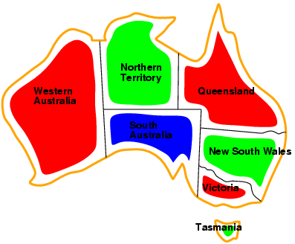
Example: Map-Coloring
Models / Solutions are complete and consistent assignments, e.g., WA = red, NT = green, Q = red, NSW = green, V = red,SA = blue, T = green

Slide 29
Constraint Satisfaction Problem: Variants
We may want to solve the following problems using a CSP
determine whether or not a model exists
find a model
find all of the models
count the number of the models
find the best model given some model quality
this is now an optimization problem
determine whether some properties of the variables hold in all models
Notes:
Get a “quick answer” then spend more time to find the model
Typical
To assess the difficulty of the problem
Same as above
If you want the largest regions to be red (can be encoded as additional constraints)
In all models do two variables have the same value? (even if it was not required by the constraints)

Slide 30
Learning Goals so far….
Define possible worlds in term of variables and their domains.
Compute number of possible worlds on real examples
Specify constraints to represent real world problems differentiating between:
Unary and k-ary constraints
List vs. function format.
Verify whether a possible world satisfies a set of constraints (i.e., whether it is a model, a solution)

Slide 31
User Study Participants Needed
What:
Use a prototype tool for updating a database
60-90 minutes duration
Why:
Help us evaluate our research
Get a $10 Starbucks gift card
Who: Anyone who has taken CPSC 304 or understands basic database concepts
Where: ICCS Building
Contact Michael Lawrence, mklawren@cs.ubc.ca

Slide 32
Lecture Overview
Constraint Satisfaction Problems
Variables , Constraints, CSPs
CSPs Methods
Generate-and-Test
Search
Arc Consistency and AC Algorithm
Abstract strategy, Details
Complexity, Interpreting the output
Domain Splitting

Slide 33
Modules we'll cover in this course: R&Rsys
Environment
Deterministic
Stochastic
Problem
Arc Consistency
Constraint Satisfaction
Vars +
Constraints
Search
Static
Belief Nets
Query
Logics
Var. Elimination
Search
Sequential
Decision Nets
STRIPS
Var. Elimination
Planning
Search
Markov Processes
Representation
Value Iteration
Reasoning
Technique
Notes:
Need to think of search beyond simple goal driven planning agent.
We started exploring the first AI Representation and Reasoning framework: CSPs

Slide 34
Standard Search vs. Specific R&R systems
Constraint Satisfaction (Problems):
State
Successor function
Goal test
Solution
Heuristic function
Planning :
State
Successor function
Goal test
Solution
Heuristic function
Answering Queries
State
Successor function
Goal test
Solution
Heuristic function
Notes:
Allows useful general-purpose algorithms with more power than standard search algorithms

Slide 35
Generate-and-Test Algorithm
Algorithm:
Generate possible worlds one at a time
Test them to see if they violate any constraints
For a in domA
For b in domB
For c in domC
if
return
return
This procedure is able to solve any CSP
However, the running time is proportional to the number of possible worlds
always exponential in the number of variables
far too long for many CSPs ☹
Notes:
The assignment space of a CSP is the space of possible worlds

Slide 36
Generate and Test (GT) Algorithms
Systematically check all possible worlds
Possible worlds: cross product of domains dom(V₁) × dom(V₂) × ... × dom(V_{n})
Generate and Test:
Generate possible worlds one at a time
Test constraints for each one.
Example: 3 variables A,B,C
For a in dom(A)
For b in dom(B)
For c in dom(C)
if {A=a, B=b, C=c} satisfies all constraints
return {A=a, B=b, C=c}
fail

Slide 37
Generate and Test (GT) Algorithms
If there are k variables, each with domain size d, and there are c constraints, the complexity of Generate & Test is
O(ckd)
O(ck^{d})
O(cd^{k})
O(d^{ck})

Slide 38
Generate and Test (GT) Algorithms
If there are k variables, each with domain size d, and there are c constraints, the complexity of Generate & Test is
There are d^{k} possible worlds
For each one need to check c constraints
O(cd^{k})

Slide 39
CSPs as search problems
states: assignments of values to a subset of the variables
start state: the empty assignment (no variables assigned values)
neighbours of a state: nodes in which values are assigned to one additional variable
goal state: a state which assigns a value to each variable, and satisfies all of the constraints
Note: the path to a goal node is not important
Notes:
CSPs can be mapped into search problems:

Slide 40
CSPs as Search Problems
What search strategy will work well for a CSP?
If there are n variables every solution is at depth…….
Is there a role for a heuristic function?
the tree is always …………. and has no…………, so which one is better BFS or IDS or DFS?
Notes:
??the
DFS is one way of implementing generate-and-test
re are no costs, so there's no role for a heuristic function??

Slide 41
CSPs as search problems
Simplified notation
Notes:
CSPs can be mapped into search problems:

Slide 42
CSPs as Search Problems
How can we avoid exploring some sub-trees i.e.,
prune the DFS Search tree?
once we consider a path whose end node violates one or more constraints, we know that a solution cannot exist below that point
thus we should remove that path rather than continuing to search
Notes:
We consider a path whose end node violates…..
this can yield us exponential savings over generate-and-test, though it's still exponential

Slide 43
Solving CSPs by DFS: Example
Problem:
Variables: A,B,C
Domains: {1, 2, 3, 4}
Constraints: A < B, B < C
Notes:
Generate and test is equivalent to not checking the constraints until the leaves
Remaining values heuristics : variable with fewest legal values (variable that generates less viable neighbors)
Degree Heuristic: variable involved in more constraints

Slide 44
Solving CSPs by DFS: Example Efficiency
Problem:
Variables: A,B,C
Domains: {1, 2, 3, 4}
Constraints: A < B, B < C
Note: the algorithm's efficiency depends on the order in which variables are expanded
Degree “Heuristics”
A=1
A=4
A=2
A=3
C=1
C=2
C=3
C=4
C=1
C=2
C=3
C=4
C=1
C=2
C=3
C=4
C=1
C=2
C=3
C=4
Notes:
MAYBE DO NOT MENTION
Minimum remaining Vallues heuristics: chose the var with less legal values. Also called fail first heuristic because it picks the var that is most likely to cause a failure soon, thereby pruning the tree. In the extreme case if the var X has zero values, the MRV heuristic will select X and failure will be detected immediately – avoiding pointless search through other vars which always will fail when X is finally tested

Slide 45
Standard Search vs. Specific R&R systems
Constraint Satisfaction (Problems):
State: assignments of values to a subset of the variables
Successor function: assign values to a “free” variable
Goal test: set of constraints
Solution: possible world that satisfies the constraints
Heuristic function: none (all solutions at the same distance from start)
Planning :
State
Successor function
Goal test
Solution
Heuristic function
Inference
State
Successor function
Goal test
Solution
Heuristic function
Notes:
Allows useful general-purpose algorithms with more power than standard search algorithms

Slide 46
Lecture Overview
Constraint Satisfaction Problems
Variables , Constraints, CSPs
CSPs Methods
Generate-and-Test
Search
Arc Consistency and AC Algorithm
Abstract strategy, Details
Complexity, Interpreting the output
Domain Splitting

Slide 47
Can we do better than Search?
Key ideas:
prune the domains as much as possible before “searching” for a solution.
Simple when using constraints involving single variables (technically enforcing domain consistency)
Definition: A variable is domain consistent if no value of its domain is ruled impossible by any unary constraints.
Example: D_{B} = {1, 2, 3, 4} ………. domain consistent if we have the constraint B ≠ 3.
Notes:
prune the domains as much as possible before selecting values from them.

Slide 48
How do we deal with constraints involving multiple variables?
Definition (constraint network)
A constraint network is defined by a graph, with
one node for every variable
one node for every constraint
and undirected edges running between variable nodes and constraint nodes whenever a given variable is involved in a given constraint.
Notes:
When all of the constraints are binary, constraint nodes are not necessary: we can drop constraint nodes and use edges to indicate that a constraint holds between a pair of variables.

Slide 49
Example Constraint Network
Recall Example:
Variables: A,B,C
Domains: {1, 2, 3, 4}
Constraints: A < B, B < C

Slide 50
Example: Constraint Network for Map-Coloring
Variables WA, NT, Q, NSW, V, SA, T
Domains D_{i} = {red,green,blue}
Constraints: adjacent regions must have different colors

Slide 51
Arc Consistency
Definition (arc consistency)
An arc is arc consistent if for each value in there is some value in such that is satisfied.
A
B
A< B
1,2
2,3
T
F
T
F
A
B
A< B
1,2,3
2,3

Slide 52

How can we enforce Arc Consistency?
If an arc is not arc consistent, all values in for which there is no corresponding value in may be deleted from to make the arc consistent.
This removal can never rule out any models/solutions
X
Y
X< Y
2,3,4
1,2,3
A network is arc consistent if all its arcs are arc consistent.

Slide 53
Learning Goals for today’s class
You can:
Implement the Generate-and-Test Algorithm. Explain its disadvantages.
Solve a CSP by search (specify neighbors, states, start state, goal state). Compare strategies for CSP search. Implement pruning for DFS search in a CSP.
Build a constraint network for a set of constraints.
Verify whether a network is arc consistent.
Make an arc arc-consistent.

Slide 54
Lecture Overview
Constraint Satisfaction Problems
Variables , Constraints, CSPs
CSPs Methods
Generate-and-Test
Search
Arc Consistency and AC Algorithm
Abstract strategy, Details
Complexity, Interpreting the output
Domain Splitting

Slide 55
Arc Consistency Algorithm: high level strategy
Consider the arcs in turn, making each arc consistent.
BUT, arcs may need to be revisited whenever….
NOTE - Regardless of the order in which arcs are considered, we will terminate with the same result
Notes:
the domains of other variables are reduced.
AIspace simple1withUnary problem

Slide 56
What arcs need to be revisited?
When we reduce the domain of a variable X to make an arc ⟨X,c⟩ arc consistent, we add……
every arc ⟨Z,c'⟩ where c' involves Z and X:
You do not need to add other arcs ⟨X,c'⟩ , c ≠ c‘
If an arc ⟨X,c'⟩ was arc consistent before, it will still be arc consistent (in the ``for all'' we'll just check fewer values)

Slide 58
Arc consistency algorithm (for binary constraints)
Procedure GAC(V,dom,C) Inputs V: a set of variables dom: a function such that dom(X) is the domain of variable X C: set of constraints to be satisfied Output arc-consistent domains for each variable Local D_{X} is a set of values for each variable X TDA is a set of arcs
1: for each variable X do
2: D_{X} ←dom(X) 3: TDA ←{〈X,c〉| X ∈ V, c ∈ C and X ∈ scope(c)}
4: while (TDA ≠ {}) 5: select 〈X,c〉 ∈TDA 6: TDA ←TDA \ {〈X,c〉}
7: ND_{X} ←{x| x ∈ D_{X} and ∃ y ∈ D_{Y} s.t. (x, y) satisfies c}
8: if (ND_{X} ≠ D_{X}) then 9: TDA ←TDA ∪ { 〈Z,c'〉 | X ∈ scope(c'), c' ≠ c, Z ∈ scope(c') \ {X} } 10: D_{X} ←ND_{X}
11: return {D_{X}| X is a variable}
Scope of constraint c is the set of variables involved in that constraint
TDA: ToDoArcs, blue arcs
in AIspace
X’s domain changed: ⇒ arcs (Z,c’) for variables Z sharing a
constraint c’ with X are added to TDA
ND_{X}: values x for X for which there a value for y supporting x
If arc was inconsistent
Domain is reduced

Slide 59
Arc Consistency Algorithm: Complexity
Let’s determine Worst-case complexity of this procedure (compare with DFS )
let the max size of a variable domain be d
let the number of variables be n
The max number of binary constraints is…….
How many times the same arc can be inserted in the ToDoArc list?
How many steps are involved in checking the consistency of an arc?
Notes:
Every time a domain value is removed
Some special cases are faster
e.g., if the constraint graph is a tree, arc consistency is O(ed)
I DO NOT THINK SO
It is linear in the number of variables n (not quadratic as the general case) check with David and Kevin

Slide 60
Arc Consistency Algorithm: Interpreting Outcomes
Three possible outcomes (when all arcs are arc consistent):
One domain is empty →
Each domain has a single value →
Some domains have more than one value → may or may not be a solution
in this case, arc consistency isn't enough to solve the problem: we need to perform search
Notes:
Otherwise, split a domain & apply arc consistency to each case.
Spiltting in half the variable with the smallest domain usually works best (who know why)
ACC: Show with Cispace, first “scheduling problem”, and then crossword 1 for splitting. What makes sense is to split the node with 6 vars to the right, show that it gets to an empty solution, backtrack, and do more s0plitting on the var with 2 values on the top-left. Done. WENT WELL

Slide 61
Lecture Overview
Constraint Satisfaction Problems
Variables , Constraints, CSPs
CSPs Methods
Generate-and-Test
Search
Arc Consistency and AC Algorithm
Abstract strategy, Details
Complexity, Interpreting the output
Domain Splitting

Slide 62
Domain splitting (or case analysis)
Arc consistency ends: Some domains have more than one value → may or may not be a solution
Apply Depth-First Search with Pruning
Split the problem in a number of disjoint cases
Set of all solution equals to….
Notes:
Otherwise, split a domain & apply arc consistency to each case.
Spiltting in half the variable with the smallest domain usually works best (who know why)
ACC: Show with Cispace, first “scheduling problem”, and then crossword 1 for splitting. What makes sense is to split the node with 6 vars to the right, show that it gets to an empty solution, backtrack, and do more s0plitting on the var with 2 values on the top-left. Done. WENT WELL

Slide 63
But what is the advantage?
By reducing dom(X) we may be able to….
Simplify the problem using arc consistency
No unique solution i.e., for at least one var, |dom(X)|>1
Split X
For all the splits
Restart arc consistency on arcs <Z, r(Z,X)>
these are the ones that are possibly………….
Disadvantage ☹: you need to keep all these CSPs around (vs. lean states of DFS)
Notes:
Combining Arc Consistency and Domain Splitting
Otherwise, split a domain & apply arc consistency to each case.
Spiltting in half the variable with the smallest domain usually works best (who know why)
ACC: Show with Cispace, first “scheduling problem”, and then crossword 1 for splitting. What makes sense is to split the node with 6 vars to the right, show that it gets to an empty solution, backtrack, and do more s0plitting on the var with 2 values on the top-left. Done. WENT WELL

Slide 64
Searching by domain splitting
Disadvantage ☹: you need to keep all these CSPs around (vs. lean states of DFS)
Notes:
Combining Arc Consistency and Domain Splitting
Otherwise, split a domain & apply arc consistency to each case.
Spiltting in half the variable with the smallest domain usually works best (who know why)
ACC: Show with Cispace, first “scheduling problem”, and then crossword 1 for splitting. What makes sense is to split the node with 6 vars to the right, show that it gets to an empty solution, backtrack, and do more s0plitting on the var with 2 values on the top-left. Done. WENT WELL

Slide 65
Searching by domain splitting
CSP, apply AC
If domains with multiple values
Split on one
CSP₁, apply AC
CSP₂, apply AC
If domains with multiple values
Split on one
If domains with multiple values…..Split on one
How many CSPs do we need to keep around at a time? Assume solution at depth m and 2 children at each split
O(2m)
O(2^{m})
O(m²)
O(2+m)

Slide 66
Final set of Learning Goals for today’s class
You can:
Define/read/write/trace/debug the arc consistency algorithm. Compute its complexity and assess its possible outcomes
Define/read/write/trace/debug domain splitting and its integration with arc consistency

Slide 67
Next Class (Chpt. 4.8)
Local search:
Many search spaces for CSPs are simply too big for systematic search (but solutions are densely distributed).
Keep only the current state (or a few)
Use very little memory / often find reasonable solution
….. Local search for CSPs

Slide 68
For next class
Will be Posted on WebCT today
Assignment2 (due next Thurs!\)
Work on CSP Practice Ex:
Exercise 4.A: arc consistency
Exercise 4.B: constraint satisfaction problems
Exercise 4.C: SLS for CSP
Read textbook:
4.8 we will finish CSPs
MIDTERM: Mon May 28th – 3PM (room TBA)

Slide 69
322 Feedback ☺ or ☹
Lectures
Slides
Practice Exercises
Assignments
AIspace
……
Textbook
Course Topics / Objectives
TAs
Learning Goals
……

Slide 70
K-ary vs. binary constraints
Not a topic for this course but if you are curious about it…
Wikipedia example clarifies basic idea…
http://en.wikipedia.org/wiki/Constraint_satisfaction_dual_problem
The dual problem is a reformulation of a constraint satisfaction problem expressing each constraint of the original problem as a variable. Dual problems only contain binary constraints, and are therefore solvable by algorithms tailored for such problems.
See also: hidden transformations

Slide 71
Extra slide (may be used here?)
Goal state: 9×9 grid completely
filled so that
each column,
each row, and
each of the nine 3×3 boxes
contains the digits from 1 to 9,
only one time each
A possible start state
(partially completed grid)
Notes:
Sudoku is a logic-based number placement puzzle. The objective is to fill a 9×9 grid so that each column, each row, and each of the nine 3×3 boxes (also called blocks or regions) contains the digits from 1 to 9, only one time each (that is, exclusively). The puzzle setter provides a partially completed grid.
Restate / justify that the following is true
Environment changes only when the agent acts
Agent can perfectly predict effect of its actions
Agent is given a goal

Slide 72
Lecture Overview
Recap of Lecture 14
Domain Splitting for Arc Consistency
Intro to Local Search (time permitting)

Slide 73
Can we have an arc consistent network with non-empty domains that has no solution?
YES
NO

Slide 74
Can we have an arc consistent network with non-empty domains that has no solution?
YES
Example: vars A, B, C with domain {1, 2} and constraints A ≠ B, B ≠ C, A ≠ C
Or see AIspace CSP applet Simple Problem 2

Slide 75
Domain splitting (or case analysis)
Arc consistency ends: Some domains have more than one value → may or may not have a solution
Apply Depth-First Search with Pruning or
Split the problem in a number of disjoint cases: CSP with dom(X) = {x₁, x₂, x₃, x₄} becomes CSP₁ with dom(X) = {x₁, x₂} and CSP₂ with dom(X) = {x₃, x₄}
Solution to CSP is the union of solutions to CSP_{i}

Slide 76
Domain splitting
Each smaller CSP is easier to solve
Arc consistency might already solve it
For each subCSP, which arcs have to be on the ToDoArcs list when we get the subCSP by splitting the domain of X?
arcs <Z, r(Z,X)>
arcs <Z, r(Z,X)> and <X, r(Z,X)>
All arcs

Slide 77
Domain splitting
Each smaller CSP is easier to solve
Arc consistency might already solve it
For each subCSP, which arcs have to be on the ToDoArcs list when we get the subCSP by splitting the domain of X?
arcs <Z, r(Z,X)> and <X, r(Z,X)>
A₁
T
H
E
S
E
c₁
T
H
IS
A₂
X
c
Y
c₂
A₃
c₃
c₄
A

Slide 78
Searching by domain splitting
CSP, apply AC
If domains with multiple values
Split on one
CSP₁, apply AC
CSP₂, apply AC
If domains with multiple values
Split on one
If domains with multiple values…..Split on one

Slide 79
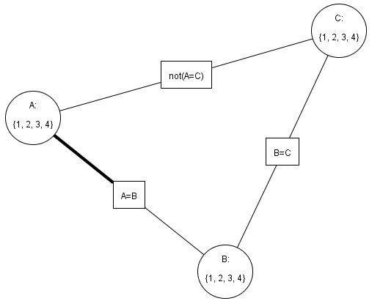
Domain Splitting in Action:
3 variables: A, B, C
Domains: all {1,2,3,4}
A=B, B=C, A≠C
Let’s trace arc consistency + domain splitting for this network for “Simple Problem 2” in AIspace

Slide 80
Arc consistency + domain splitting: example
({1,2,3,4}, {1,2,3,4}, {1,2,3,4})
3 variables: A, B, C
Domains: all {1,2,3,4}
A=B, B=C, A≠C
AC (arc consistency)
({1,2,3,4}, {1,2,3,4}, {1,2,3,4})
A ϵ {1,3}
A ϵ {2,4}
({1,3}, {1,2,3,4}, {1,2,3,4})
({2,4}, {1,2,3,4}, {1,2,3,4})
AC
AC
({1,3}, {1,3}, {1,3})
({2,4}, {2,4}, {2,4})
B ϵ {1}
B ϵ {3}
B ϵ {2}
B ϵ {4}
({1,3}, {1}, {1,3})
({1,3}, {3}, {1,3})
({2,4}, {2}, {2,4})
({2,4}, {4}, {2,4})
AC
AC
AC
AC
({}, {}, {})
({}, {}, {})
({}, {}, {})
({}, {}, {})
No solution
No solution
No solution
No solution

Slide 81
Arc consistency + domain splitting: another example
({1,2,3,4}, {1,2,3,4}, {1,2,3,4})
3 variables: A, B, C
Domains: all {1,2,3,4}
A=B, B=C, A=C
AC (arc consistency)
({1,2,3,4}, {1,2,3,4}, {1,2,3,4})
A ϵ {1,3}
A ϵ {2,4}
({1,3}, {1,2,3,4}, {1,2,3,4})
({2,4}, {1,2,3,4}, {1,2,3,4})
AC
AC
({1,3}, {1,3}, {1,3})
({2,4}, {2,4}, {2,4})
B ϵ {1}
B ϵ {3}
B ϵ {2}
B ϵ {4}
({1,3}, {1}, {1,3})
({1,3}, {3}, {1,3})
({2,4}, {2}, {2,4})
({2,4}, {4}, {2,4})
AC
AC
AC
AC
({1}, {1}, {1})
({3}, {3}, {3})
({2}, {2}, {2})
({4}, {4}, {4})
Solution
Solution
Solution
Solution

Slide 82
Another formulation of CSP as search
Arc consistency with domain splitting
States: vector (D(V₁), …, D(V_{n})) of remaining domains, with D(V_{i}) ⊆ dom(V_{i}) for each V_{i}
Start state: vector of original domains (dom(V₁), …, dom(V_{n}))
Successor function:
reduce one of the domains + run arc consistency
Goal state: vector of unary domains that satisfies all constraints
That is, only one value left for each variable
The assignment of each variable to its single value is a model
Solution: that assignment

Slide 83
Another formulation of CSP as search
Arc consistency with domain splitting
States: vector (D(V₁), …, D(V_{n})) of remaining domains, with D(V_{i}) ⊆ dom(V_{i}) for each V_{i}
Start state: vector of original domains (dom(V₁), …, dom(V_{n}))
Successor function:
reduce one of the domains + run arc consistency
Goal state: vector of unary domains that satisfies all constraints
That is, only one value left for each variable
The assignment of each variable to its single value is a model
Solution: that assignment

Slide 84
Searching by domain splitting
CSP, apply AC
If domains with multiple values
Split on one
CSP₁, apply AC
CSP₂, apply AC
If domains with multiple values
Split on one
If domains with multiple values…..Split on one
How many CSPs do we need to keep around at a time? Assume solution at depth m and 2 children at each split
O(2m)
O(2^{m})
O(m²)
O(2+m)

Slide 85
Searching by domain splitting
CSP, apply AC
If domains with multiple values
Split on one
CSP₁, apply AC
CSP₂, apply AC
If domains with multiple values
Split on one
If domains with multiple values…..Split on one
How many CSPs do we need to keep around at a time? Assume solution at depth m and 2 children at each split
O(2m): It is DFS

