Slide 1
Heuristic Search and
Advanced Methods
Computer Science cpsc322, Lecture 3
(Textbook Chpt 3.6 – 3.7)
May, 15, 2012
Notes:
Lecture 3

Slide 2
Course Announcements
Posted on WebCT
Assignment1 (due on Thurs!)
If you are confused about basic search algorithm, different search strategies….. Check learning goals at the end of lectures. Please come to office hours
Work on Graph Searching Practice Ex:
  Exercise 3.C: heuristic search
  Exercise 3.D: search
  Exercise 3.E: branch and bound search

Slide 3
Lecture Overview
Recap Uninformed Cost
Heuristic Search
  Best-First Search
  A* and its Optimality
Advanced Methods
  Branch & Bound
  A* tricks
  Pruning Cycles and Repeated States
  Dynamic Programming

Slide 4
Recap: Search with Costs
Sometimes there are costs associated with arcs.
  The cost of a path is the sum of the costs of its arcs.
Optimal solution: not the one that minimizes the number of links, but the one that minimizes cost
Lowest-Cost-First Search: expand paths from the frontier in order of their costs.
Notes:
In this setting we often don't just want to find just any solution
Instead, we usually want to find the solution that minimizes cost
We call a search algorithm which always finds such a solution optimal

Slide 5
Recap Uninformed Search
 | Complete | Optimal | Time | Space
DFS | N | N | O(b^{m}) | O(mb)
BFS | Y | Y | O(b^{m}) | O(b^{m})
IDS | Y | Y | O(b^{m}) | O(mb)
LCFS | Y Costs > 0 | Y Costs >=0 | O(b^{m}) | O(b^{m})
Notes:
Assume b finite
And step are all identical
R&N in general iterative deepening is the preferred uninformed search strategy when there is a large search space
And the depth of the solution is not known

Slide 6
Recap Uninformed Search
Why are all these strategies called uninformed?
Because they do not consider any information about the states (end nodes) to decide which path to expand first on the frontier
eg
(⟨n0, n2, n3⟩ 12), (⟨n0, n3 ⟩ 8) , (⟨n0, n1,n4 ⟩ 13)
In other words, they are general they do not take into account the specific nature of the problem.
Notes:
An uninformed search algorithm is one that does not take into account the specific nature of the problem. As such, they can be implemented in general, and then the same implementation can be used in a wide range of problems thanks to abstraction. The drawback is that most search spaces are extremely large, and an uninformed search (especially of a tree) will take a reasonable amount of time only for small examples. As such, to speed up the process, sometimes only an informed search will do.

Slide 7
Heuristic Search
Uninformed/Blind search algorithms do not take into account the goal until they are at a goal node.
Often there is extra knowledge that can be used to guide the search: an estimate of the distance from node n to a goal node.
This is called a heuristic
Notes:
Examples of h(n):
actual distance from a location, # of atoms to be resolved,
in eight puzzle:
number of tiles that are out of place
sum of the manhattan distance of each tile from its location (ACC did not metion this)
ACC: in the assignment for this module, it came up the question of whether h should be > 0, The book says so, and it makes sense because it is a cost.

Slide 8
More formally
Definition (search heuristic)
A search heuristic h(n) is an estimate of the cost of the shortest path from node n to a goal node.
h can be extended to paths: h(⟨n₀,…,n_{k}⟩)=h(n_{k})
h(n) uses only readily obtainable information (that is easy to compute) about a node.
Notes:
Lecture slides DO NOT contain everything that is said in class, but you are still responsible for this content
So, make sure you bring yourself up-to-date if you miss a class

Slide 9

More formally (cont.)
Definition (admissible heuristic)
A search heuristic h(n) is admissible if it is never an overestimate of the cost from n to a goal.
There is never a path from n to a goal that has path length less than h(n).
another way of saying this: h(n) is a lower bound on the cost of getting from n to the nearest goal.
Notes:
Lecture slides DO NOT contain everything that is said in class, but you are still responsible for this content
So, make sure you bring yourself up-to-date if you miss a class

Slide 10
Example Admissible Heuristic Functions
Search problem: robot has to find a route from start location to goal location on a grid (discrete space with obstacles)
Final cost (quality of the solution) is the number of steps
G
Notes:
the distance between two points is the sum of the (absolute) differences of their coordinates

Slide 11
Example Admissible Heuristic Functions
If no obstacles, cost of optimal solution is…
Notes:
the distance between two points is the sum of the (absolute) differences of their coordinates
``Manhattan distance'‘(L₁ distance), the distance between two points is the sum of the (absolute) differences of their coordinates

Slide 12
Example Admissible Heuristic Functions
If there are obstacle, the optimal solution without obstacles is an admissible heuristic
G
Notes:
the distance between two points is the sum of the (absolute) differences of their coordinates

Slide 13
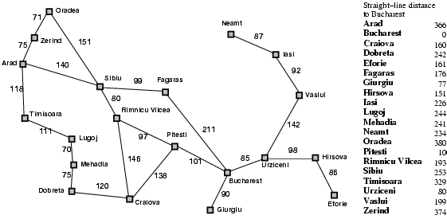
Example Admissible Heuristic Functions
Similarly, If the nodes are points on a Euclidean plane and the cost is the distance, we can use the straight-line distance from n to the closest goal as the value of h(n).
Notes:
this also makes sense if there are obstacles, or for other reasons not all adjacent nodes share an arc

Slide 14
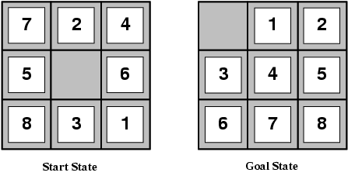
Example Heuristic Functions
In the 8-puzzle, we can use the number of misplaced tiles
Notes:
Which one is better?
E.g., for the 8-puzzle:
h₁(n) = number of misplaced tiles
h₂(n) = total Manhattan distance
(i.e., no. of squares from desired location of each tile)
h₁(S) = ? 8
h₂(S) = ? 3+1+2+2+2+3+3+2 = 18

Slide 15
Example Heuristic Functions
Another one we can use the number of moves between each tile's current position and its position in the solution
1
2
3
4
5
6
7
8
1
2
3
4
5
6
7
8
Notes:
Which one is better?
E.g., for the 8-puzzle:
h₁(n) = number of misplaced tiles
h₂(n) = total Manhattan distance
(i.e., no. of squares from desired location of each tile)
h₁(S) = ? 8
h₂(S) = ? 3+1+2+2+2+3+3+2 = 18

Slide 16
How to Construct a Heuristic
You identify relaxed version of the problem:
where one or more constraints have been dropped
problem with fewer restrictions on the actions
Robot: the agent can move through walls
Driver: the agent can move straight
8puzzle: (1) tiles can move anywhere
(2) tiles can move to any adjacent square
Result: The cost of an optimal solution to the relaxed problem is an admissible heuristic for the original problem (because it is always weakly less costly to solve a less constrained problem!)
Notes:
Overall, a cost-minimizing search problem is a constrained optimization problem
e.g., find a path from A to B which minimizes distance traveled, subject to the constraint that the robot can't move through walls
e.g., find a path from A to B which minimizes distance traveled, allowing the agent to move through walls
Later Another trick for constructing heuristics: if h₁(n) is an admissible heuristic, and h₂(n) is also an admissible heuristic, then max(h₁(n),h₂(n)) is also admissible.

Slide 17
How to Construct a Heuristic (cont.)
You should identify constraints which, when dropped, make the problem extremely easy to solve
  this is important because heuristics are not useful if they're as hard to solve as the original problem!
This was the case in our examples
Robot: allowing the agent to move through walls. Optimal solution to this relaxed problem is Manhattan distance
Driver: allowing the agent to move straight. Optimal solution to this relaxed problem is straight-line distance
8puzzle: (1) tiles can move anywhere Optimal solution to this relaxed problem is number of misplaced tiles
(2) tiles can move to any adjacent square….
Notes:
Admissible heuristics can also be derived from the solution cost of a subproblem
Put 1 2 3 4 in place (substantially more accurate than manhattan distance)

Slide 18
Another approach to construct heuristics
Solution cost for a subproblem
Original Problem
SubProblem
 | 1 | 3
8 | 2 | 5
7 | 6 | 4
 | 1 | 3
@ | 2 | @
@ | @ | 4
Current node
1 | 2 | 3
8 |  | 4
7 | 6 | 5
1 | 2 | 3
@ |  | 4
@ | @ | @
Goal node
Notes:
Substantially more accurate than Manhattan distance in some cases
So the two can be combined as described before

Slide 19
Heuristics: Dominance
If h₂(n) ≥ h₁(n) for all n (both admissible)
then h₂ dominates h₁
h₂ is better for search (why?)
8puzzle: (1) tiles can move anywhere
(2) tiles can move to any adjacent square
(Original problem: tiles can move to an adjacent square if it is empty)
search costs for the 8-puzzle (average number of paths expanded):
d=12 IDS = 3,644,035 paths
A*(h₁) = 227 paths
A*(h₂) = 73 paths
d=24 IDS = too many paths
A*(h₁) = 39,135 paths
A*(h₂) = 1,641 paths
Notes:
Data are averaged over 100 instances of the 8-puzzle, for various solutions

Slide 20
Combining Heuristics
How to combine heuristics when there is no dominance?
If h₁(n) is admissible and h₂(n) is also admissible then
h(n)= ………………… is also admissible
… and dominates all its components
Notes:
max (h₁(n) , h₂(n) )

Slide 21
Combining Heuristics: Example
In 8-puzzle, solution cost for the 1,2,3,4 subproblem is substantially more accurate than Manhattan distance in some cases
So…..
Notes:
Substantially more accurate than Manhattan distance in some cases
So the two can be combined as described before
L2 6
subp

Slide 22
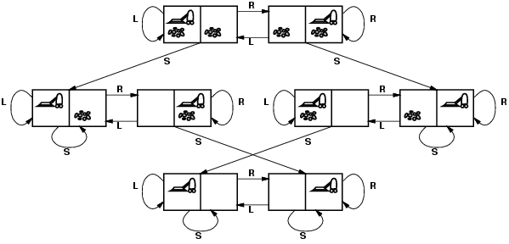
Admissible heuristic for Vacuum world?
states? Where it is dirty and robot location
actions? Left, Right, Suck
Possible goal test? no dirt at all locations
Notes:
States if the world had n locations?
Some simplifications wrt real world
Discrete location
Discrete dirt
Reliable cleaning
Room never gets messed up once cleaned

Slide 23
Lecture Overview
Recap Uninformed Cost
Heuristic Search
  Best-First Search
  A* and its Optimality
Advanced Methods
  Branch & Bound
  A* tricks
  Pruning Cycles and Repeated States
  Dynamic Programming

Slide 24
Best-First Search
Idea: select the path whose end is closest to a goal according to the heuristic function.
Best-First search selects a path on the frontier with minimal h-value (for the end node).
It treats the frontier as a priority queue ordered by h. (similar to ?)
This is a greedy approach: it always takes the path which appears locally best

Slide 25

Analysis of Best-First Search
Complete no: a low heuristic value can mean that a cycle gets followed forever.
Optimal: no (why not?)
Time complexity is O(b^{m})
Space complexity is O(b^{m})
Notes:
Misleading heuristic demo (sample Aispace problem)
Search with cost example, make MP a goal (USE FINE STEP!)

Slide 26
Lecture Overview
Recap Uninformed Cost
Heuristic Search
  Best-First Search
  A* and its Optimality
Advanced Methods
  Branch & Bound
  A* tricks
  Pruning Cycles and Repeated States
  Dynamic Programming

Slide 27
A* Search Algorithm
A* is a mix of:
  lowest-cost-first and
  best-first search
A* treats the frontier as a priority queue ordered by f(p)=
It always selects the node on the frontier with the ………….. estimated …………….distance.
Notes:
Lowest estimated total cost

Slide 28
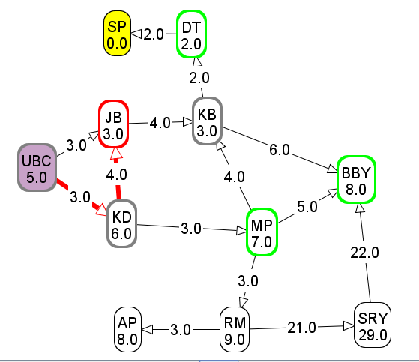
Computing f-values
F-value of ubc → kd → jb?
6
9
10
11

Slide 29
Analysis of A*
Let's assume that arc costs are strictly positive.
Time complexity is O(b^{m})
  the heuristic could be completely uninformative and the edge costs could all be the same, meaning that A* does the same thing as….
Space complexity is O(b^{m}) like ….., A* maintains a frontier which grows with the size of the tree
Completeness: yes.
Optimality: ??
Notes:
Complete it is always testing shorter underestimate of the total cost
So it is not missing anything

Slide 30
Optimality of A*
If A* returns a solution, that solution is guaranteed to be optimal, as long as
When
the branching factor is finite
arc costs are strictly positive
h(n) is an underestimate of the length of the shortest path from n to a goal node, and is non-negative
Theorem
If A* selects a path p as the solution,
p is the shortest (i.e., lowest-cost) path.

Slide 31
Why is A* optimal?
A* returns p
Assume for contradiction that some other path p' is actually the shortest path to a goal
Consider the moment when p is chosen from the frontier. Some part of path p' will also be on the frontier; let's call this partial path p''.
p''
p
p'

Slide 32
Why is A* optimal? (cont’)
p''
p
p'
Because p was expanded before p'',
Because p is a goal, Thus
Because h is admissible, cost(p'') + h(p'') ≤ for any path p' to a goal that extends p''
Thus for any other path p' to a goal.
This contradicts our assumption that p' is the shortest path.
Notes:
Because p was expanded before p'', f(p) ≤ f(p'').
Because p is a goal, h(p)=0. Thus cost(p) ≤ cost(p'') + h(p'').
Because h is admissible, cost(p'') + h(p'') ≤ cost(p') for any path p' to a goal that extends p''
Thus cost(p) ≤ cost(p') for any other path p' to a goal.
This contradicts our assumption that p' is the shortest path.

Slide 33
Optimal efficiency of A*
In fact, we can prove something even stronger about A*: in a sense (given the particular heuristic that is available) no search algorithm could do better!
Optimal Efficiency: Among all optimal algorithms that start from the same start node and use the same heuristic h, A* expands the minimal number of paths.
Notes:
In fact, we can prove something even stronger about A*: in a sense (given the particular heuristic that is available)
no search algorithm could do better!
problem: A* could be unlucky about how it breaks ties.
So let's define optimal efficiency as expanding the minimal number of paths p for which f(p) < f*, where f* is the cost of the optimal solution.

Slide 34
Sample A* applications
An Efficient A* Search Algorithm For Statistical Machine Translation. 2001
The Generalized A* Architecture. Journal of Artificial Intelligence Research (2007)
  Machine Vision … Here we consider a new compositional model for finding salient curves.
Factored A*search for models over sequences and trees International Conference on AI. 2003…. It starts saying… The primary challenge when using A* search is to find heuristic functions that simultaneously are admissible, close to actual completion costs, and efficient to calculate… applied to NLP and BioInformatics
Notes:
title: An Efficient A* Search Algorithm For Statistical Machine Translation
authors: Och, Franz Josef (RWTH Aachen University, Aachen Germany), Ueffing, Nicola (RWTH Aachen University, Aachen Germany), Ney, Hermann (RWTH Aachen University, Aachen Germany)
venue: Workshop On Data-Driven Methods In Machine Translation
year: 2001
Journal of Artificial Intelligence Research 29 (2007) 153-190 Submitted 10/06; published 06/07 The Generalized A* Architecture
Pedro F. Felzenszwalb pff@cs.uchicago.edu
Department of Computer Science University of Chicago Chicago, IL 60637
David McAllester mcallester@tti-c.org Toyota Technological Institute at Chicago Chicago, IL 60637
vision
Here we consider a new compositional model for finding salient curves.
Dan Klein and Chris Manning. 2003b. Factored A*
search for models over sequences and trees. In Proceedings
of the International Joint Conference on
Artificial Intelligence (IJCAI).
The primary challenge when using A* search is to find heuristic
functions that simultaneously are admissible, close to actual
completion costs, and efficient to calculate. In this paper,
we describe a family of tree and sequence models in
which path costs are either defined as or bounded by a combination
of simpler component models, each of which scores
some projection of the full structure. In such models, we can
exploit the decoupled behavior over each projection to give
sharp heuristics for the combined space. While we focus
on models of trees and sequences within NLP applications,
the approach can be applied more generally (and already has
been, in the case of biological sequencemodels). All the concrete
cases we consider here involve search over spaces which
are equivalent to dynamic programming lattices, though this
detail, too, is somewhat peripheral to the basic ideas.

Slide 35
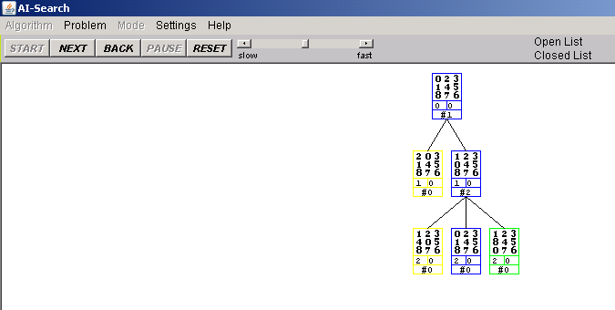
DFS, BFS, A* Animation Example
The AI-Search animation system
http://www.cs.rmit.edu.au/AI-Search/Product/
To examine Search strategies when they are applied to the 8puzzle
Compare only DFS, BFS and A* (with only the two heuristics we saw in class )
With default start state and goal
DFS will find
Solution at depth 32
BFS will find
Optimal solution depth 6
A* will also find opt. sol. expanding much less nodes

Slide 36
nPuzzles are not always solvable
Half of the starting positions for the n-puzzle are impossible to resolve (for more info on 8puzzle) http://www.isle.org/~sbay/ics171/project/unsolvable
So experiment with the AI-Search animation system with the default configurations.
If you want to try new ones keep in mind that you may pick unsolvable problems
Notes:
http://www.isle.org/~sbay/ics171/project/unsolvable
Here is a simple rule for telling if an 8 puzzle is solvable. We can call this violation of the order an "inversion". If the number of inversions is even then the puzzle is solvable. If the number of inversions is odd then the puzzle is unsolvable.

Slide 37
Learning Goals for today’s class (part 1)
Construct admissible heuristics for appropriate problems.
Verify Heuristic Dominance.
Combine admissible heuristics
Define/read/write/trace/debug different search algorithms
  With / Without cost
  Informed / Uninformed
Formally prove A* optimality

Slide 38
Lecture Overview
Recap Uninformed Cost
Heuristic Search
  Best-First Search
  A* and its Optimality
Advanced Methods
  Branch & Bound
  A* tricks
  Pruning Cycles and Repeated States
  Dynamic Programming

Slide 39
Lecture Overview
Recap Uninformed Cost
Heuristic Search
  Best-First Search
  A* and its Optimality
Advanced Methods
  Branch & Bound
  A* tricks
  Pruning Cycles and Repeated States
  Dynamic Programming

Slide 40
Branch-and-Bound Search
What is the biggest advantage of A*?
What is the biggest problem with A*?
Possible Solution:
Notes:
A search strategy often not covered in AI, but widely used in practice
Uses a heuristic function: like A*, can avoid expanding some unnecessary paths
Depth-first: modest memory demands
in fact, some people see ``branch and bound'' as a broad family that includes A*
these people would use the term ``depth-first branch and bound'‘

Slide 41
Branch-and-Bound Search Algorithm
Follow exactly the same search path as depth-first search
  treat the frontier as a stack: expand the most-recently added path first
  the order in which neighbors are expanded can be governed by some arbitrary node-ordering heuristic
Notes:
Branch and bound (BB) is a general algorithm for finding optimal solutions of various optimization problems, especially in discrete and combinatorial optimization. It consists of a systematic enumeration of all candidate solutions, where large subsets of fruitless candidates are discarded en masse, by using upper and lower estimated bounds of the quantity being optimized.

Slide 42
Branch-and-Bound Search Algorithm
Keep track of a lower bound and upper bound on solution cost at each path
  lower bound: LB(p) = f(p) = cost(p) + h(p)
  upper bound: UB = cost of the best solution found so far.
    if no solution has been found yet, set the upper bound to ∞.
When a path p is selected for expansion:
  if LB(p) ≥UB, remove p from frontier without expanding it (pruning)
  else expand p, adding all of its neighbors to the frontier

Slide 43
Branch-and-Bound Analysis
Complete ?
Optimal ?
Space complexity?
Time complexity?
yes
no
It depends
yes
no
It depends
O(b^{m})
O(m^{b})
O(bm)
O(b+m)

Slide 44
Lecture Overview
Recap Uninformed Cost
Heuristic Search
  Best-First Search
  A* and its Optimality
Advanced Methods
  Branch & Bound
  A* tricks
  Pruning Cycles and Repeated States
  Dynamic Programming

Slide 45
Other A* Enhancements
The main problem with A* is that it uses exponential space. Branch and bound was one way around this problem. Are there others?
…….
Memory-bounded A*

Slide 46
(Heuristic) Iterative Deepening – IDA*
B & B can still get stuck in infinite (extremely long) paths
Search depth-first, but to a fixed depth
  if you don't find a solution, increase the depth tolerance and try again
  depth is measured in………………
Counter-intuitively, the asymptotic complexity is not changed, even though we visit paths multiple times (go back to slides on uninformed IDS)
Notes:
depth is measured in f value
At each iteration the cutoff value is the smallest f-cost of any node that exceeded the cutoff at the previous iteration
Ok with unit cost, difficulties with real-valued costs

Slide 47
Analysis of Iterative Deepening A* (IDA*)
Complete and optimal:
Time complexity:
Space complexity:
yes
no
It depends
O(b^{m})
O(m^{b})
O(bm)
O(b+m)

Slide 48
Memory-bounded A*
Iterative deepening A* and B & B use a tiny amount of memory
what if we've got more memory to use?
keep as much of the fringe in memory as we can
if we have to delete something:
  delete the worst paths (with …………………………..)
  ``back them up'' to a common ancestor
p
p₁
p_{n}
Notes:
The oldest if they all have the same f-value
h(p)=min( (cost(pi) – cost(p)) + h(pi) ) underestimate!

Slide 49
Lecture Overview
Recap Uninformed Cost
Heuristic Search
  Best-First Search
  A* and its Optimality
Advanced Methods
  Branch & Bound
  A* tricks
  Pruning Cycles and Repeated States
  Dynamic Programming

Slide 50
Cycle Checking
You can prune a path that ends in a node already on the path. This pruning cannot remove an optimal solution.
The time is ………………… in path length.
Notes:
Using depth-first methods, with the graph explicitly stored, this can be done in constant time.??

Slide 51
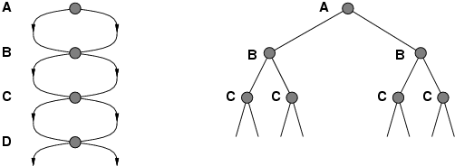
Repeated States / Multiple Paths
Failure to detect repeated states can turn a linear problem into an exponential one!

Slide 52
Multiple-Path Pruning
You can prune a path to node n that you have already found a path to
(if the new path is longer – more costly).
Notes:
This entails storing all nodes you have found paths to.
Multiple-path pruning subsumes cycle check.

Slide 53
Multiple-Path Pruning & Optimal Solutions
Problem: what if a subsequent path to n is shorter than the first path to n ?
You can remove all paths from the frontier that use the longer path. (as these can’t be optimal)
Notes:
You’ll have to regenerated them

Slide 54
Multiple-Path Pruning & Optimal Solutions
Problem: what if a subsequent path to n is shorter than the first path to n ?
You can change the initial segment of the paths on the frontier to use the shorter path.
Notes:
Can be computationally costly

Slide 55
Pruning Cycles
Example
Repeated States

Slide 56
Lecture Overview
Recap Uninformed Cost
Heuristic Search
  Best-First Search
  A* and its Optimality
Advanced Methods
  Branch & Bound
  A* tricks
  Pruning Cycles and Repeated States
  Dynamic Programming

Slide 57
Dynamic Programming
Idea: for statically stored graphs, build a table of dist(n):
  The actual distance of the shortest path from node n to a goal g
  This is the perfect search heuristic h
  dist(g) = 0
  dist(z) = 1
  dist(c) = 3
  dist(b) = 4
  dist(k) = ?
  dist(h) = ?
How could we implement that?
2
2
b
h
1
3
k
c
g
4
6
7
∞
1
z
6
7
∞

Slide 58
Dynamic Programming
This can be built backwards from the goal:
This can be built backwards from the goal:
all the neighbors m
g
b
c
a
2
d
2
b
2
g
1
1
a
c
3
3
Notes:
Dynamic programming is a general algorithm that will be used as a dual
to search algorithms in other parts of the book. The specific algorithm presented
here was invented by Dijkstra [1959]. See Cormen, Leiserson, Rivest,
and Stein [2001] for more details on the general class of dynamic programming
algorithms.
The idea of using dynamic programming as a source of heuristics for A
search was proposed by Culberson and Schaeffer [1998] and further developed
by Felner, Korf, and Hanan [2004].

Slide 59
Dynamic Programming
This can be used locally to determine what to do.
From each node n go to its neighbor which minimizes
4
2
d
2
b
2
2
g
1
1
3
a
c
3
3
3
But there are at least two main problems:
You need enough space to store the graph.
The dist function needs to be recomputed for each goal

Slide 60
Learning Goals for today’s class
Define/read/write/trace/debug different search algorithms
  With / Without cost
  Informed / Uninformed
Pruning cycles and Repeated States
Implement Dynamic Programming approach

Slide 61
Recap Search
 | Selection | Complete | Optimal | Time | Space
DFS | LIFO | N | N | O(b^{m}) | O(mb)
BFS | FIFO | Y | Y | O(b^{m}) | O(b^{m})
IDS(C) | LIFO | Y | Y | O(b^{m}) | O(mb)
LCFS | min cost | Y | Y | O(b^{m}) | O(b^{m})
BFS | min h | N | N | O(b^{m}) | O(b^{m})
A* | min f | Y | Y | O(b^{m}) | O(b^{m})
B&B | LIFO + pruning | N | Y | O(b^{m}) | O(mb)
IDA* | LIFO | Y | Y | O(b^{m}) | O(mb)
MBA* | min f | N | Y | O(b^{m}) | O(b^{m})
Notes:
Many of these are qualified
Eg. LCFS optimal if costs are > 0
Eg. A* complete if h is admissible
E.G B&B optimal if there are no infinite path
E.G BDS complete if both searches are BFS (or A*)

Slide 62
Recap Search (some qualifications)
 | Complete | Optimal | Time | Space
DFS | N | N | O(b^{m}) | O(mb)
BFS | Y | Y | O(b^{m}) | O(b^{m})
IDS(C) | Y | Y | O(b^{m}) | O(mb)
LCFS | Y | Y ? | O(b^{m}) | O(b^{m})
BFS | N | N | O(b^{m}) | O(b^{m})
A* | Y | Y ? | O(b^{m}) | O(b^{m})
B&B | N | Y ? | O(b^{m}) | O(mb)
IDA* | Y | Y | O(b^{m}) | O(mb)
MBA* | N | Y | O(b^{m}) | O(b^{m})
Notes:
Many of these are qualified
Eg. LCFS optimal if costs are > 0
Eg. A* complete if h is admissible
E.G B&B optimal if there are no infinite path
E.G BDS complete if both searches are BFS (or A*)

Slide 63
Search in Practice
 | Complete | Optimal | Time | Space
DFS | N | N | O(b^{m}) | O(mb)
BFS | Y | Y | O(b^{m}) | O(b^{m})
IDS(C) | Y | Y | O(b^{m}) | O(mb)
LCFS | Y | Y | O(b^{m}) | O(b^{m})
BFS | N | N | O(b^{m}) | O(b^{m})
A* | Y | Y | O(b^{m}) | O(b^{m})
B&B | N | Y | O(b^{m}) | O(mb)
IDA* | Y | Y | O(b^{m}) | O(mb)
MBA* | N | Y | O(b^{m}) | O(b^{m})
BDS | Y | Y | O(b^{m/2}) | O(b^{m/2})

Slide 64
Search in Practice (cont’)
Informed?
Many paths to solution, no ∞ paths?
Large branching factor?
Notes:
Uninformed: IDS (many deep solutions – do not care about optimality)
Informed:
Infinite path (in practice paths so long that cannot be kept in memory)

Slide 65
For next class
Posted on WebCT
Assignment1 (due this Thurs!)
If you are confused about basic search algorithm, different search strategies….. Check learning goals at the end of lectures. Please come to office hours
Work on Graph Searching Practice Ex:
  Exercise 3.C: heuristic search
  Exercise 3.D: search
  Exercise 3.E: branch and bound search
Read textbook:
  4.1- 4.6 we start CSPs

Slide 66
Branch-and-Bound Analysis
Completeness: no, for the same reasons that DFS isn't complete
  however, for many problems of interest there are no infinite paths and no cycles
  hence, for many problems B&B is complete
Time complexity: O(b^{m})
Space complexity:…..
  Branch & Bound has the same space complexity as….
  this is a big improvement over …………..!
Optimality: ……...
Notes:
Particularly applicable when there are many paths to the goal

Slide 67
Memory-bounded A*
Iterative deepening A* and B & B use little memory
What if we have some more memory
(but not enough for regular A*)?
  Do A* and keep as much of the frontier in memory as possible
  When running out of memory
    delete worst path (highest f value) from frontier
    Back the path up to a common ancestor
    Subtree gets regenerated only when all other paths have
    been shown to be worse than the “forgotten” path
Complete and optimal if solution is at depth manageable for available memory

Slide 68
Memory-bounded A*
Details of the algorithm are beyond the scope of this course but
It is complete if the solution is at a depth manageable by the available memory
Optimal under the same conditions
  Otherwise it returns the next reachable solution
Often used in practice for, is considered one of the best algorithms for finding optimal solutions
It can be bogged down by having to switch back and forth among a set of candidate solution paths, of which only a few fit in memory

