Slide 1
Search
Computer Science cpsc322, Lecture 2
(Textbook Chpt 3.0-3.4)
May, 10, 2012
Notes:
Lecture 2

Slide 2
Colored Cards
You need to have 4 colored index cards
  Come and get them from me if you still don’t have them
You will use these as voting cards
  Cheap low tech variant of clickers
  Please bring them to class every time

Slide 3
“Deterministic agent” means an agent that
Has perfect knowledge of its environment
Has perfect knowledge of the effect that its actions can have on the environment
Both of the above
None of the above

Slide 4
“Deterministic agent” means an agent that
Has perfect knowledge of its environment
Has perfect knowledge of the effect that its actions can have on the environment
Both of the above
None of the above

Slide 5
Modules we'll cover in this course: R&Rsys
Environment
Deterministic
Stochastic
Problem
Arc Consistency
Constraint Satisfaction
Vars +
Constraints
Search
Static
Belief Nets
Query
Logics
Var. Elimination
Search
Sequential
Decision Nets
STRIPS
Var. Elimination
Planning
Search
Markov Processes
Representation
Value Iteration
Reasoning
Technique
Notes:
R&R Sys Representation and reasoning Systems
Each cell is a R&R system
STRIPS actions preconditions and effects

Slide 6
Lecture Overview
Simple Agent and Examples
Search Space Graph
Search Procedure
Criteria to compare Search Strategies
Simple (Uninformed) Search Strategies
  Depth First and Breadth First
Uninformed Iterative Deepening (IDS)
Search with Costs

Slide 7
Simple Planning Agent
Deterministic, goal-driven agent
Agent is in a start state
Agent is given a goal (subset of possible states)
Environment changes only when the agent acts
Agent perfectly knows:
  what actions can be applied in any given state
  the state it is going to end up in when an action is applied in a given state
The sequence of actions and their appropriate ordering is the solution
Notes:
AI agents can be very complex and sophisticated
Let’s start from a very simple one
GOAL: study search, a basic method underlying many intelligent agents

Slide 8
Three examples
A delivery robot planning the route it will take in a bldg. to get from one room to another
Solving an 8-puzzle
Vacuum cleaner world
Notes:
As we have seen

Slide 9
Example1: Delivery Robot
Notes:
explicit state or features
Restate / justify that the following is true
Environment changes only when the agent acts
Agent can perfectly predict effect of its actions
Agent is given a goal

Slide 10
Example 2: 8-Puzzle?
Possible start state
Goal state
Notes:
Restate / justify that the following is true
Environment changes only when the agent acts
Agent can perfectly predict effect of its actions
Agent is given a goal

Slide 11
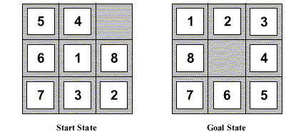
Eight Puzzle
States: each state specifies which number/blank occupies each of the 9 tiles
HOW MANY STATES ?
Operators: blank moves left, right, up down
Goal: configuration with numbers in right sequence
8⁹
2⁹
9⁹
9!

Slide 12
Eight Puzzle
States: each state specifies which number/blank occupies each of the 9 tiles
HOW MANY STATES ?
Operators: blank moves left, right, up down
Goal: configuration with numbers in right sequence
9!
Notes:
360 x 1000

Slide 13
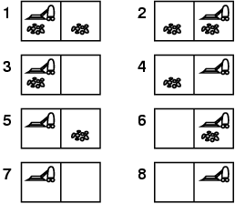
Example: vacuum world
States
  Two rooms: r1, r2
  Each room can be either dirty or not
  Vacuuming agent can be in either in r1 or r2
Possible start state
Possible goal state

Slide 14
Example: vacuum world
Possible start state
Goal state

Slide 15
…..
Suppose we have the same problem with k rooms.
The number of states is….
k³
k * 2k
k * 2^{k}
2 * k^{k}

Slide 16
…..
Suppose we have the same problem with k rooms.
The number of states is….
k * 2^{k}

Slide 17
Lecture Overview
Simple Agent and Examples
Search Space Graph
Search Procedure
Criteria to compare Search Strategies
Simple (Uninformed) Search Strategies
  Depth First and Breadth First
Uninformed Iterative Deepening (IDS)
Search with Costs

Slide 18
How can we find a solution?
How can we find a sequence of actions and their appropriate ordering that lead to the goal?
Define underlying search space graph where nodes are states and edges are actions.
b4
o113
r113
o107
o109
o111
r107
r109
r111
Notes:
Check CIspace

Slide 19
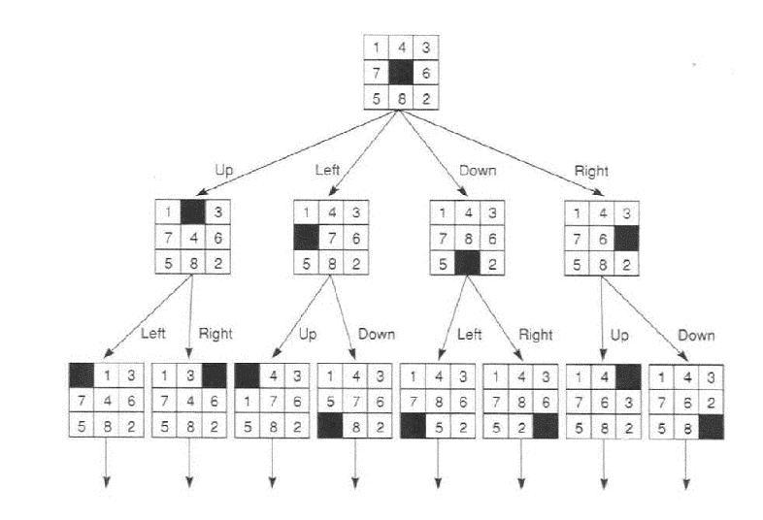
Search space for 8puzzle
Notes:
9 factorial = 362880 states

Slide 20
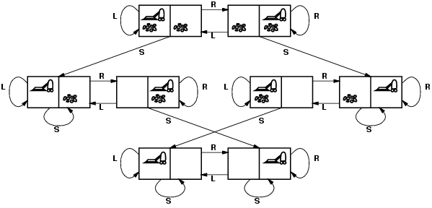
Vacuum world: Search space graph
states? Where it is dirty and robot location
actions? Left, Right, Suck
Possible goal test? no dirt at all locations
Notes:
States if the world had n locations?
Some simplifications wrt real world
Discrete location
Discrete dirt
Reliable cleaning
Room never gets messed up once cleaned

Slide 21
Lecture Overview
Simple Agent and Examples
Search Space Graph
Search Procedure
Criteria to compare Search Strategies
Simple (Uninformed) Search Strategies
  Depth First and Breadth First
Uninformed Iterative Deepening (IDS)
Search with Costs

Slide 22
Search: Abstract Definition
How to search
Start at the start state
Consider the effect of taking different actions starting from states that have been encountered in the search so far
Stop when a goal state is encountered
To make this more formal, we'll need review the formal definition of a graph...

Slide 23
Search Graph
A graph consists of a set N of nodes and a set A of ordered pairs of nodes, called arcs.
Node n₂ is a neighbor of n₁ if there is an arc from n₁ to n₂. That is, if ⟨ n₁, n₂ ⟩ ∈ A.
A path is a sequence of nodes n₀, n₁, n₂ ,.., n_{k} such that ⟨ n_{i-1}, n_{i} ⟩ ∈ A.
A cycle is a non-empty path such that the start node is the same as the end node
A directed acyclic graph (DAG) is a graph with no cycles
Given a start node and goal nodes, a solution is a path from a start node to a goal node.
Notes:
Many problem solving problems tasks can be transformed into the problem of finding paths in a graph. Searching in a graph is an appropriate level of abstraction that allows one to study search independently from the task domain

Slide 24
Examples for graph formal def.
a
b
c
d
e
f
g
h
i
j
k
l
n
Notes:
OLD example
Search Space:
neighbors(o103, [ts, l2d3, o109])
neighbors(ts, [mail])
neighbors(mail, [])
neighbors(o109, [o111, o119])
neighbors(o111, [])
neighbors(storage, [])
.
.
.
Goal: is_goal(r123)
Start: is_start(o103).

Slide 25
Examples of solution
Start state b4, goal r113
Solution <b4, o107, o109, o113, r113>
b4
o113
r113
o107
o109
o111
r107
r109
r111
Notes:
Check CIspace
There are many other solutions! But of lesser quality

Slide 26
Graph Searching
Generic search algorithm: given a graph, start node, and goal node(s), incrementally explore paths from the start node(s).
Maintain a frontier of paths from the start node that have been explored.
As search proceeds, the frontier expands into the unexplored nodes until (hopefully!) a goal node is encountered.
The way in which the frontier is expanded defines the search strategy.

Slide 27
Generic Search Algorithm
Input: a graph, a start node, Boolean procedure goal(n) that tests if n is a goal node
frontier:= [<s>: s is a start node];
While frontier is not empty:
select and remove path <n_{o},….,n_{k}> from frontier;
If goal(n_{k})
return <n_{o},….,n_{k}>;
  For every neighbor n of n_{k}
  add <n_{o},….,n_{k}, n> to frontier;
end
Notes:
Show simplestExample in AIspace USE FINE STEP

Slide 28
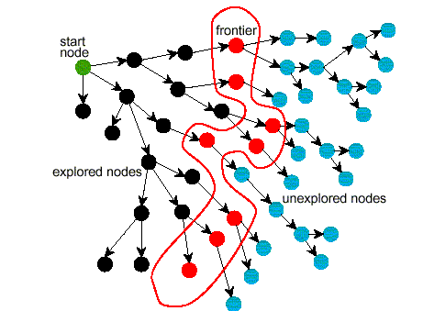
Problem Solving by Graph Searching
Ends of frontier
Notes:
MAKE TRANSPARENCY

Slide 29
Branching Factor
The forward branching factor of a node is the number of arcs going out of the node
The backward branching factor of a node is the number of arcs going into the node
If the forward branching factor of any node is b and the graph is a tree, how many nodes are n steps away from a node?
nb
b^{n}
n^{b}
n/b

Slide 30
Summary Generic Search Approach
Search is a key computational mechanism in many AI agents
We will study the basic principles of search on the simple deterministic planning agent model
Generic search approach:
  define a search space graph,
  start from current state,
  incrementally explore paths from current state until goal state is reached.
The way in which the frontier is expanded defines the search strategy.

Slide 31
Searching: Graph Search Algorithm with three bugs ☹
Input: a graph,
a start node,
Boolean procedure goal(n) that tests if n is a goal node.
frontier := { ⟨g⟩: g is a goal node };
while frontier is not empty:
select and remove path ⟨n₀, n₁, …, n_{k}⟩ from frontier;
if goal(n_{k})
return ⟨n_{k}⟩ ;
for every neighbor n of n_{k}
add ⟨ n₀, n₁, …, n_{k} ⟩ to frontier;
end while
The goal function defines what is a solution.
The neighbor relationship defines the graph.
Which path is selected from the frontier defines the search strategy.
Notes:
Discuss In groups - Give a few mins
After the algorithm returns, it can be asked for more answers and the procedure continues.

Slide 32
Lecture Overview
Simple Agent and Examples
Search Space Graph
Search Procedure
Criteria to compare Search Strategies
Simple (Uninformed) Search Strategies
  Depth First and Breadth First
Uninformed Iterative Deepening (IDS)
Search with Costs

Slide 33
Comparing Searching Algorithms: will it find a solution? the best one?
Def. (complete): A search algorithm is complete if, whenever at least one solution exists, the algorithm is guaranteed to find a solution within a finite amount of time.
Def. (optimal): A search algorithm is optimal if, when it finds a solution , it is the best solution
Notes:
Lecture slides DO NOT contain everything that is said in class, but you are still responsible for this content
So, make sure you bring yourself up-to-date if you miss a class

Slide 34
Comparing Searching Algorithms: Complexity
Def. (time complexity)
The time complexity of a search algorithm is an expression for the worst-case amount of time it will take to run,
expressed in terms of the maximum path length m and the maximum branching factor b.
Def. (space complexity) : The space complexity of a search algorithm is an expression for the worst-case amount of memory that the algorithm will use (number of nodes),
Also expressed in terms of m and b.
Notes:
m maximum depth of the search tree

Slide 35
Learning Goals for today’s Part1
Identify real world examples that make use of deterministic, goal-driven planning agents
Assess the size of the search space of a given search problem.
Implement the generic solution to a search problem.

Slide 36
Lecture Overview
Simple Agent and Examples
Search Space Graph
Search Procedure
Criteria to compare Search Strategies
Simple (Uninformed) Search Strategies
  Depth First and Breadth First
Uninformed Iterative Deepening (IDS)
Search with Costs

Slide 37

Depth-first Search: DFS
Depth-first search treats the frontier as a stack
It always selects one of the last elements added to the frontier.
Example:
  the frontier is [p₁, p₂, …, p_{r}]
  neighbors of last node of p₁ (its end) are {n₁, …, n_{k}}
What happens?
  p₁ is selected, and its end is tested for being a goal.
  New paths are created attaching {n₁, …, n_{k}} to p₁
  These “replace” p₁ at the beginning of the frontier.
  Thus, the frontier is now [(p_{1,} n₁), …, (p_{1,} n_{k}), p₂, …, p_{r}] .
  NOTE: p₂ is only selected when all paths extending p₁ have been explored.
Notes:
LIFO queue
The deepest in the current frontier

Slide 38
Depth-first search: Illustrative Graph --- Depth-first Search Frontier
Notes:
The longest path is expanded

Slide 39
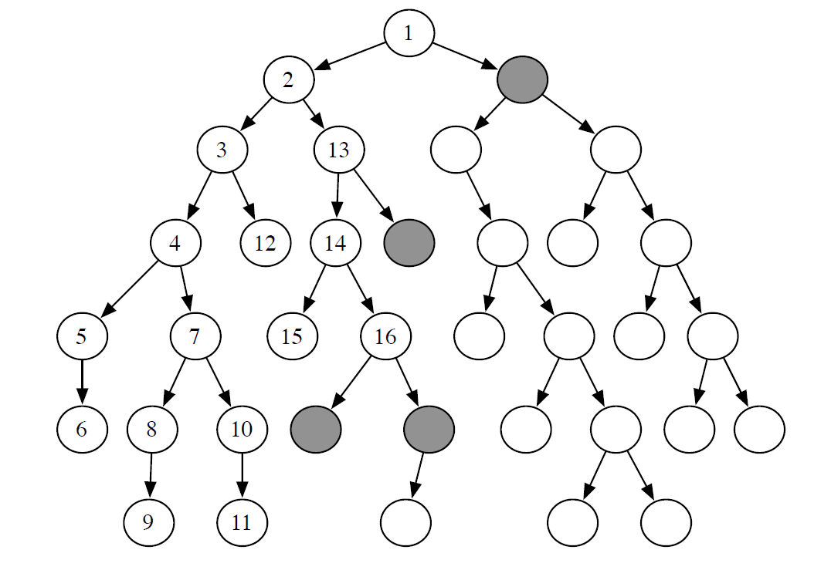
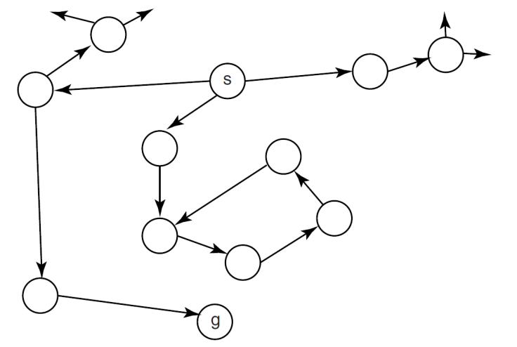
Analysis of DFS
Def. : A search algorithm is complete if whenever there is at least one solution, the algorithm is guaranteed to find it within a finite amount of time.
Is DFS complete?
No
If there are cycles in the graph, DFS may get “stuck” in one of them
see this in AISpace by loading “Cyclic Graph Examples” or by adding a cycle to “Simple Tree”
  e.g., click on “Create” tab, create a new edge from N7 to N1, go back to “Solve” and see what happens

Slide 40
Analysis of DFS
Def.: A search algorithm is optimal if when it finds a solution, it is the best one (e.g., the shortest)
Yes
No
Is DFS optimal?
E.g., goal nodes: red boxes

Slide 41
Analysis of DFS
Def.: A search algorithm is optimal if when it finds a solution, it is the best one (e.g., the shortest)
Is DFS optimal?
No
  It can “stumble” on longer solution paths before it gets to shorter ones.
    E.g., goal nodes: red boxes
see this in AISpace by loading “Extended Tree Graph” and set N6 as a goal
  e.g., click on “Create” tab, right-click on N6 and select “set as a goal node”

Slide 42
Analysis of DFS
Def.: The time complexity of a search algorithm is
the worst-case amount of time it will take to run,
expressed in terms of
    maximum path length m
    maximum forward branching factor b.
What is DFS’s time complexity, in terms of m and b ?
O(b^{m})
O(m^{b})
O(bm)
O(b+m)
E.g., single goal node -> red box

Slide 43
Analysis of DFS
Def.: The time complexity of a search algorithm is
the worst-case amount of time it will take to run,
expressed in terms of
    maximum path length m
    maximum forward branching factor b.
What is DFS’s time complexity, in terms of m and b ?
O(b^{m})
In the worst case, must examine every node in the tree
  E.g., single goal node -> red box

Slide 44
Analysis of DFS
Def.: The space complexity of a search algorithm is the worst-case amount of memory that the algorithm will use
(i.e., the maximal number of nodes on the frontier),
expressed in terms of
    maximum path length m
    maximum forward branching factor b.
What is DFS’s space complexity, in terms of m and b ?
O(b^{m})
O(m^{b})
O(bm)
O(b+m)
See how this
works in

Slide 45
Analysis of DFS
Def.: The space complexity of a search algorithm is the
worst-case amount of memory that the algorithm will use
(i.e., the maximum number of nodes on the frontier),
expressed in terms of
    maximum path length m
    maximum forward branching factor b.
What is DFS’s space complexity, in terms of m and b ?
for every node in the path currently explored, DFS maintains a path to its unexplored siblings in the search tree
  Alternative paths that DFS needs to explore
The longest possible path is m, with a maximum of b-1 alterative paths per node
O(bm)
See how this
works in

Slide 46
Analysis of DFS: Summary
Is DFS complete? NO
  Depth-first search isn't guaranteed to halt on graphs with cycles.
  However, DFS is complete for finite acyclic graphs.
Is DFS optimal? NO
  It can “stumble” on longer solution paths before it gets to shorter ones.
What is the time complexity, if the maximum path length is m and the maximum branching factor is b ?
  O(b^{m}) : must examine every node in the tree.
  Search is unconstrained by the goal until it happens to stumble on the goal.
What is the space complexity?
  O(bm)
  the longest possible path is m, and for every node in that path must maintain a fringe of size b.

Slide 47
Depth-first Search: When it is appropriate?
Appropriate
Space is restricted (complex state representation e.g., robotics)
There are many solutions, perhaps with long path lengths, particularly for the case in which all paths lead to a solution
Inappropriate
  Cycles
  There are shallow solutions
Notes:
Show AI space: Depth-first search isn't guaranteed to halt on graphs with cycles.
Space complexity is linear
Ordering heuristic is weak

Slide 48
Why DFS need to be studied and understood?
It is simple enough to allow you to learn the basic aspects of searching (When compared with breadth first)
It is the basis for a number of more sophisticated / useful search algorithms
Notes:
Show AI space: Depth-first search isn't guaranteed to halt on graphs with cycles.
Space complexity is linear

Slide 49
Breadth-first Search: BFS
Breadth-first search treats the frontier as a queue
  it always selects one of the earliest elements added to the frontier.
Example:
  the frontier is [p₁,p₂, …, p_{r}]
  neighbors of the last node of p₁ are {n₁, …, n_{k}}
What happens?
  p₁ is selected, and its end tested for being a path to the goal.
  New paths are created attaching {n₁, …, n_{k}} to p₁
  These follow p_{r} at the end of the frontier.
  Thus, the frontier is now [p₂, …, p_{r}, (p₁, n₁), …, (p₁, n_{k})].
  p₂ is selected next.

Slide 50
Illustrative Graph - Breadth-first Search

Slide 51
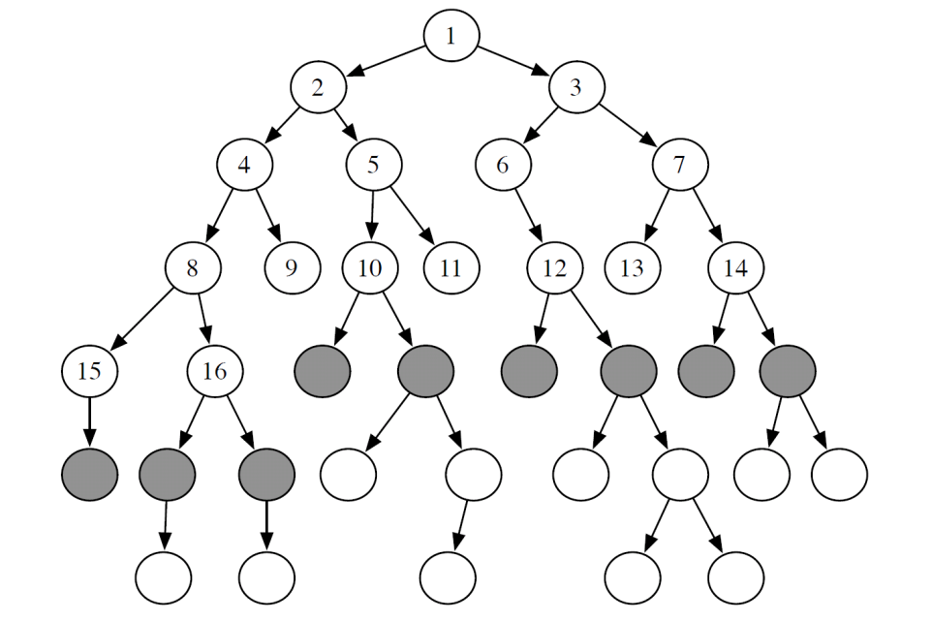
Analysis of BFS
Def. : A search algorithm is complete if whenever there is at least one solution, the algorithm is guaranteed to find it within a finite amount of time.
Yes
No
Is BFS complete?

Slide 52
Analysis of BFS
Def.: A search algorithm is optimal if
when it finds a solution, it is the best one
Yes
No
Is BFS optimal?
E.g., two goal nodes: red boxes

Slide 53
Analysis of BFS
Def.: The time complexity of a search algorithm is
the worst-case amount of time it will take to run,
expressed in terms of
    maximum path length m
    maximum forward branching factor b.
What is BFS’s time complexity, in terms of m and b ?
O(b^{m})
O(m^{b})
O(bm)
O(b+m)
E.g., single goal node: red box

Slide 54

Analysis of BFS
Def.: The space complexity of a search algorithm is the
worst case amount of memory that the algorithm will use
(i.e., the maximal number of nodes on the frontier),
expressed in terms of
    maximum path length m
    maximum forward branching factor b.
What is BFS’s space complexity, in terms of m and b ?
How many nodes at depth m?
O(b^{m})
O(m^{b})
O(bm)
O(b+m)

Slide 55


Analysis of Breadth-First Search
Is BFS complete?
  Yes
  In fact, BFS is guaranteed to find the path that involves the fewest arcs (why?)
What is the time complexity, if the maximum path length is m and the maximum branching factor is b?
  The time complexity is ? ? must examine every node in the tree.
  The order in which we examine nodes (BFS or DFS) makes no difference to the worst case: search is unconstrained by the goal.
What is the space complexity?
  Space complexity is ? ?
Notes:
Is BFS complete?
(we are assuming finite branching factor)
we must store the whole frontier in memory

Slide 56
Using Breadth-first Search
When is BFS appropriate?
  space is not a problem
  it's necessary to find the solution with the fewest arcs
  although all solutions may not be shallow, at least some are
When is BFS inappropriate?
  space is limited
  all solutions tend to be located deep in the tree
  the branching factor is very large
Notes:
there may be infinite paths

Slide 57
When to use BFS vs. DFS?
The search graph has cycles or is infinite
We need the shortest path to a solution
There are only solutions at great depth
There are some solutions at shallow depth: the other one
No way the search graph will fit into memory
BFS
DFS
BFS
DFS
BFS
DFS
BFS
DFS
BFS
DFS

Slide 58
What have we done so far?
GOAL: study search, a set of basic methods underlying many intelligent agents
AI agents can be very complex and sophisticated
Let’s start from a very simple one, the deterministic, goal-driven agent for which: the sequence of actions and their appropriate ordering is the solution
We have looked at two search strategies DFS and BFS:
To understand key properties of a search strategy
They represent the basis for more sophisticated (heuristic / intelligent) search

Slide 59
Recap: Comparison of DFS and BFS
 | Complete | Optimal | Time | Space
DFS
BFS
Notes:
Assume b finite
And step are all identical
big O notation usually only provides an upper bound on the growth rate of the function

Slide 60
Lecture Overview
Simple Agent and Examples
Search Space Graph
Search Procedure
Criteria to compare Search Strategies
Simple (Uninformed) Search Strategies
  Depth First and Breadth First
Uninformed Iterative Deepening (IDS)
Search with Costs

Slide 61
Iterative Deepening (sec 3.6.3)
How can we achieve an acceptable (linear) space complexity maintaining completeness and optimality?
 | Complete | Optimal | Time | Space
DFS
BFS
Key Idea: let’s re-compute elements of the frontier rather than saving them.
Notes:
Why not 0 2 4?
So far all search strategies that are guaranteed to halt use exponential space.
Increase the depth-bound when the search fails unnaturally (depth-bound was reached).

Slide 62
Iterative Deepening in Essence
Look with DFS for solutions at depth 1, then 2, then 3, etc.
If a solution cannot be found at depth D, look for a solution at depth D + 1.
You need a depth-bounded depth-first searcher.
Given a bound B you simply assume that paths of length B cannot be expanded….
Notes:
Why not 0 2 4?
So far all search strategies that are guaranteed to halt use exponential space.
Increase the depth-bound when the search fails unnaturally (depth-bound was reached).

Slide 63
depth = 1
depth = 2
depth = 3
. . .
Notes:
For b= 10, k = 5. BSF 111,111 and ID = 123,456 (only 11% more nodes)
The larges b the better, but even with b = 2 the search ID will take only ~4 times as much as BFS
Problem. When the branching factor is 1 at depth K, iterative deepening will
Have searched k + (k-1) + (k-2) +….1 =k(k+1)/2
Iterative deepening is good when there is a large search space and the depth of the solution is not known.

Slide 64
(Time) Complexity of Iterative Deepening
Complexity of solution at depth m with branching factor b
Total # of paths at that level
#times created by BFS (or DFS)
#times created by IDS
Notes:
If IDS returns a solution of length k why there cannot be a solution of length k-2?

Slide 65
(Time) Complexity of Iterative Deepening
Complexity of solution at depth m with branching factor b
Total # of paths generated
b^{m} + 2 b^{m-1} + 3 b^{m-2} + ..+ mb =
b^{m} (1+ 2 b⁻¹ + 3 b⁻² + ..+m b^{1-m} )≤
Notes:
How many times you create the nodes at that level
For b= 10 and d = 5. BSF 111,111 and ID = 123,456 (only 11% more nodes)
Iterative deepening is good when there is a large search space and the depth of the solution is not known.

Slide 66
Further Analysis of Iterative Deepening DFS (IDS)
Space complexity
  DFS scheme, only explore one branch at a time
Complete?
  Only paths up to depth m, doesn't explore longer paths – cannot get trapped in infinite cycles, gets to a solution first
Optimal?
O(bm)
O(bm)
Yes
Yes

Slide 67
Lecture Overview
Simple Agent and Examples
Search Space Graph
Search Procedure
Criteria to compare Search Strategies
Simple (Uninformed) Search Strategies
  Depth First and Breadth First
Uninformed Iterative Deepening (IDS)
Search with Costs

Slide 68
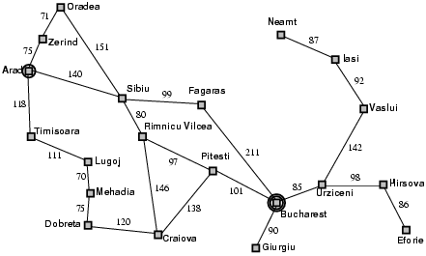
Example: Romania

Slide 69
Search with Costs
Sometimes there are costs associated with arcs.
Definition (cost of a path)
The cost of a path is the sum of the costs of its arcs:
In this setting we often don't just want to find just any solution
we usually want to find the solution that minimizes cost
Definition (optimal algorithm)
A search algorithm is optimal if it is complete, and only returns cost-minimizing solutions.
Notes:
Cost can be negative!

Slide 70
Lowest-Cost-First Search
At each stage, lowest-cost-first search selects a path on the frontier with lowest cost.
  The frontier is a priority queue ordered by path cost
  We say ``a path'' because there may be ties
Example of one step for LCFS:
  the frontier is [⟨p₂, 5⟩, ⟨p₃, 7⟩ , ⟨p₁, 11⟩, ]
  p₂ is the lowest-cost node in the frontier
  “neighbors” of p₂ are {⟨p₉, 10⟩, ⟨p₁₀, 15⟩}
What happens?
  p₂ is selected, and tested for being a goal.
  Neighbors of p₂ are inserted into the frontier
  Thus, the frontier is now [⟨p₃, 7⟩ , ⟨p₉, 10⟩, ⟨p₁, 11⟩, ⟨ p₁₀, 15⟩].
  ? ? is selected next.
  Etc. etc.
Notes:
Example with vancouver neighborhoods (simplified)
Show that

Slide 71
When arc costs are equal LCFS is equivalent to..
DFS
BFS
IDS
None of the above

Slide 72
Analysis of Lowest-Cost Search (1)
Is LCFS complete?
  not in general: for instance, a cycle with zero or negative arc costs could be followed forever.
  yes, as long as arc costs are strictly positive
Is LCFS optimal?
see how this works in AIspace:
  e.g, add arc with cost -20 to the simple search graph from N4 to S
YES
NO
IT DEPENDS

Slide 73
Analysis of Lowest-Cost Search (1)
Is LCFS complete?
  not in general: a cycle with zero or negative arc costs could be followed forever.
  yes, as long as arc costs are strictly positive
Is LCFS optimal?
  Not in general. Why not?
  Arc costs could be negative: a path that initially looks high-cost could end up getting a ``refund''.
  However, LCFS is optimal if arc costs are guaranteed to be non-negative.

Slide 74
Analysis of Lowest-Cost Search
What is the time complexity, if the maximum path length is m and the maximum branching factor is b?
  The time complexity is O(b^{m}): must examine every node in the tree.
  Knowing costs doesn't help here.
What is the space complexity?
  Space complexity is O(b^{m}): we must store the whole frontier in memory.
Notes:
The goal can be at the end of the longest path

Slide 75
Learning Goals for Search (up to today)
Apply basic properties of search algorithms: completeness, optimality, time and space complexity of search algorithms.
 | Complete | Optimal | Time | Space
DFS
BFS

Slide 76
Beyond uninformed search….
So far the selection of the next path to examine (and possibly expand) is based on ….
Notes:
Not looking inside state at the end of the path
Asking: How close is this to the goal?

Slide 77
Next Class
Assignment 1 out today
Start working on the practice exercises
Heuristic Search
Other Search Strategies
textbook.:
3.6 intro
3.6.1
3.7.1, 3.7.4

Slide 78
Learning Goals for Search (cont’)
(up to today)
Select the most appropriate search algorithms for specific problems.
  BFS vs DFS vs IDS vs BidirS-
  LCFS vs. BFS –
  A* vs. B&B vs IDA* vs MBA*
Define/read/write/trace/debug different search algorithms
  With / Without cost
  Informed / Uninformed

Slide 79
Lecture Overview
Recap
Criteria to compare Search Strategies
Simple (Uninformed) Search Strategies
  Depth First
  Breadth First

Slide 80
Learning Goals for today’s class
Apply basic properties of search algorithms: completeness, optimality, time and space complexity of search algorithms.
Select the most appropriate search algorithms for specific problems.
  BFS vs DFS vs IDS vs BidirS-
  LCFS vs. BFS –
  A* vs. B&B vs IDA* vs MBA*

Slide 81
Lecture Overview
Recap DFS vs BFS
Uninformed Iterative Deepening (IDS)
Search with Costs

Slide 82
Recap: Graph Search Algorithm
Input: a graph, a start node, Boolean procedure goal(n) that tests if n is a goal node
frontier:= [<s>: s is a start node];
While frontier is not empty:
select and remove path <n_{o},….,n_{k}> from frontier;
If goal(n_{k})
return <n_{o},….,n_{k}>;
  For every neighbor n of n_{k}
  add <n_{o},….,n_{k}, n> to frontier;
end
In what aspects DFS and BFS differ when we look at the generic graph search algorithm?

