Slide 1
Value of Information and Control
Computer Science cpsc322, Lecture 35
(Textbook Chpt 9.4)
April, 14, 2010

Slide 2
Lecture Overview
Value of Information
Value of Control
Course Summary

Slide 3
Value of Information
What would help the agent make a better Umbrella decision?
The value of information of a random variable X for decision D is:
the utility of the network with an arc from X to D minus the utility of the network without the arc.
Intuitively:
The value of information is always
It is positive only if the agent changes

Slide 4
Value of Information (cont.)
The value of information provides a bound on how much you should be prepared to pay for a sensor. How much is a perfect weather forecast worth?
77
Original maximum expected utility:
Maximum expected utility when we know Weather:
Better forecast is worth at most:
91

Slide 5
Value of Information
The value of information provides a bound on how much you should be prepared to pay for a sensor. How much is a perfect fire sensor worth?
-22.6
Original maximum expected utility:
Maximum expected utility when we know Fire:
Perfect fire sensor is worth:
-2

Slide 6
Lecture Overview
Sequential Decisions
Optimal Policy
Variable Elimination
Value of Information
Value of Control

Slide 7
Value of Control
What would help the agent to make an even better Umbrella decision? To maximize its utility.
Weather Umbrella | Value
Rain true Rain false noRain true noRain false | 70 0 20 100
The value of control of a variable X is :
the utility of the network when you make X a decision variable minus the utility of the network when X is a random variable.
Notes:
You need to be explicit about what information is available when you control X.
If you control X without observing, controlling X can be worse than observing X.
If you keep the parents the same, the value of control is always non-negative.

Slide 8
Value of Control
What if we could control the weather?
77
Original maximum expected utility:
Maximum expected utility when we control the weather:
Value of control of the weather:
100

Slide 9
Value of Control
What if we control Tampering?
-22.6
Original maximum expected utility:
Maximum expected utility when we control the Tampering:
Value of control of Tampering:
Useful to estimate how much it is worth to add…..
-20.7
Notes:
to estimate how much it is worth to add security guards to prevent tampering.

Slide 10
Learning Goals for today’s (and Mon) classes
You can:
Represent sequential decision problems as decision networks. And explain the non forgetting property
Verify whether a possible world satisfies a policy and define the expected value of a policy
Compute the number of policies for a decision problem
Compute the optimal policy by Variable Elimination
Compute value of information and control

Slide 11
Cpsc 322 Big Picture
Environment
Deterministic
Stochastic
Problem
Arc Consistency
Search
Constraint Satisfaction
Vars +
Constraints
SLS
Static
Belief Nets
Query
Logics
Var. Elimination
Search
Markov Chains and HMMs
Sequential
STRIPS
Decision Nets
Planning
Var. Elimination
Search
Representation
Reasoning
Technique
Notes:
R&R Sys Representation and reasoning Systems
Each cell is a R&R system
STRIPS actions preconditions and effects

Slide 12
After 322 …..
322 big picture
Machine Learning
Knowledge Acquisition
Preference Elicitation
Deterministic
Stochastic
Vars + Constraints
CSPs
Techniques to study
SLS Performance
Where are the components of our representations coming from?
Logics
Belief Nets
Query
More sophisticated reasoning
First Order Logics
Temporal reasoning
Description Logics
Markov Chains and HMMs
The probabilities?
The utilities?
The logical formulas?
Hierarchical Task Networks
Markov Decision Processes and
Partially Observable MDP
Planning
Partial Order Planning
More sophisticated reasoning
From people and from data!
Applications of AI
Notes:
R&R Sys Representation and reasoning Systems
Each cell is a R&R system

Slide 13
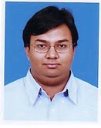
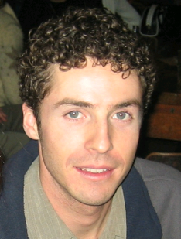
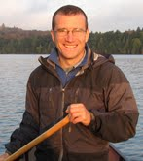
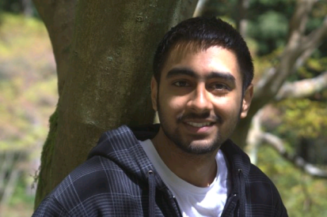
TA Evaluation Forms
Please, evaluate only TAs you have interacted with for this course
Teaching Assistants
Hammad Ali hammada@cs.ubc.ca
Kenneth Alton kalton@cs.ubc.ca (will be starting Jan 18)
Scott Helmer shelmer@cs.ubc.ca
Sunjeet Singh sstatla@cs.ubc.ca
Notes:
Hammad Ali hammada@cs.ubc.ca , TBA X150 (Learning Center)
Kenneth Alton (will be starting Jan 18) kalton@cs.ubc.ca , TBA X150 (Learning Center)
My research focuses on creating and evaluating computer algorithms for efficient path planning and control. Recently, I have been developing fast dynamic programming methods for solving static Hamilton-Jacobi partial differential equations with application to optimal control. Click on the images or links below for project descriptions and videos.
Scott Helmer shelmer@cs.ubc.ca , TBA X150 (Learning Center)
My current interests are machine learning and some of its applications in vision and planning. Some of these include the use of unsupervised learning to an achieve internal representation of the external world, collaborative filtering, aspects of active learning, and object classification using local features.
Sunjeet Singh sstatla@cs.ubc.ca , TBA X150 (Learning Center)
My research is focused on Network Security, specifically Enterprise Security. I'm hoping to apply my knowledge of networks and some machine learning concepts.

Slide 14
Announcements
Fill out Online Teaching Evaluations Survey.
It closes on Apr 17th
FINAL EXAM: Mon Apr 19, 12:00-3:00 pm DMP 310 (NOT regular room)
Final will comprise: 10 -15 short questions + 3-4 problems
Work on all practice exercises
While you revise the learning goals, work on review questions - I may even reuse some verbatim ☺
Come to remaining Office hours! I am offering two hours on Fri (10-12)

