Slide 1
Propositional Logic Intro, Syntax
Computer Science cpsc322, Lecture 19
(Textbook Chpt 5.1- 5.1.1 – 5.2)
March, 1, 2010

Slide 2
Lecture Overview
Recap Planning
Logic Intro
Propositional Definite Clause Logic: Syntax

Slide 3
Recap Planning
Represent possible actions with …..
Plan can be found by…..
Or can be found by mapping planning problem into…
Notes:
… preconditions and effects
…. Informed search forward planning
Initial: possible world
Successor: valid actions
Goal: assignment to subset of vars
Heuristics: empty-delete no negative effects

Slide 4
Solve planning as CSP: pseudo code

Slide 5
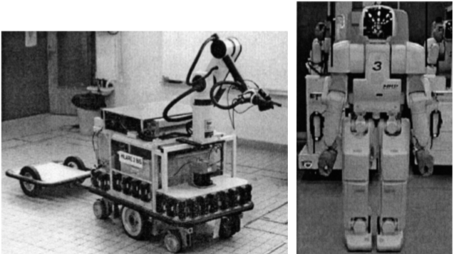
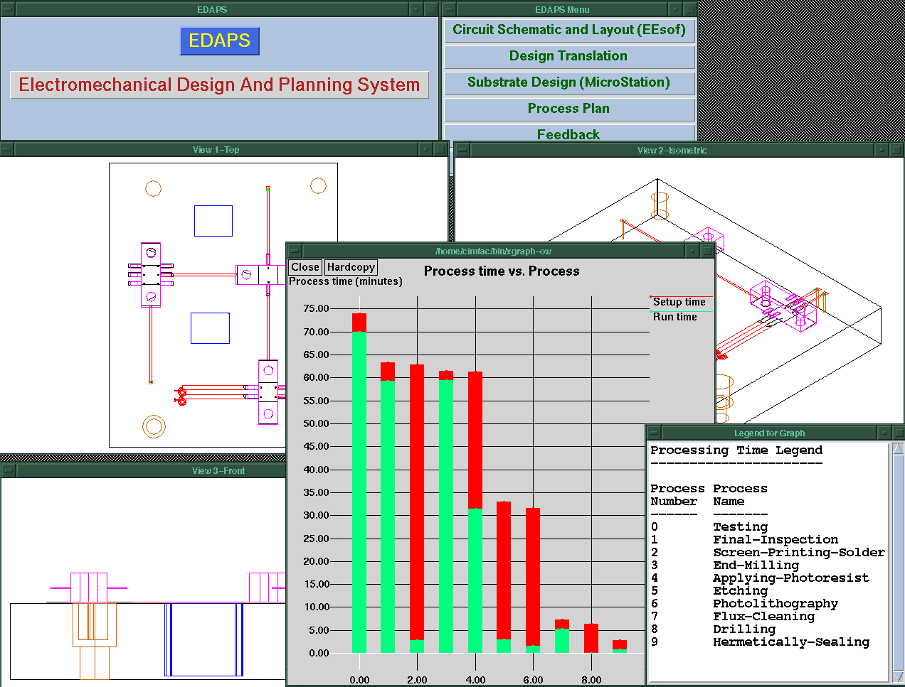
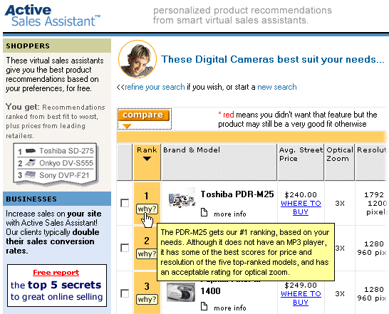
Now, do you know how to implement a planner for….
Emergency Evacuation?
Robotics?
Space Exploration?
Manufacturing Analysis?
Games (e.g., Bridge)?
Generating Natural language
Product Recommendations ….
★
Q
✦
9

A
◻
North
A
✦
7

K
◻
★
9
J
★
6

5
★
5

3
West
East

2

6

8

Q
South
Notes:
We don't have to worry about searching forwards
Particularly effective in domains for which we can get a reliable estimate of k
STanford Research Institute Problem Solver

Slide 6
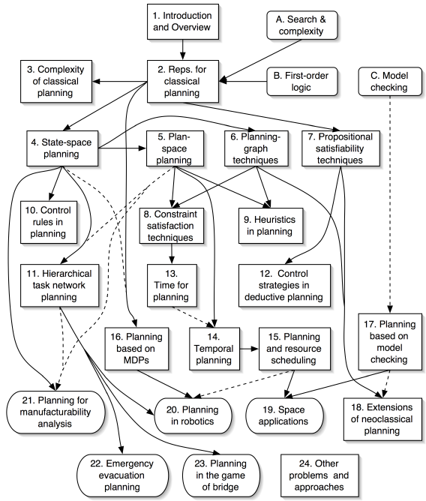
No ☹, but you (will) know the key ideas ☺!
Ghallab, Nau, and Traverso Automated Planning: Theory and Practice Morgan Kaufmann, May 2004 ISBN 1-55860-856-7
Web site:
http://www.laas.fr/planning
Notes:
Add also dialog managers and text planner as applications
of HTN and for dialogue also MDPs

Slide 7
Lecture Overview
Recap Planning
Logic Intro
Propositional Definite Clause Logic: Syntax

Slide 8
What is coming next ?
Environment
Deterministic
Stochastic
Problem
Arc Consistency
Search
Constraint Satisfaction
Vars +
Constraints
SLS
Static
Belief Nets
Query
Logics
Var. Elimination
Search
Sequential
Decision Nets
STRIPS
Var. Elimination
Planning
Search
Markov Processes
Representation
Value Iteration
Reasoning
Technique
Notes:
R&R Sys Representation and reasoning Systems
Each cell is a R&R system
STRIPS actions preconditions and effects

Slide 9
Logics in AI: Similar slide to the one for planning
Propositional Definite Clause Logics
Semantics and Proof Theory
Propositional Logics
First-Order Logics
Satisfiability Testing (SAT)
Description Logics
Hardware Verification
Production Systems
Product Configuration
Ontologies
Cognitive Architectures
Semantic Web
Video Games
Summarization
Tutoring Systems
Information Extraction

Slide 10
What you already know about logic...
From programming: Some logical operators
If ((amount > 0) && (amount < 1000)) || !(age < 30)
...
You know what they mean in a “procedural” way
Logic is the language of Mathematics. To define formal structures (e.g., sets, graphs) and to proof statements about those
We are going to look at Logic as a Representation and Reasoning System that can be used to formalize a domain (e.g., an electrical system, an organization) and to reason about it
Notes:
There are many different, but equivalent, axiomatizations of Peano arithmetic. While some axiomatizations, such as the one just described, only describe the successor operation, other axiomatizations directly describe the arithmetical operations. One such axiomatization begins with the following axioms that describe a discrete ordered semiring.[7]
∈x, y, z ∈ N. (x + y) + z = x + (y + z), i.e., addition is associative.
∀x, y ∈ N. x + y = y + x, i.e., addition is commutative.
∀x, y, z ∈ N. (x · y) · z = x · (y · z), i.e., multiplication is associative
∀x, y ∈ N. x · y = y · x, i.e., multiplication is commutative.
∀x, y, z ∈ N. x · (y + z) = (x · y) + (x · z), i.e., the distributive law.
∀x ∈ N. x + 0 = x ∧ x · 0 = 0.
∀x ∈ N. x · 1 = x.
∀x, y, z ∈ N. x < y ∧ y < z ⊃ x < z.
∀x ∈ N. ¬ (x < x).
∀x, y ∈ N. x < y ∨ x = y ∨ x > y.
∀x, y, z ∈ N. x < y ⊃ x + z < y + z.
∀x, y, z ∈ N. 0 < z ∧ x < y ⊃ x · z < y · z.
∀x, y ∈ N. x < y ⊃ ∃z ∈ N. x + z = y.
0 < 1 ∧ ∀x ∈ N. x > 0 ⊃ x ≥ 1..
∀x ∈ N. x ≥ 0.

Slide 11
Logic: A general framework for representation & reasoning
Let's now think about how to represent an environment about which we have only partial (but certain) information
What do we need to represent?
Notes:
Everything we can express in natural language ?
Def1. Meaning: a representation that expresses the linguistic input in terms of objects, actions, events, time, space… beliefs, attitudes...relationships

Slide 12
Why Logics?
“Natural” to express knowledge about the world
(more natural than a “flat” set of variables & constraints)
“Every 322 student will pass the midterm”
It is easy to incrementally add knowledge
It is easy to check and debug knowledge
Provide language for asking complex queries
Well understood formal properties
Notes:
Def1. Meaning: a representation that expresses the linguistic input in terms of objects, actions, events, time, space… beliefs, attitudes...relationships
exists x Isa(x, midterm)
courseOf(x, 322)
Isa(322, course)
forall z Student(z) AND registred(z,322) -> pass(z,x.t) AND (t > Now)

Slide 13
Propositional Logic
We will study the simplest form of Logic: Propositional
The primitive elements are propositions: Boolean variables that can be {true, false}
The goal is to illustrate the basic ideas
This is a starting point for more complex logics (e.g., first-order logic)
Boolean nature can be exploited for efficiency.
Notes:
We'll be looking at problems that could still be represented using CSPs. Why use propositional logic
Propositional logic is the simplest logic – illustrates basic ideas
Logic can be extended to infinitely many “variables” (using logical quantification)

Slide 14
Propositional logic: Complete Language
The proposition symbols p₁, p₂ … etc are sentences
If S is a sentence, ¬S is a sentence (negation)
If S₁ and S₂ are sentences, S₁ ∧ S₂ is a sentence (conjunction)
If S₁ and S₂ are sentences, S₁ ∨ S₂ is a sentence (disjunction)
If S₁ and S₂ are sentences, S₁ ⇒ S₂ is a sentence (implication)
If S₁ and S₂ are sentences, S₁ ⇔ S₂ is a sentence (biconditional)
Notes:
Propositional logic is the simplest logic – illustrates basic ideas

Slide 15
Propositional Logics in practice
Agent is told (perceives) some facts about the world
Agent is told (already knows / learns) how the world works
Agent can answer yes/no questions about whether other facts must be true

Slide 16
Using Logics to make inferences…
Begin with a task domain.
Distinguish those things you want to talk about (the ontology).
Choose symbols in the computer to denote propositions
Tell the system knowledge about the domain.
Ask the system whether new statements about the domain are true or false.

Slide 17
Electrical Environment
/down
/ up
Notes:
1 Begin with a task domain.
Electrical environment
2 Distinguish those things you want to talk about (the ontology).
Lights switches
3Choose symbols in the computer to denote propositions
sw₃_up: switch is up
live_outside: there is power in the building
4Tell the system knowledge about the domain.
sw₃_up and live_w₃ -> live_w₄
5 Ask the system whether new statements about the domain are true or false.
live_l₂
l₂_broken: light l₂ is broken
sw₃_up: switch is up
power: there is power in the building
unlit_l₂: light l₂ isn't lit
lit_l₁: light l₁ is lit
Conclusion l₂_broken
Rules
l₂_broken ← sw₃_up
∧ power ∧ unlit_l₂.
sw₃_up.
power ← lit_l₁.
unlit_l₂.
lit_l₁.

Slide 18
Lecture Overview
Recap Planning
Logic Intro
Propositional Definite Clause Logic: Syntax

Slide 19
Propositional Definite Clauses
Propositional Definite Clauses: our first logical representation and reasoning system.
(very simple!)
Only two kinds of statements:
that a proposition is true
that a proposition is true if one or more other propositions are true
Why still useful?
Adequate in many domains (with some adjustments)
Reasoning steps easy to follow by humans
Inference linear in size of your set of statements
Similar formalisms used in cognitive architectures
Notes:
To define this RSS, we'll need to specify:
syntax
semantics
proof procedure

Slide 20
Propositional Definite Clauses: Syntax
Definition (atom)
An atom is a symbol starting with a lower case letter
Definition (body)
A body is an atom or is of the form b₁ ∧ b₂ where b₁
and b₂ are bodies.
Definition (definite clause)
A definite clause is an atom or is a rule of the form h ← b where h is an atom and b is a body. (Read this as ``h if b.'')
Definition (KB)
A knowledge base is a set of definite clauses

Slide 21
PDC Syntax: Examples
ai_is_fun
ai_is_fun ∨ ai_is_boring
ai_is_fun ← learn_useful_techniques
ai_is_fun ← learn_useful_techniques ∧ notTooMuch_work
ai_is_fun ∧ relaxing_term ← getGoodGrade ∧ notTooMuch_work
ai_is_fun ← learn_useful_techniques ∧ getGoodGrade ∧ notTooMuch_work
Do any of these statements mean anything?
Syntax doesn't answer this question.

Slide 22
Learning Goals for today’s class
You can:
Verify whether a logical statement belongs to the language of full propositional logics.
Verify whether a logical statement belongs to the language of propositional definite clauses.

Slide 23
Study for midterm (Wed March 10)
Midterm: ~6 short questions (10pts each) + 2 problems (20pts each)
Study: textbook and inked slides
Work on all practice exercises and revise assignments!
While you revise the learning goals, work on review questions (will post them tomorrow)- I may even reuse some verbatim ☺
Will post a couple of problems from previous offering (maybe slightly more difficult /inappropriate for you because they were not informed by the learning goals) … but I’ll give you the solutions ☺

Slide 24
Next class
Definite clauses Semantics and Proofs (textbook 5.1.2, 5.2.2)

