Slide 1
Local Search
Computer Science cpsc322, Lecture 14
(Textbook Chpt 4.8)
February, 3, 2010
Notes:
Lecture 14

Slide 2
Announcements
Assignment1 due now!
I will be away this Fri (attending conference in HK)
  Postdoc Gabriel Murray will give lecture
  TA will offer my office hour (in X150)

Slide 3
Lecture Overview
Recap solving CSP systematically
Local search
Constrained Optimization
Greedy Descent / Hill Climbing: Problems

Slide 4
Systematically solving CSPs: Summary
Build Constraint Network
Apply Arc Consistency
  One domain is empty →
  Each domain has a single value →
  Some domains have more than one value →
Apply Depth-First Search with Pruning
Split the problem in a number of disjoint cases
  Apply Arc Consistency to each case
Notes:
Otherwise, split a domain & apply arc consistency to each case.
Spiltting in half the variable with the smallest domain usually works best (who know why)
ACC: Show with Cispace, first “scheduling problem”, and then crossword 1 for splitting. What makes sense is to split the node with 6 vars to the right, show that it gets to an empty solution, backtrack, and do more s0plitting on the var with 2 values on the top-left. Done. WENT WELL

Slide 5
Lecture Overview
Recap
Local search
Constrained Optimization
Greedy Descent / Hill Climbing: Problems

Slide 6
Local Search motivation: Scale
Many CSPs (scheduling, DNA computing, more later) are simply too big for systematic approaches
If you have 10⁵ vars with dom(var_{i}) = 10⁴
Systematic Search
Constraint Network
but if solutions are densely distributed…….

Slide 7
Local Search: General Method
  Remember , for CSP a solution is…..
  Start from a possible world
  Generate some neighbors ( “similar” possible worlds)
  Move from the current node to a neighbor, selected according to a particular strategy
  Example: A,B,C same domain {1,2,3}
Notes:
A useful method in practice for some consistency and optimization problems is local search
move from one node to another according to a function that scores how good each neighbor is
according to a function that scores how good each neighbor is

Slide 8
Local Search: Selecting Neighbors
How do we determine the neighbors?
Usually this is simple: some small incremental change to the variable assignment
  assignments that differ in one variable's value, by (for instance) a value difference of +1
  assignments that differ in one variable's value
  assignments that differ in two variables' values, etc.
  Example: A,B,C same domain {1,2,3}

Slide 9
Selecting the best neighbor
  Example: A,B,C same domain {1,2,3} , (A=B, A>1, C≠3)
A common component of the scoring function (heuristic) => select the neighbor that results in the ……
- the min conflicts heuristics
Notes:
For example, if the goal is to find the highest point on a surface, the scoring function might be the height at the current point.

Slide 10
Queens in Chess
Positions a queen can attack

Slide 11
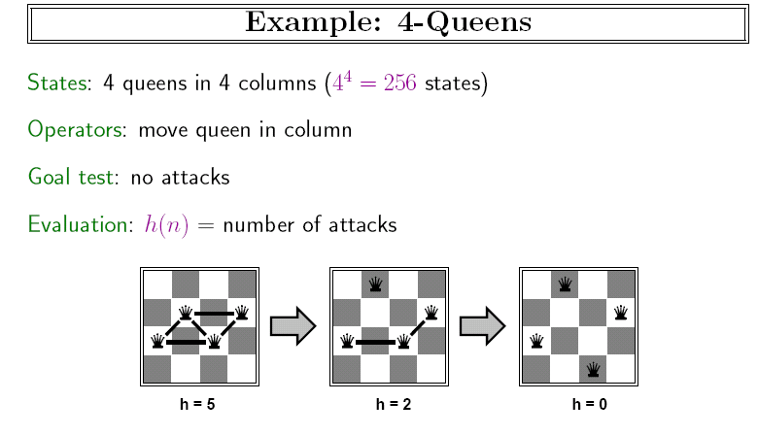
Example: n-queens
Put n queens on an n × n board with no two queens on the same row, column, or diagonal (i.e attacking each other)

Slide 12
n-queens, Why?
Why this problem?
Lots of research in the 90’ on local search for CSP was generated by the observation that the run-time of local search on n-queens problems is independent of problem size!
Notes:
It consists of an initial
search phase that starts during problem generation and a final search phase that removes conflicts During
the initial search function Initial Search an initial permutation of the row positions of the queens is
Generated
A random permutation of n queens would generate approximately .5n
collisions Since this number of collisions is very high the algorithm performance can be improved
signicantly if collisions in the initial permutation are minimized
During the final search procedure Final Search two queens are
chosen for conflict minimization If a swap (the row) of two queens reduces the number of collisions then two queens
are swapped Otherwise no action is taken The final search is repeated until all collisions are eliminated
The number of collisions on a diagonal line can be computed in constant time using a characterization
of diagonal lines

Slide 13
Lecture Overview
Recap
Local search
Constrained Optimization
Greedy Descent / Hill Climbing: Problems

Slide 14
Constrained Optimization Problems
So far we have assumed that we just want to find a possible world that satisfies all the constraints.
But sometimes solutions may have different values / costs
We want to find the optimal solution that
  maximizes the value or
  minimizes the cost
Notes:
It consists of an initial
search phase that starts during problem generation and a final search phase that removes conflicts During
the initial search function Initial Search an initial permutation of the row positions of the queens is
Generated
A random permutation of n queens would generate approximately .5n
collisions Since this number of collisions is very high the algorithm performance can be improved
signicantly if collisions in the initial permutation are minimized
During the final search procedure Final Search two queens are
chosen for conflict minimization If a swap (the row) of two queens reduces the number of collisions then two queens
are swapped Otherwise no action is taken The final search is repeated until all collisions are eliminated
The number of collisions on a diagonal line can be computed in constant time using a characterization
of diagonal lines

Slide 15
Constrained Optimization Example
  Example: A,B,C same domain {1,2,3} , (A=B, A>1, C≠3)
  Value = (C+A) so we want a solution that maximize that
The scoring function we’d like to maximize might be:
f(n) = (C + A) - #-of-conflicts
Hill Climbing means selecting the neighbor which best improves a (value-based) scoring function.
Greedy Descent means selecting the neighbor which minimizes a (cost-based) scoring function.
Notes:
For example, if the goal is to find the highest point on a surface, the scoring function might be the height at the current point.

Slide 16
Lecture Overview
Recap
Local search
Constrained Optimization
Greedy Descent / Hill Climbing: Problems

Slide 17
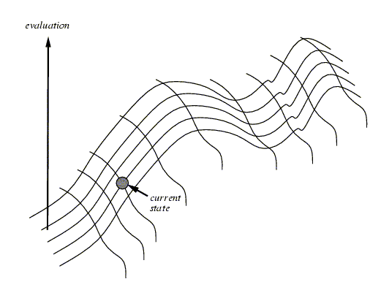
Hill Climbing
NOTE: Everything that will be said for Hill Climbing is also true for Greedy Descent
Notes:
One of the most obvious heuristics is to select the value that results in the minimum # of conflicts with the other variables - the min conflicts heuristics
Ex, in case of eight queen, it is the number of attacking queens.
Min conflict is surprising effective and can solve the million-queens problem in less than 50 steps. It has also been used to schedule the hubble telecope, reducing the time taken to schedule a week of observations from three weeks to around 10’

Slide 18
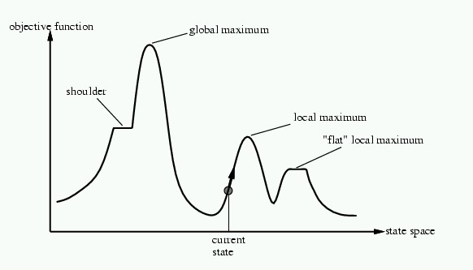
Problems with Hill Climbing
Local Maxima.
Plateau - Shoulders
(Plateau)
Notes:
No way to move from a plateau, could escape from a shoulder
With a randomly gerenated 8-queen initial state steepest ascent hill climbing gets stuck 86% of the times. Takes 4 steps on average to suceed and 3 to get stuck –good since there are 17 million states

Slide 19
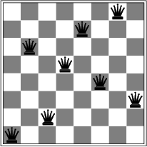
Corresponding problem for GreedyDescent
Local minimum example: 8-queens problem
A local minimum with h = 1

Slide 20
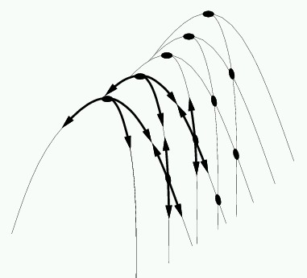
Even more Problems in higher dimensions
E.g., Ridges – sequence of local maxima not directly connected to each other
From each local maximum you can only
go downhill

Slide 21
Learning Goals for today’s class
You can:
Implement local search for a CSP.
  Implement different ways to generate neighbors
  Implement scoring functions to solve a CSP by local search through either greedy descent or hill-climbing.

Slide 22
Next Class
How to address problems with Greedy Descent / Hill Climbing?
Stochastic Local Search (SLS)

Slide 23
322 Feedback ☺ or ☹
Lectures
Slides
Practice Exercises
Assignments
AIspace
……
Textbook
Course Topics / Objectives
TAs
Learning Goals
……

