Slide 1
CSPs: Arc Consistency
& Domain Splitting
Computer Science cpsc322, Lecture 13
(Textbook Chpt 4.5 ,4.6)
February, 01, 2010
Notes:
Lecture 13

Slide 2
Lecture Overview
Recap (CSP as search & Constraint Networks)
Arc Consistency Algorithm
Domain splitting

Slide 3
Standard Search vs. Specific R&R systems
Constraint Satisfaction (Problems):
  State: assignments of values to a subset of the variables
  Successor function: assign values to a “free” variable
  Goal test: set of constraints
  Solution: possible world that satisfies the constraints
  Heuristic function: none (all solutions at the same distance from start)
Planning :
  State
  Successor function
  Goal test
  Solution
  Heuristic function
Query
  State
  Successor function
  Goal test
  Solution
  Heuristic function
Notes:
Allows useful general-purpose algorithms with more power than standard search algorithms

Slide 4
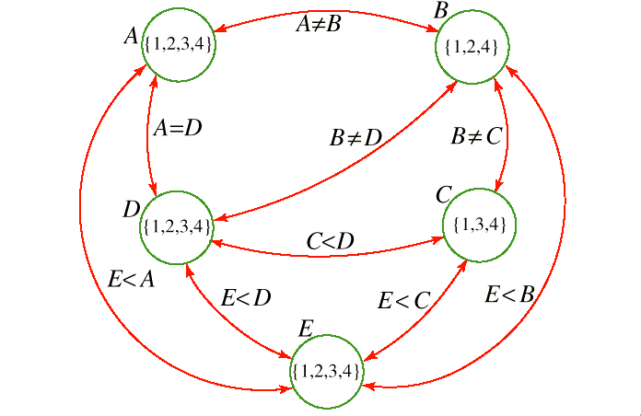
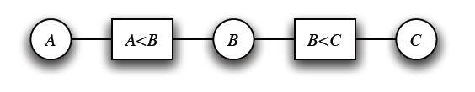

Recap: We can do much better..
Build a constraint network:
Enforce domain and arc consistency
Notes:
AIspace simple1withUnary problem

Slide 5
Lecture Overview
Recap
Arc Consistency Algorithm
  Abstract strategy
  Details
  Complexity
  Interpreting the output
Domain Splitting

Slide 6
Arc Consistency Algorithm: high level strategy
Consider the arcs in turn, making each arc consistent.
BUT, arcs may need to be revisited whenever….
NOTE - Regardless of the order in which arcs are considered, we will terminate with the same result
Notes:
the domains of other variables are reduced.
AIspace simple1withUnary problem

Slide 7
What arcs need to be revisited?
When we reduce the domain of a variable X to make an arc ⟨X,c⟩ arc consistent, we add……
every arc ⟨Z,c'⟩ where c' involves Z and X:
You do not need to add other arcs ⟨X,c'⟩ , c ≠ c‘
  If an arc ⟨X,c'⟩ was arc consistent before, it will still be arc consistent (in the ``for all'' we'll just check fewer values)

Slide 8
Arc Consistency Algorithm (for binary C)
1: Procedure GAC(V,dom,C)
2: Inputs
3: V: a set of variables
4: dom: a function such that dom(X) is the domain of variable X
5: C: set of constraints to be satisfied
6: Output
7: arc-consistent domains for each variable
8: Local
9: D_{X} is a set of values for each variable X
10: TDA is a set of arcs
11: for each variable X do
12: D_{X} ←dom(X)
13: TDA ←{〈X,c〉| c∈C and X∈scope(c)}
14:
15: while (TDA ≠{})
16: select 〈X,c〉 ∈TDA;
17: TDA ←TDA \ {〈X,c〉};
18: ND_{X} ←{x| x ∈D_{X} and there is y_{i} ∈D_{Yi} {X=x,Y=y}∈c };
19: if (ND_{X} ≠D_{X}) then
20: TDA ←TDA ∪{〈Z,c'〉|X ∈scope(c'), c' is not c, Z∈scope(c') \ {X} }
21: D_{X} ←ND_{X}
22:
23:
24: return {D_{X}| X is a variable}
Notes:
ND = New D
Non binary ND_{X} ←{x| x ∈D_{X} and some {X=x,Y₁=y₁,...,Y_{k}=y_{k}}∈c where y_{i} ∈D_{Yi} for all i} omain

Slide 9
Arc Consistency Algorithm: Complexity
Let’s determine Worst-case complexity of this procedure (compare with DFS )
  let the max size of a variable domain be d
  let the number of variables be n
  The max number of binary constraints is…….
How many times the same arc can be inserted in the ToDoArc list?
How many steps are involved in checking the consistency of an arc?
Notes:
Every time a domain value is removed
Some special cases are faster
e.g., if the constraint graph is a tree, arc consistency is O(ed)
I DO NOT THINK SO
It is linear in the number of variables n (not quadratic as the general case) check with David and Kevin

Slide 10
Arc Consistency Algorithm: Interpreting Outcomes
Three possible outcomes (when all arcs are arc consistent):
  One domain is empty →
  Each domain has a single value →
  Some domains have more than one value → may or may not be a solution
    in this case, arc consistency isn't enough to solve the problem: we need to perform search
Notes:
Otherwise, split a domain & apply arc consistency to each case.
Spiltting in half the variable with the smallest domain usually works best (who know why)
ACC: Show with Cispace, first “scheduling problem”, and then crossword 1 for splitting. What makes sense is to split the node with 6 vars to the right, show that it gets to an empty solution, backtrack, and do more s0plitting on the var with 2 values on the top-left. Done. WENT WELL

Slide 11
Lecture Overview
Recap
Arc Consistency
Domain splitting
Notes:
ACC: Show with Cispace, first “scheduling problem”, and then crossword 1 for splitting. What makes sense is to split the node with 6 vars to the right, show that it gets to an empty solution, backtrack, and do more s0plitting on the var with 2 values on the top-left. Done. WENT WELL

Slide 12
Domain splitting (or case analysis)
Arc consistency ends: Some domains have more than one value → may or may not be a solution
  Apply Depth-First Search with Pruning
  Split the problem in a number of disjoint cases
Set of all solution equals to….
Notes:
Otherwise, split a domain & apply arc consistency to each case.
Spiltting in half the variable with the smallest domain usually works best (who know why)
ACC: Show with Cispace, first “scheduling problem”, and then crossword 1 for splitting. What makes sense is to split the node with 6 vars to the right, show that it gets to an empty solution, backtrack, and do more s0plitting on the var with 2 values on the top-left. Done. WENT WELL

Slide 13
But what is the advantage?
By reducing dom(X) we may be able to….
Simplify the problem using arc consistency
No unique solution i.e., for at least one var, |dom(X)|>1
Split X
For all the splits
  Restart arc consistency on arcs <Z, r(Z,X)>
these are the ones that are possibly………….
Disadvantage ☹: you need to keep all these CSPs around (vs. lean states of DFS)
Notes:
Combining Arc Consistency and
Domain Splitting
Otherwise, split a domain & apply arc consistency to each case.
Spiltting in half the variable with the smallest domain usually works best (who know why)
ACC: Show with Cispace, first “scheduling problem”, and then crossword 1 for splitting. What makes sense is to split the node with 6 vars to the right, show that it gets to an empty solution, backtrack, and do more s0plitting on the var with 2 values on the top-left. Done. WENT WELL

Slide 14
Searching by domain splitting
Disadvantage ☹: you need to keep all these CSPs around (vs. lean states of DFS)
Notes:
Combining Arc Consistency and
Domain Splitting
Otherwise, split a domain & apply arc consistency to each case.
Spiltting in half the variable with the smallest domain usually works best (who know why)
ACC: Show with Cispace, first “scheduling problem”, and then crossword 1 for splitting. What makes sense is to split the node with 6 vars to the right, show that it gets to an empty solution, backtrack, and do more s0plitting on the var with 2 values on the top-left. Done. WENT WELL

Slide 15
Learning Goals for today’s class
You can:
Define/read/write/trace/debug the arc consistency algorithm. Compute its complexity and assess its possible outcomes
Define/read/write/trace/debug domain splitting and its integration with arc consistency

Slide 16
Next Class (Chpt. 4.8)
Local search:
Many search spaces for CSPs are simply too big for systematic search (but solutions are densely distributed).
  Keep only the current state (or a few)
  Use very little memory / often find reasonable solution
….. Local search for CSPs

Slide 17
K-ary vs. binary constraints
Not a topic for this course but if you are curious about it…
Wikipedia example clarifies basic idea…
http://en.wikipedia.org/wiki/Constraint_satisfaction_dual_problem
The dual problem is a reformulation of a constraint satisfaction problem expressing each constraint of the original problem as a variable. Dual problems only contain binary constraints, and are therefore solvable by algorithms tailored for such problems.
See also: hidden transformations

