Slide 1
Finish Search
Computer Science cpsc322, Lecture 10
(Textbook Chpt 3.6)
January, 25, 2010
Notes:
Lecture 10

Slide 2
Lecture Overview
Optimal Efficiency
Pruning Cycles and Repeated states Examples
Dynamic Programming
8-puzzle Applet
Search Recap

Slide 3
Optimal efficiency of A*
In fact, we can prove something even stronger about A*: in a sense (given the particular heuristic that is available) no search algorithm could do better!
Optimal Efficiency: Among all optimal algorithms that start from the same start node and use the same heuristic h, A* expands the minimal number of paths.
Notes:
In fact, we can prove something even stronger about A*: in a sense (given the particular heuristic that is available)
no search algorithm could do better!
problem: A* could be unlucky about how it breaks ties.
So let's define optimal efficiency as expanding the minimal number of paths p for which f(p) < f*, where f* is the cost of the optimal solution.

Slide 4
Lecture Overview
Optimal Efficiency Example
Pruning Cycles and Repeated states Examples
Dynamic Programming
8-puzzle Applet
Search Recap

Slide 5
Pruning Cycles
Example
Repeated States

Slide 6
Lecture Overview
Optimal Efficiency Example
Pruning Cycles and Repeated states Examples
Dynamic Programming
8-puzzle Applet
Search Recap

Slide 7
Dynamic Programming
Idea: for statically stored graphs, build a table of dist(n) the actual distance of the shortest path from node n to a goal.
This is the perfect……..
This can be built backwards from the goal:
g
b
c
a
2
d
2
b
2
g
1
1
a
c
3
3
Notes:
Dynamic programming is a general algorithm that will be used as a dual
to search algorithms in other parts of the book. The specific algorithm presented
here was invented by Dijkstra [1959]. See Cormen, Leiserson, Rivest,
and Stein [2001] for more details on the general class of dynamic programming
algorithms.
The idea of using dynamic programming as a source of heuristics for A
search was proposed by Culberson and Schaeffer [1998] and further developed
by Felner, Korf, and Hanan [2004].

Slide 8
Dynamic Programming
This can be used locally to determine what to do.
From each node n go to its neighbor which minimizes
4
2
d
2
b
2
2
g
1
1
3
a
c
3
3
3
But there are at least two main problems:
You need enough space to store the graph.
The dist function needs to be recomputed for each goal

Slide 9
Lecture Overview
Optimal Efficiency Example
Pruning Cycles and Repeated states Examples
Dynamic Programming
8-puzzle Applet
Search Recap

Slide 10
DFS, BFS, A* Animation Example
The AI-Search animation system
http://www.cs.rmit.edu.au/AI-Search/Product/
To examine Search strategies when they are applied to the 8puzzle
Compare only DFS, BFS and A* (with only the two heuristics we saw in class )
With default start state and goal
DFS will find
Solution at depth 32
BFS will find
Optimal solution depth 6
A* will also find opt. sol. expanding much less nodes

Slide 11
nPuzzles are not always solvable
Half of the starting positions for the n-puzzle are impossible to resolve (for more info on 8puzzle) http://www.isle.org/~sbay/ics171/project/unsolvable
So experiment with the AI-Search animation system with the default configurations.
If you want to try new ones keep in mind that you may pick unsolvable problems
Notes:
http://www.isle.org/~sbay/ics171/project/unsolvable
Here is a simple rule for telling if an 8 puzzle is solvable. We can call this violation of the order an "inversion". If the number of inversions is even then the puzzle is solvable. If the number of inversions is odd then the puzzle is unsolvable.

Slide 12
Lecture Overview
Optimal Efficiency Example
Pruning Cycles and Repeated states Examples
Dynamic Programming
8-puzzle Applet
Search Recap

Slide 13
Recap Search
 | Selection | Complete | Optimal | Time | Space
DFS | LIFO | N | N | O(b^{m}) | O(mb)
BFS | FIFO | Y | Y | O(b^{m}) | O(b^{m})
IDS(C) | LIFO | Y | Y | O(b^{m}) | O(mb)
LCFS | min cost | Y | Y | O(b^{m}) | O(b^{m})
BFS | min h | N | N | O(b^{m}) | O(b^{m})
A* | min f | Y | Y | O(b^{m}) | O(b^{m})
B&B | LIFO + pruning | N | Y | O(b^{m}) | O(mb)
IDA* | LIFO | Y | Y | O(b^{m}) | O(mb)
MBA* | min f | N | Y | O(b^{m}) | O(b^{m})
Notes:
Many of these are qualified
Eg. LCFS optimal if costs are > 0
Eg. A* complete if h is admissible
E.G B&B optimal if there are no infinite path
E.G BDS complete if both searches are BFS (or A*)

Slide 14
Recap Search (some qualifications)
 | Complete | Optimal | Time | Space
DFS | N | N | O(b^{m}) | O(mb)
BFS | Y | Y | O(b^{m}) | O(b^{m})
IDS(C) | Y | Y | O(b^{m}) | O(mb)
LCFS | Y | Y ? | O(b^{m}) | O(b^{m})
BFS | N | N | O(b^{m}) | O(b^{m})
A* | Y | Y ? | O(b^{m}) | O(b^{m})
B&B | N | Y ? | O(b^{m}) | O(mb)
IDA* | Y | Y | O(b^{m}) | O(mb)
MBA* | N | Y | O(b^{m}) | O(b^{m})
Notes:
Many of these are qualified
Eg. LCFS optimal if costs are > 0
Eg. A* complete if h is admissible
E.G B&B optimal if there are no infinite path
E.G BDS complete if both searches are BFS (or A*)

Slide 15
Search in Practice
 | Complete | Optimal | Time | Space
DFS | N | N | O(b^{m}) | O(mb)
BFS | Y | Y | O(b^{m}) | O(b^{m})
IDS(C) | Y | Y | O(b^{m}) | O(mb)
LCFS | Y | Y | O(b^{m}) | O(b^{m})
BFS | N | N | O(b^{m}) | O(b^{m})
A* | Y | Y | O(b^{m}) | O(b^{m})
B&B | N | Y | O(b^{m}) | O(mb)
IDA* | Y | Y | O(b^{m}) | O(mb)
MBA* | N | Y | O(b^{m}) | O(b^{m})
BDS | Y | Y | O(b^{m/2}) | O(b^{m/2})

Slide 16
Search in Practice (cont’)
Informed?
Many paths to solution, no ∞ paths?
Large branching factor?
Notes:
Uninformed: IDS (many deep solutions – do not care about optimality)
Informed:
Infinite path (in practice paths so long that cannot be kept in memory)

Slide 17
(Adversarial) Search: Chess
Deep Blue’s Results in the second tournament:
second tournament: won 3 games, lost 2, tied 1
30 CPUs + 480 chess processors
Searched 126.000.000 nodes per sec
Generated 30 billion positions per move reaching depth 14 routinely
Iterative Deepening with evaluation function (similar to a heuristic) based on 8000 features (e.g., sum of worth of pieces: pawn 1, rook 5, queen 10)
Notes:
Winning machine was a parallel computer (30 CPUs) + 480 VLSI chess processors
Searched 126.000.000 nodes per sec
Generated 30 billion positions per move, reaching depth 14 routinely
Standard iterative deepening alpha beta search (with transposition table)
But key to success seems to be its ability to go deeper for sufficiently interesting lines of forced/forcing moves
Evaluation functions had over 8000 features
+ opening book with 4000 positions
+ solved positions with 5 pieces and many with 6 (to extend the effective depth of the search)
Deep Blue's evaluation function looks at four basic chess values: material, position, King safety and tempo. Material is based on the "worth" of particular chess pieces. For example, if a pawn is valued at 1, then the rook is worth 5 and the Queen is valued at 9. The King, of course, is beyond value because his loss means the loss of the game.
The simplest way to understand position is by looking at your pieces and counting the number of safe squares they can attack. King safety is a defensive aspect of position. It is determined by assigning a value to the safety of the King's position in order to know how to make a purely defensive move. Tempo is related to position but focuses on the race to develop control of the board. A player is said to "lose a tempo" if he dillydallies while the opponent is making more productive advances.

Slide 18
Modules we'll cover in this course: R&Rsys
Environment
Deterministic
Stochastic
Problem
Arc Consistency
Constraint Satisfaction
Vars +
Constraints
Search
Static
Belief Nets
Query
Logics
Var. Elimination
Search
Sequential
Decision Nets
STRIPS
Var. Elimination
Planning
Search
Markov Processes
Representation
Value Iteration
Reasoning
Technique
Notes:
R&R Sys Representation and reasoning Systems
Each cell is a R&R system
STRIPS actions preconditions and effects

Slide 19
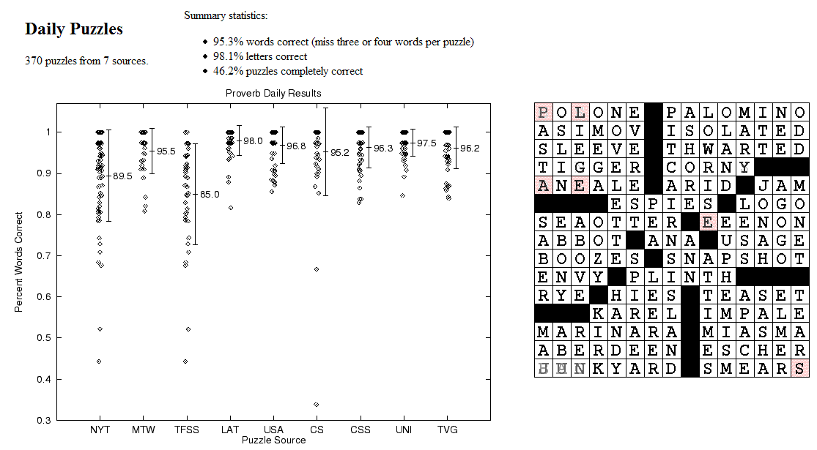
CSPs: Crossword Puzzles
Source: Michael Littman
Notes:
Variables are the places where word can go e.g. (1 across, 3 down)
Domains are words of the appropriate length (for 1 across in this example – length equals 6)
Constraints letter should be the same at the intersection
www.cs.rutgers.edu/~mlittman/papers/aaai99-solver.ps
Paper is actually about sophisticated prob. Constraint satisfaction but the example is
Good anyways

Slide 20
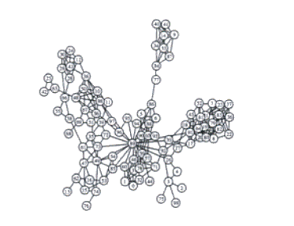
CSPs: Radio link frequency assignment
Assigning frequencies to a set of radio links defined between pairs of sites in order to avoid interferences.
Constraints on frequency depend on position of the links and on physical environment .
Source: INRIA
Sample Constraint network
Notes:
Variables are links
Domains are frequencies
Constraints ….

Slide 21
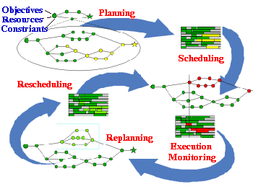
Planning & Scheduling: Logistics
Dynamic Analysis and Replanning Tool (Cross & Walker)
logistics planning and scheduling for military transport
used for the first time in the 1991 Gulf War by the US
problems had 50,000 entities (e.g., vehicles); different starting points and destinations
Same techniques can be use for non-military applications:
e.g., Emergency Evacuation
Source: DARPA
Notes:
(Re)Planning done in hours instead of in weeks
ARPA stated that this single application paid back its 30years investments in AI
Variables different tasks to be scheduled
Domains. Start-time End-time resources
Constraints. Non overlap, one before the other

Slide 22
Standard Search vs. Specific R&R systems
Constraint Satisfaction (Problems):
State
Successor function
Goal test
Solution
Heuristic function
Planning :
State
Successor function
Goal test
Solution
Heuristic function
Inference
State
Successor function
Goal test
Solution
Heuristic function
Notes:
Allows useful general-purpose algorithms with more power than standard search algorithms

Slide 23
Next class
Start Constraint Satisfaction Problems (CSPs)
Textbook 4.1-4.3

